Slide 1
Munich University of Applied Sciences
John Smith // March 2016

Slide 2
MUNICH UNIVERSITY OF APPLIED SCIENCES
In FIGURES
17,900
475
750
511
126
91
86
14
8
Students
Professors
Part-time lecturers
Administration staff
Research associates
PhD students
Degree programmes (Bachelor's and Master's)
Departments
Affiliated institutes

Slide 3
UNIVERSITIES OF APPLIED SCIENCES
CHARACTERISTICS
Bachelor, Master
PhD (cooperation w/ research universities)
DEGREES
MAIN STUDY FOCUS
practice and application
RESEARCH FOCUS
application-oriented research
CLASS SIZE
small
INTERNSHIP
Compulsory Internship Semester
REQUIREMENT FOR
PROFESSORS?
Min. 5 years industry /
professional background
Notes:
Universities of applied sciences have unique characteristics in Germany.
By comparison: Research University
Degrees
Bachelor
Master
PhD
Main study focus
research and science
Research focus
basic research
Class size
rather big
Internship
No
Industry/professional background
required for professors?
No

Slide 4










MUAS
LOCATION INFO
Automotive industry
Biotechnology
& life sciences
Design & media
Energy technology
Finance
Health/social sciences
IT & communications
Aerospace engineering
Tourism
Business services
Notes:
We are based in a leading European business hub.
With this size and location come significant opportunities and responsibility in diverse industrial, economic, and social contexts.
City of Munich info (http://www.muenchen.de/rathaus/wirtschaft/wirtschaftsstandort/kennzahlen)
State capital of Bavaria
Population of 1.5 million
Largest concentration of DAX-listed companies in Germany
Several global market leaders
Highest share of highly skilled workers in Germany (35%)
Large proportion of graduates stay in the region
Strong international community: 25% foreign nationals, consular posts
Renowned venue for trade fairs and conferences
Strong startup culture
Safety and excellent quality of living (one of the world's best cities to live in; awarded 7th place in 2015 Mercer ranking)
"Munich's economic strength stems from its broad-based economic structure, a balanced mix of large corporations, small and medium enterprises, and craft businesses in a wide range of sectors." (City of Munich info)

Slide 5
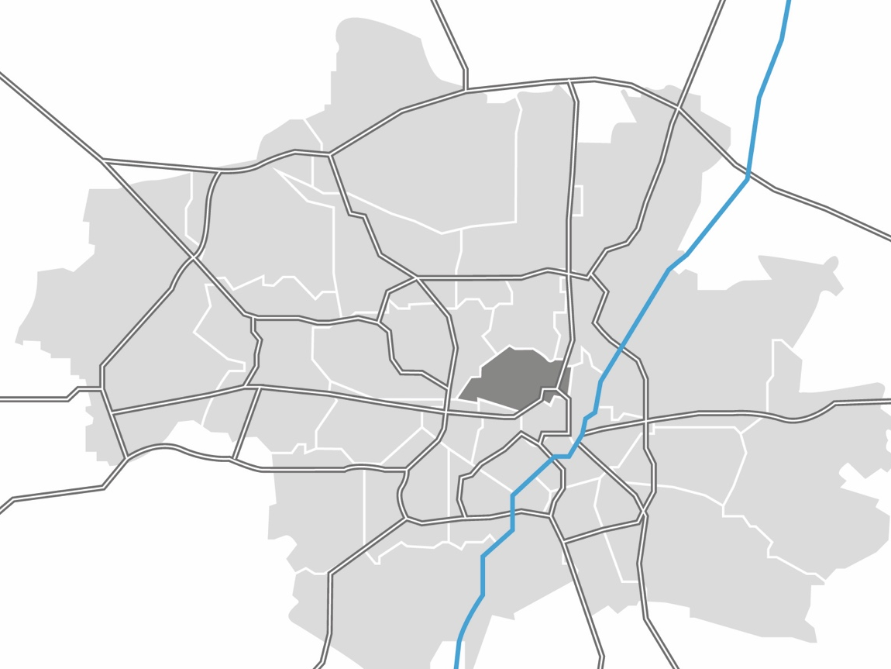
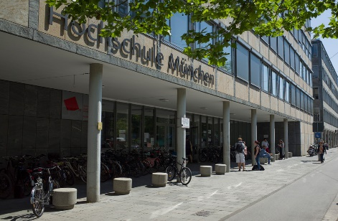
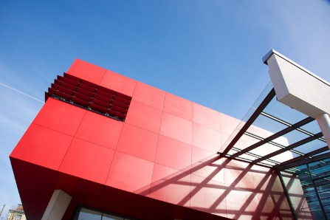
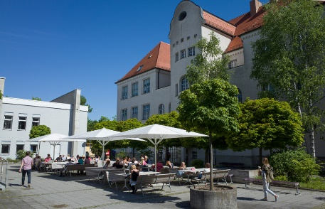
MUAS
THREE CAMPUSES
CAMPUS KARLSTRASSE
CAMPUS LOTHSTRASSE
CAMPUS PASING
Notes:
Our departments are spread over three large campuses in Munich. They each have heir individual flair and also their own cafeteria and library.
Distances:
Lothstraße/Karlstraße – Pasing: about 30-40 minutes by car or public transport
Lothstraße – Karlstraße: About 15 minutes by public transport, car or bicycle

Slide 6

MUAS
BUSINESS FIELDS
  Bachelor
  Programmes
  Part-time degree programmes
  for working
  professionals
  Master
  Programmes
  Applied
  research and
  doctoral programmes
Notes:
Munich University of Applied Sciences provides excellent applied and research-based teaching across four types of programmes:
Bachelor's degrees for school leavers and those with vocational qualifications
Master's degree programmes
Application-oriented research & doctoral programmes
Part-time degree programmes for working professionals

Slide 7
STUDY PROGRAMMES
STRUCTURE
BACHELOR
PROGRAMMES
MASTER
PROGRAMMES
SUMMER
SCHOOLS
CERTIFICATES
  7 semesters
  210 ECTS credit points
  1 internship semester
  Bachelor thesis
  3 semesters
  90 ECTS
  credit points
  Consecutive
  or continuing education
  Master thesis
  2-5 weeks
  up to 14 ECTS credit points
  full time
  University certificate
  International Engineering
  Courses in English
  European Studies
  Intercultural Communication and Cooperation
Notes:
Most of MUAS study programmes are offered in German.
There are a two study programmes completely offered in English:
Master of Engineering in Paper Technology (Department 05 – Building Services Engineering, Paper and Packaging Technology and Print and Media Technology)
Master of Sciences in Business Entrepreneurship and Digital Technology Management (Department 10 – Business)
The following study programmes are partially taught in a foreign language:
German / French: Bachelor / Master of Engineering in Production and Automation (Department 06 – Applied Sciences and Mechatronics)
German / English: Master of Sciences in Micro and Nano Technology (Department 06 – Applied Sciences and Mechatronics)
German / English: Master of Arts in Intercultural Communication and Cooperation (Department 13 – General and Interdisciplinary Studies ) This is a programme with tuition fees.
German / English: Within the Bachelor in Engineering and Management students can choose the International Module Technology which offers a few technical subjects in English during the first two semesters (Department 09 – Engineering and Management)
Every department of MUAS offers a selection of English-taught subjects (Courses in English) for German students interested in attending a course in a foreign language or for international exchange students.
For obtaining a certificate students usually have to attend 4-5 subjects and pass all necessary exams. The amount of awarded ECTS depends on each certificate and its specific contents.

Slide 8
Lifelong
learning and study
Notes:
A university education is becoming the norm.
Across all of our programme types, we develop and offer a number of suitable access paths and flexible study options for different target groups.
This means that we develop tailored programme formats and place particular emphasis on starting out at university, for example through individual consultations, mentoring programmes, aptitude tests, and relevant preparatory courses. We recognise previous achievements wherever possible – for instance in the case of applicants without a secondary school leaving certificate (German Abitur).
It also means ensuring that our study options are as flexible and family friendly as possible, for example by offering part-time or online courses,
which creates a high degree of openness and sets us apart in terms of lifelong learning and study.

Slide 9
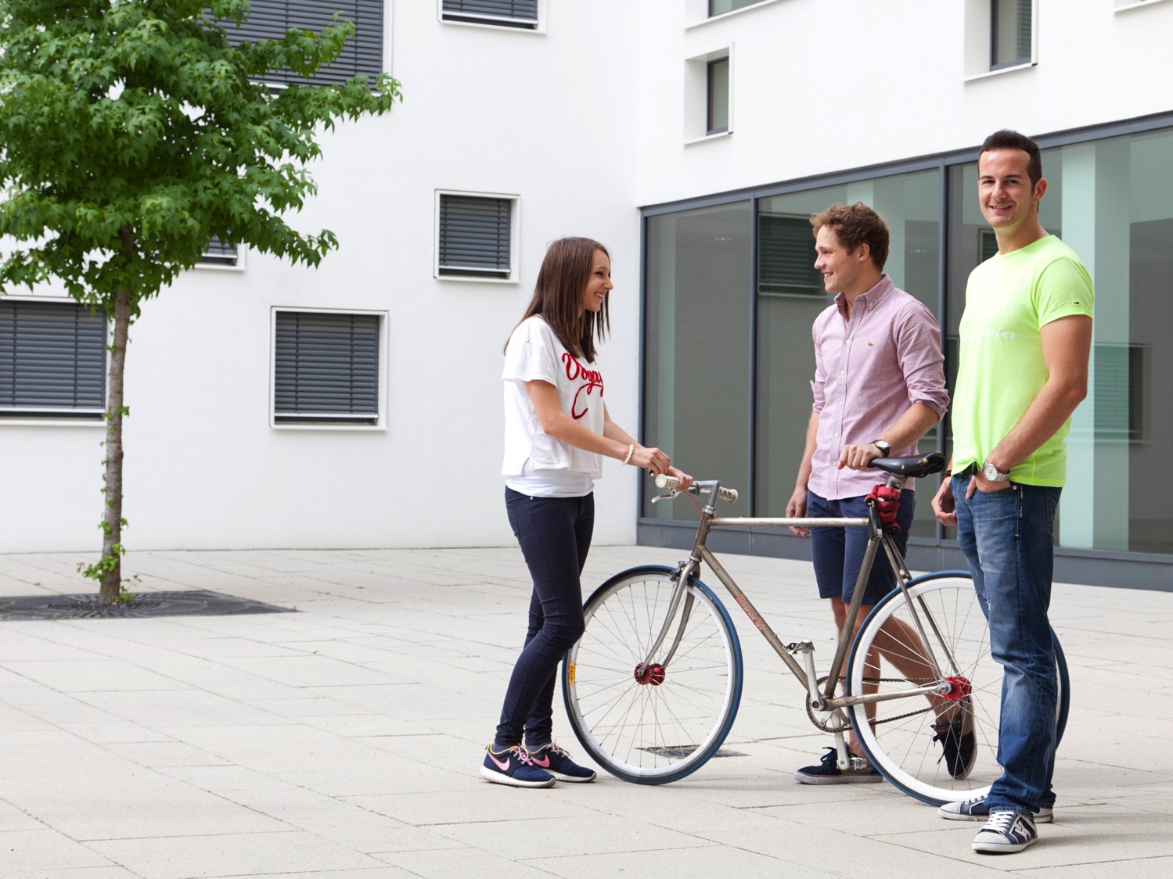
... means that we take students' experience into account, whatever stage they're at, and give them the skills they need for careers in both topical and future-oriented areas.
PURSUING QUALITY
IN TEACHING AND STUDY
Julia Bergmeister
Notes:
For us, the notion of pursuing quality in teaching and study means taking into account our students' experience, whatever stage they're at, and giving them the skills they need for (academic) careers in both topical and future-oriented areas.
Transferable skills, both for new students starting university and new graduates on the labour market, are a core objective.
Here at Munich University of Applied Sciences, we have created the right environment to do so:
Expert advice and personal consultations
Family-friendly focus and a health-conscious study and working environment
Sensitivity in dealing with gender and diversity issues, e.g. through mentoring programmes
Career advice and offers in our Career Center

Slide 10

FURTHER DEVELOPMENT
WITH A FOCUS ON THE FUTURE
Attractive teaching formats
and programme options
Offerings for non-traditional
students
Doctoral programmes and
research training groups
University-wide startup culture
E-learning and digitalisation
Julia Bergmeister
Notes:
We actively engage with our educational mandate and aim to secure an outstanding position as a university of applied sciences with a difference.
We recognise the future demands of society and industry and as we develop, we maintain a critical, yet open-minded, awareness for current trends, such as how all areas of life are becoming digitised.
Our aim is to solidify and strengthen this profile, continuously improve quality, and achieve sustainable innovation in research, teaching, and continuing education, and we are pursuing this objective by means of publicly and internally funded projects.
Attractive teaching formats and programme options, new teaching methods for MINT subjects (Equipped for the future [ZUG] project and HD MINT, Federal Ministry of Education and Research [BMBF])
https://www.hm.edu/lehre/
Degree programmes for non-traditional students (Open University Upper Bavaria, BMBF)
https://www.hm.edu/oho/
Doctoral programmes (cooperative research training programme on building services engineering and energy efficiency, joint programme under Bavaria's science forum)
https://www.hm.edu/allgemein/forschung_entwicklung/doktoranden/index.de.html
Reinforcing a university-wide startup culture (AHEAD, EXIST)
E-learning and digitisation
https://www.hm.edu/allgemein/hochschule_muenchen/zentrale_services/hochschulentwicklung_1/digitales_studieren_bayern/digitalisierung/digitalisierung_startseite.de.html
Internal funding programmes: Teaching (QualiFIVE), research, and continuing education
https://intranet.hm.edu/unterstuetzung_lehre/foerderprogramme/index.de.html

Slide 11

INTERDISCIPLINARY
DIVERSITY
Engineering / Business / Social Sciences / Design / General Studies
Notes:
The university tackles broad societal challenges by embracing interdisciplinary diversity.
We offer degree programmes and active academic exchange in the areas of engineering, business, social sciences, and design.
Our Department of General and Interdisciplinary Studies is unique in granting every student the opportunity to experience a cross-disciplinary education and to develop their personal skills.
This diversity is deeply rooted in our history:
Founded in 1971
The result of seven institutions from different fields coming together: engineering schools and advanced technical schools
Strong vocational training tradition dating back to the beginning of industrialisation in Germany
Over the past 40 years, we have continued to expand and develop:
We have steadily increased the range of programmes on offer
We introduced a focus on research, which has become a top priority -> we now offer doctoral programmes!
Lifelong learning and continuing education have emerged as an important new field
We took early action in response to the European Bologna reforms, and today we offer approved, high-quality degree programmes
We changed our name to "Munich University of Applied Sciences"

Slide 12


OUR STUDENTS SHAPE
THEIR OWN PROFILE
Entrepreneurial thinking and action
Education for sustainable development
International experience and intercultural skills
Notes:
Nurturing our graduates' characters is especially important to us:
we want our students' entrepreneurial, sustainable, and international attitude to be the reason they stand out from the crowd.
By fostering these additional cross-disciplinary skills, we give students the tools they need to contribute to society and approach their careers with foresight, creativity, and a sense of responsibility.
And that's not all:
In each of these areas, we also offer specific degree programmes with an even stronger focus on innovation, sustainability, or internationalism. Examples include:
B.A. in Management of Social Innovations (entrepreneurial and sustainable)
B.A. in Renewable Energies (sustainable)
M.A. in Intercultural Communication (international)
B.A. in International Project Management (international)

Slide 13



THIS MEANS THEY ARE...
ENTREPRENEURIAL
Courses based on "real projects"
Lecture series on social innovation
Startup support at the Strascheg Center for Entrepreneurship
"Entrepreneurship" certificate programme
Social Entrepreneurship Academy
Notes:
In the context of entrepreneurial thinking and action, this means that for example…
Students from different departments develop an entrepreneurial attitude by participating together in hands-on projects and case studies
Topics related to (social) entrepreneurship are covered in the lecture series on social innovation, for example
Startup teams receive top-quality, personalised support at the Strascheg Center for Entrepreneurship (approx. 25 teams and 10 startups every year)
Our students have the opportunity to enhance their entrepreneurial skills through various certificate programmes (Academic Program for Entrepreneurship [APE], Social Entrepreneurship Academy Programme [SEA], Innovation Camp, etc.)
In 2011, together with our Strascheg Center for Entrepreneurship, we became an EXIST Startup University and have since established a leading position in the "Gründerradar" German startup ranking system.
The funding we receive from the EXIST support programme (approx. €1.1 million each year, Federal Ministry of Education and Research) enables us to cultivate a strong entrepreneurial attitude among our students.
As part of the Social Entrepreneurship Academy and the 4Entrepreneurship network, we have joined forces with Munich's other universities (LMU, TUM, and Universität der Bundeswehr) to foster entrepreneurial thinking and action.

Slide 14


THIS MEANS THEY ARE...
SUSTAINABLE THINKERS
ZukunftGestalten@HM project seminar (shaping the future at MUAS)
ETHIKUM certificate
"Engineering for Sustainability" summer school
Student projects on sustainable mobility
Research and development on sustainability issues
(over 40% of third-party funding)
Notes:
In the context of sustainability, this means that for example...
In the ZukunftGestalten@HM project seminar (shaping the future at MUAS), students from different departments aim to independently find solutions to issues facing society in the future (e.g. development plans for the north of the city in collaboration with the City of Munich in 2015)
From the first semester onwards, students can gain an additional qualification in ethics and sustainability, free of charge, thanks to the ETHIKUM certificate.
Munich-based and international students explore sustainability issues in the field of engineering at the Engineering for Sustainability summer school
Student projects on sustainable mobility:
Team Hydro2Motion (developing a vehicle that consumes as little energy as possible for the Shell Eco-marathon® competition);
MunicHMotorsport Electric team (mobility with electric drive systems);
sustainable mobility (Department for Mechanical, Automotive and Aeronautical Engineering, open to all students)
Over 40% of the third-party funding we attract for research and development is earmarked for sustainability – and this research then feeds into our teaching.
Our activities in this field extend beyond our university's walls, and our "AG Hochschule und Nachhaltigkeit Bayern" network (Bavarian working group on universities and sustainability) was selected as an official initiative as part of the UNESCO Decade of Education for Sustainable Development in Germany.

Slide 15


THIS MEANS THEY ARE...
INTERNATIONAL
International experience on campus
at MUAS (internationalisation @ home)
Exchange and double degree programmes
Courses in English / language certificate
Munich Summer Schools of Applied
Sciences
EU research projects (Horizon 2020 and
Erasmus + funding programmes)
Notes:
Our students and researchers gain international experience and intercultural skills…
On campus at MUAS: Because they themselves come from a number of different countries and cultures, which allows them to get to know other cultures
Through the International Club and Welcome Service for exchange students
By coming into contact with exchange students and teachers
By participating in the university's international summer schools
By studying international case studies and issues within their modules
Because they can gain valuable experience by participating in exchange or double degree programmes at one of our many partner universities
Because they can their improve their professional English-language skills in over 100 specialist courses taught in English, and complete UNIcert programme certificates in several languages
Because they can participate and meet international students at the international Summer School programmes held at MUAS
Because teaching at the university is enhanced by our participation in international research and development projects
In addition, MUAS has a strong international focus, which it reinforces through a number of partnerships and networks:
Strategic partnerships
California Polytechnic State University
Tampere University of Applied Sciences
International networks and consortia
German Universities of Applied Sciences (UAS7), offices in New York and São Paulo
Global E³ Engineering Education Exchange with prestigious universities
INUAS network with Zurich University of Applied Sciences and FH Campus Wien (Vienna)
German universities abroad
e.g. Chinese-German University of Applied Sciences (CDHAW)
e.g. Franco-German University (DFH)
Over 200 partner universities

Slide 16
International activities
In FIGURES
200+
13%
195
4+60
17
3
100+
75
Partner universities
International students
Incoming exchange students
Fellows + guest lecturers per year
Double degree programmes
Summer Schools
Subject courses in English
Foreign language courses

Slide 17
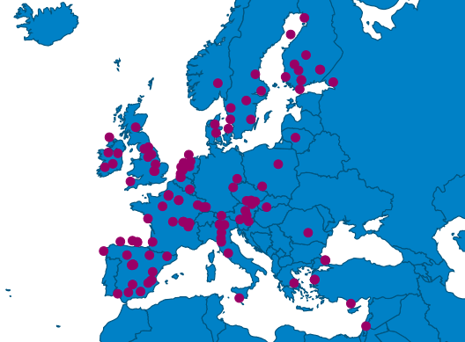
PARTNER UNIVERSITIES
Austria
Baltic States
Belgium
Croatia
Cyprus
Czech Republic
Denmark
Finnland
France
Great-Britain
Hungary
Ireland
Italy
Luxembourg
Malta
Netherlands
Norway
Poland
Portugal
Romania
Slovakia
Spain
Sweden
Switzerland
Turkey …
EUROPE
Notes:
Schriftgröße kann hier vergrößert werden, wenn Auswahl der Partner reduziert wird

Slide 18
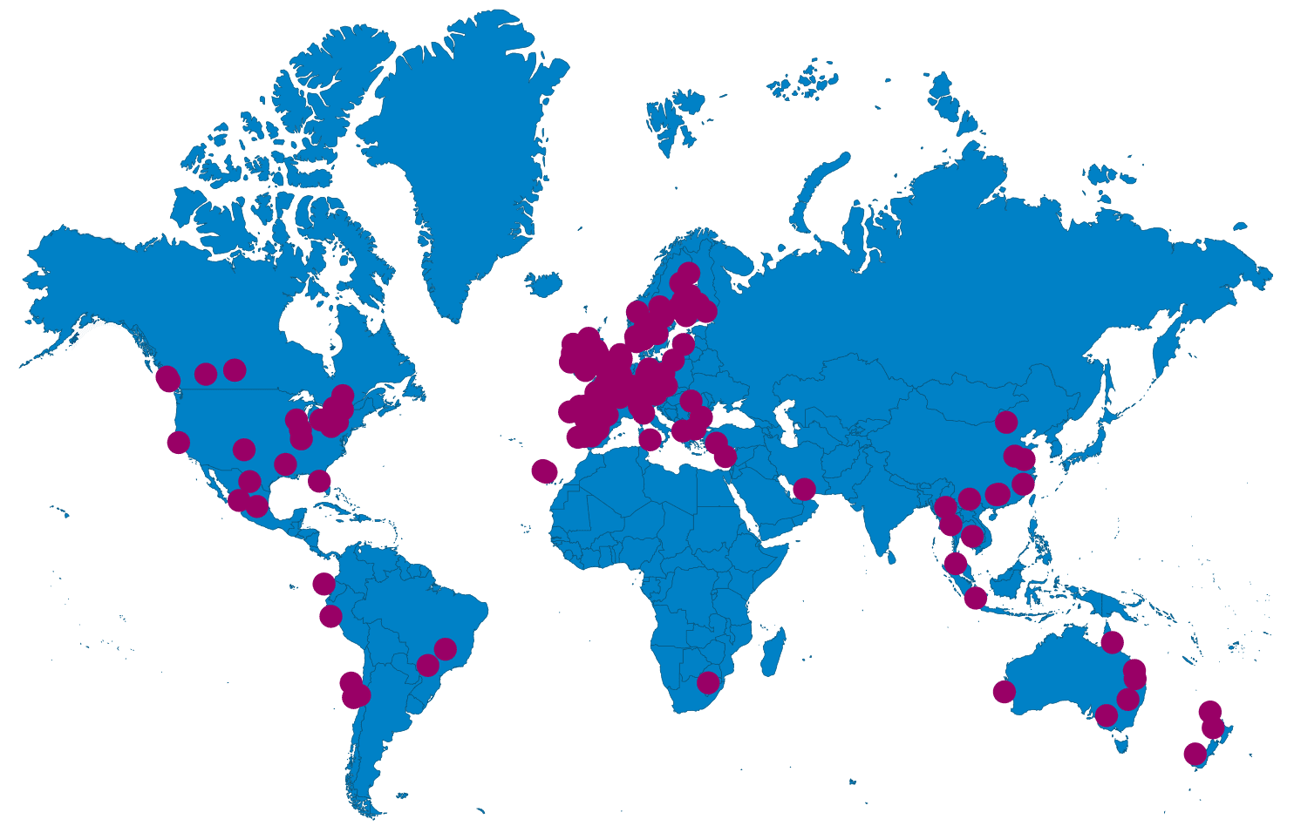
PARTNER UNIVERSITIES
WORLDWIDE
Argentina
Australia
Brazil
Canada
Chile
China
Ecuador
Jordan
Malaysia
Mexico
New Zealand
Peru
Russia
South Africa
South Korea
Taiwan
Thailand
USA
Vietnam
…
Notes:
Schriftgröße kann hier vergrößert werden, wenn Auswahl der Partner reduziert wird

Slide 19
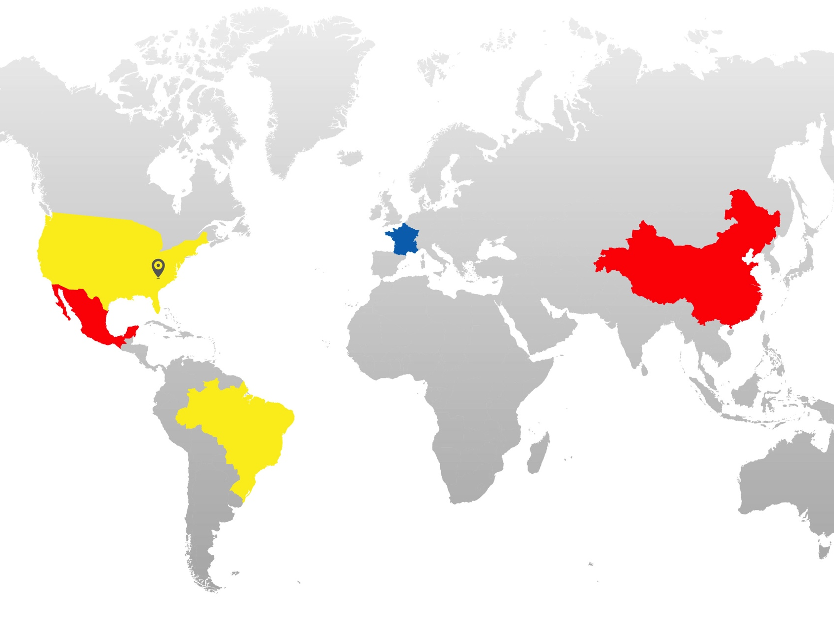




MUAS INTERNATIONAL
NETWORKS AND CONSORTIA
UAS7
Global E3
DFH
DHIK
German Universities of Applied Sciences – Offices in New York
and São Paulo
Global Engineering Education Exchange
Université Franco-Allemande
German University Consortium
for International Cooperations
Notes:
UAS7 (with liason offices in New York, Sao Paulo)
UAS7 is a strategic alliance of seven leading German Universities of Applied Sciences committed to excellence in teaching and research. UAS7 stands for:
well-established and future-oriented degree programmes 'made in Germany'
commitment to programmes of professional relevance
Application-oriented courses
international perspective on a distinctly European and German basis
efficient learning environments with small classes
close relationships to the German business community
locations in major cities throughout Germany
Members:
Berlin School of Economics and Law
Bremen City University of Applied Sciences
TH Cologne – University of Applied Sciences
Hamburg University of Applied Sciences
Münster University of Applied Sciences
Osnabrück University of Applied Sciences
MUAS
Global E3
Global E³ is an exchange programme for engineering students. With member universities in over 20 countries, students at over 70 universities have the opportunity to study abroad. Global E³ exchanges about 250-300 students a year. Over 70 universities worldwide—35 in the United States and 39 in Asia, Australia/Pacific, Europe, Latin America, and the Middle East—comprise the Global E3 consortium. This consortium is administered by the Institute of International Education (IIE) in New York, under the guidance of the member-elected Executive Committee. Students from members of this consortium may apply to go to any participating university outside their own country.
UFA/DFH
The UFA/DFH is a network of 186 universities in Germany and France which offers about 183 binational and trinational study programmes. At the moment approx. 6.500 students are enrolled in these study programmes. Our Department of Applied Sciences and Mechatronics offers a German-French study programme in „Production and Automation“ together with the French partner university Ecole Polytechnique Fondation (EPF) in Sceaux near Paris.
DHIK (CDHAW at Tongji University in China and MDHK at Tec de Monterrey in Mexico)
The German University Consortium for International Cooperations (Deutsches Hochschulkonsortium für Internationale Kooperationen – DHIK) unites 26 German Universities of Applied Sciences, who offer exchange and double degree programmes for engineering students with foreign universities.
The programmes combine the profile of applied sciences education with intercultural experience and knowledge, valuable for industries operating in both countries. At present the DHIK maintains partnerships with Tongji University in Shanghai, China (CDHAW) and the Tecnológico de Monterrey in Monterrey, Mexico (MDHK).

Slide 20
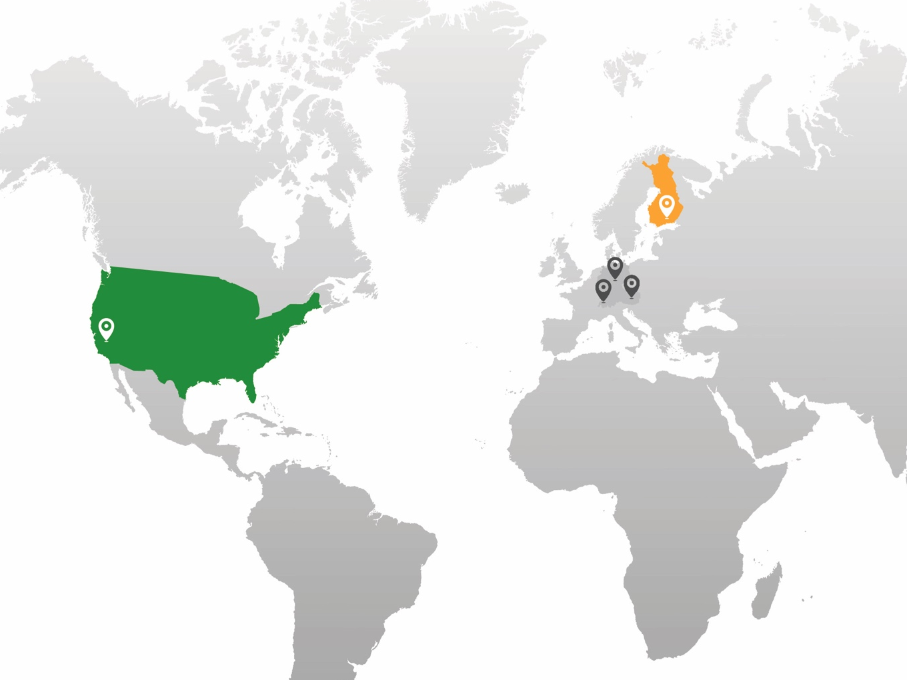



MUAS INTERNATIONAL
STRATEGIC PARTNERS
Cal Poly
TAMK
INUAS
San Luis Obispo, California
Tampere, Finland
International Network of Universities of Applied Sciences München, Wien, Zürich
Notes:
Besides over 200 partner univerisities world-wide, MUAS has three strategic partner universities:
California Polytechnic State University in San Luis Obispo
TAMK in Tampere, Finnland
INUAS (FH Campus Wien, ZHAW in Zurich)
MUAS has a close relationship to its strategic partners. Not only do we exchange students, professors and staff, but we also work closely together on common topics (research or teaching).
For example, within INUAS all participating universities are currently working on the topic „The future of urban living environments“.
In general we foster interdisciplinary projects, workshops and student projects within our strategic partnerships.

Slide 21
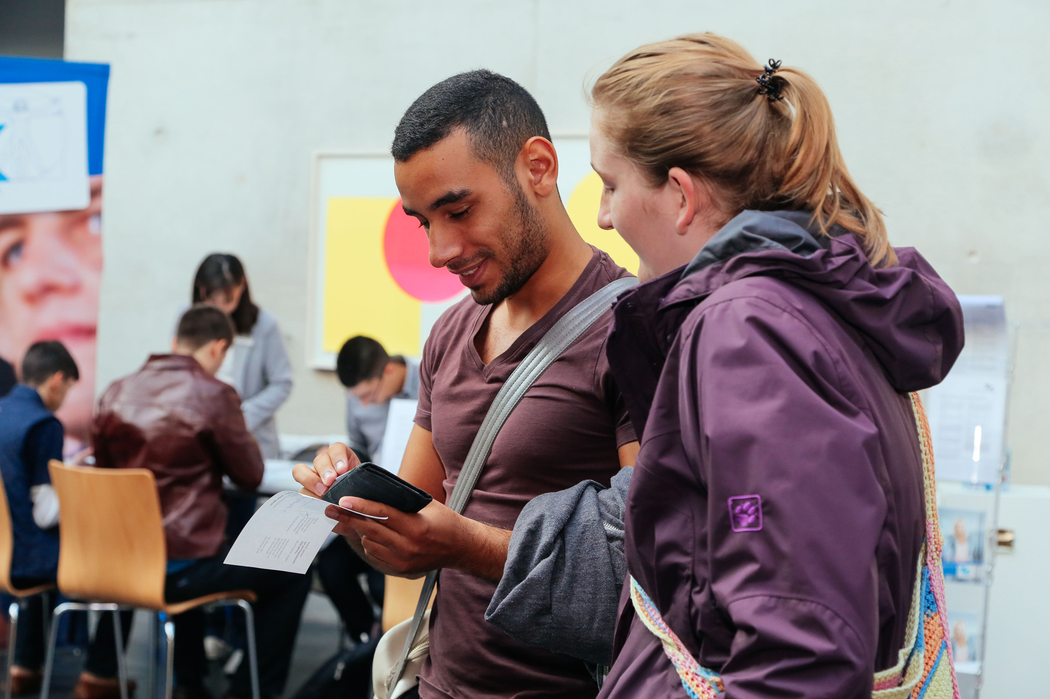
SERVICES FOR
INCOMING STUDENTS AND STAFF
Welcome Service
Assistance with housing
Cultural programme
German language course
Scholarships and financial support
International Club
Sandra Solveig Sommerrkamp
Notes:
We offer several services for incoming students and staff:
Welcome service:
for students incl. Airport pick-up and buddy programme
Guest lecturers: International lunch, meeting with the president, administrative paperwork etc.)
Assistance with housing: student residences, guest apartments for professors
Cultural programme: separate programmes for students and staff; several trips in and around Munich during the semester
German Language Course: Before or during the semester, mostly for students but open to guest lecturers
Scholarships and financial support: Fellowship for staff; for students STIBET, Erasmus+ with partner countries, in-house financial support, Study and Internship Program (UAS7)
International Club: student initiative, various activities for international students

Slide 22



ADDITIONAL INFORMATION
John Smith
Position
Munich University of Applied Sciences
Lothstr. 34
80335 Munich
Tel. +49 89 1265-xxxx
Fax +49 89 1265-xxxx
Email john.smith@hm.edu
www.hm.edu

Slide 23
MUAS
ACADEMIC CALENDAR
APPLICATION DEADLINE EXCHANGE
  Winter semester 15.05.
  Summer semester 15.11.
LECTURE AND EXAM PERIODS
  Winter semester 01.10. – 15.02.
  Summer semester 15.03. – 31.07.
APPLICATION DEADLINE FULL-TIME DEGREE
  Winter semester 15.07.
  Summer semester 15.01.
Notes:
German Intensive Language Course (prior to winter semester): beginning of September. Different levels (with or without any previous knowledge)
Compulsory Orientation Days for students (prior to semester start): beginning of March for summer semester, first half of September for winter semester

Slide 24
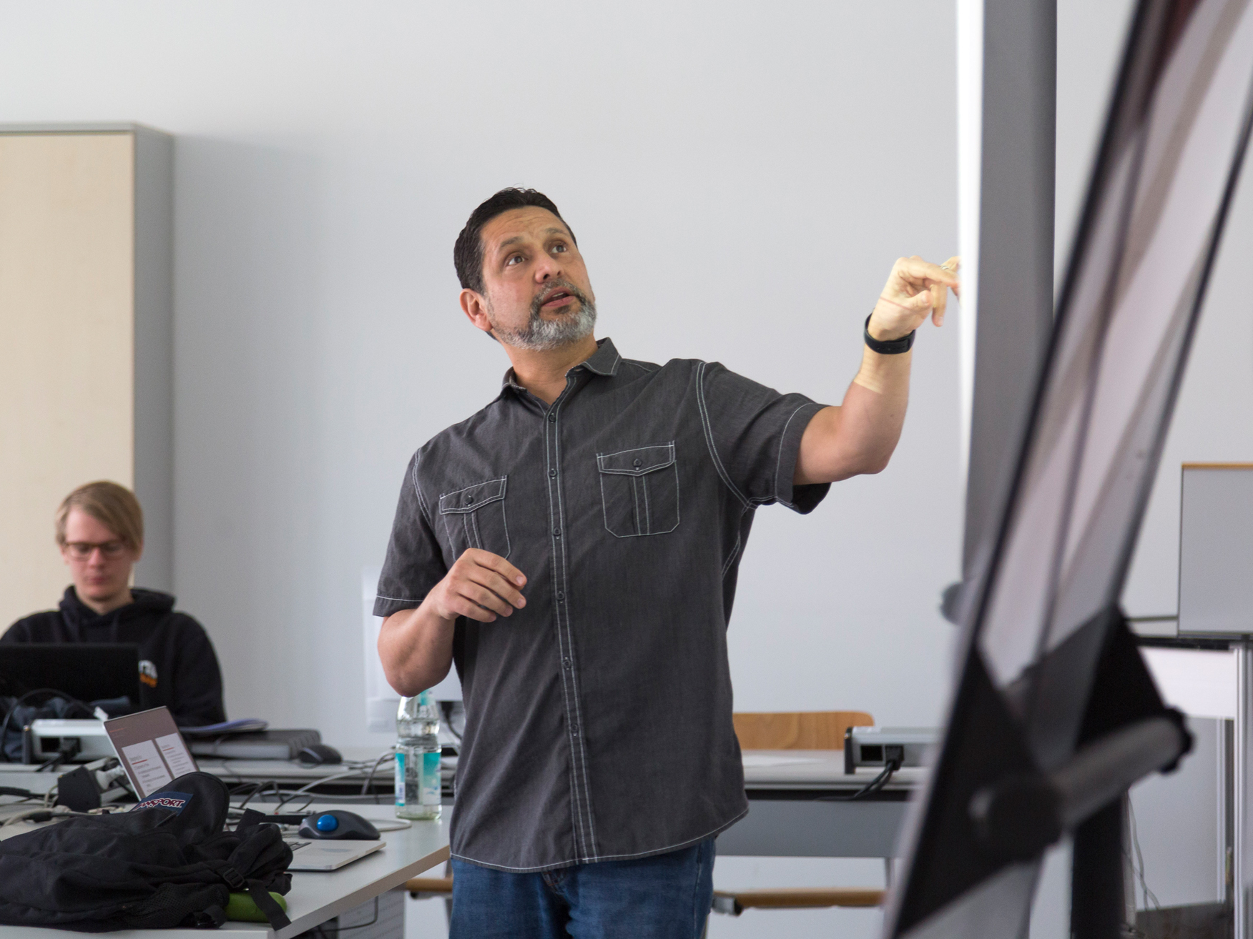
TEACHING AT MUAS
FELLOWSHIP PROGRAMME
Fellowship programme:
4 fellows per academic year
Duration: one semester (8 hours teaching / week)
Other teaching possibilities:
Guest lectureship
Teaching contract
Sandra Solveig Sommerrkamp
Notes:
MUAS offers a broad variety of teaching and research opportunities for visiting academics from all over the world.
We want to strengthen the links to our worldwide partners and gladly welcome international faculty and staff for both short and longer-term visits to our institution.
Depending on the intended duration of stay, we can offer different placements and funding schemes ranging from short-term teaching assignments to longer-term professorships.
MUAS Fellowship programme:
Candidates who are considering teaching abroad for a longer period are eligible to apply for the MUAS Fellowship programme. The programme supports visits from 3 to 6 months with an expected teaching load of about 30 teaching hours per month.
The fellowship covers travel expenses, an allowance for accommodation and a teaching honorarium.
Selected scholars are awarded a certificate and become honorary fellows at MUAS.
Courses in English:
Our Courses in English offer specialised courses in all subject areas to our full-time and exchange students. We invite international professors to contribute to our Courses in English by teaching classes in their area of expertise in English.

Slide 25
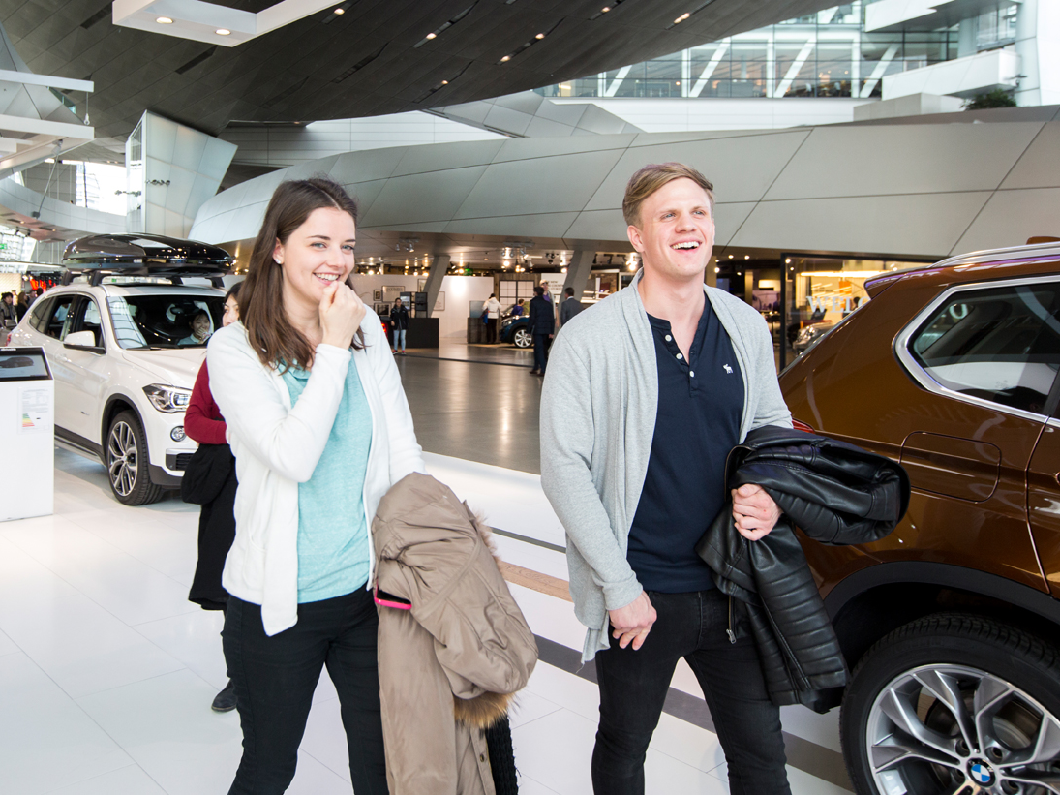
SUMMER SCHOOL
ENGINEERING FOR SUSTAINABILITY
Duration: 5 weeks
Dates: Beginning of July to beginning of August
Target group: Advanced undergraduates
Required fields: mechanical, automotive or electrical engineering
Credit points: 14 (ECTS) / 10 (US)
Notes:
This Summer School is taught in cooperation with MUAS strategic partner Cal Poly (California Polytechnic State University).
Courses are taught by a professor from MUAS (1 week) and the following week by a professor from Cal Poly (1 week).
Application period: mid-December – beginning of March
Offered courses:
German Language and Culture Course: compulsory for each participant
Additionally, students choose 2 out of 6 courses.
Course offer might change:
German Language and Culture (first week each day, next 4 weeks each Friday)
Smart Vehicles
Smart Environments
Microcontrollers or Alternative Energy Vehicles
Internal Combustion Engines
Hydraulic and Pneumatic Systems
Sustainable Entrepreneurship
Cultural Programme:
Munich by bike (guided tour)
BMW factory guided tour
Dachau concentration camp
Munich Documentation Center for the History of National Socialism
Lake Herrenchiemsee
Deutsches Museum
Student tutors will organize several activities and events in addition to the offical cultural programme.
Costs:
For non-partner universities:
1.790 EUR programme fee + approx. 1.000-1.200 EUR for accommodation (shared bed rooms, 3-4 students)
For partner universities:
1.650 EUR programme fee + approx. 1.000-1.200 EUR for accommodation (shared bed rooms, 3-4 students)

Slide 26
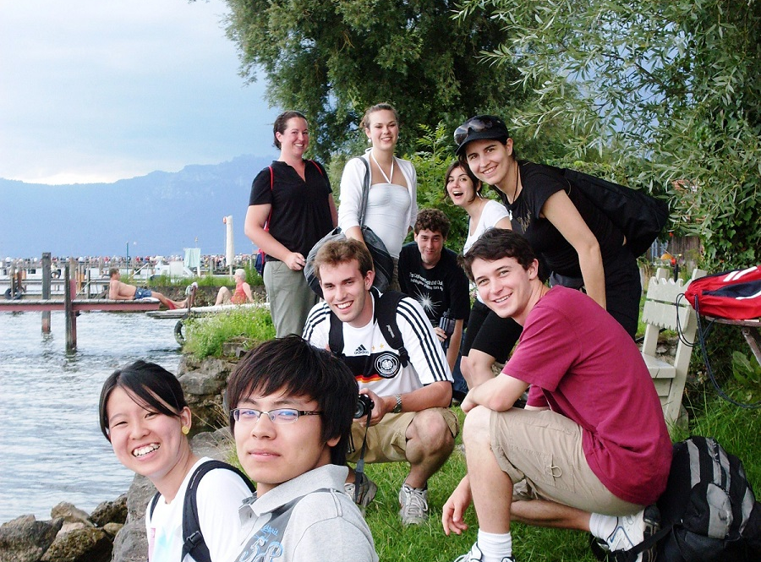
SUMMER SCHOOL
GLOBAL SUPPLY CHAINS
Operational excellence – Managing global
supply chains the German way
Duration: 2 weeks
Dates: Beginning of July to mid-July
Target group: Advanced undergraduates / graduates
Required fields: economics / business administration
Credit points: 6 (ECTS) / 3 (US) recommended
Notes:
Application period: mid-December – beginning of March
Offered courses:
Future Supply Chain Management
Operational Excellence – the German Way
Doing Business in Germany
First week classes at MUAS, second week: bus tour and company visits.
Cultural Programme:
Munich by bike (guided tour)
If possible students can participate in the cultural programme of the „Engineering for Sustainability“ summer school, depending on their schedule.
Costs:
1.695 EUR programme fee
approx. 500 EUR for accommodation in Munich
approx. 200 EUR accommodation during bus tour.
Single or double beedrooms

Slide 27
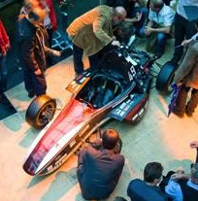

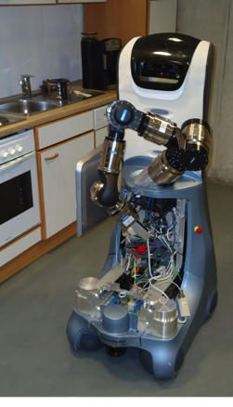
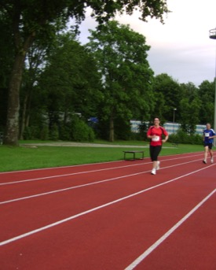
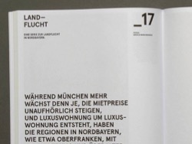

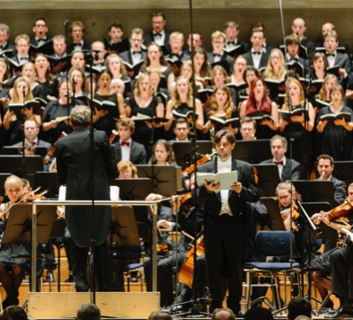
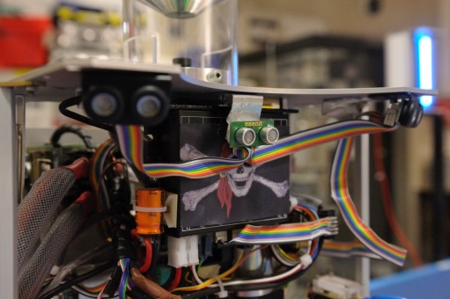
MUAS
STUDENT ACTIVITIES
Formula Student (+Electric)
Hydro2Motion
Choir, Orchestra, Big Band
Robot workshop
c.lab (3D prototyping)
Central University Sports “ZHS”
MHM Magazine
HM Cinema
International Club
Notes:
MUAS has a rich student life with lots of clubs, projects and activities.
Other activities: Band room, Christian Academic Communities

Slide 28
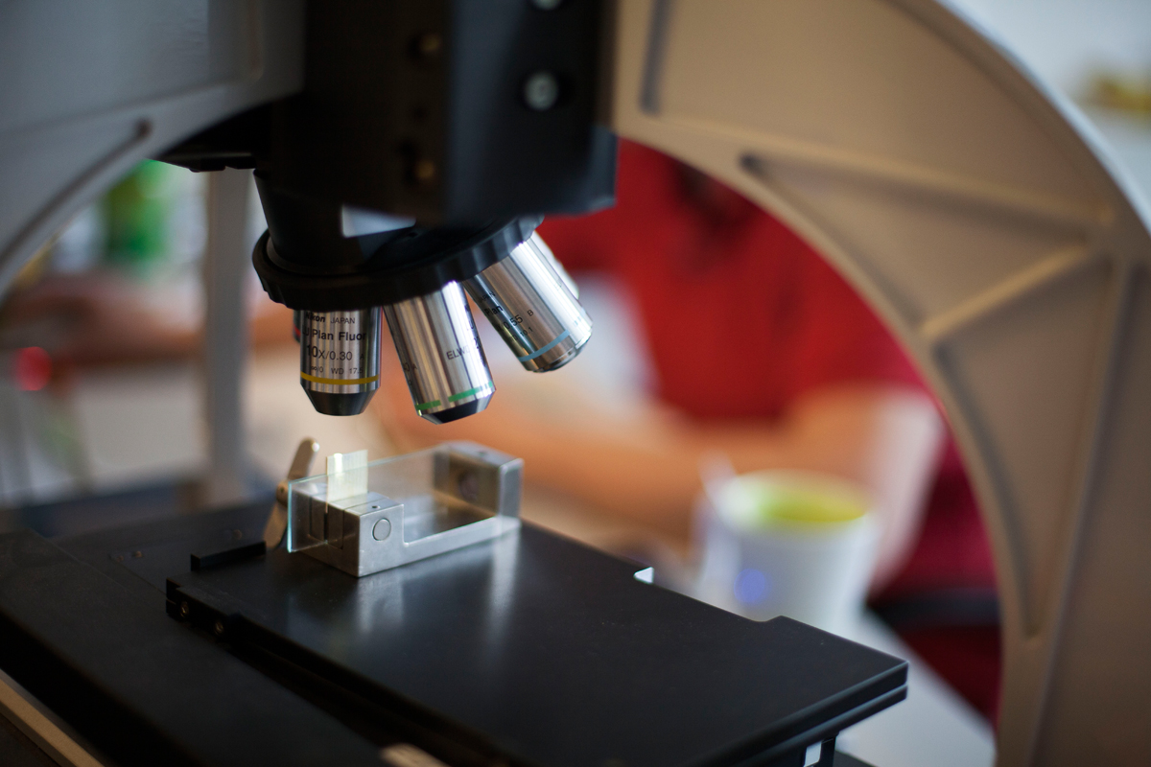
MUAS RESEARCH
MAJOR FIELDS
Automotive
Digitalisation
Energy Efficiency
Production & Materials
Socio-economic Innovations
N.N.
Notes:
Applied research and development at Munich University of Applied Sciences has a broad basis and covers engineering, economics, social sciences and design. The vast majority of R&D projects fit into the following five subject areas:
• Automotive
• Digitalisation
• Energy efficiency
• Production and materials
• Socio-economic innovations

Slide 29
MUAS RESEARCH
In FIGURES
5
8
12
88
91
126
13.4
Major fields
Affiliated institutes
Competence centres
Research projects (publicly funded)
Ph.D. students
Research associates
million Euro third party funds
Notes:
In addition to specialist laboratories, the University has competence centres and affiliated institutes. The competence centres at Munich University of Applied Sciences undertake application development and research in close partnership with industry.
The affiliated institutes (such as the Strascheg Center for Entrepreneurship) are legal bodies, independent in organisational and legal terms, that are affiliated with the University as associations or enterprises.
All research work at Munich University of Applied Sciences is funded by third parties, for example by the Bavarian State Ministry of Science, the Bavarian Ministry of Economic Affairs, the Bavarian State Ministry of the Environment and Consumer Protection, the Federal Ministry of Education and Research (BMBF), the Federal Ministry of Economics and Technology (BMWi), the German Research Association (DFG), the EU, contract research for industry, etc.

Slide 30

RESEARCH
SCIENCE SUPPORT CENTRE (FORWIN)
Scientists
Executive Board
Adminis-tration
internal
FORWIN
external
General
Public
Funding
Body
Industry Partners
Notes:
The central point of contact for funding opportunities and applications is the Science Support Centre (FORWIN). The Science Support Centre is the point of contact for researchers at Munich University of Applied Sciences (internally) and potential (external) partners from commerce and industry.
The team supplies answers to questions like:
What forms of collaboration are possible between the University and industry partners?
What funding opportunities are there at Munich University of Applied Sciences for research projects?
What options are there for applying research results?

Slide 31
YOUNG ACADEMICS
PH.D. PROGRAMMES
  Individual
  Projects
  Structural Cooperations
  International Cooperations
  Training
  Programme
Notes:
There are a range of options for completing a doctorate at Munich University of Applied Sciences.
1) Individual projects: Projects that are undertaken through an individual arrangement with a university (e.g. LMU or TUM). The university in question sees the students as ‘external PhD students’.
2) International partnerships:
Munich Node with Univ. of Plymouth: The ‘Munich Node’ is a collaboration between the Department of Engineering and Management at Munich University of Applied Sciences. It offers new, attractive qualification options in a range of programmes including PhDs. Junior researchers work on their PhD under the supervision of Plymouth University, but are based locally in Munich for three to five years until the programme’s completion.
DBA: The ‘Doctoral Degree in Business Administration’ (DBA) is an application-oriented doctoral programme with a strong European focus geared towards the requirements of industry and commerce. The Strascheg Center for Entrepreneurship (SCE), in collaboration with Munich University of Applied Sciences, offers this part-time doctoral programme in close partnership with Edinburgh Napier University and Glamorgan University. The main focus is innovation management. The title ‘Doctor of Business Administration’ is awarded by Edinburgh Napier University or Glamorgan University once the doctorate has been completed successfully.
NITIM: In terms of continuing academic education, Strascheg Center for Entrepreneurship (SCE) offers a European focus as the basis for an international higher education career. A monthly PhD colloquium is held by the Munich NITIM division and is open to interested doctoral students from various departments. Twice a year, one-week NITIM PhD seminars are held at European partner universities. Besides completing a thesis, there are opportunities for students to attend conferences, gain publication experience and manage academic projects. All publications are written in English. Enrolment and defence are possible at the Universität der Bundeswehr München [Munich University of the Armed Forces].
3) Structural partnerships with TUM:
Cooperative graduate programme (KGk.): The Building Services Engineering and Energy Efficiency programme is a thematic graduate centre composed of various departments of Munich University of Applied Sciences and the Technical University of Munich (TUM) and has the following objectives:
• Interdisciplinary, holistic approach to tackling research questions in building physics, building services engineering and energy provision and conversion
• Scientific qualification of junior science and engineering researchers in a research environment that was previously very diverse
• Enabling candidates to complete their doctorates on a structured basis within 3.5 years with a broad qualification profile
Munich School of Engineering (MSE): Munich School of Engineering (MSE) offers teaching and research on technologies in the fields of environment & climate, energy & raw materials and mobility & infrastructure. As an integrative research centre, it brings together various departments of the Technical University of Munich and Munich University of Applied Sciences, among others.
Doctoral Networks in the Bavarian Academic Forum: Bavarian universities (e.g. the Technical University of Munich) and universities of applied sciences (including Munich University of Applied Sciences) will work closer together on collaborative doctoral programmes in future, following the model of the Bavarian Academic Forum (BayWISS). Doctoral projects at Munich University of Applied Sciences will be supported by partnered professors from the institutions involved. The title will be awarded by a university, the university of applied sciences will be mentioned on the award certificate.
4) Qualification programme: To support junior scientific researchers, the Science Support Centre organises seminars and workshops with the objective of specialist and cross-disciplinary qualification, for example in method or writing proficiency.

Slide 32
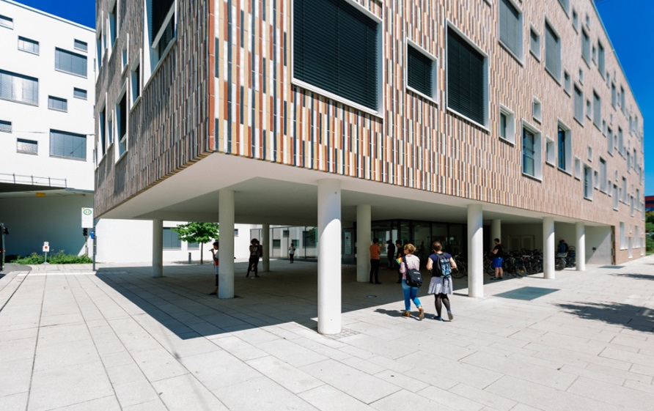
MUAS
CAMPUS LOTHSTRASSE
  Central administration and services
  CAREER Center
  E-Learning Center
  Science Support Center
  Center for Continuing Education
  Library
  IT Services
  General Chemistry Laboratories
  Strascheg Center for Entrepreneurship
  9 departments
Notes:
The modern and dynamic Lothstraße campus is the heart of Munich University of Applied Sciences. Situated to the north-west of the Central Station (Hauptbahnhof), the campus has nearly 11,800 students and is the largest and oldest of the university. All central administration units and services are based here, as are nine departments.
Distances:
Lothstrasse – Pasing: about 30-40 minutes by car or public transport
Lothstrasse – Karlstrasse: About 15 minutes by public transport, car or bicycle
Departments
Mechanical, Automotive and Aeronautical Engineering (Department 03)
Electrical Engineering and Information Technology (Department 04)
Building Services Engineering, Paper and Packaging Technology and Print and Media Technology (Department 05)
Applied Sciences and Mechatronics (Department 06)
Computer Science and Mathematics (Department 07)
Engineering and Management (Department 09)
Design (Department 12)
General and Interdisciplinary Studies (Department 13)
Tourism (Department 14)

Slide 33
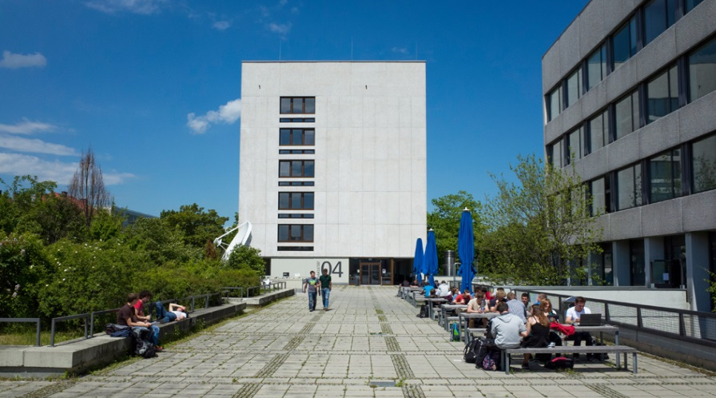
MUAS
CAMPUS LOTHSTRASSE
  Departments
  Mechanical, Automotive and Aeronautical Engineering
  Electrical Engineering and Information Technology
  Building Services Engineering, Paper and Packaging Technology, Print and Media Technology
  Applied Sciences and Mechatronics
  Computer Science and Mathematics
  Engineering and Management
Notes:
The modern and dynamic Lothstrasse campus is the heart of Munich University of Applied Sciences. Situated to the north-west of the Central Station (Hauptbahnhof), the campus has nearly 11,800 students and is the largest and oldest of the university. All central administration units and services are based here, as are nine departments.
Distances:
Central Station – Lothstrasse: about 10 minutes by public transport
Lothstrasse – Pasing: about 30-40 minutes by car or public transport
Lothstrasse – Karlstrasse: About 15 minutes by public transport, car or bicycle
Services and central administration units
Administration
CAREER Center
E-Learning Center
Science Support Center
Center for Continuing Education
Library
IT Services
General Chemistry Laboratories
Strascheg Center for Entrepreneurship

Slide 34
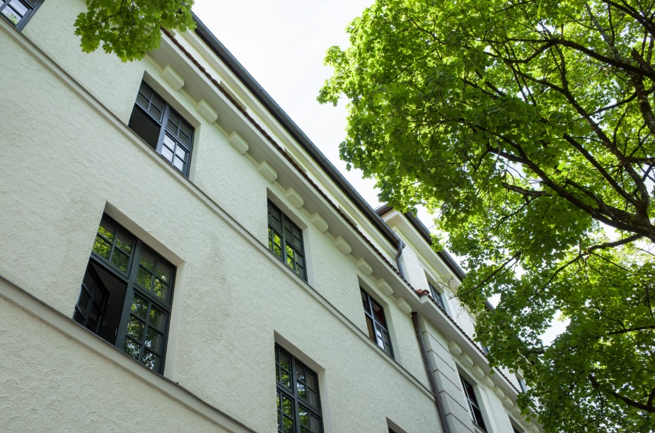
MUAS
CAMPUS LOTHSTRASSE
  Departments
  Design
  General and
  Interdisciplinary Studies
  Tourism
Notes:
The modern and dynamic Lothstrasse campus is the heart of Munich University of Applied Sciences. Situated to the north-west of the Central Station (Hauptbahnhof), the campus has nearly 11,800 students and is the largest and oldest of the university. All central administration units and services are based here, as are nine departments.
Distances:
Central Station – Lothstrasse: about 10 minutes by public transport
Lothstrasse – Pasing: about 30-40 minutes by car or public transport
Lothstrasse – Karlstrasse: About 15 minutes by public transport, car or bicycle
Services and central administration units
Administration
CAREER Center
E-Learning Center
Science Support Center
Center for Continuing Education
Library
IT Services
General Chemistry Laboratories
Strascheg Center for Entrepreneurship

Slide 35
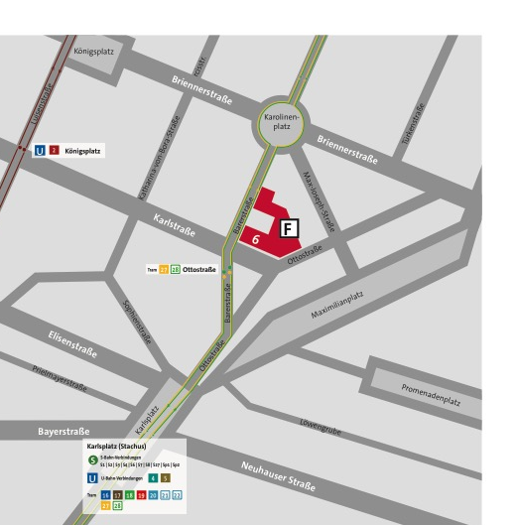

MUAS
CAMPUS KARLSTRASSE
  Departments
  Architecture
  Civil Engineering
  Geoinformatics
Notes:
The Campus at Karlstraße is located in Munich's museum district, near to Karlsplatz (Stachus) in the centre of town. It houses the departments of Architecture, Civil Engineering and Geoinformatics in a historic building and architectural highlight from the 1950s. The listed building is one of the few examples of consistently modern architecture from when Munich was rebuilt after World War II. Around 2,050 students are taught in the three departments.
Distances:
Central Station – Karlstrasse: 5-10 minutes by public transport
Karlstrasse – Lothstrasse: about 15 minutes by public transport, car or bicycle
Karlstrasse – Pasing: about 30-40 minutes by public transport or car

Slide 36
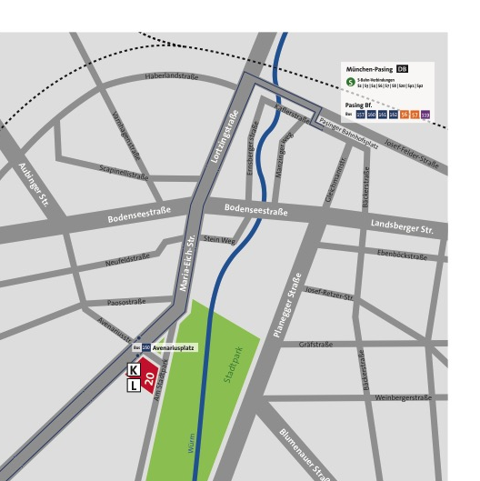

MUAS
PASING CAMPUS
  Departments
  Business Administration
  Applied Social Sciences
Notes:
The Pasing campus with its leafy courtyards and historic buildings is situated in the western part of Munich near the Pasinger Stadtpark (Pasing City Park). It is home to the departments of Business Administration and Applied Social Sciences, with around 4,150 students.
Distances:
Central Station – Pasing: about 25 minutes by public transport
Pasing – Lothstrasse/Karlstrasse: About 30-40 minutes by car or public transport

Slide 37
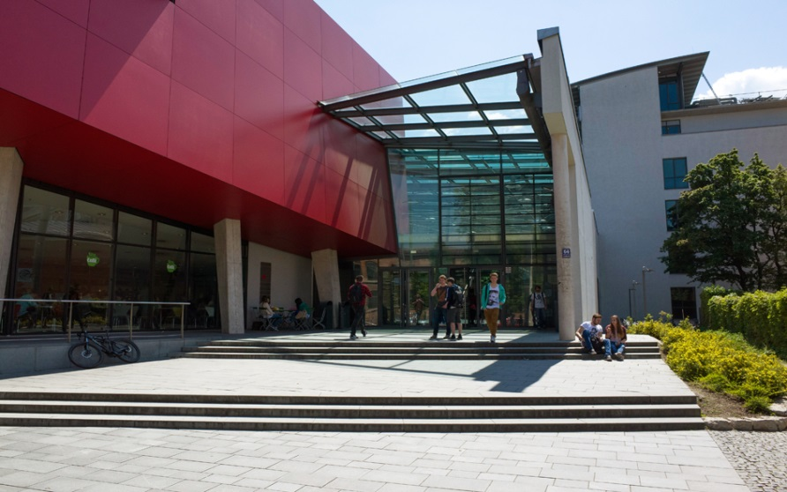
CAMPUS XX
DEPARTMENT OF XX
  Degree programmes
  Xx
  Xx
  xx
Notes:
Present basic information on your department in this slide, e. g.:
Degree programmes
(Research) Projects
Rankings
Staff or student numbers
…
The slide can be repeated more than once for different department-related topics.

Slide 38
RANKINGS
Gründungsradar Stifterverband:
(Entrepreneurship nationwide)
U-Multirank:
(worldwide)
  Co-publications with industrial partners, worldwide, including universities:
  Publications with regional businesses, nationwide, including universities:
No. 1 (2016)
No. 2 (2013)
No. 1 (2012)
No. 3 (2015)
No. 2 (2015)

Slide 39
RANKINGS
Wirtschaftswoche/Universum University Ranking
(nationwide)
  Electrical Engineering:
  Computer Science:
  Mechanical Engineering:
  Information Systems and Management:
  Engineering and Management:
University Employability Ranking (trendence/Emerging, nationwide)
No. 1 (2016)
No. 1 (2016)
No. 1 (2016)
No. 1 (2016)
No. 2 (2016)
No. 5 (2016)

Slide 40
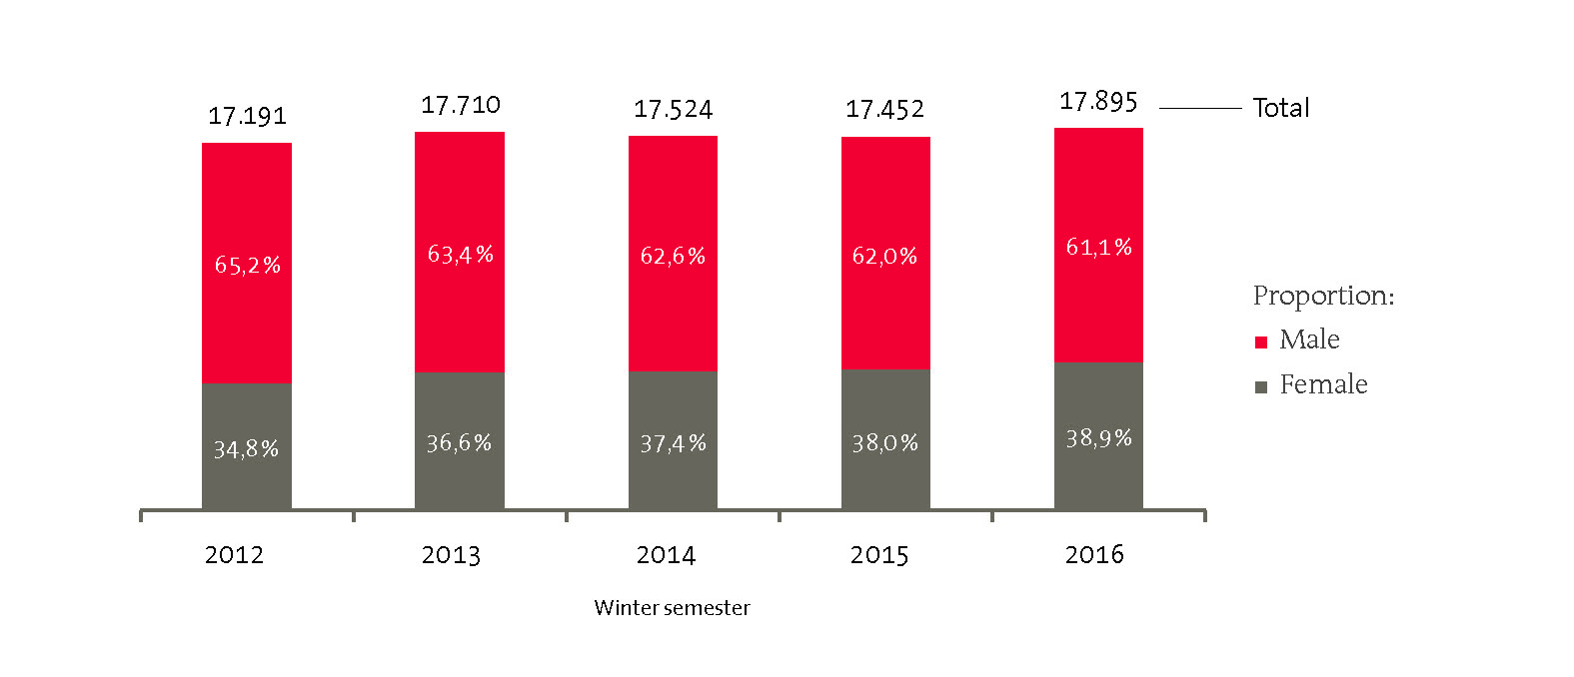
NUMBER OF STUDENTS
2012-2016
Notes:
Diese und alle anderen Statistiken werden aus dem Jahresbericht direkt geliefert und nur noch eingepasst

Slide 41
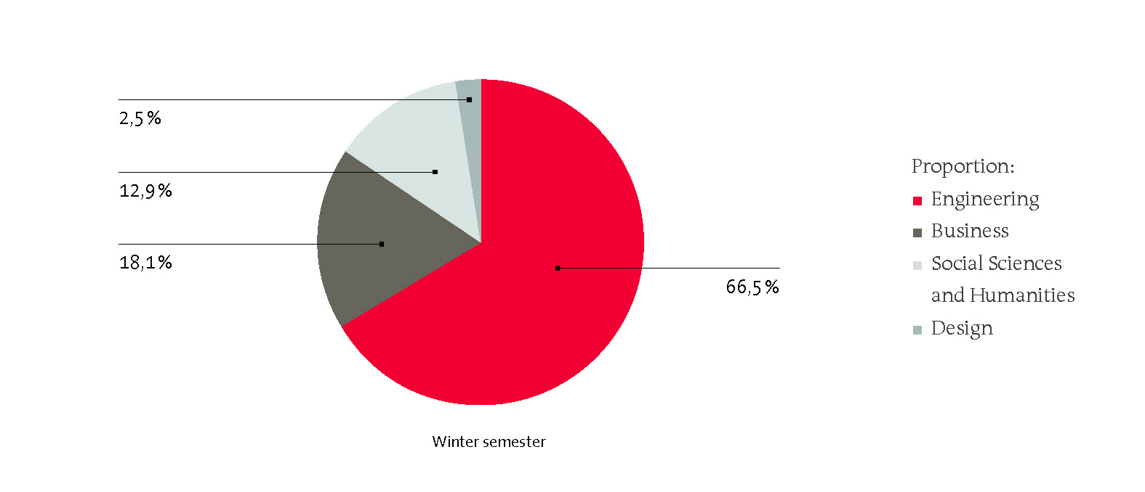
NUMBER OF STUDENTS PER
FIELD OF STUDY 2016

Slide 42
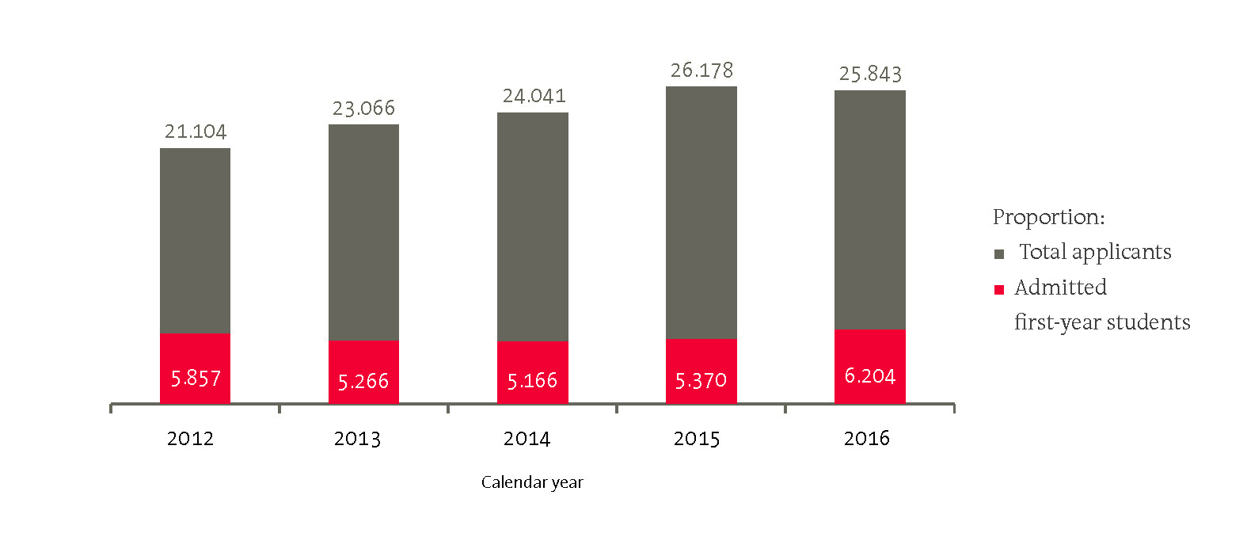
NUMBER OF APPLICANTS /
FIRST-YEAR STUDENTS
2012-2016

Slide 43
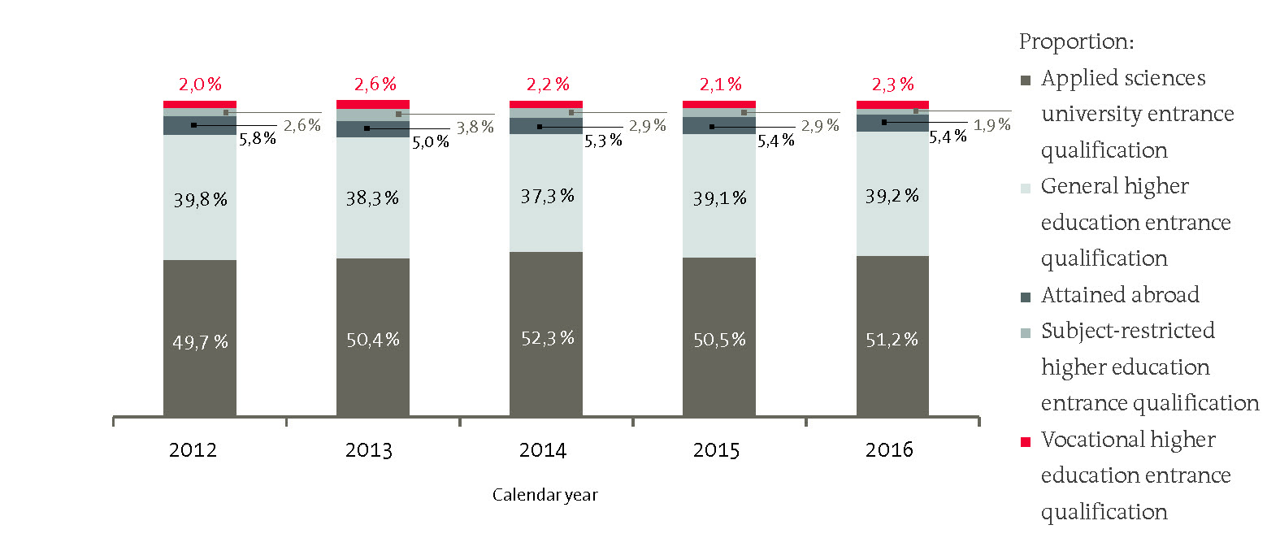
NUMBER OF FIRST-YEAR STUDENTS
PER ENTRANCE QUALIFICATION
2012-2016

Slide 44
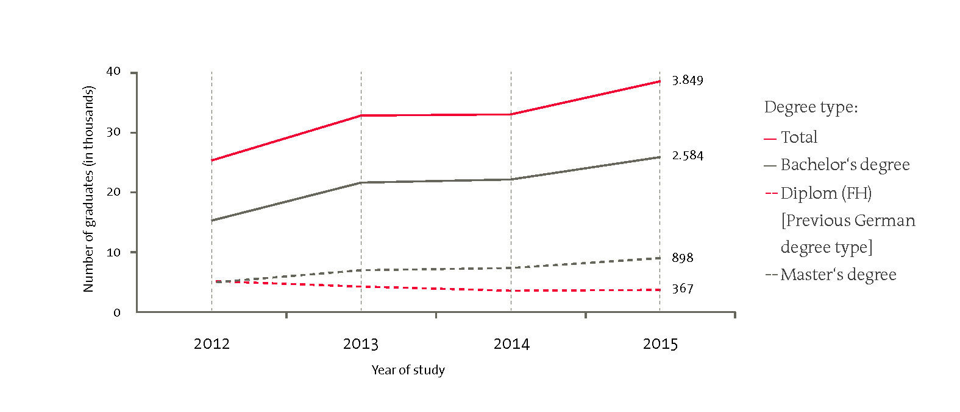
NUMBER OF GRADUATES PER
FINAL DEGREE TYPE 2012-2015

Slide 45
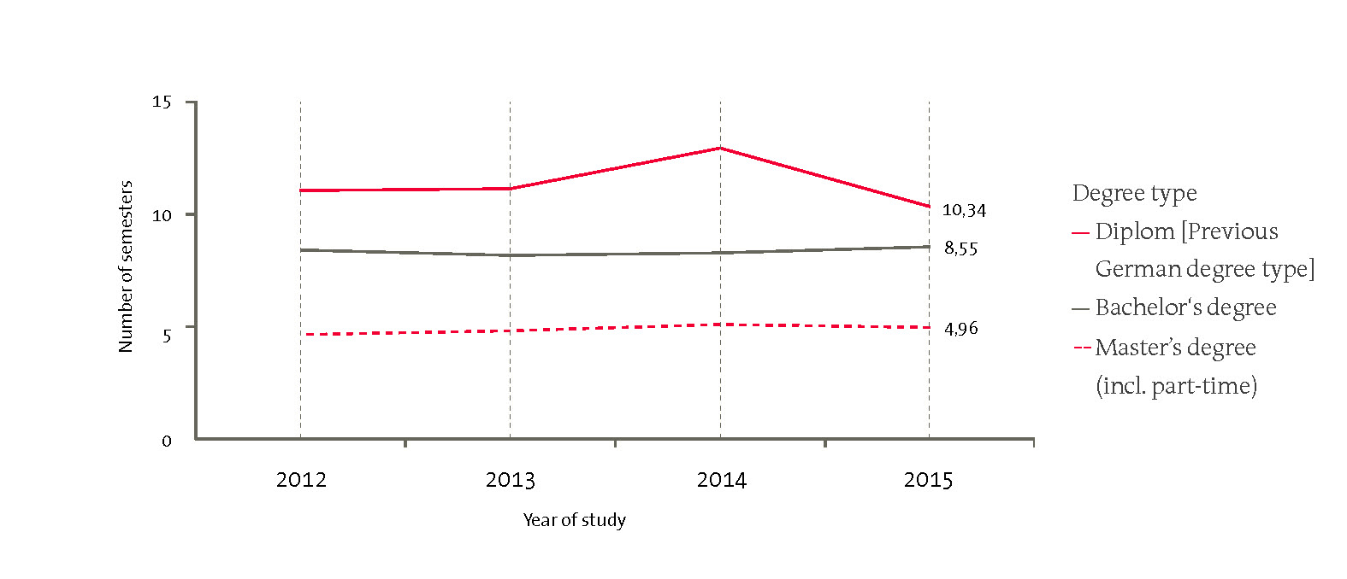
DURATION OF STUDIES /
FINAL DEGREE TYPE 2012-2015

Slide 46
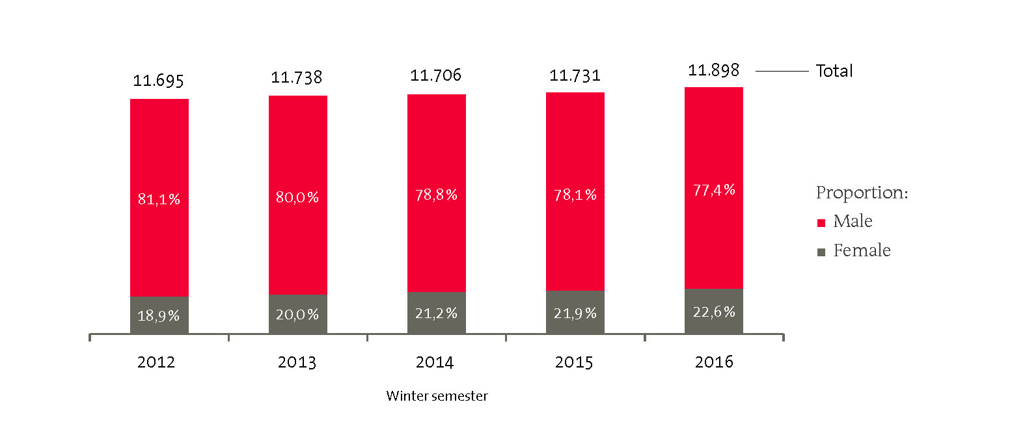
NUMBER OF “STEM” STUDENTS
2012-2016

Slide 47
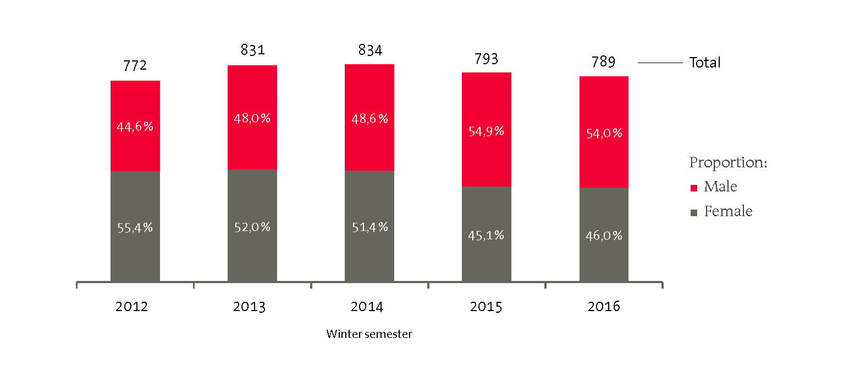
NUMBER OF STUDENTS ON DUAL STUDY PROGRAMMES
2012-2016

Slide 48
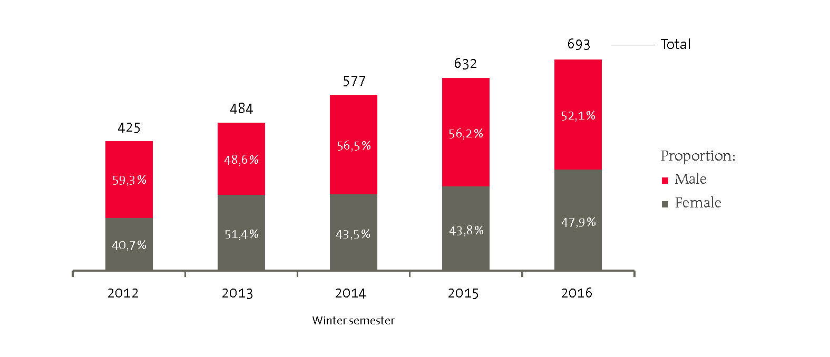
NUMBER OF CONTINUING EDUCATION STUDENTS
2012-2016

Slide 49
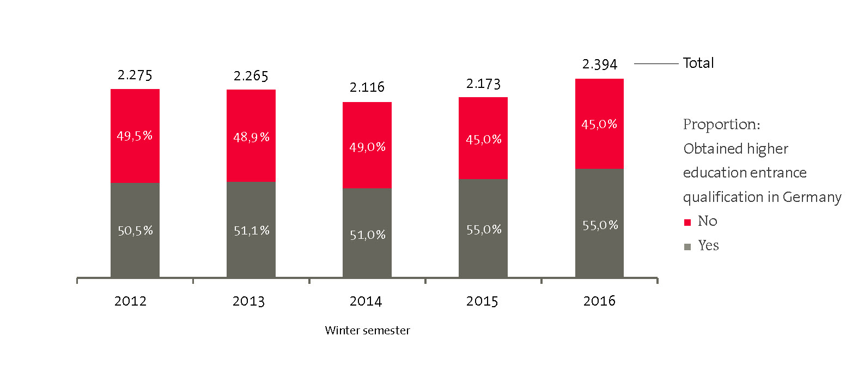
NUMBER OF FULL-TIME
INTERNATIONAL STUDENTS
2012-2016

Slide 50
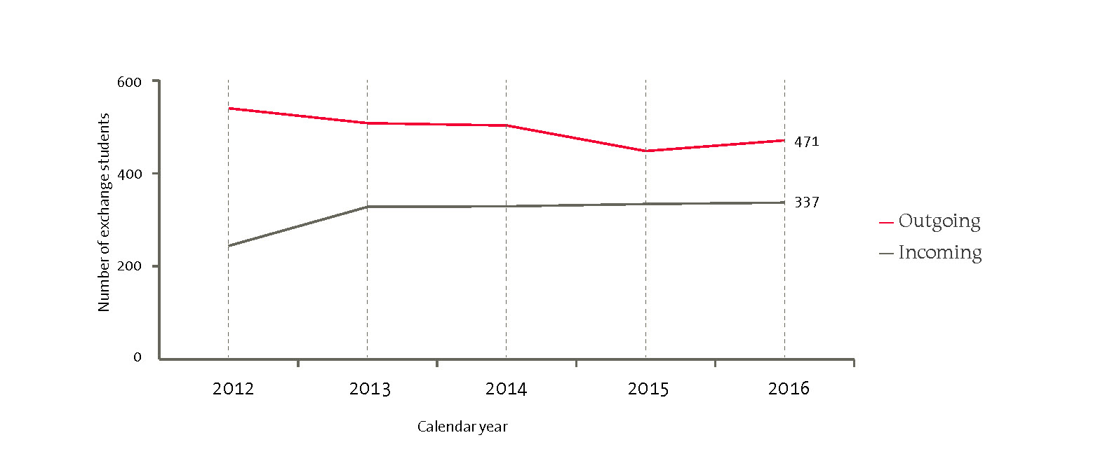
NUMBER OF EXCHANGE STUDENTS
2012-2016

Slide 51
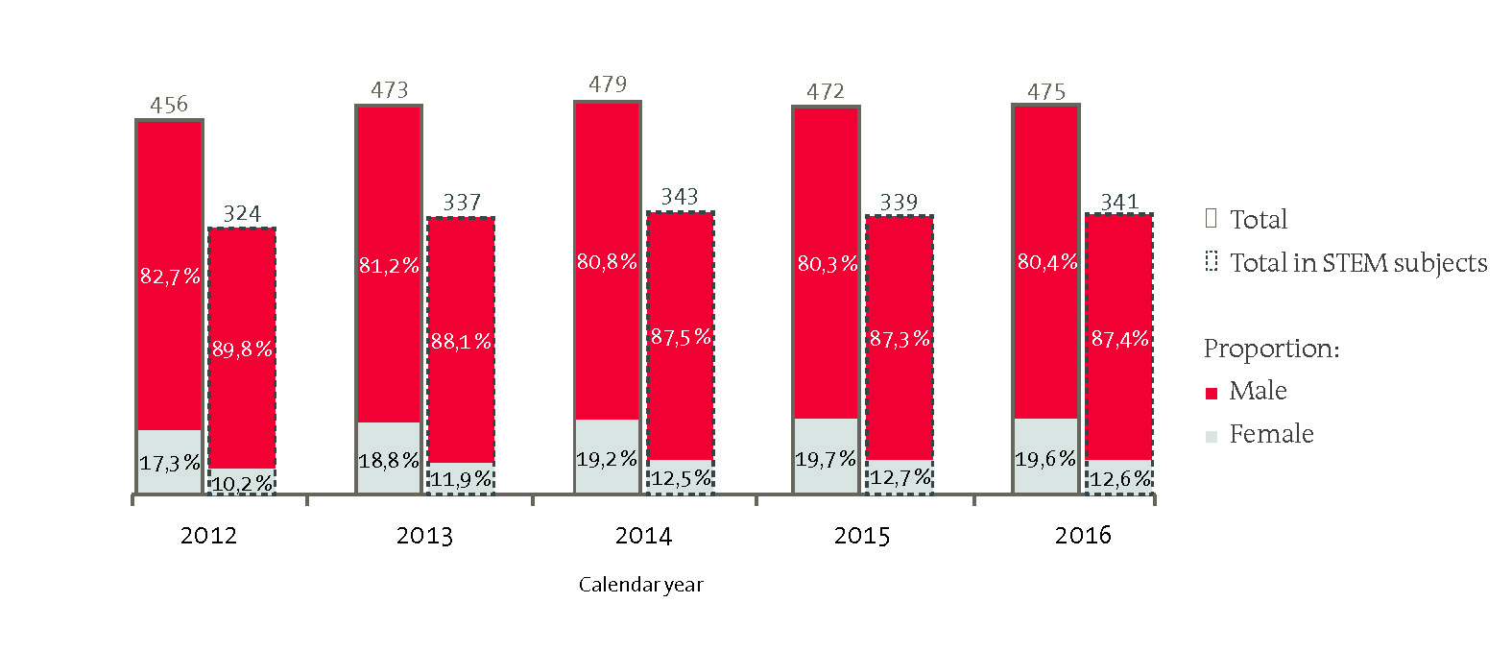
NUMBER OF PROFESSORS
2012-2016

Slide 52
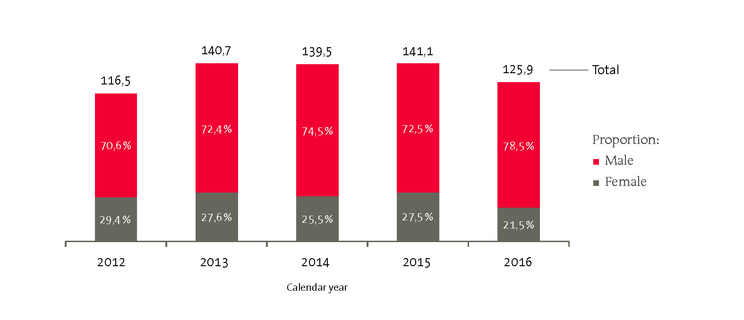
NUMBER OF RESEARCH
ASSOCIATES 2012-2016

Slide 53
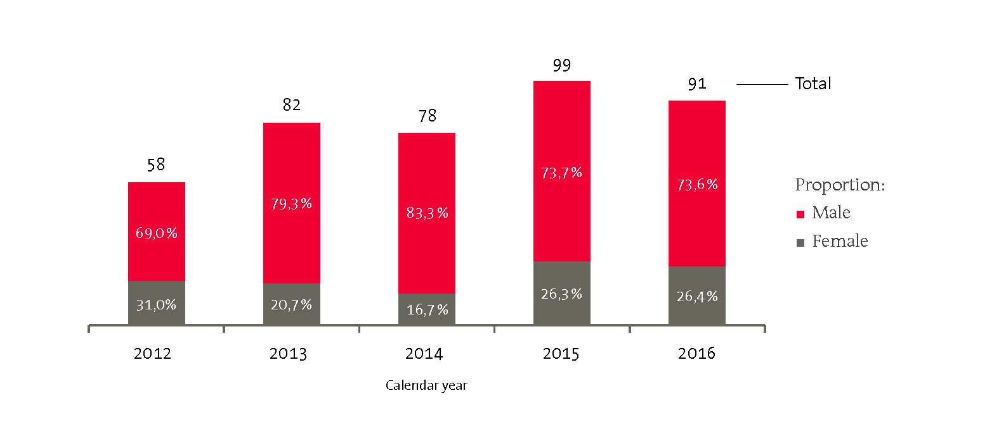
NUMBER OF DOCTORAL
CANDIDATES 2016

Slide 54
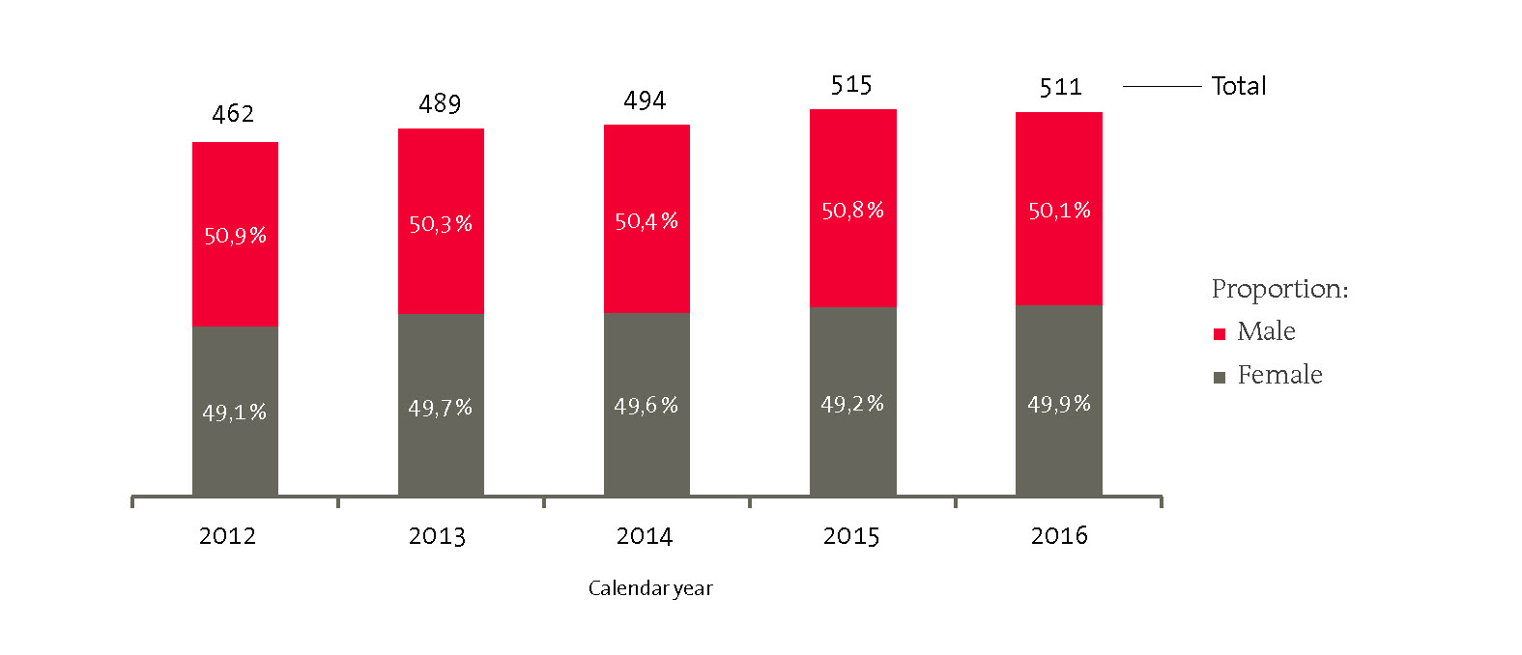
NUMBER OF NON-ACADEMIC
STAFF 2012-2016

Slide 55
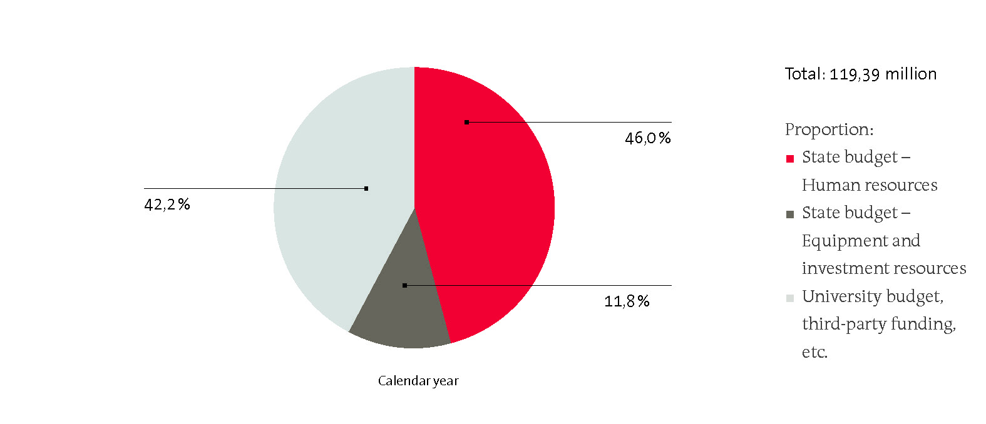
BUDGET TOTAL
2016

Slide 56
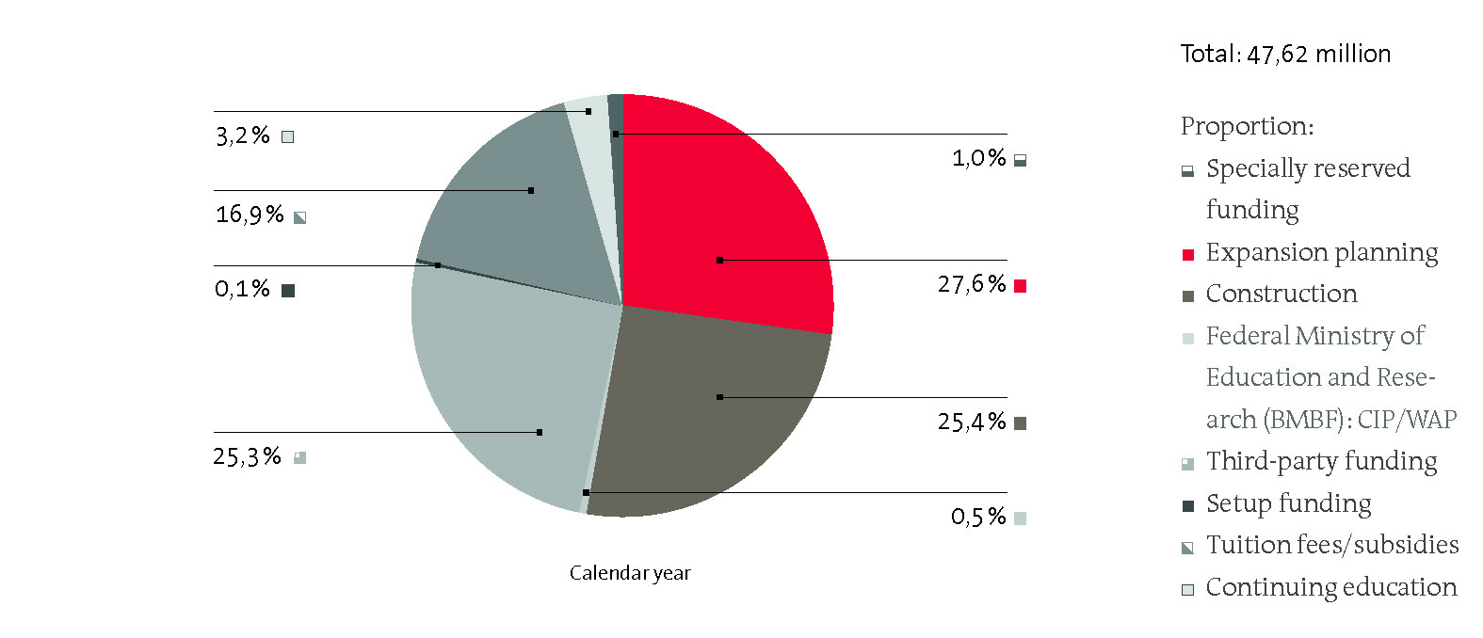
BUDGET BREAKDOWN
ADDITIONAL BUDGETS 2016

Slide 57
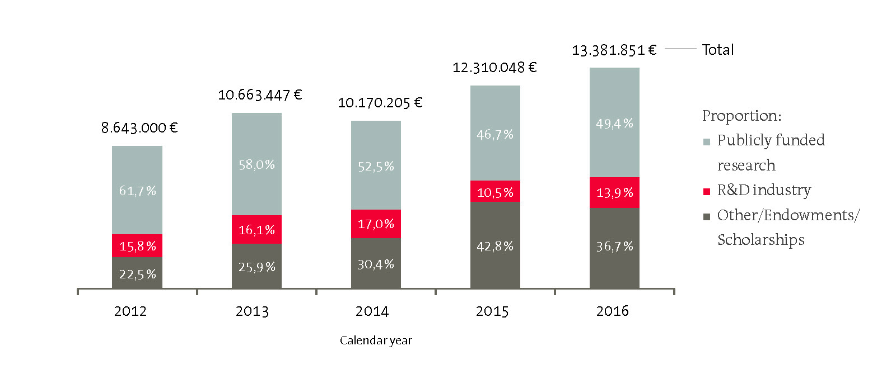
THIRD-PARTY FUNDING PER
FUNDING SOURCE 2012-2016

