Slide 1
The Department of Electrical Engineering and Information Technology FK04
at the University of Applied Sciences Munich
http://www.ee.hm.edu/

Slide 2
MUNICH UNIVERSITY OF APPLIED SCIENCES
In FIGURES
18,000
475
750
511
126
91
86
14
8
Students
Professors
Part-time lecturers
Administration staff
Research associates
PhD students
Degree programmes (Bachelor's and Master's)
Departments
Affiliated institutes

Slide 3
UNIVERSITIES OF APPLIED SCIENCES
CHARACTERISTICS
Bachelor, Master
PhD (cooperation w/ research universities)
DEGREES
MAIN STUDY FOCUS
practice and application
RESEARCH FOCUS
application-oriented research
CLASS SIZE
small
INTERNSHIP
Compulsory Internship Semester
REQUIREMENT FOR
PROFESSORS?
Min. 5 years industry /
professional background
Notes:
Universities of applied sciences have unique characteristics in Germany.
By comparison: Research University
Degrees
Bachelor
Master
PhD
Main study focus
research and science
Research focus
basic research
Class size
rather big
Internship
No
Industry/professional background required for professors?
No

Slide 4










MUAS
LOCATION INFO
Automotive industry
Biotechnology & life sciences
Design & media
Energy technology
Finance
Health/social sciences
IT & communications
Aerospace engineering
Tourism
Business services
Notes:
We are based in a leading European business hub.
With this size and location come significant opportunities and responsibility in diverse industrial, economic, and social contexts.
City of Munich info (http://www.muenchen.de/rathaus/wirtschaft/wirtschaftsstandort/kennzahlen)
State capital of Bavaria
Population of 1.5 million
Largest concentration of DAX-listed companies in Germany
Several global market leaders
Highest share of highly skilled workers in Germany (35%)
Large proportion of graduates stay in the region
Strong international community: 25% foreign nationals, consular posts
Renowned venue for trade fairs and conferences
Strong startup culture
Safety and excellent quality of living (one of the world's best cities to live in; awarded 7th place in 2015 Mercer ranking)
"Munich's economic strength stems from its broad-based economic structure, a balanced mix of large corporations, small and medium enterprises, and craft businesses in a wide range of sectors." (City of Munich info)

Slide 5
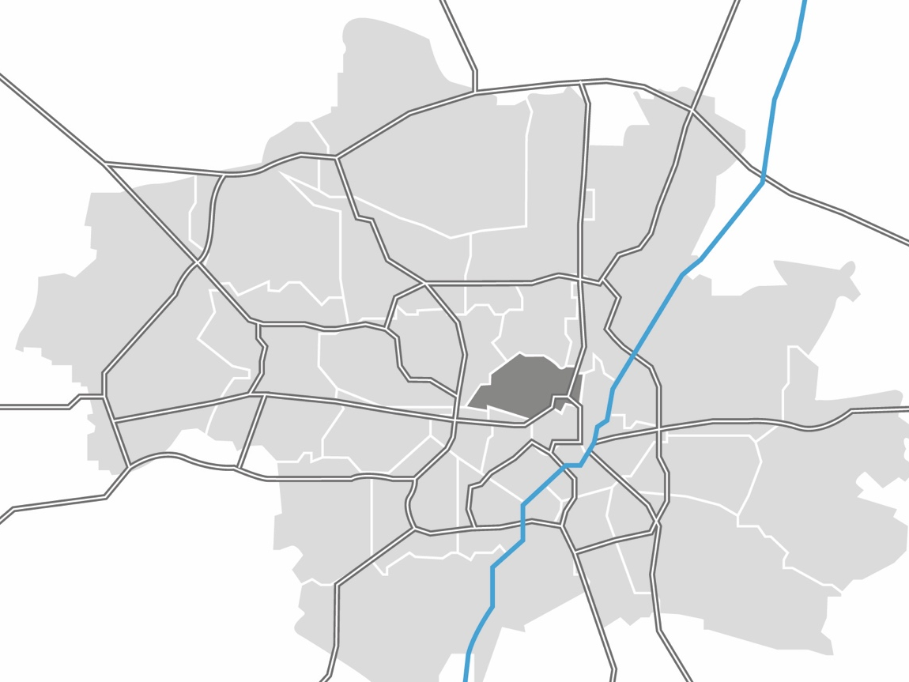
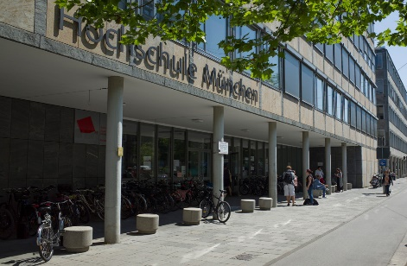
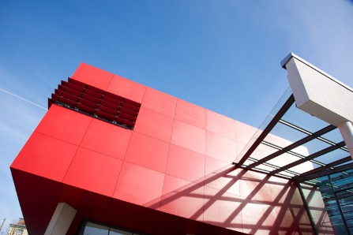
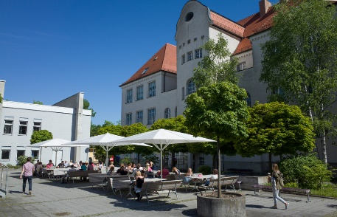
MUAS
THREE CAMPUSES
CAMPUS KARLSTRASSE
CAMPUS LOTHSTRASSE
CAMPUS PASING
Notes:
Our departments are spread over three large campuses in Munich. They each have heir individual flair and also their own cafeteria and library.
Distances:
Lothstraße/Karlstraße – Pasing: about 30-40 minutes by car or public transport
Lothstraße – Karlstraße: About 15 minutes by public transport, car or bicycle

Slide 6
Department FK04- Overview
Department FK04 Structure in Figures
1350
490
41
30
50
36
3
3
Students
freshman/year
fulltime professors
other employees (lab and admin)
visiting lecturers (about 30 each semester)
laboratory facilities for teaching and research
Bachelor Programs
Master Programs

Slide 7
Bachelor- and Masterprograms
STRUCTURE
Master Electrical Engineering
Master Systems Engineering
Master of Science
Master of Systems Eng.
10
Masterthesis
10
Masterthesis
9
theoretical courses
9
theoretical courses
8
theoretical courses
8
theoretical courses
qualification test
qualification test
Bachelor
Bachelor
Bachelor
7
courses + bachelor thesis
.
Choice
between
AE, AT,
KT, TI
7
courses + bachelor thesis
.
7
courses + bachelor thesis
.
OUTSIDE
HM
6
courses (main studies)
6
courses (main studies)
6
courses (main studies)
5
industrial training period
5
industrial training period
5
industrial training period
preliminary test
preliminary test
preliminary test
4
courses (basic studies)
4
courses (basic studies)
4
courses (basic studies)
3
courses (basic studies)
3
courses (basic studies)
3
courses (basic studies)
intermediate test
intermediate test
1. Hürde
2
2
intermediate test
2
courses (basic studies)
courses (basic studies)
courses (basic studies)
1
courses (basic studies)
1
courses (basic studies)
1
courses (basic studies)
Bachelor EI
Bachelor RE
Bachelor EM
7
Notes:
Most of MUAS study programmes are offered in German.
There are a two study programmes completely offered in English:
Master of Engineering in Paper Technology (Department 05 – Building Services Engineering, Paper and Packaging Technology and Print and Media Technology)
Master of Sciences in Business Entrepreneurship and Digital Technology Management (Department 10 – Business)
The following study programmes are partially taught in a foreign language:
German / French: Bachelor / Master of Engineering in Production and Automation (Department 06 – Applied Sciences and Mechatronics)
German / English: Master of Sciences in Micro and Nano Technology (Department 06 – Applied Sciences and Mechatronics)
German / English: Master of Arts in Intercultural Communication and Cooperation (Department 13 – General and Interdisciplinary Studies ) This is a programme with tuition fees.
German / English: Within the Bachelor in Engineering and Management students can choose the International Module Technology which offers a few technical subjects in English during the first two semesters (Department 09 – Engineering and Management)
Every department of MUAS offers a selection of English-taught subjects (Courses in English) for German students interested in attending a course in a foreign language or for international exchange students.
For obtaining a certificate students usually have to attend 4-5 subjects and pass all necessary exams. The amount of awarded ECTS depends on each certificate and its specific contents.

Slide 8
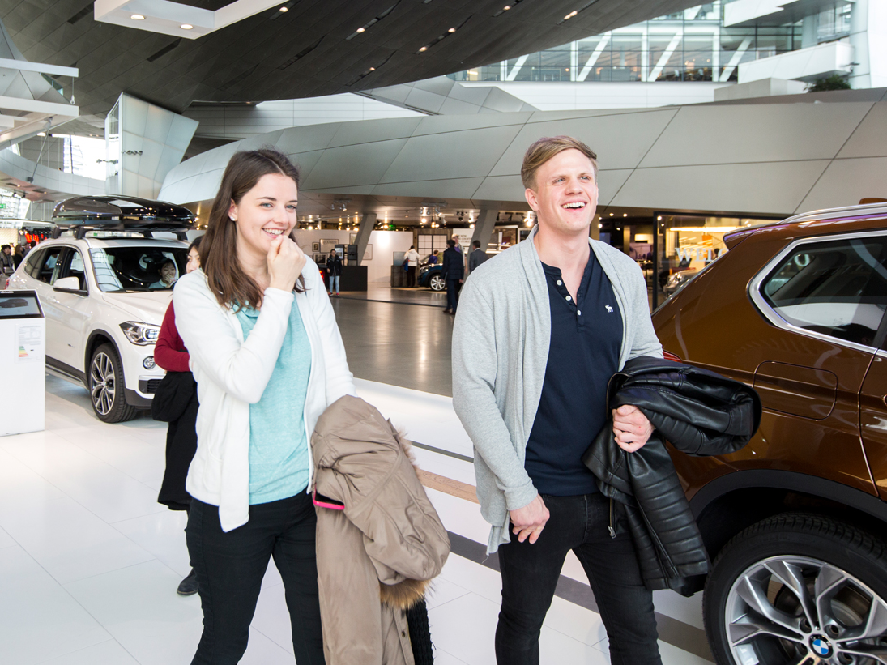









HM Dual
STUDY PROGRAM
We offer so called dual studies opportunities in cooperation with the consortium university dual bavaria and with numerous industrial partner companies.
Notes:
There are two basic types:
studies and vocational training in combination
Duration 4,5 years
Dual degree: Bachelor degree and certificate from Chamber of Commerce and Industry
studies with intensive industrial internship periods
Bachelor: duration 3,5 years
Master: duration 1,5 years
Student is during his studies funded by and bounded by contract to industrial partner
Bachelor – Master degree

Slide 9

HM Dual
STUDY PROGRAM
There are two basic types:
studies and vocational training in combination
Duration 4,5 years
Dual degree: Bachelor degree and certificate from Chamber of Commerce and Industry
studies with intensive industrial internship periods
Bachelor: duration 3,5 years
Master: duration 1,5 years
Student is during his studies funded by and bounded by contract to industrial partner
Bachelor – Master degree
Notes:
The university tackles broad societal challenges by embracing interdisciplinary diversity.
We offer degree programmes and active academic exchange in the areas of engineering, business, social sciences, and design.
Our Department of General and Interdisciplinary Studies is unique in granting every student the opportunity to experience a cross-disciplinary education and to develop their personal skills.
This diversity is deeply rooted in our history:
Founded in 1971
The result of seven institutions from different fields coming together: engineering schools and advanced technical schools
Strong vocational training tradition dating back to the beginning of industrialisation in Germany
Over the past 40 years, we have continued to expand and develop:
We have steadily increased the range of programmes on offer
We introduced a focus on research, which has become a top priority -> we now offer doctoral programmes!
Lifelong learning and continuing education have emerged as an important new field
We took early action in response to the European Bologna reforms, and today we offer approved, high-quality degree programmes
We changed our name to "Munich University of Applied Sciences"

Slide 10
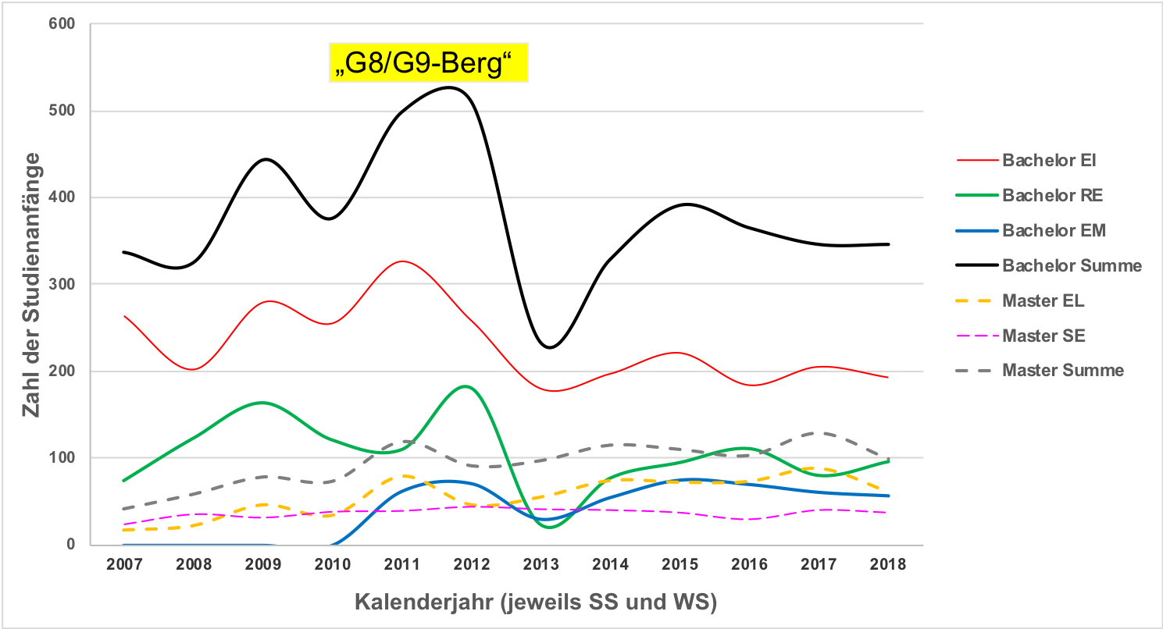
STATISTIK BEGINNERS
Beginners
calender year (summer and winter semester)
Notes:
-Undergoing changes over midddle time periods which makes it difficult to handle
-in germany public university, there is by law a claim on a seat if you like to study for the first time, but we have limited capacity so we fill the seats with the best graded students until our capacity is reached.
-there is a shift in interest inbetween the bachelor programs mainly due to public focus fed by long term industrial news

Slide 11
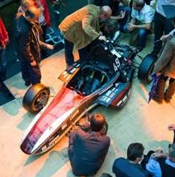

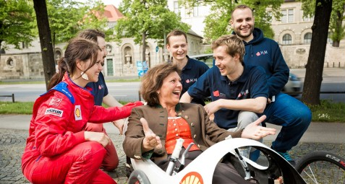
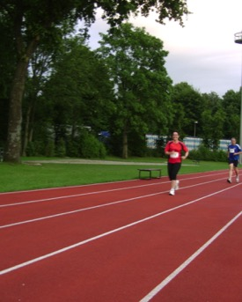
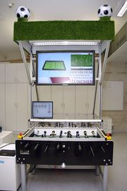
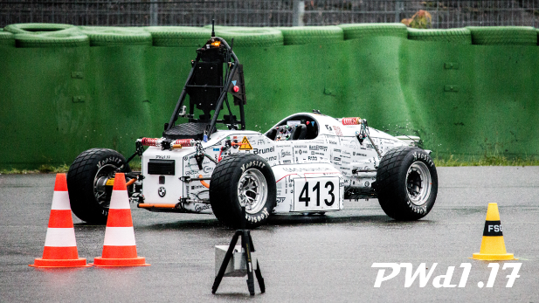
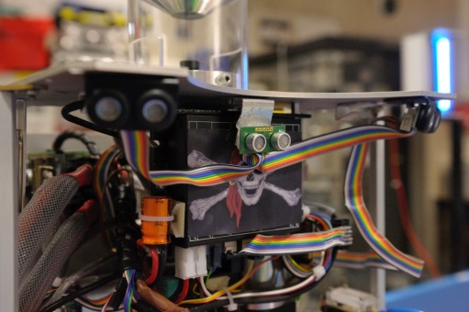
LONG-TERM STUDENTS PROJECTS
Formula Student Electric
https://www.munichmotorsport.de
Shell Eco Marathon
ProCK
Formula Student driverless

Slide 12
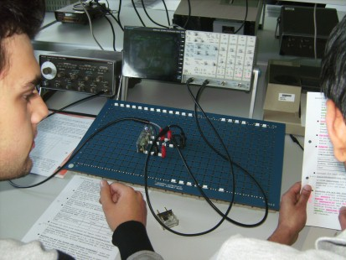
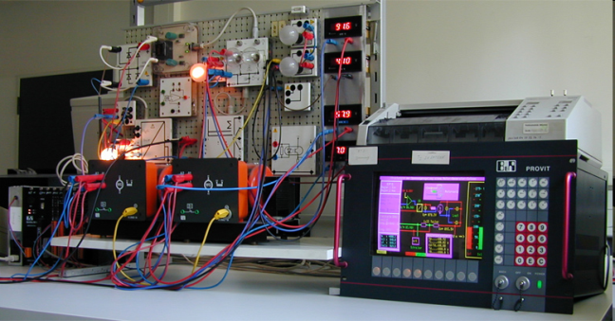
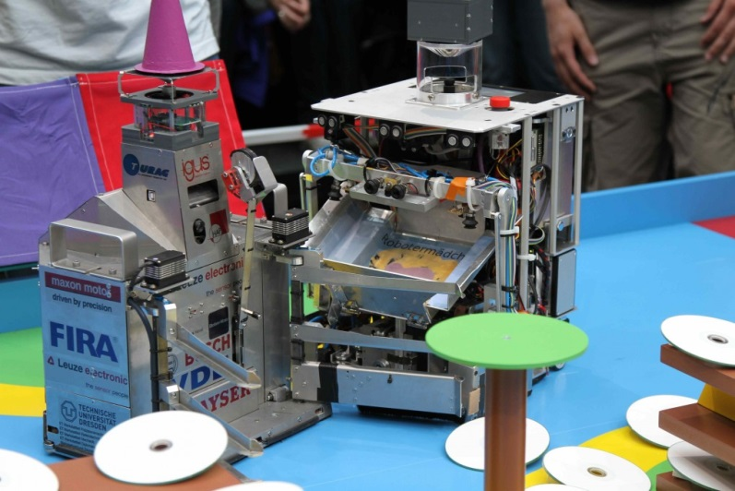
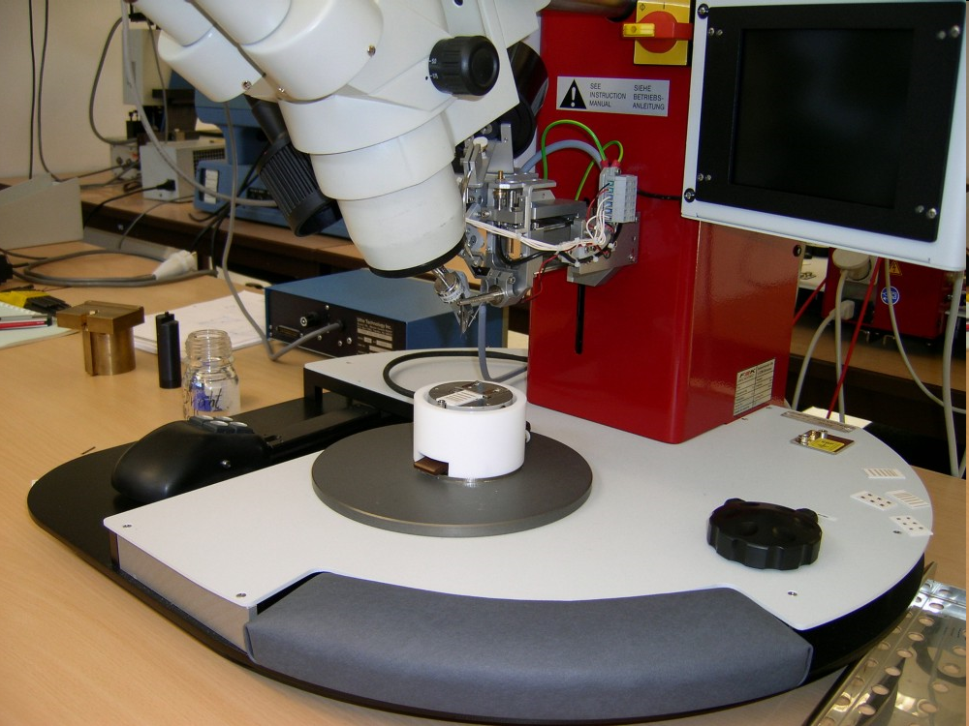
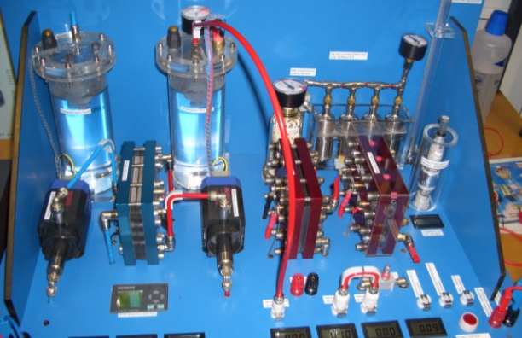

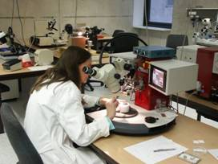
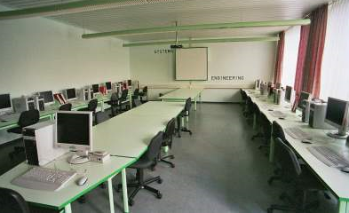

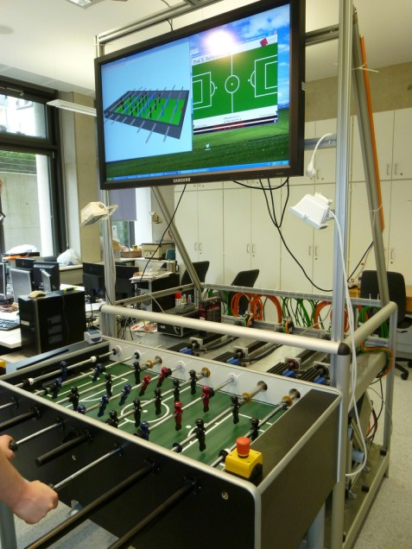
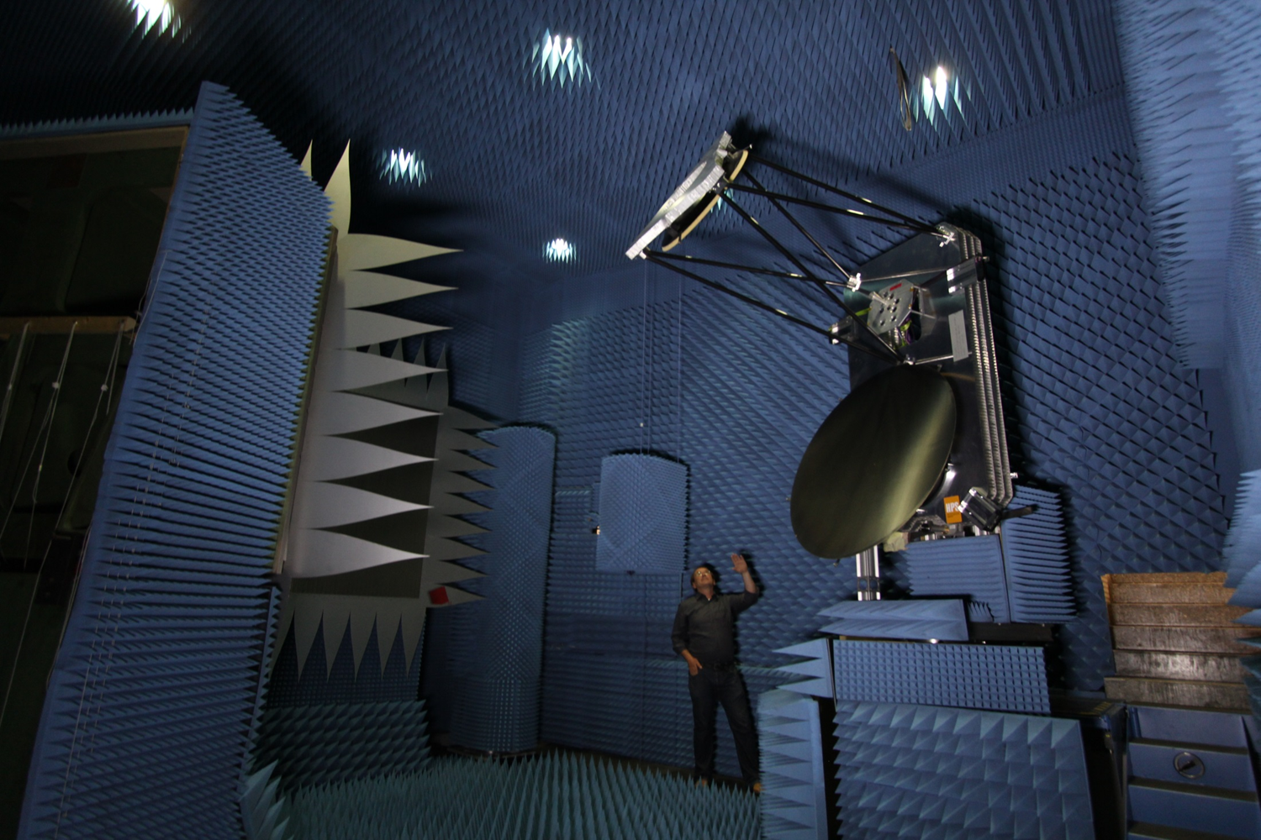
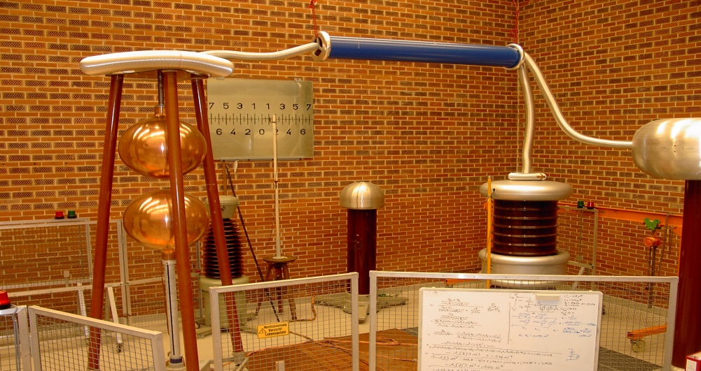
Research and Development
Notes:
Ca. 25 Forschungsschwerpunkte (inkl. An-Institute, Competence Center und Forschungsgruppen sowie einzelne ForscherInnen)

Slide 13
List of Laboratories (for Teaching and/or Research)
Packaging of Integrated Circuits
Realtime Operation Systems and Programming
Computer Networking
Digital Technologies
Electrical Engines and Machinery
Electrical Measurement Technology
Electronics
Fundamentals of Electric Engineering
High-Frequency Techniques
High Voltage Engineering
Power Electronics
Mechatronics
Microcomputer
Microcomputer Systems
Microelectronics
Microwave Techniques
Multimedia Applications
Pattern Recognition & Artificial Intelligence
Communication Satellites (Compact Range)
Optical Communications
Computer Applications
Control Theory and Technology
Analog Circuit Technology
Analog Signal Processing
Software Development
Solar Techniques und Energy Systems
Systems Engineering
Material Science
Communication Transmission
Computer-Kicker
Robotics Laboratory
Workshop fine mechanics

Slide 14
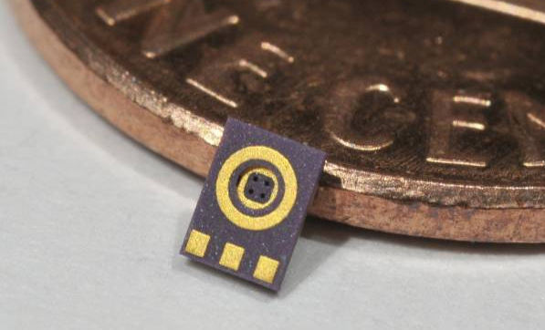
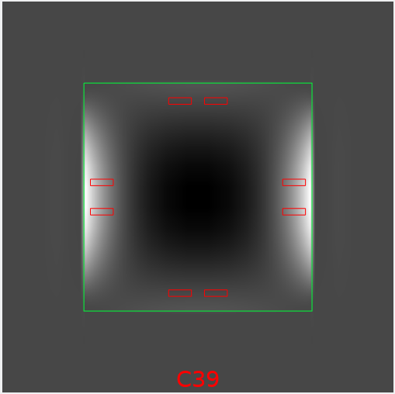
Applied Research: Sensors
Project SimuSens: Development of a framework for the simulation of the thermomechanical stress in sensors.
Project Partner: tdk-electronics
Funded by the German Ministry of Research
Tasks of the UAS:
Development of material models for solder and polymers
Simulation of pressure sensors and microphones
Verification of the simulations by measurements
Development of low stress packages
MEMS-Microphone 2 x 3 mm²
Stress on a pressure sensor chip
Prof. Dr. G. Feiertag
Notes:
Funded within the program „Forschung an Fachhochschulen mit Unternehmen“. Funding ca. 485,000 Euro for two PhD Students. Simulations with open source software Code_Aster. Project partners EPCOS and FK06

Slide 15
Applied Research: High frequency components
Project MoMiFI: Miniaturization of high frequency modules for mobile phones.
Project partners: RF360, a Qualcomm/TDK Joint Venture, ASM, Christian Koenen GmbH
Funded by the Bavarian Ministry of Economics
HF-Module, ca. 3 x 4 mm²
Tasks of the UAS-Munich:
Development of copper pillar bumps as an replacement for solder bumps for micro-acoustic components
Assembly of test modules, reliability testing, analysis and optimization of process and design
Copper Pillar Bumps
HF Filter
Module Substrate
Prof. Dr. G. Feiertag
Notes:
Funding within funding program electronic systems in Bavaria. Total funding ca. 900,000 € for ca. 1,900,000 € total project costs. The UAS gets ca. 350,000 Euro mainly for PhD student

Slide 16

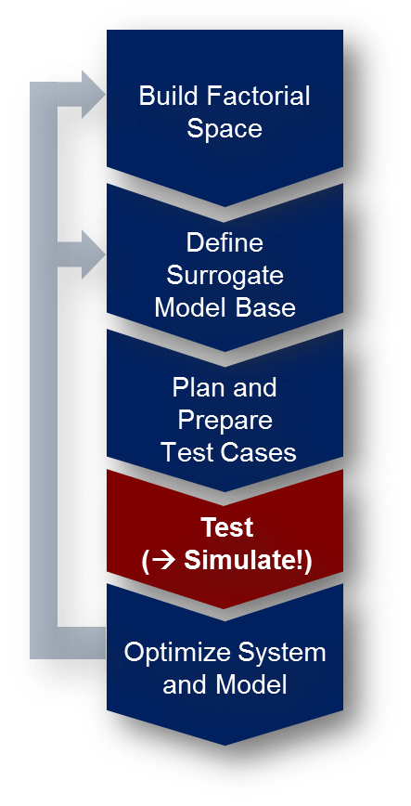
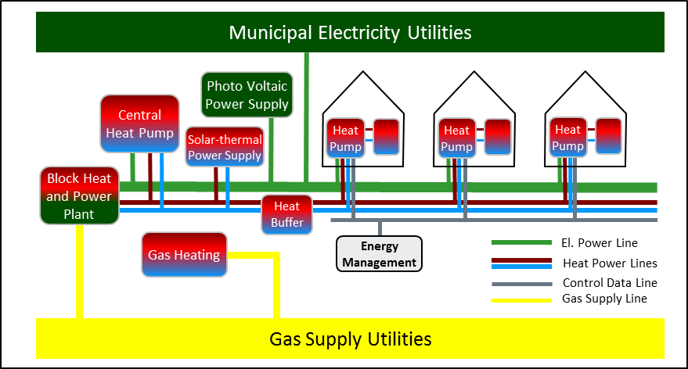
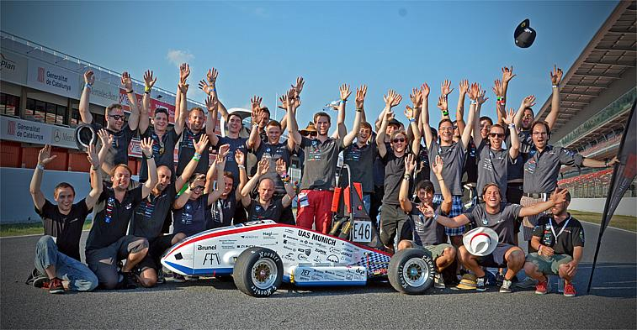
Applied Research: Engineering of Complex Systems
Entering new technologies involves:
Large amount of unknown solutions
Lack of „proof-of-concept“
Extending the V-Model allows to manage related uncertainties
„Hyper Space Exploration“ is a multi-criterial trade-off-analysis making use of:
Design of (virtual) experiment
Surrogate modelling
Model-driven system optimization
Our applications:
Sustainable energy systems
Automotive top-level design (FEVs)
Complex Controler Design
Prof. Dr. H. Palm
Notes:
Systems Engineering Labor
Wir beschäftigen uns mit der Entwicklung von komplexen Systemen im Umfeld disruptiver (nicht-kontinuierlicher) Technologiewechel
In diesem Umfeld tauchen beim Systementwurf typisch 2 Fragen auf: a) wie finde ich die für einen Anwendungsfall beste (anstelle der erstbesten) Lösung? b) Woher weiß ich ob diese Lösung funktioniert?
Da das Behebung von Fehlern beim Systembau ungefährt 10.000-mal soviel kostet wie diese Fehler bereits im Systementwurf zu eliminieren lohnt sich bei neuen Technologien die „Hyper-Space-Exploration (HSE)
Bei der HSE erweitern wir das V-Modell um einige Elemente: a) Design-of-(virtual)-Experiment basierte Studie b) Statistische Verfahren der Surrogat-Modell-Bildung c) Künstliche Intelligenz und Modell-basierte Optimierung
Unsere Anwendungen liegen in den Bereichen: a) Entwicklung nachhaltiger Energiesysteme b) Elektrofahrzeuge c) Entwurf komplexer Regler
Kontakt: Herbert.palm@hm.edu

Slide 17
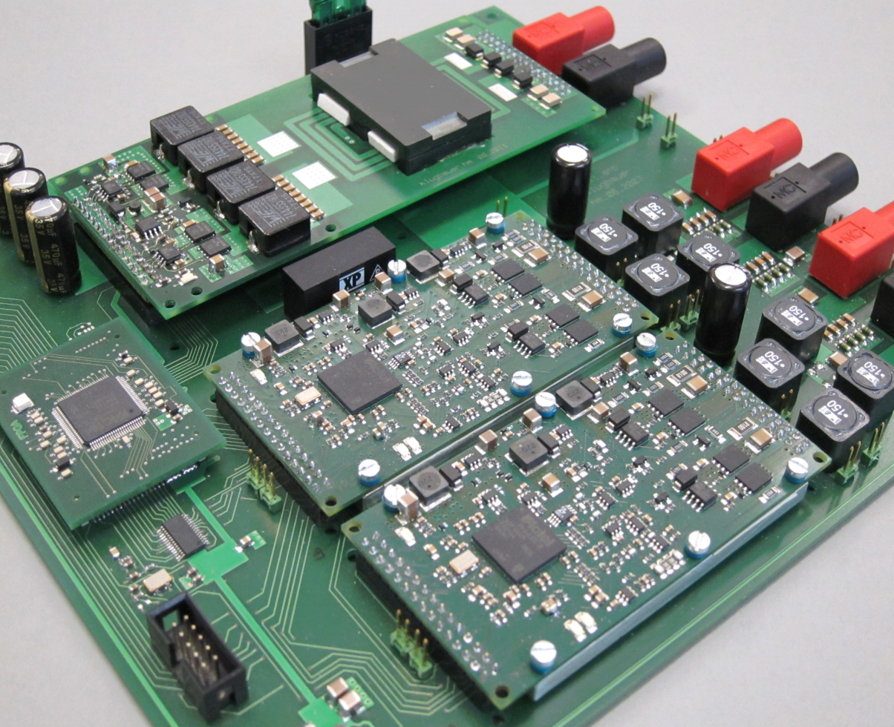
Applied Research: Energy Efficient Class-D
Amplifiers for ELA
Topic: Energy-efficient 100V system amplifier for ELectroacoustic infrAstructure (ELA)
100V system amplifier for ELA without line transformer
Up to 400 W with 97% efficiency without fan or heat sink
Module size only 9 cm x 5 cm x 1 cm
High efficiency under all load conditions due to integrated variable supply voltage concept (patented)
Switched-mode power supply using low-cost planar transformer
Continuous self-test of the whole system
Josef Klugbauer, Prof. Dr. C. Münker
Notes:
Topic: Robust, extremely efficient Class-D amplifiers for deployment in public infrastructure systems
Public address audio systems in subway stations, shopping malls etc. usually are realized as 100 V systems, requiring bulky and expensive line transformers in the amplifier.The vast majority of amplifiers is existing systems rely on analog amplifiers with inherent low power efficiency.
The digital class-D amplifier developed in the Circuit Design Lab (Labor Schaltungstechnik) runs on an integrated variable supply voltage that minimizes losses under light to heavy load conditions. It reaches an efficiency of 97%, enabling operation of up to 400 W per module without fan or heat sink.
The supply voltage reaches up to 150 V, allowing operation in 100 V systems without the line transformer. The variable switched-mode power supply is implemented using a low-cost planar transformer with printed coils and a snap-on magnetic core.
The tiny module size of only 9 cm x 5 cm x 1 cm, the fan-less cooling and the lack of the line transformer allow implementing 16 amplifier channels in the space of one former analog amplifier with improved emergency battery operation.
Current research topics include further improvement of audio quality beyond HiFI DIN 45500 and asynchronous sample rate conversion for high-end operation in streaming media systems.

Slide 18
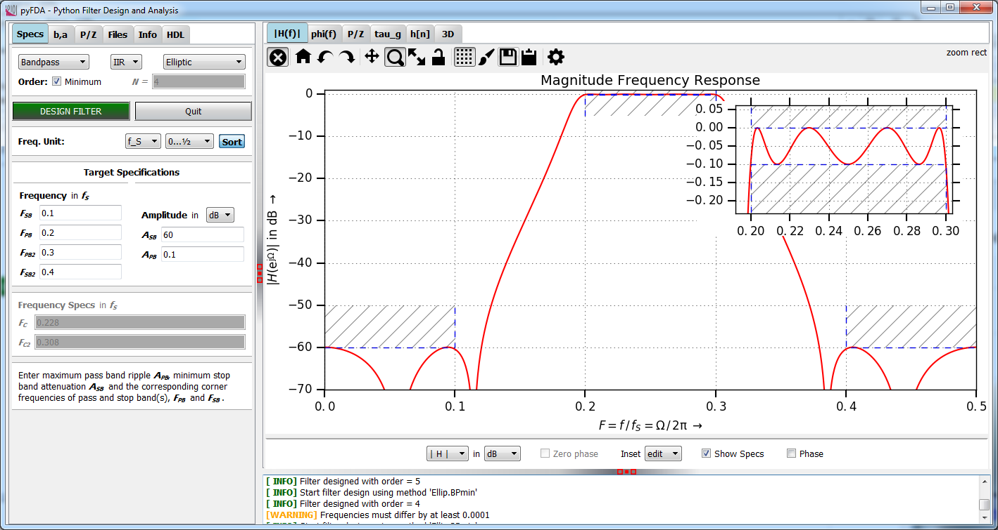
Applied Research: Digital Filter Design Tool pyFDA
Topic: User-friendly open-source tool for design, analysis and synthesis (VHDL and Verilog) of discrete-time fixpoint filters
Application Areas: Digital signal processing and FPGA design for R&D and education
Open-Source: Developed with Python and Qt-Widgets (github.com/chipmuenk/pyfda)
Modular architecture for fast development of new filters and analysis modules
Google Summer of Code 2018: - Link pyFDA and myHDL (www.myhdl.org) for easy VHDL and Verilog code generation - Implement more complex (a.o. systolic FIR) filters and synthesize them
Prof. Dr. C. Münker
Notes:
Topic: Implementing fixpoint filters on FPGAs and low-cost (i.e. without floating point unit) microcontrollers is still a field where a lot of expert knowledge is required. The pyFDA tool eases the design and analysis process of those filters with a user-friendly UI and lots of analysis options. A fast fixpoint library allows quantization, re-simulation and export of fixpoint coefficients in various formats. The software is targeted for both educational and R&D purposes. New filter algorithms can be added easily (and have been added by users on GitHub) due to the modular architecture.
A Google Summer of Code Project has just started that targets the streamlining of the design process: The goal is to create a link between pyFDA and myHDL, a Python module for simulating and generating HDL code, allowing improved fixpoint filter simulations and direct export of VHDL and Verilog code.

Slide 19
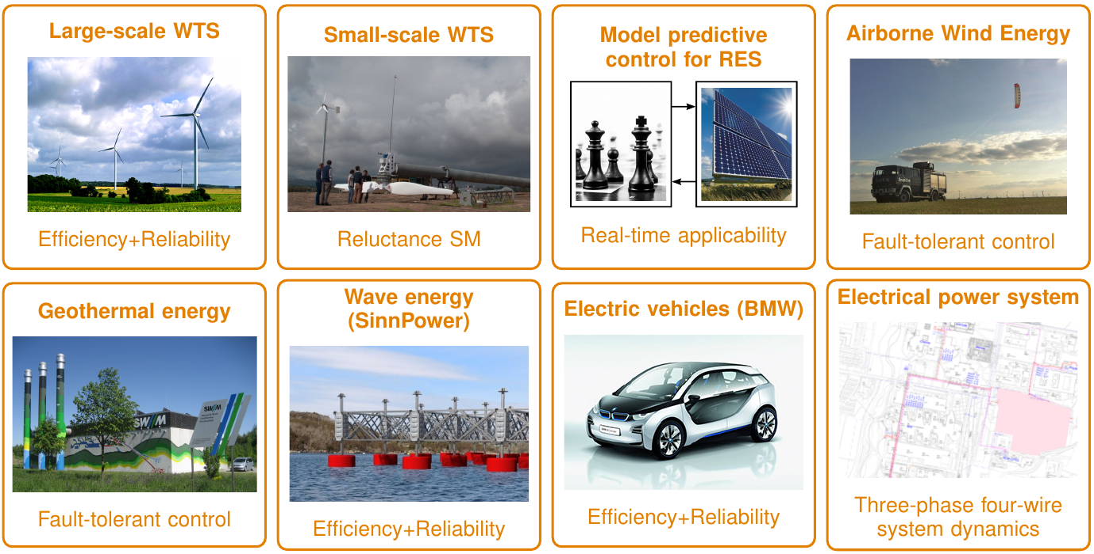
Applied Research: Fault-tolerant and efficient mechatronic and regenerative energy systems
Prof. Dr.-Ing. Christoph M. Hackl
Notes:
- 8 projects (see above)
-9 PhD students,
- Over 2 Mio. € budget (EU ITN H2020, DFG, Bavarian government, BMBF, BMWi, etc.)
- Over 100 peer-reviewed publications
- Interdisciplinary approach: power electronics, electrical machines, mechatronic and regenerative energy systems & systems theory

Slide 20

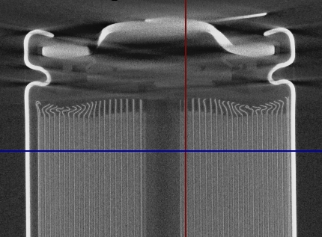
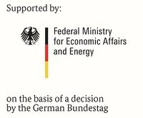







Applied Research: Detection & Localization of mechanically induced damages in lithium ion batteries (ReVISEDBatt)
Research:
Realistic mechanical stresses, such as shocks, vibrations and external forces
Damages in cell and module components
Effects on operational and aging behavior
Detection methods
Objectives:
Knowledge of damage mechanisms
Development of novel early detection methods
Online application in battery management systems
Project:
Project period: 2017/09 – 2020/09
Staff at HM: one research fellow, student workers
Notes:
Gesamtvorhaben umfasst umfangreiche Tests (Schock, Vibration, Druck) mit Batteriezellen und Modulen.
Schwerpunkt der HM: Detektion, Fehlererkennung → mögliche spätere Anwendung in einem Batteriemanagementsystem
Eine wiss. Mitarbeiter an der HM im Projekt (Bolormaa Große)
Foto Batterie mit dem CT vom Gregor Feiertag erstellt.

Slide 21
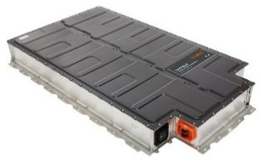
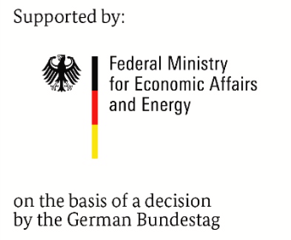



Applied Research: Universal connection of automotive traction batteries for stationary applications (UnABESA)
Second-Life applications
for traction batteries
Plug & Play
coupling element
AC-Grid
Research objectives
Universal architecture for different batteries and applications
Highly efficient power electronics with innovative control
Optimized power flow in heterogeneous battery systems
Applications
Frequency regulation
Peak shaving
Decentralized storage
Challenges
No standardized design
Different battery properties
Costs
Project:
Project period: 2017/06 – 2020/06
Staff at HM: two research fellows, student workers
Prof. Dr. S. Schramm, Prof. Dr. Bohlen
Notes:
Automotive batteries provide high safety and reliability at quickly decreasing costs. Using these batteries in stationary applications, as first use or in 2nd-life, is thus desirable. Connecting these batteries to the electric AC-grid not only requires a power inverter, but also bulky transformers to match the different voltage levels and provide galvanic insulation. Often modifications to the control system (software and/or electronics) are necessary to operate these batteries outside a vehicle. In the project UnABESA an architecture is investigated and optimized that can overcome these disadvantages.
Core component of the project is the coupling element comprising a highly efficient DC/DC-converter with galvanic coupling and an intelligent interface that screens the automotive-specific communication interface. Hardware design of the power electronics, control and switching patterns as well as an optimized inductive component are research topics that aim at a highly efficient and compact converter. Furthermore, the development of a control strategy for the power sharing between different automotive-batteries is also part of the research.

Slide 22


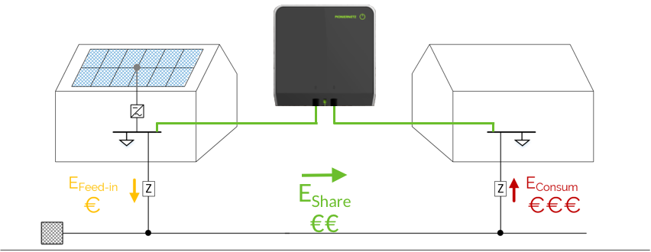
Applied Research: Private Grid Coupling
Hard Facts
Mains parallel
Galvanic isolated
Surplus energy transferred
Depending on energy production and - consumption
Customer Value
PV plant is more profitable
economic benefits for producer and receiver
more people get access to renewable energy.
contribution to a successful energy revolution
Prof. Dr. S. Schramm
Notes:
Private Grid Coupling – Goal: share renewable energy with neighbor
Government funded startup
3 founders from our department

Slide 23
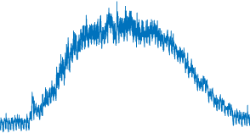
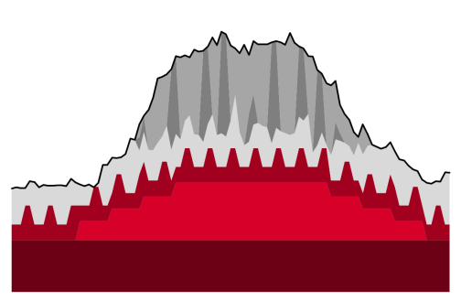

Applied Research: Analysis of complex energy systems
Goal: Development of a process for automated and data-based analysis of complex energy systems and identification of (essential) consumers
Research Interests:
- Which parameters influence energy consumption in complex energy systems?
- How can this data be captured and utilized?
- In which resolution and measuring accuracy are these data needed?
- Which methods of data analysis (big data, machine learning, NILM) can be applied to the data?
- How can consumers (types) be recognized?
- How can changing structures be recognized during operation?
Prof. Dr. S. Schramm
Notes:
Zu Folie 23 - Analysis of complex energy systems - gibt es nun einen eingereichten Antrag, aber noch keine Rückmeldung über die Bewilligung „NuData Campus - Nutzungsdaten basierte Optimierung von Gebäuden und Anlagen am Beispiel der Hochschule München“, mit mind. 6 wissenschaftlichen Mitarbeitern aus HM und TUM, da wird sich auch an der HM etwas tun…

Slide 24
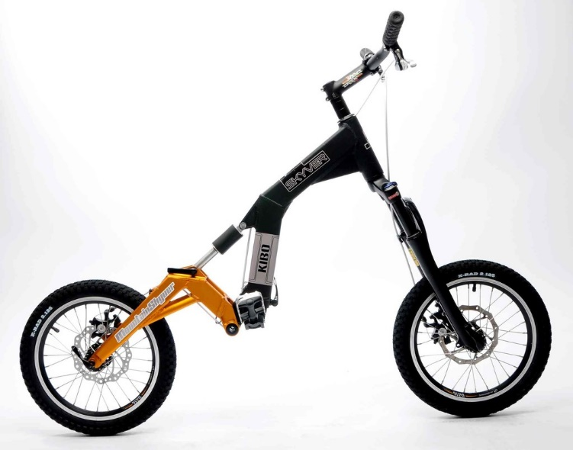
Applied Research: E-Scooter
Partner: UAS-Munich, Auswall
Tasks of UAS Munich
development of electronics for motor control
development of innovative motor control algorithms
using new non-contact torque sensoring (magnetostriction)
using heart-rate sensors to determine required motor torque (rehabilitation)
development of “Pedelec-Mode“ for E-Scooter to avoid requirement for numberplates and to wear helmets for vehicles with motor support above 6km/h
Prof. Dr. S. Hecker

Slide 25
Applied Research: ASG and ANC using existing
Electric Drives
Partner: UAS-Munich (FK03+04), BMW, MdynamiX AG also supported by BMWi (ZIM)
Idea: Using existing electric drives (e.g. steering motor) in passenger cars as loudspeaker for
Active Sound Generation (ASG) for electric cars
outside warning sounds for pedestrians (without additional outside loudspeaker)
company typical branding of motor sound
Active Noise Cancellation (ANC) for combustion and electric cars
suppressing tonal noise (e.g. cavity noise from tires or combustion motor noise) inside the car without using microphones and loudspeakers
avoid expensive active and passive damper systems (e.g. active engine mounts)
Prof. Dr. S. Hecker

Slide 26
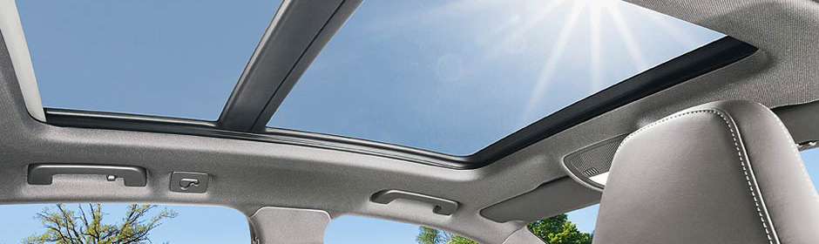
Applied Research: Anti-Pinch Protection for Sliding Roofs
Partner: UAS-Munich, Webasto AG
Tasks of UAS Munich
Development of adaptive algorithms for correction of Hall sensor errors
Development of a multi-rate observer for exact motor speed estimation
Development of observer based fault detection algorithms for anti-pinch system
Development of robust motor speed controller for improved roof acoustics
Prof. Dr. S. Hecker
Notes:
Since 2012 we have a collaboration with Webasto to develop and improve the algorithms for speed control and the anti-pinch system for sliding roofs of vehicles.

Slide 27
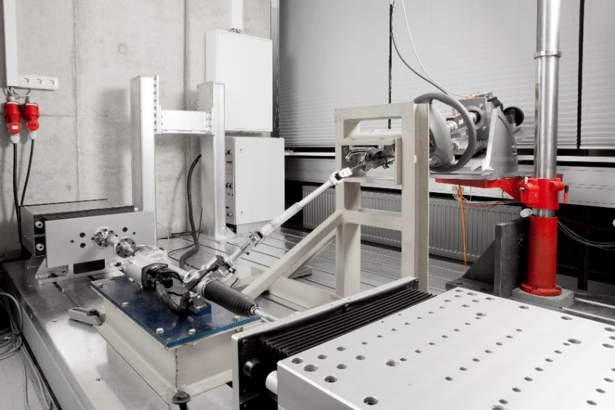
Applied Research: Multi purpose HiL-Testbench
Partner: UAS-Munich (FK 03+04), MdynamiX AG, TU Vienna
Idea: development of high performance hardware in the loop testbench for automotive components
Tasks
Development of robust, model predictive, multi-input, multi-output control algorithms
Allow HiL-tests for automotive components (e.g. steering system, engine mounts, active dampers) with bandwidths up to 40 Hz
Real-time simulation of remaining vehicle dynamics and environment to allow driver in the loop testing
Prof. Dr. S. Hecker

Slide 28
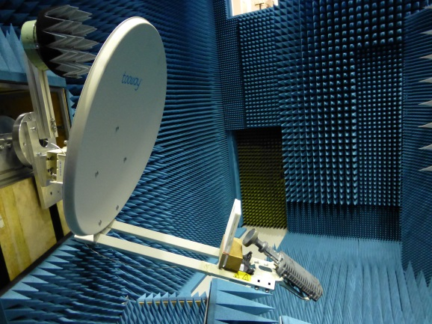
Frequency Selective Plate [FSP] for Multiplex Use of a Parabolic Antenna for TV and Internet
Direct order from Eutelsat S. A. (Paris) worldwide third biggest provider of satellite communication services .
HM has the leadership in conception, development and qualification
Rollout of FSP actual in Greece, total volume 1 Million terminals (Europe, North Africa and Mead east)
Patent: Inventor is HM Owner is Eutelsat
Follow up project starts in 2015, runtime 3 years
one PHD Student, several student assistants
Direct competition with European enterprises and universities
Prof. Dr. G. Strauß
Notes:
There is a growing market for internet access by satellite, especially for regions where the telecommunication infrastructure is weak. This is true not only for rural regions but also for strongly growing mega cities e.g. Istanbul or Paris. The French satellite provider Eutelsat offers a system with data rates of up to12 Mbit / s per user. The only prerequisites for this link to the internet are
a 30 Voltage source
the tooway terminal with a parabolic antenna and the tooway feed with modem
and of cause a direct view to the satellite
The system can handle more than one million terminals in Europe, North Africa and Middle East.
The HM has developed a so called Frequency Selective Plate (FSP), which allows the simultaneous and independent use of the antenna for TV and the described internet access. Instead of two parabolic antennas there is now only one antenna necessary. Because the product was developed for the mass market, there were tough constraints for the cost structure. Nevertheless the specifications for the Data Uplink has to be satisfied, otherwise other satellites in a geostationary orbit could be disrupted.
The FSP is now in use in Greece, and is about to be rolled out in Turkey. Triggered by the fast and successful development at the HM, a three year project will be started a.s.a.p. Especially software for calculating the electromagnetic fields has to be developed further, a PHD student will do more research and prepare the next round of development. The project is 100 percent funded by Eutelsat.

Slide 29
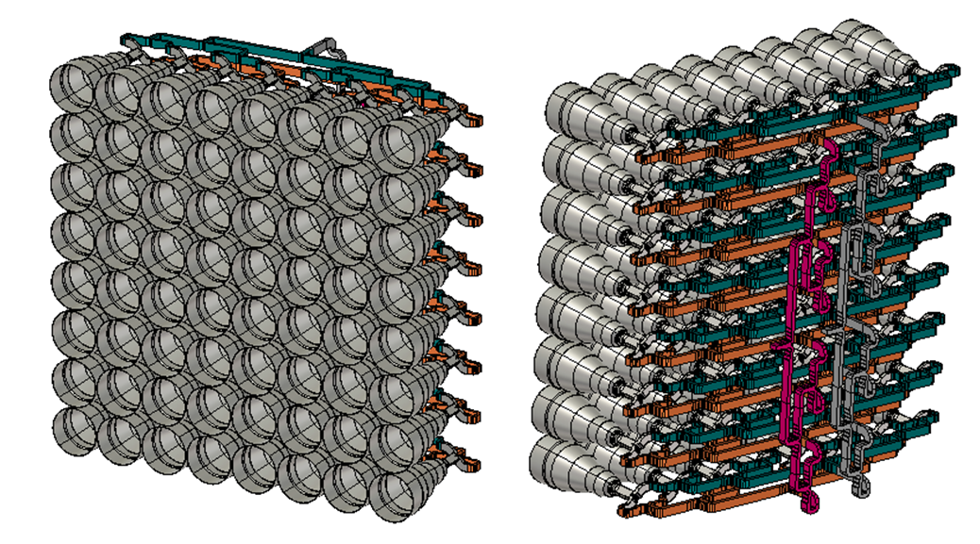
LISA MS+
Target: Development of an antenna system for very high data rates between low orbit satellites
Development for „SatCom on the Move”
Space approval Mid 2015
Cooperation with
Airbus (earlier EADS Astrium GmbH)
Institute for Mobil and Satellite Communication IMST GmbH
Technical University of Munich TUM, Institute for light weight construction
Deutsches Zentrum für Luft- und Raumfahrt DLR
Prof. Dr. G. Strauß
Notes:
This project is funded by the BMBF. The goal is the development of an antenna system for a high data link between a satellite on a low orbit and a satellite on a geostationary orbit.
Partners are
Airbus (earlier EADS Astrium GmbH)
Institute for Mobil and Satellite Communication IMST GmbH
Institute for light weight construction, Technical University of Munich TUM
Deutsches Zentrum für Luft- und Raumfahrt DLR
The lab for Satcom will perform the measurements of the antenna, where very high precision is required. A space qualified system is expected to be up and running in summer 2015.

Slide 30
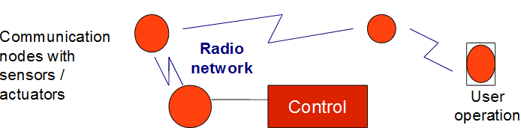
Applied Research: E min
Issue: Optimization of In-house Communication for Minimizing the Power Consumption in Buildings
Starting grant Hochschule München
Sensor network for wireless communication
Optimization of sensor network for minimum energy supply
Operation strategies for minimum electrical power
Operation strategies for minimum heating power
Prof. Dr. T. Michael

Slide 31
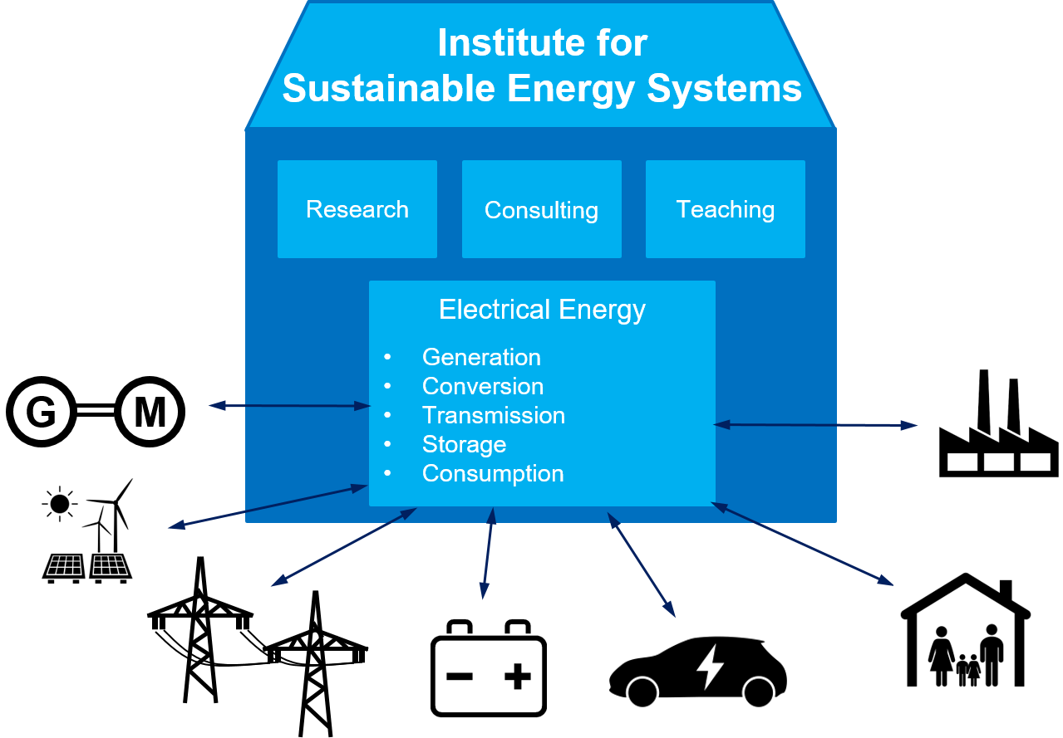
Research Institute „Sustainable Energy Systems“
The Research Institute „Sustainable Energy Systems“ contributes significantly to a sustainable energy system and an efficient energy use by own research, consultation and teaching activities.

Slide 32
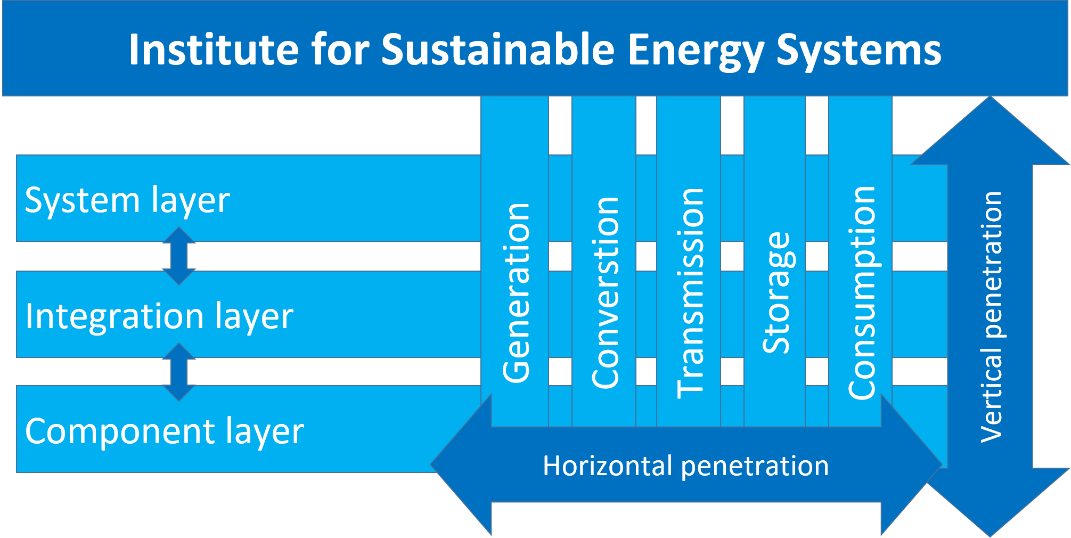
Research Institute „Sustainable Energy Systems“

Slide 33
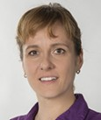
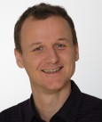
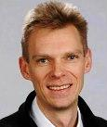
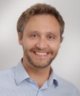
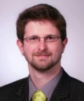
Research Institute „Sustainable Energy Systems“
Prof. Stephanie Uhrig, FK04 since 2017 „Power Engineering“
Prof. Simon Schramm, FK04 since 2014 „Renewables and Grid Integration “
Prof. Herbert Palm, FK04 since 2008 „Systems Engineering“
Prof. Christoph Hackl, FK04 since 2018 „Mechatronic and Renewable Eenergy Systeme “
Prof. Oliver Bohlen, FK04 since 2014 „Electric Energy Storage Systems “

Slide 34


…some impressions of our labs
Power Electronics
Power Electronics

Slide 35

…more…
Microelectronics
Microelectronics

Slide 36



…and more…
Energy Systems
Energy Systems
Operating Systems and Programming

Slide 37


…and even more…
Pattern Recognition
& Artificial Intelligence
Systems Engineering
Digital Signal
Processing

Slide 38




…the end
Comm. Satellites
Compact Range
Control Technology
Analog Circuit Technology

