Slide 1

VCF Operations: Adoption
Tailoring Aria Operations 8.18 into your operations management
[Put your name here, as this becomes your deck]
[This deck designed for Field and Partners]
August 2024
Notes:
Guides for practical VCF Operations adoption along with your customer. It starts with the simplest idea.
This is part of Operationalize Your World, a suite of asset (book, deck, importable content).
Iwan ‘e1’ Rahabok, e1@broadcom.com,
Mobile: Singapore 9119-9226

Slide 2
Value Add: Day 1 | Day 2
Ops Your World focuses on Day 2. Make sure Day 1 is done properly first.
Operationalize Your World
Day 1 | Day 2
Focus on the product. It is about features or functionalities. | Focus on the people. It is about operations and what each role does.
Deploy both Log Insight and Aria Ops appliances. Configure collection, policies, users. | Day 2 assumes VCF Ops 5.2 is up and running.
Set up roles in the products. | Find out who actual the users for each role. More than name, you know both their needs and wants. How will the person contribute to VCF Operations adoption? Likely >20 people, from different departments
Teach users how to create, modify, and manage alerts. Generic tutorial that covers alert, condition, symptom, recommendation, etc. | Explain the overall design considerations behind all the alerts. Tailor the alerts for different class of service. Explain the design behind the condition and threshold of each alert, and how they are rolled up to higher object.
Teach users how to create, modify, and manage dashboard. Generic tutorial that covers widget, views, interaction, sharing, etc. | Explain the overall Functional Architecture (the design consideration behind all the dashboards, and how they are designed top down to form a suite). For each person, explain the meaning behind relevant dashboard. Customise the threshold for each relevant metrics. No dashboard is relevant for everyone, so map them accordingly.
Demo the capacity management features. What If, policy, automation, projection algorithm, configuration settings, etc. | Understand which clusters and datastores belong which class of service. Create a group for each. Explain the best practice of capacity management, and how it relates to performance management and cost/price management.
Day 1 Tasks
VCF Operations 5.2
Importable Content Kit
Notes:
This deck focuses on Day 2. There is a lot of material on Day 1 already, but hardly on Day 2. That’s why this document assumes you’ve done day 1.
This slide shows example of Day 1 vs Day 2 tasks in Aria Ops

Slide 3
Day 2 Value Adds
How to get regular and broad VCF Operations usage, sorted from easy to hard.
Feature | Tasks for SE/TAM | Product-related Tips
Proactive daily check | What's important for customers to check first thing in the morning to prevent issue on that day? Not looking at tomorrow, as it can be covered by another check tomorrow morning. Establish a morning routine, make it part of SOP. The check should take no longer than 15 minutes else it’s too taxing. Study the org chart, identify the actual person who needs to do the job. Tailor the Aria Ops dashboard to the user. If there are >1 person, personalize for each. | Use the proactive daily check dashboard. To monitor a subset of the environment, create group. If you have Log Insight, import the content pack.
NOC Screens | Understand what urgent issues matter to day-to-day operations team. What issues cause them to react urgently? Educate how the live streaming NOC screens complement the morning proactive health check. | Use the 4 OOTB dashboards. Set up auto-rotation if you have <4 screens. Prevent screen time out in browser.
Alert | Explain the overall Functional Architecture (the design consideration behind all the alerts, and how they are designed top down). Let it run for 1 week. Adjust the threshold, based on performance profiling & complaint analysis. | Use Policy (do overall design to avoid policies sprawl) to zone the alerts into specific section of the environment. KB: Guest OS False Positive
vSphere dashboard suite | Explain how they are designed as a suite, as opposed to individual dashboard. Some are further designed to complement existing product pages. Start with the 4 vSphere inventory dashboards as knowing what you have is fundamental to the rest of operations management. | vSphere inventory: 4 dashboards
 | Ensure the VM Performance dashboard is used by both application team and infrastructure team. Working with the VCF champion, explain to application team both the dashboard and the metrics used. | VM Performance dashboard
 | Find out who monitor vSphere Clusters. Make sure they know how to use the dashboard | vSphere Custer Performance dashboard
Performance Baselining | Explain the Guest OS profiling to both application team and infrastructure team | Infra Performance profiling dashboard. Guest OS profiling dashboard
Reclamation | Start with low hanging fruit, which does not require application team approval. This is potentially a long term, regular activities as it involves large group of people (application team). | Show how the page and the dashboard work together.
Notes:
This slide provides examples of what you can do to get adoption going.
Alert: Note 5.2 only completes vSphere. vSAN and NSX have not been overhauled yet.

Slide 4
Different Team → Different Goals → Different Engagement
3 types of system engagements: Alert | Projected screen | Dashboard
Speed of Operations (longer bar = faster pace, more reactive, shorter term)
L1 (NOC Team)
Real time. Rely on alerts and streaming projected screens. Reactive. Manage alerts
escalation
L2 (Platform Team)
These team work daily, not hourly let alone real time.
Their goal is to prevent alert, by proactive health check.
They do not rely on alerts, but deal with escalation from L1.
L2 (Storage Team)
L2 (Network Team)
L2 (Security Team)
Capacity Team
Weekly, looking ahead 1 quarter to 1 year
Audit/Compliance Team
Monthly, looking at the past
Notes:
This slides shows the various team relevant for Aria Ops. Within each team, there are different persona as each member may have slightly different roles.
Alert is for L1 Day-to-day Operations Team, not other team.
It’s not for capacity team, troubleshooting team, audit team, management team. All these are not the frontliner, responsible for live, minute by minute operations. They get notified by L1 (the Ops Team), ideally via workflow in vRealize and not email.
Ops Team is bottom-up. They deal case by case, not big picture.

Slide 5
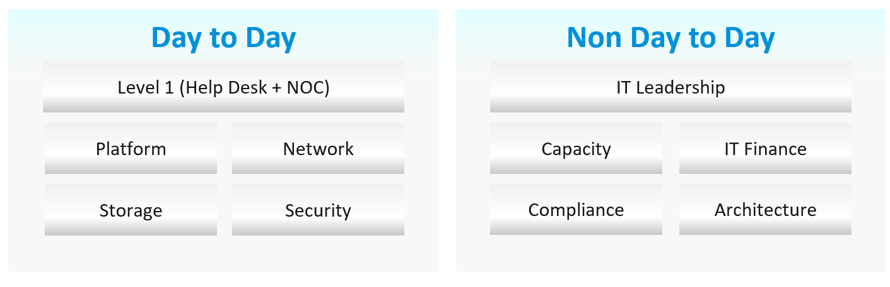
VCF Operations: Users
Who are doing what in VCF Operations? What’s their needs and wants? Weave the product into the process.
Role | Name | Requirements | Solution
NOC Team | Iwan Reebok
Platfrom Admin/Architect | Name 01
Storage Admin/Architect | Name 02
Network Admin/Architect | Name 03
Compliance Auditor | Name 04
Security Admin/Architect | Name 05
Capacity Planner | Name 06
Head of Operations | Name 07
Head of Infrastructure | Name 08
Application Architect | Name 09
K8 Architect | Name 04
SRE | Name 05
 | Name 06
 | Name 04
 | Name 05
 | Name 06
Identify each relevant departments: Network, Storage, Capacity, Security, Compliance, IT Operations, etc.
Work with your champion to fill up the above table, and enable each person to use the tool. Tailor the dashboard for each person and make it part of they do.
Notes:
There are many personas required to keep operations running well. Some are directly involved in the day-to-day operations, while others focus on the big picture, hence requiring a longer time frame.
Document all the roles and responsibilities. Now you know why I make this document editable.
There is a many-to-many relationship between “jobs to be done” and persona. It reflects the dynamic nature of live operations. You have team members taking leave or away, hence you need someone else to step in on an ad-hoc basis.
This is a critical step. Broadcom account team needs to know who exactly.
To make VCF Ops used, find the actual users. The employees or contractors belong to a department, so find the department head first.

Slide 6
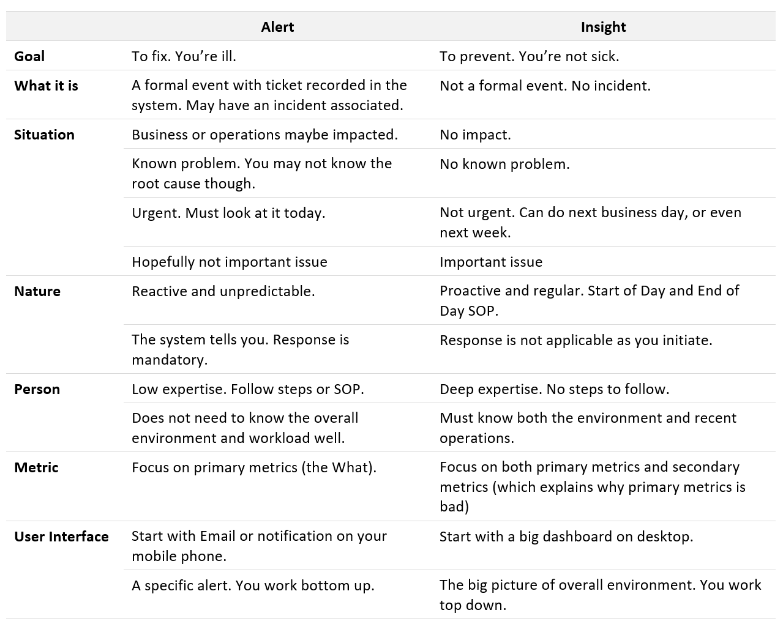

How Insight complements Alert
Alert
Insight
Alert should be seen in totality.
For each alert, there could be many not crossing the threshold
Notes:
This is a big change with VCF Ops 8.18. It no longer relies on alerts as the main driver of operations

Slide 7



IT Operations Transformation
Alert-driven → Insight-driven
What should you do so alerts are no longer the starting line of operations?
NOC Screens
Start each day with a proactive daily health check. Look at the overall environment, not just the issue crossing the thresholds. The dashboard aims to minimize alerts by analysing underlying issues. It is focused, only for 24-hour.
Since you only check the dashboard in the morning, what happens to the rest of the day? The NOC set of dashboards complement the daily check and alert. They provide live, real-time, information. They are conveniently projected on the big screens for NOC Team to glance. It is always available, and auto-refresh.
Both the Daily Check and the NOC Screens have very short timeline. Max 1 day. If you have quarterly workload, you will not see them. This is where a performance profiling comes in. It’s based on 3 months data.
Timeline: Now
Done by L1 Team
Alerts
Daily Check
Timeline: Negative
Done by L1 Team
The result is reduced dependency on alerts.
Alerts become guard rail, just in case human forgets (as to err is human), or system suddenly fail.
Timeline: 24 hours
Done by L2 Team
Performance Profiling (1-2x a year)
Timeline: 1 quarter
Done by L2 Team
Notes:
The above shows L1 and L2. In large organisations, they are split further into 3.
Dashboard name:
Daily Check
vSphere Daily Check
NOC Screens:
Live! vSphere Cluster Performance
Live! vSphere Cluster Utilization
Live! vSphere Heavy Hitters VM
Live! vSphere VM Changes
Performance Profiling
Guest OS Performance Profiling
vSphere Performance Profiling
The performance profiling exercise looks at CPU, memory, network and disk holistically, to baseline the actual performance of all VMs.
Before vs After. 8.17 vs 8.18:
Ops Overview → Daily Proactive
5 minute → 20 second + 5 minute
NOC is stronger + new one
Alerts overhaul. Deleted, new

Slide 8
Proactive Operations
What cadence do you need to avoid alerts today?
 | Live NOC Screens | Daily Preventive Check | Longer Cadence
Purpose | Real time visibility into the overall environment, so live fire is attended right away. | Prevent alerts of the day. Tomorrow is another day as it will be checked tomorrow morning. | Larger optimization and issue avoidance. Deep and broad analysis of the whole environment.
 | Urgent (hopefully not important) | Medium urgency/importance | Important (definitely not urgent)
Timeframe | Focus: last 5 minutes | Focus: next 12 hours | Focus: Weekly – Quarterly
 | Data: 1 hour | Data: 1 week | Data: 1 year
Usage Interaction | Live. Always on and projected on the big screen. | 2x a day. Once at start of day, the other at end of day. | No standard flow or usage. Multiple usage throughout the week/month, depending on the persona and need. Total screentime varies widely as user may move from screen to screen.
 | Screentime: 10 seconds. User can derive meaning within seconds, simply by glancing over a distance. | Screentime: 10 minutes
 | No interaction as there is no keyboard/mouse. See from a distance. It auto-refreshes and auto-rotate | Standard interaction process. User follows a set of check, including these pages of 5.2: Diagnostic Findings, Configuration Drift, Compliance. | Rich interaction. Flexible flow, depending on the need at that time. User may create custom dashboard with super metric and group.
 | The UI is dual purpose. NOC user can access bottom part of the UI for interaction.
Human | L1 (first liner). Users are typically seated at the NOC room. | L2 (expert). These experts specialize on certain areas, such as network. | Auditor, Capacity Planner, Performance Specialist, Cost Specialist
Primary Content | Availability. Performance. Security. Same area of concern, but the Daily Check is broader and deeper as it has much longer horizon |  | Capacity (utilization, reclamation, optimization). Sustainability.
Notes:
The actual may vary from customers. So discuss with the actual team, and adjust.

Slide 9
Urgent vs Important
Not urgent? Do not alert, regardless of importance. Use Daily Check instead
Analogy: hospital Accident & Emergency department is not the place you do important but not urgent (e.g. annual health check)
Urgency is closely related to importance. Hence they are often mistaken as the same thing, as Alert that are important tend to be urgent.
Examples of ambiguity:
1 VM has high disk latency is an urgent problem if the owner is a VIP customer who complains loudly. It is not important since the VM is not in production and 99K other VMs are doing well. As more and more VM get affected, and business feel the pain, the problem becomes important.
Availability issue tends to be urgent problem, as you need to restore fast. Performance issue tends to be less urgent, especially if it has gone away by itself.
Examples of Important but not Urgent
“Host is in maintenance mode for at least 72 hours” is not urgent as it’s been down for 3 full days. It’s important as that’s not normal.
“A recoverable memory error has occurred on the host” is not urgent as the issue has been recovered. You likely need to replace hardware. As the problem can spread, it’s an important one. You need to schedule a hardware scan, which may require a schedule downtime.
You notice vMotion has been taking 300% longer in the last 12 hours, going up from the usual 0.2s to 0.6x second in 10 large clusters, where a total of 10K production VMs are running. But it’s a low level issue that none of the app owners have not noticed. Not urgent, but important as it can potentially turn into a big problem.
You notice a performance problem that has happens randomly. It went away by itself within 5 minutes, so the owner kinda “forgive” your IaaS. But the problem hit VMs randomly, and it’s been going on a few times a day for a few days. Different owners are impacted so each does not really complain as each is rarely hit. You feel it’s risky to add more VMs.
Majority of configuration issues
Important
Red
Alerts
Orange
Alerts)
Urgent
Alert is a small subset.
It’s a guard rail, just in case human forgets
Most issues should be prevented via daily health check.
Red Alerts = push via messaging to mobile phone.
Orange Alerts = display in VCF Ops Console, main screen of NOC Team.
Notes:
Alert is only for issue that is urgent. Important but not urgent should be dealt via purpose-built SOP Dashboard page, else they clutter the alert page
Urgent alerts are sent automatically via email or messages (SMS, WhatsApp).
Non urgent alerts (which could be important) require users to login to vRealize Operations
Urgent is critical. Important is crucial.
Critical: Needing immediate attention. Time critical means it’s urgent
Crucial: Of the greatest possible importance.

Slide 10
Insight & Alert: Different Urgency
Yellow is not suitable for Alert as it’s noisier due to lower threshold
High
Importance
Something happened or changed
Urgent?
When do I act?
ASAP
Yes.
Buzz me now
Reactive → Alert
Proactive → Health Check
Non-urgent issue, regardless of importance, should not be pushed via alert. Build a daily habit instead.
Reactive is confirmed issue, hence you must react. You are ill.
Proactive aims to prevent, hence you must initiate. You are healthy.
Alert is push, health check is pull. Email vs daily login to console.
No such thing as Yellow Alert anymore as that’s covered by Daily Health Check.
Do you need to act on it today?
Sometimes today
Medium
Importance
Above is about an object. It may have its metric crossed a threshold, its configuration changed, or its state changed.
The wider the impact, the higher the importance.
Low Importance
No. Next Business Day is better.
Don’t buzz me as it’s better for me to see them as a group as part of Daily Health Check.
How to prevent Alert and Symptom in the first place?
We need to check potential root cause, underlying metrics and events that may develop into alerts or symptoms. This proactive Health Check give us insight.
UI wise, it shows pattern, trend and correlation from multiple metrics, events, across different objects. Health Check puts a structure so the insights can be seen as a group and the overall picture is shown.
Notes:
The solution to alert storm requires us to question the purpose of alert
What, exactly, is alert? What distinguish red criticality versus orange criticality versus yellow criticality?
Non-urgent, early warning should be dealt via dashboard. Must use your SOP Dashboard, and change operations from proactive instead of reactive. So this is actually forming a good habit.
Alert is not for things you do intentionally
If you enable SSH or enable promiscuous mode as you need to check or troubleshoot something, you do not need to be alerted. This is an issue for Audit Team, who will later (typically weekly or monthly) questions Ops Team on why SSH was enabled.
red = attend as soon as possible. No, no need to drop everything you do right now, but do it today not tomorrow. orange = attend today, not tomorrow. Say the alert happens early in your office hours. Red means you need to attend within 1-2 hours. Orange gives you extra lead time to react. Say the alert happens late during the day. You're about to go home. In this case both colors don't really matter as you gotta clear the alerts before you go home. You can’t wait until tomorrow morning.

Slide 11
Insight & Alert: Different Metrics
Health Check is on the same time spectrum with Alert. Its goal is to prevent alerts
The point when
you know it’s a problem
The point when
your customers know
it’s a problem if you do nothing
Health Check focuses on insight, which are made of root-cause metrics and related events. It requires deeper technical expertise, operational awareness on DC major activities, and knowledge of the system architecture.
Prevention Window
Alert
Insight
Examples:
vMotion stun time > 0.2 second
ESXi VMkernel queue > 1 ms
Higher than expected overall utilization.
Higher than expected undesirable security events
Higher than expected availability events (e.g. VM Reset, VM Power Off)
Examples:
VM CPU Contention > 5%
VM Disk Latency > 40 ms
Cluster CPU Contention > 5% at 90th percentile.
Notes:
Alert is doing a disservice as it turns something proactive into reactive.
Health Check should not check for issues that can be alerted.
If alert/trigger is possible, then there is no need to proactively check the same metrics or properties.
Example:
Alert is set when VM Memory Contention > 4%
Symptom is set when VM Memory Contention > 2% (Orange) and > 0% (Yellow)
So what should health check do?
If you run it every hour, it’s not practical. You won’t be in front of the screen every hour as you have things to do. You need to be notified via email or message. So it becomes an alert, meaning it’s redundant.
If you run it every day, you can do so while in front of the screen. You don’t need to be notified. You’ve got both Alert and Symptoms, so Health Check has no value here.
Health Check should check to prevent alert
Reason is the periodic check done on longer interval, such as daily. If you do hourly, isn’t alert a better way so you’re not keep getting health check result 24x a day?

Slide 12
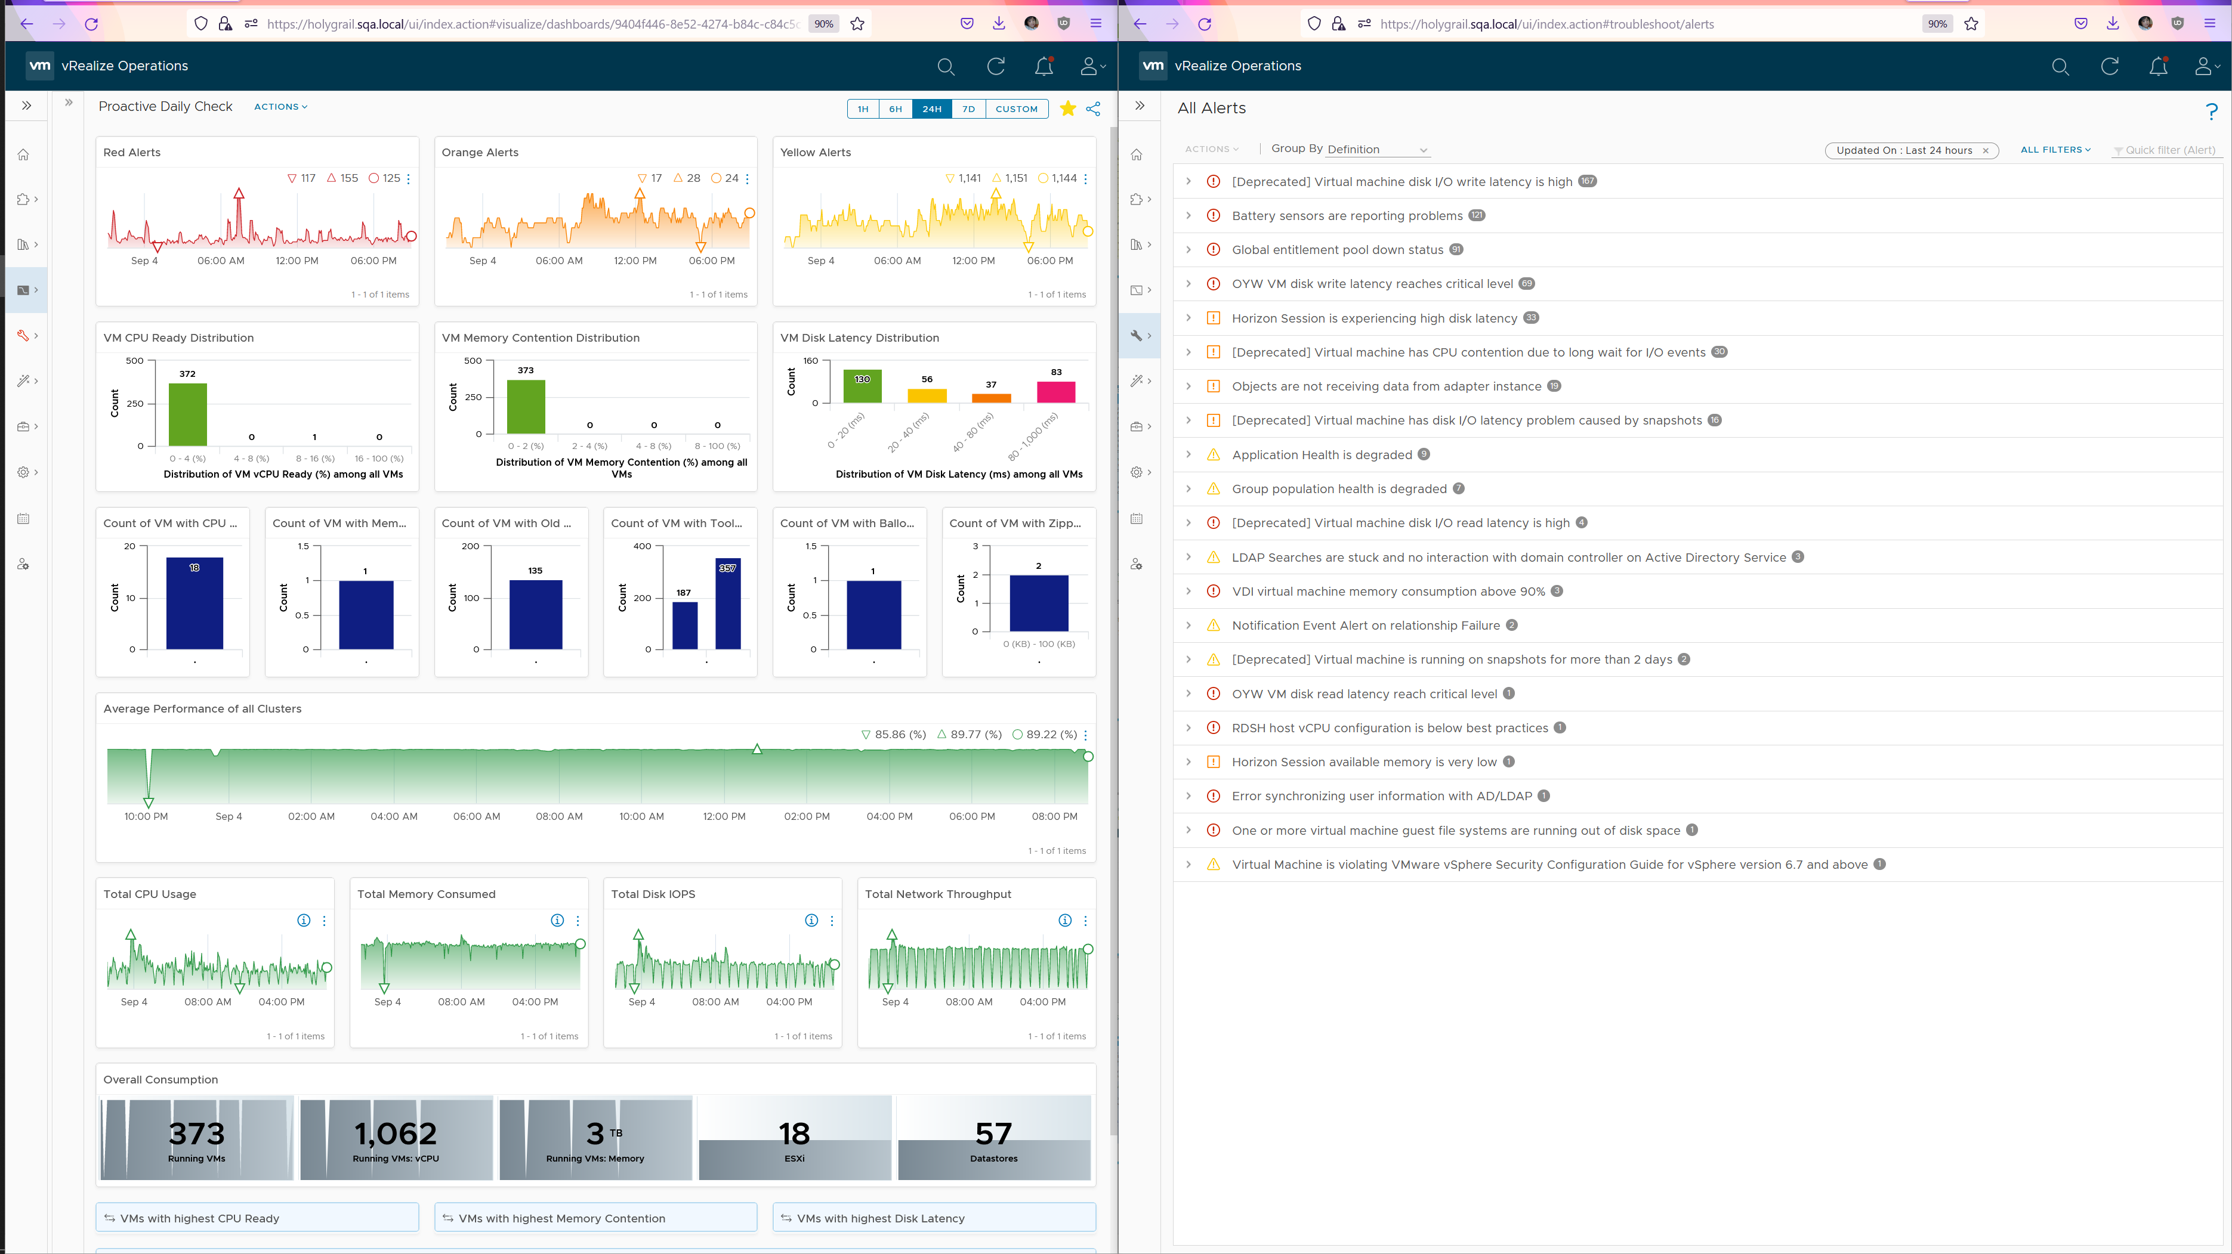
Using Alerts and Insight together
Open 2 separate browser windows + VCF Operations Diagnostic
Insights.
UI is visual. Trend charts and Distribution charts showing overall picture.
Alerts
UI is task-oriented. A list of alerts to act on. Start with the most prevalent or most critical alerts
A great way to justify why your work requires a 50” 4K curved monitor to your management.
You’re welcome.

Slide 13
Reactive vs Proactive
Proactive Alert is an oxymoron
Proactive means you’re doing before something happened which forces you to react.
The moment you react, you’re reactive.
Just because the business is not impacted does not make it proactive.
For example:
vSAN shows high disk latency on Sunday midnite. You’re called to investigate, before business become impacted on Monday morning. You fixed it just in time.
Does that “just in time fix” make it a proactive alert?
What if the same alert happens during business hours and business impacted? Does that make it reactive?
By above definition, proactive deals with “hint” instead of real problem
That’s why it requires someone with knowledge of what’s going on in the DC.
Don’t confuse “observation” with issue, insight vs alert.
If you lump observation (insight) under alerts, you will get noise. Noise will bury your actual alerts.
Analogy: Think of Alerts as your Accident/Emergency Department. You can have dozens of departments dealing with all sorts of illness, but only 1 central location for urgent matters

Slide 14
Daily Check
Proactive Health Check

Slide 15
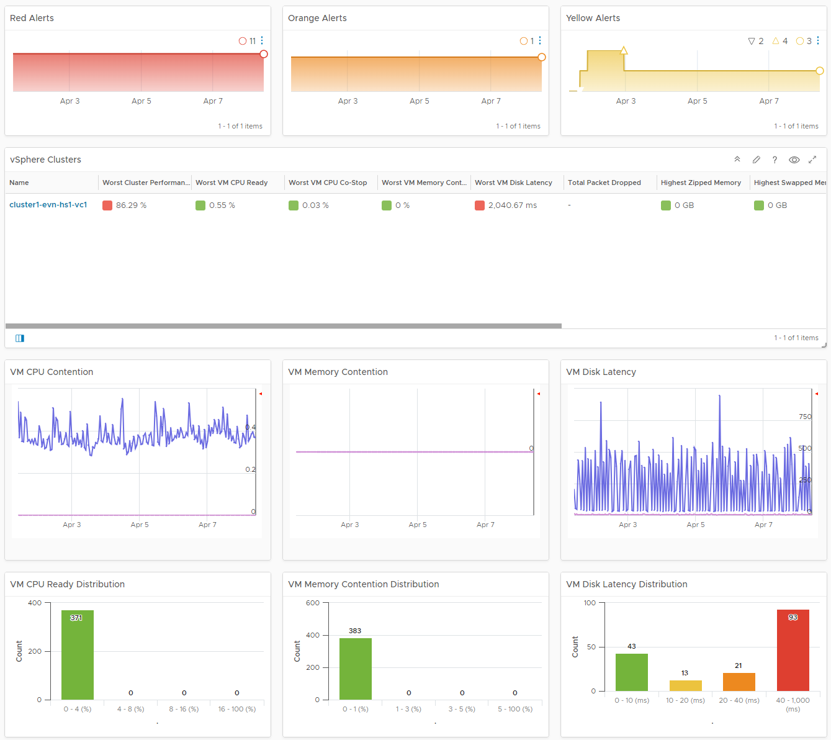
vSphere Daily Check
Are they matching the Change Requests? Can you minimize alerts in the next 12 hours?
Alerts Trend
Check both the absolute amount and the pattern. Compare it with your expectation on that day. Is today a special date, where high demand is expected? Any relevant changes approved during last night change window that will impact supply and demand?
Are the clusters performing as expected?
vSphere Cluster is a logical group where “similar” VMs live together.
The table is sorted by the overall performance, where the least performing cluster is shown at the top.
In large environment with >100 clusters, group them based on importance so you can attend to the top clusters first. For each group, track the lowest performance so you don’t have to check individual cluster if the value is good.
The columns sports leading indicator, as it uses worst() not average. It checks 9 key performance metrics. Adjust the threshold to your comfort level. 4 utilization metrics are shown to catch abnormal peak.
Is performance trending “correctly”?
What’s the overall IaaS performance among all the VMs? Is it a CPU, memory, disk problem? To do that, dive into a specific cluster. This section automatically shows its performance in the last 24 hours.
The 3 table covers CPU, memory and disk. Expect CPU contention to higher and more volatile than memory contention. Add network drop packets if the issue exist in your environment.
Each table shows 2 lines (worst and average). Are they inline with your expectation, both the absolute amount and their pattern over time? Make sure the average is well below your comfort level.
If the worse is far higher, you have an isolated incident. If they are close and the average is not low, you have a widespread issue.
How many VMs are affected?
The distribution charts places all the VMs in 4 levels of performance (green, yellow, orange, red). Attend to the red category first.
They are based on 20-second peak metric, not 5-minute average. This gives you a leading indicator. Each value is based on the highest in the last 24 hours, to enable daily comparison.
Add network drop packets if the issue exist in your environment.
Notes:
What do you check
Performance: Contention
Performance: Utilization
Configuration
Availability
Inventory
Is the trend unusual? Form an expectation of what’s normal for your environment as it develops pattern. Compare it with what’s happening (e.g. DC upgrade, public holiday).

Slide 16
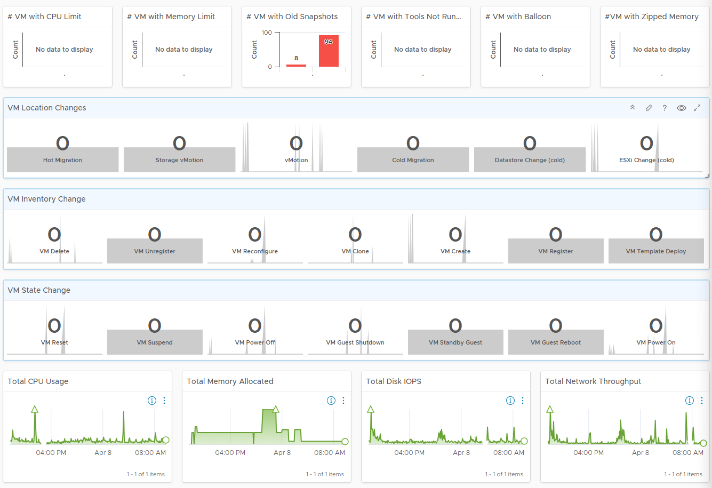
vSphere Daily Check
… continued.
Any VMs with potential issues?
What configuration issues can cause availability, performance, or security issues?
Expect these checks to show no result, or very low number.
Is the environment more volatile than expected?
High volatility increases chances of alerts.
There are 20 types of VM changes that can happen to a VM. They are grouped into 3 logical sets. For each set, the changes are shown in order of urgency, where the least desired changes are shown first.
Each of the 20 changes are unique. Ensure they match the approved change requests and expected changes of that day.
State = VMs power state change. Abnormal change such as reset, suspend and power off are shown first.
Location = VMs are moved to another host or datastore. This can be hot or cold migration. Hot migration is shown first as they might impact performance.
Inventory = VMs are added or remove, hence impacting count of inventory.
Total Demand
Are they higher than expected? On the other hand, a big drop means the amount of work completed is less, which could indicate availability or performance issue.
The CPU widget uses Usage metric as it is aware of CPU clock speed. The memory widget uses allocation as memory load is much more stable, reflecting its nature as cache of disk space.
Notes:
vSphere Daily Check
Not all clusters are equal

Slide 17
Log Insight
Are undesirable events rising? Are the patterns matching your expectation?
Area | Information | Description
Availability & Performance & Inventory & Configuration | Total Events | All (good and bad). Suitable for something that have expected ceiling or pattern, such as vSphere DRS, vCenter Tasks. If DRS becomes a lot more active, it could be bad for performance
 | Error Event | If this is increasing more than the environment growth, over a period of time, something amiss. However, log entries tend to be dirty with fake error messages. The higher the proportion of fakes, the less useful the log becomes. If it’s too many, group so we can see if there is change among the group Examples: vCenter Tasks ended with error
Availability & Performance | Undesirable Event | Not what you want, but they may not be errors as some changes are legitimate. Examples for Inventory: VM deletion, folder deletion Example for Configuration: snapshot during office hours, VM setting change (e.g. limit set), resource pool created Examples for Performance: vMotion bandwidth, vMotion stun time, vMotion downtime, VMkernel SCSI latency, Long VMFS reserve time Example for Availability: VM powered off, VM reset, Guest Shutdown, vSphere HA, ESXi states (maintenance mode) You need to compare actual with expectation. For example, if you delete 258 VM and logs say 261, something not right.
Security | Undesirable Event | Examples: “Loosening” Firewall changes (e.g. disable, allow all IP), root login, administrator login, dangerous console commands such as deletion, promiscuous mode enabled, ports being opened, SSH enabled, DCUI enabled
Audit | Not Applicable | Not for day to day. It’s for audit team, who don’t check daily. Who did what action to which object, and when.
If you react, you lose. You need to anticipate. However, the longer the prediction, the higher the chance of wrong prediction. Hence aim for the next 10 hours, at the start of your day. Look at signs of storm brewing, such as undesirable events, increasing or strange utilization patterns, soft errors, etc.
Notes:
vCenter Tasks ended with error. Need to clean up the query as some errors are not true error

Slide 18
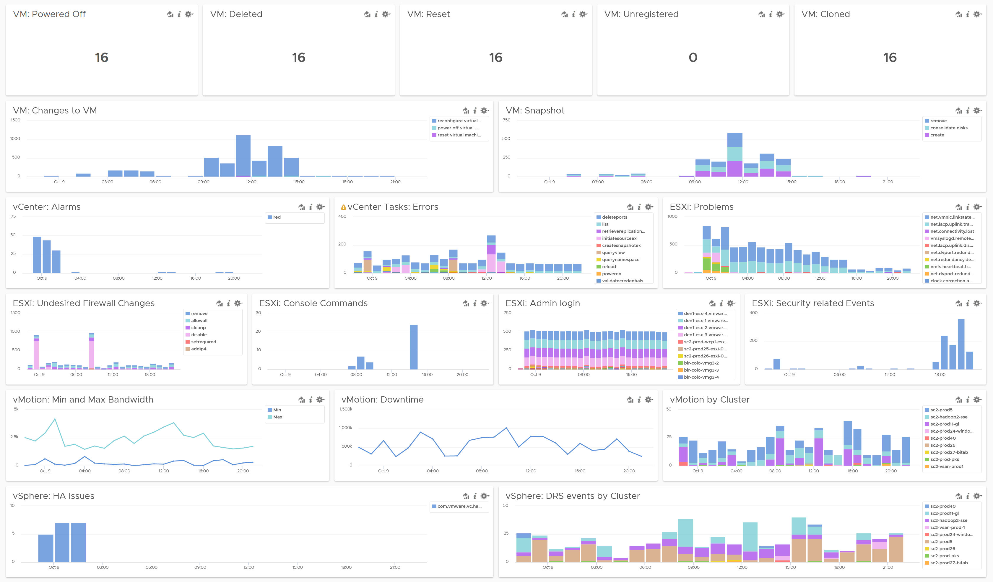
Logs Daily Check
Preferably 2x a day: Start of Day and End of Day
Undesirable VMs events.
There are bounds to be “negative” events in large environment. Are they inline with your expectation? Right amount and right timing?
Harmless events such as VM relocation, snapshot, powered on were filtered out
Undesirable VM changes & Snapshot.
Are they inline with your expectation? Harmless changes filtered out. Are changes and snapshot taken during office hours?
Issue
vCenter Alarms, vCenter tasks that ended with error, and ESXi potential problems.
Security
Are we being attacked? What are the footprint of a security attack? Any malicious changes? Anyone issuing shell commands at ESXi console? Unusual login by root? Activities in management network?
vMotion
Failure? Is the bandwidth lower than expected? Is the downtime longer than expected? Some clusters did a lot more vMotion than usual?
HA and DRS
Any issue with HA and DRS? Is DRS a lot more active than expected? Which cluster is behaving abnormally when?
Notes:
This needs import. Not available OOTB

Slide 19
NOC Screen
Dashboard for the NOC Team

Slide 20
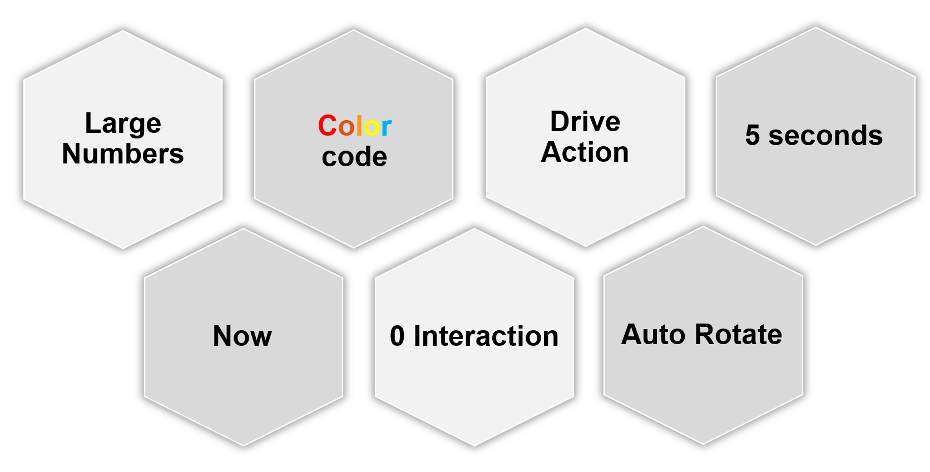
NOC Screens
Best practices
Availability
Performance
Security
Configuration
Inventory
Compliance
Auto-rotate
Each screen is ~60 seconds to prevent “boredom” from static screen.
Customize to fit your operations (people, size of environment, business workload).
Adjust threshold accordingly.
Notes:
Point of the slide: you need to collaborate with Call Center team, so they can value add and filter. What information do they need? What do you need from them? What’s the Exit Criteria and Entry Criteria?
Reference in the book:
Part 2 of the book. See the NOC Dashboard section

Slide 21
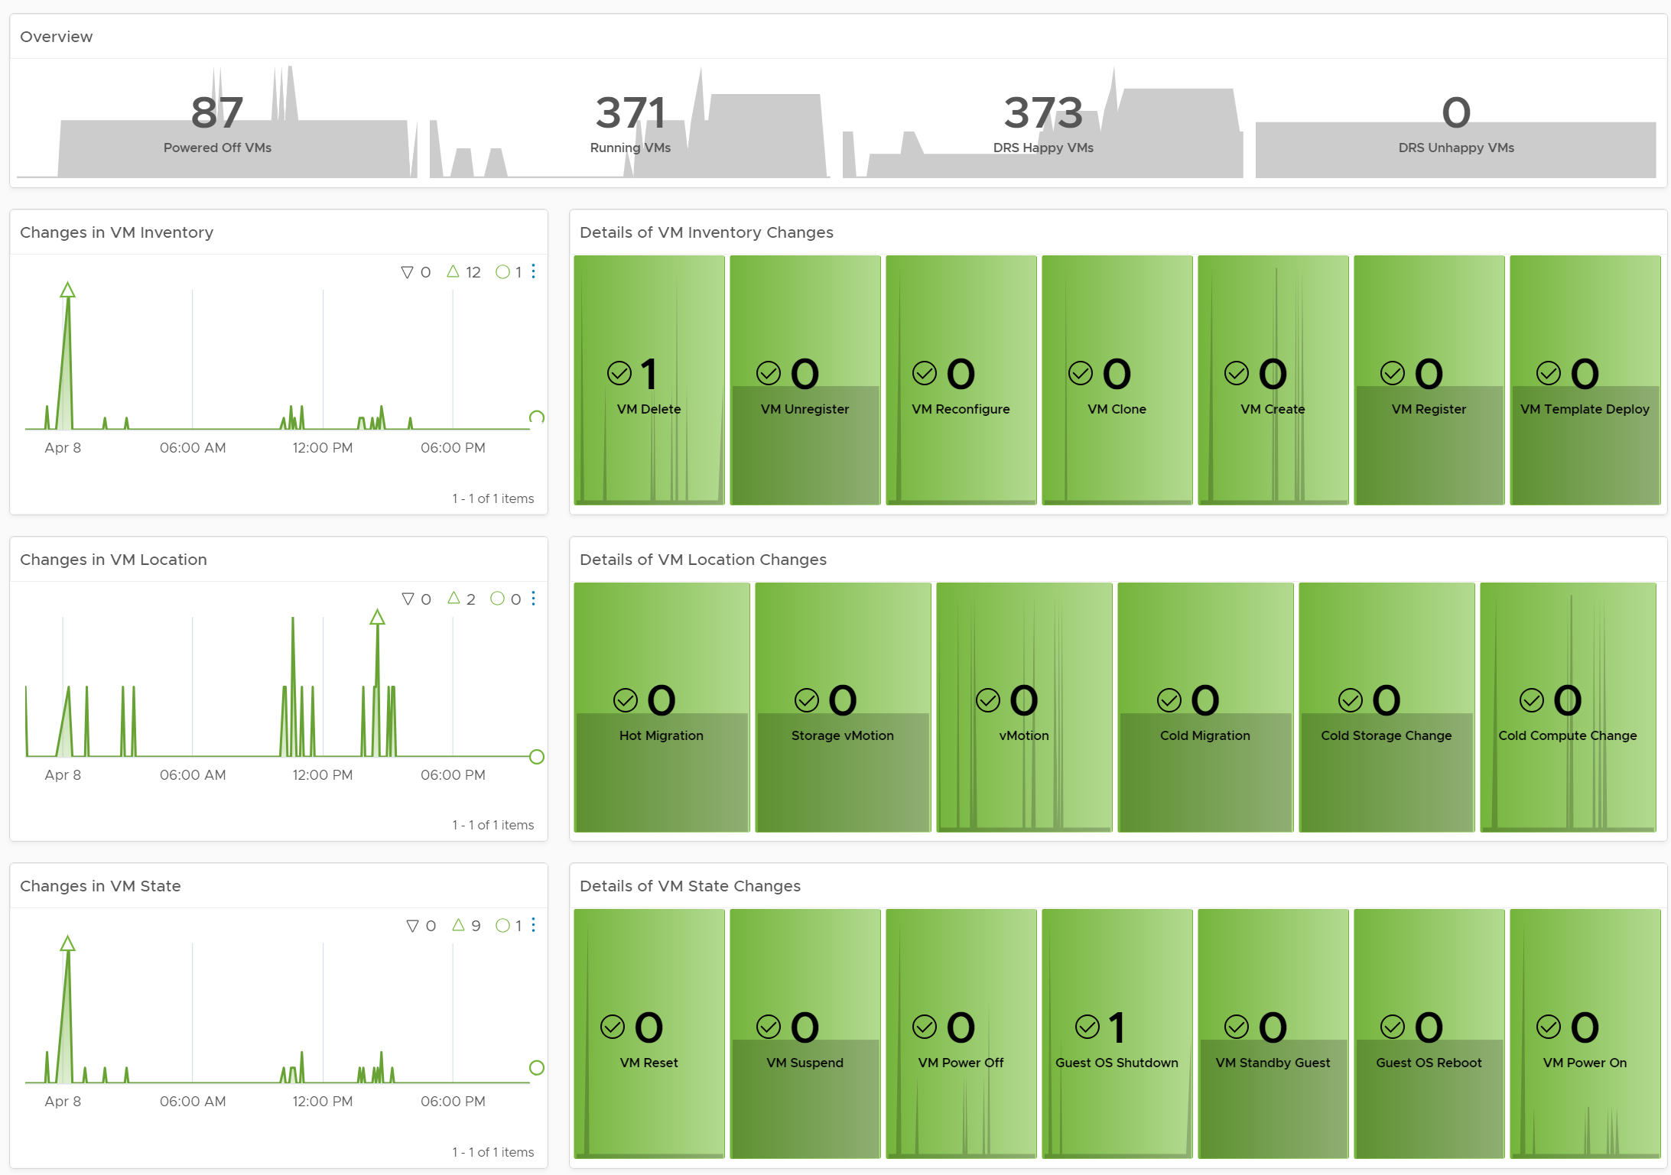
Live! VM Changes
Is the environment more volatile than usual?
You’ve got the right number of Running VMs?
The number should match your expectation, which should be correct. Too high can cause performance issue. Too low is a sign of availability problem.
High DRS Unhappy VMs is potential performance issue.
VM Inventory Changes
Are VM are added or removed as per expectation? Are they done the right way (cloning vs free style creation vs template based deployment), matching our policy?
Why do we have high count of VMs being unregistered or deleted?
VM Location Changes
VMs are moved to another host or datastore. This can be hot or cold migration. Hot migration is shown first as they likely impact performance as it changes both the compute and storage.
Pay attention to the first 2 as they take the longest amount of time.
On the other hand, cold migration is typically an activity that should match change request as the VMs are shutdown.
VM State Changes
Reset is the least desired, hence it’s shown first. It is used as last resort.
Suspend and Power Off are least preferred, as these action should be done from within the Guest OS. Expect these numbers to be low.
A high number of powered on VMs could lead to high demand. Typically, how many days passes before your New VMs becomes active? It can take days or weeks before the VMs usage grow to its “full size”.

Slide 22
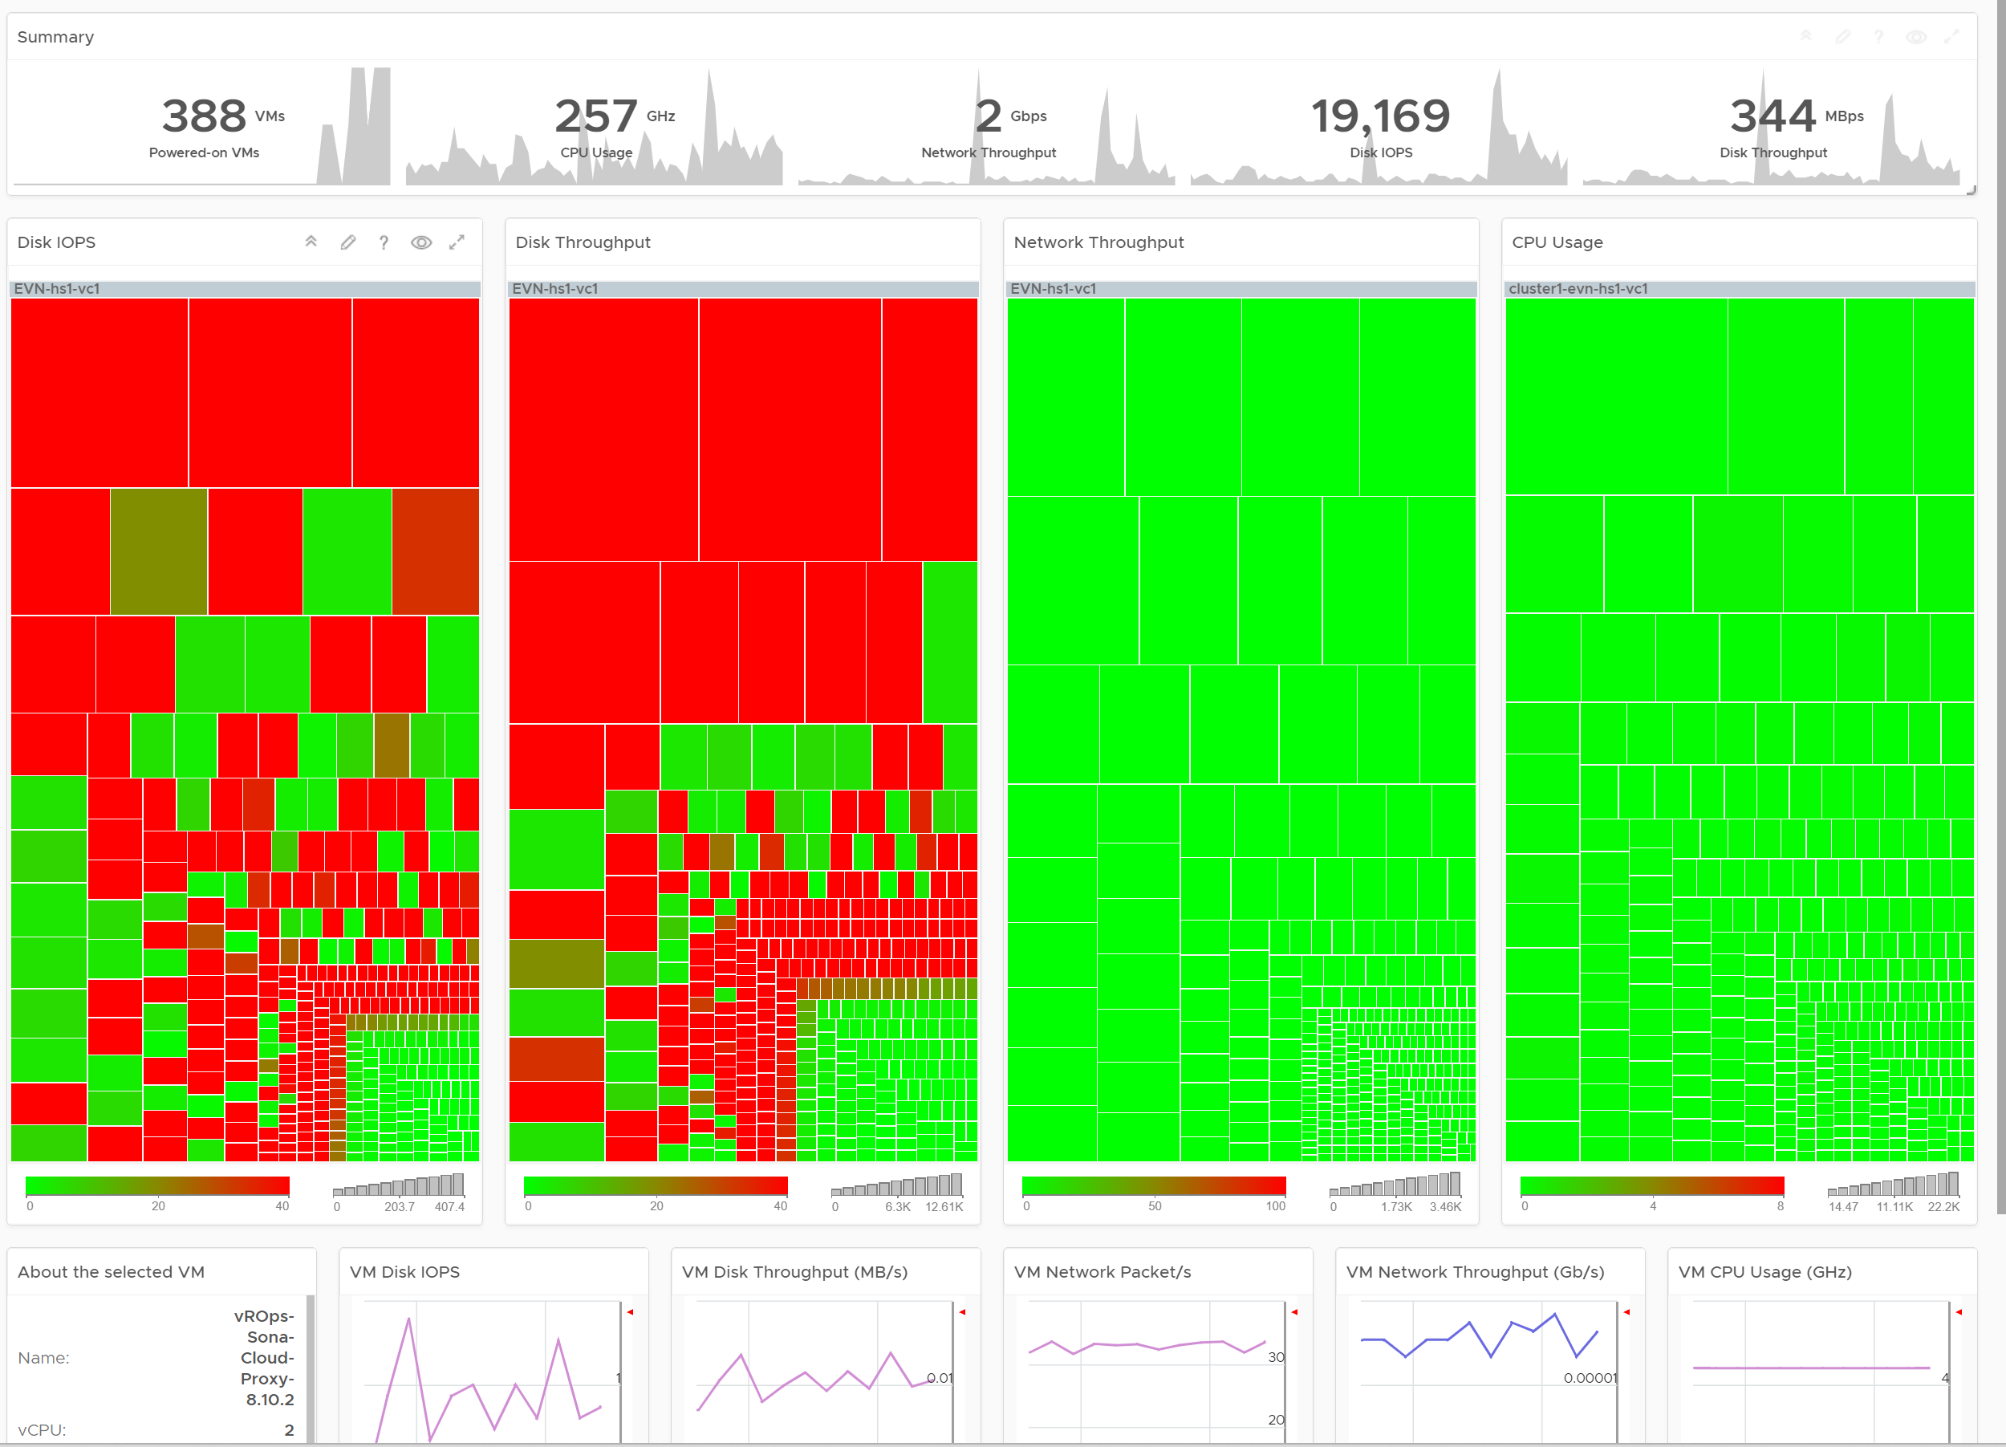
Live! Heavy Hitters
Which VMs hit the shared infra hard?
What do the key metrics say?
Are the overall demand within your infrastructure capability to deliver? Did demand rise abnormally?
Who are the heavy hitters? Are they causing problems to themselves or others?
There are 4 area where VM can impact the shared infrastructure with high demand
Disk IOPS
Disk Throughput
Network Throughput
CPU Usage
Memory not shown as it’s basically disk space. There is no “hit” as it just sits there occupying the space.
Disk Space is not shown for the reason above.
Network packet/second not shown as dashboard can’t support 5 columns. If you rearrange, it will look odd. It’s added in the trend chart.
This section not for display in projected screen
To be used as interactive troubleshooting. See next slide

Slide 23
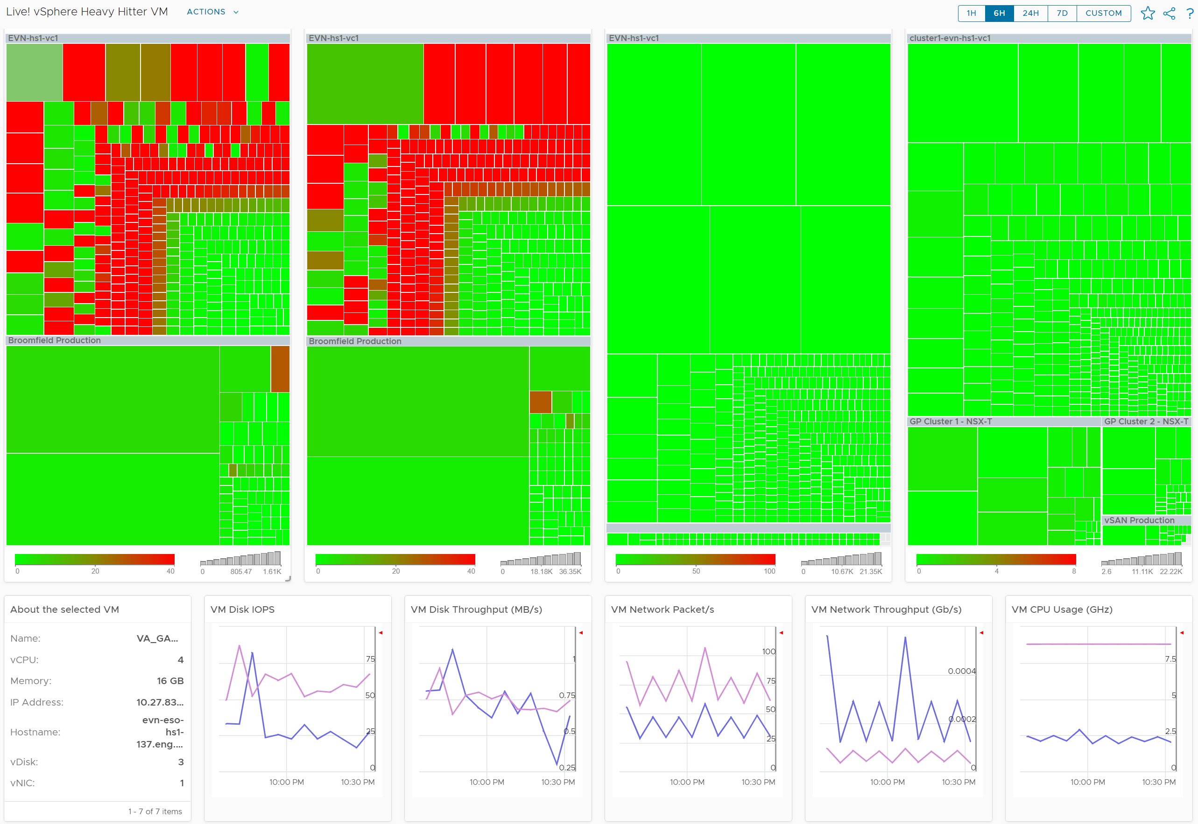
(continued) Live! Heavy Hitters
Lower section is designed for interactive usage by NOC Team
Drill Down
This section is interactive. NOC staff can click a VM, and relevant details will be automatically shown. Important information is also shown. From there user can go to the object summary.
5 types of “hit” on the shared infrastructure are shown. For each, breakdown between read and write, transmit and receive, etc. are provided.

Slide 24
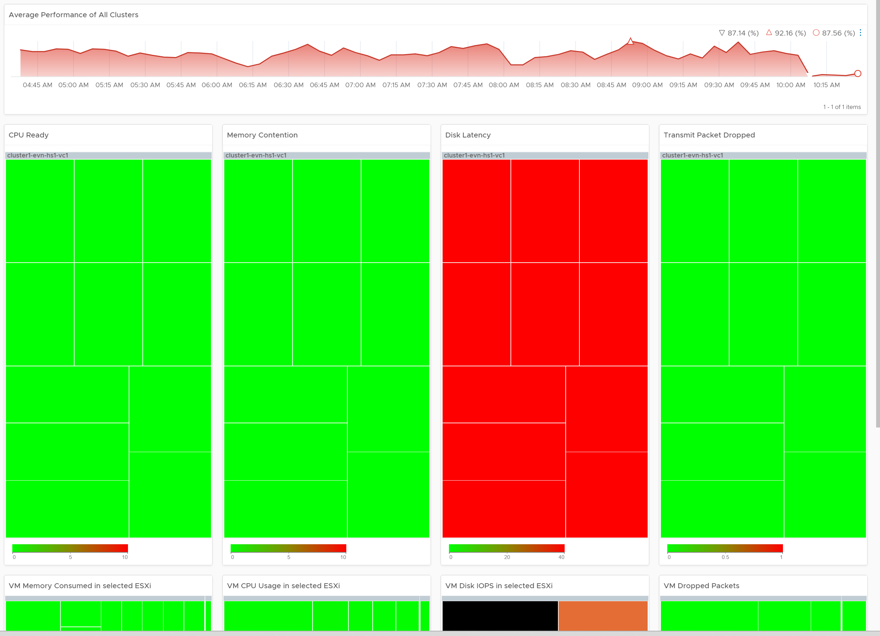
Live! vSphere Cluster Performance
Are they serving the VMs well?
What’s our overall performance?
The number is the average of all clusters. If you have 10K VM, this is the average of 40K metrics as each VM has 4 (CPU, memory, disk, network). As a result, it takes a serious degradation to bring this number down. This number should match your business cycle if your environment is mostly virtualized.
Detail Performance
Since you have HA, where at least 1 host can go down without impacting performance, that means no hosts should be running hot when there is no HA. Especially true for CPU and memory.
What problems do we have?
CPU, memory, disk, network?
From the screenshot, we can easily see we have burning issue with storage performance. The other 3 areas are fine.
Are the ESXi struggling to serve its VM?
If yes, which one? In which cluster? How many of them struggling?
Any imbalanced clusters?
Since the heatmap is grouped by cluster, any imbalance will be clearly shown.
The heatmap has fixed size as the focus is performance, not capacity. This enables the 4 heatmap to work together as 1 unit. Yes, the location of each ESXi is identical on all 4 widgets. You’re welcome.
If you have 2 distinct class of service, clone the dashboard. Set the dashboard threshold to match the promised SLA of that class of service (e.g. Gold)
This section not for display in projected screen
To be used as interactive troubleshooting. See next slide
Notes:
Expected Action by Help Desk
Balance the cluster by moving workload. Find out why DRS does not balance.
Stop provisioning new VM if SLA is breached.

Slide 25
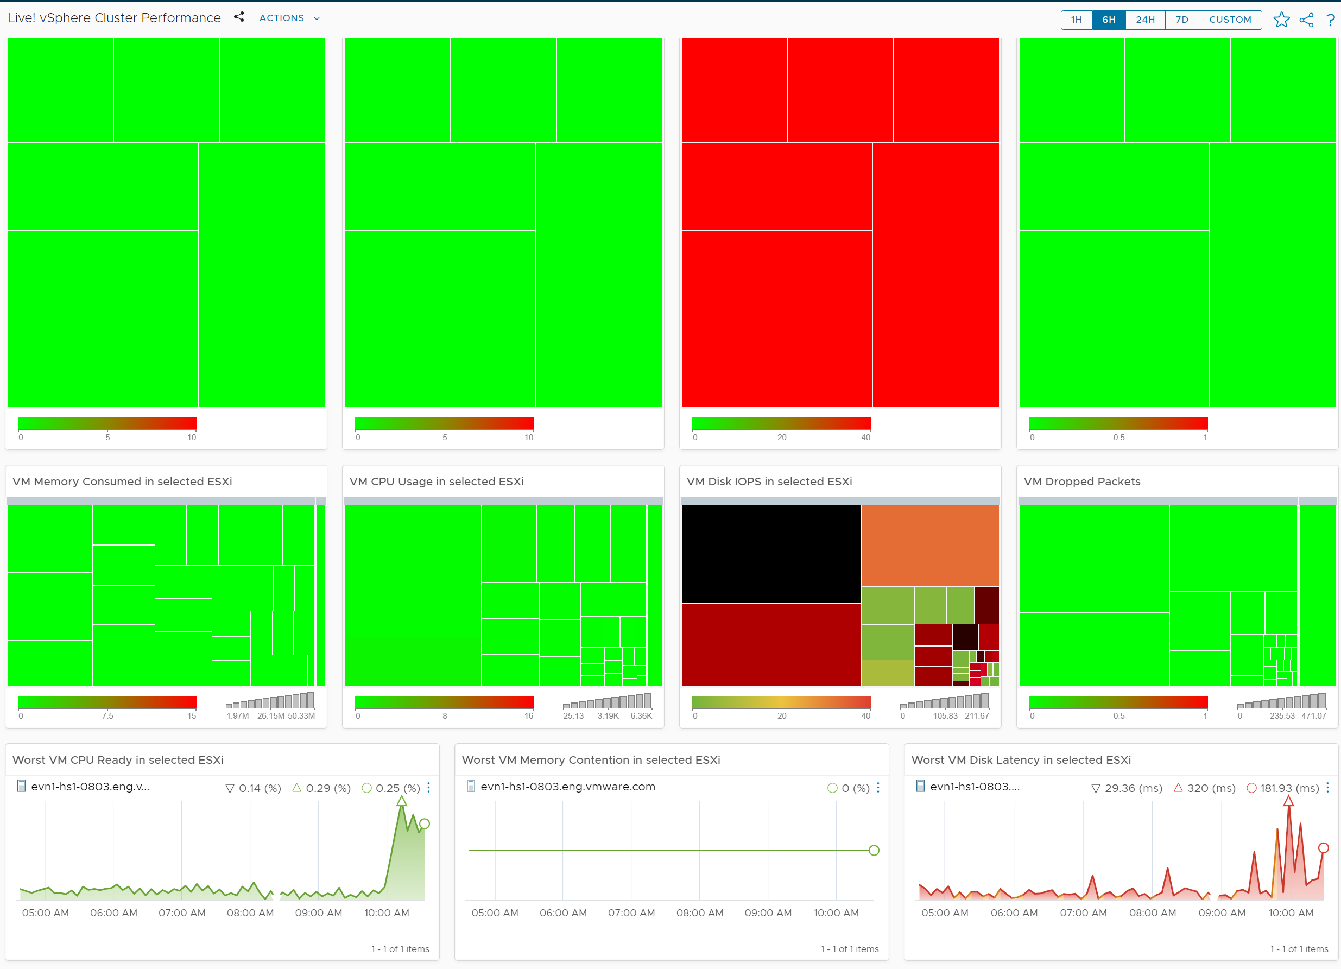
(continued) Live! vSphere Cluster Performance
Lower section is designed for interactive usage by NOC Team
Are slow performance caused by villain VMs? If yes which ones?
This section is interactive. NOC staff can click an ESXi, and all the running VMs are shown.
Memory Consumed is used, and not Guest OS metrics, as it better represents the footprint on the VM.
CPU Usage is shown, and not CPU Net Run, as it better represents the footprint on the VM.
Tips: if you have enough screen real estate, add Disk Throughput and Network Packet/second
What’s the trend of performance? Any pattern?
A pattern that does not match business cycle or change window is worth investigating.
The 3 trend charts are color coded.
Tips: add a trend chart to show the network dropped packet

Slide 26
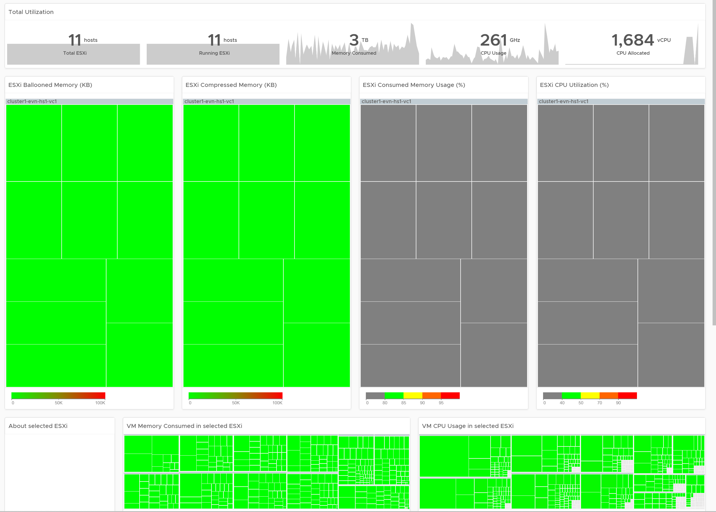
Live! vSphere Cluster Utilization
Are they running hot?
Are the key metrics correct?
These important numbers should match your expectation. For demand side, while a big jump is a concern, a big drop in total workload is a bigger concern.
ESXi Utilization
Are the ESXi running hot?
If yes, which one? In which cluster?
Since you have HA, they should not be running too high when there is no HA event.
Any imbalanced clusters?
Since the heatmap is grouped by cluster, any imbalance will be clearly shown.
This dashboard works together with Cluster Performance dashboard. The exact location of an ESXi is the same in both dashboard.
3 counters are used for Memory as Consumed is not enough as it’s mostly cache. So Balloon and Compressed are added as they signal high utilization.
This section not for display in projected screen
To be used as interactive troubleshooting. See next slide

Slide 27
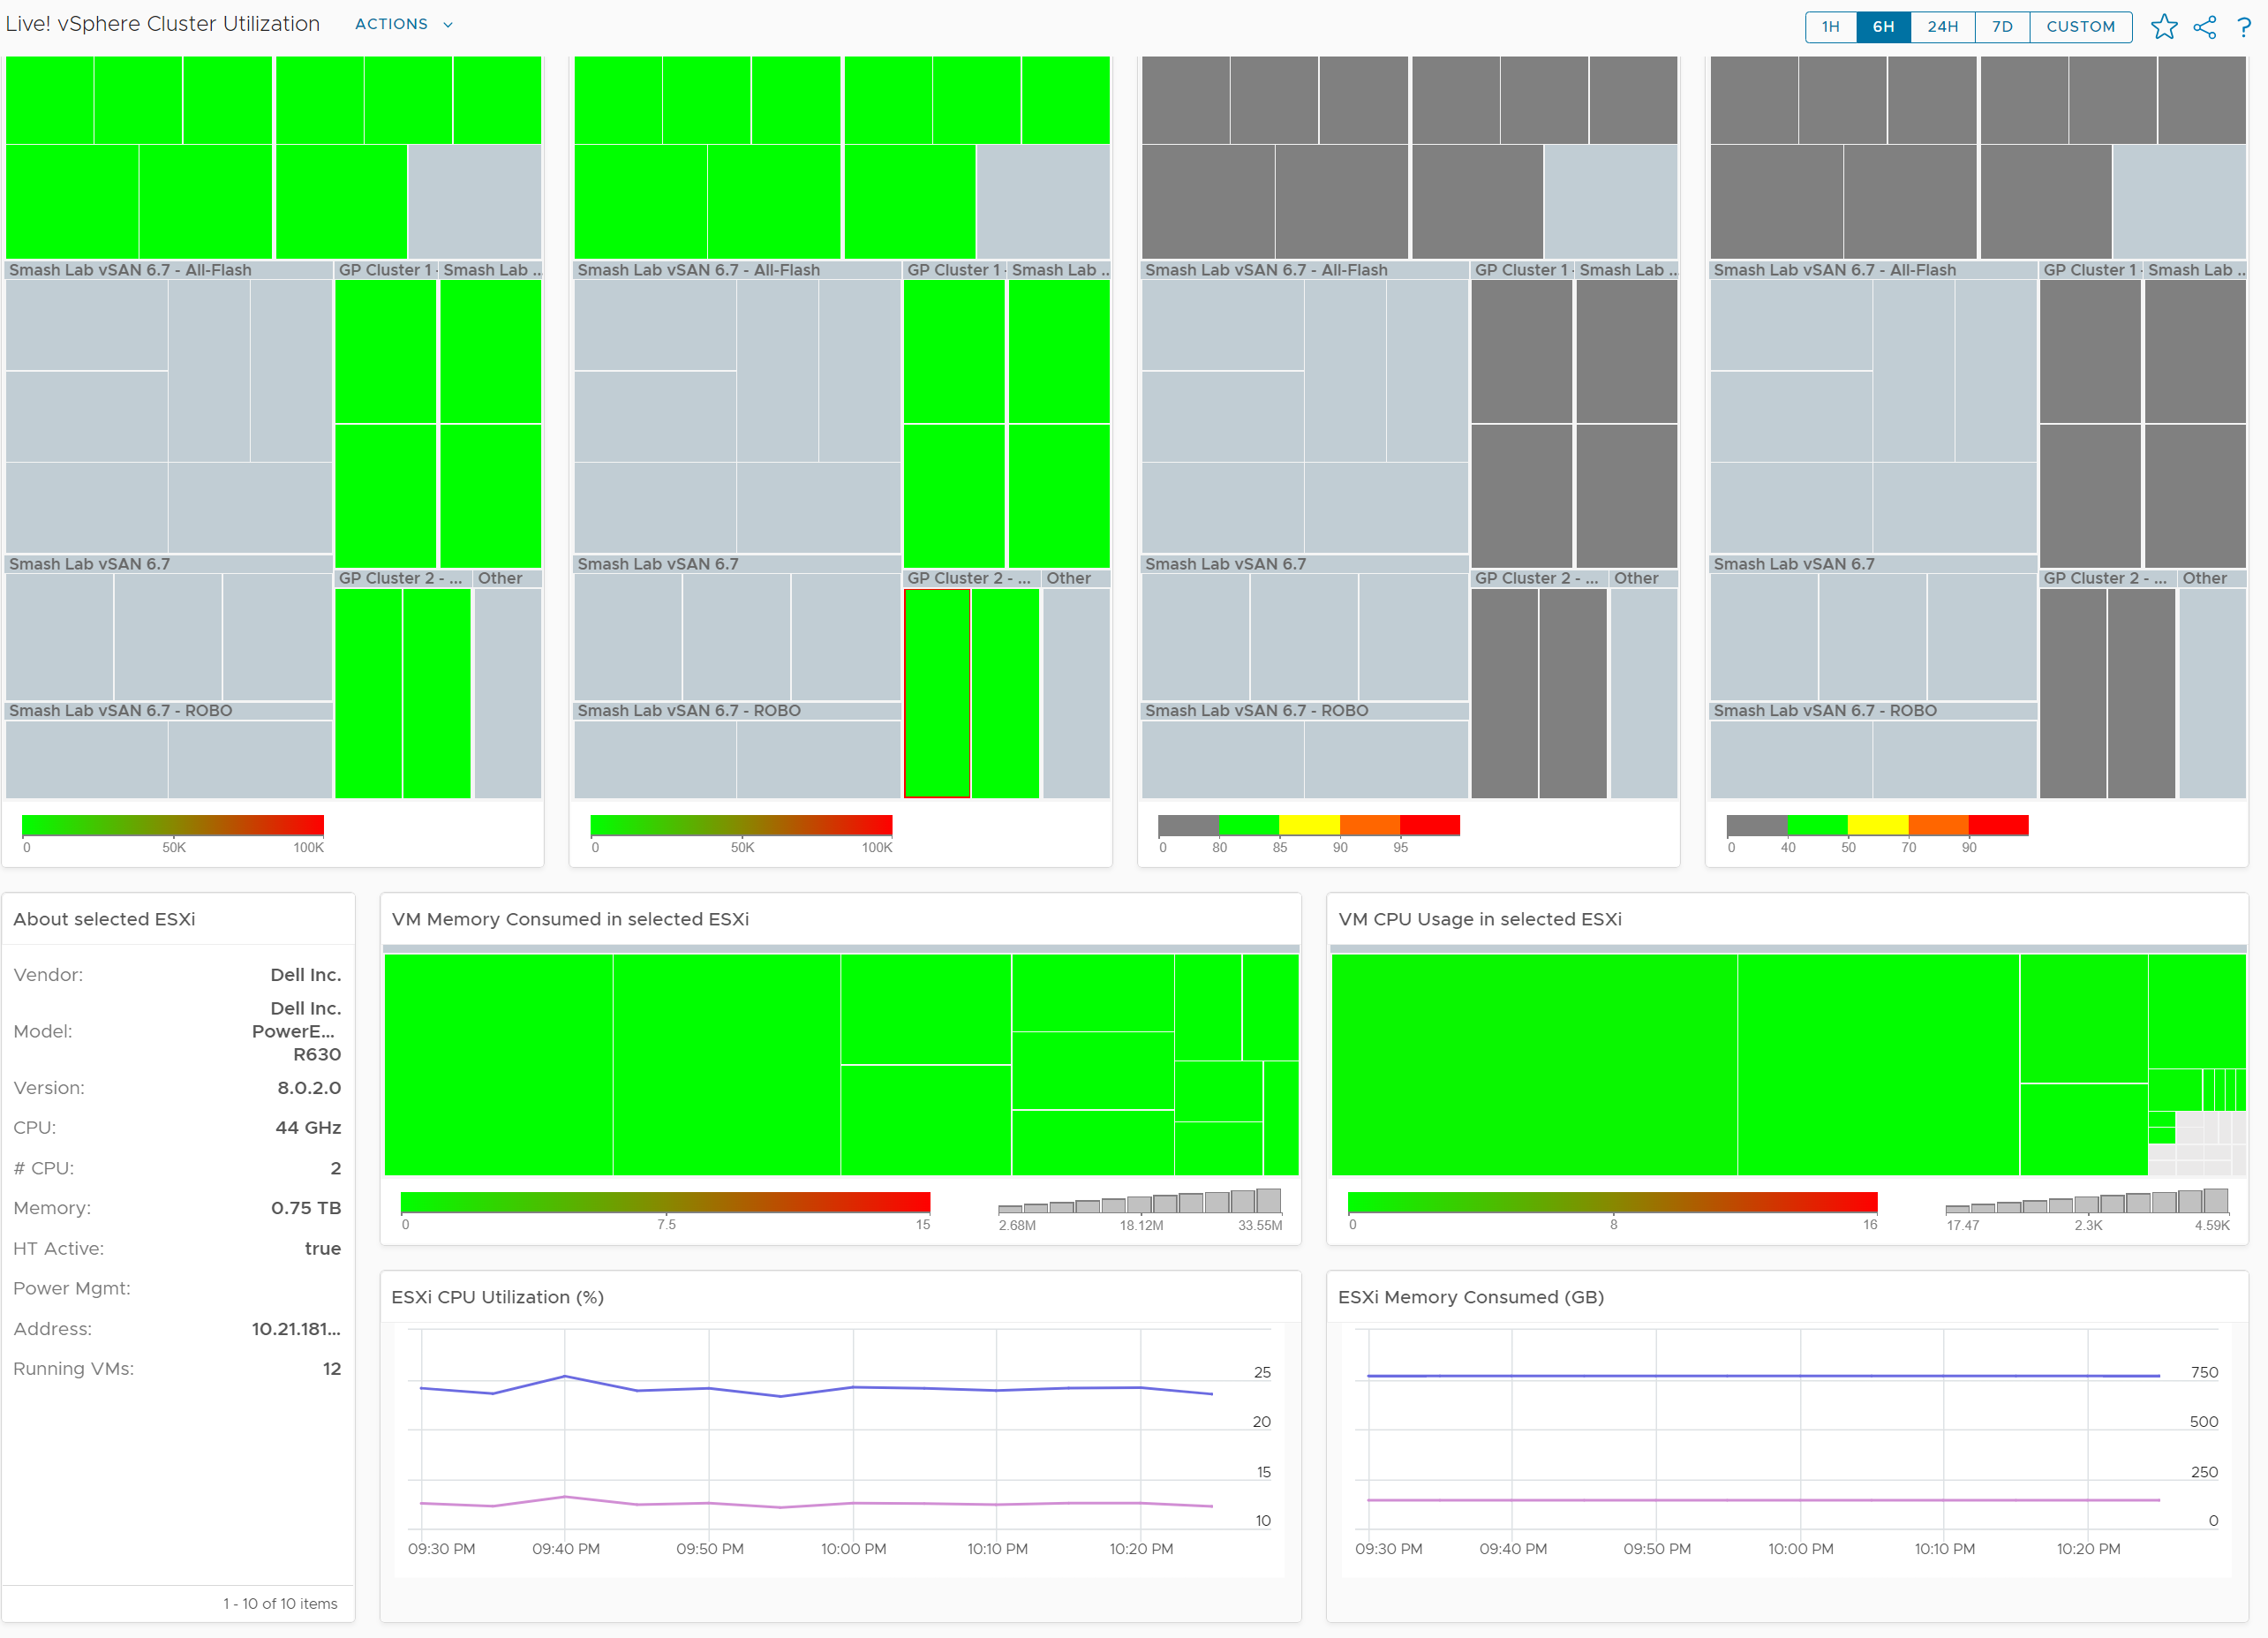
(continued) Live! vSphere Cluster Utilization
Lower section is designed for interactive usage by NOC Team
Drill Down
This section is interactive. NOC staff can click an ESXi, and all the running VMs are shown. Important information ESXi is also shown. From there user can go to the object summary.
Are they any villain VMs? How heavy is their demand relative other VMs?
If there are villain VMs, as opposed to kernel load, use the heavy hitters VM dashboard. See next screen.

Slide 28
Alerts
Functional Architecture

Slide 29
The 3R of Alerts
Complete is not only when nothing else should be added, but also when nothing else should be removed.
Rapid | It’s urgent, hence you want to know the problem as soon as possible. If time is not an essence, then a daily SOP with dashboard is more effective as you can see the big picture. Avoid sending alerts to personas that do not deal with day-to-day operations. Long term actions such as capacity management is best served with dashboard
Real | Don’t confuse alert with symptom. If the issue is not real, there is no need to trigger an alert. That’s why in general you do not set up an alert on inventory changes, as inventory is merely an account of something.
Rare | If it happens too frequent, it will numb you. Alert focuses on exception, not the big picture. As a result, you want this to be minimal. If the whole house is on fire, it’s too late for an alert.

Slide 30
Overall Approach
Content Architecture of VCF Alerts
What to alert? | What not to Alert | Future Alerts
Configuration. High risk settings that cause urgent problems such as slow performance, outage, or security hacking. Capacity. While high utilization is ideal, a sustained and very high load is typically not expected, as it can cause slow performance. For disk space, it can lead to availability issue. Compliance. It is based on violation to rules, which are typically security or audit requirements. Performance & Availability. See below & speaker notes | Issues that do not trigger urgent situation. They are more like symptom, which is best checked proactively every morning and before end of business day. Majority of configuration issues (incorrect, outdated, suboptimal) are best done via health check as they are not urgent. Most of capacity issues (reclamation, downsizing) are best handled via daily check and weekly planning. No alerts on inventory movement & volatility as the thresholds are situation dependant. That’s why Daily Check and NOC Screens are provided. | Availability issues are not yet reviewed in 5.2, but will be reviewed in future. Distributed Port Group and Distributed Switch are merely collection of ESXi (physical network for uplinks, and virtual network for both VM and VMK networks). We will add alerts once we determine if the noise is worth it. Datastore Cluster. Storage DRS is a lot less common than DRS.
 | Contention | Very High Consumption
Guest OS | CPU, Disk | None
VM | CPU, Memory, Disk, Network. | CPU runaway (Availability)
Resource Pool | CPU, Memory | None
ESXi | CPU, Memory, Network. | CPU, Memory
Cluster | CPU, Memory, Disk (R/W) | CPU, Memory
Datastore | Read Latency, Write Latency | Disk space (Availability)
Notes:
There are 3 types of Availability problems:
The protection is gone. System is still up. If it’s unlikely that the system will go down, catch this as part of SOP.
Soft errors. Have an orange alert, as the hard error can happen soon.
System is dead. Have a red alert.
Configuration mistakes can cause availability, performance, capacity and security. Examples:
Availability. Incompatibility between software versions could cause an outage.
Capacity. Disabling CPU SMT will reduce the number of logical processor.
Security. Outdated software may contain known security vulnerability

Slide 31
Specific vs Generic
When to create which type?
 | Generic Alert | Specific Alert
What it is | It covers the symptom. The cause could be many. It’s symptom oriented | It covers specific cause. It’s cause oriented
Examples | VM did not get the CPU time it asked | VM had CPU contention due to CPU Co-stop caused by snapshots
 |  | VM had CPU contention due to CPU Co-stop caused by too many vCPUs
Strength | Alert name will be simpler | Alert name will be more precise
Weakness | Can’t tell the actual problem. For example, is it read or write latency? But do we need to know at this stage, since alert is just the tip of the iceberg? Can we pass this to Insight, where we can see more? | Very complex to design. It does not cover unknown cause. So we still need the catch all as the last resort. That means designing the alert is complex as the catch all typically contains certain traits.
 | Recommendation is a long list of possibilities. Can be solved by Having a condition in recommendation, so it’s not a long list of irrelevant recommendation. Having information instead of just plain text. | Most causes are not known, so this has limited use case. For example, we can’t prove that snapshot is causing CPU contention or even disk latency. We only know probable cause, so we’re unable to prove the actual. We pray that we make some changes and the problem goes away magically.
 |  | Many known causes are due to misconfiguration. Why wait for alert to address the incorrect config? Regular health check should be provided.
Suitable for | All roles | Mostly only for Infra Team. Not so suitable for VM Owner as she does not and should not care about underlying infra problem.
Notes:
There is only 1 Symptoms, which is “One of the virtual disk has high Read or Write Latency”. The rest is not symptom, but probable root cause. Confusing between the 2 will result in many alerts definition, as you need to create 1 alert for each.
Instead of saying Ready Time is high, say “Ready Time is high because of Limit”.
Limitation: we do not know the root cause for majority of the problems, so this has limited use.

Slide 32
Contention and Consumption alerts
They mostly impact performance. A few impact availability.
Type of Alerts |  | Guest OS | VM | Resourc Pool | ESXi | Cluster | Datastore | vSwitch | Port Group
Contention | CPU | 1 | 1 | 1 | 1 | 1 | N/A | N/A | N/A
 | Memory | Future | 1 | 1 | 1 | 1 | N/A | N/A | N/A
 | Disk | 1 | 2 | N/A | Future | Future | 0 | N/A | N/A
 | Network | Future | 1 | N/A | 2 | N/A | N/A | Future | 1
Consumption | CPU | Future | 1 | N/A | 1 | 1 | N/A | N/A | N/A
 | Memory | Future | N/A (see Guest OS) | N/A | 1 | 1 | N/A | N/A | N/A
 | Disk | 1 |  | N/A | N/A | N/A | 1 | N/A | N/A
 | Network | Future | Future | N/A | Future | N/A | N/A
Number shows the count of alerts. When it’s >1 that means there are different alerts covering different metrics
N/A = No need to have it. Use case or workflow does not seem suitable for alert, considering the noise generated.
Future = future consideration if it’s proven worth the noise.
Telegraf = requires metric & event from Telegraf agent
Symptom = insufficient urgency as alert. Best part of daily check.
Notes:
New object type coverage: Resource Pool, Guest OS
ESXi has 2 metrics as 1 for dropped, 1 for error packets.
The Disk consumption is about disk space, not IOPS.
Datastore disk latency is deprecated. See slide for details

Slide 33
The 3 Types of Consumption Metrics
We need to be clear on terminology. 1 English word → 1 clear meaning
Type of Metrics | Primary Application in Operations
Contention | Performance Management
Consumption | Capacity Management Cost Management
Context | Configuration Management Compliance Management Inventory Management
Type
Utilization | measures the actual consumption. There is on standard naming convention in the industry, so after a while you have a wide variety of names. Examples are IOPS, throughput, active, usage and workload. It is the main input for the capacity family of metrics (Capacity Remaining, Time Remaining, Recommended Size).
Reservation | is used in capacity to prevent contention from happening. Think of it as seat reservation in a restaurant. It can overlap with utilization because an object can have lower or higher reservation relative to its utilization at different times.
Allocation | is used in capacity when utilization is too low to be used.

Slide 34
Contention Alerts
Overall conditions used across objects
Alert Type | Object | Orange Alert
CPU Contention | VM | Peak vCPU Ready > 16% AND CPU Contention > 4%
 | ESXi | Same conditions are used for all 3 objects: >25% of VM population has CPU Contention > 3% AND 20-second vCPU Ready > 12% For cluster, we measure directly at VM level so it’s closer to what we care, which is the application. Aggregating from ESXi is less accurate. For resource pool, the symptom does not work with cascading RP. Stacking RP on top of RP complicates operations .
 | Cluster
 | Resource Pool
Memory Contention | VM | Peak Memory Contention > 8% AND Memory Contention > 2%
 | ESXi | Same conditions are used for all 3 objects: >25% of VM population has Peak Contention > 4% AND Contention > 1% For cluster, we measure directly at VM level so it’s closer to what we care, which is the application. Aggregating from ESXi is less accurate. For resource pool, the symptom does not work with cascading RP. Stacking RP on top of RP complicates operations .
 | Cluster
 | Resource Pool
Disk Read Latency | VM | Read Latency > 20 ms AND Peak Read-or-Write Latency > 80 ms. The 20-second peak cover both read and write.
 | Datastore | >25% of VM population has latency > 10 ms AND highest VM latency > 40 ms AND Overal Datastore Latency > 5 ms. Many:many relationship makes it impossible for us to set condition at VM level.
Disk Write Latency | VM | See read latency
 | Datastore | See read latency
Red has 2x the threshold of Orange level.
20-second peak threshold is set at 4x higher of 5-minute metric.

Slide 35
20-sec vs 5-minute
Both are needed. Do we do OR or AND logic?
A common complaint is vR Ops shows no performance problem when there is a problem.
Many performance issue do not sustain for 300 seconds. Even those that last for hours, actually consist of many short bursts. We’ve analysed and proved it.
Since 20-sec is 15x sharper than 5-minute, it did capture the problem where 5-minute failed.
K8 and VDI workload are dynamic, short burst.
How to cater for the above, without having excessive alerts?
Set the 20-sec at higher threshold.
OR Logic: Should we set it at 15x higher? This could be a short burst. On the other hand, 15x or even 8x is too high to be practical. It no longer makes sense.
AND Logic: Set is at 4x but requires both to fire. So we want it to persist for 5 minute, not just a short burst of 20 second. This is the solution we take.
All Yellow Alerts are disabled
1 hour
Not covered by Alerts. Used Insight (dashboard)
5 min
20 sec
10
20
40
80
160
320
VM Disk Latency (ms)
Notes:
General feedback is our 300-second average is too long.

Slide 36
Alert: Remediation
Majority of alerts do not actually have known root cause. Correlation is weak.
We need to stop thinking that IT products has good observability. IT systems actually have poor visibility into what happens. Can you troubleshoot when your web browser is slow even though your laptop is fast and utilization is low?
No, you can’t. If you can’t troubleshoot a single PC, why do you expect we can troubleshoot something far more complex? Observability is always a second-class citizen in product development. Most products only have few meaningful metrics. Even if they do have the metrics, they don’t provide API. Even if they have, the metrics could be unreliable or buggy.
Consumer Layer
(VM, AWS EC2, AWS S3, Guest OS, App, Container, Horizon Applications, K8 Pod, etc.)
This is what we care, as App Team can complain that business is affected, and that would be a problem. Infra team will look bad if they do not know, so alert needs to be triggered.
In the ideal world, every cause of consumer-level problems can be explained by an alert at provider level. But due to poor observability, majority of the problems can’t be explained. That’s why top 2 solutions are reboot and “throw hardware into it”.
Provider Layer
(Kubernetes Node, vSphere, vSAN, NSX, vRealize, Horizon Servers, etc.)
We only care about this layer if it’s causing problem to consumer. If not, we should investigate but can do it quietly as no application is affected. All alerts here can be disabled unless they are “suppressing” consumer-alert
How to intelligently fire alert at this level instead? We can’t use static threshold as it’s rigid rule (on/off). There are multiple dimensions to consider before we suppress all the children alerts.
Notes:
Another misperception due to lack of understanding is observability. We seem to think we can define thousands of alerts and somehow AI will correlate them. We can’t, as there is no metric.
We can still have the alerts by saying “it could be”. It does not have to be 100% certain

Slide 37
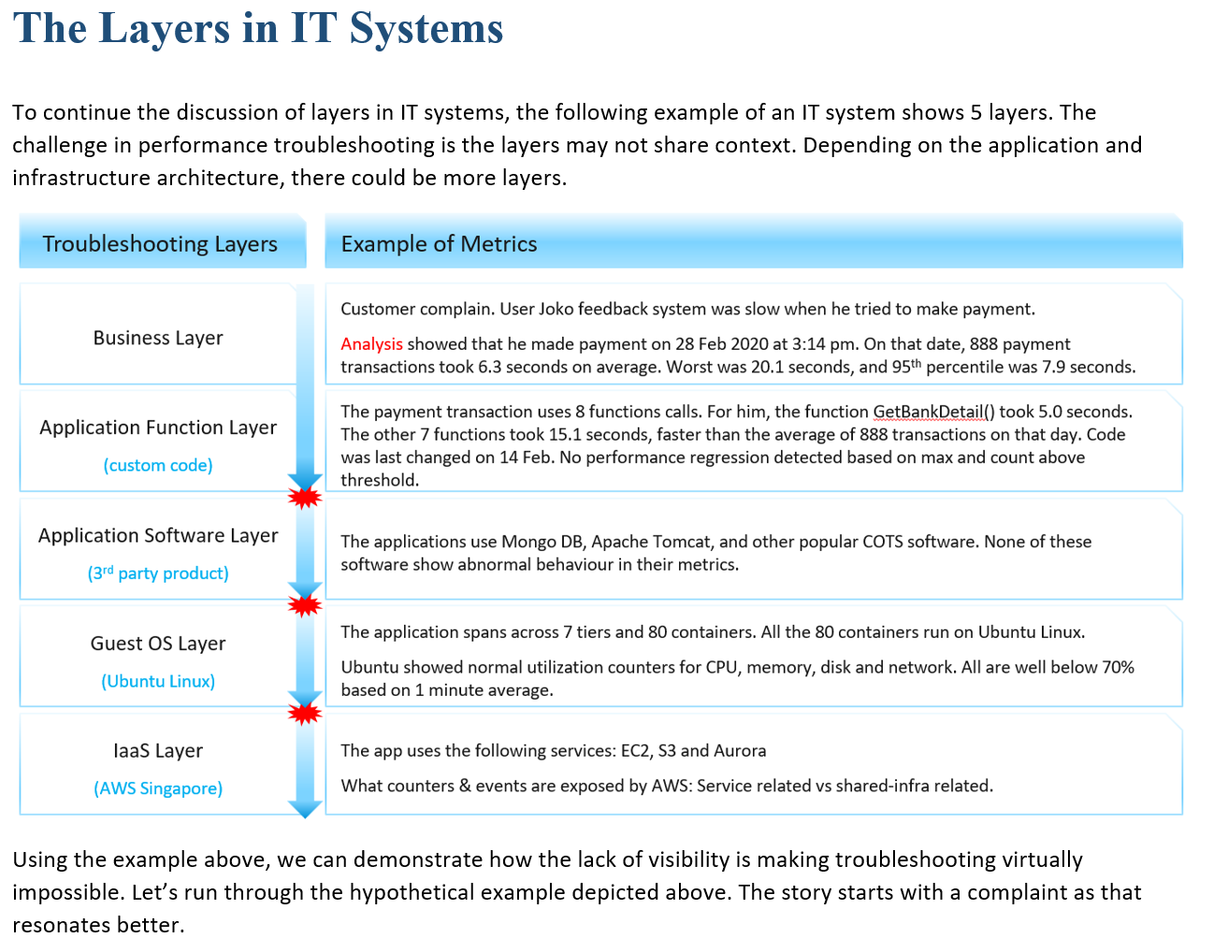
Alert: Remediation
RCA requires deep expertise as context is lost, even with Function Tracing
RCA today is largely an exercise of elimination. It is a process that requires human expertise on the architecture. For example, to troubleshoot Tanzu, you need to know K8 + vSphere + Tanzu specific implementation.
Lower layer or stack does not carry information from upper stack. For example, ESXi SCSI commands can’t be traced to specific VM.
Notes:
Maybe one day we can have AI-assisted troubleshooting. I envisage the human expert “records” the steps. This becomes the training dataset

Slide 38
Alerts
New alerts in VCF Ops 5.2

Slide 39
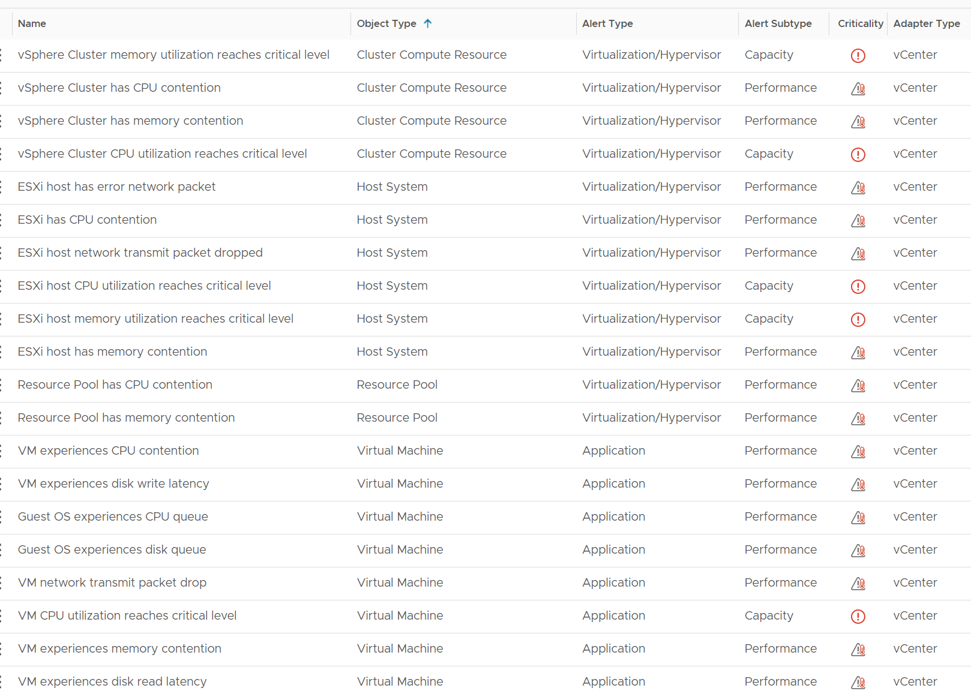
20 New Alerts
Notice they now sport a naming convention. It’s easier to read as they are shorter. It’s easier sport gap as they are consistent.
Alert Type and subtype are also fixed.
Capacity alert is only on Red as it’s a guard rail.

Slide 40
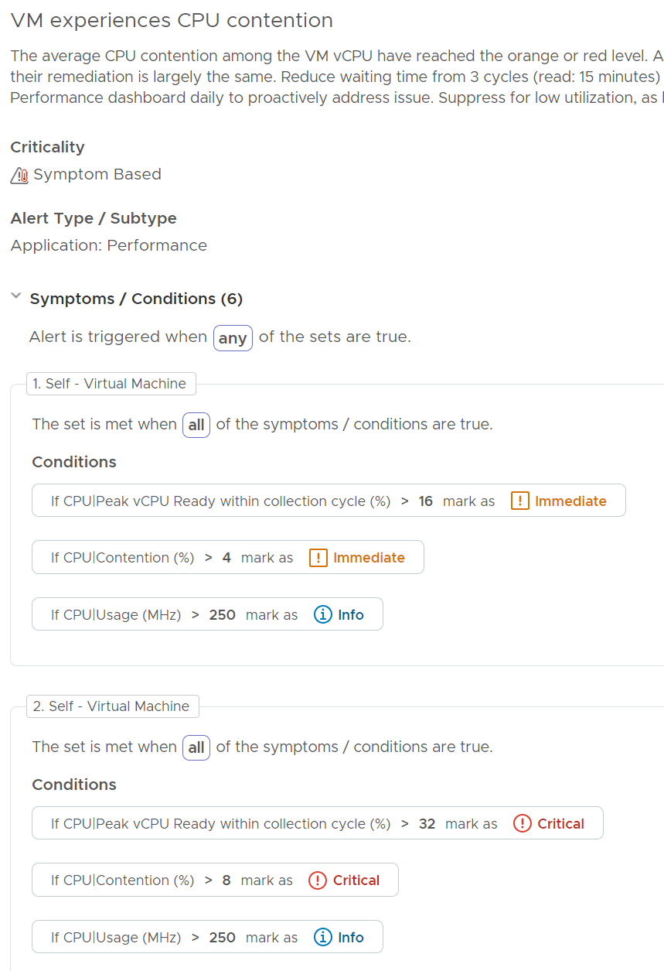
CPU Contention: VM
Enhancements
Instead of CPU Latency metric, it uses CPU Ready + CPU CoStop + Overlap + Other Wait.
Added CPU Usage to eliminate triggered alert when hardly anyone affected.
Add 20-sec peak to ensure problem is real. We use CPU Ready to eliminate false positive below.
Reduced noise. No yellow.
Limitation:
bug on vSphere 7.0 U2 onwards impacting Other Wait metric in certain corner case. No workaround at ESXi level. We added CPU Ready as an AND condition to eliminate this.
Notes:
Old alerts are deprecated as they use volatile metrics

Slide 41
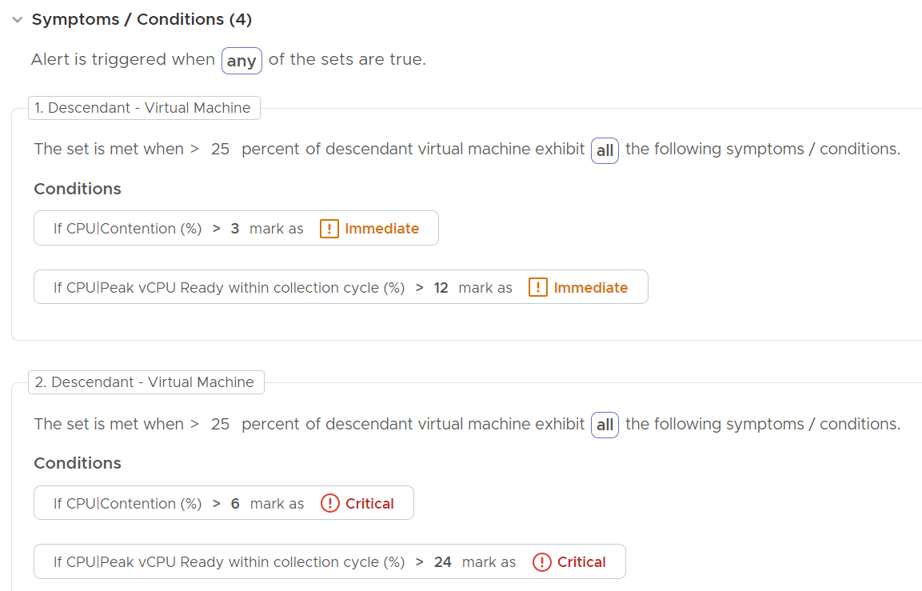
CPU Contention: Cluster | ESXi | Resource Pool
Design for the new alert
Cluster and ESXi
The symptoms use lower threshold than the one on VM as you do not want to wait until 25% of the VM population reach the problem.
Resource Pool
The symptoms use the same threshold as VM as it generally has less VM than ESXi. If that’s not the case for your environment, adjust to match ESXi.
Enhancement over previous release
Measured at VM, not ESXi.
We disable yellow. Only orange and red level.
We add 20-sec to tighten the condition, reducing the false positive
Notes:
Enhancements over previous version:

Slide 42
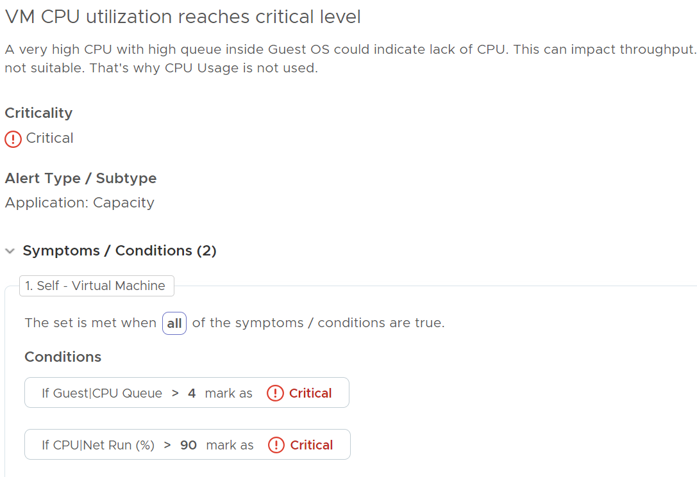
CPU Utilization: VM
VM CPU Utilization alert
Enhancements
Previous alert is based on CPU Usage > 100%. This results in noise as Usage goes up easily due to power management. The new alert uses the Net Run (%) metric.
Added Guest OS CPU Queue to ensure that there is actual bottleneck, as opposed to running optimally. This should result in a more meaningful alert.
Customization Tips:
If you need to catch those heavy hitters VM, use a dashboard. Create a View List and take 90th percentile of CPU Usage (GHz) in the last 1 month. See the storage heavy hitter or network top talker as example.

Slide 43
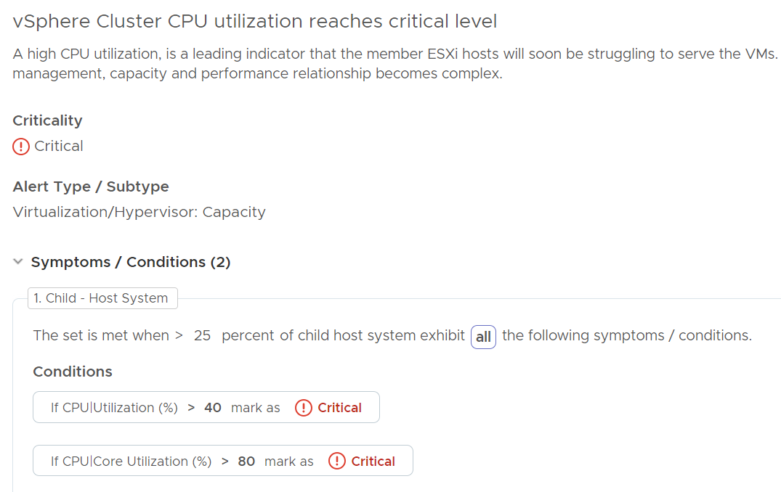
CPU Utilization: ESXi Host | Cluster
Design for the new alert
Enhancements
Previous alert used CPU Workload (%) metric, which is based on Usage (%).
We have coverage at host level too, nost just cluster level. Previous alert was tracking imbalance at cluster level, hence unable to report which exact host. It was also mixing CPU and memory in 1 alert.
Cluster level checked is measured at host, not using average number at cluster level.
Focus is on capacity management, not performance. Space, not speed.

Slide 44
Memory Contention: VM
Complex relationship between Probable Cause and Recommendation
Probable Cause | Recommendation
Swapped to Host Cache | Check VM Configuration Limit Shares relative to other VM, not just its absolute amount. Ensure the share is proportional to the configured size. Tools working well. If not, ESXi can’t do balloon and go straight to swap & compress. Check VM Event vMotion if it’s taking much longer than 0.2s Check Infra (ESXi) Is ESXi utilization high? If cluster utilization is not high, could be caused by High VM – Host Affinity. ESXi Memory Latency (%). A sign of ESXi struggling is other VMs are affected too. High reservation. Unlike CPU, memory is a form of storage, hence it’s not transient. Check Infra (Resource Pool) VM under Resource Pool? If yes, check parent RP is not causing the shares or limit issue. This can be tricky large RP in cluster with many hosts as the RP metric is at cluster level, while you’re looking at 1 host only.
Compressed | Check the parent ESXi for high reservation. Unlike CPU, memory is a form of storage, hence it’s not transient.
Swapped
Shares | Check shares relative to other VM, not just its absolute amount. Ensure the share is proportional to the configured size.
Limit
vMotion
Unlike CPU, there is only 1 metric, which is memory latency. But…
There are many causes, and they in turn can be further caused by many things. For example, swapped or compressed could be due to shares, which in turn is due to ESXi high utilization or RP constraint.
As there are many: many relationship between cause and effect, it’s better we just list them.
Balloon is not a cause as it’s a Guest OS level metric. See the memory chapter.
We can’t distinguish how much each part contributes. For example, VM 001 has 51% memory contention. This could be due to
5 MB was limited Limit
1 MB was swapped
2 MB was compressed
Shares played a part
We do not know how many % are from each source, as the counter does not tell
Notes:
Existing 3 alerts are deprecated because:
Correlation between memory latency and the specific symptoms are not clear or could be wrong. It can't be proven also. It’s best not to state it as it could be misleading.
In the case of Memory Limit, it’s just one of the factors causing contention. There are other factors, such as high usage on parent ESXi and VM share, and it’s impossible to see which one actually caused the problem.

Slide 45
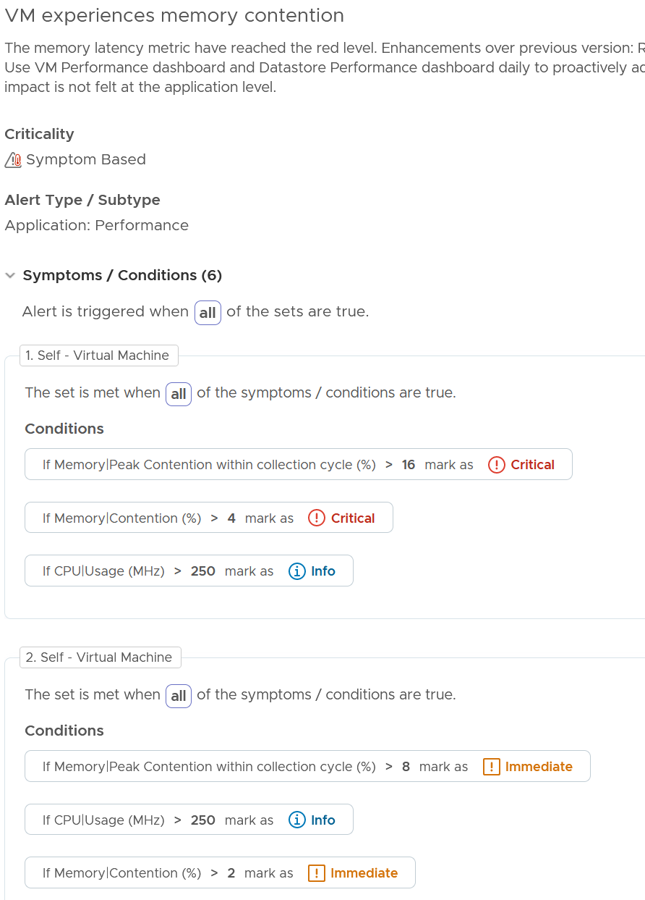
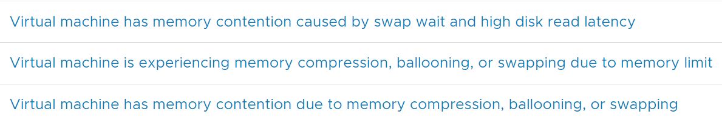
Memory Contention: VM
Design for the new alert
Enhancement over existing 3 alerts
Reduce waiting time from 3 cycles (read: 15 minutes) to 1 for faster reaction.
Reduce noise by not having yellow.
Add 20-sec peak to ensure there is indeed a real slowness.
Added condition to eliminate low utilization.
Memory Latency is more complete than CPU Swap Wait metric.
Remove Balloon metric, disk latency metric, Tools running status. They have weak correlation with latency
The 3 Old Alerts:
Notes:
[e1: why 250

Slide 46
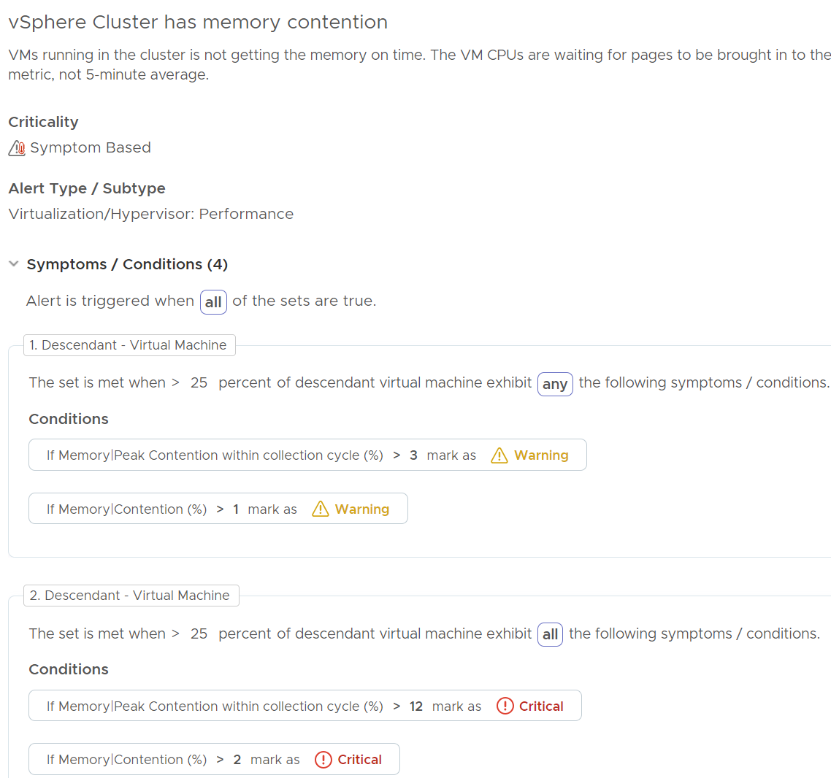
Memory Contention: ESXi | Cluster
Design for the new alert
Enhancements:
Add 20-second peak to ensure there is a high spike.
Reduce noise by using both 20-second and 5-minute
Better coverage as all other conditions have been removed.
Simplified. 2 instead of 10.
Reduce noise by not having yellow. Use daily SOP dashboard to proactively prevent.

Slide 47
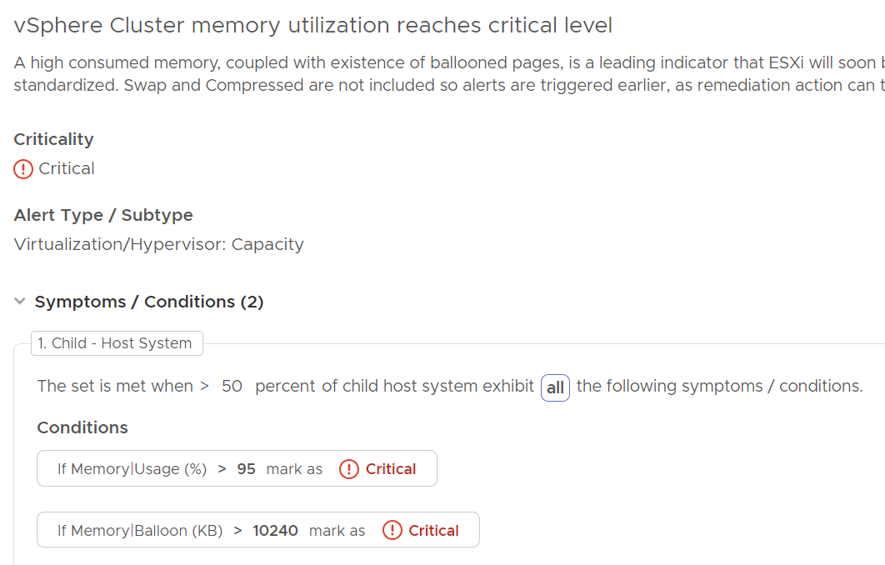
Memory Utilization: ESXi | Cluster
Design for the new alert, reflecting the nature of memory as cache
It’s set at 50% of host members as clusters are mostly <20 hosts, and memory functions as cache.
Enhancement:
Use Usage (%) instead of Workload (%)
Only has Critical. Remove Orange and yellow as memory functions as cache
Add Balloon to ensure the host is under memory pressure
Remove dependency on DRS
Alert at a single ESXi Host has the same condition for ease of operations.
Notes:
It’s mostly cache. So, whatever you give, it will be consumed over time. No need to alert unless performance is affected (e.g., paging becomes excessive).

Slide 48
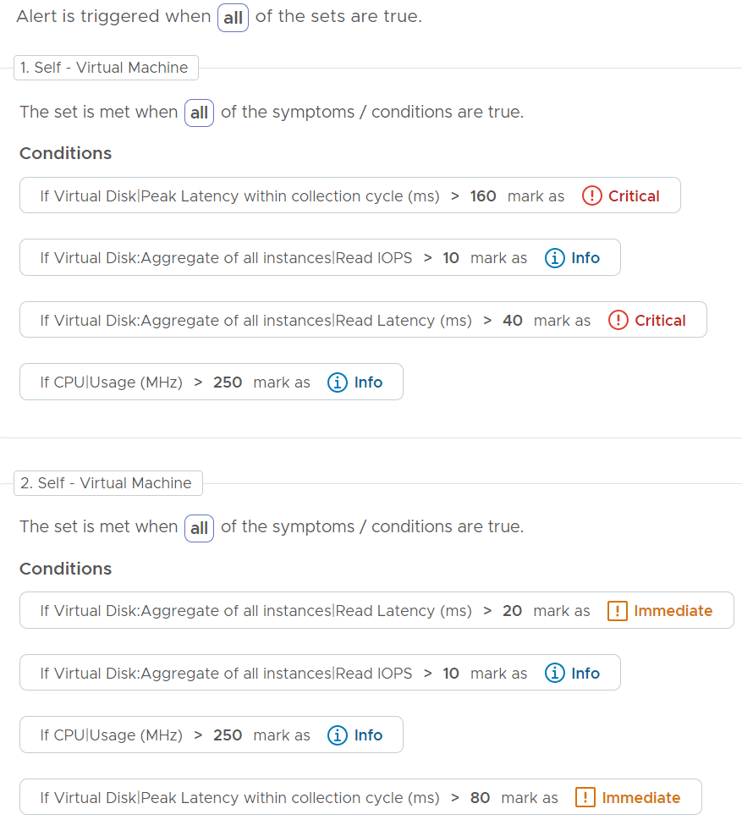
Disk Latency: VM
1 alert for read, 1 alert for write
Enhancements over previous version:
Reduce waiting time from 3 cycles (read: 15 minutes) to 1 for faster reaction.
Add 20-second metric to reduce false positive.
Remove yellow. Use VM Performance dashboard and Datastore Performance dashboard daily to proactively address storage issue.
Rename the alert. Remove the word high as its unclear if it maps to red or orange or yellow.
Suppress for low utilization, as likely the impact is not felt at the application level. Threshold used is Total IOPS > 5 (this means total 1500 IOs since we measure in 5 minutes)

Slide 49
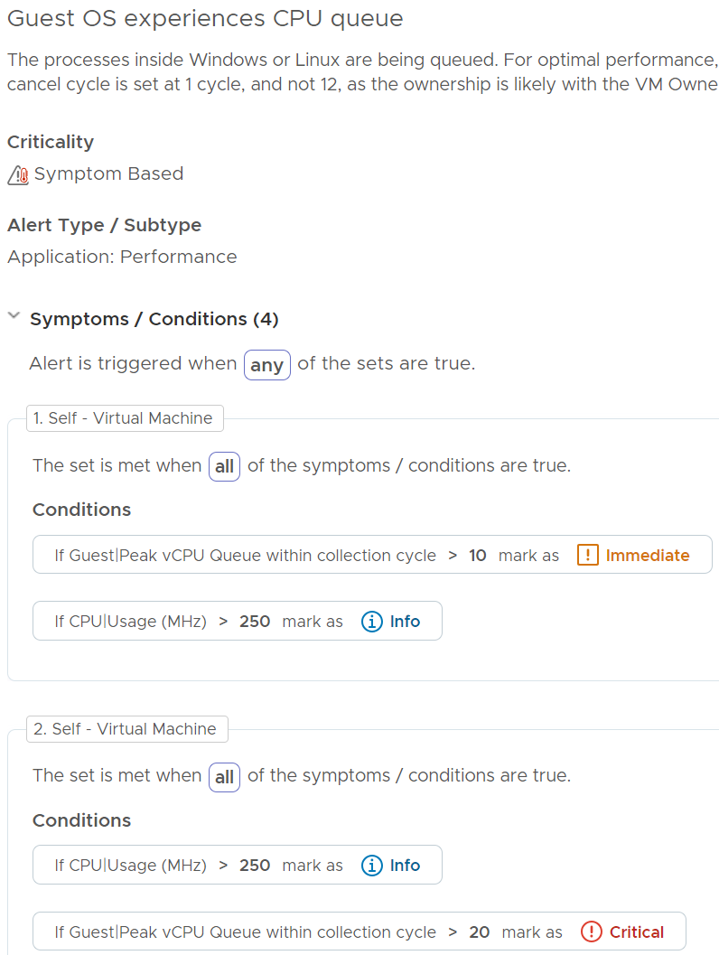
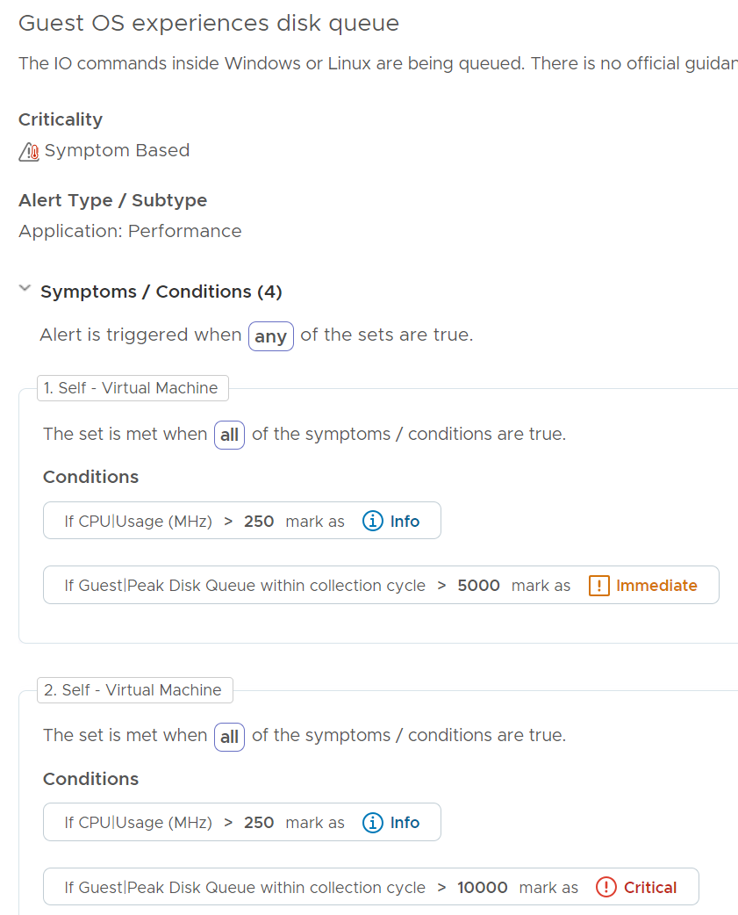
Guest OS
Covering issue within Windows or Linux OS
Note there is no yellow. Proactively tackle non-urgent issue using dashboard.
These alerts are suitable for self-service as it’s not related to the shared IaaS.

Slide 50
vSphere Dashboards
Design Consideration behind the suite of dashboards
Inventory
What do I have where? Is the inventory movement & volatility matching expectation of the day?
VM
vSphere Compute
vSphere Storage
vSphere Network
In addition to these dashboards, you have:
1 dashboard for Proactive Daily Check. This is the main dashboard you review each morning to avoid alerts of the day.
4 dashboards for NOC Screens. They complement the daily check by streaming live situation.
2 dashboards for IT Executives. For managers who need the summary, big picture information.
2 dashboards for baseline performance profiling. To be used every 1-2 quarters for comprehensive review.
Cost & Price dashboards.
Configuration
Any important settings that are incorrect, inconsistent, outdated, or suboptimal?
VM
vSphere Cluster
ESXi Host
vSphere Storage
vSphere Network
Performance
Any VMs that is not being served as promised by our shared IaaS platform? What’s causing the issue?
VM
Top Talkers
Heavy Hitters
vSphere Compute
vSphere Storage
vSphere Network
Capacity
Are we utilizing our capacity well? How much can we reclaim? When must we buy additional capacity?
VM
Capacity
VM Rightsize
VM Reclaim
vSphere Compute
vSphere Storage
Availability
This is the foundation. If the system is down, you don’t have performance nor security problem.
VM
vSphere

Slide 51
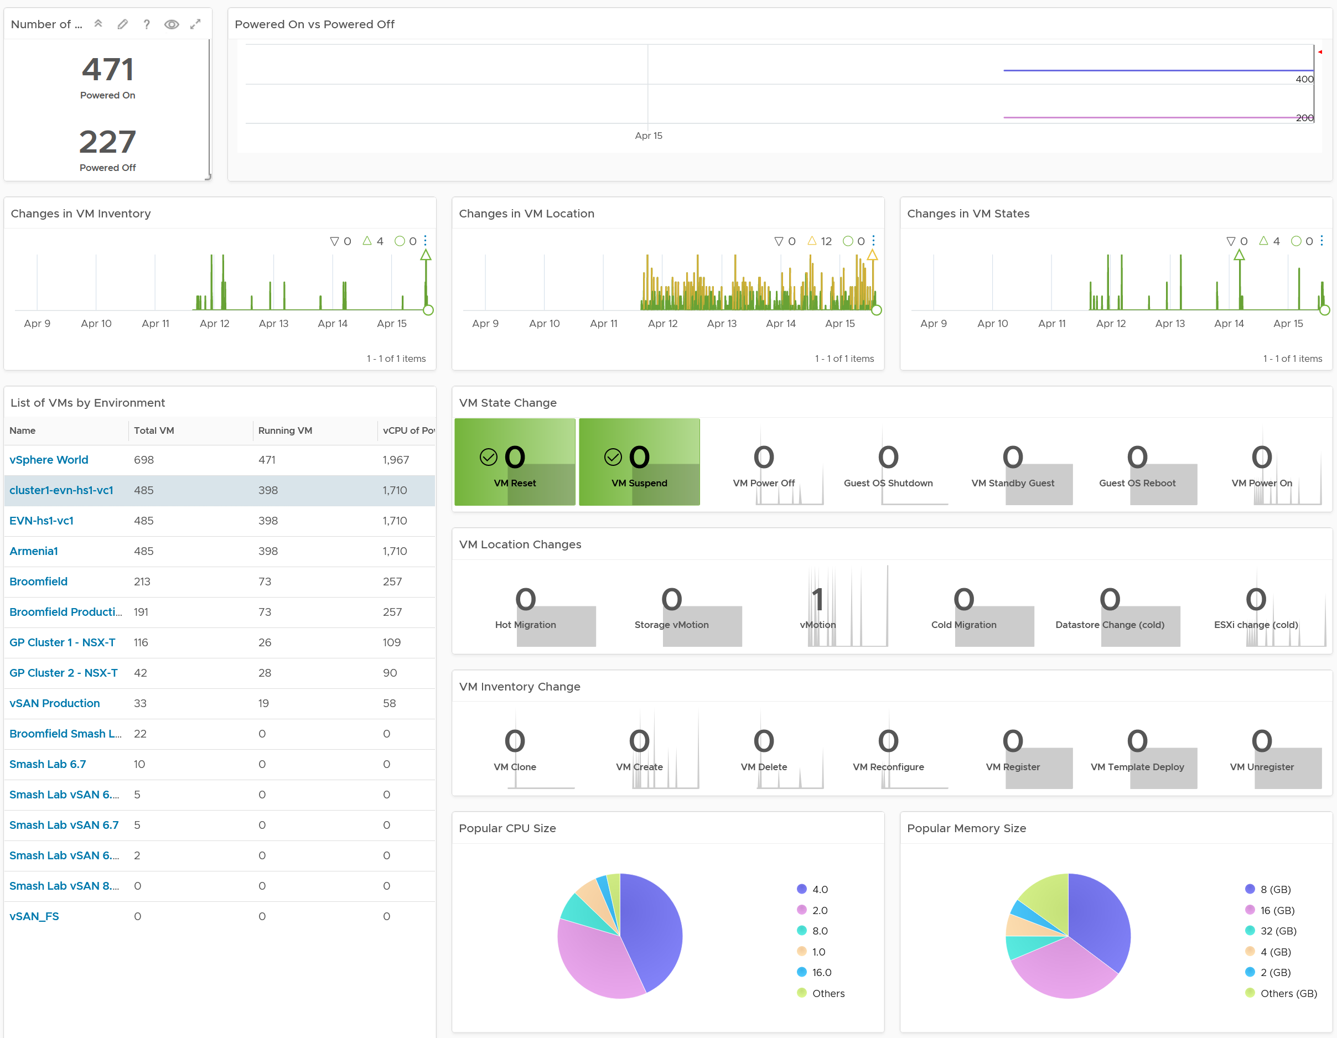
VM Inventory Dashboard
Cover 20 types of changes in inventory
Do we have the correct numbers of VM running?
Both the running VM and powered off VM should match expectation. Their trending should be inline with business cycles.
Too many VMs powered off is not a good thing. They pose both security risk and capacity risk.
Is the environment more volatile than expected?
High volatility increases chances of alerts.
There are 20 types of VM changes that can happen to a VM. They are grouped into 3 logical sets. For each set, the changes are shown in order of urgency, where the least desired changes are shown first.
Each of the 20 changes are unique. Ensure they match the approved change requests and expected changes of that day.
State = VMs power state change. Abnormal change such as reset, suspend and power off are shown first.
Location = VMs are moved to another host or datastore. This can be hot or cold migration. Hot migration is shown first as they might impact performance.
Inventory = VMs are added or remove, hence impacting count of inventory.
VM Size Demographic
What are the popular sizes? Do you have many large VMs? Pay attention to those whose size exceeds a single CPU socket as it creates NUMA effect.

Slide 52
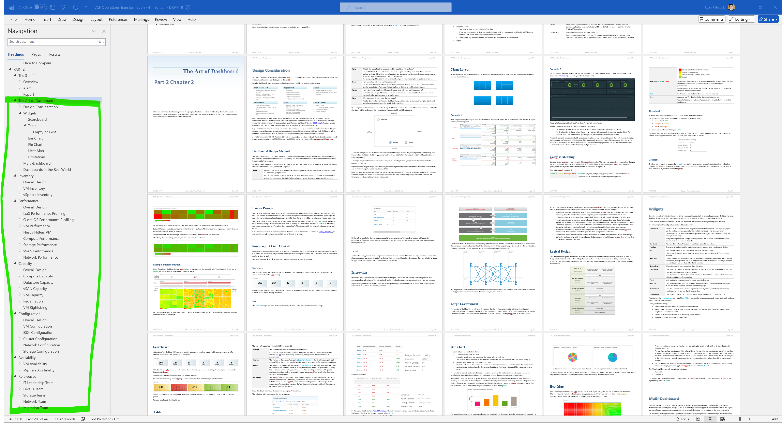

Slide 53

“VM” Infra KPI Counters
From Application Team viewpoint, VM and Guest OS are the same thing
CPU
RAM
Network
Disk
Inside Guest OS
(Linux, Windows)
Run Queue
Context Switch
Paging Rate (MB/s)
Committed %
OS Output Queue Length
Driver Queue
OS Queue
Driver Queue
Utilization
In Use
Modified + Standby
Throughput (bps, pps)
Latency
Latency
Outside Guest OS
(VM)
Run | Used
System + VMX + MKS
Zipped, Swapped, Swapped to Host Cache
Throughput (bps, pps)
IOPS.
Throughput (Large Block)
Ready + Co-Stop + Overlap
Other Wait + Swap Wait
Contention
TX Dropped Packet
Normalized Latency
Outstanding IO
Latency
Other performance counters:
vMotion stun time. Reported by Log Insight
NUMA migration Reported by ESXCLI
P-State & Xeon Hyper Thread effect. Reflected by Used, Usage, Demand
What counters are not included in the above? Why?
Why is utilization included?
Notes:
There are many counters that can impact a VM/GOS performance. Focus on contention, not utilization. I listed utilization here as data is averaged every 5 minutes. Within that 300 seconds, there can be short burst of contention which is not properly reported. Ideally, what we need in vR Ops is both the average and peak (1 second peak). So 1 is the average of 300 data points, while the peak captures the worst.
Can you notice what counters are missing?
VM Memory Balloon. This is an ESXi counter for utilization. While it’s charged to the VM, it does not mean the VM has memory performance, nor it is running out of capacity.
VM CPU Usage and Demand.
We will share what can be monitored with vR Ops and how you can combine/aggregate these counters into 1.
For OS Output Queue Length, in Windows it’s under PerfMon: Network Interface. Thanks Cameron Fore for the answer!

Slide 54
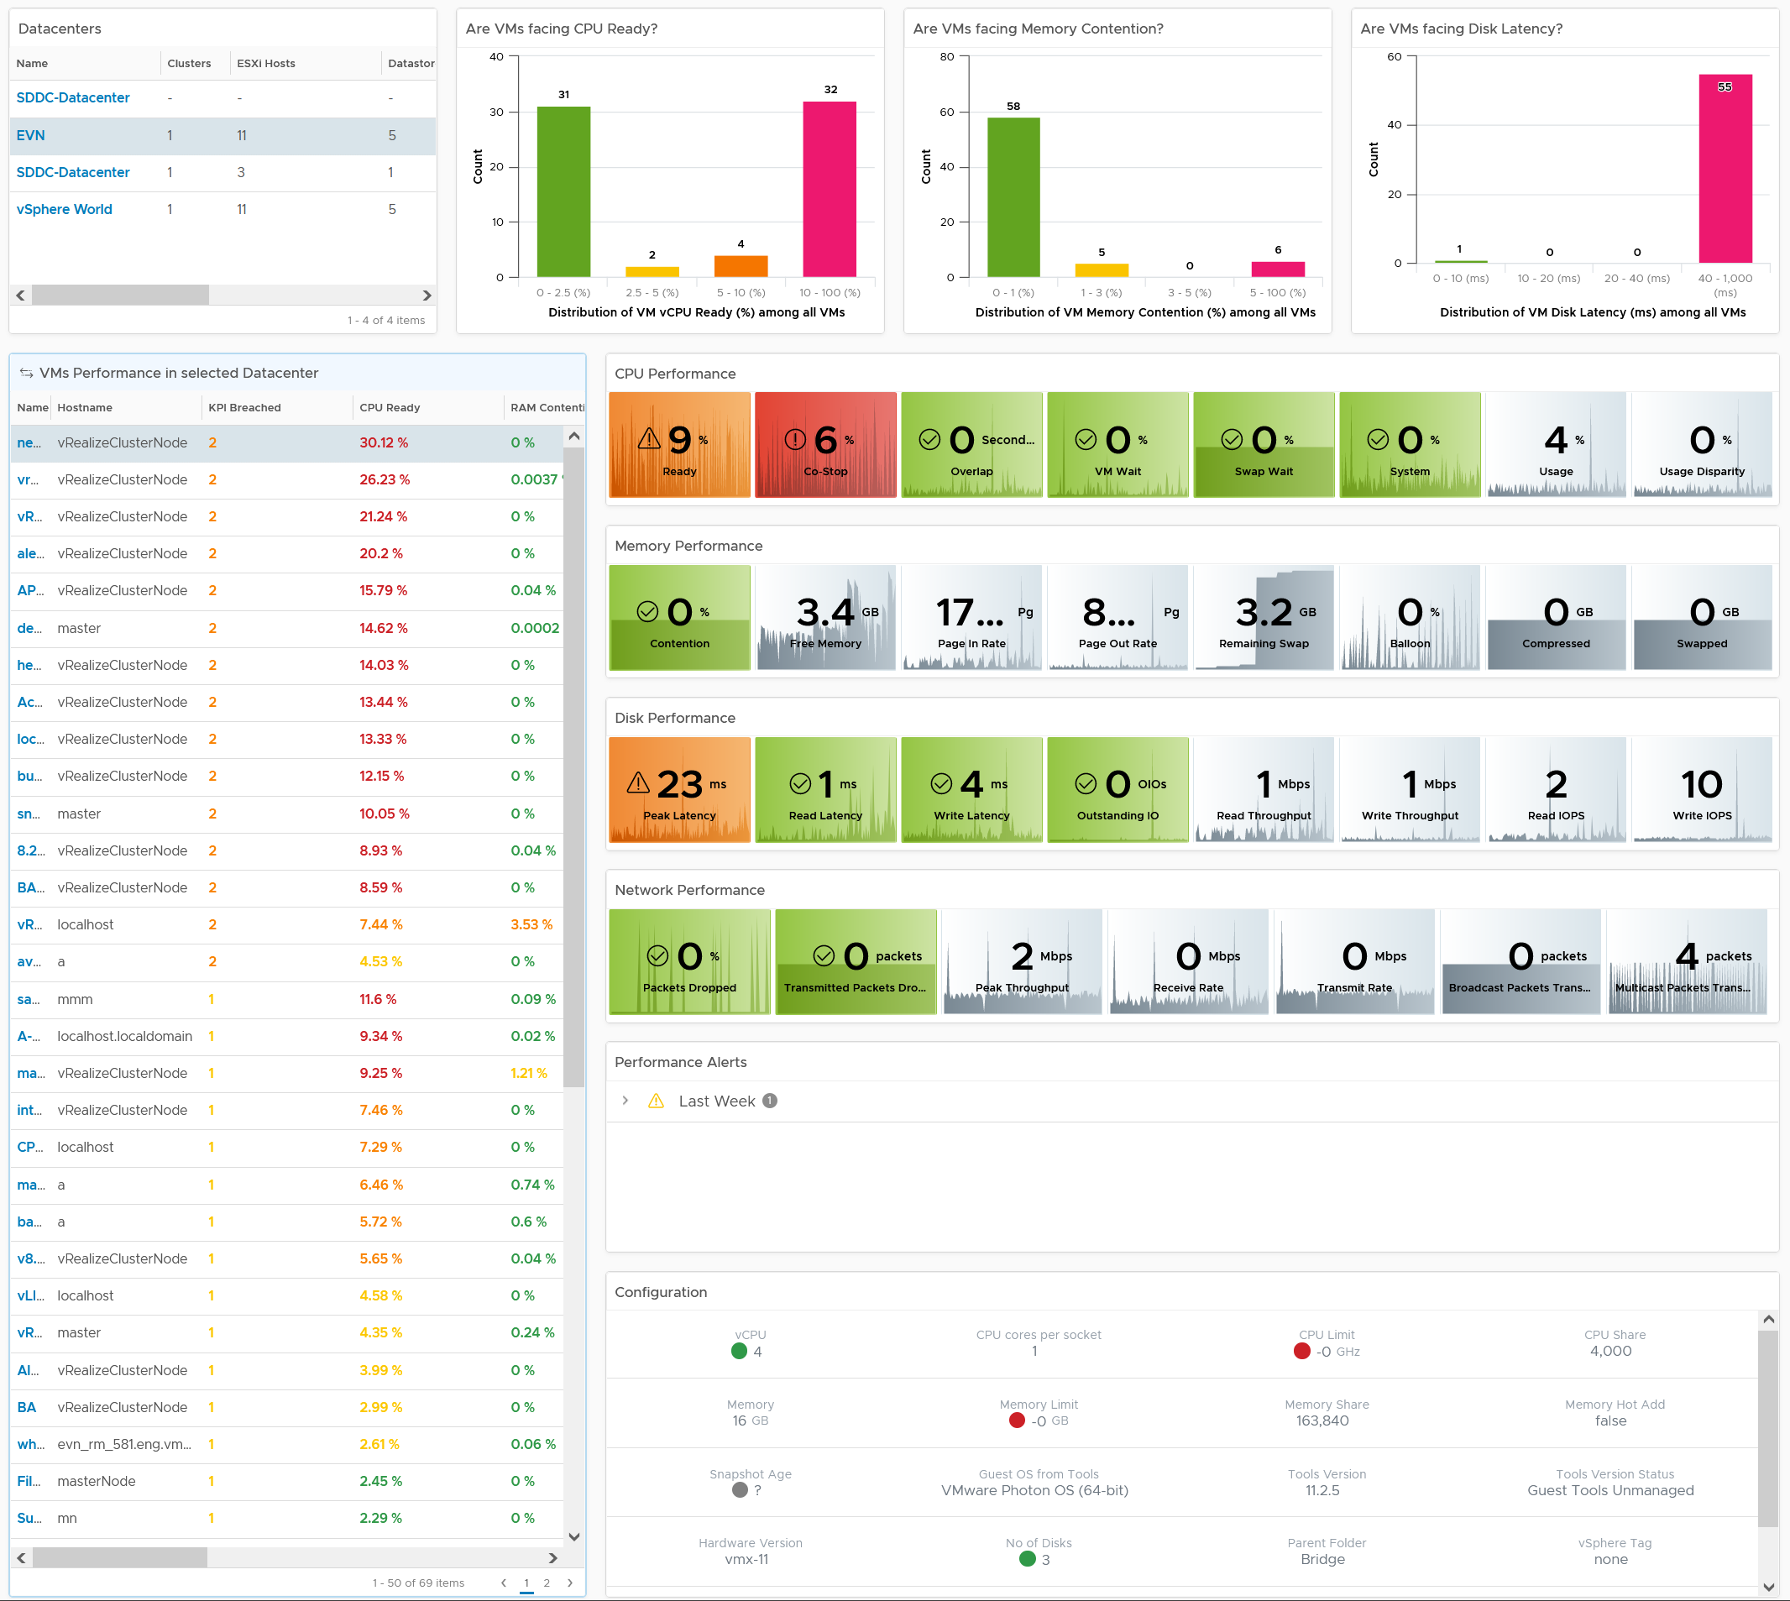
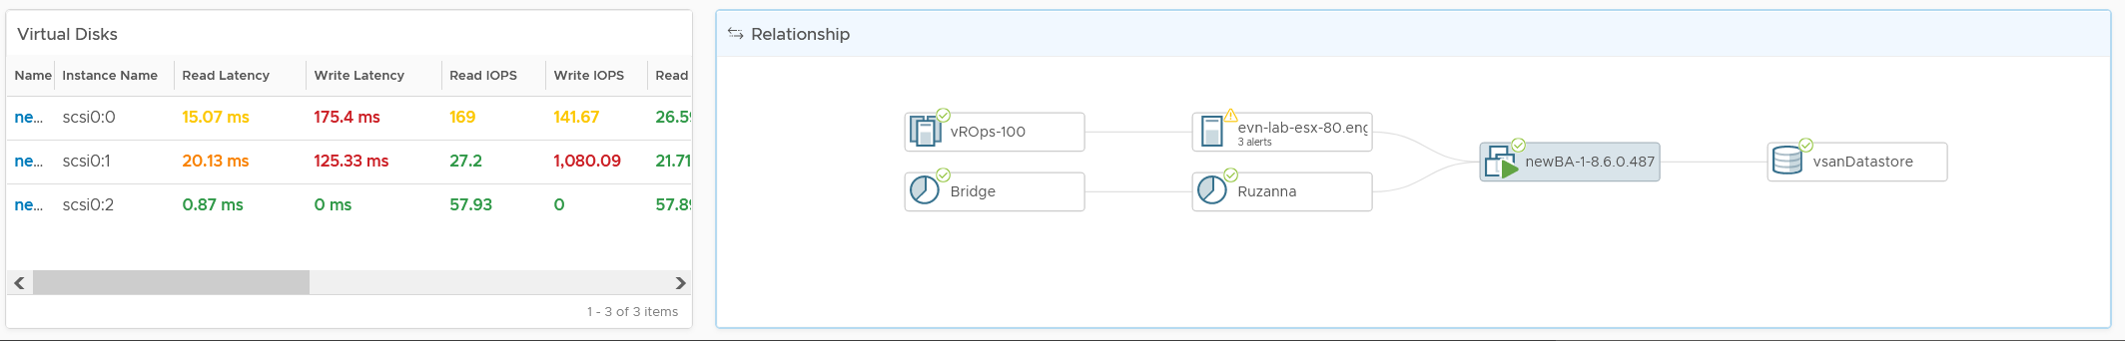
Overall Analysis
Quickly see the big picture
Pro Tip: add cluster for large environment
VM
Analyse many VMs.
Color coded. User configurable.
Sort | Filter | Export.
Choose any time period. Peak follows!
In-page Drill down. Context retain.
KPI Metrics.
Both Contention n Utilization
Guest OS and VM
Color coded.
vCPU and vDisk level, not just VM average
31 KPI Metrics
Relevant Alerts
Only Performance alert
Relevant Configuration
that impact performance
Virtual Disks
Drill down to Read & Write
Navigate to related object
Notes:
Summary
Bird-eye view
Clearly shows where the problem is
CPU | Memory | Disk | Network
Clearly show what the problem is
Read or Write?
Received or Transmit?
Contention caused by high utilization?
Detail
No need to figure out what metrics to choose!
Dashboard Time
Relevant alerts
Relevant configuration
Is it caused by underlying infra?
Can drill up to cluster, host, vSAN and datastore

Slide 55
Performance vs Capacity
Context: IaaS
Focus at…
Relevant Time
Counter
Availability SLA
Utilization
IaaS Performance
Each VM. How the IaaS serves its VMs, hence it’s using VM-level metrics
1 second – 5 minutes
Contention. Utilization is for preventation and troubleshooting, not monitoring.
Does not take into account as it’s not relevant
Based on raw capacity. Usable Performance
IaaS Capacity
The IaaS. Capacity exist at Infra layer. VM Capacity Management is merely right sizing
1 month – 1 year
Utilization. Drive it to the max, while ensuring there is no contention.
Takes into account. Tier 1 is in fact Availability-driven.
Based on usable. Usable Capacity vs Total Capacity
Notes:
Point of the slide: 2 sides of the same coin. Related but not the same.
Reference in the book:
Part 1 Chapter 2 Performance: read the Performance vs Capacity section

Slide 56
2 Dimensions of Performance
How Deep vs How Broad
How severe is the problem?
What’s the worst that happens to a single VM.
Once you know this, the next logical question is below.
How widespread is the problem?
How many VMs are affected?
The answer impacts the course of troubleshooting. Is it isolated incident or widespread?
Isolated → look at the affected VM more closely
Widespread → look at common area (e.g. cluster, datastore, resource pool, host)
 | Metric | Green | Yellow | Orange | Red
How Broad? | % VM with CPU Ready >1% | <2.5% | < 5 | < 10 | > 10
 | % VM with RAM Contention >1% | 0% | < 2.5 | < 5 | > 5
 | % VM with Disk Latency >10 ms | 0% | < 2.5 | < 5 | > 5
How Deep? | Max VM CPU Ready | < 2.5% | < 5 | < 7.5 | > 7.5
 | Max VM RAM Contention | < 1% | < 3 | < 5 | > 5
 | Max VM Disk Latency | < 10 ms | < 20 | < 30 | > 30
Notes:
Point of the slide: using 2 dimensions make it easier than 1.
Reference in the book:
Part 1 Chapter 2 Performance: read the “Breadth vs Depth” section

Slide 57
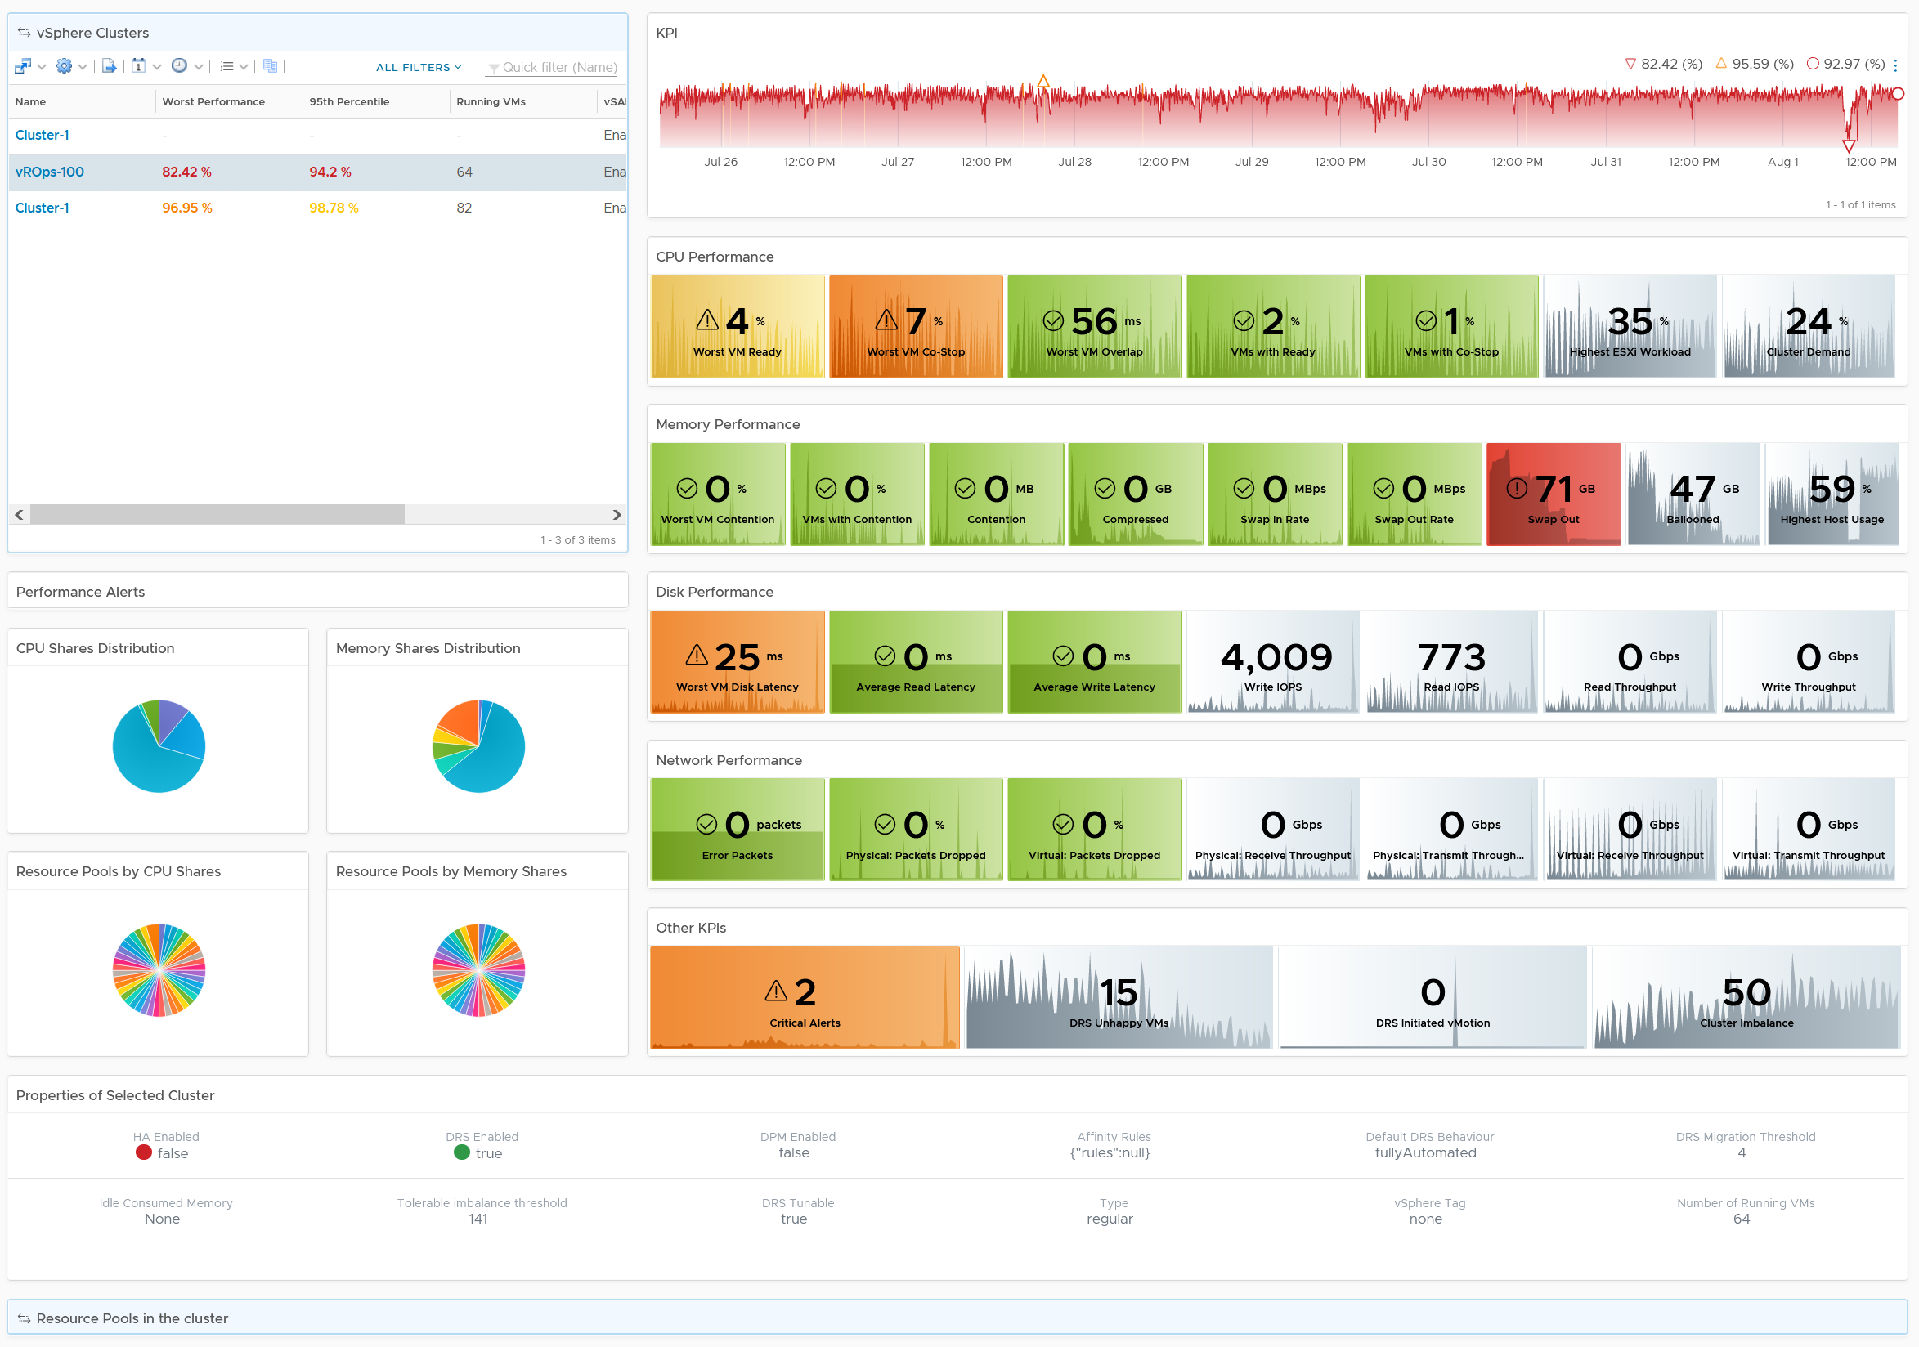
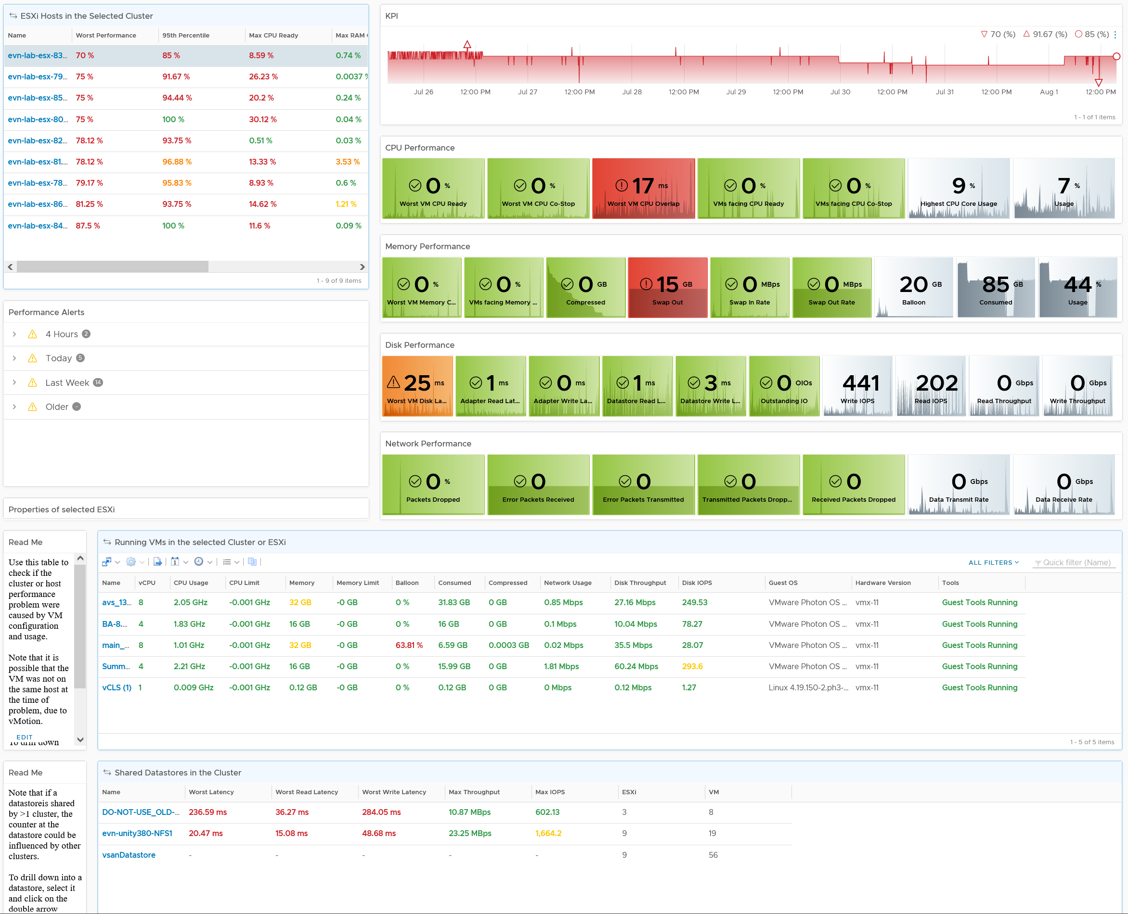
Level: Cluster
Clearly shows where the problem is
KPI line chart shows health trend over time
CPU | Memory | Disk | Network
Absolute value and Relative movement
Analyse
Many Clusters
KPI Metrics.
Contention
Utilization
Cluster
Alerts
Shares
Resource Pool
Relevant
Configuration
Level: ESXi
Analyse
Many ESXi
KPI Metrics.
Contention
Utilization
Alerts
Configuration
Analyse
Many VMs
Level: VM
Datastore
Analyse
Many Datastores
Notes:
Clearly show what the problem is
Read or Write?
Received or Transmit?
Contention caused by high utilization?
Relevant alerts added.
Relevant configuration added
Drill down
Resource Pool is now added. It’s missing in 8.2
In-place drill down to ESXi. No need to context switch into another dashboard.
More with Less
Less dashboard but more info.
Optimized for larger monitor
Great excuse to get that 4K monitor. E1 uses 43” and he recommends one. You’re welcome.

Slide 58
Relative Performance Analysis
Quantifyin the complaints
If the application team are….
Happy ☺
Unhappy ☹
Mixed ☺ ☹
Profiling is a proactive exercise to ensure performance is maintained as your environment grow or change.
Profiling prevents infrastructure from being blamed for application-level changes. For example, if your database size grow, it can slow down the application.
Establish the SLA while everyone is still happy.
If it’s unclear if the issue is due to IaaS or not, then the profiling quantifies the complaints so they can be measured.
It shows how bad the situation is, and how much improvement is needed. This can help in justifying additional capacity or tech refresh.
It might prove the blame on infrastructure is not right, if the counters are good.
It also reveals the full picture as it analyses the entire VMware environment, not just the VM with complaints.
Some are happy and while others are not.
In large environment with many VM Owners, it’s common to see different owners have different threshold. A 10% CPU Ready may be acceptable for Owner A yet a 2.5% CPU Ready causes Owner B to be upset, even though both VMs are in the same class of service.
Profiling brings up these facts to facilitate discussion to get everyone agree on the same SLA, because it’s a shared platform.

Slide 59
2 levels of Profiling
Guest OS and IaaS are 2 different realms, hardly aware of each other.
Windows/Linux involves discussion with application team.
Metric Types
Operations Management
Business Application
Business metrics
Performance & Capacity
VM
VM
App Contention
App Performance
Guest OS
Container
Service
App Utilization
App Capacity
Container Contention
Container Performance
Container Utilization
Container Capacity
Guest OS Contention
Guest OS Performance
Guest OS Profiling
Guest OS Utilization
Guest OS Capacity
VM Contention
VM Performance
Compute Virtualization
VM Utilization
VM Capacity
IaaS Profiling
Supporting Layers
ESXi Contention
ESXi Performance
Storage Virtualization
Network Virtualization
ESXi Utilization
ESXi Capacity
Physical Resource
Contention metrics
Performance
Utilization metrics
Capacity
Notes:
High utilization does not compromise performance, so long there is no Q.
If Q = 0, then utilization at 100% is in fact maximum performance. If we can’t measure Q, then put buffer (90% utilization)

Slide 60
Why 2 types of Profiling?
1 for consumer, 1 for provider
Business Application
Business Performance
Owned by respective App Team
VM
VM
App Contention
Guest OS
Service
App Utilization
Guest OS Contention
Individual VM optimization
Guest OS Utilization
VM Contention
VM Utilization
Infrastructure optimization
ESXi & Datastores
ESXi Contention
ESXi Utilization
vSAN, NSX & Physical infrastructure
vSAN & NSX metrics
Secondary Metrics
Hardware metrics

Slide 61
Proactive Operations require the environment to be “healthy”
Profile to establish acceptable baseline
Relative Performance
Socialize (Change Management)
Class of Service
Absolute Performance
Result
KPI
SLA
Performance Optimization
Architecture Review
Capacity Optimization
Using VCF + related tech best practice (e.g. MS Windows, physical networking)
Tech Refresh
Notes:
Enterprise IT always has class of services. Production and development are typically given different treatment. Within production, not all business applications are of equal importance. Find out all these differences and begin defining the class of services. A single vSphere cluster and a single datastore should only belong to a single class of service.
Relative performance means it’s based on complaint. Many complaints do not have exact measurements at infrastructure, and concrete evidence on the root cause.
Absolute performance is based on actual measurements over a comprehensive set of metrics across all objects. It’s typical to have millions of data points.
1 - 3 months of data needed. 26298 data points per quarter
Review the architecture if it supports the class of service. If not, you need to align them. For example, you may need to redesign cluster, datastore and move VMs to the correct resource provider.
If the complaints are not valid, the actual performance is well within expectation and matches industry best practice, and the SDDC architecture suits the IaaS business goals, then you can go ahead and define the KPIs and SLA. This becomes the baseline.
You have 3 inputs to consider to form a realistic KPI
Complaints. Feeling.
Actual Performance. Fact.
Industry Best Practice. Proven guidelines. External view.
Performance optimization
Use tools such as Skyline, Health Analyzer, Log Insight and Aria Operations.
KPI
There are 2 parts: VM and IaaS.
Use the VM KPI (%) metrics. If you do not own OS, then exclude OS level metrics.
Use 99.9th percentile as SLA is typically 99.9% or higher.
Cover last 1 - 3 months.
To prove for a specific VM, simply plot the VM KPI (%) over time.
The KPI is designed for proactive operations, hence it contains utilization metric.
Change Management is crucial as there are multiple parties.
Infra Senior Management
Application Teams
Slide to explain to senior IT Management on why you’re doing the exercise.
This is a long process..., as you’re actually dealing with VMs, not just infrastructure
Compare with original condition so you can demonstrate improvement

Slide 62
Going Forward to Proactive Operations
Assumption: the complaint is due to IaaS, and not Guest OS or Application
Relative Data | Absolute Data | Recommendation
Valid Complaint | Bad Performance | Adopt industry best practice. Review gaps between actual performance and industry best practice. Align design & configuration with performance best practice. If hardware is old, tech refresh to increase capacity and performance, while reducing cost.
Valid Complaint | Good Performance | If the performance issue is short lived, analyse further with 20-sec peak. If this is the cause, improve performance further. Discuss and quantify the required performance with application team. Use tech refresh but focus on performance, not capacity.
No Complaint | Bad Performance | Assess if there is a risk for future complaint. If yes, this is your window to improve. Ideally, align design & configuration with industry best practice. If hardware is old, tech refresh to increase capacity and performance, while reducing cost.
Align with Best Practice
Tech Refresh
Notes:
Good Performance = better than industry best practice.

Slide 63
Summary
How to summarize from millions of datapoints?
For each VM, analyze at least 1 quarter worth of data, to capture quarter-end run.
Worst Values
Each row is a VM.
3 months gives you 26,298 data points.
26.3 millions per 1000 VM.
99.9th percentile means eliminating the worst 29.8 data points per VM.
That means ignoring the worst 131 minutes of the 3 months period (covering maintenance, upgrade, exceptional activities)
Best Value in 3 months
99.9th Percentile value
Take the Worst
Take the Average
Analyse these 2 numbers
Notes:
If the average of the worst is higher then the worst of the 99th percentiles, that means you have a lot of one-time, 5 minute spike impacting many VM.
If

Slide 64
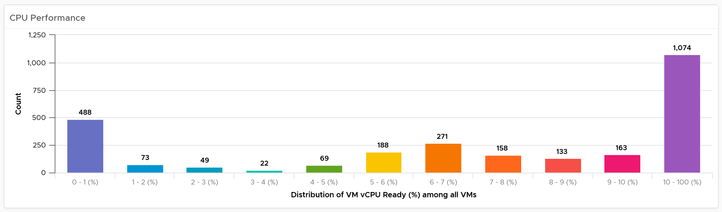
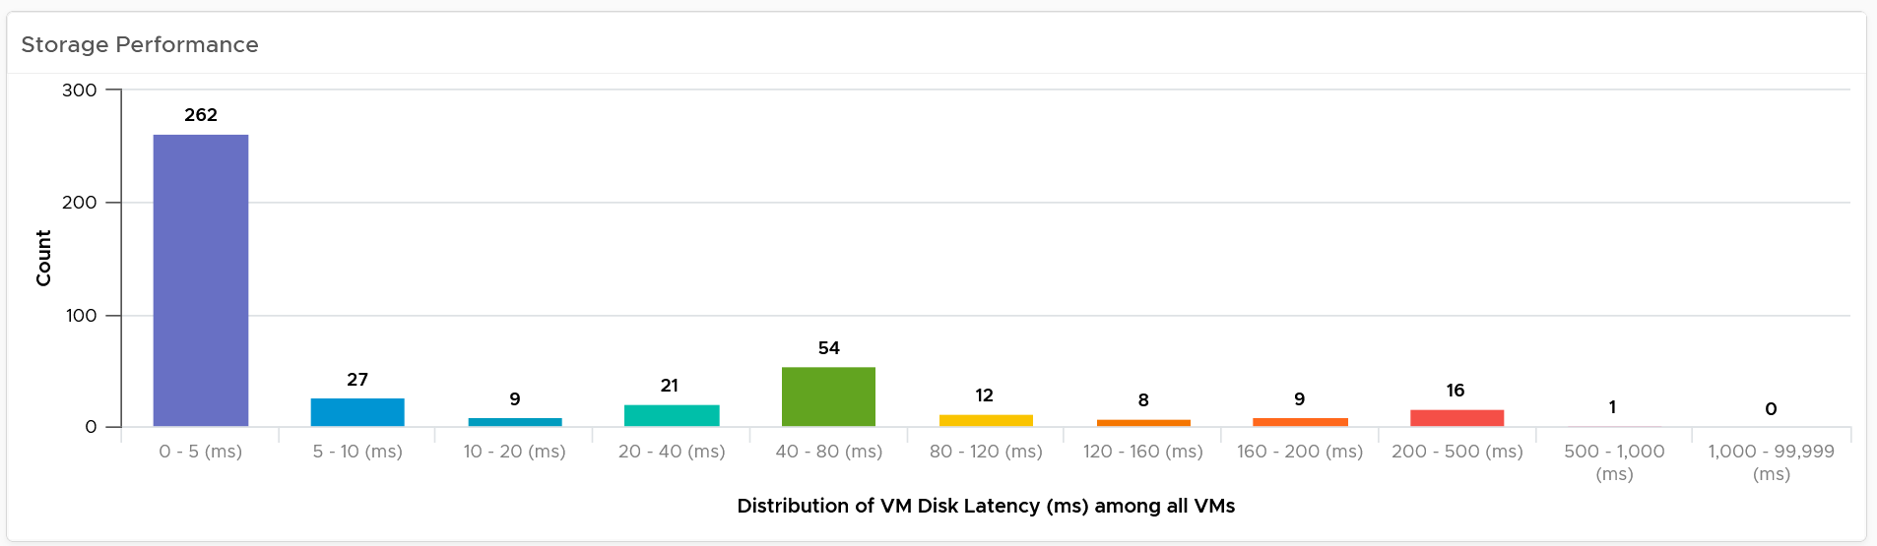
Distribution
Is the bad performance an outlier? Or you have 2-tier IaaS?
Table does not show the distribution among the values.
A distribution chart can tell if there is outlier (really bad value but rare) or you have real problem (plenty of bad values).
Expect your Gold clusters or datastore to outperform your bronze. All tiers should match your expectation, and ideally a bit better than your promise to your customers
Notes:
More on Performance Dashboard chapter.

Slide 65
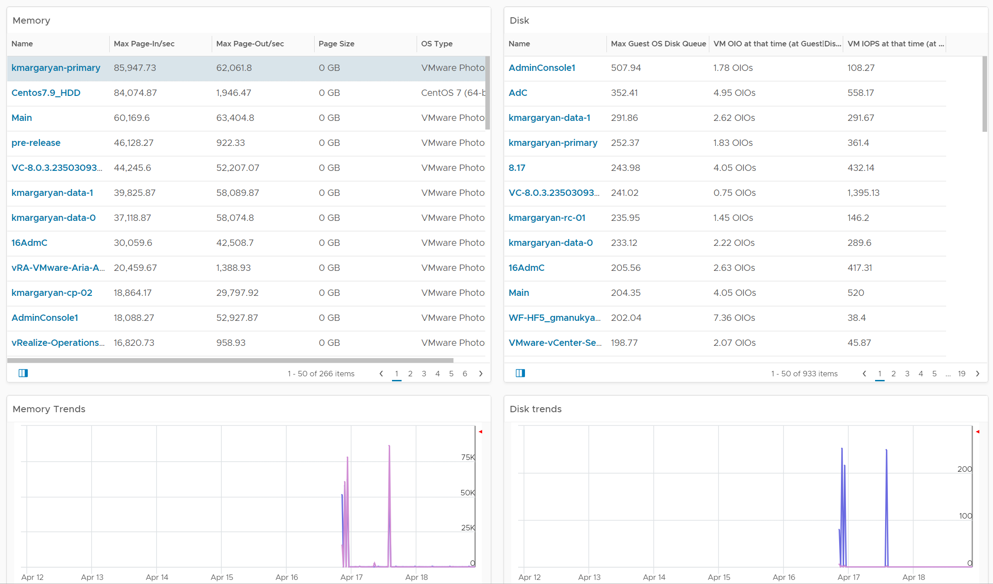
Guest OS Performance Profiling
Proactively check for KPI in Windows or Linux
Arm our VCF Admin with facts to discuss performance issue with application team.
Encourage VCF Admin to install VMware Tools, as data is provided by Tools (hence it’s agentless).
CPU check
CPU Queue, with corresponding CPU Run at the peak of CPU Queue. High queue not supported with high run indicates application creating excessive threads.
CPU Context Switch. This is an expensive operations as CPU cache has to be warmed up and instructions loaded/unloaded.
Memory check
Memory page-in vs memory page-out
Disk IO check
Disk queue, with corresponding Disk IOPS at the peak of the Queue
Notes:
More on Performance Dashboard chapter.

Slide 66
Reclamation
Start from the easiest
Non VM
Orphaned
Powered Off
Idle
Oversized
Unused?
ISO
VMDK
RDM
LUN
Disk
LUN
Power off first
Power off first
Power off first
CPU allocation only
CPU allocation only
CPU
Memory
Memory
Memory
Need a stoke-take process as owners may not reply to mass emails
Power them off first, as fall back just in case you there is misunderstanding between infra and app team
Notes:
Point of the slide: many areas of opportunities. So start with the easiest

Slide 67
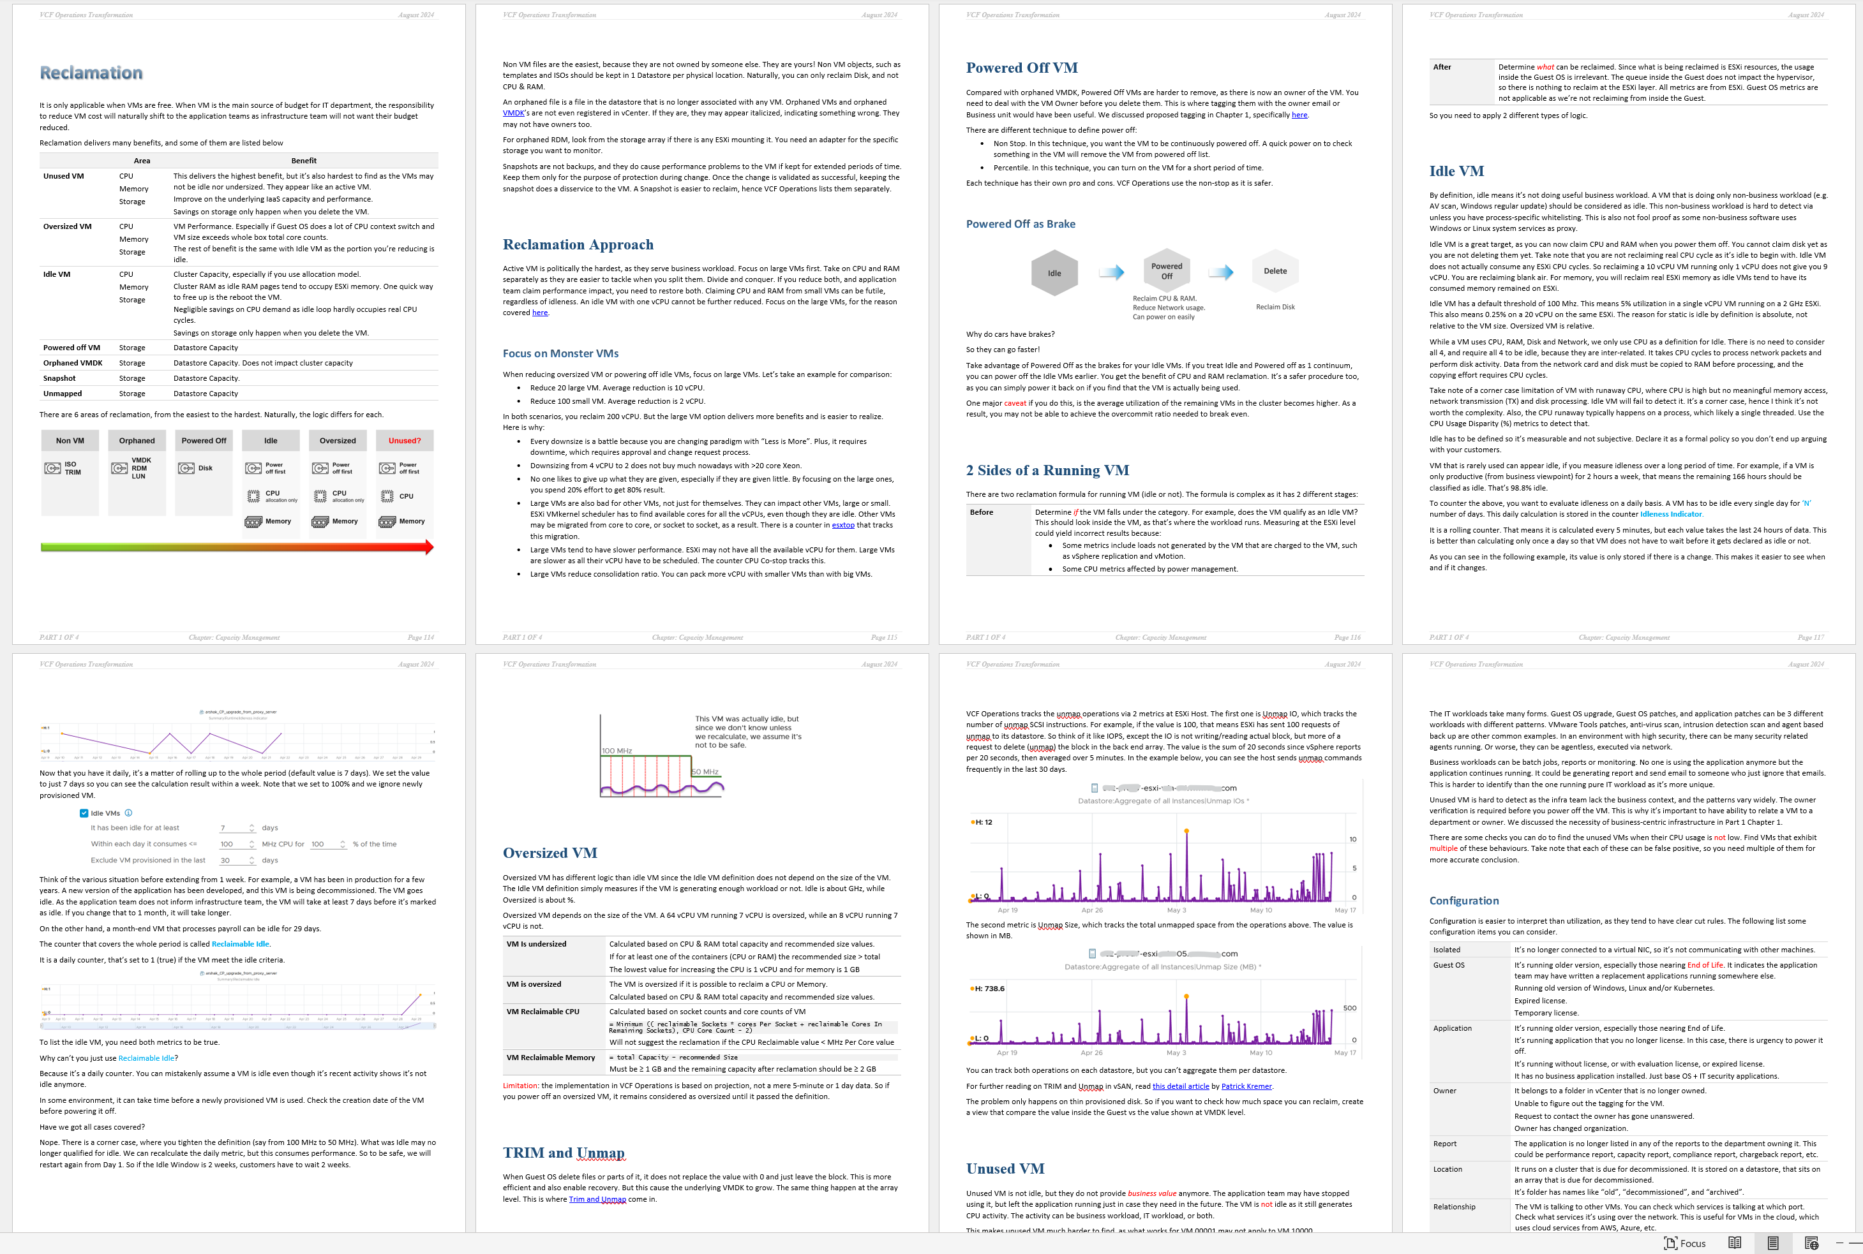

Slide 68
Metrics
See vSphere Metrics deck and book
Notes:
Leading the Industry, not just playing catch up

