Slide 1
Critical Applications
Infra-layer Observability for mission critical business applications
Iwan ‘e1’ Rahabok
VCF Division, VMware by Broadcom
July 2025
Notes:
An area where CIO cares is mission critical applications. By that we meant business application, not individual ISV products (e.g. MongoDB, Apache Tomcat).
Since they serve different business purpose, using different software, but run on the same IaaS, how do prove they are all performing well?
Iwan ‘e1’ Rahabok
e1@broadcom.com

Slide 2
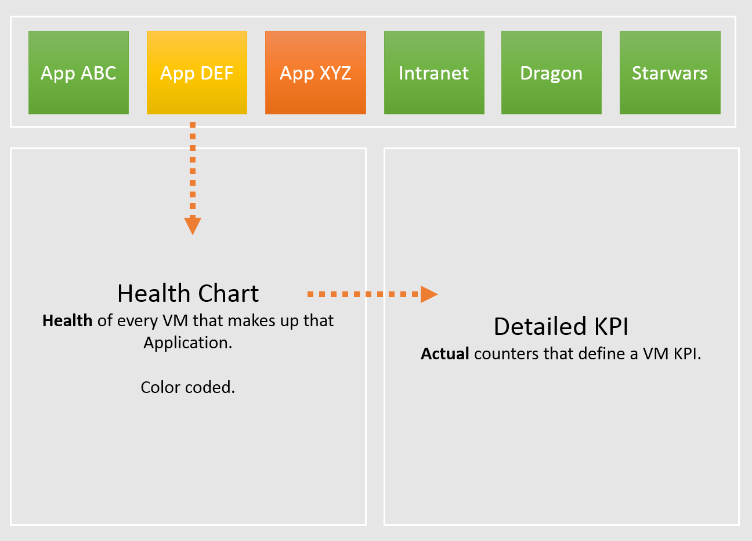
Dashboard: Overall Design
If business is affected, is it because of Infra? Be transparent and details
Mission Critical Business Systems.
Keep to Top 10 only. #11 is definitely less critical than #1, so focus on the top 10 first. Once settled then expand to more.
Do not include non-critical systems. While they have the same KPI, their score is lower hence they will drag down the company-wide score and “dominate” the screen as they will be more “yellow, orange, or even red”.
On the big screens.
For all System Owners to see everyone applications, not just their own. Transparency builds trust.
Color coded. Threshold based. Easy to see pattern.
Goes deep.
Drill down to actual raw counter.
Cover both contention & utilization.
Context of the business applications
Notes:
List of Tier 1 applications. Avoid listing all applications, as it will cluster the screen. Not all apps deserve to be on the front page, as the monitoring team will be overwhelmed.
For each business application, show their configuration, performance, capacity, inventory and availability

Slide 3
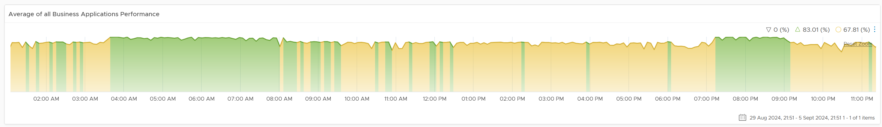
Dashboard Design
All of Mission Critical Applications, regardless of type (classic, modern, hybrid)
Business Application
Colored Trend Charts. Easier to see pattern or business cycle.
1 per Business Application. Keep to Top 10 most strategic system to the business.
0 – 100% for ease of interpretation
Create using VCF Operations Business Application object.
A large biz app with legacy components can include K8 and non K8 architecture.
Application Tier
Colored Trend Charts. Easier to see pattern of each tier.
Group of VM.
Map a tier to a vCenter VM Folder.
VM
Colored Trend Charts. Easier to see pattern of each tier.
Group of VM.
Map a tier to a vCenter VM Folder.
Windows | Linux
2 separate dashboards
K8 Namespace
Colored Trend Charts. Easier to see pattern of each tier.
K8 Workload
Colored Trend Charts. Easier to see pattern of each tier.
K8 Pod
Colored Trend Charts. Easier to see pattern of each tier.
Container
Colored Trend Charts. Easier to see pattern of each tier.
Notes:
It supports 2 types:
Business Applications → K8 Namespace → Workload → K8 Pod → Container.
Business Applications → Application Tier → VM
Limitation:
* It does not yet support hybrid, where it has both
Since there are 2 end targets, the drill down need to branch out.
Further enhancements you can do:
Navigate to applications such as database.
Navigate to see context, such as underlying compute, storage, network infrastructure.
Enter expert troubleshooting mode.

Slide 4
The Super App
What if the business application is super large, with diverse footprints?
There are 3 generations of applications
Classic. 3-5 tier architecture.
SOA. Using Enterprise Service Bus.
Modern. Using micro services and K8.
Super App
In complex application, you may need to model it as super-app.
A super-app presents itself as 1 application to end users, but consist of multiple, independent business offerings.
E.g. A travel apps which offers flights, trains, hotels, car rental, tours. There are over-arching process connecting them, but users can choose just one of them. Within the Flight, it may consist of multiple business applications. More related, yet still independent with clear business boundaries.
Dashboard
A “parent” dashboard is required. It drills down into the business application dashboard.
A mega app like this has to be strategic to the top line, and deserves its own dashboard.
This is not yet developed. If you can’t build it let me know.
Super Biz App
(multiple business offerings to customers)
KPI = Average (Biz App Group)
Biz App Group 1
Biz App Group 2
Biz App Group 3
Biz App Group 4
KPI = Lowest of (Biz App in the Group)
Biz App 1
Biz App 2
Biz App 3
Biz App 4
KPI = Lowest of (Tiers)
K8 WL 1
K8 WL 2
K8 WL 3
Tier 1
KPI = Lowest of (K8 Workloads, VMs)
2 additional object types, above the Business Application:
Super App. This is basically a group of groups. Yes, 2 levels of logical grouping as the application spans diverse business offering.
Biz App Group. This is a group of business applications performing related similar business offering, yet different enough to require independent application architecture. Or it could be mixed of legacy applications from acquisition.
Notes:
Point of this slide: for a very large app with thousands of components and mix of classic & modern, best to create a dedicated dashboard. Similar to what we did for K8, you start with the common dashboard, then navigate away to it.
I recommend Source: https://www.oreilly.com/library/view/design-patterns-for/9781492090700/ch01.html for further reading
Biz App = Min (Tiers in the Biz App)
Tier = Average (VM)
Super Biz App = Average (Groups that form the huge Biz App)
Biz App Group = Min (Biz App that forms the group)

Slide 5
The 3 Realms
A story of 3 Teams. Each should ensure their own layers are healthy instead of meddling with others’ job
Layers
Sample Metrics
Business
Business Results
How much sales do we make today?
How many customers buy our products this week?
On average, how long did the XYZ transaction take this hour?
How many customers login yesterday?
On average, how long do they stay?
Handmade
Most common metric is Page Response Time
Business Transaction
Application
Individual Node
How long does SQL Query ABCD take in the past 7 days?
What’s SQL Server free memory value 1 hour ago?
What’s the overall application uptime?
Are my apps configured for performance?
Vertical
Metrics depends on each apps and its configuration
“The System”
IaaS
Windows | Linux
What’s Windows CPU Run Queue?
What’s the peak VM CPU Contention in the past 24 hours?
What’s the total IO hitting vSAN from 9 – 6 pm yesterday?
What’s the buffer in physical switch right now?
VM & Container
Horizontal
Common Metrics applicable for all apps
K8 & Virtual Infra
Physical Infra
Notes:
Point of the slide: There are 3 levels of observability. Focus on your own first, before meddling with other people territory. That’s why the lines separating are shown in red.
The upper layer is also harder to measure as they are mostly business metrics. What we can do as IT is page response time and error rate.
The second layer requires Telegraf agent and Log Insight agent.
Page Response Time is how many second the app or website respond to the user. Users don’t care what technology is used. When a user clicks a button on the mobile app or website, she expects the system to get back within seconds, not minutes.

Slide 6
Lack of Cross Stack Observability
Why Top-to-Down troubleshooting requires a lot of real-world battle experience
Vertical in Nature
Troubleshooting Layers
Example of Metrics
Business Layer
Customer complain. User Joko feedback system was slow when he tried to make payment.
Analysis showed that he made payment on 28 Feb 2020 at 3:14 pm. On that date, 888 payment transactions took 6.3 seconds on average. Worst was 20.1 seconds, and 95th percentile was 7.9 seconds.
Application Function Layer
(custom code)
The payment transaction uses 8 functions calls. For him, the function GetBankDetail() took 5.0 seconds. The other 7 functions took 15.1 seconds, faster than the average of 888 transactions on that day. Code was last changed on 14 Feb. No performance regression detected based on max and count above threshold.
Application Software Layer
(3rd party product)
The applications use Mongo DB, Apache Tomcat, and other popular COTS software. None of these software show abnormal behaviour in their metrics.
Guest OS Layer
(Ubuntu Linux)
The application spans across 7 tiers and 80 containers. All the 80 containers run on Ubuntu Linux.
Ubuntu showed normal utilization counters for CPU, memory, disk and network. All are well below 70% based on 1 minute average.
IaaS Layer
(AWS Singapore)
The app uses the following services: EC2, S3 and Aurora
What counters & events are exposed by AWS: Service related vs shared-infra related.
Horizontal in Nature
There is no context-passing when going down the stack.
In most cases, lower stack was not and should not be designed based on upper stack. Example: ESXi IO Blender effect
Notes:
Point of this slide: it’s a misperception that you can auto-magically root cause the performance issue in complex multi-layered, shared architecture. And we’re not even talking public cloud and K8.
Using the example above, we can demonstrate how the lack of visibility is making troubleshooting virtually impossible. Let’s run through the above. The story starts with a complaint as that resonates better.
At the Business Layer, you can see the performance of each business transaction. You not only know which user was affected, you know what transaction was affected as the metric has transaction ID. You can trace it in the code as you know how long each function calls take place, assuming you log for every single transaction.
The problem starts when you move beyond your code and into Commercial of the Shelves (COTS) software. The software may show that its queue is 10000, which is 5000 more than what the manual say it can handle. But you have no idea if user Joko transaction was in that queue or not. The COTS software metrics do not relate to users anymore, let alone individual transactions. The red explosive icon marks where context is lost.
Moving from application to infrastructure resulted in another loss of context. Windows or Linux has no idea what applications you’re running. As far as the OS is concern, every application is just a process. It will report basic CPU, Memory, Disk and Network utilization per process. More advanced metrics are reported at OS-level, system wide. For example, you do not know if your process was the one experienced network packet loss. The packet loss metric is a system-wide metric.
Moving from individual EC2 or VM to the shared infrastructure results in another loss of context. In the case of public cloud, you may not get visibility into the physical layers at all.

Slide 7
What you measure vs what you manage
You can’t manage what you cannot measure
Metric Types
Operations Management
Business Application
Business metrics
Performance & Capacity
VM
VM
App Contention
App Performance
Guest OS
Container
Service
App Utilization
App Capacity
High utilization does not compromise performance, so long there is no Q.
If Q = 0, then utilization at 100% is in fact maximum performance. If we can’t measure Q, then put buffer (90% utilization)
Container Contention
Container Performance
Container Utilization
Container Capacity
Guest OS Contention
Guest OS Performance
Guest OS Utilization
Guest OS Capacity
VM Contention
VM Performance
VM Utilization
VM Capacity
Compute Virtualization
ESXi Contention
ESXi Performance
Supporting Layers
ESXi Utilization
ESXi Capacity
Storage Virtualization
Network Virtualization
Contention metrics
Performance
Physical Resource
Utilization metrics
Capacity
Notes:
Point of this slide: be clear on what exactly needs to be measured. For each layer, determine the metrics
Service is a process or application running inside the Guest OS. Take MS SQL. It has utilization (e.g. SQL memory) and contention (e.g. query in the queue). SQL memory can be full, and that does not mean it has memory performance.
Guest OS Queue means the request aren’t even sent to the underlying VM. The hypervisor does not know that there is a demand, as it’s stuck in the Guest OS. Windows or Linux kernel has not processed it yet. As you can imagine, Guest OS queue directly impacts application performance.
CPU Run Queue means not enough CPU, so it’s capacity issue. Also, Queue should only happen when utilization is high. High Q on Low Utilization indicates unbalanced distribution. Adding more CPU won’t solve the unbalance.
Same thing with RAM. If there is plenty of free RAM, then paging should be low. If there is a lot of Paging but Free RAM is high, then it’s something wrong.
Guest OS Performance is not the same with VM Performance. Reason is not all loads may come down to the VM. Guest OS performance is impacted by queue inside the Guest.
Guest OS Capacity: right sizing
VM Capacity: snapshot, CPU system
Does high utilization impact VM performance? No
A VM does not become slower when going from 10% to 95%. We are not dealing with mechanical machine here. A VM can run at 100% all the time, so long the queue is low, it’s fine. In fact, that’s what you want!
VM Performance here covers Guest OS also. VM + Guest OS should be seen as 1, as Application team does not care. A VDI does not even care about the OS.
Example of Infra Contention: VMkernel Queue, ESXi physical NIC buffer overflow. Infra level contention that cannot be tied to specific VM.

Slide 8
Infra KPI for Multi-tier Application
1 metric per business application
Biz App KPI = Worst (App Tier Infra KPI, K8 Namespace)
The formula uses worst as a tier performance can impact the overall performance. The app may be classic architecture or modern cloud native.
Load balancer
Load balancer
Product Management
Payments
Web Server
Web Server
Web Server
Web Server
Pod 1
Pod N
Pod 1
Pod N
Shipping
Refund
Load balancer
Load balancer
App Server
App Server
App Server
App Server
Pod 1
Pod N
Pod 1
Pod N
Customers
Discount
DB Server
(Active)
DB Server
(Passive)
Pod 1
Pod N
Pod 1
Pod N
App Tier KPI = Average (VM Infra KPI)
Has to be average, else a single VM dominates entire business applications. In a large business system with many VM, using Worst could result in too many alerts (alerts fatigue)
K8 Namespace KPI (%)
K8 Workload KPI
K8 Pod KPI
Container KPI
Notes:
Point of this slide: the 2 type of application architecture have their own performance modelling.
The K8 app is more complex, hence the formula is not shown here. It will be covered later on.
Classic App:
An Application spans multiple VMs, and has multiple tiers. It might include physical servers. It might also include non-servers, e.g. Load Balancers.
An Applicaton spans multiple software and Guest OS.
An Application may use all styles of containment: physical server, VM, container and serverless.
An Application may span multiple physical location. It uses global load balancers.
LB can be physical, virtual, or a service.
Implementation at vR Ops: Each Tier should be a group or tag or Application Tier
Reference in the book:
Part 4 Chapter 4 Super Metrics.

Slide 9
Dashboards
Implementation on Aria Ops 8.18
Notes:
What this section cover:
How the 2 dashboards implement the requirements.
It does not cover the supporting dashboards and object summary page.

Slide 10
Overview
How the dashboards work together
Supporting Dashboards
Navigate manually. No context passing available.
MS Windows
Guest OS Profiling
Database set of dashboards
Mission Critical Business Application
VM Performance
2 separate dashboards due to difference in metrics between Windows and Linux.
Optional dashboard as it needs Telegraf agent on each VM
vSphere set of dashboards
Linux
K8 app requires navigating to K8 dashboard
See the backing vSphere VM of the selected K8 Node
K8 Application Performance
K8 set of dashboards + object summary page
Drill down as needed
Notes:
Point of this slide: there are 2 custom dashboards. The rest is existing dashboard and pages from Aria Ops 8.18

Slide 11
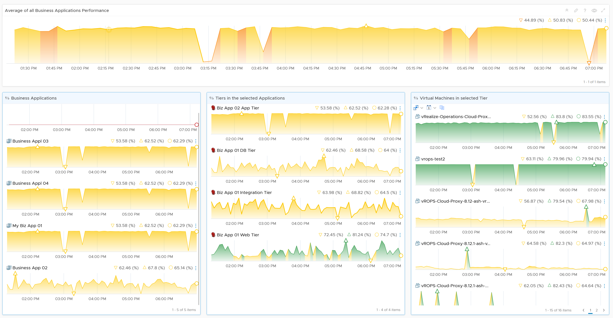
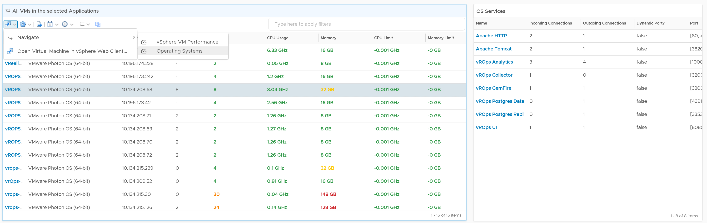
Average Performance of all Business Applications
As this has all your mission critlcal apps, it becomes your stock market index. Make sure it moves in line with your expectation. The larger or more matured the business applications are, the more stable this index should be.
4 Levels of drill down
All Biz App → 1 Biz App → Application Tier → VM.
VMs in the same tier should have similar performance, else your Load Balancer is not balancing based on load.
All are color coded and in percentage (0 – 100%)
4 equal range for ease of observation:
Green: 75 – 100%
Yellow: 50 – 75%
Orange: 25 – 50%
Red: 0 – 25%
Drill down to VM Performance dashboard, and further into Windows or Linux
VM and Guest OS details
List of VMs. Sortable to see which VMs are having the issue.
From a VM, see the processes (application) running.
Notes:
First custom dashboard

Slide 12
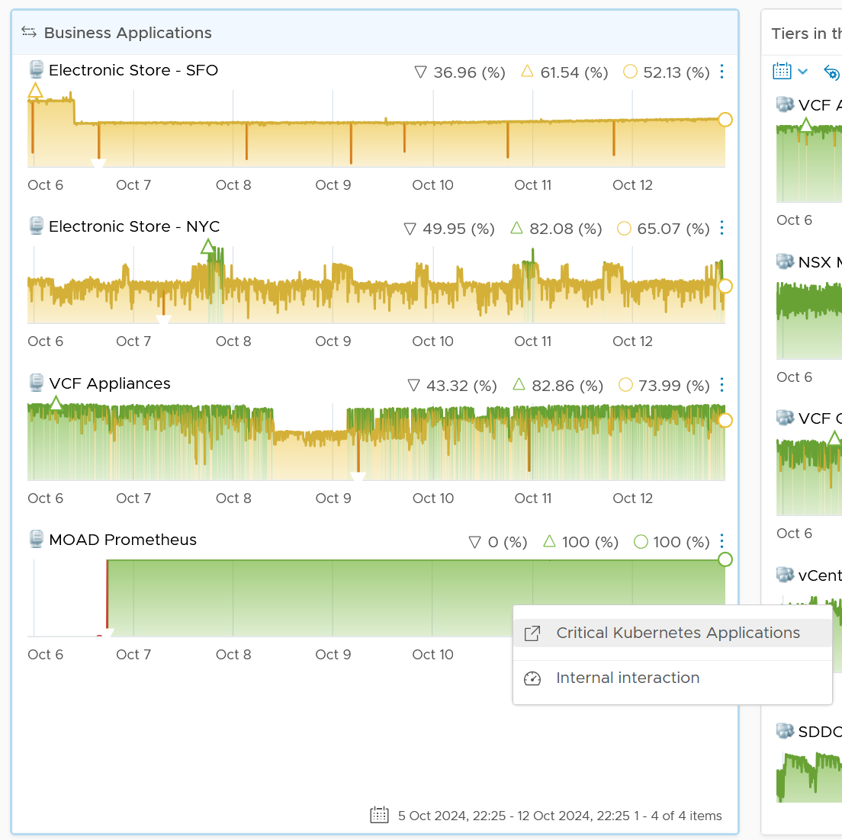
Navigating to K8 dashboard
This widget has filter to hide the dummy object.
From here, navigate to a purpose-built dashboard for K8
Notes:
The dashboard needs

Slide 13
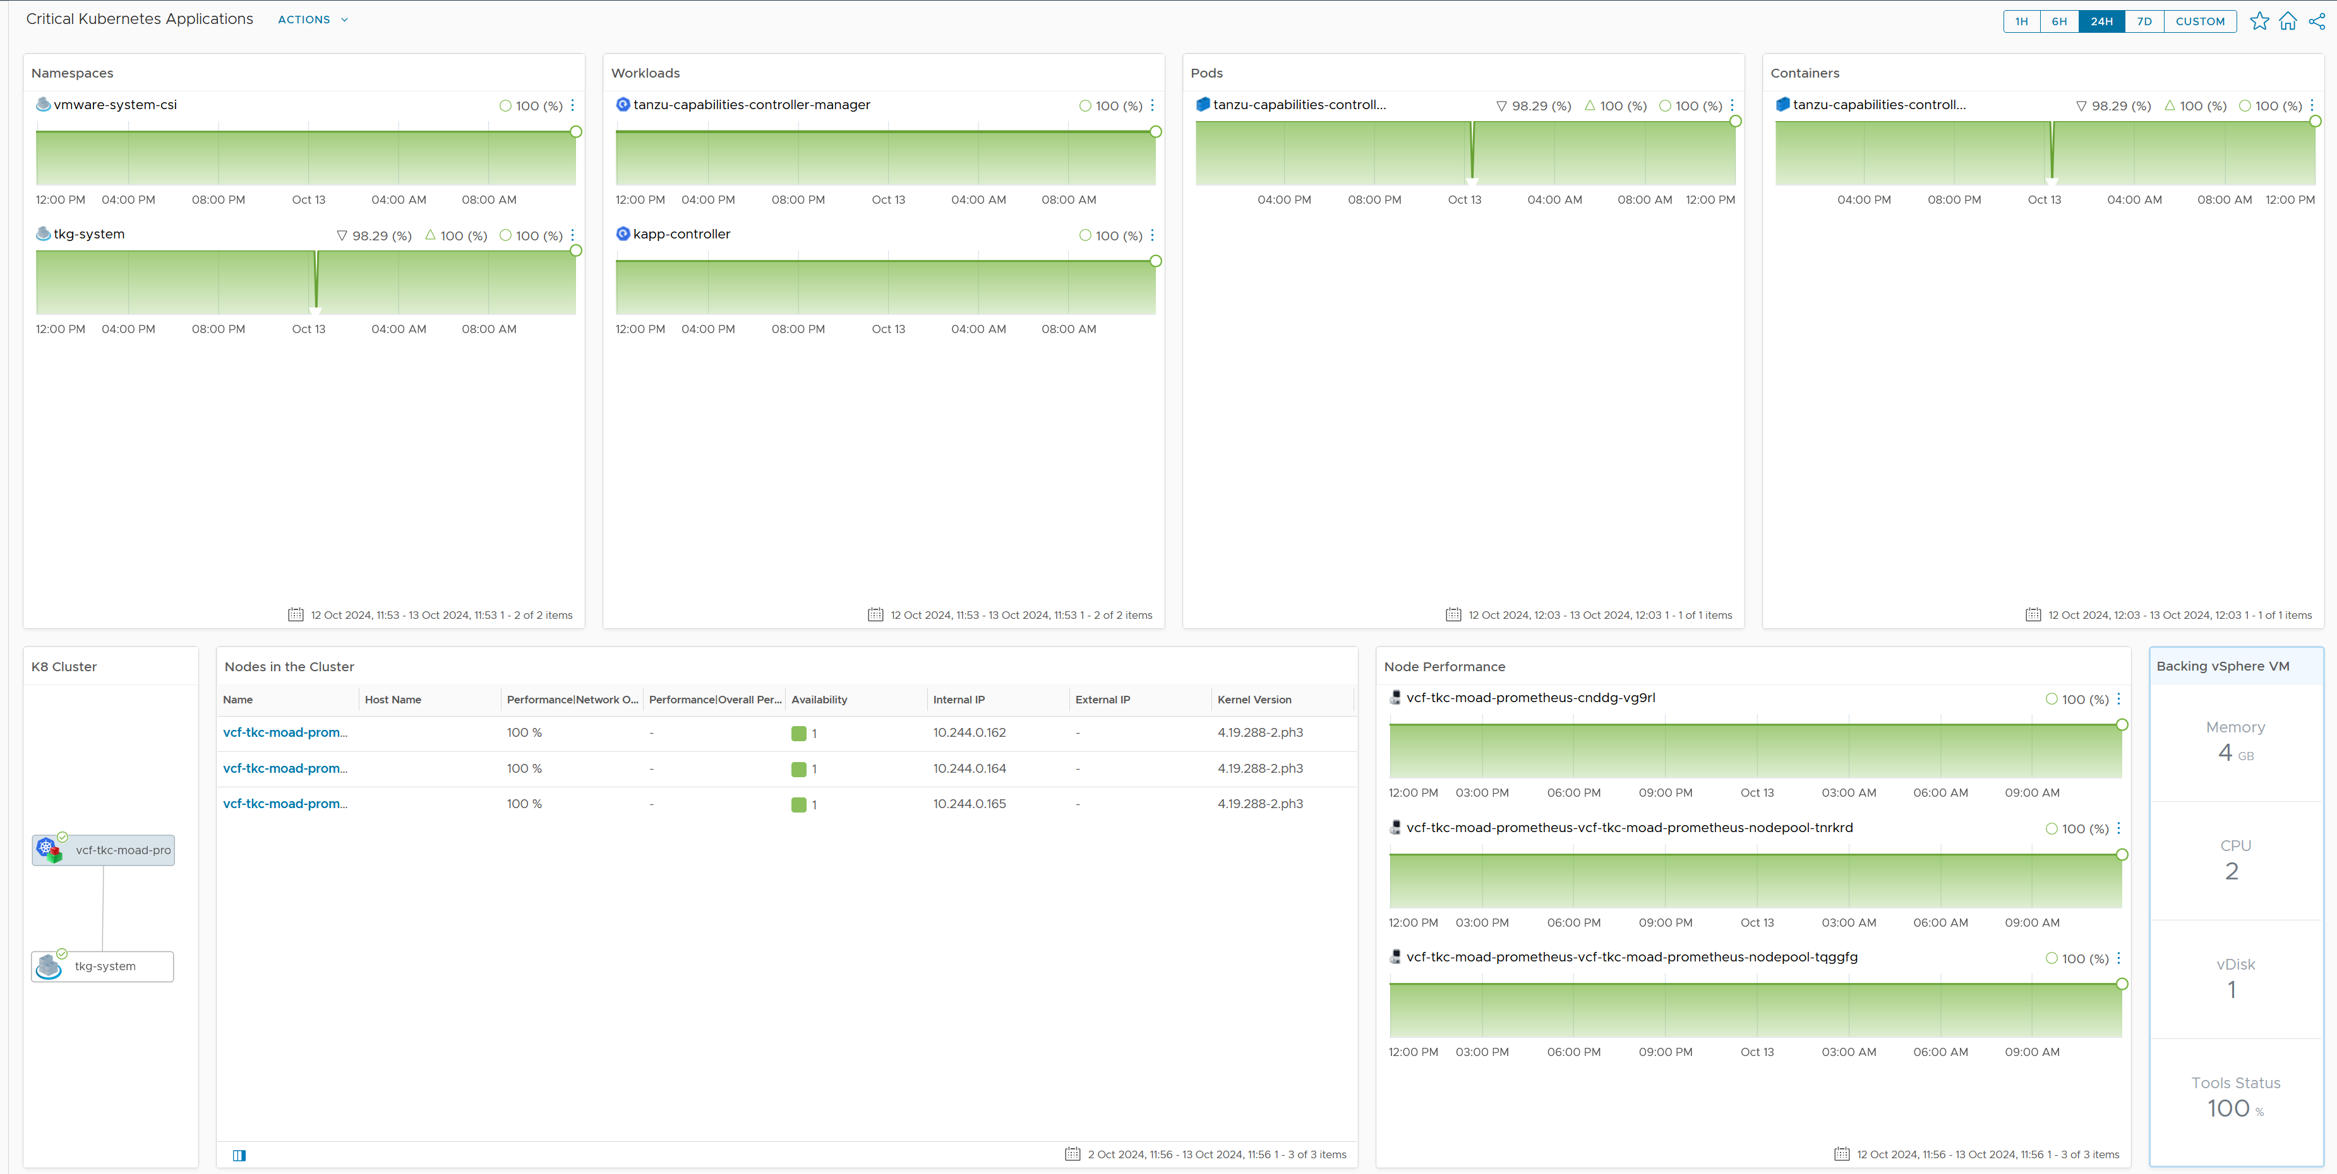
Critical K8-based App
App and Infra visibility
Application perspective.
The application can span multiple namespaces.
Formula for each KPI explained in K8 section.
Infrastructure perspective
K8 cluster where the namespace run.
K8 nodes. Drill down to the underlying vSphere VM. Navigate into the VM performance dashboard.
Notes:
Note that you need to have the detail collection. By default the K8 adapter does not collect enough performance metric for Pod and Container.

Slide 14
Classic App
3-layer application

Slide 15
“VM” Infra KPI Counters
From Application Team viewpoint, VM and Guest OS are the same thing
CPU
RAM
Network
Disk
Inside Guest OS
(Linux, Windows)
Run Queue
Context Switch
Paging Rate (MB/s)
Committed %
OS Output Queue Length
Driver Queue
OS Queue
Driver Queue
Utilization
In Use
Modified + Standby
Throughput (bps, pps)
Latency
Latency
Outside Guest OS
(VM)
Run | Used
System + VMX + MKS
Zipped, Swapped, Swapped to Host Cache
Throughput (bps, pps)
IOPS.
Throughput (Large Block)
Ready + Co-Stop + Overlap
Other Wait + Swap Wait
Contention
TX Dropped Packet
Normalized Latency
Outstanding IO
Latency
Other performance counters:
vMotion stun time. Reported by Log Insight
NUMA migration Reported by ESXCLI
P-State & Xeon Hyper Thread effect. Reflected by Used, Usage, Demand
Quiz:
What counters are not included in the above? Why?
Why is utilization included?
Answer in the book
Notes:
There are many counters that can impact a VM/GOS performance. Focus on contention, not utilization. I listed utilization here as data is averaged every 5 minutes. Within that 300 seconds, there can be short burst of contention which is not properly reported. Ideally, what we need in vR Ops is both the average and peak (1 second peak). So 1 is the average of 300 data points, while the peak captures the worst.
Can you notice what counters are missing?
VM Memory Balloon. This is an ESXi counter for utilization. While it’s charged to the VM, it does not mean the VM has memory performance, nor it is running out of capacity.
VM CPU Usage and Demand.
We will share what can be monitored with vR Ops and how you can combine/aggregate these counters into 1.
For OS Output Queue Length, in Windows it’s under PerfMon: Network Interface. Thanks Cameron Fore for the answer!

Slide 16
VM Infra KPI (%) metric
How do we define the performance of a single VM, from infrastructure viewpoint?
 | Metric | Green | Yellow | Orange | Red
Guest OS Contention | Peak CPU Run Queue Length per vCPU | 0 – 2 | 2 – 4 | 4 – 8 | 8 – 16
 | Peak Disk Queue Length (count) | 0 – 20 | 20 – 40 | 40 – 80 | 80 – 160
Guest OS Utilization | Free Memory (MB) | 512 – 1024 | 256 – 512 | 128 - 256 | 0 - 128
Guest OS | RAM Page-out Rate (page/sec) | 0 – 1000 | 1K - 2K | 2K – 4K | 4K – 8K
VM Contention | Peak CPU Co-Stop among any vCPU (%) | 0 – 1% | 1 – 2 | 2 – 4 | 4 – 8%
 | Peak CPU Ready among any vCPU (%) | 0 – 2% | 2 – 4% | 4 – 8% | 8 – 16%
 | Peak CPU Overlap (%) | 0 – 0.5% | 0.5 – 1 | 1 – 2 | 2 – 4%
 | Peak RAM Contention (%) | 0 – 0.5% | 0.5 – 1 | 1 – 2 | 2 – 4%
 | Peak Read/Write Latency among vDisk (ms) | 0 – 10 ms | 10 – 20 ms | 20 – 40 ms | 40 – 80 ms
 | Peak Network TX Dropped packet (%) | 0% - 0.25% | 0.25 – 0.5% | 0.5 - 1% | 1 - 2%
VM Utilization | CPU Net Run | 0 – 95% | 95 - 97% | 97 – 99% | 99 - 100%
IaaS High Utilization | VM Memory Ballooned (%) | 0 – 2% | 2 – 4% | 4 – 8% | 8 – 16%
IaaS high utilization | VM Memory Compressed + Swapped (%) | 0% - 0.25% | 0.25 – 0.5% | 0.5 - 1% | 1 - 2%
Peak = The highest “20 second average” in the 5-minute period
CPU Usage is set to high as 95% is actually very good performance. In future we should replace with value from Tools.
Not included
Guest OS: Dead Process. Not sure what value to set, as we need to profile. In future can add
Network errors packets (%). No metric. Needs Tools
Network queue. No such metric.
Network RX Dropped Packets. Too many false positive.
CPU Context Switch. Not sure what values to set.
RAM Page-in. This could be binary or proactive page in.
RAM Page Fault. How to measure?
Swapped File Remaining. Corelate with available memory?
vMotion. No visibility. It’s an event. Plus what value should we assign?
Other Wait. Too many CPU metrics relative to others. Rare bug resulting in false positive.
Most utilization, such as disk IOPS. As no way to put them into brackets.
Undesired network packets, such as broadcast and multicast. They do not actually cause performance.
Notes:
Reference in the book:
Part 1 Chapter 2 Performance Management: read the “Optimized Performance” section
Limitation:
No weightage
No override

Slide 17
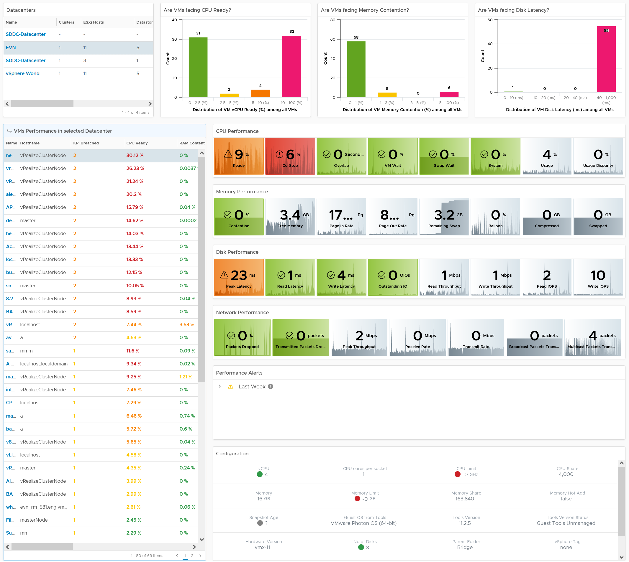
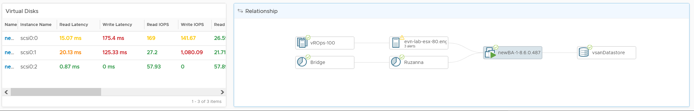
Summary
Quickly see the big picture.
CPU, Memory, Storage
List
Analyse many VMs.
Color coded. User configurable.
Sort | Filter | Export.
Choose any time period. Peak follows!
In-page Drill down. Context retain.
Metrics
See next slide
VM Performance
Drill down into this dashboard to see details of a specific VM.
From here, drill down further to see inside Windows or Linux
Alerts
Relevant alerts that impact performance
Configuration
Relevant settings that impact performance
Virtual Disks
Drill down to Read & Write
Relationship
Navigate to related object
Notes:
Summary
Bird-eye view
Clearly shows where the problem is
CPU | Memory | Disk | Network
Clearly show what the problem is
Read or Write?
Received or Transmit?
Contention caused by high utilization?
Detail
No need to figure out what metrics to choose!
Dashboard Time
Relevant alerts
Relevant configuration
Is it caused by underlying infra?
Can drill up to cluster, host, vSAN and datastore

Slide 18
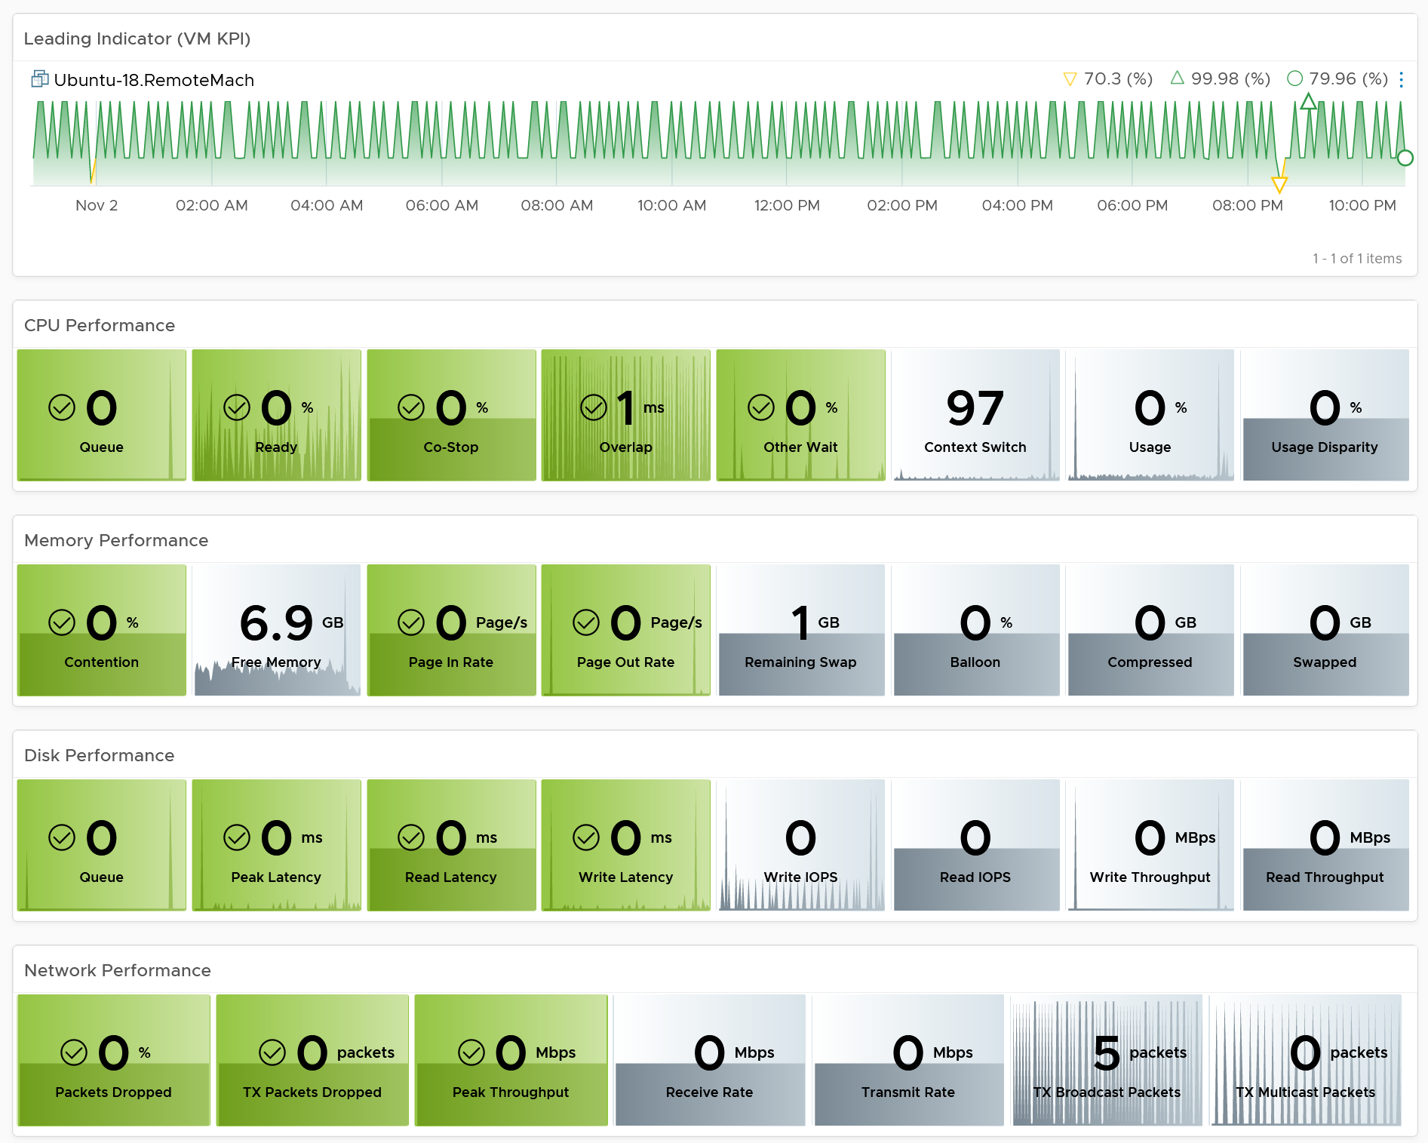
31 Performance Metrics
Cover both Guest OS and VM
Since the focus is performance (and not capacity), the contention metrics are shown first, then consumption.
Color coded. Customize after you do performance profiling (ideally based on 3 months data to capture quarter end peak).
It shows details at vCPU and vDisk level, not just VM average.
Guest OS metrics require VMware Tools.

Slide 19
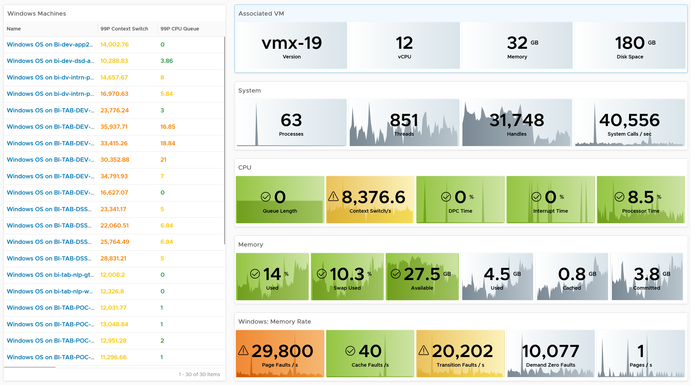
Windows Dashboards
Designed to complement the VM Dashboard
Drill down from VM into Guest OS. Go back up (via the Parent VM scoreboard widget)
Covers Windows and Linux.
Customize as you deem appropriate. Use the performance baseline profiling technique to establish threshold that is suitable for your mission critical VMs

Slide 20
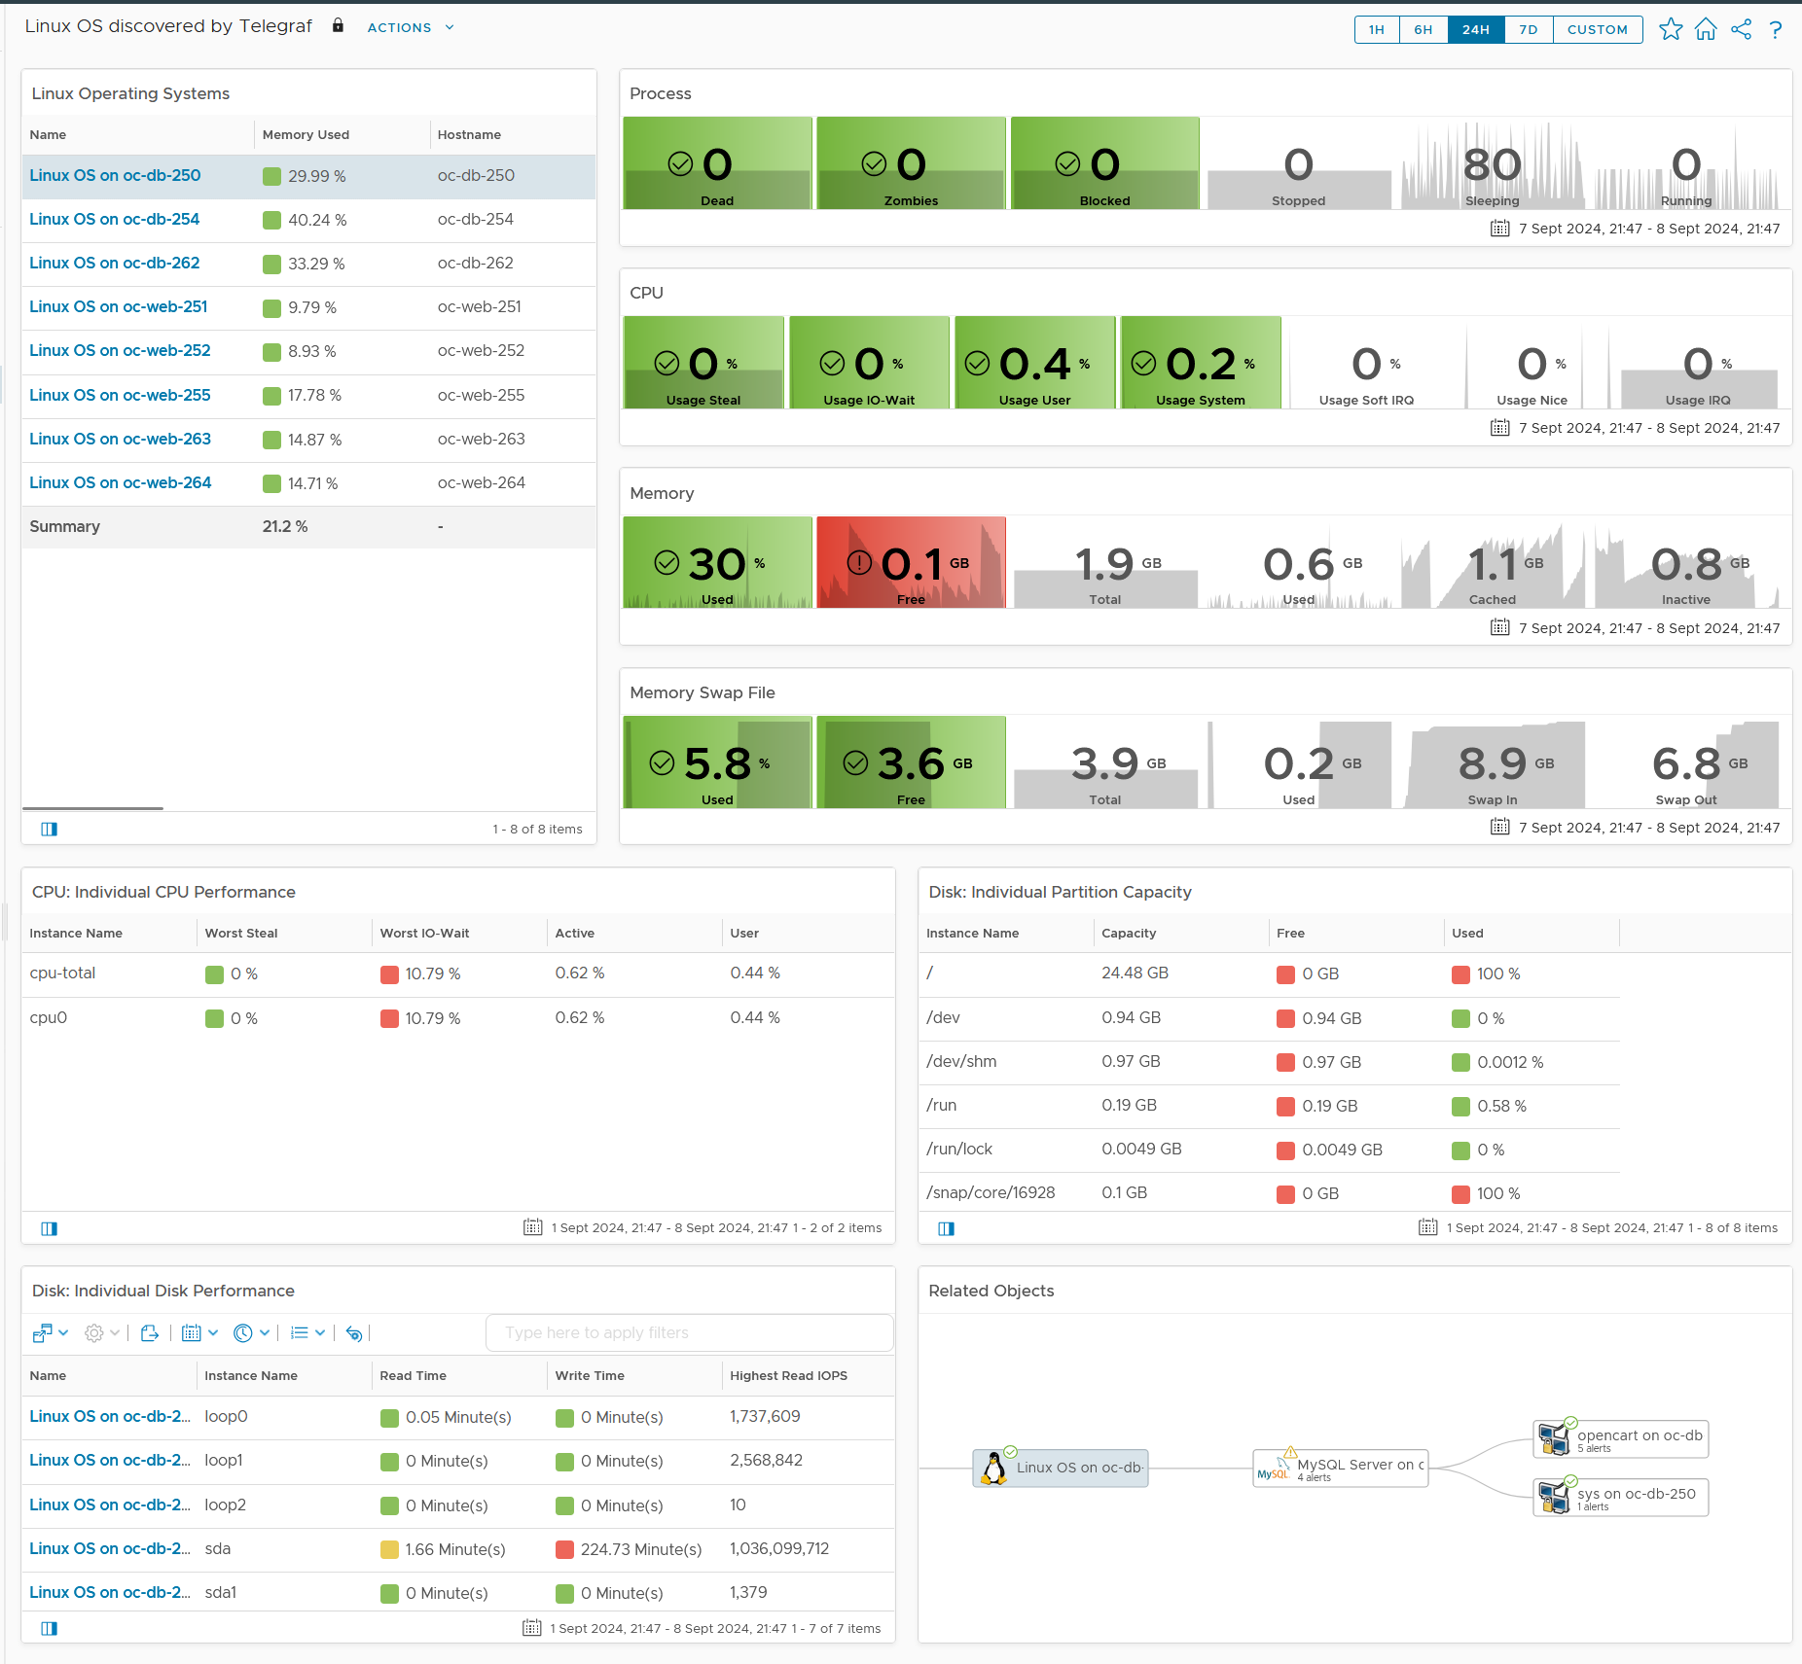
Linux Dashboard

Slide 21
Modern App
K8 based application

Slide 22
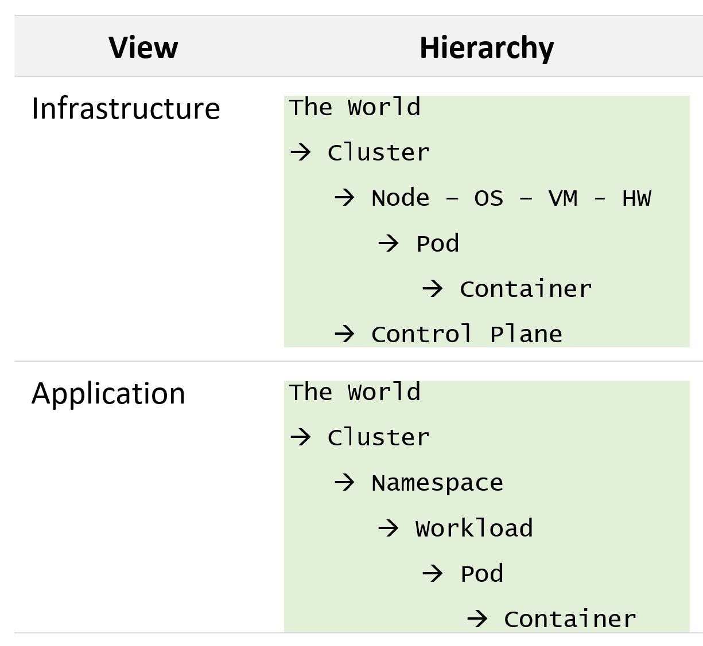
K8 Observability
The dual path of Kubernetes World
Infrastructure view is for people responsible for the shared infrastructure. This should connect to underlying infrastructure (virtual and physical).
Application view cover metrics that impact the application. In K8, this includes CPU/Memory/Disk/Network metrics
The largest object in K8 is the World object, which covers all the clusters in the entire environment.
Unlike vSphere, there is no parent object above cluster. No Data Center and vCenter defining the “environment”
Notes:
Limitation of 5.2: In current implementation, we do not have Workflow object. Rather we have 1 object for each type of workflow

Slide 23
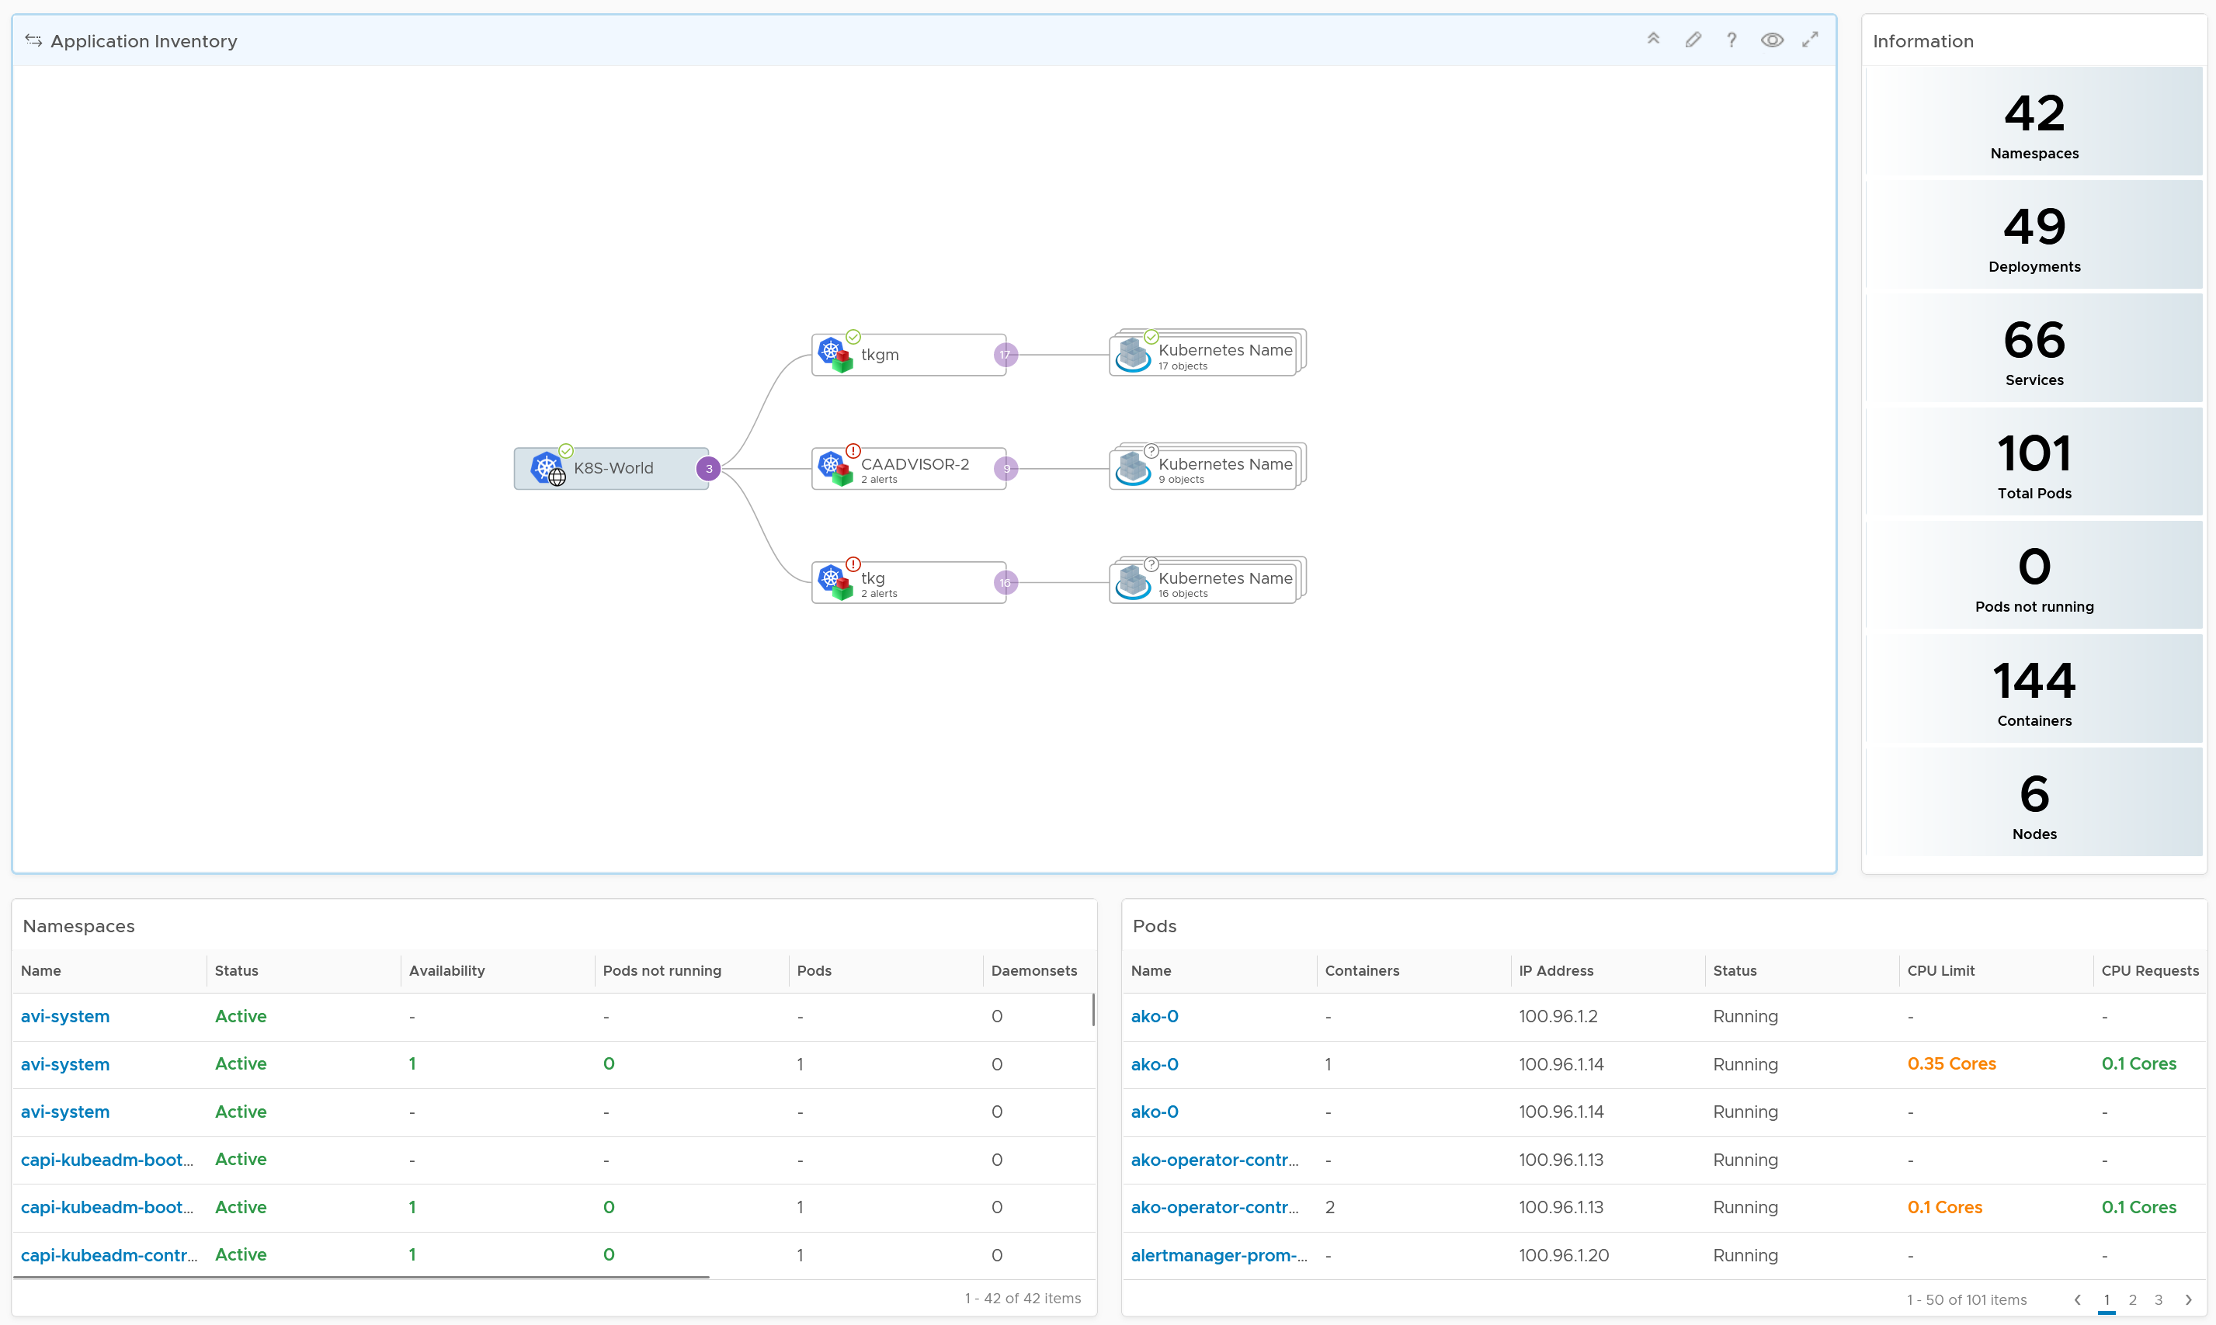
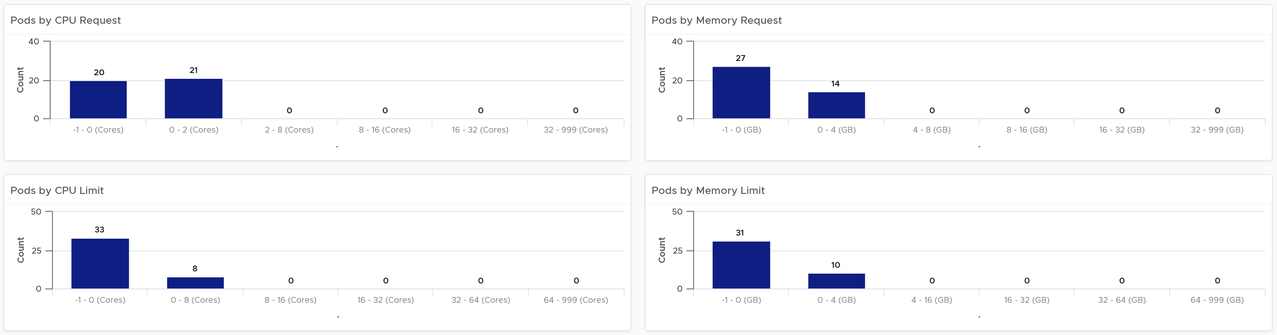
Inventory of K8 Applications
From this you can navigate to:
Infrastructure Inventory, to see from Node viewpoint
Application Performance, to prevent or fix.
Relevant inventory information is automatically shown
Namespaces
Interactive list, for entire environment or in selected cluster.
Select a namespace to list the pods in it.
Pods
Entire environment, in selected cluster, in selected namespace
Pod CPU Requests vs Pod CPU Limit.
Are the size distribution in line with your expectation?
Request and Limit are related. In mission critical environment, there should be overcommit. Sum of Limit does not exceed Node capacity, hence Requests are redundant
Pod Memory distribution.
It should be “similar” to CPU.
Be careful with Request as it’s “sticky” as memory is basically cache.
Notes:
Inventory: Application

Slide 24
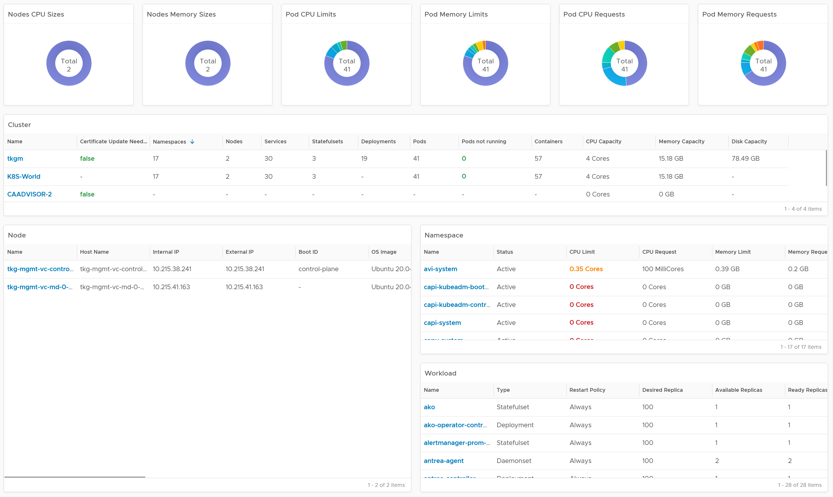
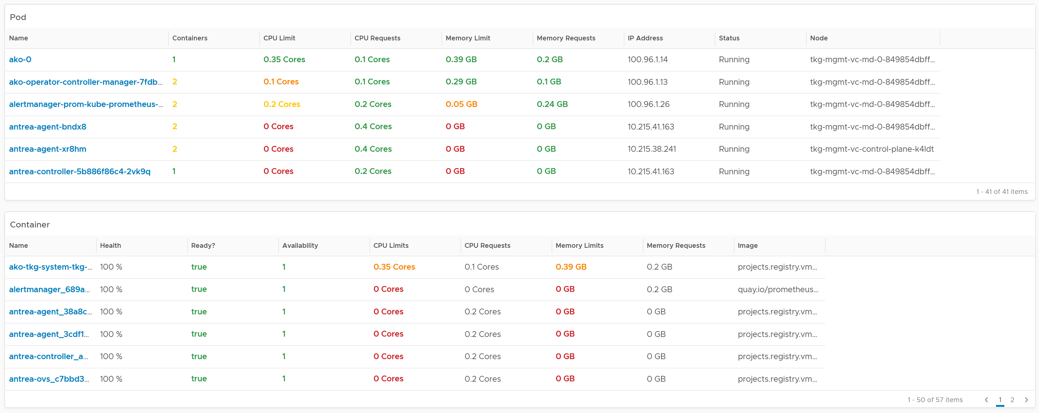
Node
CPU and Memory config distribution
Pod
CPU and Memory config distribution
Clusters
Interactive List. Drill down to all tables below.
Nodes
Interactive List. Drill down to pods and containers.
Nodes in a cluster should have identical configuration.
Namespace
Interactive List. Drill down to workload, pods and containers
Workload
Pods
Pods in a workload should have identical configuration.
Container
A pod should have 1, maximum 2, containers.

Slide 25
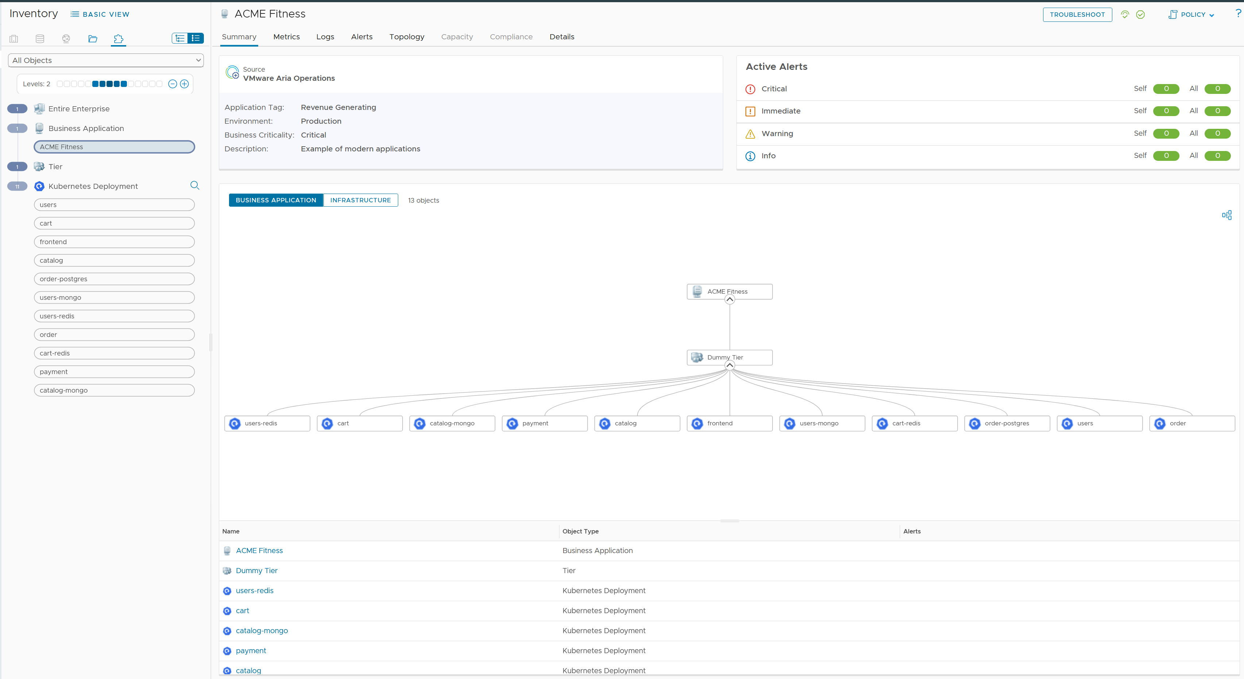

Slide 26
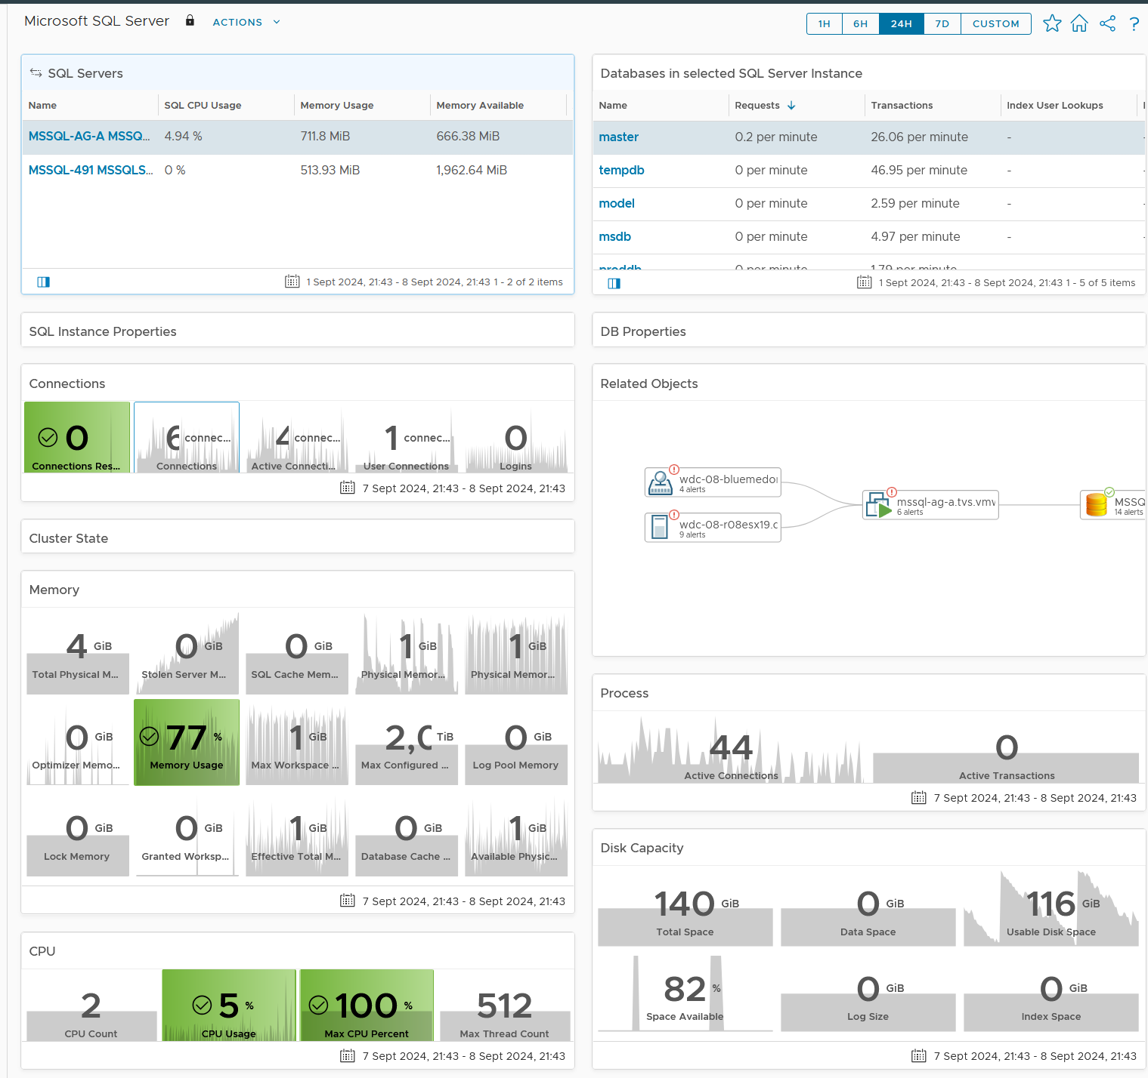
Microsoft SQL Server
4 Levels of drill down
All Biz App → 1 Biz App → Application Tier → VM.

Slide 27
Implementation
Using Aria Operations 8.18
Notes:
While it works in earlier release, it’s a lot more work, and accuracy is reduced

Slide 28
Reflect the Business
vSphere UI: Folder Structure should map to Business Applications
In vSphere Client.
Create a folder for each business application
Ensure each folder name is unique, even across different vCenter Servers. Otherwise VCF Operations will get the wrong VM.
See the structure as example →
In VCF Operations
Create 1 Business Application object for each business application
Limitation: Create 1 custom group for each application tier. A business app with 3 tiers needs 3 custom group
Business Unit B
Business Unit C
Business Unit D
Biz Unit C: Department 1
Biz Unit C: Department 2
Biz Unit C: Department 3
C.2: Application A
C.2: Application B
C.3: Application C
C.2.B: Web Tier
C.2.B: App Tier
C.2.B: DB Tier
VM 1
VM 2
VM 3
Pro Tip: Start with the most critical business application. No need to map the whole environment as it takes time to get buy-in from app team and senior management

Slide 29
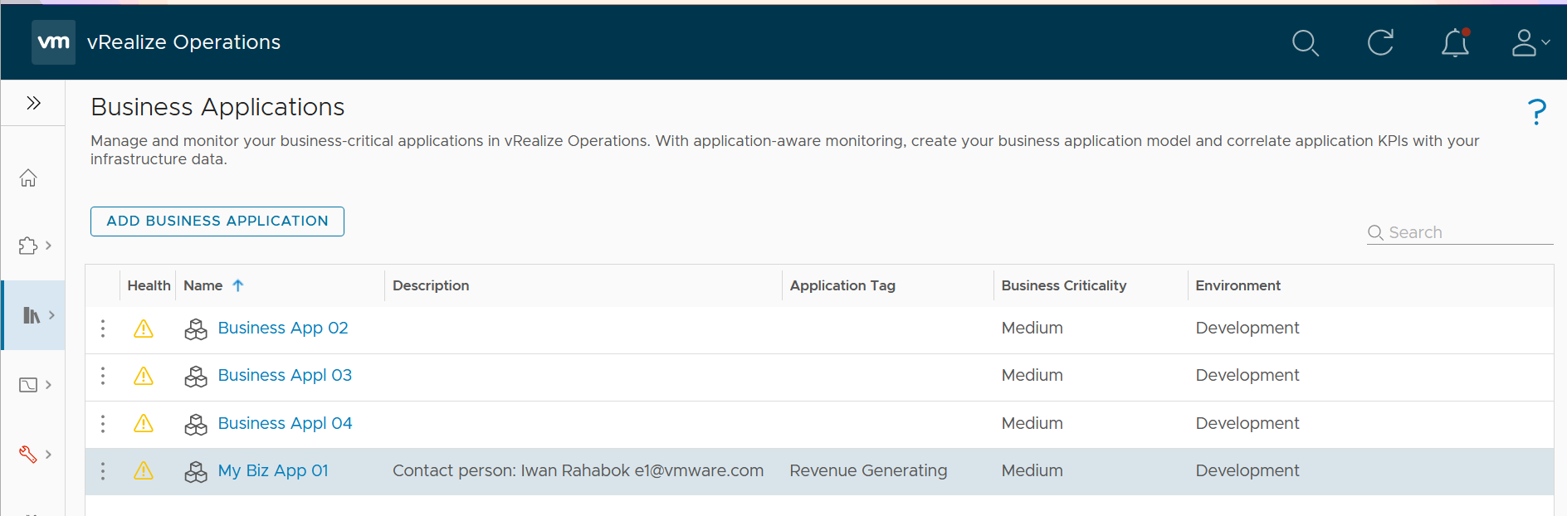
Business Application
Step 1: create the business application
Create 1 business application object for each Biz App. Note this is just the top level object, serving as parent object to Application Tier and VM
Key in contact or owner as this column support sorting
This column does not support sorting
Notes:
Limitation: the columns can’t appear on a dashboard

Slide 30
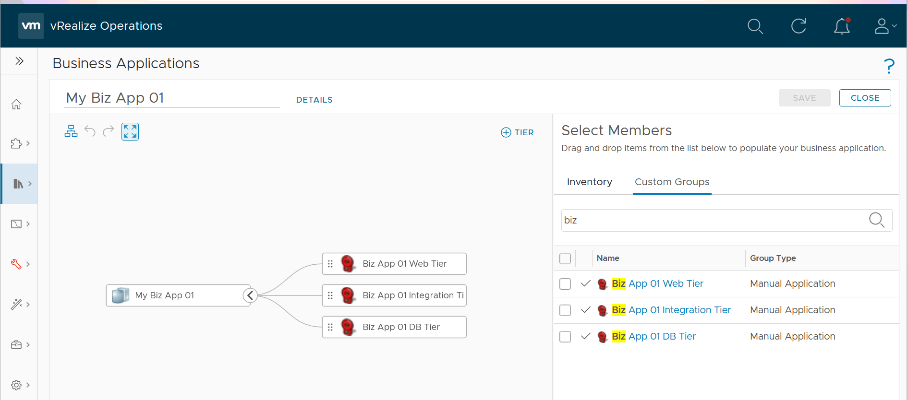
Business Application Tier
2 levels only. No need to create sub-tier as it complicates the super metric. If you need more, contact me as the dashboard will not work
Choose from Custom Group, as the members can be dynamic.
Notes:
1 group for each business application
1 group for each tier in the business applications
Make sure they are VM. Other objects will be ignored

Slide 31
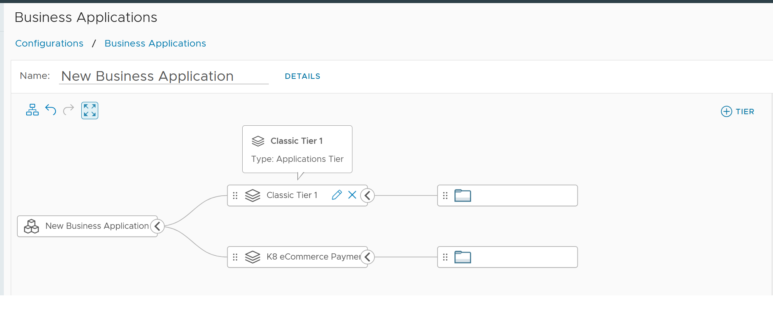
Business Application Tier
A mandatory object in Aria Operations
2. Click here to create the Applications Tier object
4A. Drag the vSphere VM Folder (created in vCenter) associated with the tier
3A. Name the business tier with what CIO can relate
1. Create 1 Biz App for each mission critical system
4B. Drag the related K8 namespace object here. The children’s workload will be implied
3B. Name the CNA microservices with what CIO can relate
Notes:
1 group for each business application
1 group for each tier in the business applications
Make sure they are VM. Other objects will be ignored.
2 levels only. If you need more, contact me as the dashboard will not work

Slide 32
Business Application Tier
A mandatory object in Aria Operations
2. Click here to create the Applications Tier object
3. Name the business tier with what CIO can relate
4. Drag the vSphere VM Folder (created in vCenter) associated with the tier
1. Create 1 Biz App for each mission critical system
Notes:
1 group for each business application
1 group for each tier in the business applications
Make sure they are VM. Other objects will be ignored.
2 levels only. If you need more, contact me as the dashboard will not work

Slide 33
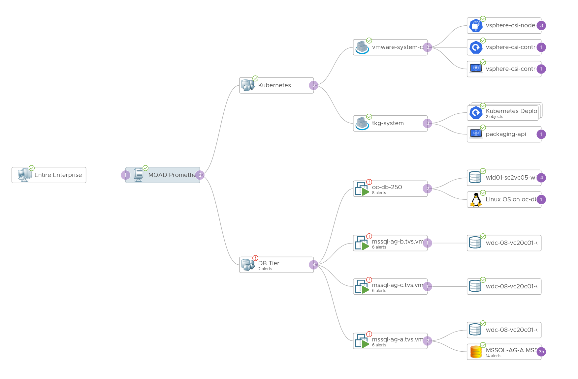
Hybrid Application
Classic and modern (K8) component
The workload is automatically included
A K8 Namespace
Put all K8 namespaces under this object
Classic type.
A single Tier.
Ideally, use vCenter VM folder

Slide 34
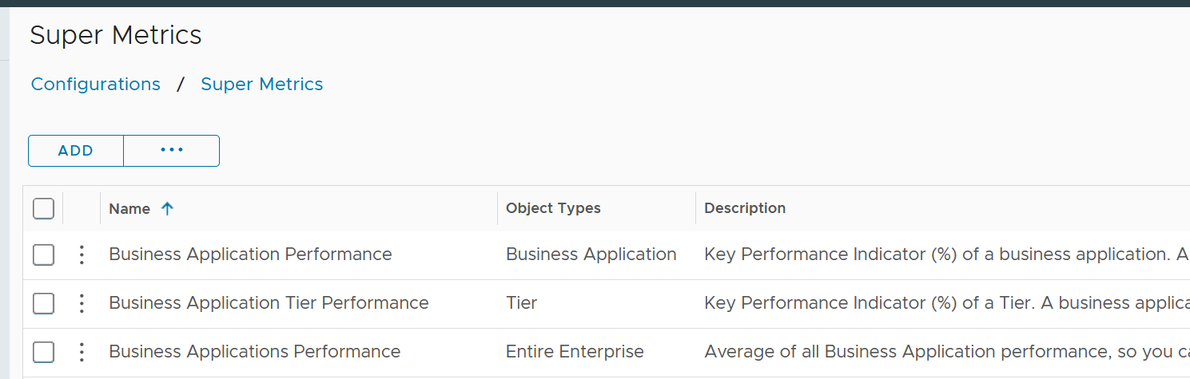
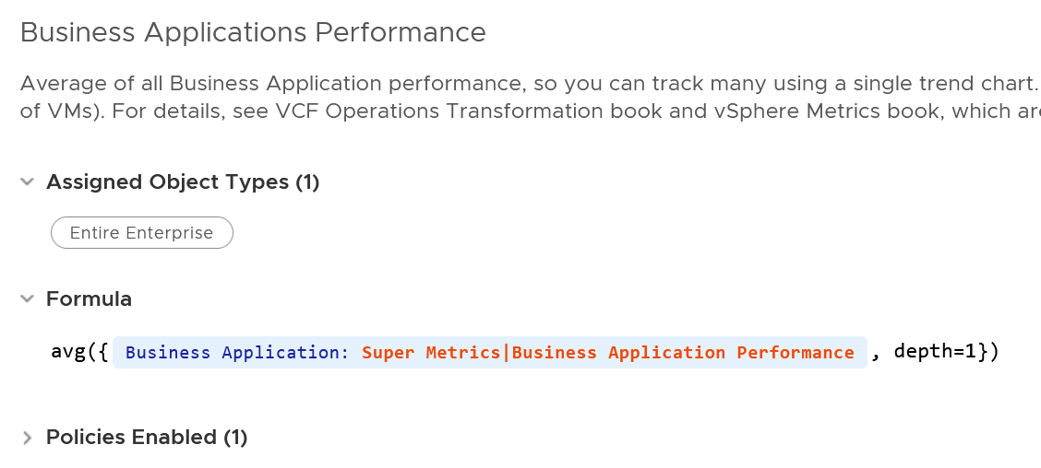
Super Metrics
3 metrics, 1 for each object type

