Slide 1


India VMUG
The Rise of Private Cloud Architect
Iwan ‘e1’ Rahabok
e1@broadcom.com e1ang 9119 9226
Notes:
Context: an informal chat with vCommunity members about their career.
This is not a formal presentation, corporate – corporate. This is human to human connecting.

Slide 2
Singapore
The World
Notes:
[ice breaker slide]
Round the world. 2x. East. West.
It’s surprising to witness that we’re more alike than different. It does not matter whether you are a bank, telco, west, east, govt, private, you have the same requirements.
Let me prove that to you.

Slide 3
Top Requirements
2P
The 3rd P
Notes:
All those travelling meeting customers convince me that you all share the top requirements.
I call it the 2P.
Pay Rise and Promotion
The problem with these 2 Ps is they don’t happen every day.
You asked for The 3rd P.
Piece of mind. You’re tired of blamestorming, fire fighting, defending your infrastructure, and thankless nights.

Slide 4



Why The 3rd P
Your Customers
Your Boss
“Need more HW! Your infra is slow”
“Your infra is not full. Add more VM!”
You
Notes:
So how The 3rd P happen? What’s causing it? Why Hero becomes Zero?
Well, the 2 most important roles in your organization are both pressing you.
Your customers is demanding better service, faster performance, higher uptime, fewer disruption.
Your CIO is demanding less budget.
You’re squeezed in between.
You are a pro. You can architect a solid enterprise-grade global infrastructure
So why are you squeezed in between? This is something we want to solve.
So we analyse further. We probe deeper. Why are you in this predicament?
The short answer is because your Customers and your Boss aren’t measuring the same thing. You need to align them.
If you need to know the answer right now, the short answer is because your Customers and your Boss aren’t measuring the same thing. You need to align them.
Kenon Owens and I created the Operationalize Your World because we see a lot of VMware Admin/Engineer/Architect struggle. They are squeezed in between their customers and their boss.
On a lighter note, the photos are Kames https://www.linkedin.com/in/ksubramz/ and Karen https://www.linkedin.com/in/karenaghajanyan/ You have this material because of their leadership. I’m indebted to them.

Slide 5

You are a Jedi Master
Best Performance?
Lowest Cost?
Do you spot the solution to your problem?
Notes:
It is illogical that you’re in this predicament, because you know VMware well. You are a pro.
You can architect a solid enterprise-grade global infrastructure.
Can you architect a high performance virtual platform that matches physical? Sure you can. Essentially, do not overcommit.
Can you architect the lowest cost? Simple. Just ask your CIO how much budget he gives you, and find the cheapest hardware. After all they are all commodity hardware.
Quiz: Can you now see the solution?
Let me give you another hint [click to next slide]

Slide 6
Mission: Build a Private Cloud
Total Budget: $ xx millions over 5 years
Expected Load: xxx thousands of VMs
Availability: Always
Performance: Great
Security: No Compromise
Notes:
You’re in the predicament because of what happened at the top of your organisation.
CEO tells the CIO the need to be competitive in business, and grow market share. CEO believes the future is more tech driven, and they need a strong & secure platform to support all types of applications. CFO does not like the high price of public cloud. Private cloud became a natural option. Looking at the overall company finance, CFO allocates the budget. CIO looks the projected company growth, and translate that into IT infrastructure demand.
Executive Planning done.
IT Planning and Architecture start.
CIO ask you, the trusted infrastructure architect to plan and design the private cloud that delivers that strategic project. On time, on budget, on quality.
What did you say?
You said “Of course!”
Implied in the ask are 3 hidden conditions.
=======
BTW, if the problem is hard to solve, because it started many years ago…
We create the Operationalize Your World workshop + toolkit because we see a lot of VMware Admin/Engineer/Architect struggle. They are squeezed in between their customers and their boss.

Slide 7



Unifying the Consumer & Provider Layers
Your Message: “You get what you paid for”
Price/Performance defines the IaaS offering.
The reason Gold Class is 2x the price of Silver because it is 2x better. That’s the fair way to justify higher price.
While hardware and architecture are identical, the SLA per VM is better.
Better in all 4 aspects of SLA:
Higher availability
Faster performance
More secured
Better service.
“Performance”
Consumer
Price
Provider
Notes:
And the reason why their demand doesn’t connect well is because they are looking at different things. So you need to unify them. Design the same model for both entities. Same operational models, else you are caught in between.
For SLA, the most important that your application care the most is Performance SLA. Availability SLA and Security SLA are a given.
What if VM is free? The business requesting the VMs need to write the business justification for each class of service.

Slide 8
Class of Service
Formally defining the Price/Performance relationship
Tier | Price | Overcommit | “Performance” | Positioning
Gold | Highest | 1:1 | Perfect (100%) | Performance Guarantee. Suitable for mission critical applications.
Silver | Moderate (50% of Gold) | 1:2 | Great (95%) | 50% discount for only 5% penalty. Suitable for most Production workload.
Bronze | Low (25% of Gold) | 1:4 | Good (90%) | 75% discount for only 10% penalty. Suitable for Test & Dev workload.
Free | Free! (funded by higher tiers) | 95% Utilization | Best Effort (~85%) | Suitable for temporary project. No Availability SLA, no Performance SLA
Notes:
So how should you architect this price performance?
Start with the highest as that’s the easiest to understand by your customers. It is there for comparison.
We will discuss the price in the next slide. For now, the key point is the relative comparison.
Gold is as good as physical. No need to set reservation as there is no overcommit. To each VM, it’s as if each VM is not sharing an ESXi. Performance will be ideal. Contention will be 0 as resources is always available.
As you can imagine, this leads to a lot of wastage as most workloads don’t run 100% all the time. They peak from time to time, and most of the time is well below 50%. CEO won’t appreciate the total cost.
I put performance in quote as it’s more than speed. Think of the word Value instead. It covers 4 dimensions: availability, performance, security and service. We will elaborate some of these in the next section.
You then introduce Silver.
5% performance penalty for a 50% price discount is a bargain.
BTW, performance here means all the 4 types of SLA: Availability, Performance, Security + Compliance, and Service. We’ll elaborate 3 slides down the road.
Does 95% performance means you only get 95% of what you’re asking? Does it mean you only get 9.5 GB of memory when you’re asking 10 GB? If that’s the case then every app team will simply be asking for 5% more than they need ☺
5% penalty means there is time when you ask for the resource, you have to wait for a few seconds. So you still get the resource, just that there is latency. What exactly it is, and how it’s calculated, it’s documented in-depth in the book.
Free Tier
The Free Tier is useful to convey the value of the SLA. Human nature tends to appreciate something when after it’s taken away from us.
Business wise, the free tier must be funded by paid tiers. Since it is free, you are excused from providing SLA. It’s acceptable for them to have unpredictable downtime and slow time. Commercial cloud providers provide free tier that are intentionally designed to be slower and less reliable, because they want you to upgrade and pay.
Hardware is identical for all tiers. It is SDDC, not HDDC
Point of this slide: SLA needs to start at Day 0.
Reference in the book:
Part 1 Chapter 1 Overview: read the Service Level Agreement section

Slide 9
Example: Class of Service
Agree with CIO on the business model before deciding on hardware. Quantify the Service, then choose the Hardware
Tier | Price | Compute | Storage | Performance | Remarks
1 (Platinum) | Highest | 1:1 | N/A (allocation is not applicable as it does not impact performance and carries capacity risk) | Perfect (100%) | CIO decided not to offer, as no business wants to pay the price. They want it, but unable to justify the price
2 (Gold) | Moderate (33% of Gold) | CPU 1:3 RAM 1:1 | All Flash | Great (95%) | Based on 50/50 split between CPU & RAM. 0% discount on PCU and 67% discount on RAM results in 33% overall discount Hardware sizing should maximize consumption. Based on 1 vCPU 4 GB RAM. Typical standard. 48 core X 3x overcommit X 4 GB RAM per vCPU = 576 GB. Add additional CPU and RAM for vSAN and NSX as appropriate
3 (Silver) | Low (67% of Gold) | CPU 1:6 RAM 1:2 | All Flash | Good (90%) | Gold SLA (99.95%) vs Silver SLA (99.9%) Viewing from 0.05% vs 0.10%, the Silver SLA is 2x lower. This maps to 5% and 10%
4 (Free) | Free | n/a | Hybrid | n/a | VM size capped to 2 vCPU 8 GB RAM. No performance consideration. Drive utilization high.
Identical hardware & infrastructure for ease of operations. Difference is in SLA, which is at VM level
Notes:
Your ESXi size needs to be balanced. By that it means it has to map to demand. If your VMs are compute heavy, then your hardware should map to it, else you’re wasting money and the excess will not be used.
A good general rules of thumb is 1:4 ratio between CPU:RAM. If you have 64 CPU cores then you only need 256 GB RAM for your Tier 1
40 cores x 3:1 Ratio x 4 GB per vCPU gives 480 GB RAM. This is pretty close to 512 GB. You still have 32 GB for All Flash vSAN.

Slide 10
Price
Public Cloud
Budget → Unit Cost
Enterprise Private Cloud
Price
Tenants
VM Price is set by industry, not you. Your price need to be competitive.
Silver Class: Lower Price, Same Performance.
It’s a commodity business. Accept it.
Your Total Budget ≤ Public Cloud Total Price.
Once spent, you can’t save cost. You can only defer future spending. Depreciate cost over ≥ 5 years.
Total Cost / Total Capacity → Your Unit Cost.
Unit Cost: per CPU Core, per GHz, per GB RAM, per TB Disk.
No such thing as VM Cost. Only VM Price.
Progressive Pricing to tackle overprovisioning at the source.
Notes:
Let’s talk about how your price is industry leading.
Price is what your customers pay. In the case of enterprise IT, the various line of business pays the central IT department. One reason why public cloud was born was the developers were not happy with the service and price from central IT. So you need to nail this down.
The public cloud have set the price. It’s a commodity business. Most developers see hardware as piece of boxes. So know your competitors price and lead the industry. You can absolutely lead in both price and value. By a wide margin, not just 10 – 20%.
Price has nothing to do with your cost. The tenants will not pay higher price than public cloud simply because your cost is high. If you’re bloated internally, these line of business will not appreciate it. System Architect tends to think in terms of Cost. Business Architect will start with Price, and then ensure Cost can be covered to at the end they don’t make a loss.

Slide 11
VM Cost?
There is no such as thing as VM Cost.
Week 1
Month 3
In this initial roll out, the IaaS Team starts with just 5 VM to ensure the platforms are performing as expected. They are proving that the actual performance settings, availability settings, security settings, are working as they should be.
The VM Owners are in fact given a discount to be part of this real-world test.
VCF Workload Cluster.
VM 001 cost is VERY high
VCF Workload Cluster.
VM 001 cost is low.
The cluster total hardware. 5 years support fully paid as part of ELA with Dell.
Licensed of MS Windows DC Edition and Broadcom VCF fully paid for 5 years as part of ELA
Notes:
There is a common misperception that you need to calculate the cost of each VM, and then charge it back.
You see, there is no such thing as the cost of VM 123.
Let’s use a hotel analogy to show the point.
I stay in a hotel for 2 nights.
On night 1, I used all the free facilities as I stayed most of the time in the hotel. Swimming pool, executive lounge, parking, breakfast, etc.
On night 2, I used none as I was outside all the time. I just use it for sleeping, nothing else.
The cost to the hotel is much higher on night 1.
Does the hotel calculate the cost per night for every single guest and their stays? They don’t.
They simply have an overall idea of average expected cost per room type. They use this high level number as budgeting.
Back to vSphere Cluster.
The cluster has a unit cost per physical core. If you provide stateless workload such as transient K8 pod, then you charge per GHz.
The cluster also has a unit cost per GB of RAM.
I’d not add network as the flexibility is not worth the complexity. Simply divide the cost into CPU and RAM.
The cluster cost must be depreciated over a long time as it’s an asset, working with accounting department.
Cost is always about the infrastructure hardware, software and services you buy. So once paid, you can’t save any money. Deleting a file, which is what a VM is basically, does not save you anything. What you can save is future purchase. You do this by deferring the purchase to next quarter or next FY.

Slide 12
“Performance” SLA
Availability
Is it up?
Performance
Not just per VM. It covers CPU, Memory, Disk, Network.
Security
Is it protected? Does it comply with required industry regulation?
Exceed Public Cloud: Per VM SLA. Not on your infrastructure
Service
Support for the IaaS Service to ensure workload run best
Public Cloud does not have.
Public Cloud does not have.
Easily far exceed
Notes:
As shared, there are 4 elements that make up Performance in the Price/Performance.
The most basic one is Availability. If the ESXi is dead, you don’t have performance or security problem. Nobody can hack it.
Take note the SLA is on the VM, not your cluster. This is one area where you lead over public cloud. They have no SLA on your VM. In fact, they expect you to deploy in multiple availability zone and take care of high availability on a per application basis. Another word, they do not support pets. Only cattle.
Just because something is up, does not mean it’s fast. In fact, if the VM is so slow, it’s as good as dead as it’s useless.
Performance also cover individual VM. In fact, it covers each of the 4 elements. So there are actually 4 SLA for each VM.
Security and Compliance cover the various best practices settings that you need to apply. As you don’t want to have weak point, you need to have 1 SLA for all.
Service is the only SLA that is not directly impacting the VM. It’s more about tech support that you provide, to prevent the first 3 from happening. For example, you have proactive analysis for Gold, but not for Bronze. This is necessary as you’re outnumbered by the apps team, so you can’t serve every VM equally.

Slide 13
KPI as Stepping Stone
Complaint
KPI
SLA
SLA is part of business contract.
SLA = 1 month average of SLI.
Pricing & QoS are used to differentiate each class.
IaaS Performance is quantified & measured.
Insight based, with SOP.
Self-service portal.
RCA is closed when alert set up.
Reactive.
Blamestorming.
Alerts-driven.
You walk from where you stand
Notes:
Many of you aren’t operationally ready for SLA. So what can you do?
IaaS Operations Maturity
Point of this slide: If you do not have Formal SLA, then don’t jump into it until you know your own, actual, performance. Quantify your real numbers.
SLA is an agreement between 2 parties. KPI is not. It’s an absolute number, not relative to a promise.
How KPI complements SLA
KPI is leading indicator. SLA is lagging indicator. KPI gives insight into what could happen. SLA simply reports what already happened.
KPI is easier to implement. It does not require class of service. It tracks absolute (facts), not relative to promise.
E.g. it reports disk latency of 11 ms. Whether that meets SLA or not depends on the class of service.
KPI looks at more counters. SLA is limited to what you’re comfortable putting on the business contract (hint: keep it to 1 counter per service)
Complaint-based Operations
Metrics based on user complains
Blamestorming among team. Politics come into play.
Alerts-driven, not insight driven. Reactive and firefighting.
KPI
Using both 20-second average and 5-minute average.
Performance for both Consumer and Provider objects are quantified & measured.
KPI includes Guest OS, if IT owns VM sizing.
1 common policy for all. No formal class of service defined. Performance is based on production environment.
Insight based, with SOP.
RCA is closed with alerts set up so if it happens again it’s faster to fix.
Customers can track the KPI via self-service portal.
SLA:
SLA is measured on 5-minute average.
SLA = 1 month average of SLI of that specific month.
SLA is part of business contract.
1 policy for each Class of Service.
Pricing & QoS are used to differentiate each class.
Reference in the book:
Part 1 Chapter 1 Overview: read the Service Level Agreement section

Slide 14

Purpose-driven Architecture
You buy SDDC from vendors. You sell IaaS to your customers.
Purpose
Serve the Pods, VMs & Applications. The primary focus, hence metrics, come from these consumer layers.
KPI
Is it serving the Pods or VMs or Applications well? Consider availability, performance, security, and service.
Cost
Lower than Public Cloud, especially VMware-based. Achieved by higher density and simpler customer experience.
Pillars
Class of Service. With Performance SLA + Availability SLA + Security SLA
Proof of Success
Happy customers.
Proactive Operations, not Complaint driven. Insight-based, not Alert-based
Notes:
Point of this slide: Begin with the end in mind
Major difference between SDDC and IaaS
Most architecture, especially central storage array, lacks the per-VM latency as the array only sees LUN.
What proves that the architecture has delivered. What metrics should be used to measure that?
Reference in the book:
Part 1 Chapter 1 Overview: read the Purpose-Driven Architecture section

Slide 15
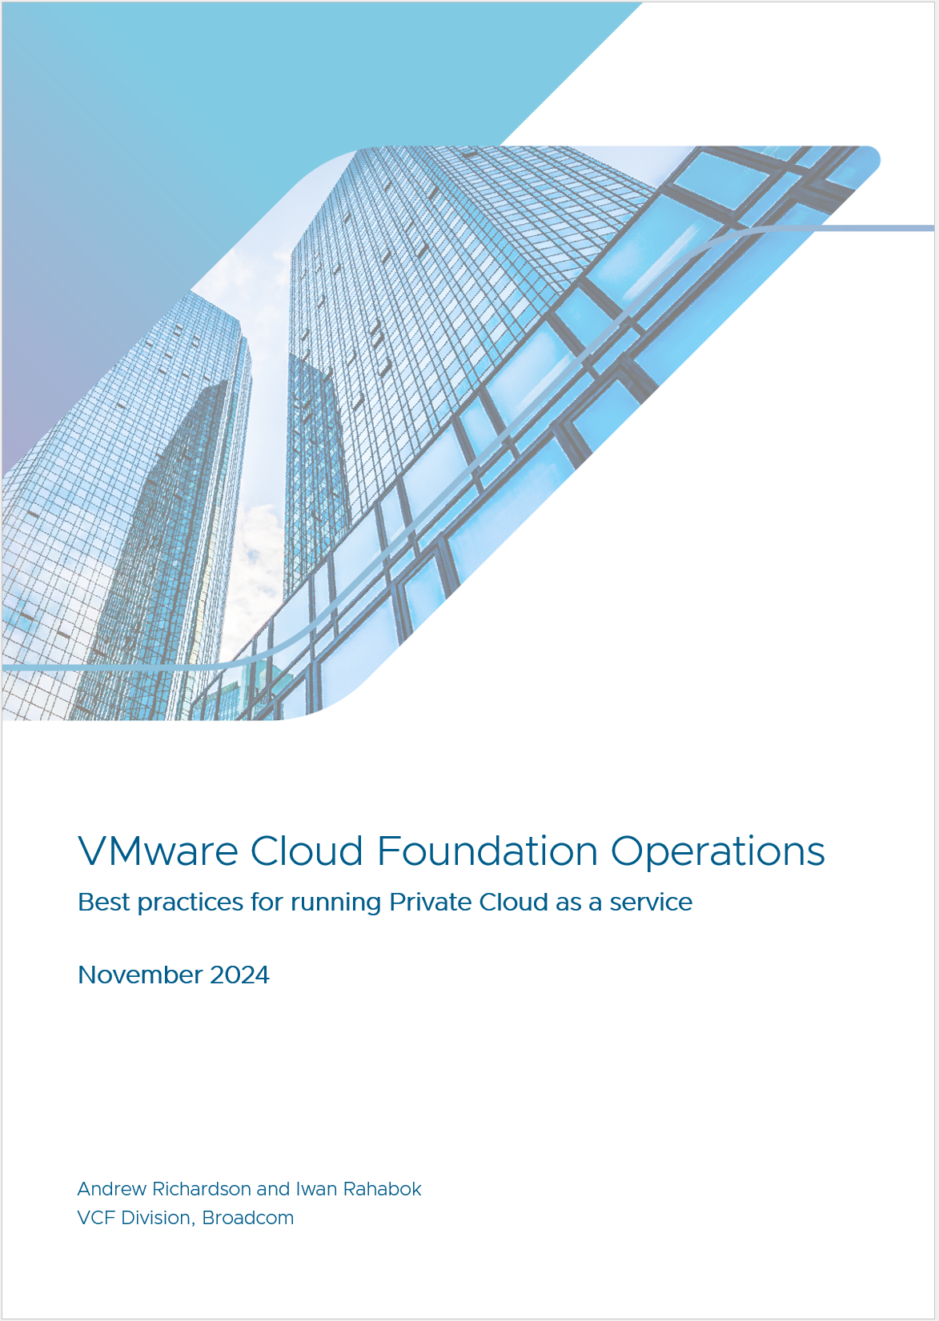
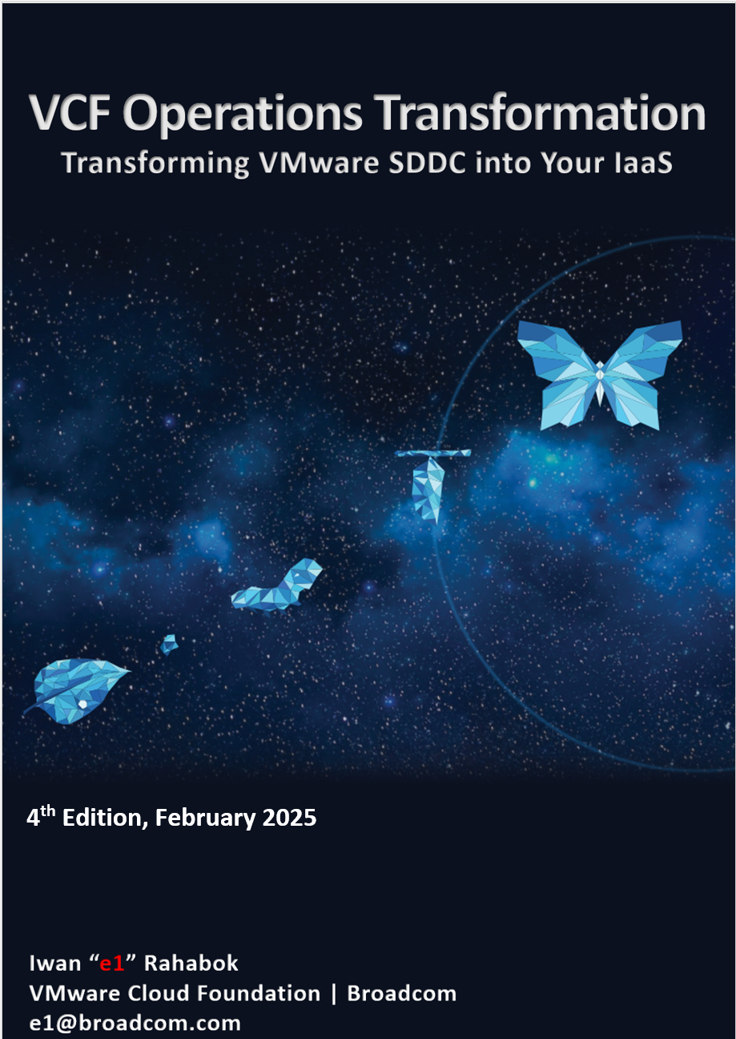
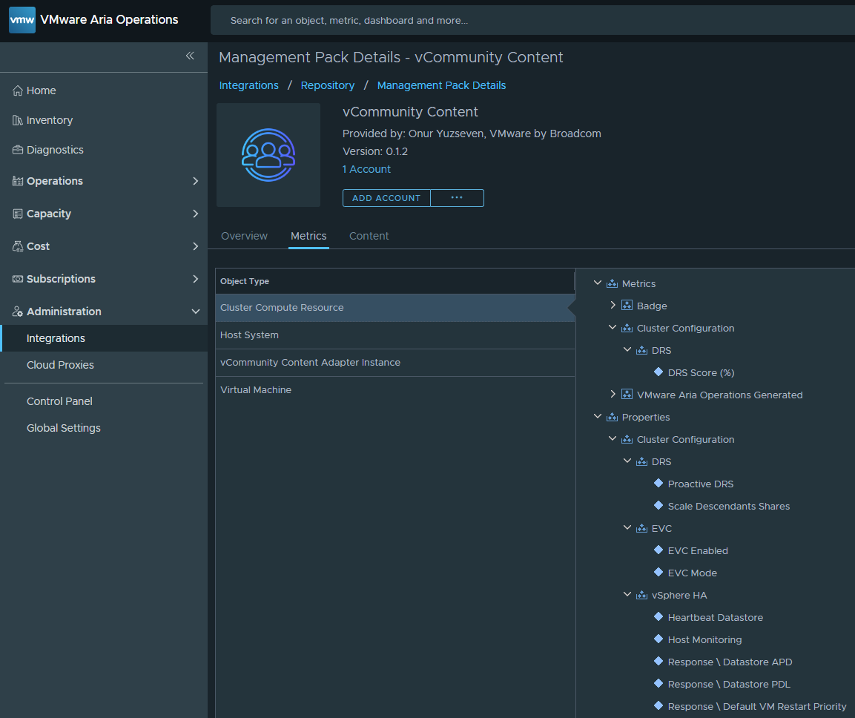
https://community.broadcom.com/vmware-code
Notes:
You can find the details of my presentation at this website. [demo it]
The first one is a CIO level executive summary. It’s a 25 page booklet designed for Private Cloud Architect to have a strategic level discussion with senior IT leadership.
Authored by Andrew Richardson, PSO out of Sydney for strategic operations transformation.
The second one is a 475 page deep dive into operations management.
The third one is toolkit. You can download and install this VCF Ops management pack. Developed by Onur Yuzseven, Broadcom TAM, Turkey
Review and let us know.

Slide 16
The Rise of Private Cloud Architect
Relevance to the Business
Cost
Service
Architecture
Notes:
The takeaway of the keynote.
Once in a lifetime opportunity.
Architect the whole element. Go beyond compute. Cover storage, network, security, automation, operations.
Business: Builds upon the service by adding the financial element (costing and pricing) that results in a profitable business.
Service Architect: Focuses on planning, defining, and monitoring classes of services. Defines SLAs and KPIs, so actual vs plan can be compared.
System Architect: Focus on the technology. Design and build reliable architecture of an integrated system, with automation capabilities.

Slide 18
The Rise and Fall of Infrastructure Architect
Infra Admin → Private Cloud Lead Architect
Impact on your work
Impact on you
Relevance to Business
X86
Commodity
Business Architect
Service Architect
Systems Architect
System
Services
Cloud
Consumer
Bespoke
Standardized
Infra Architect needs to move up from “techie”. IaaS, not SDDC. DaaS, not EUC
Notes:
Key point: architecture is becoming a given, so move up as that’s where your career needs to go. You can’t beat the young ones with tech. For example, I met a 20s engineer that graduates with AI degree. He knows AI deeper than I do. Or a 20s with 3 years of solid K8 experience. What they can’t beat you is your years of experience. That translates into ability to engage with CIO, and relationship in the industry.
Commodity: it initially hit servers, and now it’s hitting storage too. Dedicated storage arrays are literally disappearing, being replaced with converged infrastructure. Storage Admin job is going down with the arrays. Part of network is also being virtualized.
Reference in the book:
Part 1 Chapter 1 “Overview” chapter, especially VCDX and VCTX section.
Part 4 Chapter 9 “Infrastructure Architect” chapter for background and personal sharing. We all have our story
[e1: add DevOps impact?

Slide 19
Terminology

Slide 20
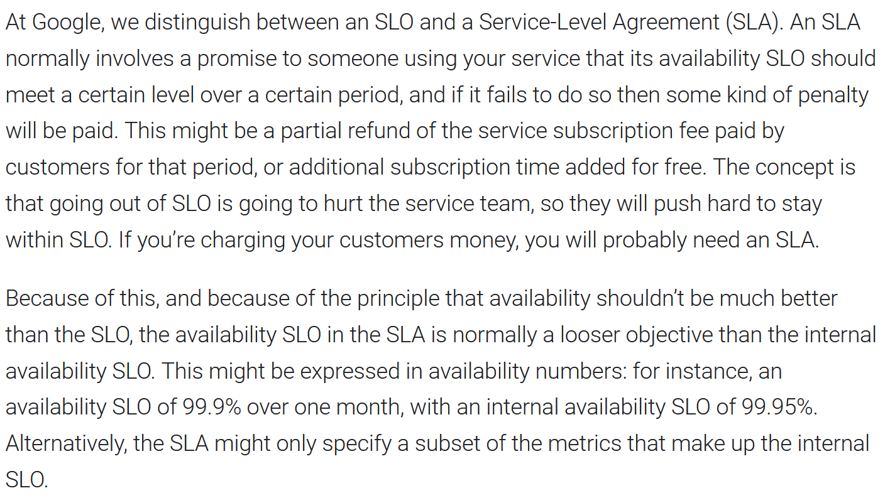
SLI vs SLO vs SLA vs KPI
Do we need 4 jargons? Let’s analyse a few examples…
Read the entire article, carefully https://cloud.google.com/blog/products/devops-sre/sre-fundamentals-sli-vs-slo-vs-sla. You will notice something wrong. Here are some examples:
1
Google assumes that SLA is only about Availability. Entire article does not even mention the other 3 SLA type. Just because something is up, does not mean it’s fast or secured.
“Going out of SLA” is better
“within SLA” is better.
This paragraph is flipping between SLA and SLO. The term SLO is used 4x, and on each the term SLA does the job. Classic case of PCMCIA.
For internal, KPI is better, as it’s more than just the service, but include underlying subsystem that indirectly support the service. KPI is layered, reflecting the subsystems used in troubleshooting.
Conclusion: SLO is not required. Just use SLA and KPI. SLI should be called SLA Leading Indicator
2
3
4
5

Slide 21
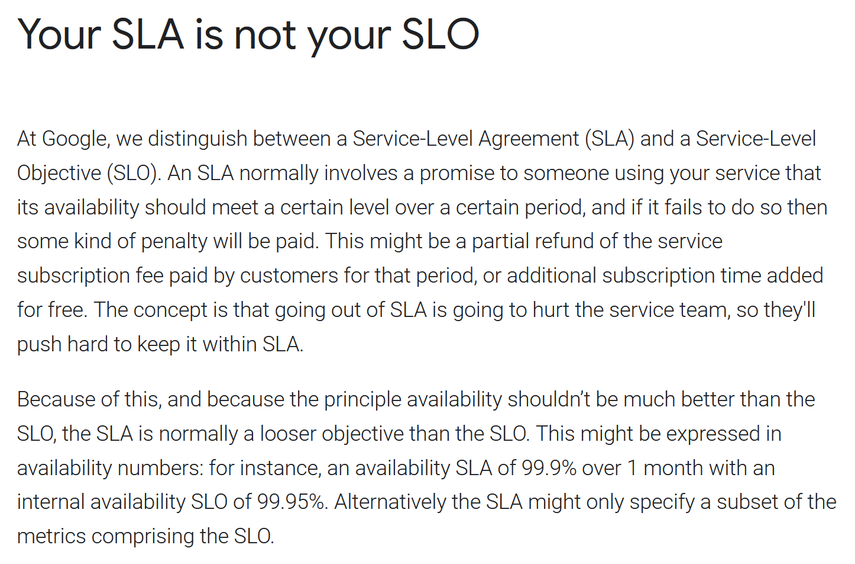
SLO is not a “looser objective” than SLA
Don’t confuse Internal vs External
Another article. Again, read the entire article, slowly https://cloud.google.com/blog/products/devops-sre/availability-part-deux-cre-life-lessons. You will notice something wrong. Here are some examples:
Wrong. That’s just a buffer you set internally. There is no need to elevate a buffer to the level where it becomes a peer of the real thing.
Again, confusing internal vs external. Internally, you certainly have buffer and more metrics. That’s expected. Some of these metrics, properties, events, logs are not directly related to the service specified in the contract. Labelling all of them as service are wrong. The correct term is KPI. It’s been around for decades, no need to throw it out of the window.
1
2

Slide 22
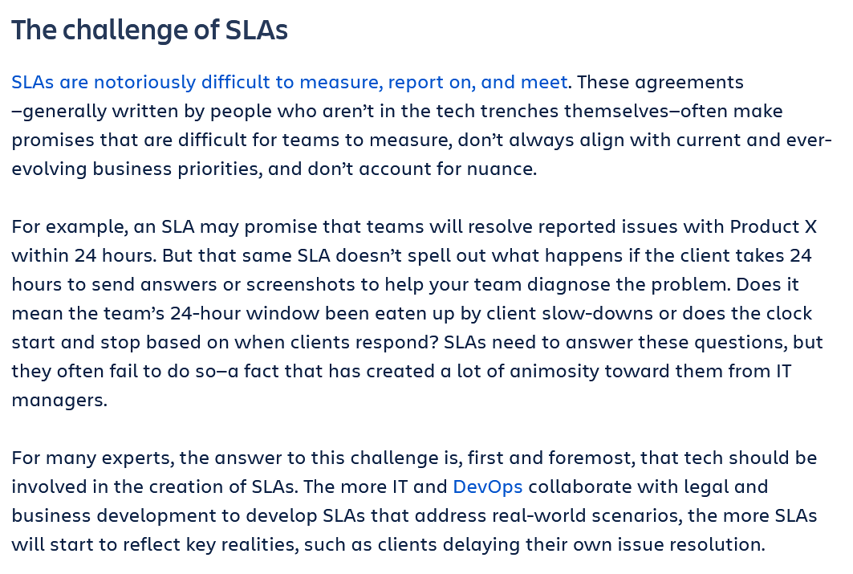
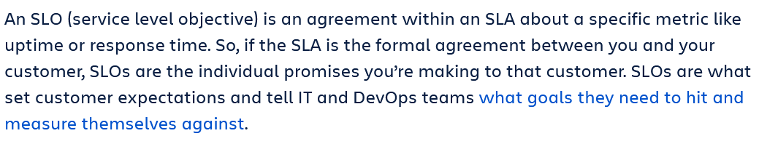
PCMCIA: Example 2
Where theory complicates practicality
Another article. Read the entire article first https://www.atlassian.com/incident-management/kpis/sla-vs-slo-vs-sli, before reading this.
It does not have to be. It’s all computer science, not art, it can be quantified.
Wrong example. It’s like doctor who promise to cure your illness X within 24 hours. SLA must be tied to what you sell, not what your customers sell. Understand the IT layers and persona within each layer.
Exactly. It’s just a metric within the SLA. No need to give it a big name, elevating its status to equal. SLA, just like any legally binding business contracts, has different sections and clause. Giving each section a brand name confuse IT Pro who are not involved in day to day operations. Sure, the lawyers have their clauses. That’s their job and they are paid for to take care of that. As far as IT guy, the metric is the SLA. If you really want to label it, give it a label that clearly show it’s a part of SLA, and not its peer. Names like SLA Metrics or SLA Definition.
Conclusion:
Even the vendors are confused. This is from Atlassian, a specialist vendor on ITSM. If Google and ITIL specialists are confused, no wonder the rest is.
1
2
3

Slide 23
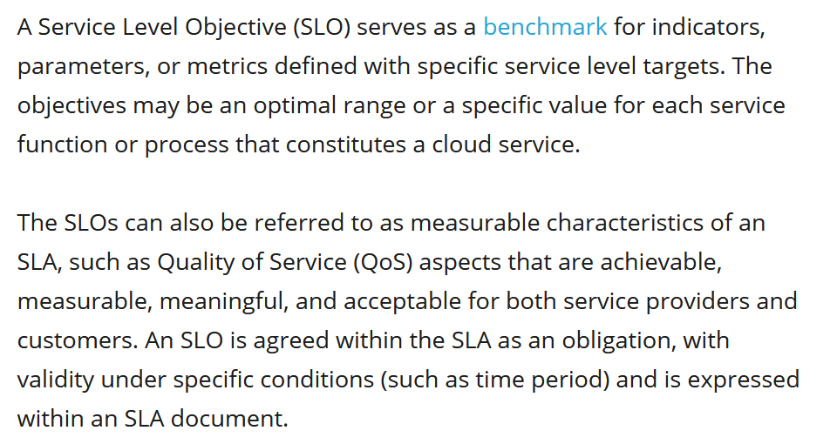
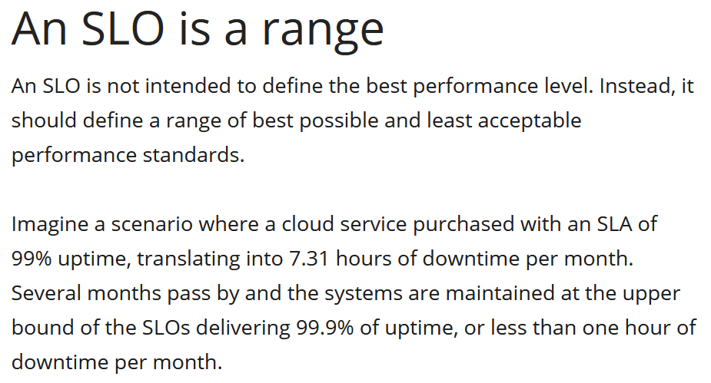
PCMCIA: Example 3
Even BMC is confused
1
1
2
If SLO is the “measurable” part of an SLA, what do you call the unmeasurable part? What’s the point of having a business contract that can’t be measured? SLA has to be measureable, else it’s not an SLA as it’s subjective. BTW, it’s not an objective. It’s a commitment. It’s not the goal or target, but the minimum. So aim higher just in case something wrong happens.
It’s not a range. It’s a threshold, like 10 ms disk latency. It’s precisely defined, no ambiguation.
SLA is a better word here.
BMC further adds Reliability concept, elevating it as peer to Availability. https://www.bmc.com/blogs/slo-service-level-objectives/ this adds further complexity. It reminds me of Observability, which requires many pages and time wasted to explain why it’s different to Monitoring and Troubleshooting. The problem of focusing too much on the theory is you complicate the day to day operations.

