Slide 1


vSphere Metrics
Capacity + Performance Deep Dive
Iwan ‘e1’ Rahabok
e1@broadcom.com
e1ang 9119 9226
Notes:
This workshop to show why it’s needed to know the metrics well. Lack of deep understanding resulting in suboptimal utilization
Challenge or Issues faced by customers

Slide 2
Takeaway
What you get from the session
Guest OS
Use contention within Windows or Linux to explain application performance is not because of shared infrastructure.
Explain why Guest OS metrics aren’t the same with VM metrics, and when to use which ones.
VM
Reduce oversized VM by using CPU Run instead of CPU Usage.
Reduce confusion by clarifying performance vs capacity
Measure the 4 types of VM CPU contention
ESXi
Gain capacity by using CPU Utilization instead of CPU Usage.
Increase confidence by measuring contention directly as a separate metric.

Slide 3
ESXi CPU Metric

Slide 4
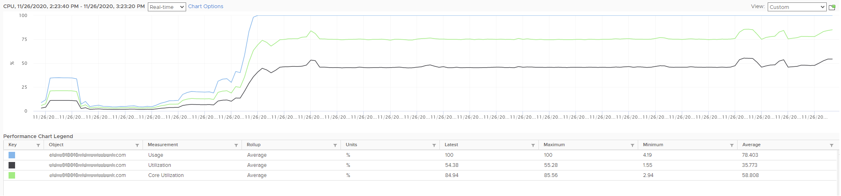
ESXi: CPU Utilization
Is it 50% or 75% or 100%?!
What is the actual utilization since there are 3 metrics?
Why is Usage > 2x of Utilization? What causes the values to differ widely?
Notes:
Quiz #1
3 counters, 3 meanings. Why?
Why is Utilization (%) fluctuating yet Usage (%) remains constant? Notice both Utilization varies between 45% and 55% while Usage remains flat at 100%.
What is the actual utilization since there are 3 metrics? Which one is which?
Why is Usage (%) = 100% when Utilization (%) is around 47%? The gap is more than double.
Why is Core Utilization (%) in the “middle”? What does it actually measure then?
To answer, we need to go through each question:
What are these 3 metrics?
To answer, we need to answer what is Total Capacity first.

Slide 5
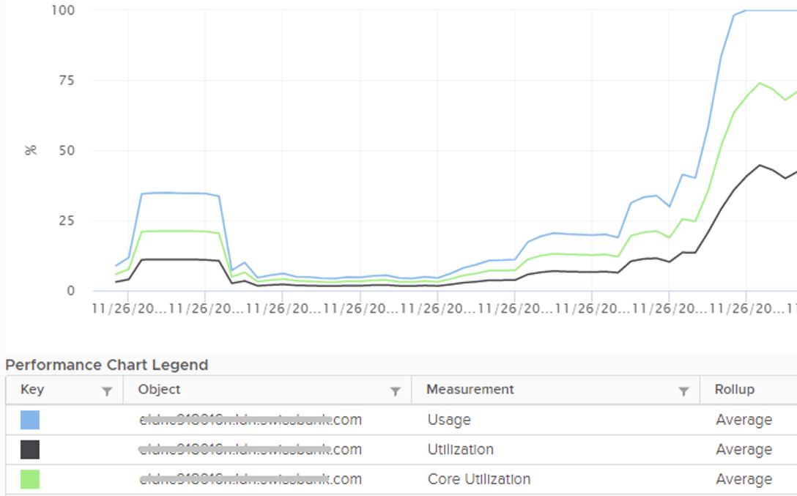
For those standing at the back….☺
Usage
Utilization
Core Utilization
Notes:
Zoom in for those standing at the back

Slide 6
Car | CPU
There are 2 aspects for CPU utilization
A car is travelling… | A CPU is running…
In the last 10 minutes, it drove for 9 minutes and stopped for 1 minute. So it was moving for 90% of the time. | In the last 10 minutes, it ran for 9 minutes and idle for 1 minute. So it was running for 90% of the time.
When it was moving, its speed average 60 km/hour. Speed varies due to traffic. | When it was running, its speed average 3 GHz. Speed varies due to power management.
CPU Run (%)
CPU Usage (MHz)
1-Core Turbo Speed
MHz
All-Cores Turbo Speed
Base Clock Speed
Idle
Run
Idle
Run
Time (seconds)
Notes:
With this slide, we distinguish the state (run or not) vs speed (when it is running).
On the next slide, we will cover between Thread and Core

Slide 7
vCPU | pThread | pCore
There are 3 different perspectives. Measured independently.
The passage of time. Reported every 20000 millisecond in vCenter UI
The actual CPU instruction processing happens in the core, not in the thread. So it’s the core that is “running”. Think of the thread as the entry gates. Whether it’s 1 or 2 gates providing the input, the core is working.
VM vCPU perspective
Co-stop
Ready
Wait
Idle
Run
Thread perspective
Idle
Utilisation
Run
Wait
Idle
Ready
Co-stop
Utilisation
Idle
Core perspective
Core Utilisation
Idle
Core Utilisation
Notes:
2 physical threads sharing a core. They run in parallel. Each adds up to 100%, but the core only adds up to 100%, causing confusion.

Slide 8
Why 2 metrics are needed
You want all cores used first, before threads are sharing a core
Core Utilization
Thread Utilization
100%
All cores are fully utilized. Before this point, you have idle core.
Any point here means ≥ 1 cores are running 2 threads, yet ≥ 1 core is idle. Not good.
50%
≥ 1 cores are running 2 threads. Be careful of performance impact
This combination does not exist, as it’s not possible for the pair of values.
Buffer for Cluster HA. Don’t reach this else availability issue creates performance issue
0%
Can you now explain why Core Utilization (%) can be up to 2x higher Thread Utilization (%)?
What’s the difference between “Core Util = 50% Util = 50%” AND “Core Util = 100%, Util = 50%”?

Slide 9
Summary
“Time Taken”
CPU run time in the sampling period
“Distance Travelled”
CPU cycles processed during the run
The Usage metric has 3 factors:
Running time
Efficiency of the run
Speed of the run
VM vCPU Run (%)
ESXi Thread Utilization (%)
ESXi Core Utilization (%)
VM vCPU Usage (MHz)
ESXi Thread Usage (MHz)
ESXi Core Usage (MHz)
The 3 metrics maps to the 3 layers.
A VM vCPU maps to a physical thread, which in turn runs on a shared core.
Efficiency
Account for Hyper Threading impact
VM | vCPU 1 | Usage → | 625 MHz
VM | vCPU 2 | Usage → | 625 MHz
ESXi | Thread 1 | Usage → | 625 MHz
ESXi | Thread 1 | Usage → | 625 MHz
ESXi | Core | Usage → | 1250 MHz
In this example, the CPU base speed is 1 GHz for ease of calculation.
Notice the sum of both threads equal the core.
Frequency
Account for CPU Speed impact
All the 5 counters are volatile, typically upwards 15% - 40% due to Turbo Boost.

Slide 10
The 6 Metrics
Summary. Putting it all together
ESXi Metric Name | Easier Name
Utilization (%) | Thread Utilization (%) | The primary counter for ESXi Capacity utilization
Core Utilization (%) | Core Utilization (%) | If this is not 100%, not all cores are utilized. There is imbalance (due to NUMA, shares, limit).
Usage (MHz) | Average Cycle Speed (MHz) | The average CPU speed if it were running non-stop during the collection period. Consider Efficiency and Frequency. Think of “throughput” instead.
Used (ms) | Do not use | Second is illogical to express speed.
Used (%) | Do not use | Tend to under report as the 100% is based on nominal speed.
Usage (%) | Do not use

Slide 11
ESXi Capacity: what exactly is the value?
A tale of 2 ESXi hosts
ESXi 01
ESXi 02
Core: 20
Thread: 40
Speed: 1 GHz
Core: 10
Thread: 20
Speed: 2 GHz
Different specification. So the 2 answers must be different. But which ones?!
Capacity?
40 threads
20 GHz
25 GHz
40 GHz
It depends
Capacity?
20 threads
20 GHz
25 GHz
40 GHz
It depends
Notes:
So that was ht utilization. What about the capacity?
Quiz #2
On ESXi 2, VM will run 2x faster, but you can only run half as many VMs. If you run the same number of vCPU as you do on ESXi 1, the VMs on ESXi 2 will compete and incur ~50% CPU Ready time. Workload performance likely becomes unpredictable. That means ESXi 2 has 2x the performance, but 0.5x the capacity. The 200% performance only happens when you run at 50% capacity of ESXi 1. When you load ESXi 2 with 1x the capacity of ESXi 1, its performance could drop below 1x of ESXi 1.
The above shows the imperfect correlation between performance and capacity. This is why you cannot use a single number to measure both.
Answer
ESXi 1 = 40 threads
ESXi 2 = 20 threads
You can see that Capacity is not expressed in GHz.
Performance is not expressed in MHz. It’s about the VM, hence it’s about VM CPU contention

Slide 12
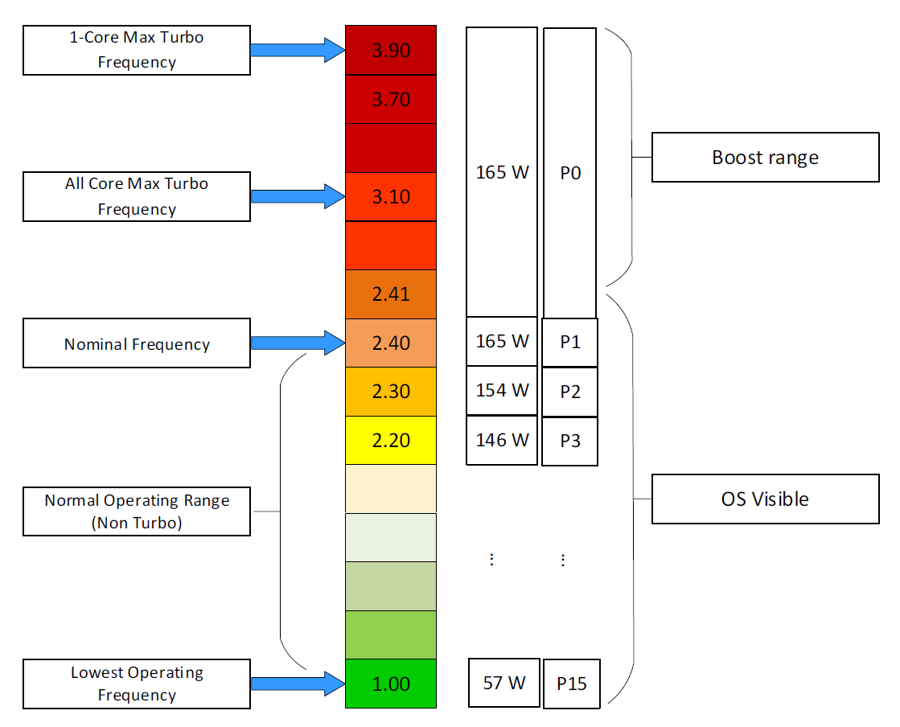
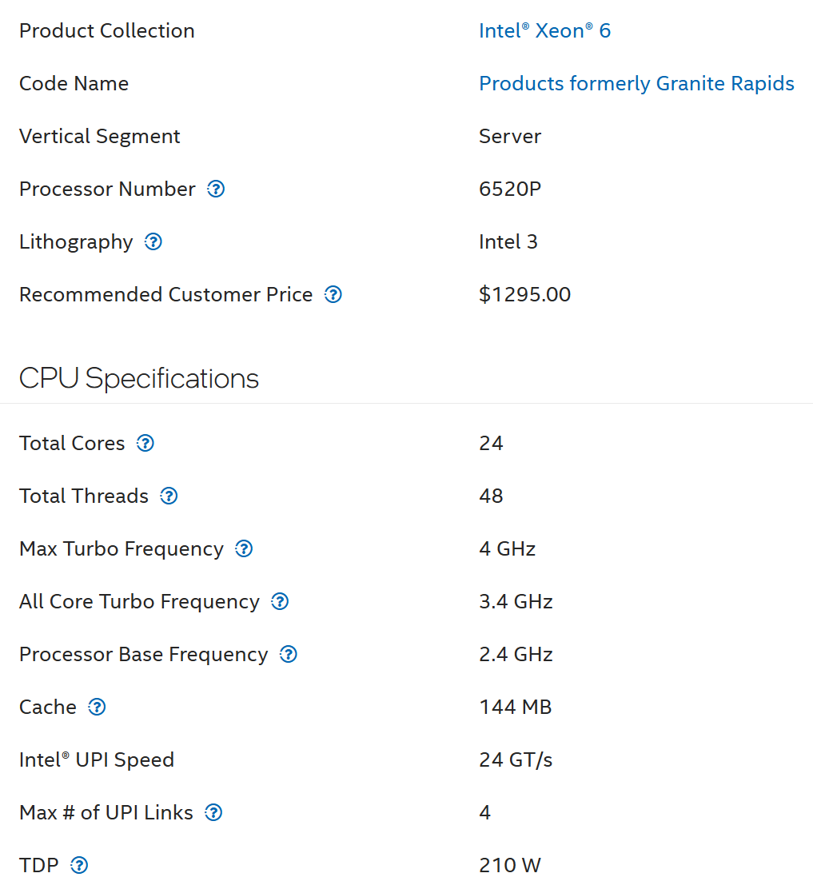
What, in reality, is your CPU Speed?
29% higher speed
42% higher speed
Notes:
Why CPU Usage (%) is too conservative
Usage at 100% is artificially capped as the total “capacity” is fluid and varies per core
https://www.intel.com/content/www/us/en/products/sku/242640/intel-xeon-6520p-processor-144m-cache-2-40-ghz/specifications.html

Slide 13
ESXi Capacity: what exactly is the value?
A tale of 2 ESXi hosts
ESXi 01
ESXi 02
Core: 20
Thread: 40
Nominal Speed: 1 GHz
All Cores Turbo: 1.2 GHz
Single Core Turbo: 2 GHz
Core: 10
Thread: 20
Speed: 2 GHz
All Cores Turbo: 2.4 GHz
Single Core Turbo: 4 GHz
Different specification. So the 2 answers must be different. But which ones?!
Capacity?
20 GHz
25 GHz
30 GHz
40 GHz
Capacity?
20 GHz
25 GHz
30 GHz
40 GHz
Notes:
So that was ht utilization. What about the capacity?
Quiz #2
On ESXi 2, VM will run 2x faster, but you can only run half as many VMs. If you run the same number of vCPU as you do on ESXi 1, the VMs on ESXi 2 will compete and incur ~50% CPU Ready time. Workload performance likely becomes unpredictable. That means ESXi 2 has 2x the performance, but 0.5x the capacity. The 200% performance only happens when you run at 50% capacity of ESXi 1. When you load ESXi 2 with 1x the capacity of ESXi 1, its performance could drop below 1x of ESXi 1.
The above shows the imperfect correlation between performance and capacity. This is why you cannot use a single number to measure both.
Answer
ESXi 1 = 40 threads
ESXi 2 = 20 threads
You can see that Capacity is not expressed in GHz.
Performance is not expressed in MHz. It’s about the VM, hence it’s about VM CPU contention

Slide 14
The Answers
2 answers, 1 for Demand Model, 1 for Capacity Model. You need both
Total Capacity | ESXi 01 | ESXi 02
Demand Model | 30 GHz | 30 GHz
 | Assuming All Core Turbo delivers 20% boost for both servers.
 | = 20 cores x 1 GHz x 1.25 x 1.2 | = 10 cores x 2 GHz x 1.25 x 1.2
Allocation Model | 40 threads | 20 threads
These numbers masks a critical information that the 2 ESXi hosts have different speeds.
These numbers do not consider performance. The 20 threads delivers same CPU compute cycles as the 40 threads.
This is the answer. However, in capacity planning, you need to consider Reservation & Utilization
This is why you need to use both numbers when doing capacity planning and monitoring.
Notes:
We put 20% as the extra speed. What you get is likely more than 20%. Let’s see 2 examples.

Slide 15
Utilization
Just a means to an end. It’s not something you manage
Utilization depends on the purpose.
Different goal → different interpretation and metrics
Performance
100% utilization is not only good, it’s perfect. So long there is no queue, drive this high
Low utilization may mean bad performance. Check Q
Look at actual utilization. Ignore Buffer and HA.
Use 20-second peak and 5 minute interval at the same time
Look at 1 second – 1 hour
Capacity
100% utilization is bad, especially it breaches Usable Capacity
Low utilization always mean good capacity. Cost is bad
Look at relative utilization. Include Buffer and HA.
Use hourly or daily average. Peak is taken care of by measuring contention directly.
Look at 1 day – 1 year
Notes:
Now let’s look at Utilization.
Point of the slide: do not manage utilization as its meaning depends on the purpose. It is just a means to an end. It is an input to something that you care. That something are performance and capacity
Reference in the book:
Part 1 Chapter 2 Performance: read the Performance vs Capacity section

Slide 16
Performance vs Capacity
Speed vs Space
Focus
Time
Counter
Availability SLA
Utilization
Cluster Performance
VM How the IaaS serves its VMs
1 second – 1 hour
Contention. Utilization is for troubleshooting, not monitoring.
Does not take into account. Not relevant
Based on raw. Usable Performance
Cluster Capacity
ESXi Are the ESXi running hot?
1 day – 1 year
Utilization. So long there is no contention.
Takes into account. Tier 1 is in fact Availability-driven.
Based on usable. Usable Capacity vs Total Capacity
Notes:
Quiz: What’s the difference between a vSphere Cluster Performance metric and vSphere Cluster Capacity metric?
Point of the slide: 2 sides of the same coin. Related but not the same.
Performance does not take into account Availability SLA.
A VM can have capacity problem, and not performance problem. A VM can also have performance problem, and not capacity problem. Or you can have both. They are related, but not identical. The reasons are the counters are different.
Reference in the book:
Part 1 Chapter 2 Performance: read the Performance vs Capacity section

Slide 17
VM CPU Metric

Slide 18
Quiz: Which metrics to use to rightsize VM CPU?
Context: Your App Team is asking for upsize. They say the VM needs more CPU
What metric best proves the need to upsize?
VM CPU Demand (MHz)?
VM CPU Usage (MHz)?
VM CPU Usage (%)?
VM CPU Net Run (%)?
Guest OS CPU Utilization (%)?
What metric estimate the size of the upsize?
VM CPU Demand (MHz)?
VM CPU Usage (MHz)?
VM CPU Ready (ms)?
Guest OS CPU Run Queue?
Guest OS CPU Context Switch?
Notes:
This is a tricky question. Think carefully

Slide 19
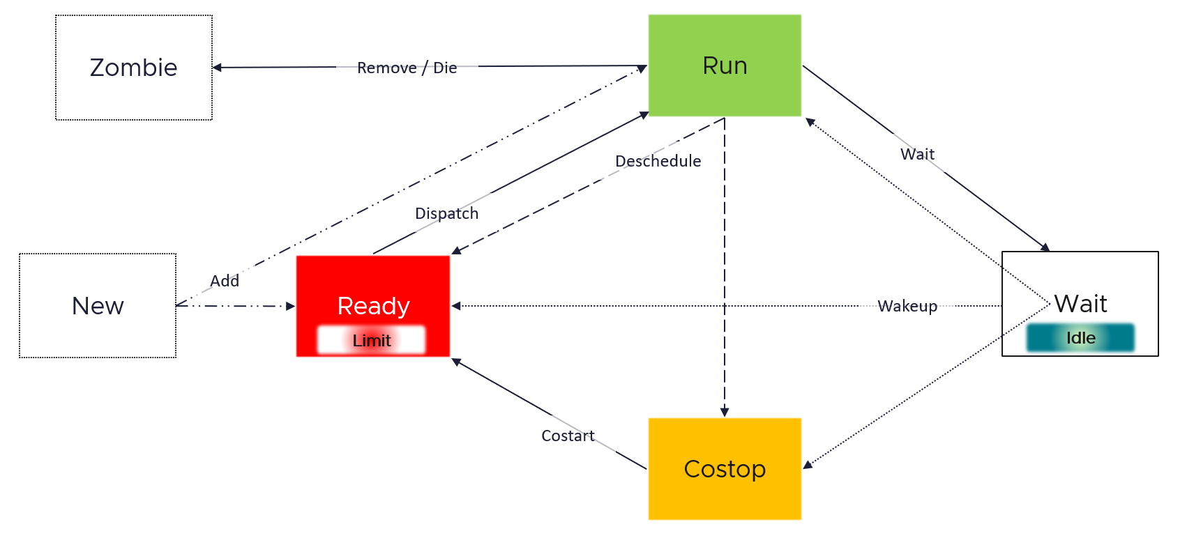
VM: CPU Metrics
Basic CPU Lifecycle, without CPU Frequency and HT complication
Notes:
The state diagram is simplified. The 2nd diagram show there are nuances in 3 of the states.
Run excludes Overlap. That’s why VCF Ops 5.2 sports a new counter called Net Run (%).
Wait includes Idle, as technically the vCPU is not doing work. Hence Guest OS level wait, any kind of wait, will result in Idle in underlying VM vCPU.
Scheduling / state changes, we’ll also look at what I’d call “accounting” later.

Slide 20
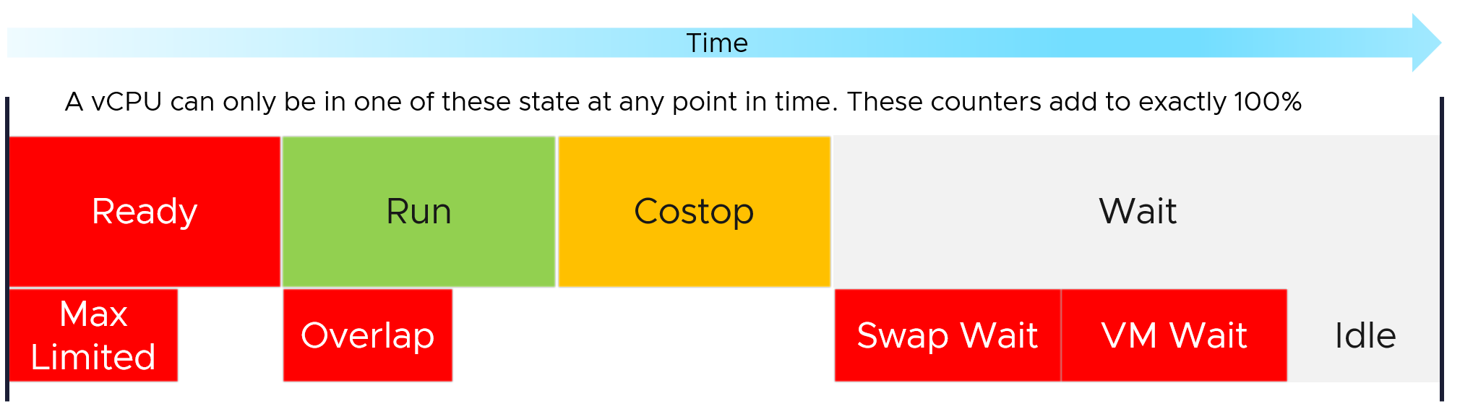
Metrics over Time
Why are the base metrics in millisecond?

Slide 21
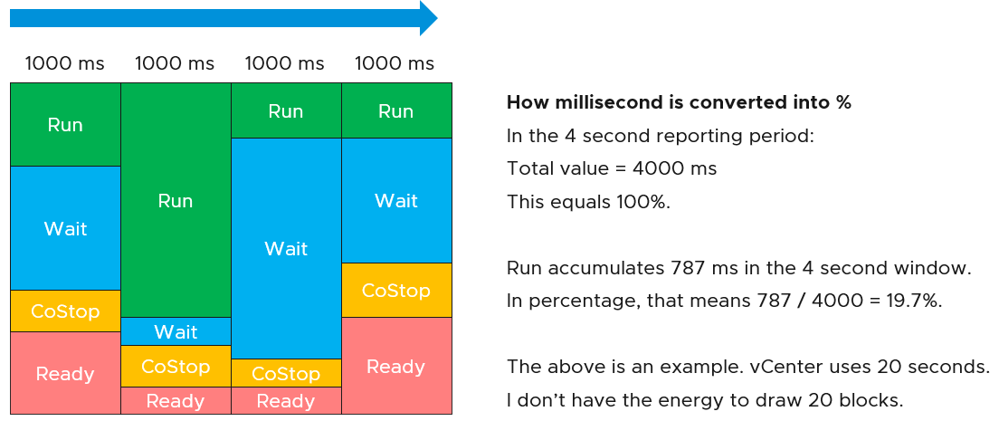
From ms to %

Slide 22
Why “performance” drops by 50% when CPU Run remains at 100%?
1.7 GHz
Single Core Boost Frequency
1.3 GHz
All Cores Boost Frequency
1.0 GHz
Nominal Frequency
Run: | 100%
Usage: | 1.7 GHz
Run: | 100%
Usage: | 1.3 GHz
Run: | 100%
Usage: | 0.8 GHz
0
Notes:
In all 4 cases, the VM vCPU is 100%. CPU Run (ms) = 20000 ms.
VM CPU Usage (GHz) shows 4 different numbers.
37.5% = Accounting penalty. Happens when both threads in a core are running (hence competing).
CPU Usage (%) metric does not reveal this transition.

Slide 23
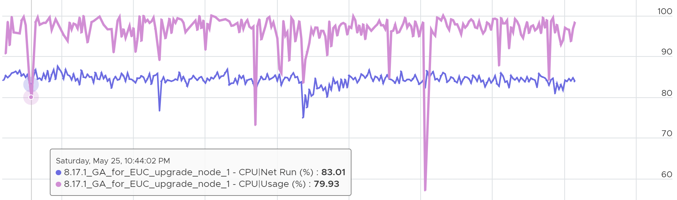
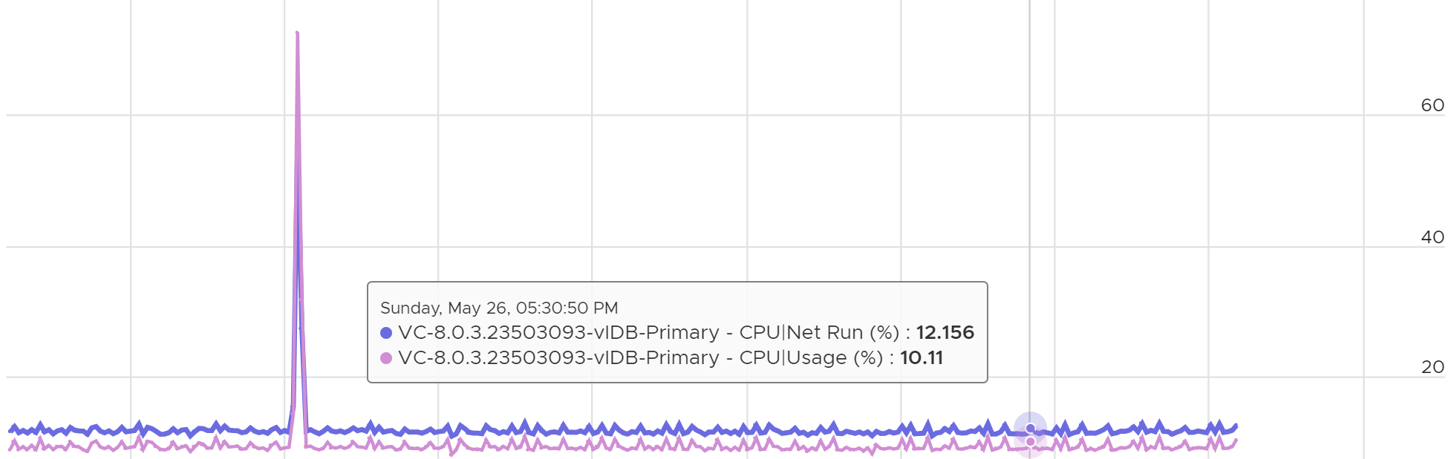
VM: CPU Usage vs CPU Net Run
During high utilization, Usage (%) will over report due to CPU turbo boost
During low utilization, Usage (%) will under report due to power savings
Notes:
Usage is more volatile, less suitable for capacity. Usage is needed in Performance

Slide 24
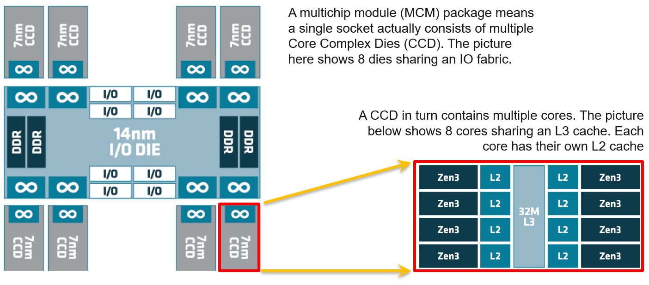
CPU: System on a Chip

Slide 25
Guest OS CPU Metrics

Slide 26
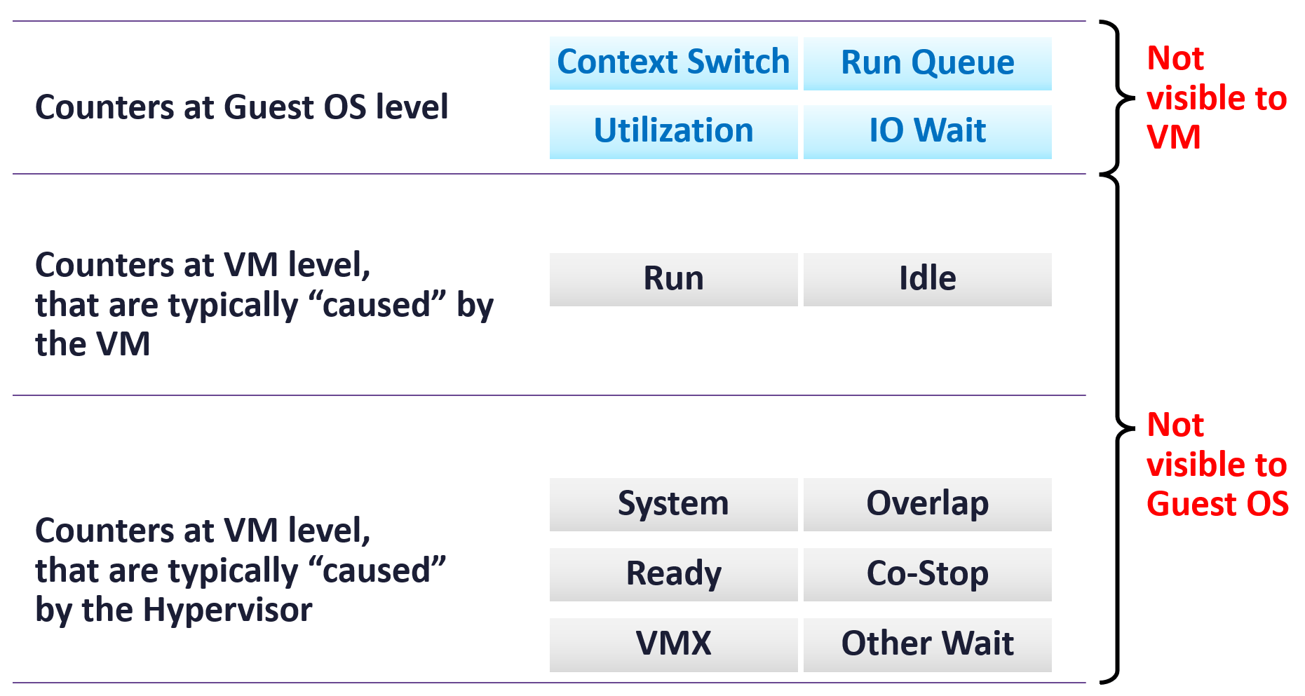
Guest OS vs VM
2 different realms

Slide 27
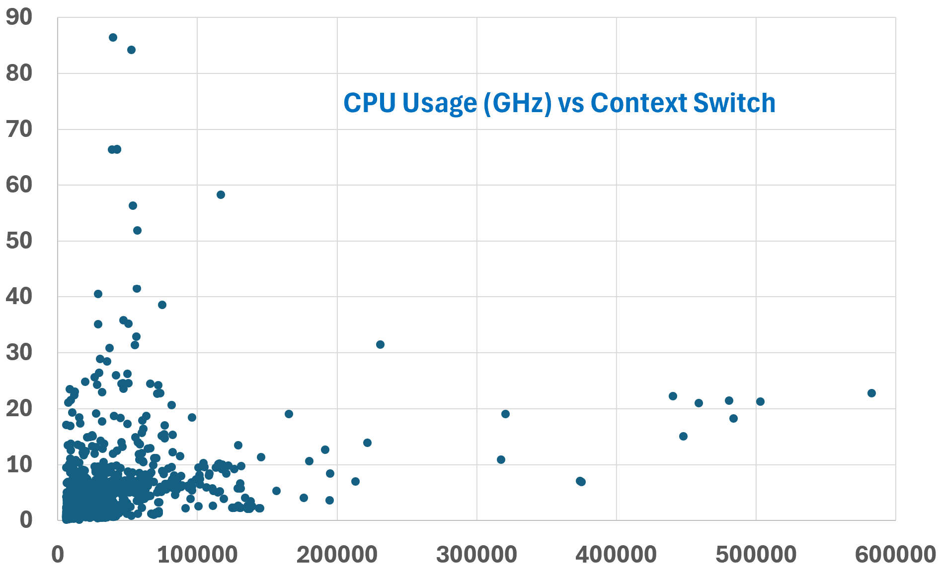
CPU Context Switch
It does not correlate with CPU Usage

Slide 28
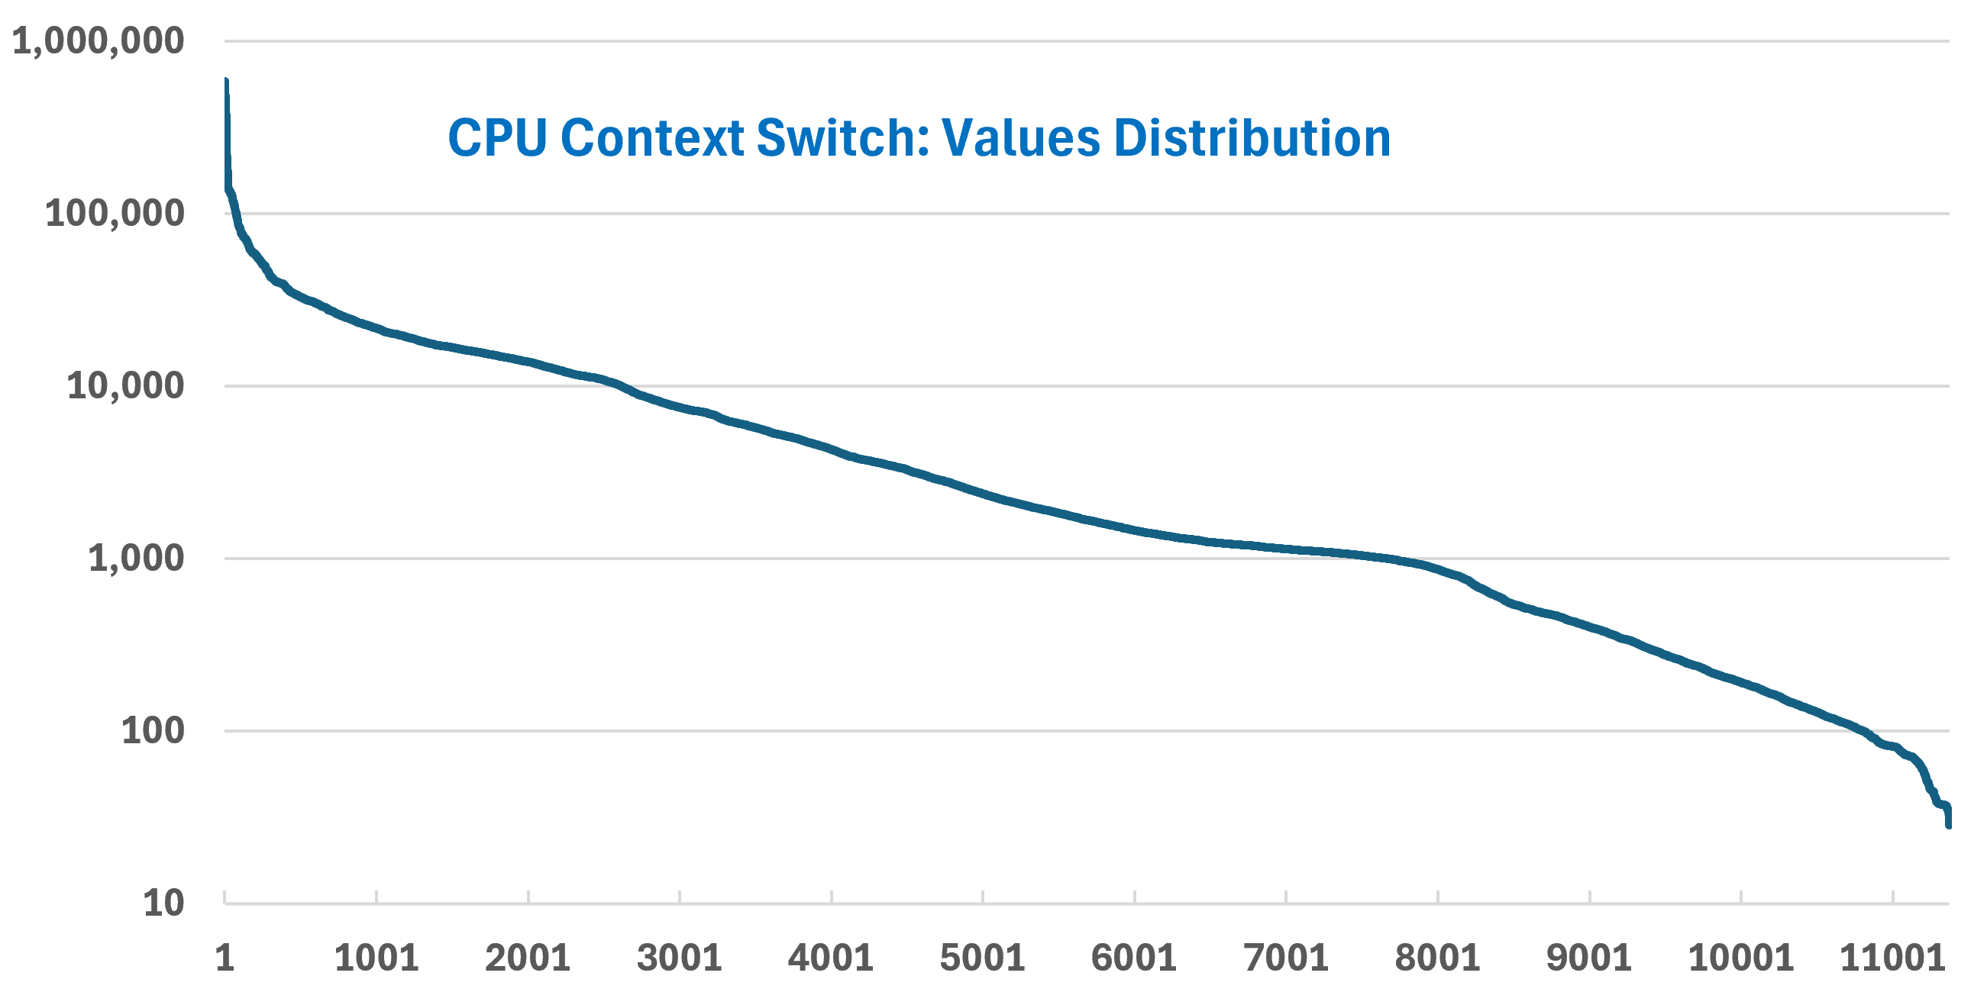
CPU Context Switch
The chart is a Log-10 scale. Why a very wide distribution?
Notes:
[e1: find out why it can be millions?? What’s the impact on CPU performance?

Slide 29
CPU Run Queue
Notes:
Definition
[e1: find out

Slide 30
CPU Run Queue: Distribution

Slide 31
Memory Metrics

Slide 32
Memory: The 4 Layers are independent
Windows/Linux manage memory independently of VMM layer
In-Use
Free
Guest OS perspective
VM perspective
Cache
Granted
Compressed
Swapped
Ballooned
Shared
ESXi-perspective of the VM.
This is physical view.
Consumed
Swapped
Notes:
Problems at Guest Layer
High Used, low Cache, near 0 Free.
Problems at VM Layer
Latency
High Ballooon
Moderate Swapped or Compressed
High Host Cache
High Cache Miss rate
Problems at ESXi Layer
High Active
High Reservation

Slide 33
Process (e.g. Chrome.exe)
Active
Passive
Guest OS (e.g. Windows)
balloon
VM
TPS
ESXi Host
DIMM
VMkernel
VM overhead
compressed
Disk
Swapped to host cache or disk

Slide 34
Quiz: Which metrics to use to rightsize VM Memory?
Context: Your App Team is asking for upsize. They say the VM needs more memory
What metric best proves the need to upsize?
VM Memory Consumed?
VM Memory Active?
Guest OS Used Memory?
Guest OS Total – Free Memory?
Guest OS Used + Cache Memory?
What metric estimate the size of the upsize?
VM Memory Ballooned?
VM Memory Swapped + Zipped?
VM Memory Latency?
Guest OS Memory Page-in Rate?
Guest OS Memory Page-out Rate?
Notes:
This is a tricky question. Think carefully

Slide 35
Performance (%)

Slide 36
Performance (%) Modelling
How to quantify vSphere performance?
Using number that is easy to understand (e.g. 0 – 100%)
Color coded: Green → Yellow → Orange → Red.
Encourage Proactive Operations
Handle metrics with different importance
Handle rarely-happen metrics
Notes:
Key Features
Color coded. 4 ranges (not 2, so we can have transition or warning
We can afford to have powerful dashboard as customers can focus on the color first, before reading the text.
Reduces the need of K8 expert as it aggregate raw metrics into a single, simple Performance (%).
Sports Weightage. More important metric can have higher weightage.
Sport Condition. To handle rarely happens yet critical metric.
Support early warning.
Primary and Secondary. The primary defines the performance (the What), the secondary explains why the primary is bad (the Why). K8 has poor correlation between What and Why
With formula that is complete, credible and customizable.
The model are flexible
We can add or remove metrics.
Same model adopted by vSphere, vSAN and Horizon. All adapters should use this.
We should build UI so customers can add modify if they want to (there is little business value actually, but some customers may insist). T

Slide 37
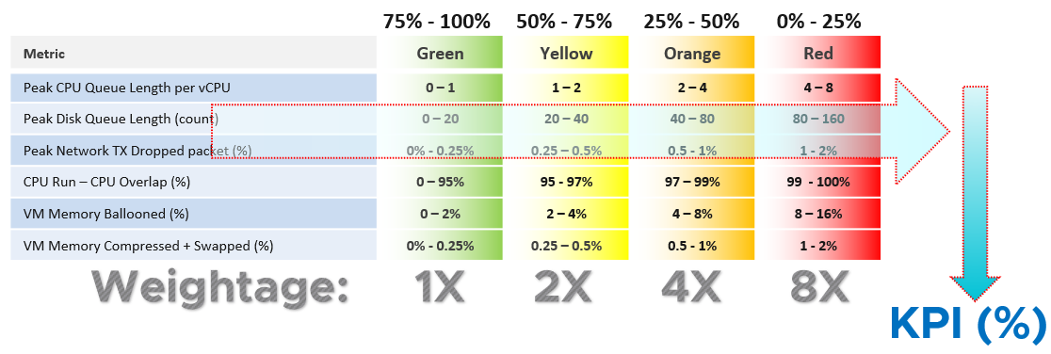
The Performance (%) metric
The same 2x 4x 8x concept is applied in the threshold themselves. E.g. 1 → 2 → 4 → 8, or 2 → 4 → 8 → 16 being used
Average, not Worst()
No need per policy. This is raw, fact. It’s KPI, not SLA. Gold is supposed to be better than Bronze, and this metric will prove it
Notes:
Weighted Average supports Early Warning. If you have many metrics that make up the KPI, and one of them is red but the remaining is all green, the overall KPI value may not reveal that there is a problem. That single red does not have enough weight to bring down the rest.
You can add weightage for each component. In future we can add it, using shares (not percentage). The drawback of share is the value is relative. If you 1 share for metric A and 1000 for metric B, it’s good as ignoring metric A.
We’re not adding weightage to keep the concept simple.
It’s not per policy. Gold VM should not have different metrics. If we need to present a different set in the future, that should be done via Class of Service.

Slide 38
IaaS KPI Metrics
How to start if you do not have SLA
Performance Metric (%)
Biz App KPI (%) | The metric is supported by 2 metrics Application Layer KPI (%) Infrastructure Layer KPI (%)
VM KPI (%) | It contains Guest OS counters. If the value drops, IaaS team need to check if it’s Guest OS or VM or infrastructure by looking at the components’ metric. It’s unaware of Class of Service as it’s not a relative counter. However, Gold VM is expected to perform better and higher KPI reflects that.
vSphere Cluster KPI (%) | Includes both VM and ESXi, so it is not the average of the VM KPI. VM KPI also contains Guest OS metrics, which is irrelevant to the Cluster KPI. Gold Cluster is expected to deliver better and higher KPI reflects that.
vSAN KPI (%) | It aims to answer if the issue is at vSAN or not, hence it only contains vSAN related.
NSX Edge KPI (%) | NSX has 3 distinct part (Edge, ESXi and Managers). We can’t combine the 3rd one as it’s on management plane. What we can combine is among multiple NSX “instances”
NSX Managers KPI (%)
vSphere DC is not something that can be modelled as it has server, storage and network elements. Rolling-up is not possible
Notes:
Dashboard:
A table in dashboard can’t have different columns showing different time period. You can’t have columns showing last 1 day, last 1 week and last 1 month in the same table. As a workaround, use the Health Chart

Slide 39
VM Performance (%)
 | Metric | Green | Yellow | Orange | Red
Guest OS Contention | Peak CPU Run Queue Length per vCPU | 0 – 1 | 1 – 2 | 2 – 4 | 4 – 8
 | Peak Disk Queue Length (count) | 0 – 20 | 20 – 40 | 40 – 80 | 80 – 160
Guest OS Utilization | Free Memory (MB) | 512 – 1024 | 256 – 512 | 128 - 256 | 0 - 128
Guest OS | RAM Page-out Rate (page/sec) | 0 – 1000 | 1K - 2K | 2K – 4K | 4K – 8K
VM Contention | Peak CPU Co-Stop among any vCPU (%) | 0 – 1% | 1 – 2 | 2 – 4 | 4 – 8%
 | Peak CPU Ready among any vCPU (%) | 0 – 2% | 2 – 4% | 4 – 8% | 8 – 16%
 | Peak CPU Other Wait (%) | 0 – 1% | 1 – 2 | 2 – 4 | 4 – 8%
 | Peak CPU Overlap (%) | 0 – 0.5% | 0.5 – 1 | 1 – 2 | 2 – 4%
 | Peak RAM Contention (%) | 0 – 0.5% | 0.5 – 1 | 1 – 2 | 2 – 4%
 | Peak Read/Write Latency among vDisk (ms) | 0 – 10 ms | 10 – 20 ms | 20 – 40 ms | 40 – 80 ms
 | Peak Network TX Dropped packet (%) | 0% - 0.25% | 0.25 – 0.5% | 0.5 - 1% | 1 - 2%
VM Utilization | CPU Run – Overlap | 0 – 95% | 95 - 97% | 97 – 99% | 99 - 100%
IaaS High Utilization | VM Memory Ballooned (%) | 0 – 2% | 2 – 4% | 4 – 8% | 8 – 16%
IaaS high utilization | VM Memory Compressed + Swapped (%) | 0% - 0.25% | 0.25 – 0.5% | 0.5 - 1% | 1 - 2%
Notes:
How do we define the performance of a single VM, from infrastructure viewpoint?
Peak = 20 second average.
CPU Usage is set to high as 95% is actually very good performance. In future we should replace with value from Tools.
Metrics Not included
See book
Limitation:
No weightage
No override

Slide 40
Notes:
sum([ ({‌This Resource: ‌guest|20_sec_peak_cpu_queue} as cpuQ < 1 ? (100 - ( cpuQ / 1 * 25 ) ) : cpuQ < 2 ? (75 - ((cpuQ- 1)/1 * 25))*2 : cpuQ < 4 ? (50-((cpuQ- 2) /2 * 25))*4 : (25 - (min([cpuQ -4,4])/4*25))*8), ({‌This Resource: ‌guest|20_sec_peak_disk_queue}as DiskQ < 20 ? (100 - ( DiskQ /20 * 25 ) ) : DiskQ < 40 ? (75 - ((DiskQ - 20)/20 * 25))*2 : DiskQ < 80 ? (50-((DiskQ - 40) /40 * 25))*4 : (25 - (min([DiskQ -80,80])/80*25))*8), ({‌This Resource: ‌cpu|20_sec_peak_readyPct} as Ready < 2 ? (100 - ( Ready /2 * 25 ) ) : Ready < 4 ? (75 - ((Ready - 2)/2 * 25))*2 : Ready < 8 ? (50-((Ready - 4) /4 * 25))*4 : (25 - (min([Ready -8,8])/8*25))*8), ({‌This Resource: ‌cpu|20_sec_peak_costopPct} as coStop < 1 ? (100 - ( coStop /1 * 25 ) ) : coStop < 2 ? (75 - ((coStop - 1)/1 * 25))*2 : coStop < 4 ? (50-((coStop - 2) /2 * 25))*4 : (25 - (min([coStop -4,4])/4*25))*8), ({‌This Resource: ‌cpu|20_sec_peak_iowaitPct}as oWait < 1 ? (100 - ( oWait/1 * 25 ) ) : oWait < 2 ? (75 - ((oWait - 1)/1 * 25))*2 : oWait < 4 ? (50-((oWait - 2) /2 * 25))*4 : (25 - (min([oWait -4,4])/4*25))*8), ({‌This Resource: ‌cpu|20_sec_peak_overlap} as Overlap < 0.5 ? (100 - ( Overlap/0.5 * 25 ) ) : Overlap < 1 ? (75 - ((Overlap - 0.5)/0.5 * 25))*2 : Overlap < 2 ? (50-((Overlap - 1) /1 * 25))*4 : (25 - (min([Overlap -2,2])/2*25))*8), ({‌This Resource: ‌mem|20_sec_peak_host_contentionPct} as mLatc < 0.5 ? (100 - ( mLatc/0.5 * 25 ) ) : mLatc < 1 ? (75 - ((mLatc - 0.5)/0.5 * 25))*2 : mLatc < 2 ? (50-((mLatc - 1) /1 * 25))*4 : (25 - (min([mLatc -2,2])/2*25))*8), ({‌This Resource: ‌virtualDisk|20_sec_peak_totalLatency_average} as dLatc < 20 ? (100 - ( dLatc/20 * 25 ) ) : dLatc < 40 ? (75 - ((dLatc - 20)/20 * 25))*2 : dLatc < 80 ? (50-((dLatc - 40) /40 * 25))*4 : (25 - (min([dLatc -80,80])/80*25))*8), ({‌This Resource: ‌guest|mem.free_latest}as mFree /1024 > 512 ? min([mFree/1024 - 512,512])/512 * 25 + 75 : mFree/1024> 256 ? ((mFree/1024- 256)/256 * 25 + 50)*2 : mFree/1024> 128 ? ((mFree/1024- 128) /128 *25 + 25)*4 : mFree/1024/128*25*8), ({‌This Resource: ‌guest|page.outRate_latest}as PageO < 1000 ? (100 - ( PageO/1000 * 25 ) ) : PageO < 2000 ? (75 - ((PageO - 1000)/1000 * 25))*2 : PageO < 4000 ? (50-((PageO - 2000) /2000 * 25))*4 : (25 - (min([PageO -4000,4000])/4000*25))*8), ({‌This Resource: ‌mem|balloonPct}as Balloon < 2 ? (100 - ( Balloon/2 * 25 ) ) : Balloon < 4 ? (75 - ((Balloon - 2)/2 * 25))*2 : Balloon < 8 ? (50-((Balloon - 4) /4 * 25))*4 : (25 - (min([Balloon -8,8])/8*25))*8),({‌This Resource: ‌cpu|net_run} as Run < 80 ? (100 - ( max([Run - 60,0]) / 20 * 25 )) : Run < 90 ? (75 - ((Run - 80)/10 * 25))*2 : Run < 95 ? (50-((Run - 90) /5 * 25))*4 : (25 - ((Run - 95)/5*25))*8),({‌This Resource: ‌Super Metrics|Memory Zipped and Swapped} as ZipSwap < 0.5 ? (100 - ( ZipSwap/0.5 * 25 ) ) : ZipSwap < 1 ? (75 - ((ZipSwap - 0.5)/0.5 * 25))*2 : ZipSwap < 2 ? (50-((ZipSwap - 1) /1 * 25))*4 : (25 - (min([ZipSwap -2,2])/2*25))*8), ({‌This Resource: ‌net|droppedTxPct_max} as netTXd < 0.25 ? (100 - ( netTXd/0.25 * 25 ) ) : netTXd < 0.5 ? (75 - ((netTXd - 0.25)/0.5 * 25))*2 : netTXd < 1 ? (50-((netTXd - 0.5) /1 * 25))*4 : (25 - (min([netTXd -2,2])/2*25))*8) ]) / sum([ (cpuQ < 1 ? 1 : (cpuQ < 2 ? 2 : (cpuQ < 4 ? 4 : 8))) , (diskQ < 20 ? 1 : (diskQ < 40 ? 2 : (diskQ < 80 ? 4 : 8))), (Ready < 2 ? 1 : (Ready < 4 ? 2 : (Ready < 8 ? 4 : 8))) , (coStop < 1 ? 1 : (coStop < 2 ? 2 : (coStop < 4 ? 4 : 8))) , (oWait < 1 ? 1 : (oWait < 2 ? 2 : (oWait < 4 ? 4 : 8))) , (Overlap < 0.5 ? 1 : (Overlap < 1 ? 2 : (Overlap < 2 ? 4 : 8))) , (mLatc < 0.5 ? 1 : (mLatc < 1 ? 2 : (mLatc < 2 ? 4 : 8))) , (dLatc < 20 ? 1 : (dLatc < 40 ? 2 : (dLatc < 80 ? 4 : 8))), (mFree / 1024 < 128 ? 8 : (mFree / 1024 < 256 ? 4 : (mFree / 1024 < 512 ? 2 : 1))) , (PageO < 1000 ? 1 : (PageO < 2000? 2 : (PageO < 4000 ? 4 : 8))), (Balloon < 2? 1 : (Balloon < 4? 2 : (Balloon < 8? 4 : 8))), (Run < 80 ? 1 : (Run < 90 ? 2 : (Run < 95 ? 4 : 8))) , (ZipSwap< 0.5 ? 1 : (ZipSwap< 1 ? 2 : (ZipSwap< 2 ? 4 : 8))) , (netTXd < 0.25 ? 1 : (netTXd < 0.5 ? 2 : (netTXd < 1 ? 4 : 8))) ])

Slide 41
vSphere Cluster Performance (%)
 | Metrics | Green | Yellow | Orange | Red
How Deep? | Worst Peak vCPU Ready among all VMs | 0 – 4% | 4 – 8 | 8 - 16% | 16 - 32%
 | Worst vCPU Co-Stop among all VMs | 0 – 2% | 2 – 4 | 4 – 8 | 8 - 16%
 | Worst Memory Latency among all VMs | 0 – 1% | 1 – 2 | 2 – 4 | 4 – 8%
 | Worst ESXi (error + dropped) network packets | 0% - 0.2% | 0.2 – 0.4% | 0.4 – 0.8% | 0.8 – 1.6%
How Broad? | Average Peak vCPU Ready among VMs | 0 – 1% | 1 – 2 | 2 – 4 | 4 – 8%
 | Average Peak vCPU Co-Stop among VMs | 0 – 1% | 1 – 2 | 2 – 4 | 4 – 8%
 | Average Memory Latency among VMs | 0% - 0.5% | 0.5 – 1% | 1 - 2% | 2 - 4%
 | Percentage of vMotion | 0 – 1% | 1 – 2 | 2 – 4 | 4 – 8%
 | Average (swapped + zipped) memory | 0% - 0.25% | 0.25 – 0.5% | 0.5 - 1% | 1 - 2%
 | Average Balloon memory | 0 – 1% | 1 – 2 | 2 – 4 | 4 – 8%
Notes:
We’re not doing 95th Percentile and Average for Other Wait and Overlap. They are less popular metrics, less practical too. As at 7 Aug 2022, the bug on CPU Other Wait on vSphere 7.0U2 or later has not been fixed.
We’re not doing the “Percentage of VM population experience CPU Ready > 1%” and “Percentage of VM population experience Memory Contention > 0%” as they measure the same purpose with the average.
Counters not available
There are counters that are only available in esxtop. They are not available in vCenter REST API, so they are not retrieveable.
Examples are Local:Remote memory ratio for VM.
We’re not doing 95th Percentile and Average for Other Wait and Overlap. They are less popular metrics, less practical too. As at 7 Aug 2022, the bug on CPU Other Wait on vSphere
Future enhancement:
90th or 95th percentile complements Worst and Average. We put a more stringent threshold for leading indicator.
Add utilization. But this needs a new counter.
Add CPU Overlap. Low priority for now as the number is always low so it will make the overall score greener
Add CPU Other Wait once the bug in vSphere is fixed. Low priority as number is always low

Slide 42
Size the Guest OS, not the VM

Slide 43
Notes:
I can see a lot of people are going to be sleeping well tonight!
Thank You

Slide 44
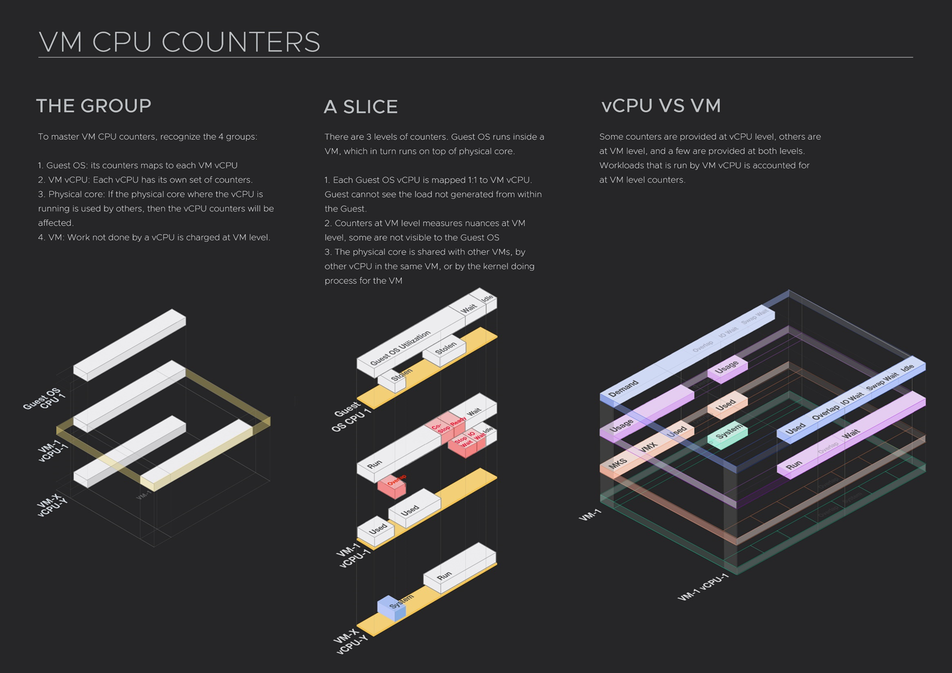
Metrics are complex
In VCF Operations 5.2, we’ve started the simplification without losing visibility
4 layers. 4 different sets of metrics
  Process vs Guest OS vs VM vs ESXi
  Know them well so correct alerts with correct metrics are set
We’ve started adding Guest OS alerts.
  Helps VCF Admin defends the IaaS (VM, Resource Pool) layer from complaint that it’s not serving the VMs well.
  The queue are likely higher than industry standard, but no complain. This is akin to you have plague in your artery but you don’t feel it.
Notes:
CPU utilization is merely one input to the real questions, which are
1. How much CPU do I need? This is Capacity question.
2. Am I having a CPU performance problem? This is Performance question.
The counters you choose need to be mindful of Multi Threading and CPU Frequency Scaling. Multi-threading is available in both Intel Xeon and AMD EPYC. In the case of Intel, the 2nd thread reduces the performance of the 1st thread by 37.5%. CPU clock speed directly impacts the speed of the CPU. Power Management and Turbo Boost are not visible by the Guest OS
There are 4 types of CPU Performance:
CPU ping pong within the Guest. This is tracked by Guest OS Context Switch
Queue in one of the Guest OS CPU. This is tracked by Guest OS Run queue.
CPU ping pong at the hypervisor level. PMEM counter in VMkernel tracks this.
CPU frozen by hypervisor. Tracked by Overlap, Ready, Co-Stop
CPU waiting is not a CPU problem. It’s IO or Memory problem. CPU waits longer for IO due to double processing of IO, is tracked by IO Wait. CPU Waiting for RAM is tracked by Swap Wait.
Notice CPU utilization is not part of the performance counters. 100% utilization is in fact perfect performance, as you get highest throughput and most amount of work done. So long there is no queue, you actually want utilization to be 100% and not 99%.
CPU Utilization is used in Capacity.

Slide 45
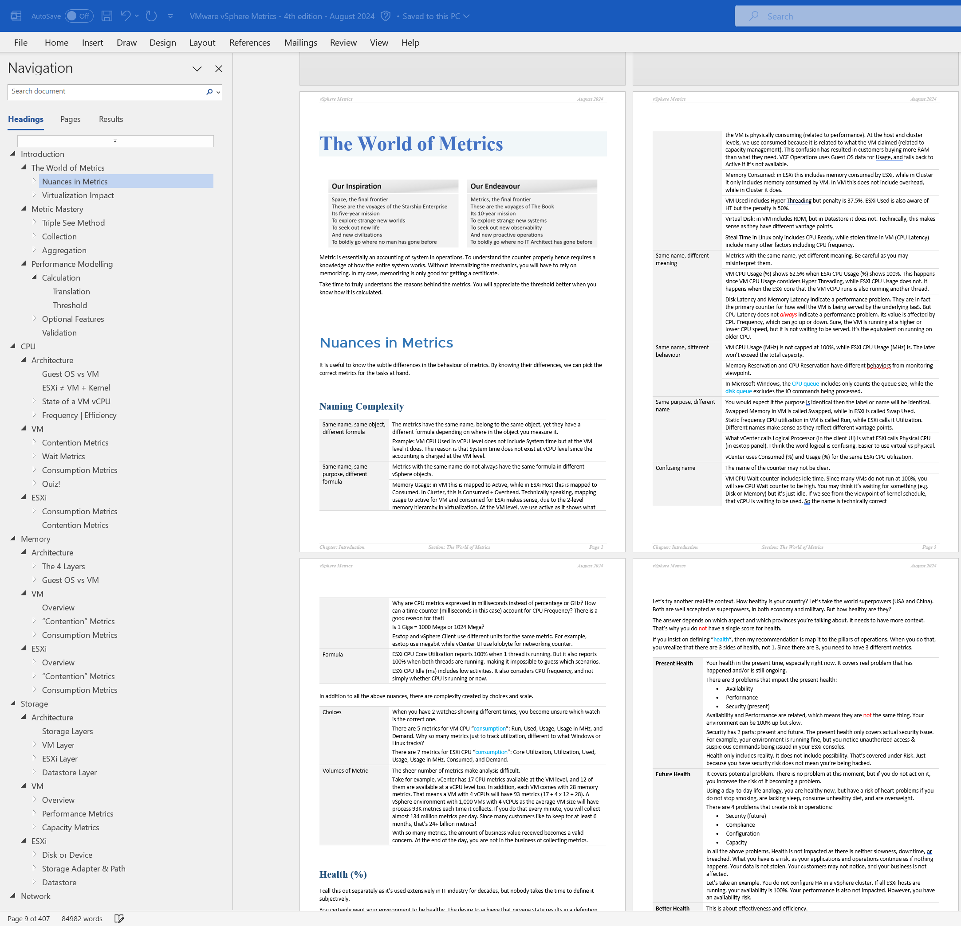
Nuances in Counters
New layer alters behavior of adjacent layers. Virtualization impacts metrics differently
Nuance | Examples
Same name, different formula | Memory Usage: VM maps to Active, ESXi maps to Consumed, Cluster maps to Consumed + ESXi Overhead Memory Consumed: in ESXi this includes memory consumed by ESXi, while in Cluster it only includes memory consumed by VM (VMkernel memory excluded)
Same name, different behavior | VM RAM Reservation is permanent (once requested), hence impacts memory utilization. VM CPU Reservation is on demand, it does not impact CPU utilization.
Same name, different meaning | Disk Latency and Memory Latency indicate performance problem. CPU Latency does not. It excludes Ready & Co-Stop, the 2 main performance metrics.
Same meaning, different name | VM CPU Run = ESXi CPU Utilization. VM CPU Latency (in vCenter) = VM CPU Contention (in vR Ops)
Same name, different formula, depending on where you measure it | VM CPU Used in vCPU level does not include System time. At VM level it does. Reason is System time does not exist at vCPU level.
Notes:
Virtualization adds a layer between physical hardware and Guest OS. This changes these 2 layers substantially from management viewpoint.
This side effect of changes in architecture can also be seen in container and Kubernetes. These 2 changes how monitoring is done.
vSphere counters are more complex than physical machine counters, because it has many components. There are also inconsistencies, some are caused by the nature of virtualization. When virtualized, the 4 elements of infrastructure (CPU, RAM, Disk, Network) behave differently.
Disk Latency measures roundtrip. Memory Latency measures time spent (which is similar to roundtrip). This needs double verification if memory latency measures the amount of memory waiting.

Slide 46
KPI → SLI → SLA
How they work together. Consumer and Provider. 6 metrics
KPI
Example
Start with this. If you don’t have KPI, promising SLI will result in even more complaint. You need to back up your SLI with actual ability to monitor and troubleshoot. KPI goes wider and deeper than SLI.
It measures absolute performance (fact, reality), not relative (against promised threshold). If Gold is better than Bronze, you need to be able to prove it. KP applies the same Green-Yellow-Orange-Red range for all, regardless of class of service. KPI is not related to contract.
VM KPI includes VM, Guest OS, and Apps metrics.
Cluster KPI >< average of its VM KPI.
Infra KPIs are internal to provider, while VM KPI is for each VM owner. They measure different things. This is KPI, not SLI, so the 2 layers are not related. VM KPI has Guest OS metrics, which is irrelevant to Infra. Cluster KPI has ESXi metrics.
(Notice the inconsistency in the numbers. They are intentional to show the difference between KPI, SLI and SLA)
KPI (last 5 minutes)
Gold VM 001 and Bronze VM 001 happen to be unlucky. Other VMs are doing better, as cluster number is higher.
Gold VM 001
99.3%
Gold Cluster 01
99.6%
Bronze VM 001
88.8%
Bronze Cluster 01
93.1%
SLI
KPI can’t explain why Gold can be better than Bronze yet Gold fails SLA while Bronze pass SLA. This is where SLI comes in. Notice the name Service Level. SLI is a small subset of the KPI metrics. Only the ones listed in the business contract.
KPI is absolute, SLI is relative.
VM SLI = Average of 4 SLI (CPU, RAM, Disk, Network)
1 standard for all class of service. So expects Bronze to fail more, which is what it should be.
Cluster SLI >< Average of its VM SLI
Cluster SLI = Count of VM that fails SLA.
SLI is a 5-minute counter, so can’t be used yet as the business contract is defined in 30-days. SLA is required for that. Both use the same metric.
Notice Cluster SLI does not care about VM SLI value. It only cares pass or fail. It counts how many fails that’s all.
Why Bronze VM KPI is lower than its SLI? Unlikely but possible. Reason is KPI uses more metrics & scope includes Guest OS (not just IaaS).
The Gold VM and the Gold Cluster fail to meet their promised threshold. But this is just 5 minute, it does not mean SLA is breached.
SLI (last 5 minutes)
Gold VM 001
75%
Gold Cluster 01
2 / 100 VM
98%
Bronze VM 001
100%
Bronze Cluster 01
0 / 200 VM
100%
SLA
VM SLA = 30-day average of VM SLI.
Yes, a simple average over the SLA measurement period.
Warning: It can take up to 30-days to “forget” the failure in the past because the counter is average of last 30 days. It does not care about the future
Cluster SLA >< 30-day average of Cluster SLI.
Cluster SLA >< Average of its VM SLA
It is % of VM who fails SLA.
SLA is compared against guarantee. It’s typically near 100% but never 100%. E.g. Gold is 99.99% while Bronze is 99.97%
It is both the goal and the reality. No such thing as internal SLA as that’s just SLA + Buffer.
SLA (last 30 days)
Looking at the last 30 days, Gold pass while Bronze fail. A single SLI failure may not mean SLA failure.
Gold VM 001
Pass
Gold Cluster 01
0 / 100 VM
100%
Bronze VM 001
Fail
Bronze Cluster 01
2 / 200 VM
99%

Slide 47
Capacity Planning

Slide 48
ESXi Capacity Planning
Allocation Model and Demand Model: use both together
Hyper Threading
All Cores Turbo
160 GHz
128
Base Frequency x Cores
Threads, not Core
Usable Capacity
= Total Threads – Hypervisor Overhead
= 128 – 12
= 116 threads
Count overcommit ratio from this number.
30 GHz
12
Hypervisor Overhead
Hypervisor Overhead
0 GHz
0
Total Capacity | 64 cores
Total Capacity | 128 threads
Base Clock speed | 2.5 GHz
All Cores Turbo | 3.2 GHz
Kernel Overhead (NSX, vSAN, etc.) | 30 GHz
 | 12 threads
Effective speed per thread
= 3.2 GHz All Cores Turbo * 1.25 HT / 2 threads
= 2.0 GHz
Notes:
Usable Capacity
= (64 cores * 3.2 GHz All Cores Turbo * 1.25 HT) – 30 GHz
= 256 – 30
= 226 GHz
Reservable Capacity
= ( Base Clock Speed * Total Cores ) – Kernel Reservation
= 2.5 * 64 – 10
= 144 GHz
2.0 GHz is the CPU Capacity per vCPU you tell to VM Owners
Hypervisor overhead is everything. ESXi, vSAN, NSX, vSphere Replication, etc.
vSphere does not consider HT and All Cores Turbo

