Slide 1
VMware vSphere: Install, Configure, Manage [V8]

Slide 2

Course Introduction

Slide 3
Importance
As a vSphere administrator, you require knowledge about vSphere components and resources and how they work together in your environment. You also require practical skills in installing, deploying, and managing your vSphere environment. By developing your knowledge and skills, you can build and run a highly scalable vSphere virtual infrastructure.

Slide 4
Learner Objectives (1)
Install and configure ESXi hosts
Deploy and configure vCenter
Use the vSphere Client to create the vCenter inventory and assign roles to vCenter users
Create and configure virtual networks using vSphere standard switches and distributed switches
Create and configure datastores using storage technologies supported by vSphere
Use the vSphere Client to create virtual machines, templates, clones, and snapshots
Create a content library for deploying virtual machines
Manage virtual machine resource use

Slide 5
Learner Objectives (2)
Configure ESXi hosts to support vSphere vMotion and vSphere Storage vMotion migrations
Create and configure a vSphere cluster that is enabled with vSphere High Availability and vSphere Distributed Resource Scheduler
Manage the life cycle of vSphere to keep vCenter and ESXi hosts up to date

Slide 6
Course Outline
Course Introduction
vSphere and Virtualization Overview
Installing and Configuring vSphere ESXi
Deploying and Configuring vCenter
Configuring vSphere Networking
Configuring vSphere Storage
Deploying Virtual Machines
Managing Virtual Machines
Deploying and Configuring vSphere Clusters
Managing the vSphere Lifecycle

Slide 7
Typographical Conventions
The following typographical conventions are used in this course.
Conventions | Use and Examples
Monospace | Identifies command names, command options, parameters, code fragments, error messages, filenames, folder names, directory names, and path names: Run the esxtop command. ... found in the /var/log/messages file.
Monospace Bold | Identifies user inputs: Enter ip a.
Boldface | Identifies user interface controls: Click the Configuration tab.
Italic | Identifies book titles: vSphere Virtual Machine Administration
< > | Indicates placeholder variables: <ESXi_host_name> ... the Settings/<Your_Name>.txt file

Slide 8
References (1)
Title | Location
VMware ESXi Installation and Setup | https://docs.vmware.com/en/VMware-vSphere/8.0/vsphere-esxi-8.0-installation-setup-guide.pdf
vCenter Server Installation and Setup | https://docs.vmware.com/en/VMware-vSphere/8.0/vsphere-vcenter-80-installation-guide.pdf
vCenter Server and Host Management | https://docs.vmware.com/en/VMware-vSphere/8.0/vsphere-esxi-vcenter-80-management-guide.pdf
vSphere Virtual Machine Administration | https://docs.vmware.com/en/VMware-vSphere/8.0/vsphere-esxi-vcenter-server-80-vm-administration.pdf
vSphere Networking | https://docs.vmware.com/en/VMware-vSphere/8.0/vsphere-esxi-vcenter-80-networking-guide.pdf
vSphere Storage | https://docs.vmware.com/en/VMware-vSphere/8.0/vsphere-esxi-vcenter-80-storage-guide.pdf

Slide 9
References (2)
Title | Location
vSphere Resource Management | https://docs.vmware.com/en/VMware-vSphere/8.0/vsphere-esxi-vcenter-80-resource-management-guide.pdf
vSphere Availability | https://docs.vmware.com/en/VMware-vSphere/8.0/vsphere-esxi-vcenter-80-availability-guide.pdf
Managing Host and Cluster Lifecycle | https://docs.vmware.com/en/VMware-vSphere/8.0/vsphere-esxi-vcenter-80-vsphere-lifecycle-manager.pdf
VMware Compatibility Guide | https://vmware.com/resources/compatibility
VMware Product Lifecycle Matrix | https://lifecycle.vmware.com
VMware Configuration Maximums | https://configmax.vmware.com

Slide 10
VMware Online Resources
Documentation for vSphere: https://docs.vmware.com/
VMware Communities: https://communities.vmware.com
Start a discussion.
Access the knowledge base.
Access documentation, technical papers, and compatibility guides.
Access communities.
Access user groups.
VMware Support: https://www.vmware.com/support
VMware Hands-on Labs: https://hol.vmware.com
VMware Learning: https://www.vmware.com/learning
Access course catalog.
Access worldwide course schedule.

Slide 11
VMware Learning Overview
You can access the following Education Services:
VMware Learning Paths:
Help you find the course that you need based on the product, your role, and your level of experience
Can be accessed at https://vmware.com/learning
VMware Customer Connect Learning, which is the official source of digital training, includes the following options:
On Demand Courses: Self-paced learning that combines lecture modules with hands-on practice labs
VMware Lab Connect: Self-paced, technical lab environment where you can practice skills learned during instructor-led training
Certification Exam Prep: Comprehensive video-based reviews of exam topics and objectives to help you take your certification exam
For more information, see https://vmware.com/learning/connect-learning.
Notes:
VMware Customer Connect Learning offers different subscriptions. For a comparison of the subscriptions, go to https://vmware.com/learning/connect-learning and click WHICH SUBSCRIPTION IS RIGHT FOR YOU?.

Slide 12
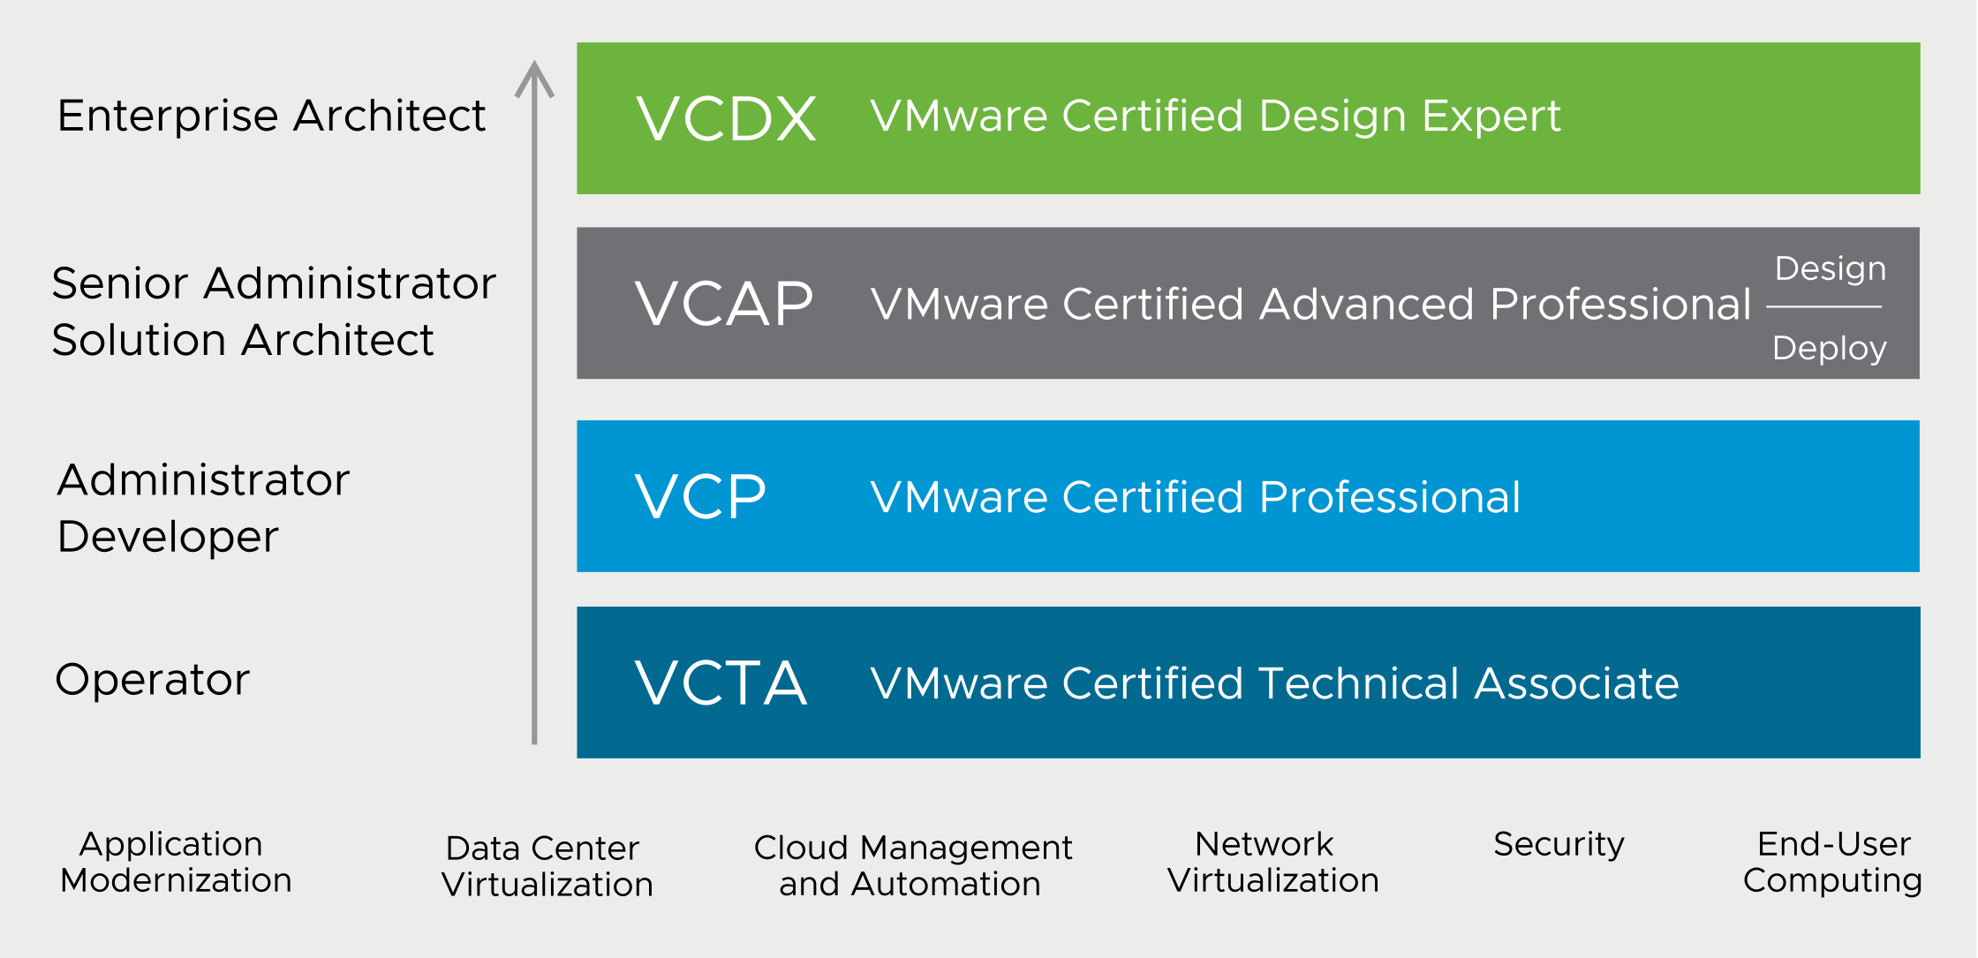
VMware Certification Overview
VMware certifications validate your expertise and recognize your technical knowledge and skills with VMware technology.
Notes:
VMware certification sets the standards for IT professionals who work with VMware technology. Certifications are grouped into technology tracks. Each track offers one or more levels of certification (up to four levels).
For the complete list of certifications and details about how to attain these certifications, see https://vmware.com/certification.

Slide 13
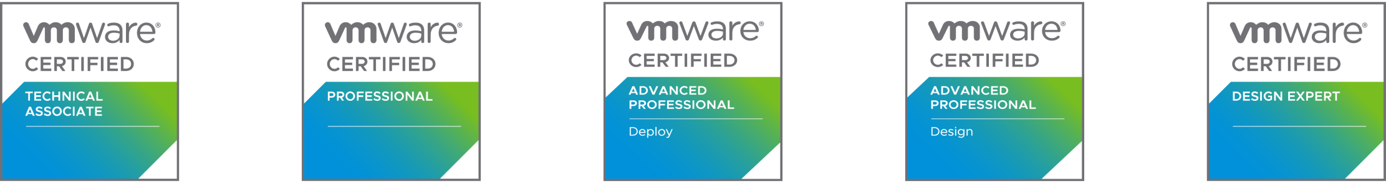

VMware Credentials Overview
VMware badges are digital emblems of skills and achievements. Career certifications align to job roles and validate expertise across a solution domain. Certifications can cover multiple products in the same certification.
Specialist certifications and skills badges align to products and verticals and show expanded expertise.
Notes:
Digital badges have the following features:
Easy to share in social media
Validate and verify achievement
Contain metadata with skill tags and accomplishments
Based on Mozilla's Open Badges standard
For the complete list of digital badges, see https://www.pearsonvue.com/vmware/badging.

