Slide 1
Managing the vSphere Lifecycle

Slide 2
Importance
Managing the life cycle of vSphere involves keeping vCenter and ESXi hosts up to date and integrated with other VMware and third-party solutions. It also involves keeping VMware Tools and virtual hardware in a VM up to date. To achieve these goals, you must understand how to keep vCenter up-to-date and how to use the features provided by vSphere Lifecycle Manager, namely, cluster-level management of ESXi hosts.

Slide 3
Module Lessons
Managing the vCenter Life Cycle
Overview of vSphere Lifecycle Manager
Managing the Life Cycle of ESXi Hosts and Clusters
Managing the Life Cycle of VMware Tools and VM Hardware

Slide 4

Managing the vCenter Life Cycle

Slide 5
Learner Objectives
Plan for vCenter updates and upgrades by generating interoperability reports
Recognize how to update vCenter with the latest patches, updates, and upgrades

Slide 6
About Upgrades, Updates, and Patches
vSphere products distinguish between upgrades, updates, and patches:
Upgrades:
Major change to the software
Either digit in the release number changes, for example, 6.7, 7.0, 8.0
Updates and Patches:
Smaller changes to the software
Update number is added to release number, for example, 7.0 Update 3

Slide 7
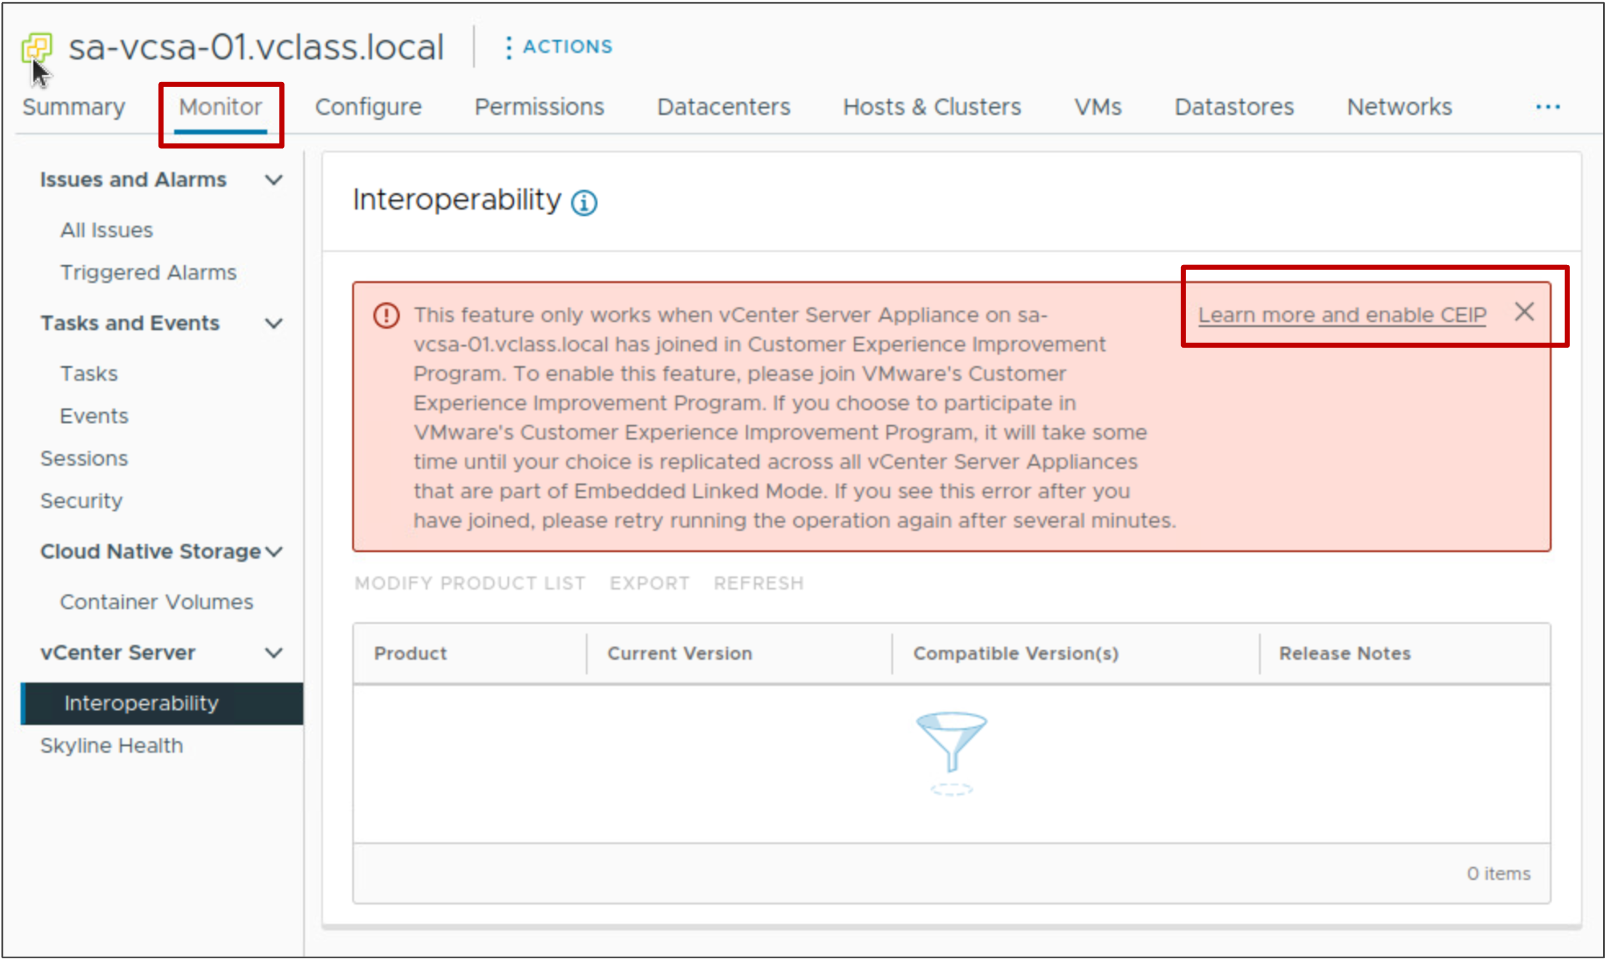
Planning for vCenter Updates and Upgrades
To plan for vCenter updates and upgrades, you can produce interoperability reports about VMware products associated with vCenter.
You check VMware products against both the installed version of vCenter and the version to which you plan to upgrade.
To generate interoperability reports, you must first join the VMware Customer Experience Improvement Program (CEIP).
Notes:
The Customer Experience Improvement Program (CEIP) is a program that provides you with features to help you proactively manage your vSphere environment. The vCenter interoperability report, also referred to as vCenter Server Update Planner, is one of the features that CEIP offers.
To join CEIP, click the Learn more and enable CEIP link in the message and click JOIN PROGRAM.
Alternatively, you can join or leave the program using the following steps:
From the main menu, select Administration.
Under Deployment, select Customer Experience Improvement Program.
Click JOIN PROGRAM (or LEAVE PROGRAM).
You can find more information on VMware's CEIP by visiting https://www.vmware.com/solutions/trustvmware/ceip.html

Slide 8
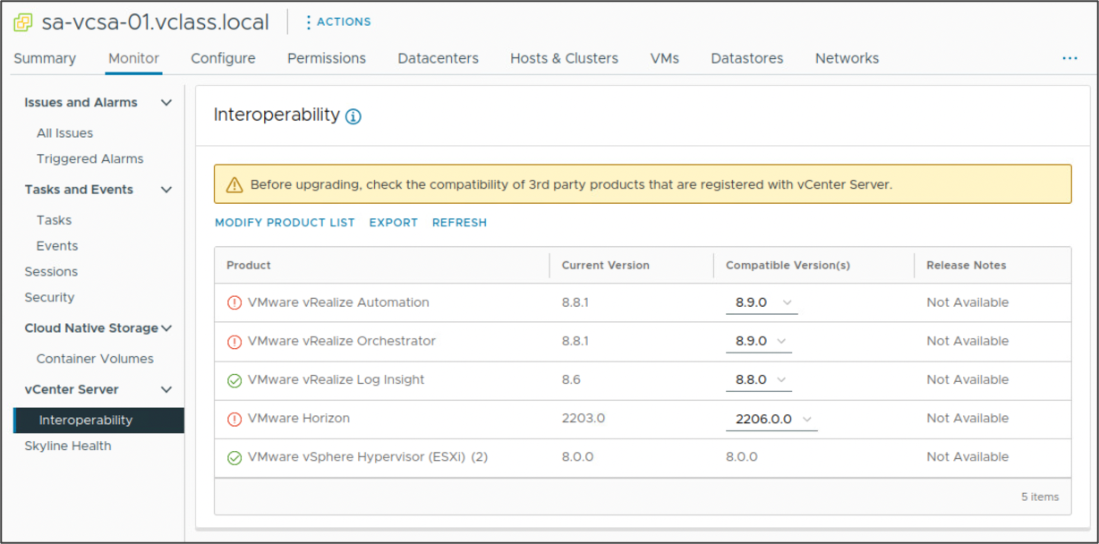
Generating the Interoperability Report
The Interoperability page on the vCenter instance's Monitor tab shows VMware products that are currently registered with vCenter and their compatibility with the current version of vCenter.
You can export report results in CSV format and use the report as a guide to prepare for an update.
Notes:
In the vSphere Client, the Interoperability page appears on the Monitor tab of vCenter. This page displays VMware products currently registered with vCenter.
This report shows the product name, the current version of the product, and the product version that is compatible with the current version of vCenter.
If VMware products in your environment are undetected, you can click MODIFY PRODUCT LIST to manually add them to the list of products to check and regenerate the interoperability report.

Slide 9
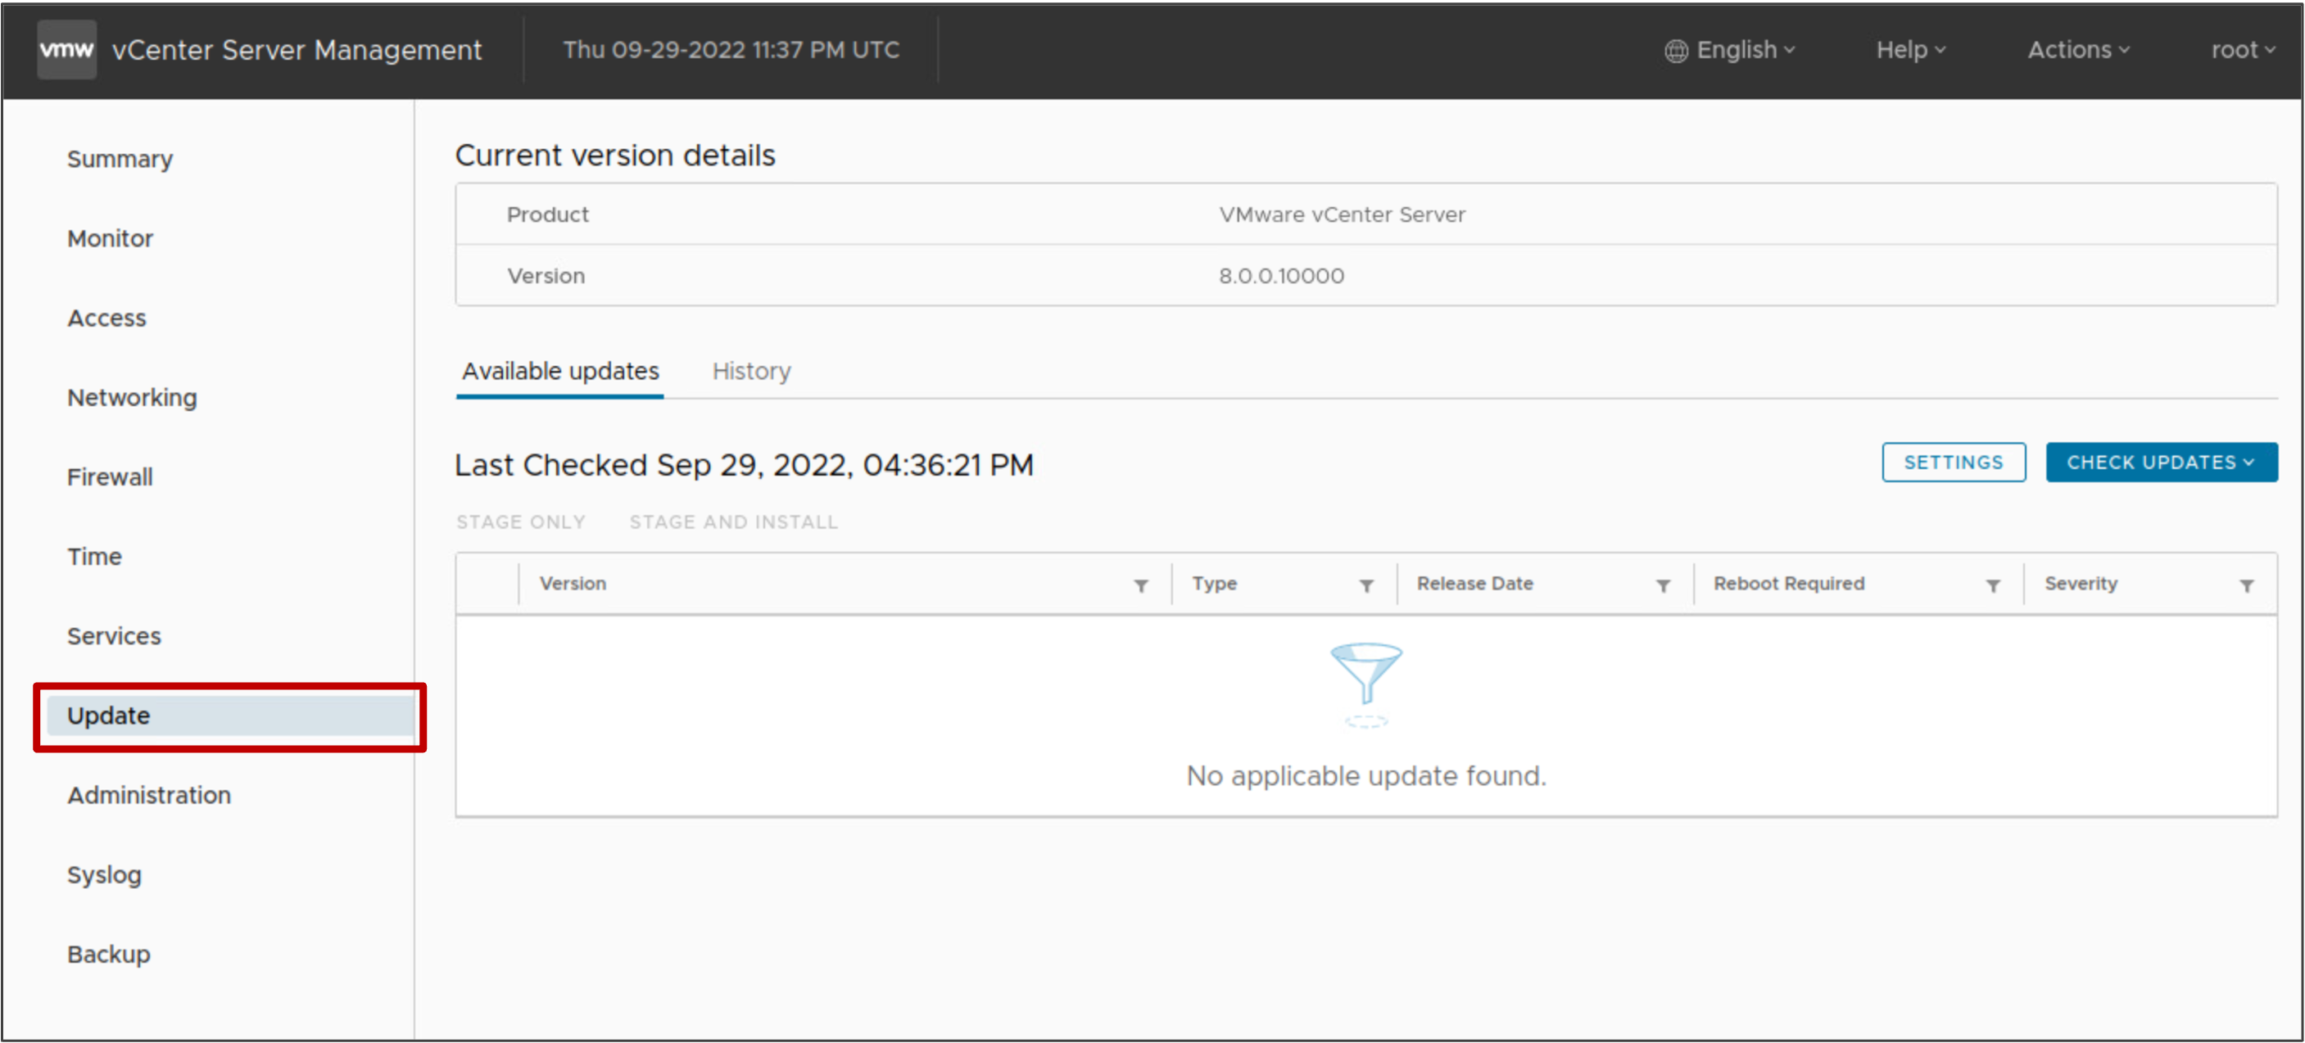
Updating and Patching vCenter
To manage the life cycle of vCenter, use the vCenter Management Interface to update and patch vCenter.
Notes:
The Update pane lists the vCenter updates that you can select. Details include release date, version, severity, and other information about each vCenter update available. The Type column tells you if the release item is an update, an upgrade, or a patch. If multiple versions appear, the recommended version is preselected.
vCenter updates and patches are located in a default VMware repository URL. You can configure the vCenter Server Appliance to use the default VMware repository URL or a custom repository URL, for example, a repository URL that you previously built on a local Web server running within your data center.
For details about upgrading and patching vCenter, see vCenter Server Upgrade at https://docs.vmware.com/en/VMware-vSphere/index.html.

Slide 10
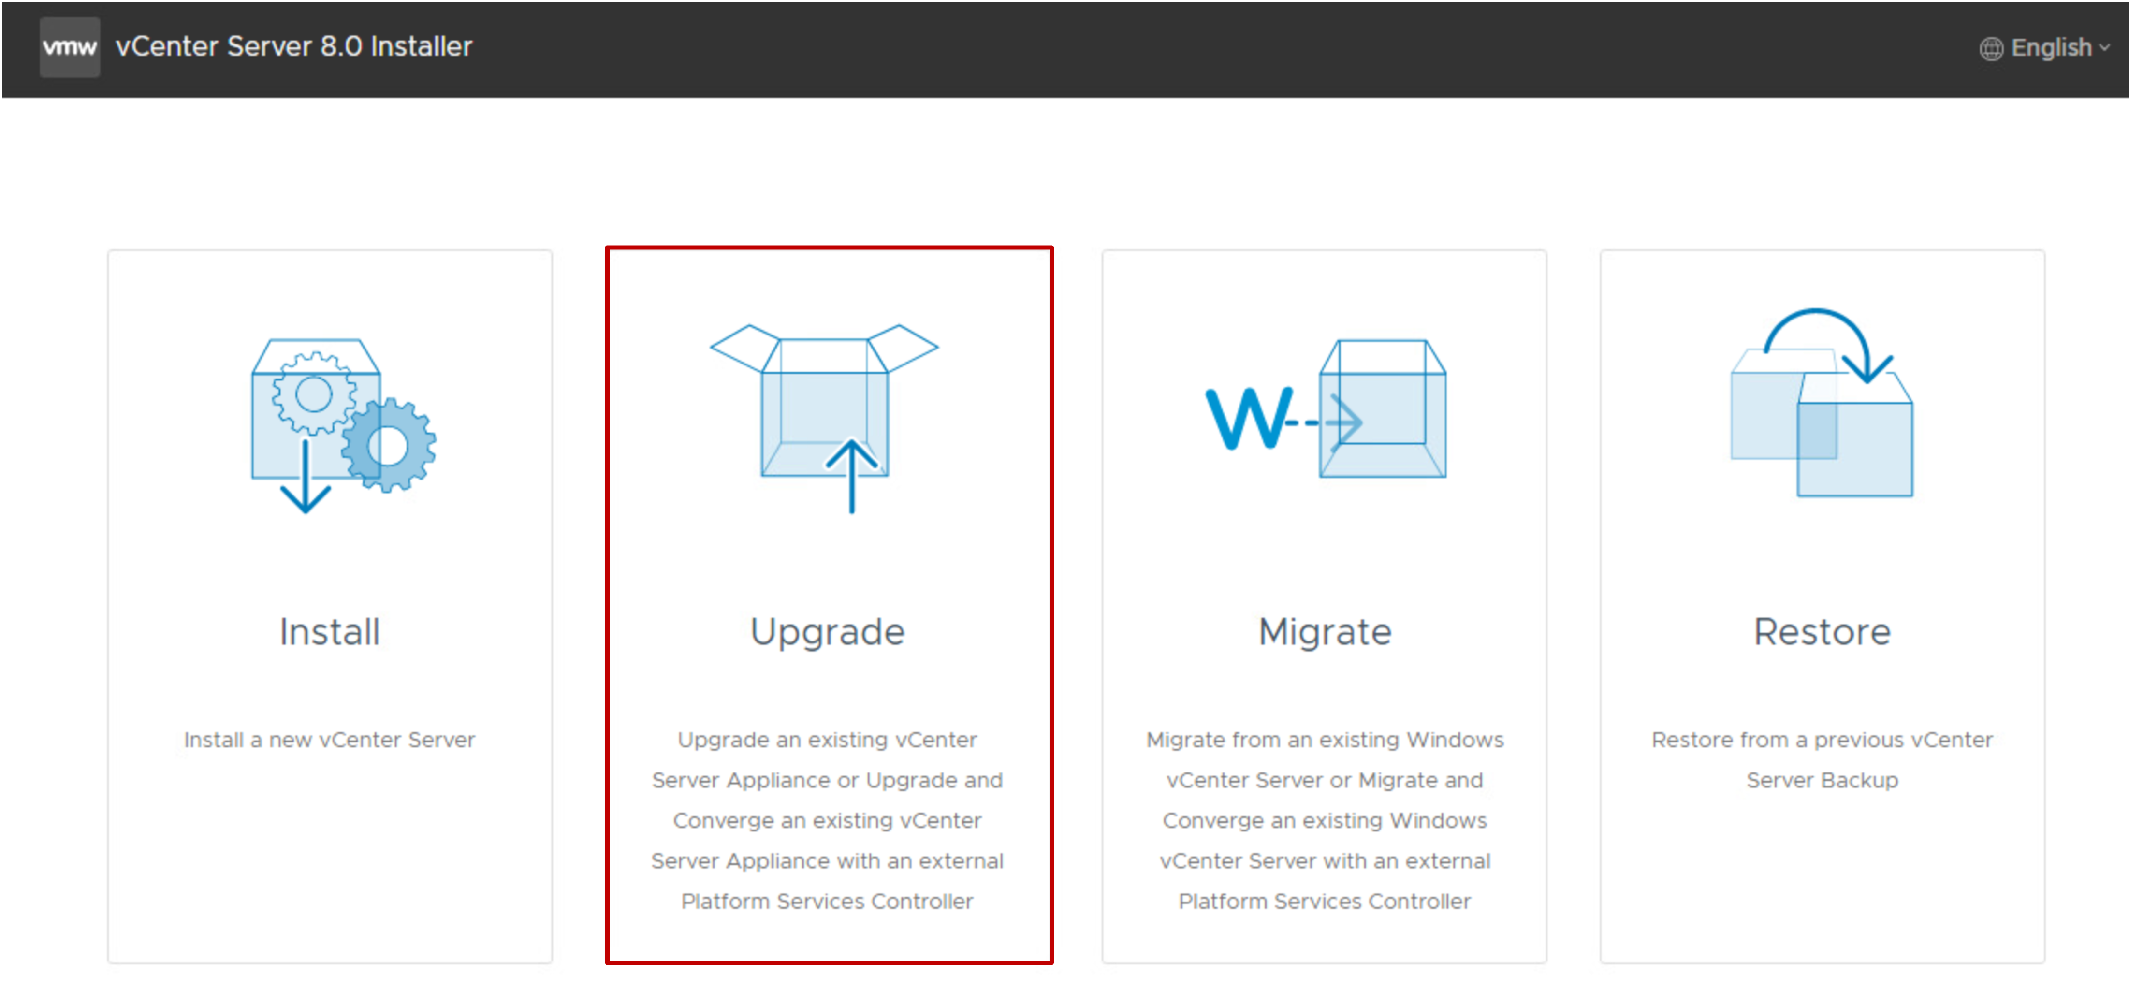
Upgrading vCenter Server Appliance
You use the vCenter installer to upgrade vCenter Server Appliance to a newer version.
Notes:
For details about upgrading vCenter, see vCenter Server Upgrade at https://docs.vmware.com/en/VMware-vSphere/index.html.

Slide 11
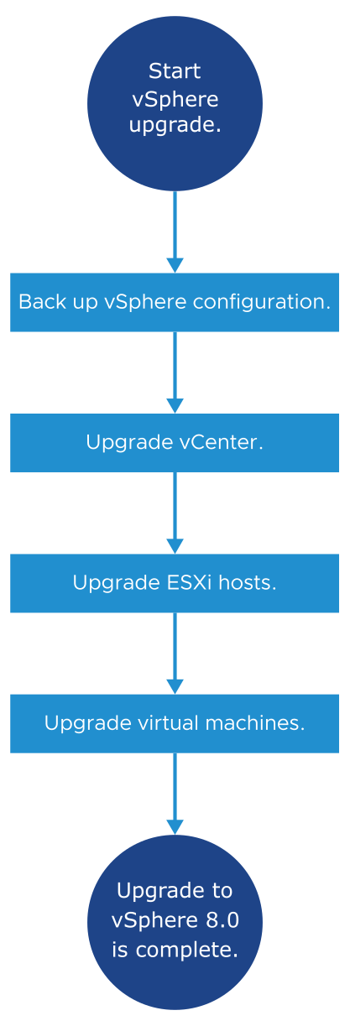
Overview of the vSphere Upgrade Process
vSphere is a product with multiple components to upgrade.
Knowing the required sequence of tasks is vital for a successful vSphere upgrade.
Notes:
Upgrading vSphere includes the following tasks:
Read the vSphere release notes.
Verify that you backed up your vSphere configuration.
If the vSphere environment includes VMware solutions or plug-ins, verify that they are compatible with the vCenter version to which you upgrade.
Upgrade vCenter.
Upgrade your ESXi hosts.
Upgrade your VMs manually or by using vSphere Lifecycle Manager.
For details about upgrading vCenter, see vCenter Server Upgrade at https://docs.vmware.com/en/VMware-vSphere/index.html.
For details about upgrading ESXi, see VMware ESXi Upgrade at https://docs.vmware.com/en/VMware-vSphere/index.html.
For details about upgrading VMs with vSphere Lifecycle Manager, see Managing Host and Cluster Lifecycle at https://docs.vmware.com/en/VMware-vSphere/index.html.

Slide 12
Review of Learner Objectives
Plan for vCenter updates and upgrades by generating interoperability reports
Recognize how to update vCenter with the latest patches, updates, and upgrades

Slide 13
Overview of vSphere Lifecycle Manager

Slide 14
Learner Objectives
Recognize features of vSphere Lifecycle Manager
Import images into the vSphere Lifecycle Manager image depot
Change the download source for patches and updates

Slide 15
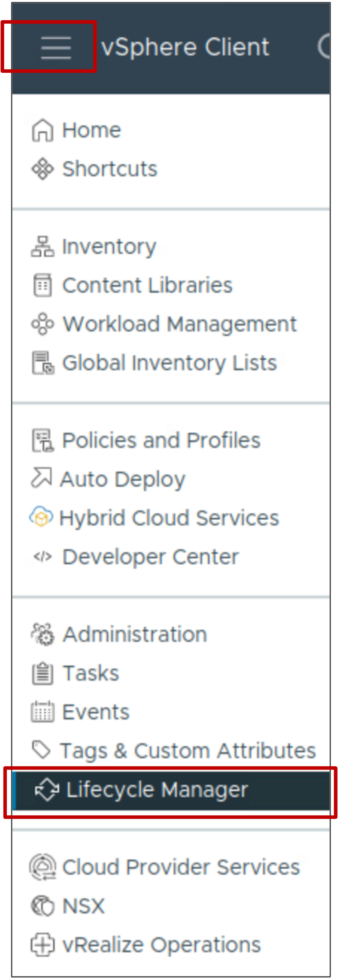
About vSphere Lifecycle Manager
vSphere Lifecycle Manager enables centralized and simplified life cycle management for ESXi hosts in a cluster through the use of images.
vSphere Lifecycle Manager includes the following tasks:
Managing VMware Tools and VM hardware upgrades
Upgrading and patching ESXi hosts
Installing and updating third-party software on ESXi hosts
Installing and updating ESXi drivers and firmware
Standardizing ESXi images across hosts in a cluster
From the main menu, select Lifecycle Manager.

Slide 16
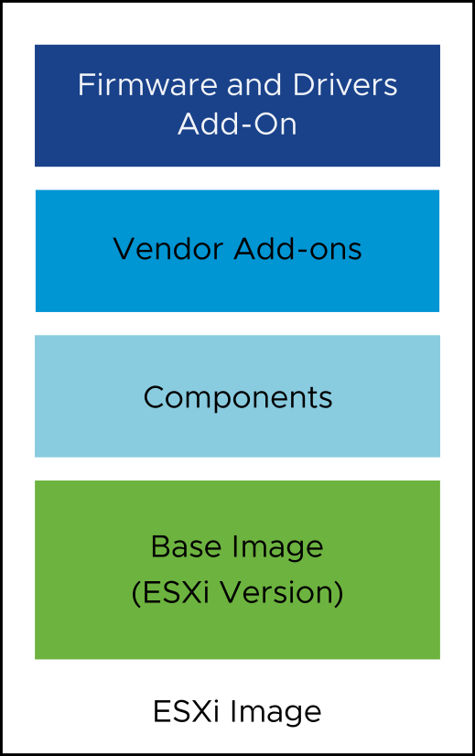
About Images
Managing clusters with images helps to standardize the software running on your ESXi hosts.
An ESXi image consists of several elements:
ESXi base image: An update that provides software fixes and enhancements
Components: A logical grouping of one or more VIBs (vSphere Installation Bundles) that encapsulates functionality in ESXi
Vendor add-ons: Sets of components that OEMs create and distribute
Firmware and Drivers Add-On: Firmware and driver bundles that you can define for your cluster image
  Requires the Hardware Support Manager plug-in for the desired server family
To maintain consistency, you apply a single ESXi image to all hosts in a cluster.
Notes:
The ESXi base image is a complete ESXi installation package and is enough to start an ESXi host. Only VMware creates and releases ESXi base images.
The ESXi base image is a grouping of components. You must select at least the base image or vSphere version when creating a cluster image.
The component is the smallest unit that is used by vSphere Lifecycle Manager to install VMware and third-party software on ESXi hosts. Components are the basic packaging for VIBs and metadata. The metadata provides the name and version of the component.
On installation, a component provides you with a visible feature. For example, a third-party vendor's network driver is provided as a component. Components are optional elements to add to a cluster image.
Vendor add-ons are custom OEM images. Each add-on is a collection of components customized for a family of servers. OEMs can add, update, or remove components from a base image to create an add-on. Selecting an add-on is optional.
The firmware and drivers add-on is a vendor-provided add-on. It contains the components that encapsulate firmware and driver update packages for a specific server type. To add a firmware and drivers add-on to your image, you must first install the Hardware Support Manager plug-in for the respective family of servers.

Slide 17
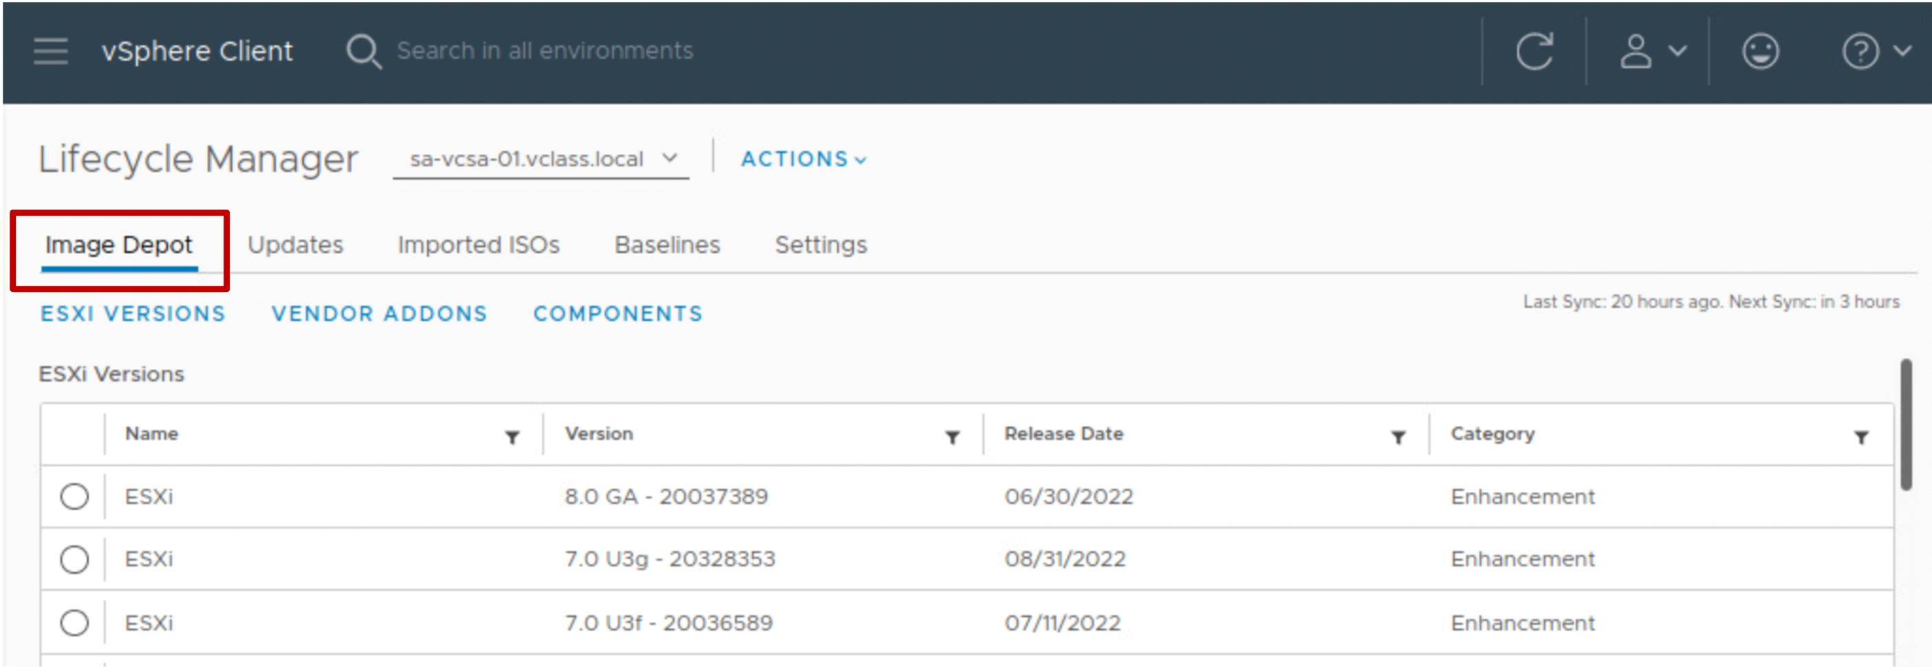
About Image Depots
The vSphere Lifecycle Manager image depot represents all software available for consumption to vSphere Lifecycle Manager:
The depot is located on the vCenter system.
In the Image Depot tab, you can view details about downloaded content:
ESXi base images
Vendor add-ons
Third-party components
Notes:
When you select a downloaded file, the details appear to the right:
When you select an ESXi version, the details include the version name, build number, category, and description, and the list of components that make up the base image.
When you select a vendor add-on, the details include the add-on name, version, vendor name, release date, category, and the list of added or removed components.
When you select a component, the details include the component name, version, publisher, release date, category, severity, and contents (VIBs).
Downloading host updates and related metadata is a predefined automatic process that you can modify. The automatic download task is enabled by default and starts immediately after you deploy vCenter. After the initial download, the task runs according to its schedule.

Slide 18
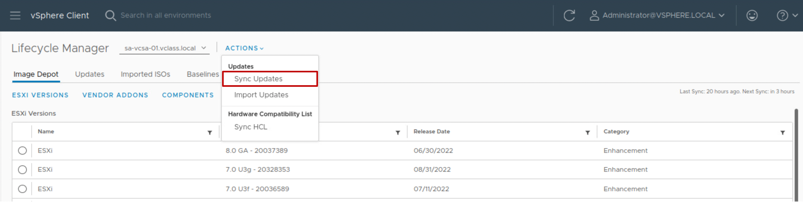
Importing Content Into the Image Depot from Online Sources
At regular intervals, vSphere Lifecycle Manager downloads updates from configured download sources to the image depot.
Regardless of the download schedule, you can manually initiate synchronization between the image depot and the download sources.
From the ACTIONS drop-down menu in the Lifecycle Manager pane, select Sync Updates.
Notes:
An online depot is the hosted version of the software updates that VMware, OEMs, and third-party software providers ship. You enable vSphere Lifecycle Manager to access an online depot by providing a URL to that depot.
An Internet connection is required to access an online depot.

Slide 19
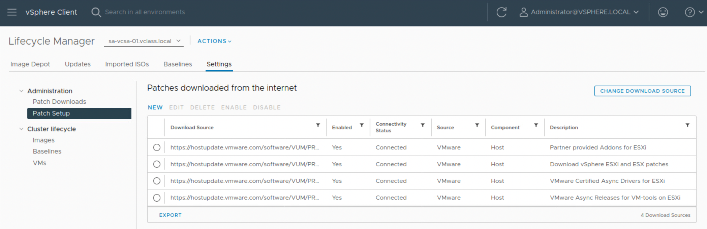
Specifying the Download Source
Select Settings > Patch Setup to view the default download sources.
From this pane, you can change the download source or add a URL to configure a custom download source.
Notes:
You can click NEW to add other download sources besides the VMware download sources. For example, third-party vendors might provide a download source (depot) that contains images for additional components such as CIM modules.
However, working with additional third-party depots and independent components is rarely necessary. In most cases, the vendor add-ons that are available in the official VMware depot provide full OEM customization for ESXi.
vSphere Lifecycle Manager downloads to the local vSphere Lifecycle Manager depot the content from all the online depots that you configure it to use.

Slide 20
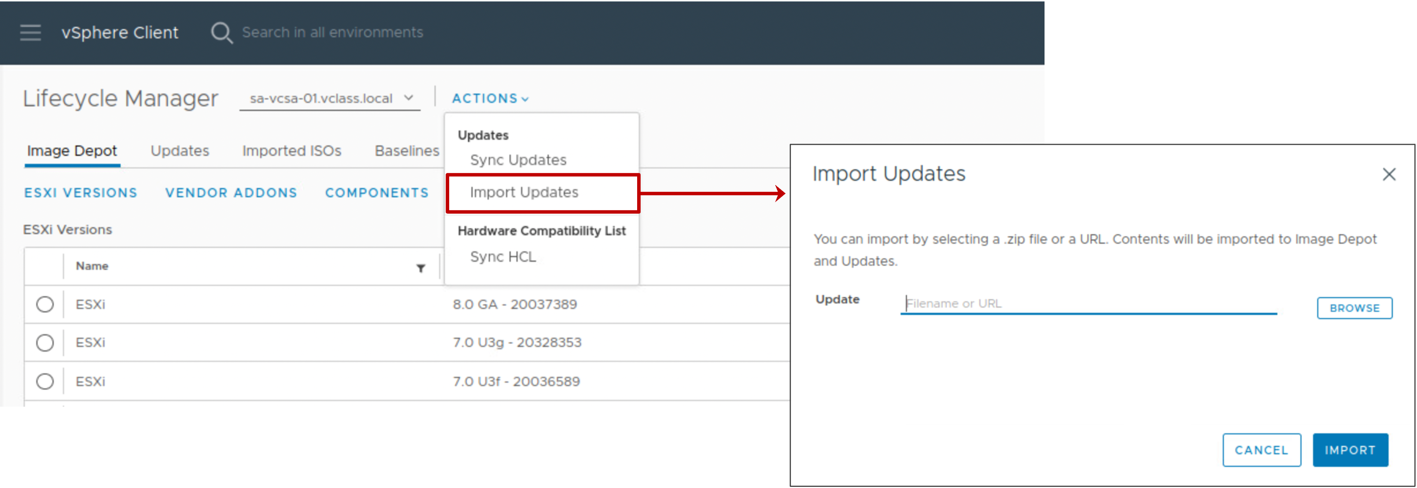
Importing Content Into the Image Depot from Offline Sources
You can also import updates from an offline bundle:
From the Actions drop-down menu, select Import Updates.
Enter a URL or browse for a ZIP file that contains the update (an ESXi image, vendor add-on or component).
Notes:
You use the import option to populate the vSphere Lifecycle Manager depot with updates from an offline bundle, for example, one provided by VMware. Apart from the legacy patches and extensions, an offline bundle can also contain an ESXi base image, a vendor add-on, or third-party software, for example, asynchronous drivers specific to the OEM hardware requirements.

Slide 21
Review of Learner Objectives
Recognize features of vSphere Lifecycle Manager
Import images into the vSphere Lifecycle Manager image depot
Change the download source for patches and updates

Slide 22
Managing the Life Cycle of ESXi Hosts and Clusters

Slide 23
Learner Objectives
Activate vSphere Lifecycle Manager in a cluster and define a cluster image
Validate ESXi host compliance against a cluster image
Remediate ESXi hosts using vSphere Lifecycle Manager
View recommended images for a cluster

Slide 24
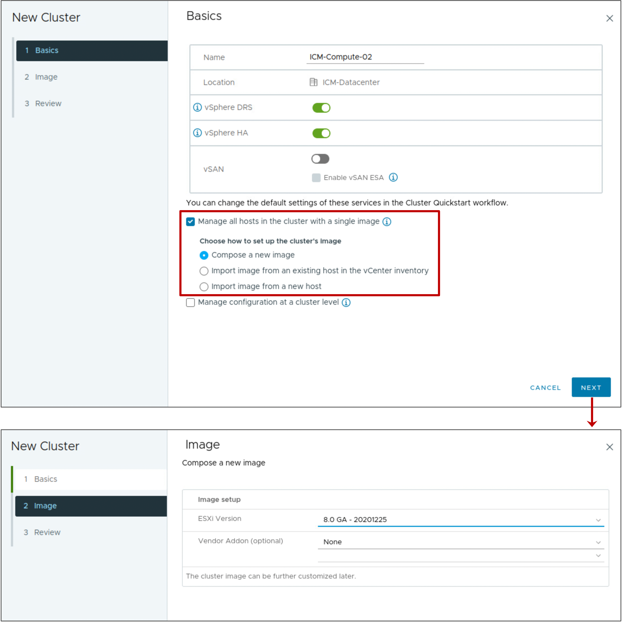
Creating a Cluster and Specifying an Image
A vSphere Lifecycle Manager cluster is a cluster of ESXi hosts that you can manage with a single image.
When creating a cluster, you can select a cluster image:
Create a cluster.
Select the Manage all hosts in the cluster with a single image check box.
Choose the image to use for the cluster.
Notes:
In the Create Cluster wizard, you specify an image to be applied to the hosts. You can import an image from an ESXi host that is in the same or a different vCenter instance. You can also import an image from an ESXi host that is not managed by vCenter:
Import image from an existing host in the vCenter inventory: Select this method to import an image from a host that is in the same vCenter inventory.
Import image from a new host: Select this method to import an image from a host that is in a different vCenter instance or a standalone host that is not added to a vCenter instance. You can use the option to move the selected host to the cluster.

Slide 25
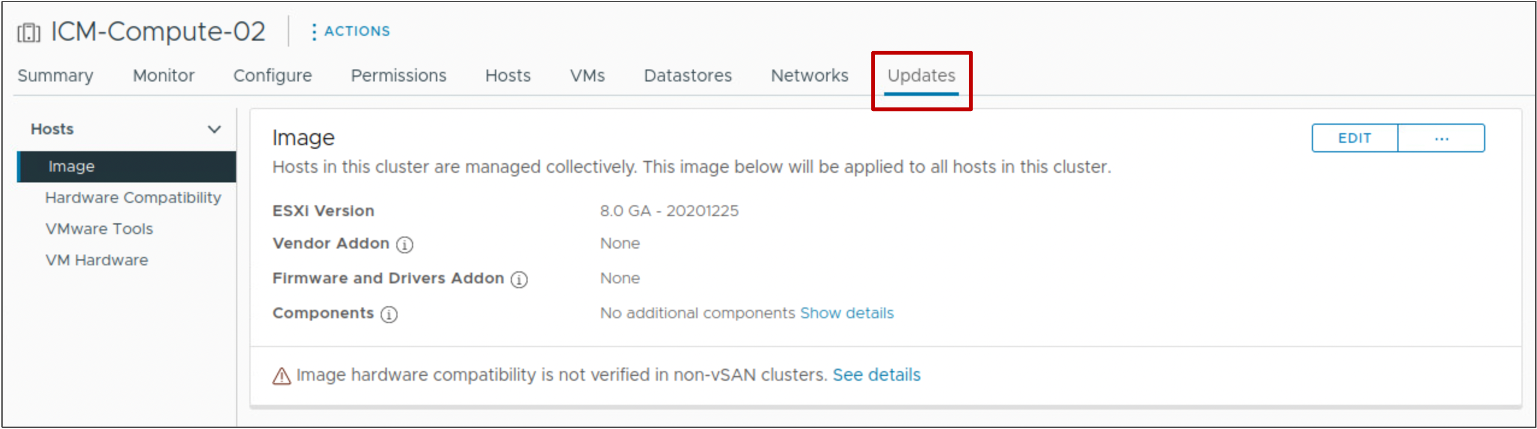
Viewing Cluster Image Information
The Image pane in the Updates tab shows the image for the cluster.

Slide 26
Overview of Managing Clusters with vSphere Lifecycle Manager
Over time, software updates become available in the image depot.
Using images from the image depot to update ESXi hosts is a multi-stage process:
Check the compliance of the ESXi hosts in the cluster against the image specification.
Run a remediation pre-check on the hosts in the cluster to ensure software and hardware compatibility with the image.
Remediate the non-compliant ESXi hosts in the cluster.

Slide 27
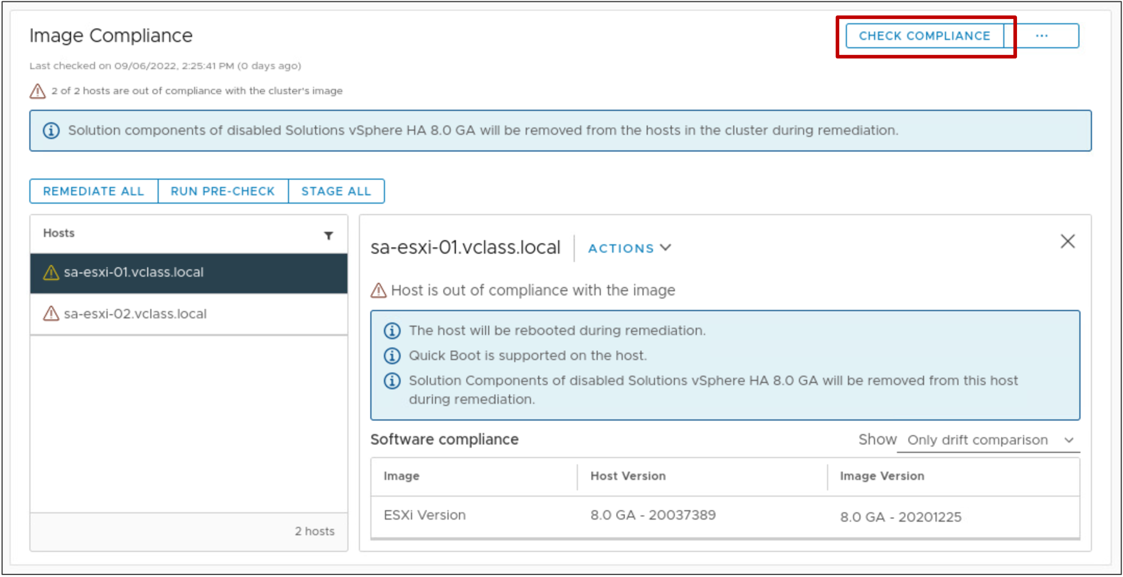
Checking Compliance of Host Against an Image
After you define a cluster image, you can perform a compliance check to compare the cluster image with the software and firmware that runs on the ESXi hosts in the cluster.
Notes:
The status of a host can be unknown, compliant, out of compliance, or not compatible with the image.
A host status is unknown before you check compliance.
A compliant host is one whose installed software and firmware matches the ESXi image defined for the cluster and with no standalone VIBs or differing components.
If the host is out of compliance, a message about the impact of remediation appears. In the example, the host must be rebooted as part of the remediation. Another impact that might be reported is the requirement that the host enters maintenance mode.
A host is not compatible if it is running software and firmware that is newer than the desired cluster image version, or if the host does not meet the installation requirements for the vSphere build.
You can check the image compliance at the level of various vCenter objects:
At the host level for a specific ESXi host in a cluster
At the cluster level for all ESXi hosts in the cluster
At the data center level for all clusters and hosts in the data center
At the vCenter level for all data centers, clusters, and ESXi hosts in the vCenter inventory.

Slide 28
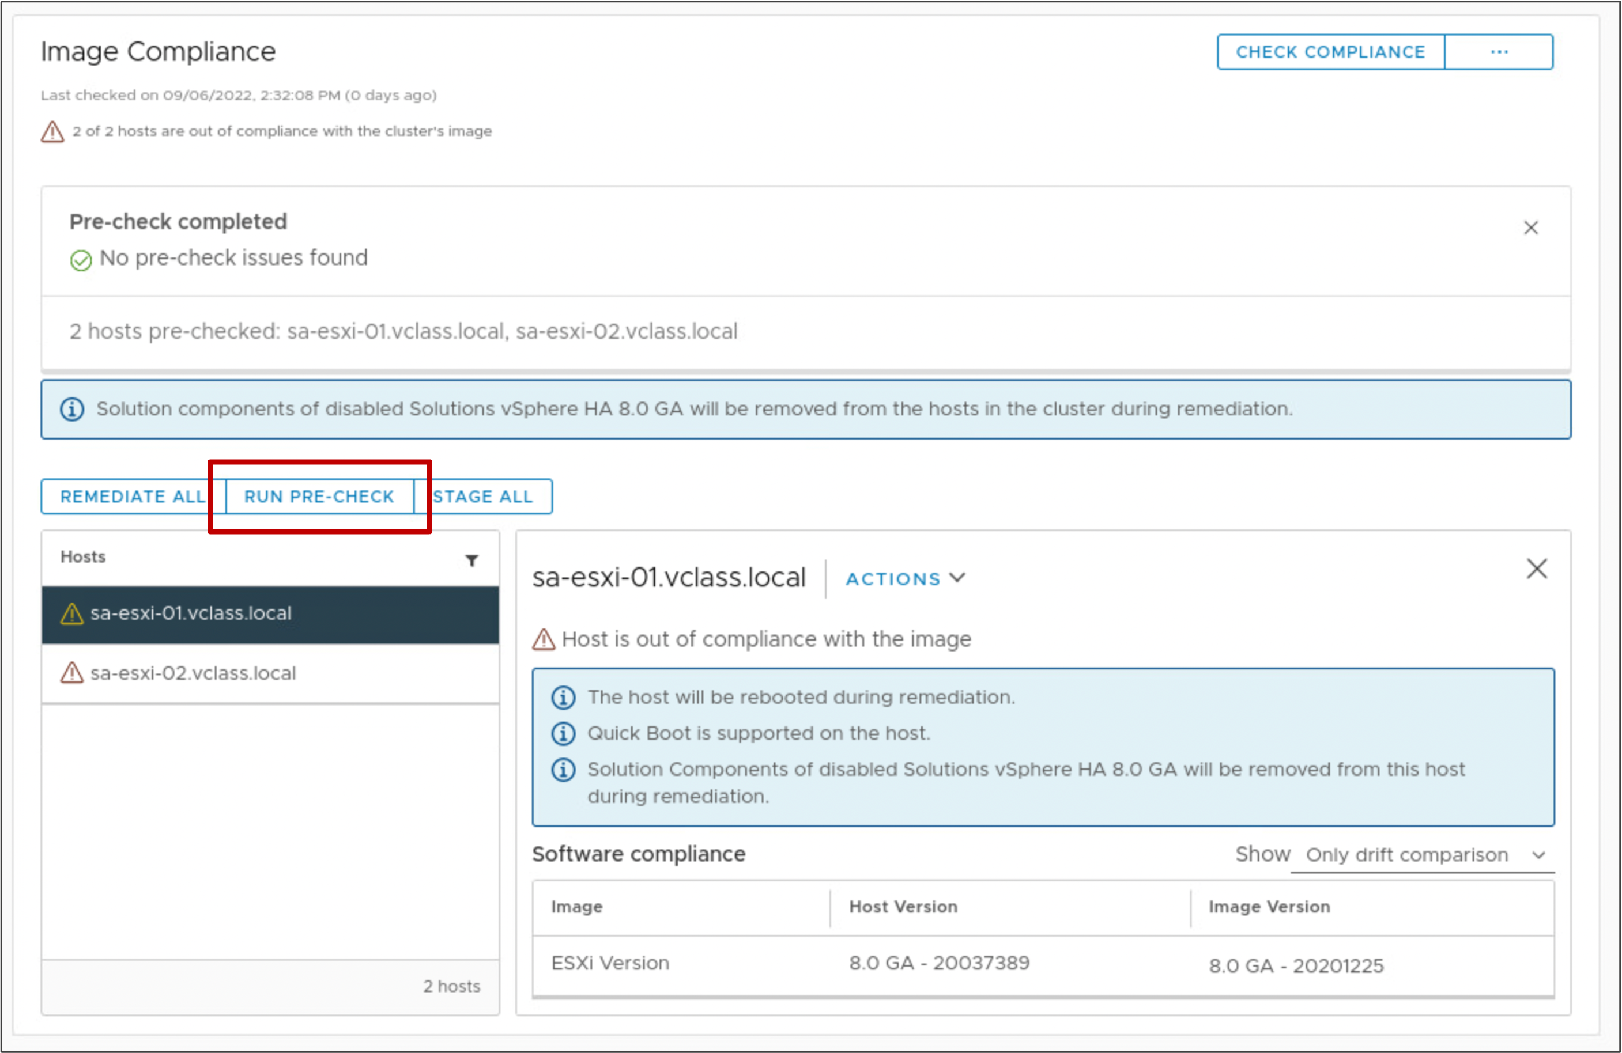
Running a Remediation Pre-check
To ensure that the cluster's health is good and that no problems occur during the remediation process of your ESXi hosts, you can perform a remediation pre-check.

Slide 29
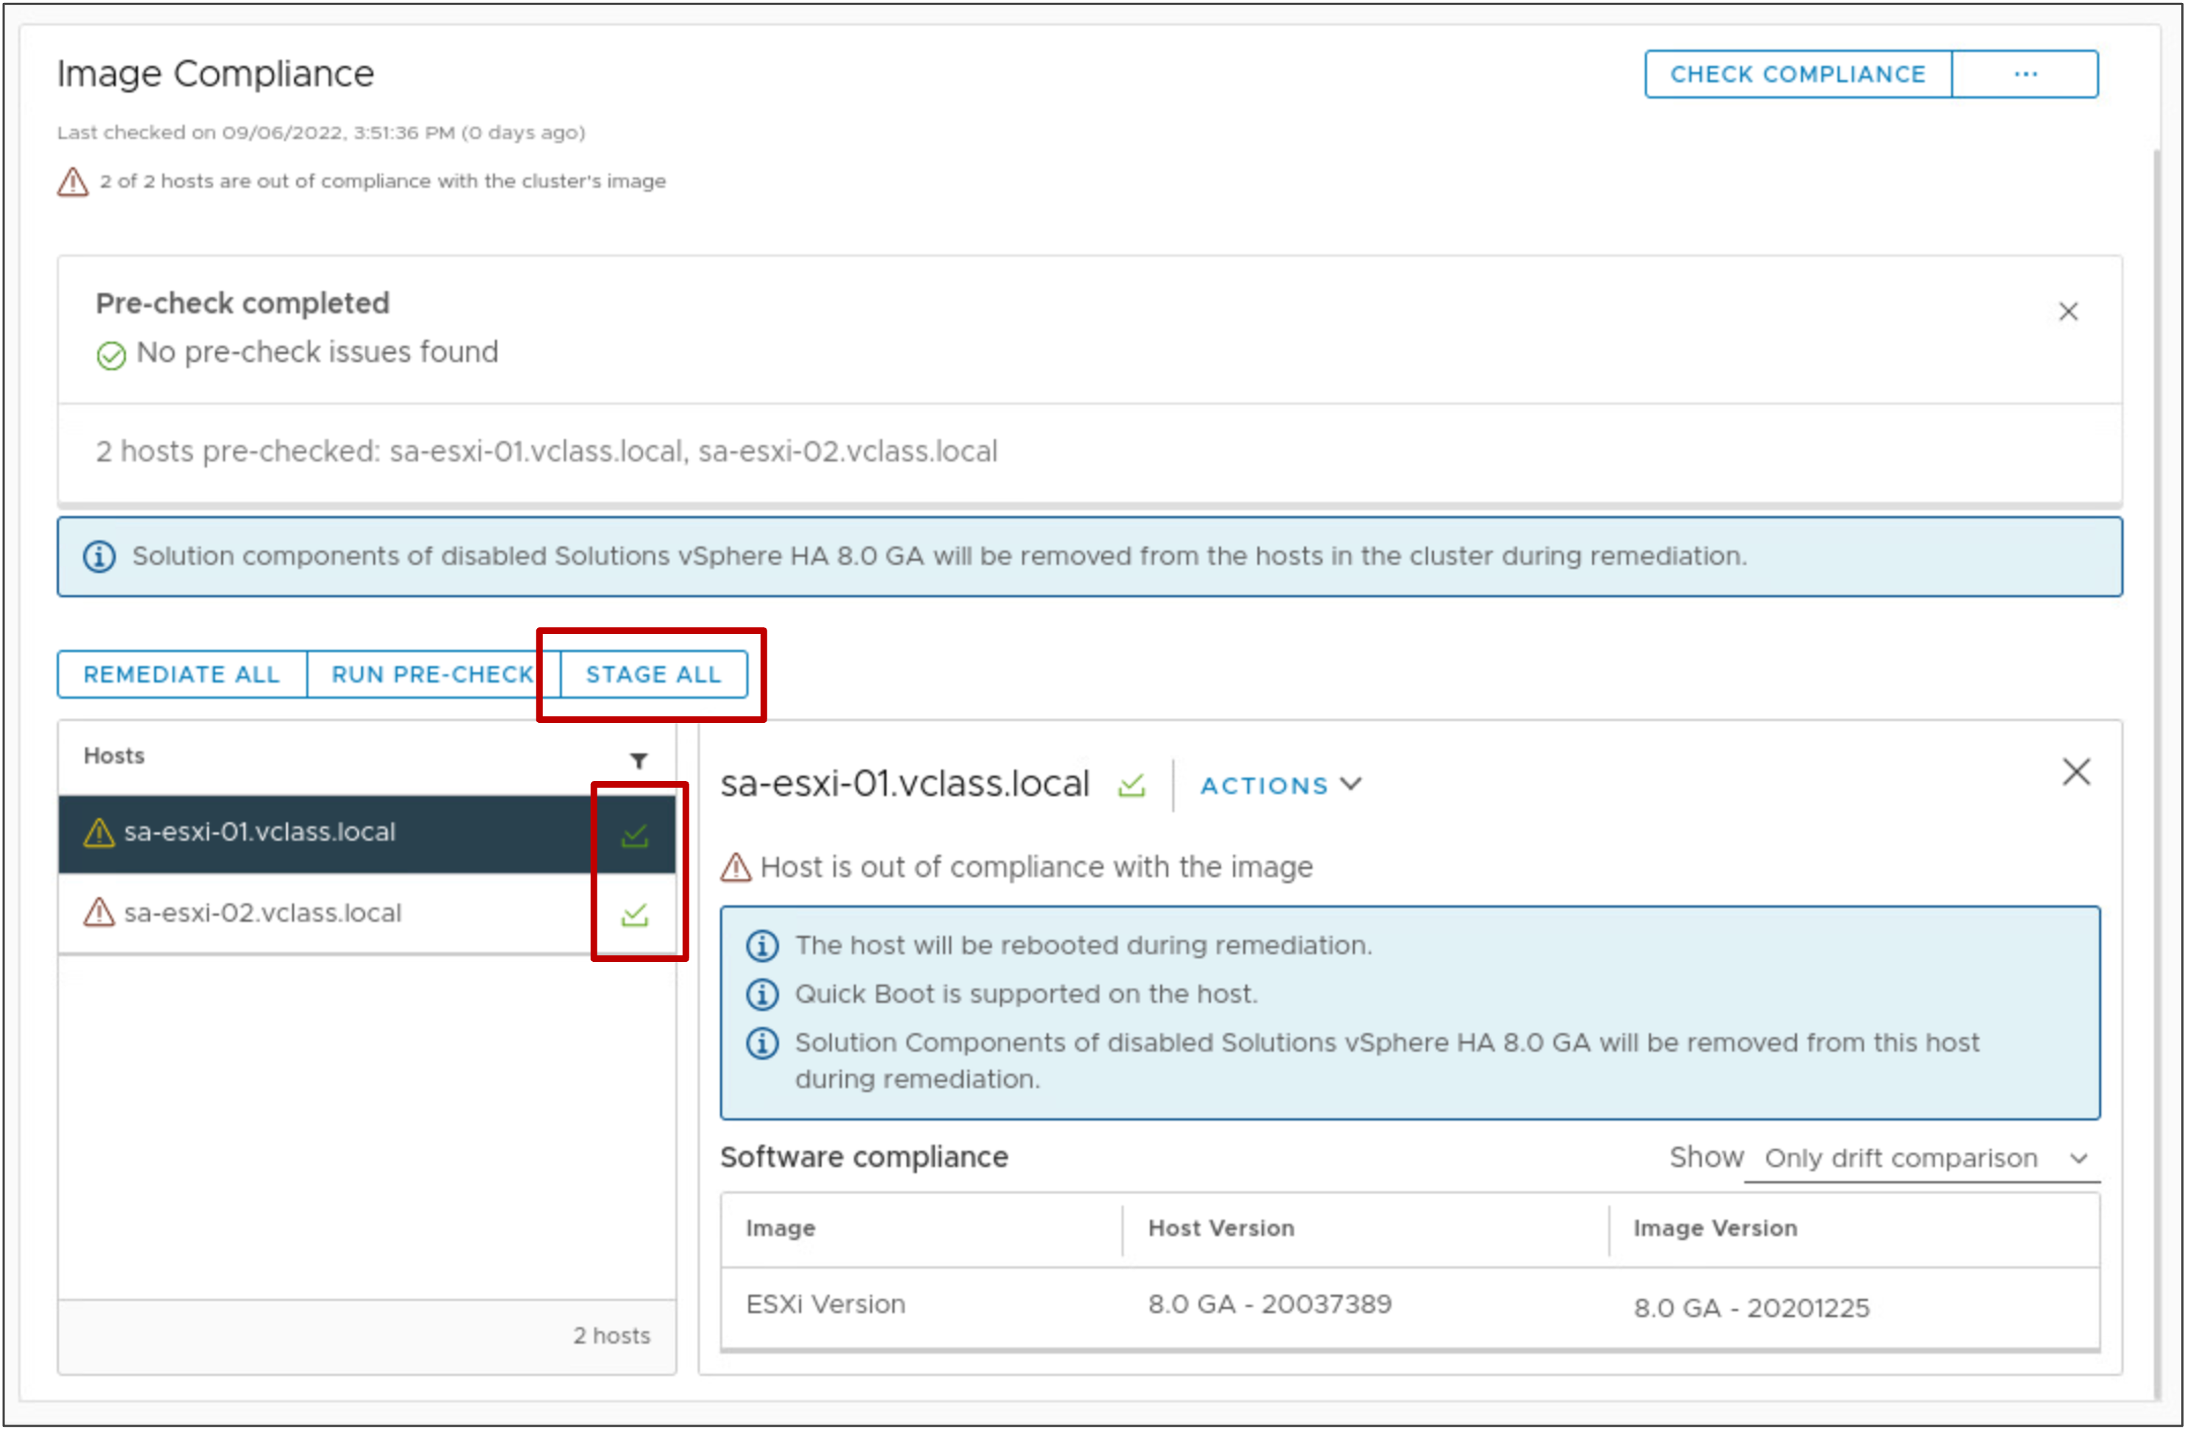
Staging the Cluster
Staging is the process during which vSphere Lifecycle Manager downloads patches and extensions from the image depot to the ESXi hosts.
During staging, the patches and extensions are not installed on the host.
Staging patches and extensions speeds up the remediation process, because the patches and extensions are already available locally on the hosts.
A green icon next to a host indicates that the current image has been staged to the host.
Notes:
Staging patches and extensions speeds up the remediation process and minimizes the time that each host spends in maintenance mode.
Without staging, the patches and extensions are transferred to the host during maintenance mode. As a result, the host is unavailable to run VMs for a longer period of time than if the updates were staged beforehand.

Slide 30
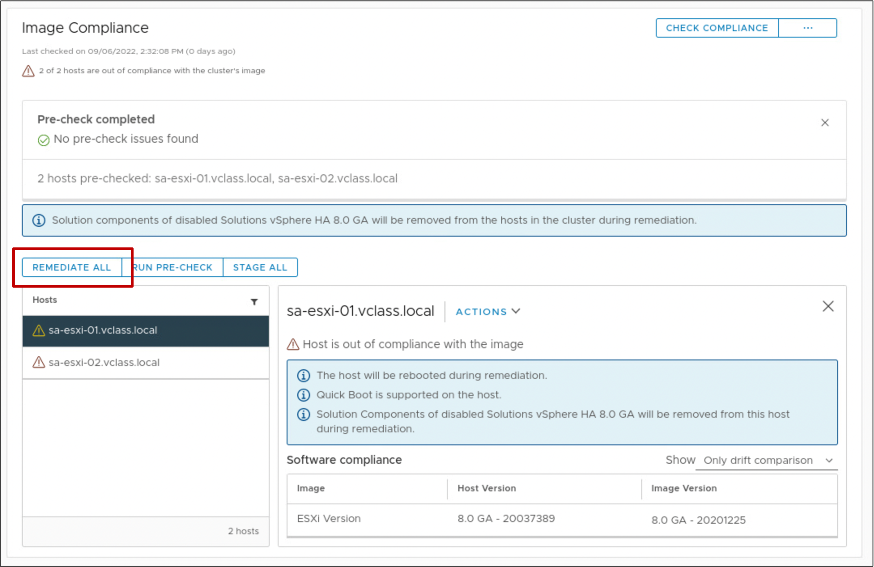
Remediating a Cluster Against an Image
Remediation makes the selected hosts compliant with the cluster image.
You can remediate the entire cluster or a single ESXi host, or simply pre-check hosts without updating them.
The goal is to make the entire cluster compliant with the image.
Notes:
vSphere Lifecycle Manager can perform a remediation pre-check on images. If the pre-check is successful, vSphere Lifecycle Manager applies the image to the hosts.
During each step of a remediation process, vSphere Lifecycle Manager determines the readiness of the host to enter or exit maintenance mode or be rebooted.
When you remediate a cluster that you manage with an image, vSphere Lifecycle Manager applies the following elements to the ESXi hosts:
ESXi image version
Optional: vendor addon
Optional: firmware and driver addons
Optional: user specified components

Slide 31
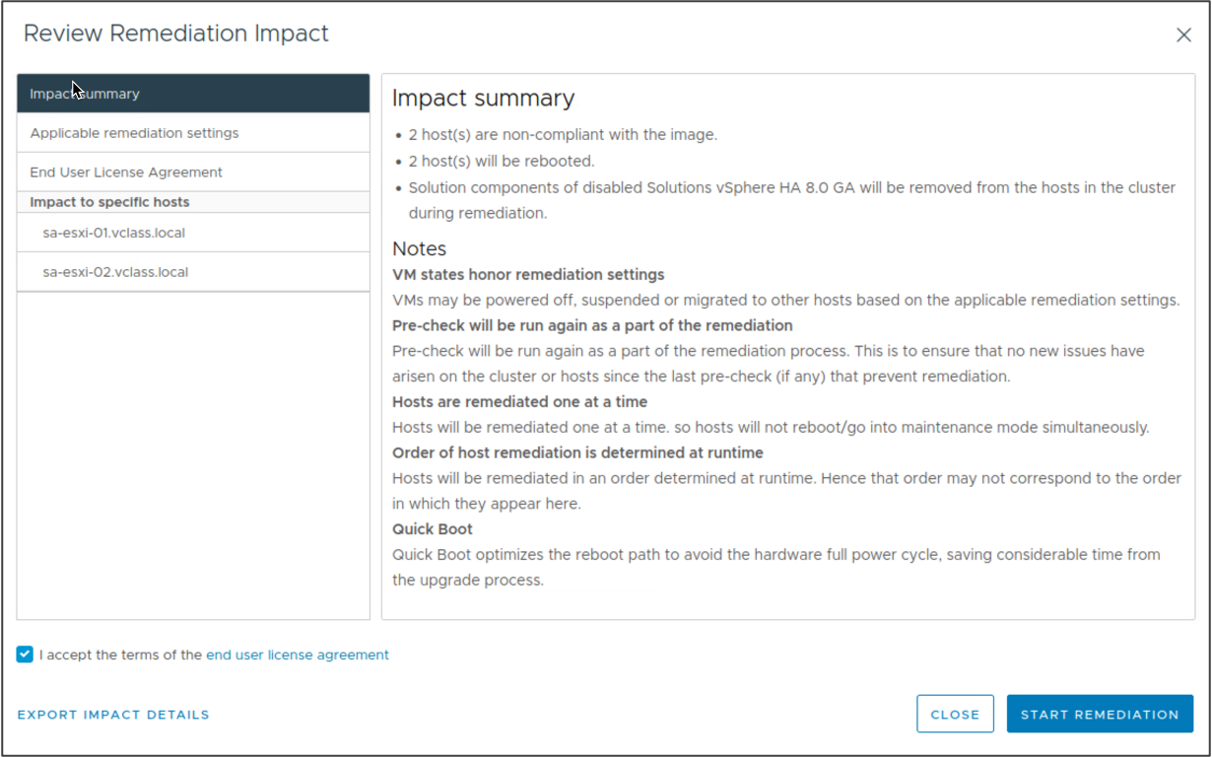
Reviewing Remediation Impact
The Review Remediation Impact dialog box contains information about all changes that remediation performs on the hosts in the cluster.
vSphere Lifecycle Manager performs a remediation pre-check before each remediation.
If the pre-check is successful, vSphere Lifecycle Manager applies the image to the hosts.
Notes:
The Review Remediation Impact dialog box includes the following information:
Impact summary
Applicable remediation settings
End User License Agreement
Impact to specific hosts

Slide 32
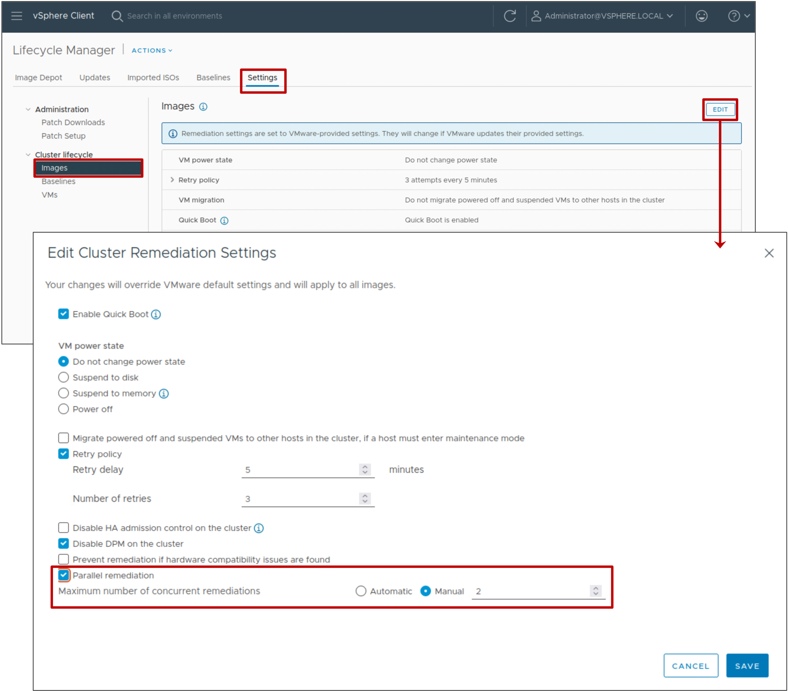
Parallel Remediation
You can configure vSphere Lifecycle Manager to perform parallel remediation in a cluster.
Parallel remediation remediates all hosts that are in maintenance mode in parallel instead of in sequence.
You can also specify the maximum number of concurrent remediations.
Notes:
When upgrading a cluster with vSphere Lifecycle Manager, by default, ESXi hosts are remediated sequentially, which can be a time-consuming process. To speed up the cluster upgrade process and reduce the downtime window, you can configure
vSphere Lifecycle Manager to remediate hosts in parallel using the cluster image. The hosts must be in maintenance mode. Hosts that are not in maintenance mode are skipped, but you can upgrade them separately later.

Slide 33
vSphere Lifecycle Manager Integration with vSphere DRS
When performing remediation operations on a cluster that is configured for vSphere DRS, vSphere Lifecycle Manager automatically integrates with vSphere DRS:
When vSphere Lifecycle Manager places hosts in the maintenance mode, vSphere DRS evacuates each host before the host is patched.
When vSphere Lifecycle Manager attempts to place a host in the maintenance mode, certain checks are performed to verify that the ESXi host can enter the maintenance mode.
The vSphere Client reports any configuration problems that might prevent an ESXi host from entering the maintenance mode.
After a host is patched and rebooted, vSphere Lifecycle Manager exits the host from the maintenance mode and vSphere DRS migrates some VMs back to the host.

Slide 34
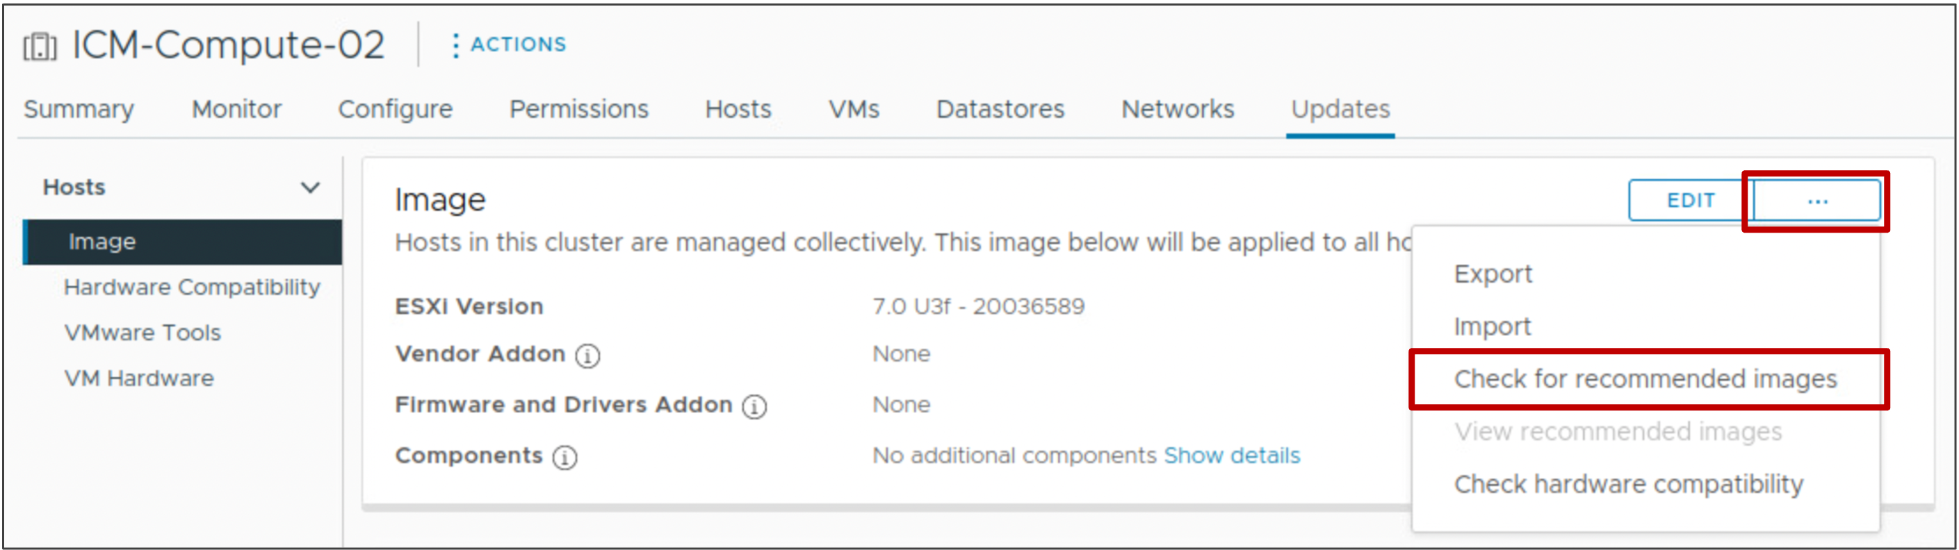
Recommended Images
Using vSphere Lifecycle Manager, you can check for recommended images for a cluster that you manage with an image.
vSphere Lifecycle Manager checks for compatibility across the image components. The process verifies that the recommended image has no missing dependencies or conflicting components.
Notes:
To generate recommendations, vSphere Lifecycle Manager checks what software is available in the vSphere Lifecycle Manager depot. vSphere Lifecycle Manager also checks the depot for what firmware is available from the selected hardware support manager. Based on the available software, firmware, and, for vSAN clusters, the hardware compatibility checks, vSphere Lifecycle Manager provides you with the latest and most appropriate image for your environment.

Slide 35
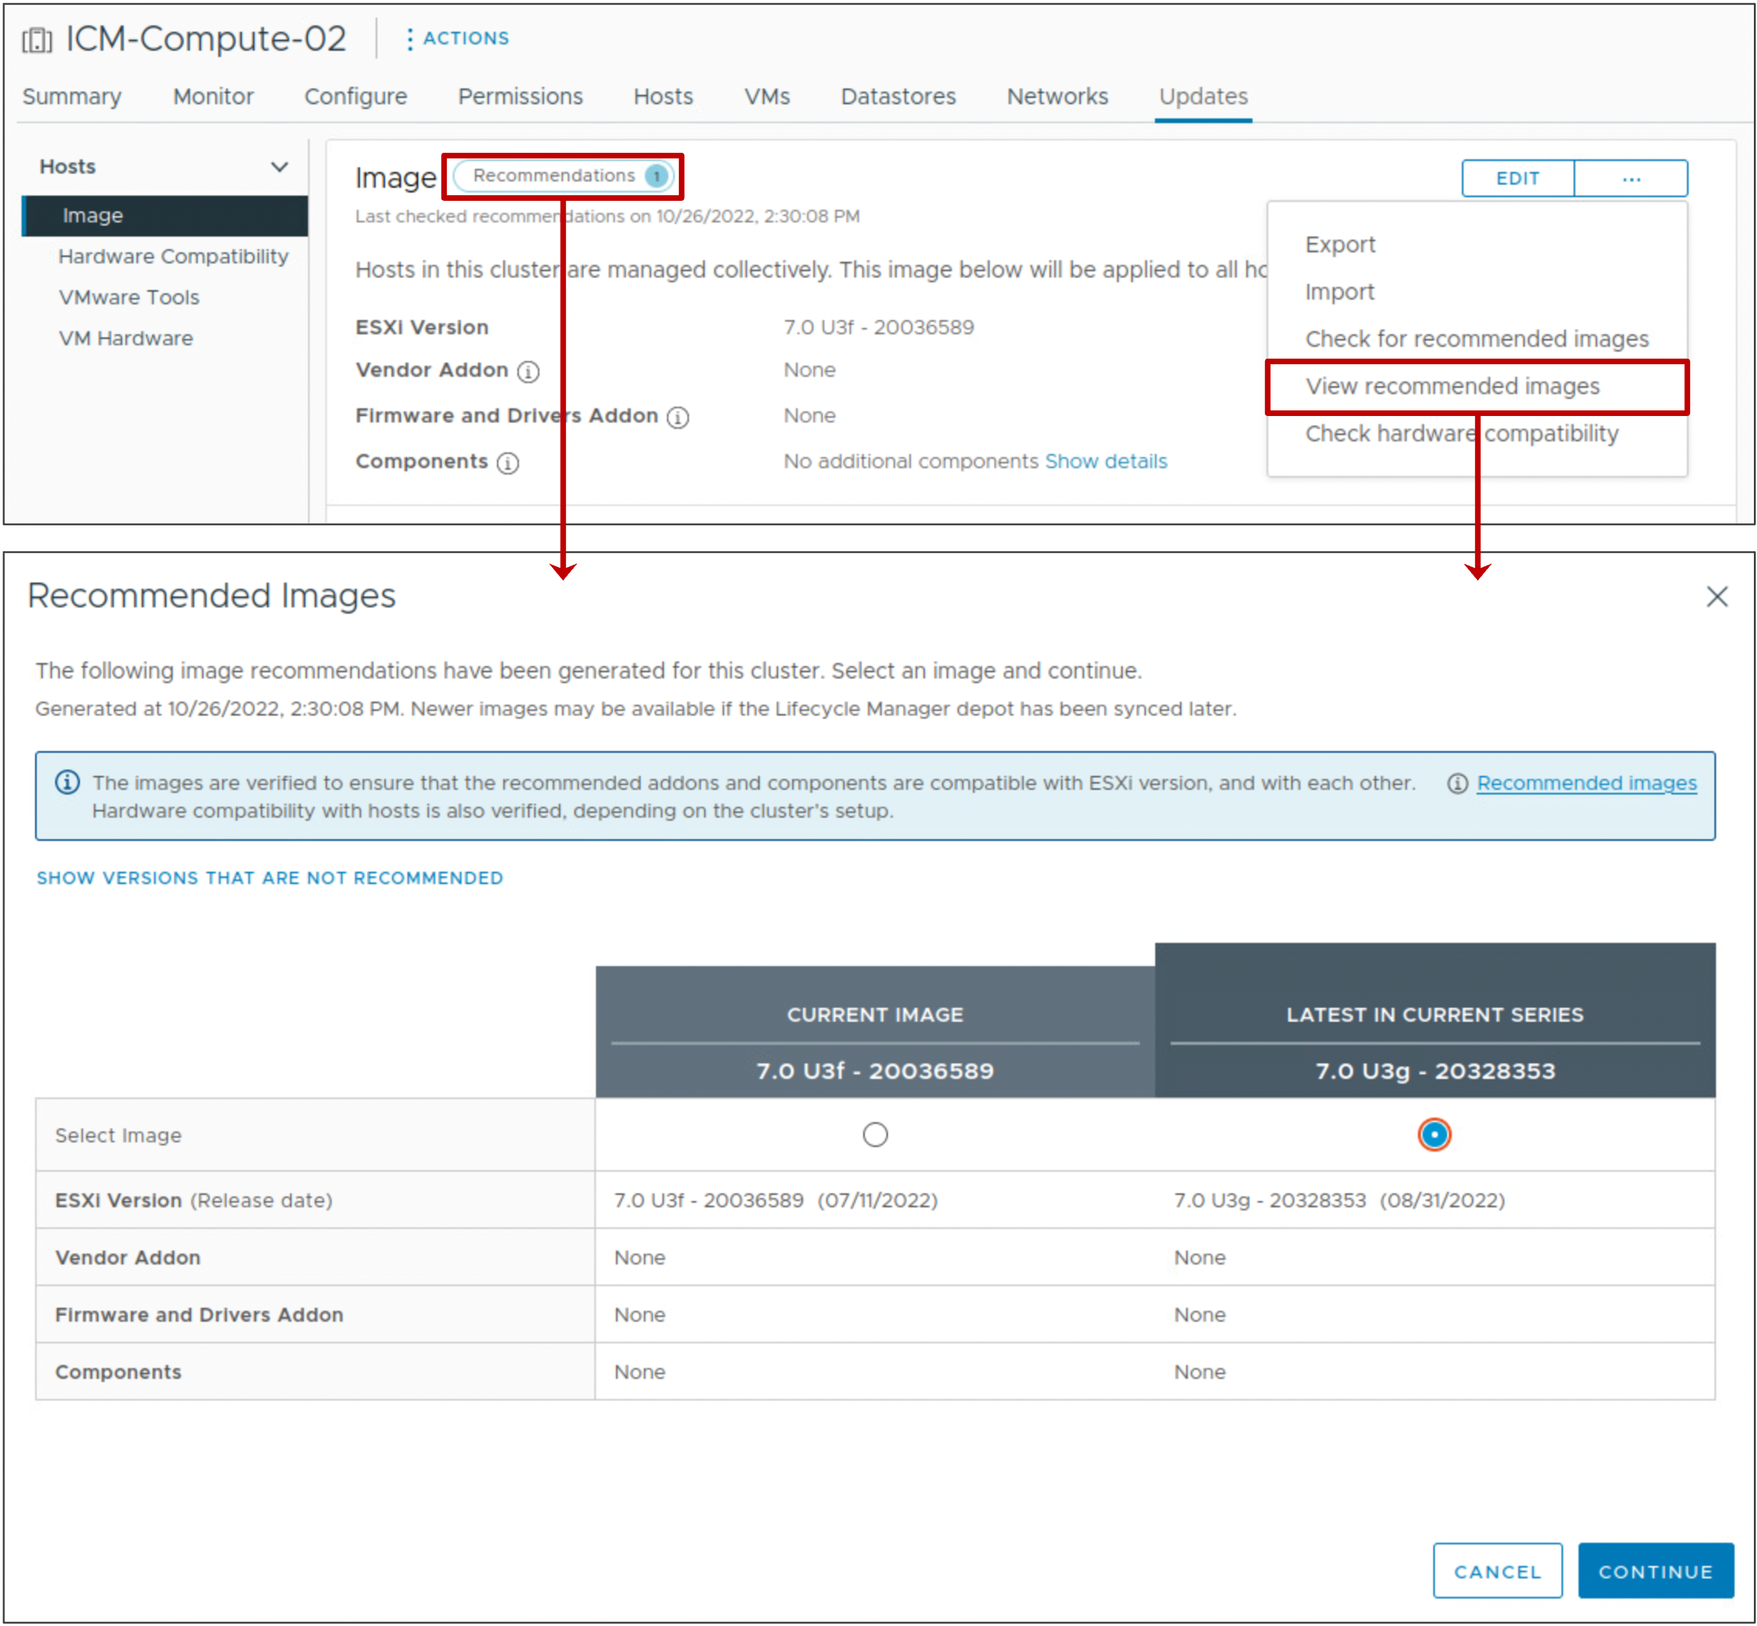
Viewing Recommended Images
To view recommended images for a cluster, click Recommendations at the top, or select View recommended images from the drop-down menu.
The recommended image is always in the major release series of the ESXi version of the image for the cluster.
Notes:
The recommendation that vSphere Lifecycle Manager generates is based on the major ESXi version in the image that the cluster uses. vSphere Lifecycle Manager recommends the most recent ESXi version that causes no hardware compatibility problems or regressions.
For example, if the current image for the cluster is version 7.0 U3f and the versions 7.0U3g and 8.0 are available in the image depot, the latest image in the current series recommendation ESXi version 7.0U3g. Version 8.0 is not considered to be the latest image version because 8.0 starts a new series of a major release.
When you view recommended images, the following types of images appear in vSphere:
CURRENT IMAGE: The image specification that is running on the cluster.
LATEST IN CURRENT SERIES: If available, a later version in the same release series appears.
If the current image is the same as the latest release, no recommendations appear.

Slide 36
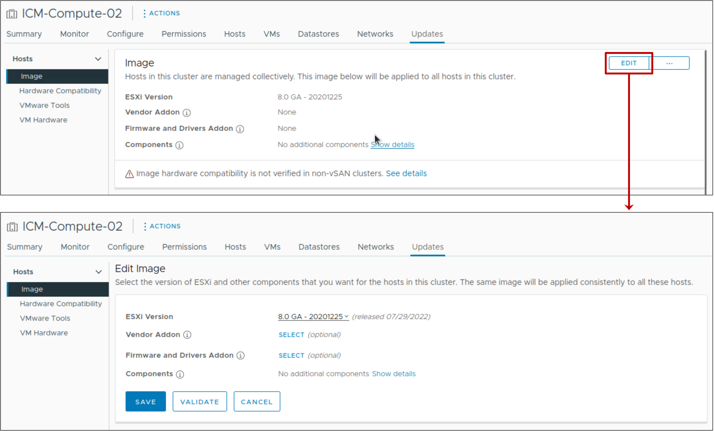
Customizing Cluster Images
After you start managing a cluster with an image, you can edit the image:
Change the base image.
Change, add, and remove components.
Before saving the image specification, you can validate it:
Ensures completeness of the image
Verifies that the image has no missing component dependencies
Confirms that components do not conflict with one another
Notes:
You can edit the image by changing, adding, or removing components, such as the ESXi image version, vendor add-ons, firmware and driver add-ons, and other components.

Slide 37
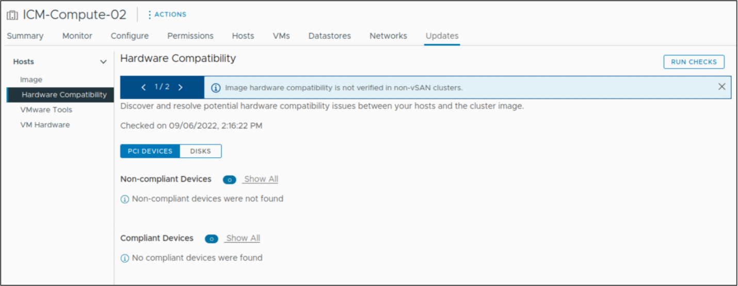
Hardware Compatibility
Hardware compatibility checks ensure that the host or cluster hardware is compliant with the VMware Compatibility Guide and vSAN Hardware Compatibility List.
Notes:
Hardware compatibility lists are lists of hardware certified for use with various vSphere releases.
The VMware Compatibility Guide contains information about server models and I/O devices that are certified for use with particular vSphere releases. You can access this guide at https://www.vmware.com/resources/compatibility/search.php.
Besides VMware Compatibility Guide, vSAN maintains a separate hardware compatibility list that lists all I/O and networking device controller hardware and the respective firmware versions certified for use with vSAN. The vSAN HCL also contains information about the disk drives that a specific vSphere release supports and the earliest disk drive firmware version certified for use with vSAN. You can view information in the vSAN hardware compatibility list at https://www.vmware.com/resources/compatibility/search.php?deviceCategory=vsan.

Slide 38
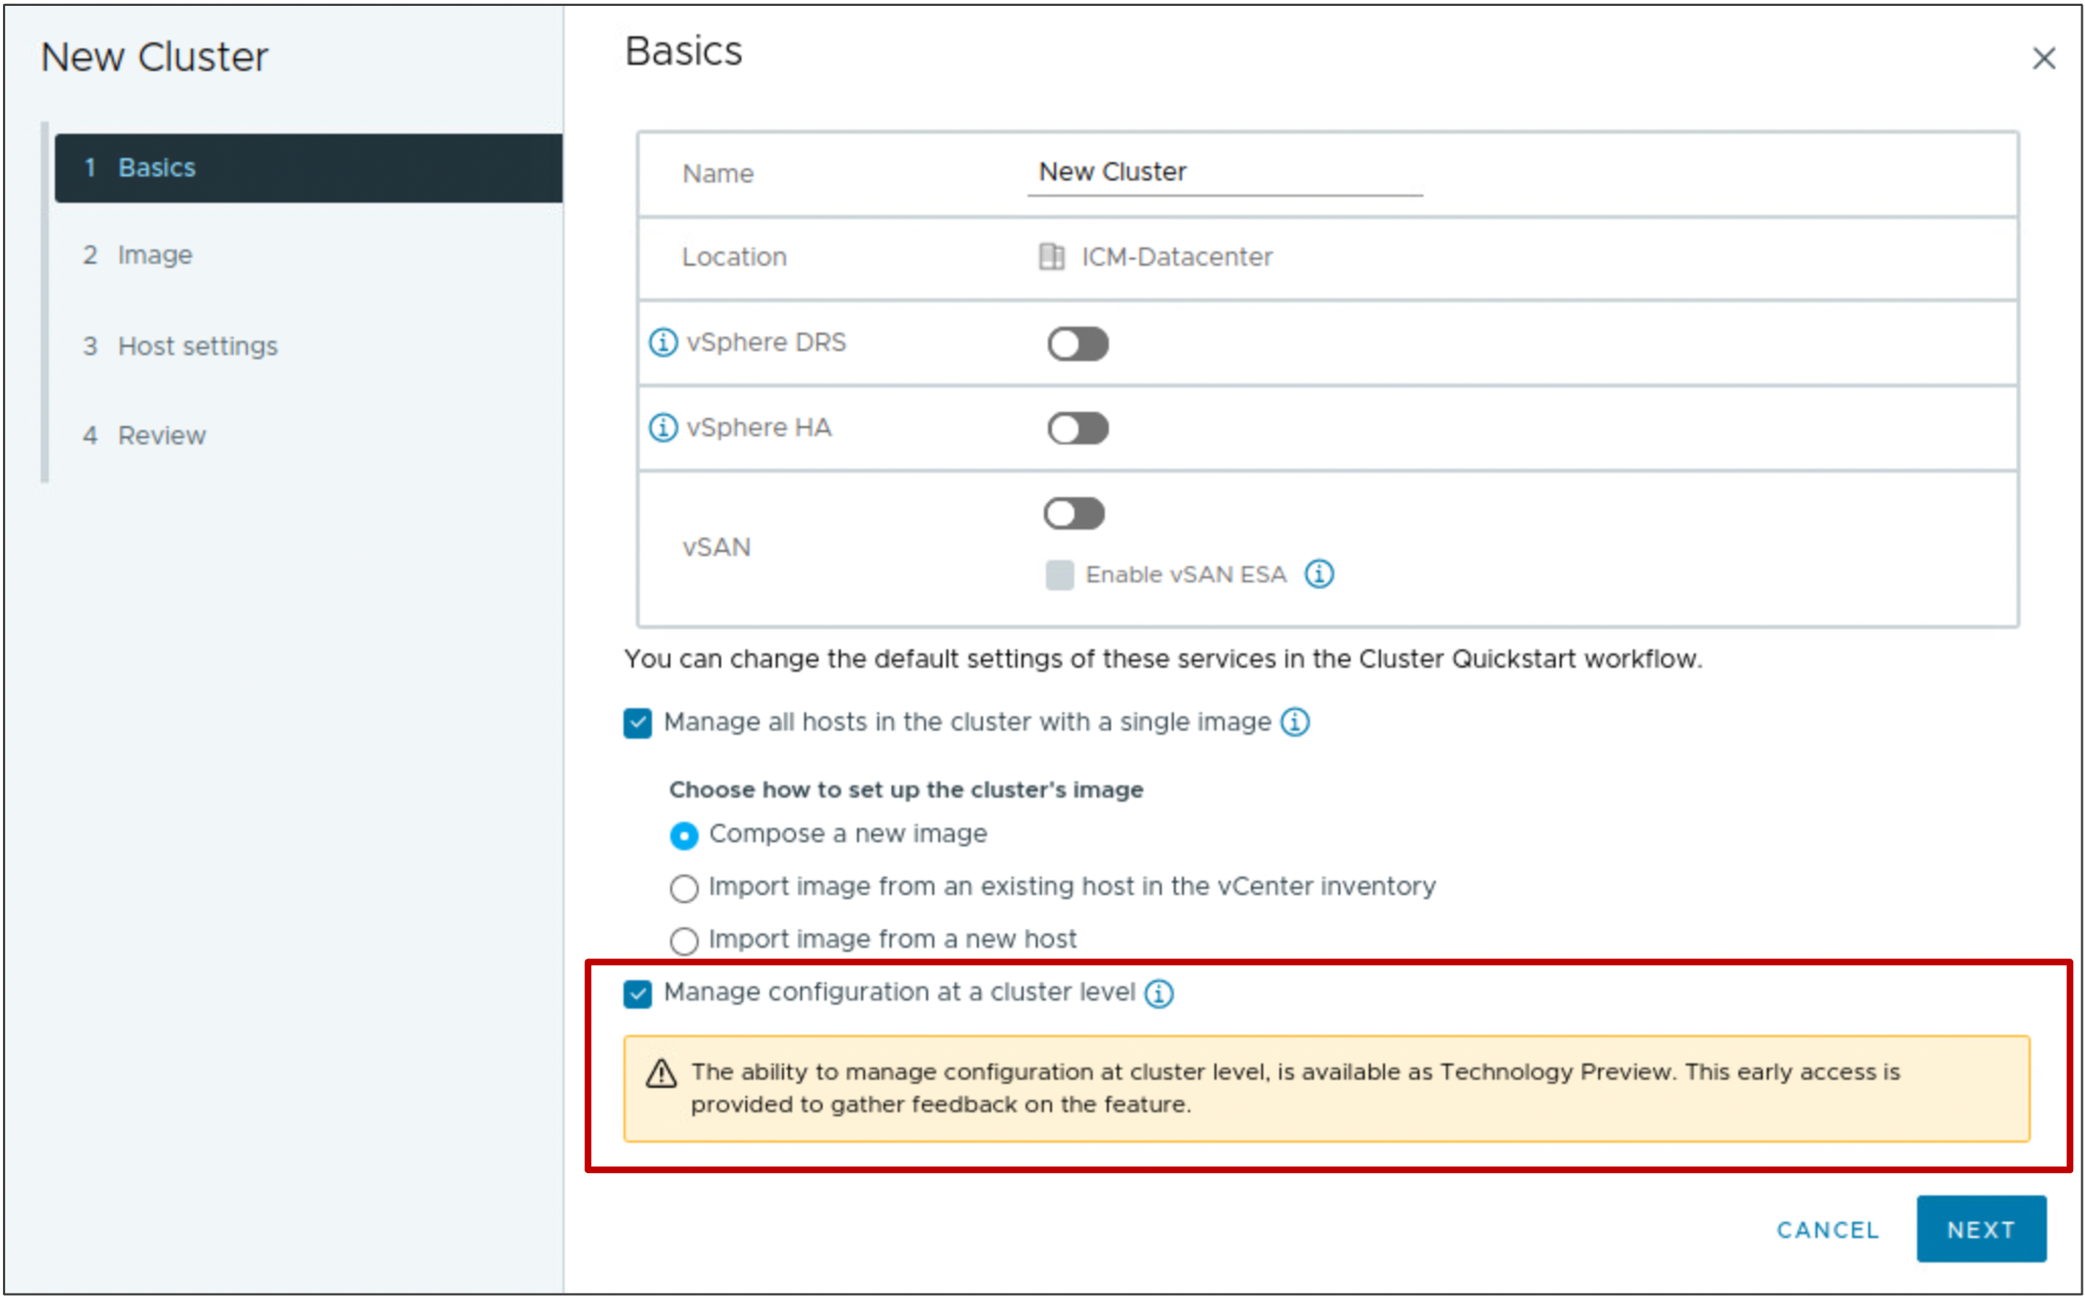
Tech Preview: Managing Host Configurations
You can manage the configuration settings of all hosts in a cluster:
Known as Configuration Manager
A Tech Preview feature: vSphere 8.0 provides you with early access to test the feature and provide feedback.
Notes:
To manage the configuration settings of all hosts in a cluster, you must first manage the cluster with a single image.
Also, all hosts in the cluster must be 8.0 or later.
Configuration Manager does not support the configuration of vSphere Distributed Switches or VMware NSX for ESXi hosts.
Since Configuration Manager is a technology preview (Tech Preview) feature, support requests are serviced. This feature should not be used in a production environment.
For production environments, use host profiles to manage the configuration settings of the hosts in a cluster. For details, see vSphere Host Profiles at https://docs.vmware.com/en/VMware-vSphere/index.html.

Slide 39
Review of Learner Objectives
Activate vSphere Lifecycle Manager in a cluster and define a cluster image
Validate ESXi host compliance against a cluster image
Remediate ESXi hosts using vSphere Lifecycle Manager
View recommended images for a cluster

Slide 40
Managing the Life Cycle of VMware Tools and VM Hardware

Slide 41
Learner Objectives
Use vSphere Lifecycle Manager to upgrade VMware Tools and VM hardware

Slide 42
Keeping VMware Tools Up To Date
VMware can provide a new release of VMware Tools with a release of ESXi.
New releases include:
Bug fixes
Security patches
New driver support for ESXi enhancements
Performance enhancements for virtual devices
Keeping VMware Tools up to date is an important part of ongoing data center maintenance.

Slide 43
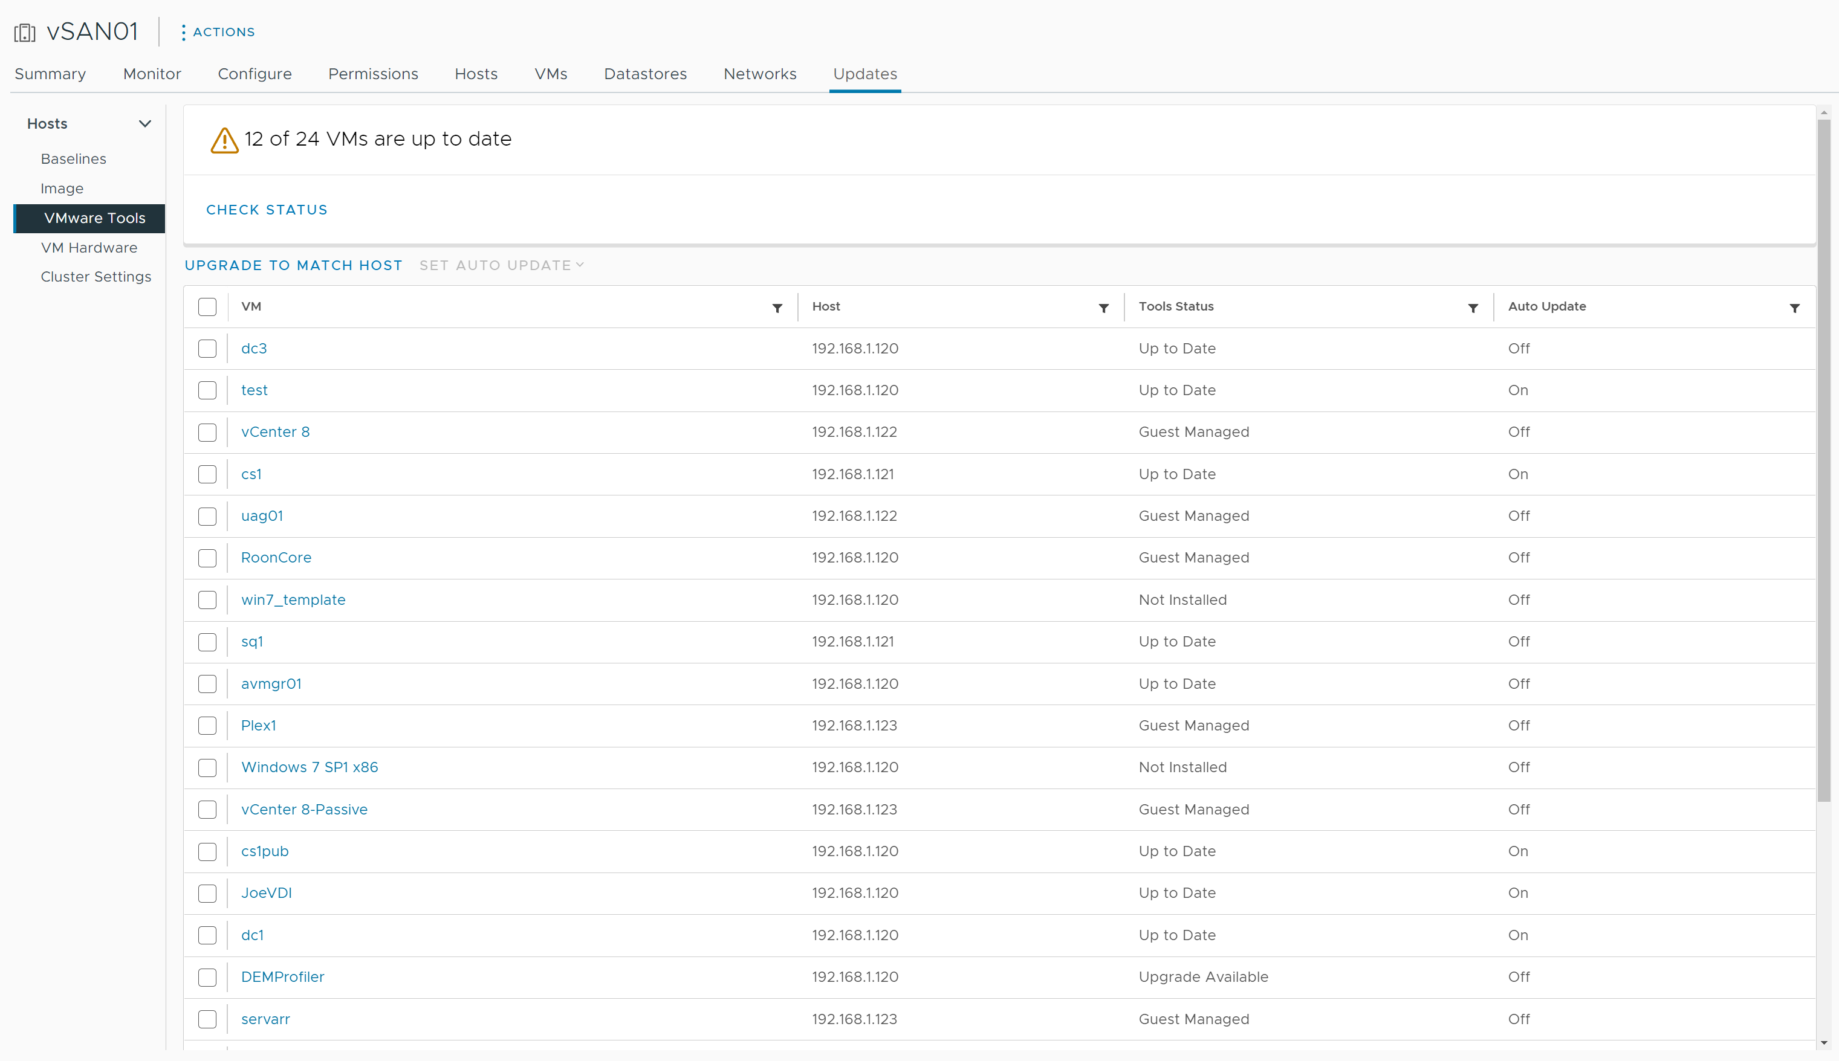
Upgrading VMware Tools (1)
From a host or cluster's Updates tab, select VMware Tools.
Step 1: Check the status of VMware Tools running in your VMs:
Up to Date
Upgrade Available
Version Unsupported
Not Installed
Guest Managed
Unknown
Notes:
A VM has one of the following VMware Tools status values:
Up to Date:
VMware Tools is installed, supported, and the version is compliant.
VMware Tools is installed, supported, and the version is newer than the version that is available on the ESXi host.
Upgrade Available:
VMware Tools is installed, but the version is old.
VMware Tools is installed and supported, but a newer version is available on the ESXi host.
Version Unsupported:
VMware Tools is installed, but the version is old.
VMware Tools is installed, but the version has a known problem and must be immediately upgraded.
VMware Tools is installed, but the version is too new to work correctly with this virtual machine.
Not Installed: VMware Tools is not installed on this virtual machine. Consider installing VMware Tools in this VM.
Guest Managed: vSphere does not manage VMware Tools. For example, your VM is running the Linux OpenVMTools package. Use native Linux package management tools to upgrade VMware Tools.
Unknown: The status of the virtual machine has not been checked. Verify that the VM is powered on before you click CHECK STATUS.

Slide 44
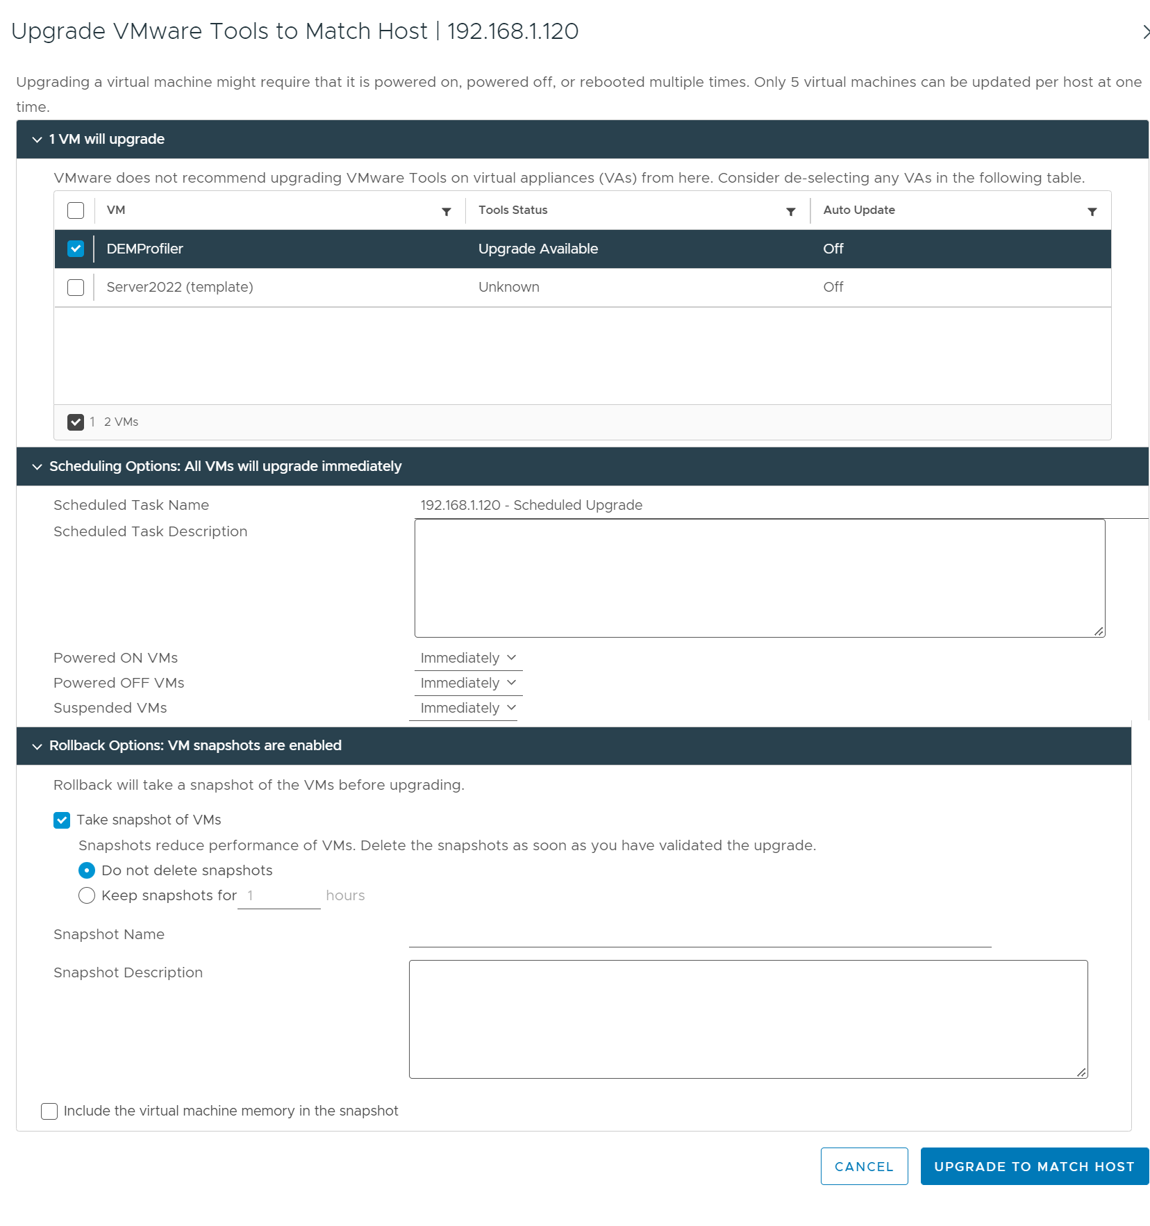
Upgrading VMware Tools (2)
Select the VMs that use VMware Tools whose version you want to upgrade.
Step 2: Click UPGRADE TO MATCH HOST.
Select the VMs to upgrade.
Schedule the upgrade.
Plan the upgrade during your maintenance window.
Select rollback options.
Notes:
Plan the VMware Tools upgrade during your maintenance window, especially if a reboot of the VM is required after the upgrade completes.

Slide 45
Keeping VM Hardware Up To Date
With almost every update of ESXi, VMware provides a new release of VM hardware.
As ESXi improves its hardware support, VMware often carries that support into its VMs.
New releases include:
Greater configuration maximums
New types of hardware (for example, vGPU, vNVMe, vSGX, vTPM, and so on)
Always upgrade VMware Tools before upgrading VM hardware.
Consider upgrading VM hardware only when new features are required.

Slide 46
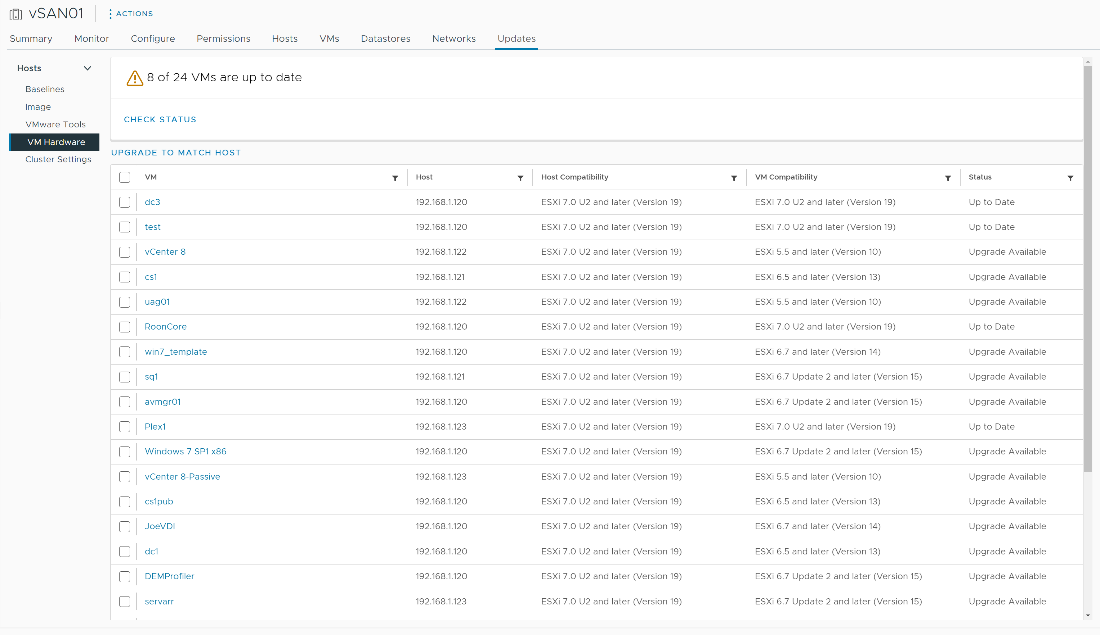
Upgrading VM Hardware (1)
Select VM Hardware to upgrade your VMs' hardware.
Step 1: Check the status of the VM hardware running in your VMs:
Upgrade Available: Upgrade VM hardware to match the current version available for your ESXi hosts.
Up to Date: The version of VM hardware configured in the VM matches the latest available version for the ESXi host.

Slide 47
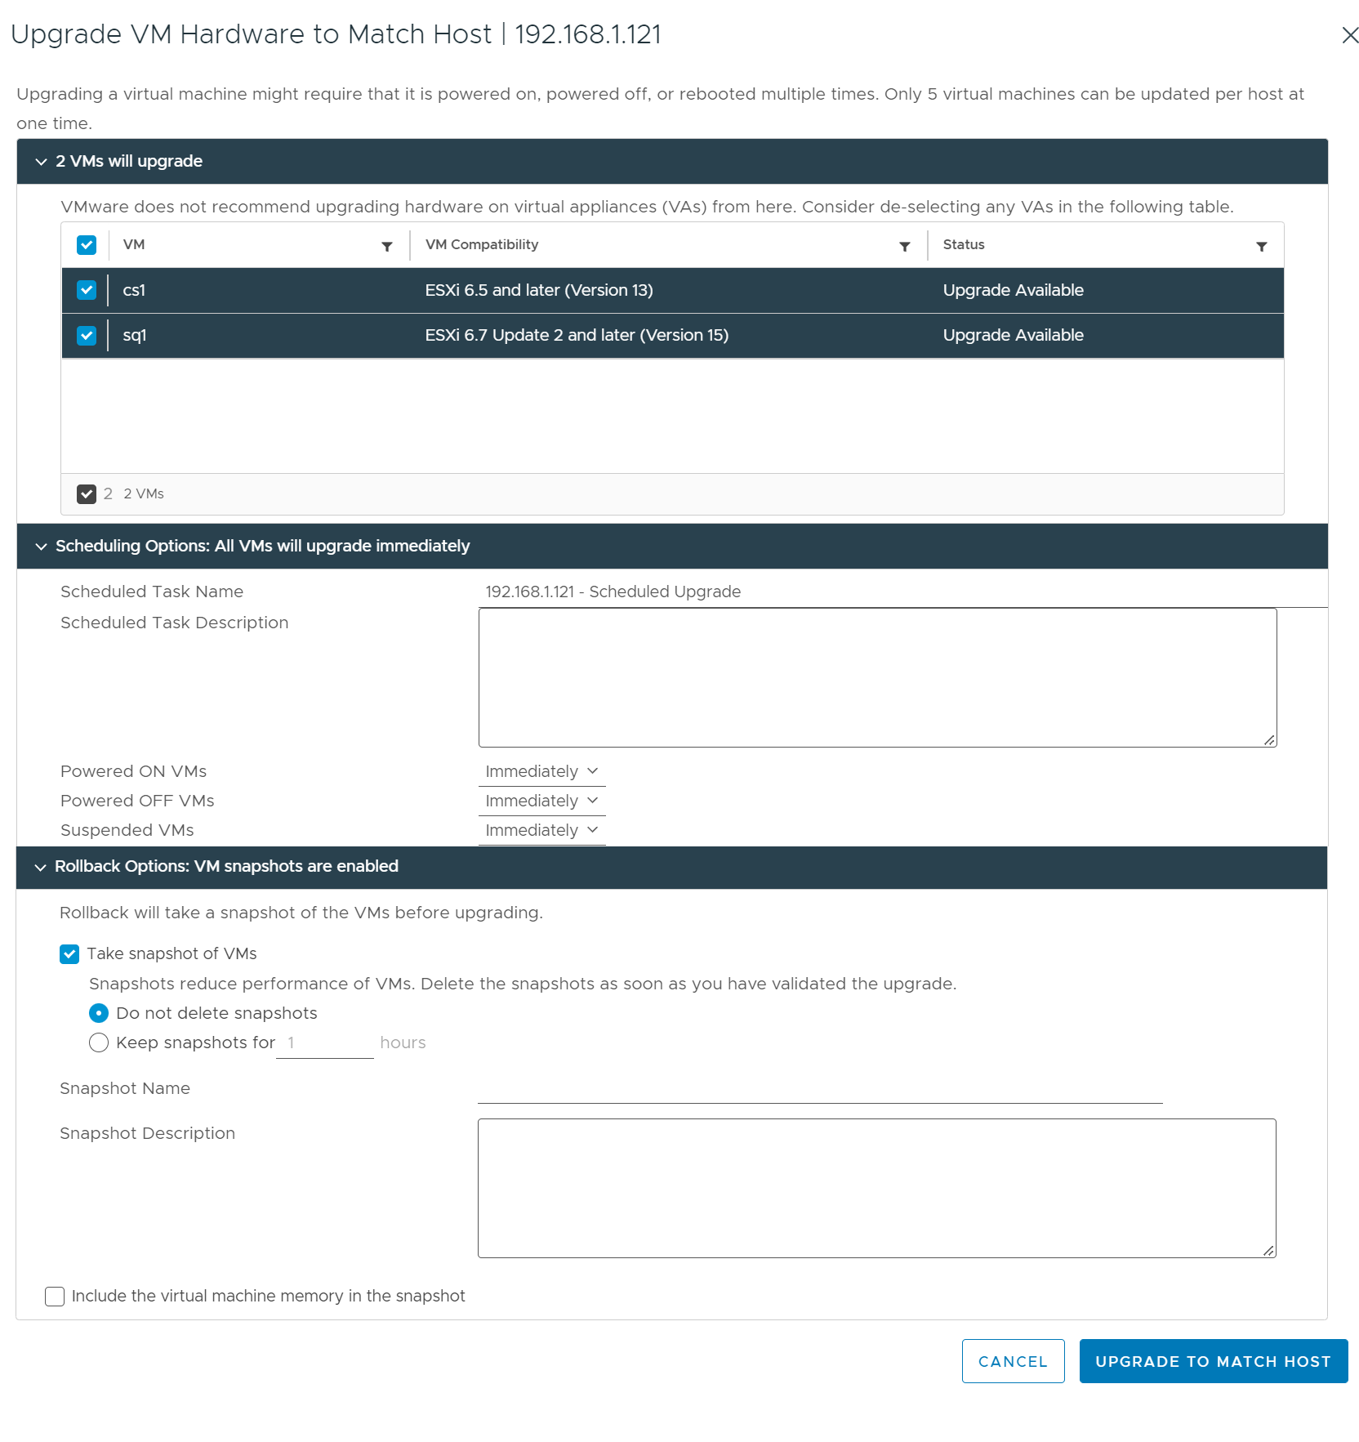
Upgrading VM Hardware (2)
Step 2: Select the VMs whose hardware version you want to upgrade.
Step 3: Click UPGRADE TO MATCH HOST.
Schedule the upgrade.
Plan the upgrade during your maintenance window.
Select rollback options.

Slide 48
Lab 1: Using vSphere Lifecycle Manager
Update ESXi hosts using vSphere Lifecycle Manager:
Create a Cluster and Select an Image
Add ESXi Hosts to the Cluster
Check for Host Compliance
Remediate Noncompliant Hosts

Slide 49
Review of Learner Objectives
Use vSphere Lifecycle Manager to upgrade VMware Tools and VM hardware

Slide 50
Key Points
You can generate interoperability reports to verify that your vCenter system meets the minimum requirements for a successful upgrade. It also verifies the order in which vCenter and other products should be upgraded.
vSphere Lifecycle Manager centralizes automated patch and version management for clusters, ESXi hosts, drivers and firmware, VM hardware, and VMware Tools.
In vSphere Lifecycle Manager, you can manage ESXi hosts by using images.
Keeping VMware Tools up to date is an important part of ongoing data center maintenance.
Consider upgrading VM hardware only when new features are required.
Questions?

