Slide 1
vSphere and Virtualization Overview

Slide 2
Importance
As a vSphere administrator, you must be familiar with the components on which vSphere is based.
You must also understand the following concepts:
Virtualization, the role of the ESXi hypervisor in virtualization, and virtual machines
Fundamental vSphere components and the use of vSphere in the software-defined data center
When to use each one of the user interfaces to administer and manage vSphere environments

Slide 3
Module Lessons
vSphere Virtualization Overview
vSphere Virtualization of Resources

Slide 4

vSphere Virtualization Overview

Slide 5
Learner Objectives
Explain basic virtualization concepts
Describe vSphere
Describe how vSphere fits in the software-defined data center
Describe vSphere+
Recognize the user interfaces for accessing vSphere

Slide 6
Terminology (1)
Virtualization is associated with several key concepts, products, and features.
Term | Definition | Examples
Operating system | Software designed to allocate physical resources to applications | Microsoft Windows, Linux
Application | Software that runs on an operating system, consuming physical resources | Microsoft Office, Chrome
Hypervisor | Specialized operating system designed to run VMs | ESXi, Workstation, Fusion
Virtual machine | Specialized application that abstracts hardware resources into software
Guest | The operating system that runs in a VM (also called the guest operating system) | Microsoft Windows, Linux
Host | Physical computer that provides resources to the ESXi hypervisor

Slide 7
Terminology (2)
Term | Definition
vSphere | Server virtualization product of VMware that combines the ESXi hypervisor and the vCenter Server management platform
Cluster | Group of ESXi hosts whose resources are shared by VMs
vSphere vMotion | Feature that supports the migration of powered-on VMs from host to host without service interruption
vSphere HA | Cluster feature that protects against host hardware failures by restarting VMs on hosts that are running normally
vSphere DRS | Cluster feature that uses vSphere vMotion to place VMs on hosts and ensure that each VM receives the resources that it needs

Slide 8
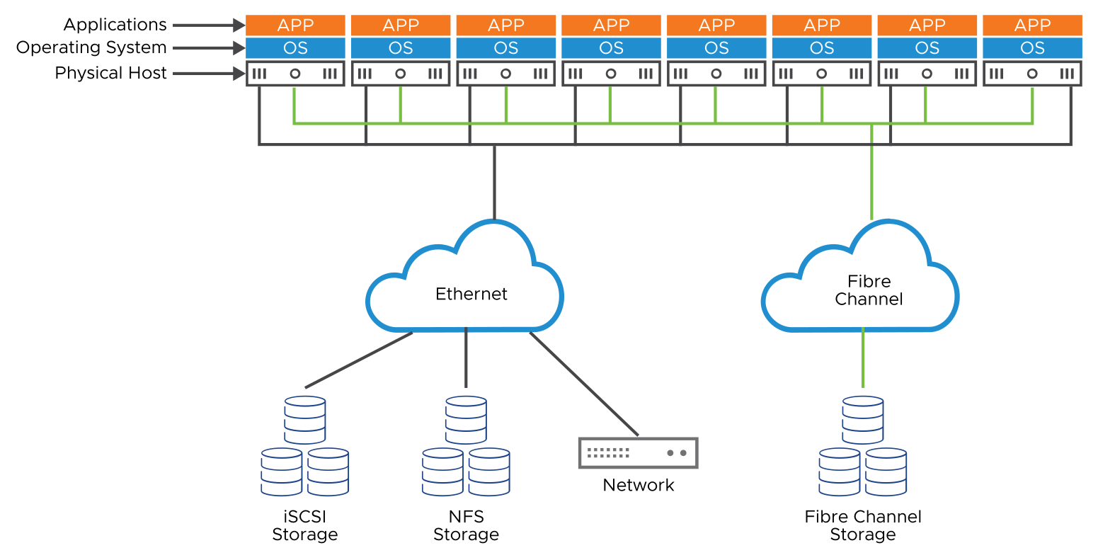
Data Center Physical Infrastructure
Notes:
Traditionally, operating systems and software run on a physical computer. Several challenges are posed to running a large number of physical servers in a data center. The model is not flexible and can be inefficient. The planning and cost of proper infrastructure (square footage, rack space, power, cooling, cabling, and server provisioning) are but a few of the problems that IT staff must address.
Typically, a one-to-one relationship exists between a physical computer and the software that it runs. This relationship leaves most computers vastly underused. The cost of the space and power required to house, run, and keep these systems cool can be expensive.
Provisioning physical servers is a time-consuming process. In nonvirtualized environments, time must be allotted to procure new hardware, place it in the data center, install an operating system, and patch the operating system. Installing and configuring the required applications can take weeks. This process also includes a myriad of other tasks to integrate the system into the infrastructure, for example, configuring firewall rules, enabling switch ports, and provisioning storage.

Slide 9
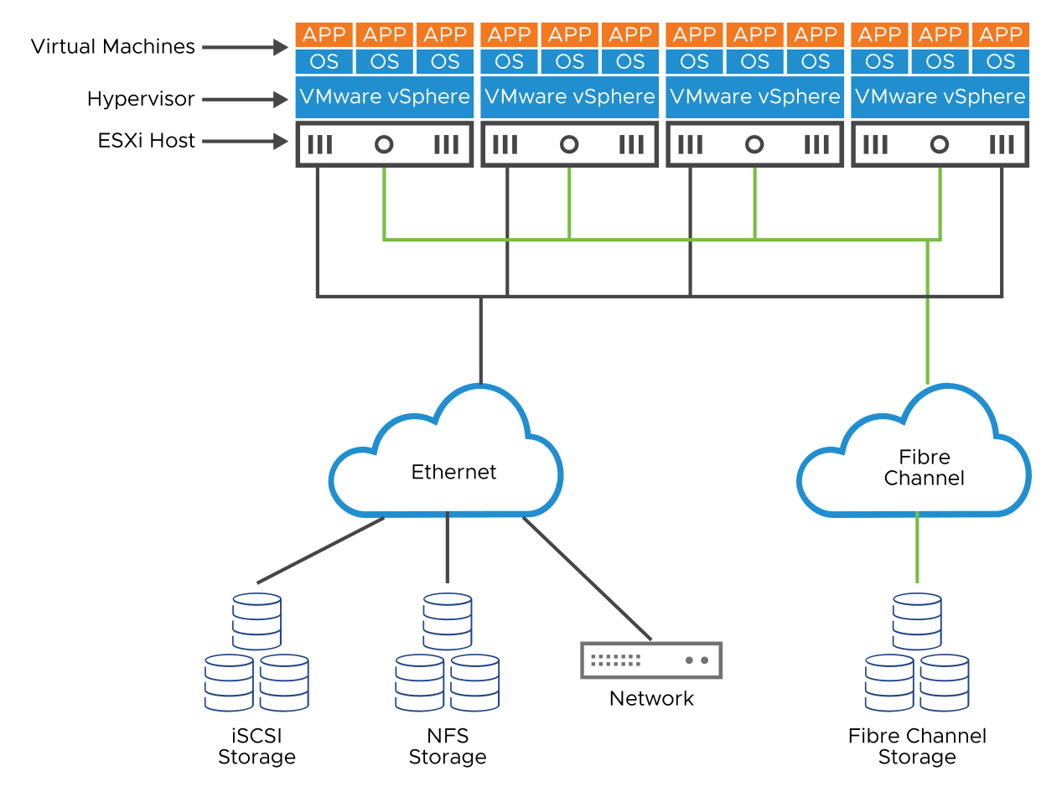
About the Virtual Infrastructure
Notes:
Virtualization enables you to run more workloads on a single server by consolidating the environment so that your applications run on virtual machines. Converting to a virtualized data center reduces the required data center square footage, rack space, power, cooling, cabling, storage, and network components by reducing the sheer number of physical machines.
The reduction of physical machines can be realized by converting physical machines to virtual machines and consolidating the converted machines onto a single host.
Using virtualization technology also changes the way servers are provisioned. You do not need to wait for the hardware to be procured or cabling to be installed. Virtual machine provisioning is performed using an intuitive graphical user interface. In contrast to the long process of deploying physical servers, deploying virtual machines can be deployed in a matter of minutes.

Slide 10
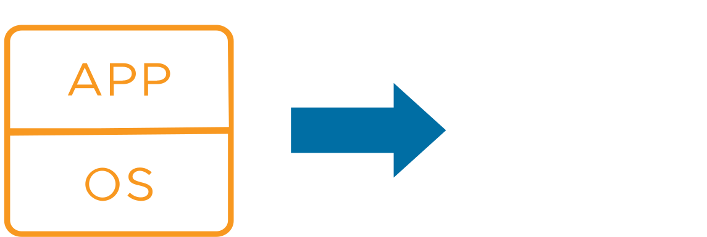
About Virtual Machines
A virtual machine (VM) is a software representation of a physical computer and its components.
The virtual machine includes the following components:
Guest operating system
VMware Tools
Virtual resources, such as:
CPU and memory
Network adapters
Disks and controllers
GPUs
Notes:
A virtual machine (VM) includes a set of specification and configuration files and is supported by the physical resources of a host. Every VM has virtual devices that provide the same functionality as physical hardware but are more portable, more secure, and easier to manage.
VMs include an operating system, applications, VMware Tools, virtual resources, and hardware that you manage in the same way that you manage a physical computer.
VMware Tools is a bundle of drivers. Using these drivers, the guest operating system can interact efficiently with the virtual hardware. VMware Tools also adds extra functionality so that ESXi can better manage the VMs use of physical hardware.

Slide 11
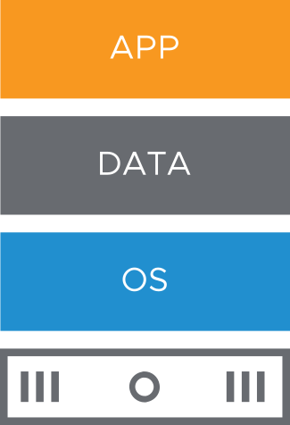
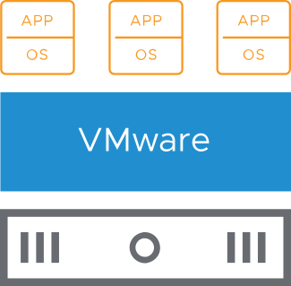
Benefits of Using Virtual Machines
Physical machines have the following constraints:
Difficult to move or copy
Bound to a specific set of hardware components
Often have a short life cycle
Require personal contact to upgrade hardware
Virtual machines provide the following benefits:
Easy to move or copy
Independent of physical hardware because VMs are encapsulated into files
Isolated from other VMs running on the same physical hardware
Insulated from physical hardware changes
Notes:
In a physical machine, the operating system (for example, Windows or Linux) is installed directly on the hardware. The operating system requires specific device drivers to support specific hardware. If the computer is upgraded with new hardware, new device drivers are required.
If applications interface directly with hardware drivers, an upgrade to the hardware, drivers, or both can have significant repercussions if incompatibilities exist. Because of these potential repercussions, hands-on technical support personnel must test hardware upgrades against a wide variety of application suites and operating systems. Such testing costs time and money.
Virtualizing these systems saves on such costs because VMs are 100 percent software.
Multiple VMs are isolated from one another. You can have a database server and an email server running on the same physical computer. The isolation between the VMs means that software-dependency conflicts are not a problem. Even users with system administrator privileges on a VM guest operating system cannot breach the layer of isolation to access another VM. The users must explicitly be granted access by the ESXi system administrator. As a result of VM isolation, if a guest operating system running in a VM fails, other VMs on the same host are unaffected and continue to run.
A guest operating system failure does not affect access and performance:
Users can still access the other VMs.
The operational VMs can access the resources that they need.
The other VMs can still perform.
With VMs, you can consolidate your physical servers and make more efficient use of your hardware. Because a VM is a set of files, features that are not available or not as efficient on physical architectures are available to you, for example:
You can rapidly and consistently provision VMs.
With VMs, you can use live migration, fault tolerance, high availability, and disaster recovery scenarios to increase the uptime and reduce recovery time from failures.
You can use multitenancy to mix VMs to specialized configurations, such as a demilitarized zone (DMZ).
With VMs, you can support legacy applications and operating systems on newer hardware when maintenance contracts on the existing hardware expire.

Slide 12
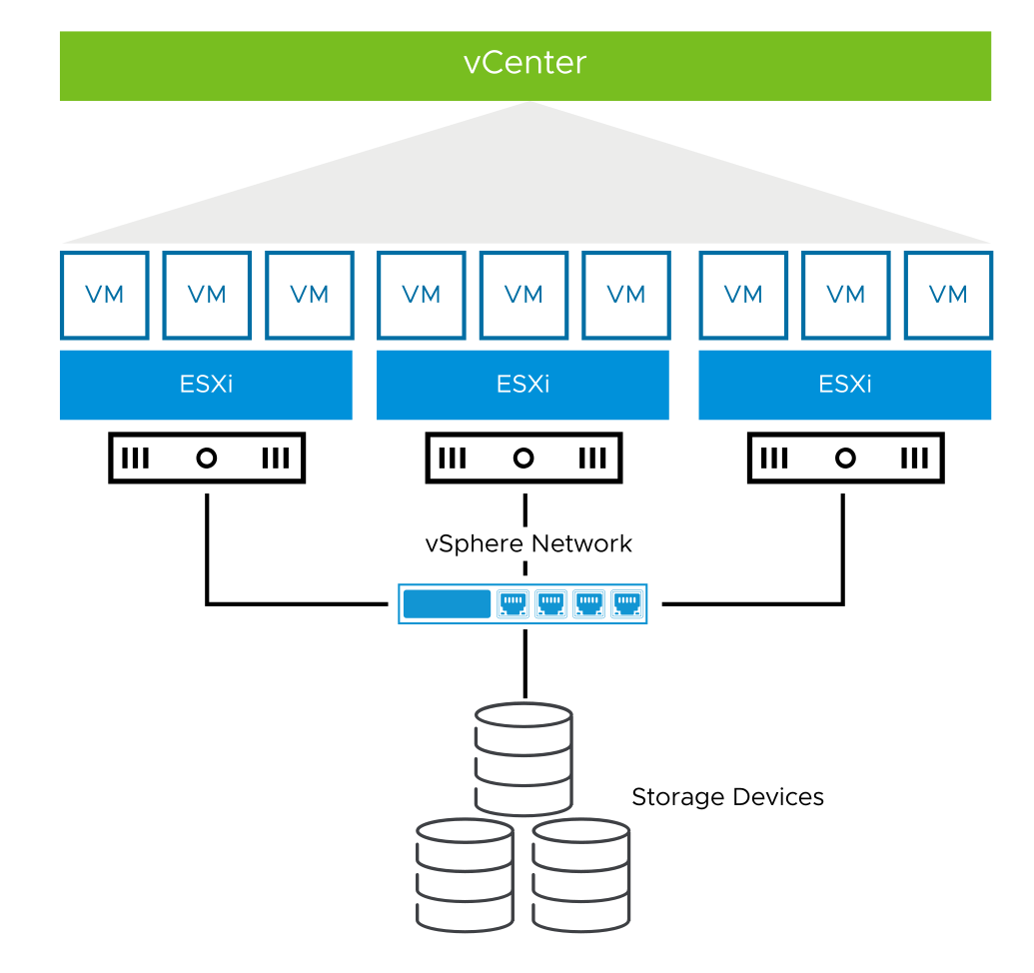
About vSphere
vSphere is the virtualization platform that includes two core administrative components for running virtual machines:
ESXi: Hypervisor on which you run virtual machines
vCenter: Central administration platform for ESXi hosts, virtual machines, storage, and networking
Notes:
vCenter Server and ESXi are core to run a vSphere environment.
vSphere is a virtualization platform that provides virtualization, management, resource optimization, application availability, and operational automation capabilities.
vSphere virtualizes and aggregates the underlying physical hardware resources across multiple systems and provides pools of virtual resources to the data center.
In addition, vSphere provides a set of distributed services that enable detailed, policy-driven resource allocation, high availability, and scalability of the entire virtual data center.

Slide 13
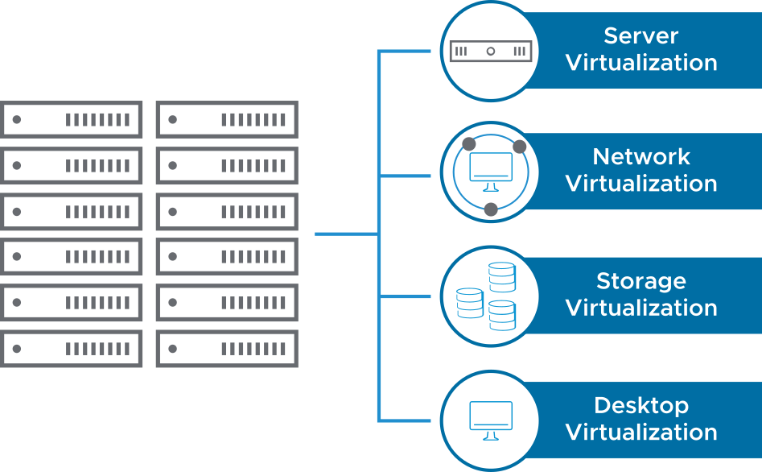
Types of Virtualization
Virtualization is the process of creating a software-based representation of a physical unit, such as a server, desktop, network, or storage device.
Virtualization is the single most effective way to reduce IT expenses while boosting efficiency and agility for all business sizes.
Notes:
Server virtualization allows companies to create multiple operating systems that run on a single physical server, called VMs. Each VM has access to the underlying server’s computing resources.
Network virtualization is the complete reproduction of a physical network in software. Applications run on the virtual network exactly as if on a physical network.
Storage virtualization is the process of creating a software-based representation of network storage devices into what appears to be a single unit.
By deploying desktops as a managed service, you can respond more quickly to changing needs and opportunities.

Slide 14
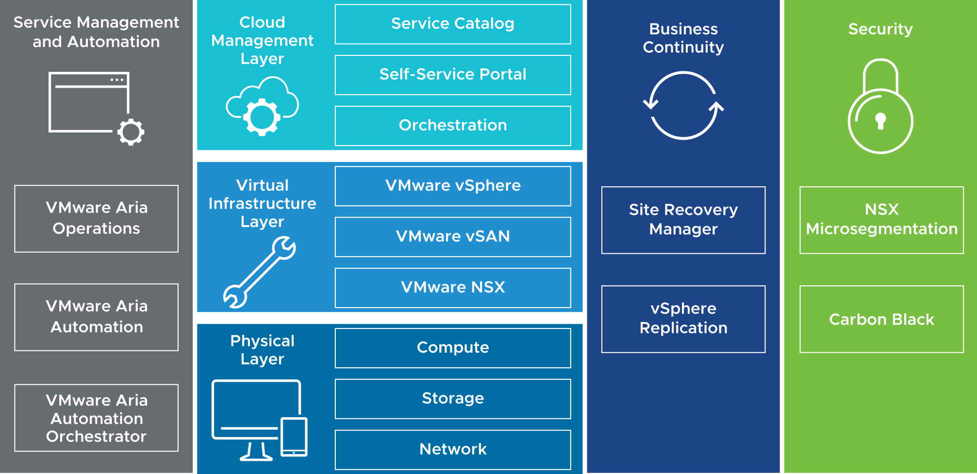
About the Software-Defined Data Center
In a software-defined data center (SDDC), all infrastructure is virtualized, and the control of the data center is automated by software. vSphere is the foundation of the SDDC.
Notes:
A software-defined virtual data center (SDDC) is deployed with isolated computing, storage, networking, and security resources that are more efficient, more manageable, and more scalable than the traditional, hardware-based data center.
All the resources (CPU, memory, disk, and network) of a software-defined data center are an abstraction in software of the physical resources. The abstraction provides the benefits of virtualization at all levels of the infrastructure, independent of the physical infrastructure.
An SDDC can include the following components:
Service management and automation: Use service management and automation to track and analyze the operation of multiple data sources in the multiregional SDDC. Deploy VMware Aria Operations and vRealize Log Insight across multiple nodes for continued availability and increased log ingestion rates.
Cloud management layer: The layer includes the service catalog, which has the facilities to deploy. The cloud management layer also includes orchestration, which provides the workflows to deploy catalog items, and the self-service portal for end users to access and use the SDDC.
Virtual infrastructure layer: The layer establishes a robust virtualized environment that all the other solutions can integrate. The virtual infrastructure layer includes the virtualization platform for the hypervisor, pools of resources, and virtualization control. Additional processes and technologies build on the infrastructure to support Infrastructure as a Service (IaaS) and Platform as a Service (PaaS).
Physical layer: The lowest layer of the solution includes compute, storage, and network components.
Security: Customers use the layer of the platform to meet the demanding compliance requirements for virtualized workloads and manage business risk.

Slide 15
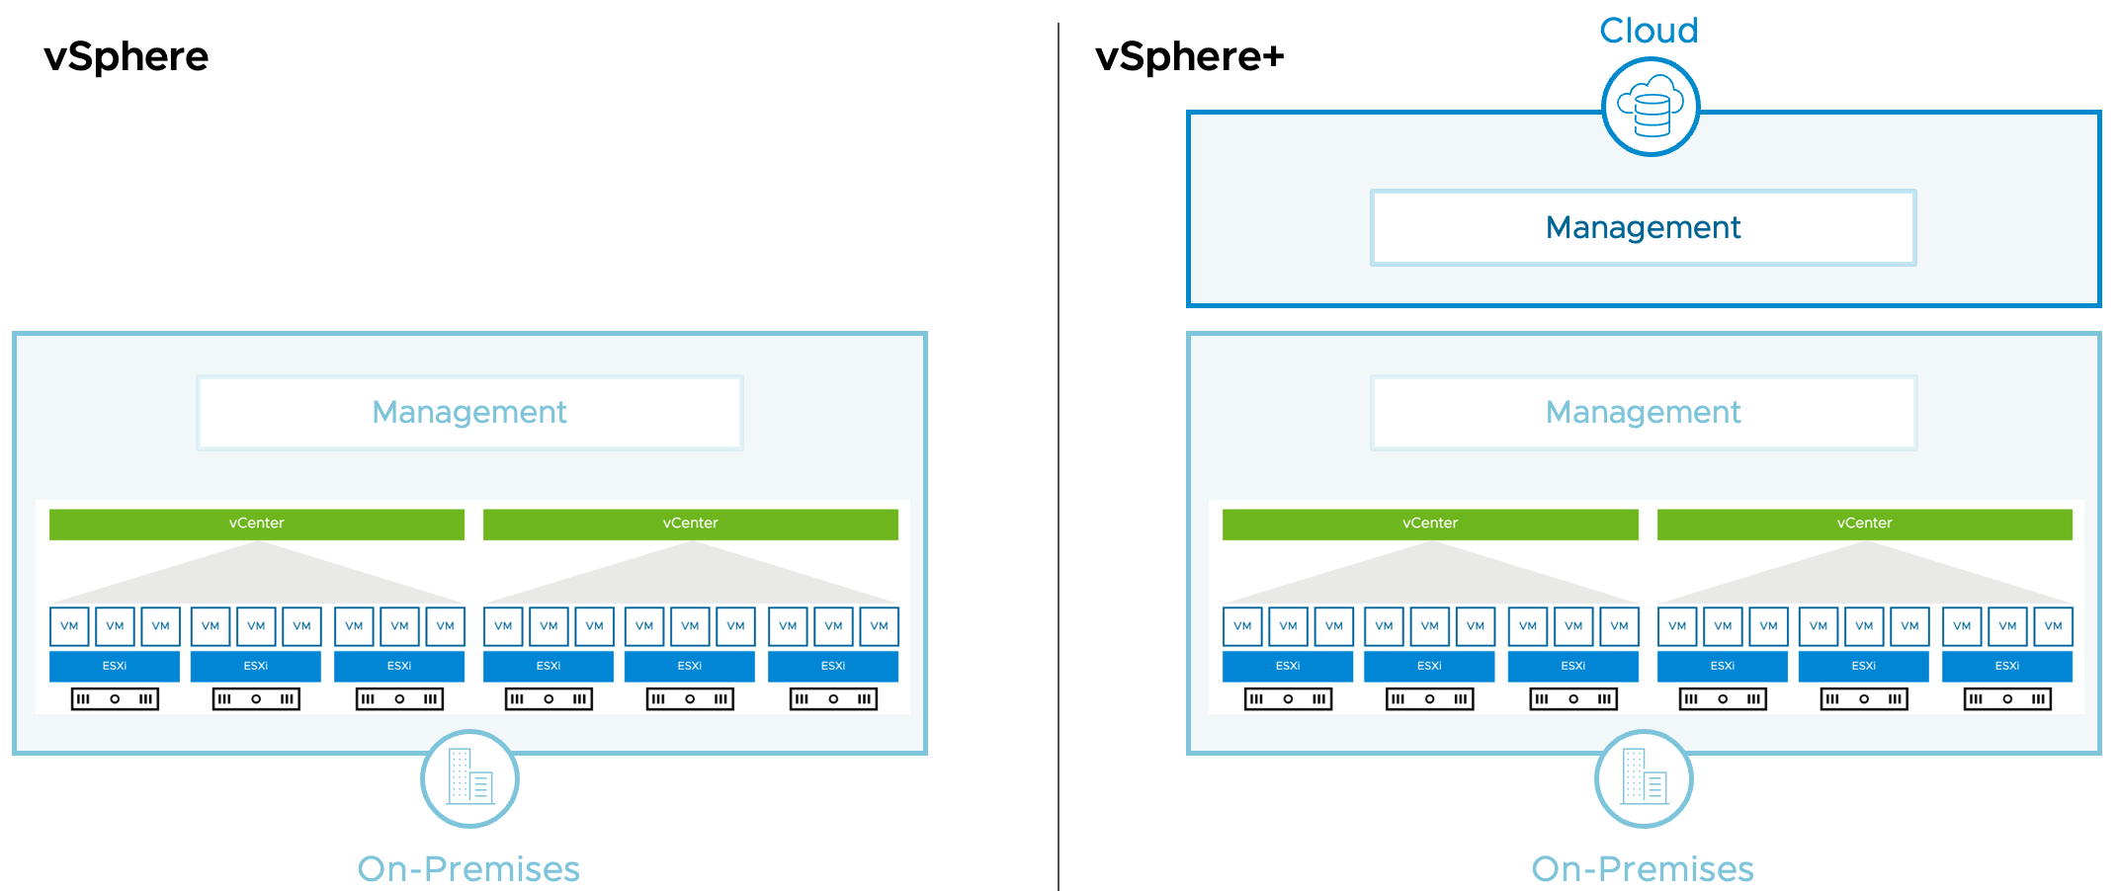
About vSphere+
VMware vSphere+ is a subscription-based offering that brings the benefits of cloud to on-premises workloads.
vSphere+ consists of on-premises and cloud components that interact with each other.
vSphere+ lets you centrally manage your on-premises workloads from a cloud console, with access to cloud services.
Notes:
vSphere+ supports traditional workloads based on VMs, plus modern workloads based on containers. There is no difference between vSphere+ and vSphere in the types of workloads supported. Your workloads run on-premises on ESXi hosts. None of your workloads or on-premises vSphere infrastructure are moved to the cloud.
vSphere+ consists of both on-premises and cloud components:
On-premises components:
vCenter instances and ESXi hosts
Cloud gateway that connects vCenter instances to the VMware Cloud Console
Cloud components:
VMware Cloud Console, where you can centrally manage on-premises infrastructure and access cloud services
Cloud services for admins (or IT operations) and developers (or DevOps) that augment and enhance on-premises capabilities
vSphere+ has no special hardware requirements beyond the basic vSphere requirements.
For more details on vSphere+, see https://vsphereplus.com.

Slide 16
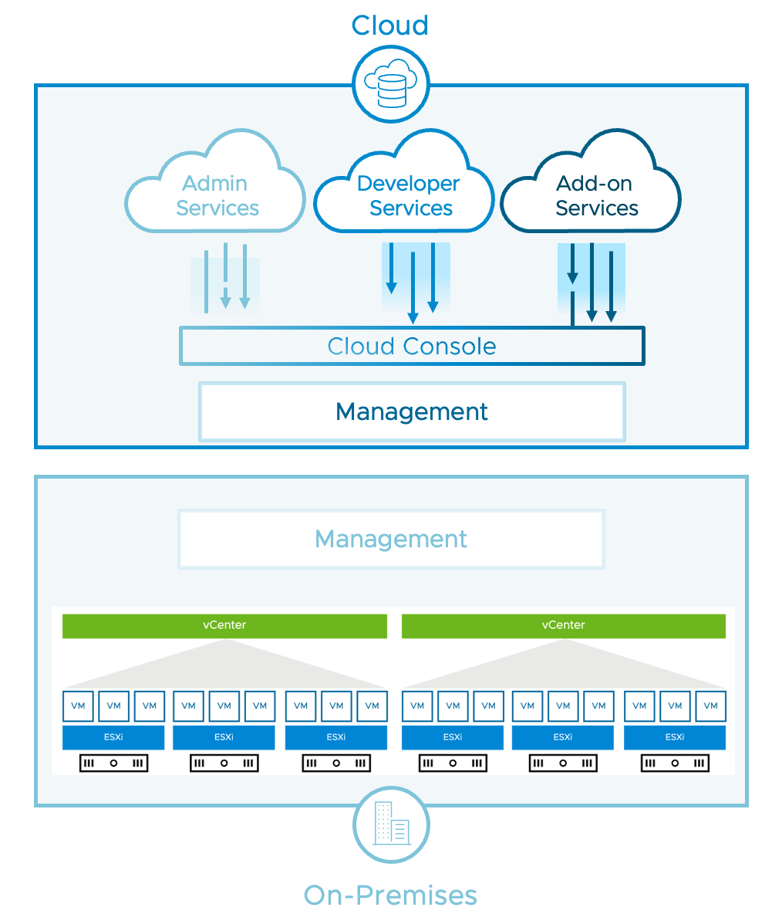
vSphere+: Accessing Cloud Services
vSphere+ lets you access cloud services to augment and enhance on-premises capabilities:
Admin Services
Inventory management
Events and alerts management
VM provisioning
Lifecycle management
Configuration management
Developer Services
Tanzu Kubernetes Grid
Tanzu integrated services
Add-On Services
Disaster recovery
Notes:
VMware is developing vSphere+ add-on services to expedite disaster recovery, ransomware protection, capacity planning and more. For a list of add-on services currently available for purchase or in development, contact your VMware partner or sales representative.
vSphere+ includes extensive developer services, including VM service, Storage service, Network service, Registry service, Tanzu Kubernetes Grid service, Tanzu integrated services, Tanzu Mission-Control Essentials and more. These services are included with vSphere+ at no additional charge.
vSphere+ includes extensive admin services, including Global Inventory service, Event View service, Security Health Check service, VM Provisioning service, Lifecycle Management service, Configuration Management service and more. These services are included with vSphere+ at no additional charge.

Slide 17
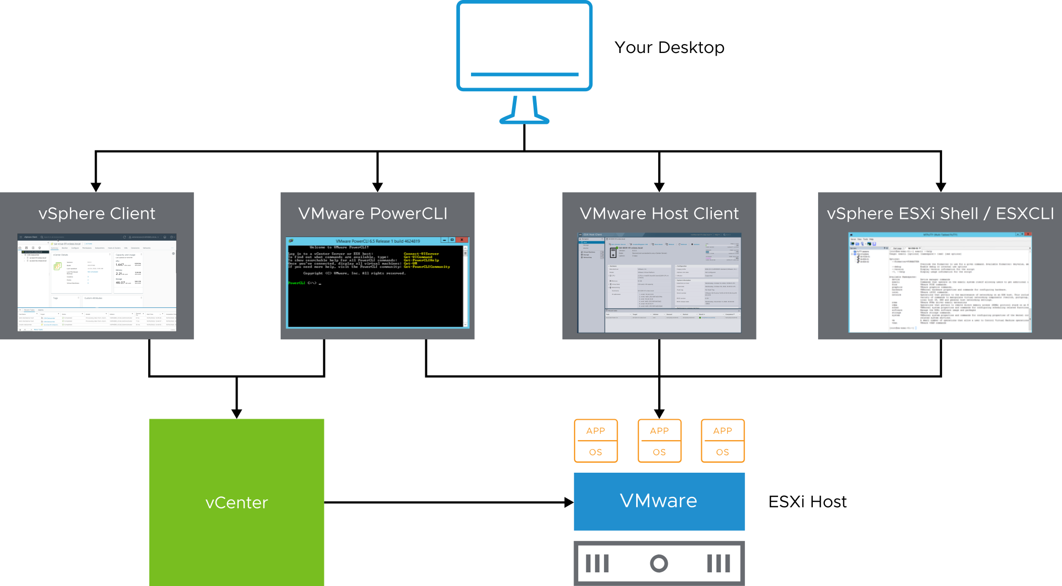
vSphere User Interfaces
You can use the vSphere Client, PowerCLI, VMware Host Client, vSphere ESXi Shell and ESXCLI to interact with the vSphere environment.
For information about ports and protocols, see https://ports.vmware.com.
Notes:
VMware Host Client is an HTML5-based user interface that you can use to manage individual ESXi hosts directly when vCenter Server is unavailable. VMware Host Client is provided from ESXi. You access it from a supported browser at https://<ESXi_FQDN_or_IP_Address>/ui.
The vSphere Client is an HTML5-based client. You manage the vSphere environment with the vSphere Client by connecting to vCenter Server and managing the vCenter Server object inventory. You access the vSphere Client from a supported browser at https://<vCenter_FQDN_or_IP_Address>/ui.
PowerCLI is a command-line and scripting tool that is built on Windows PowerShell. The tool provides a PowerShell interface to the vSphere API. PowerCLI provides more than 700 cmdlets for managing and automating vSphere. For more information about PowerCLI, see https://code.vmware.com/web/tool/12.0.0/vmware-powercli.
vSphere ESXi Shell provides a command-line interface for running essential maintenance commands. You use the vSphere ESXi Shell mainly for troubleshooting purposes.
From the vSphere ESXi Shell, you can run ESXCLI commands. You can use the ESXCLI command set lets you remotely manage ESXi hosts. ESXCLI commands can be run against a vCenter system and target any ESXi system. You can download ESXCLI from the VMware {code} page at https://code.vmware.com/web/tool/7.0/esxcli. You can install ESXCLI on a Windows or Linux system.

Slide 18
Lab 1: Accessing the Lab Environment
Log in to the Console VM and access the vSphere Client and VMware Host Client:
Access the Student Console
Log In to an ESXi Host with VMware Host Client
Log In to vCenter with the vSphere Client

Slide 19
Review of Learner Objectives
Explain basic virtualization concepts
Describe vSphere
Describe how vSphere fits in the software-defined data center
Describe vSphere+
Recognize the user interfaces for accessing vSphere

Slide 20
vSphere Virtualization of Resources

Slide 21
Learner Objectives
Explain how ESXi interacts with resources:
CPUs
Memory
Networks
Storage
GPUs

Slide 22
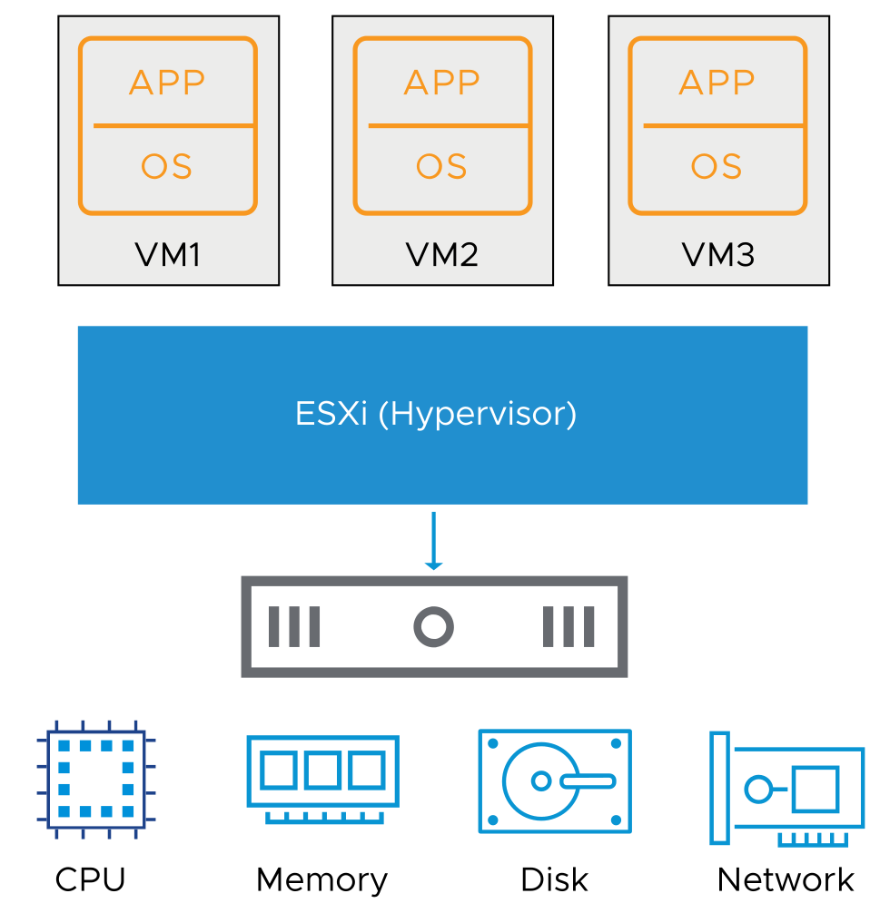
Virtual Machine: Guest and Consumer of ESXi Host
Any application in any supported OS can run in a VM (guest) and use CPU, memory, disk, and network from host-based resources.
Notes:
A virtual machine is an abstraction in software of a physical machine. ESXi manages the physical resources that are used by virtual machines as virtual resources.
For the list of all supported operating systems, see VMware Compatibility Guide at https://www.vmware.com/resources/compatibility.

Slide 23
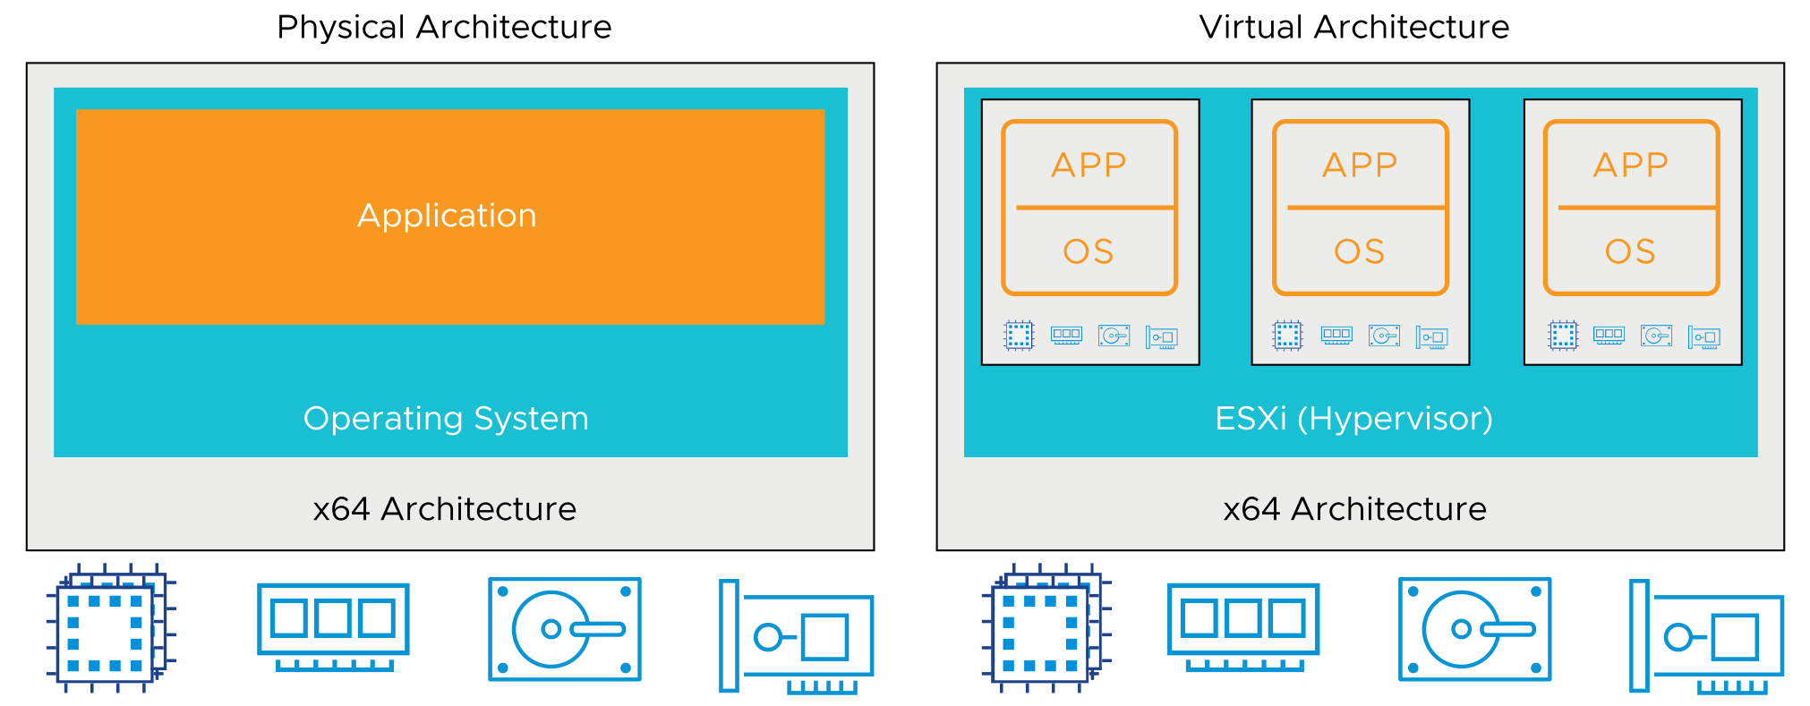
Physical and Virtual Architecture
Virtualization technology abstracts physical components to software components and provides solutions for many IT problems.
Notes:
You can use virtualization to consolidate and run multiple workloads as VMs on a single computer.
The slide shows the differences between a virtualized and a non-virtualized host. In traditional architectures, the operating system interacts directly with the installed hardware. The operating system schedules processes to run, allocates memory to applications, sends and receives data on network interfaces, and reads from and writes to attached storage devices. In comparison, a virtualized host interacts with the installed hardware through a thin layer of software called the virtualization layer or hypervisor.
The hypervisor provides physical hardware resources dynamically to VMs as needed to support the operation of the VMs. With the hypervisor, VMs can operate with a degree of independence from the underlying physical hardware. For example, a VM can be moved from one physical host to another. In addition, its virtual disks can be moved from one type of storage to another without affecting the functioning of the VM.

Slide 24
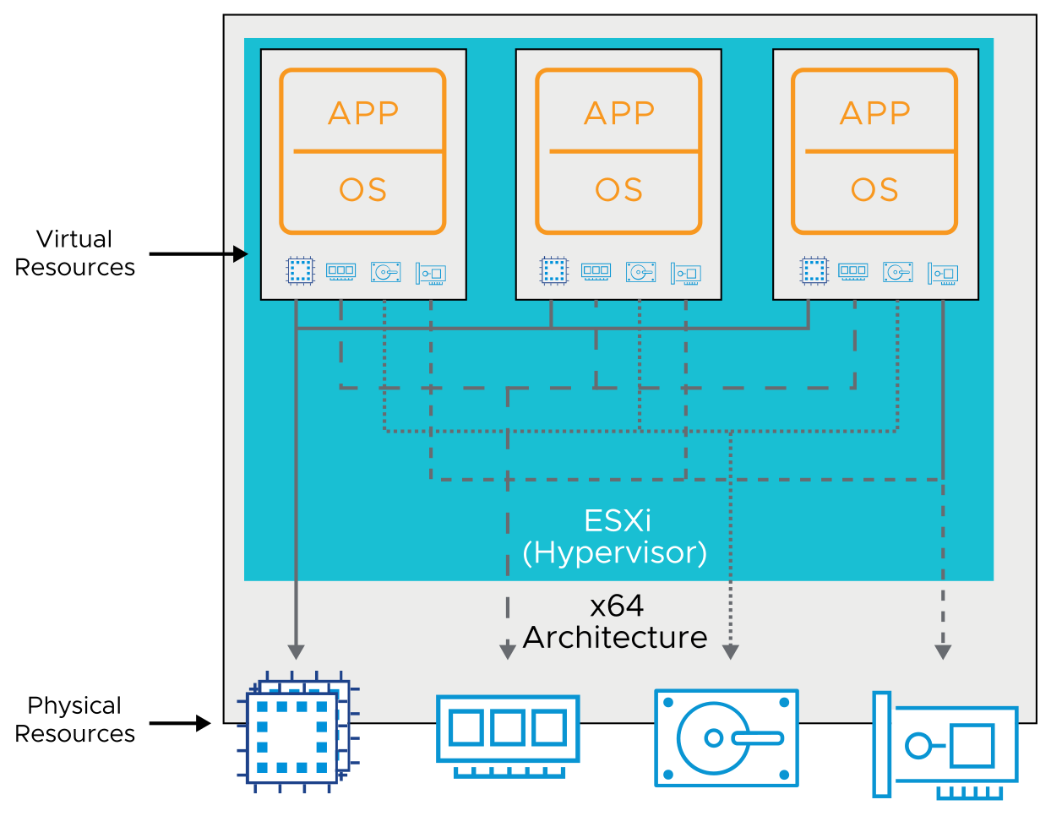
Physical Resource Sharing
Multiple VMs, running on a physical host, share computing, memory, network, and storage resources of the host.
Notes:
With virtualization, you can run multiple VMs on a single physical host, with each VM sharing the resources of one physical computer across multiple environments. VMs share access to CPUs and are scheduled to run by the hypervisor. In addition, VMs are assigned their own region of memory to use and share access to the physical network cards and disk controllers. Different VMs can run different operating systems and applications on the same physical computer.
When multiple VMs run on an ESXi host, each VM is allocated a portion of the physical resources. The hypervisor manages VM schedules, similarly to traditional operating system management of memory allocation and application scheduling. These VMs run on various CPUs. The ESXi hypervisor can also over commit memory. Memory is over committed when the combined virtual RAM of your powered-on VMs is larger than the physical RAM available on the host.
VMs, like applications, use network and disk bandwidth. However, VMs are managed with elaborate control mechanisms to manage how much access is available for each VM. With the default resource allocation settings, all VMs associated with the same ESXi host receive an equal share of available resources.

Slide 25
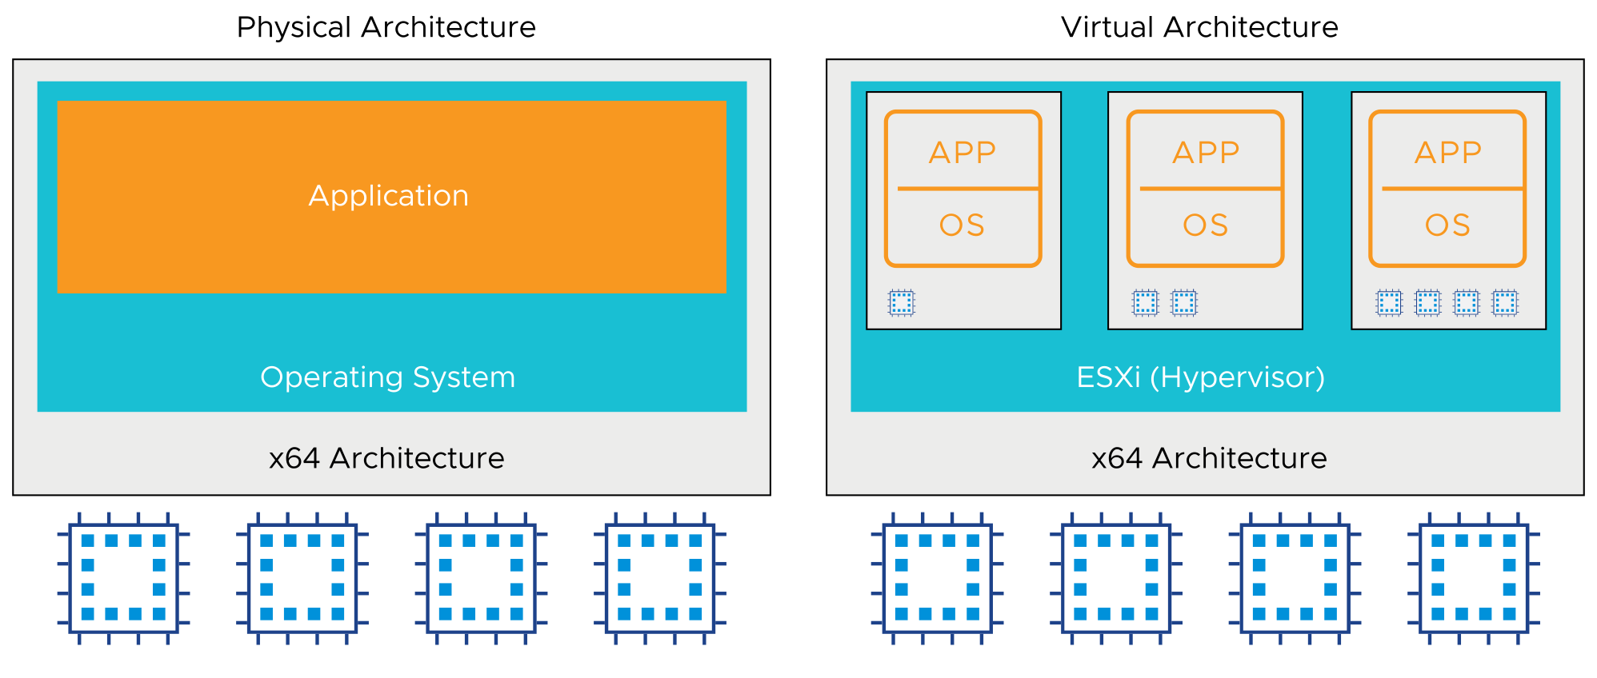
CPU Virtualization
In a physical environment, the operating system assumes the ownership of all the physical CPUs in the system.
CPU virtualization emphasizes performance and runs directly on the available CPUs.
Notes:
The virtualization layer runs instructions only when needed to make VMs operate as if they were running directly on a physical machine. CPU virtualization is not emulation. With a software emulator, programs can run on a computer system other than the one for which they were originally written. Emulation provides portability, but might negatively affect performance. CPU virtualization is not emulation because the supported guest operating systems are designed for x64 processors. Using the hypervisor, the operating systems can run natively on the hosts’ physical x64 processors.
When many virtual VMs run on an ESXi host, the VMs might compete for CPU resources. When CPU contention occurs, the ESXi host time slices the physical processors across all virtual machines so that each VM runs as if it has a specified number of virtual processors.

Slide 26
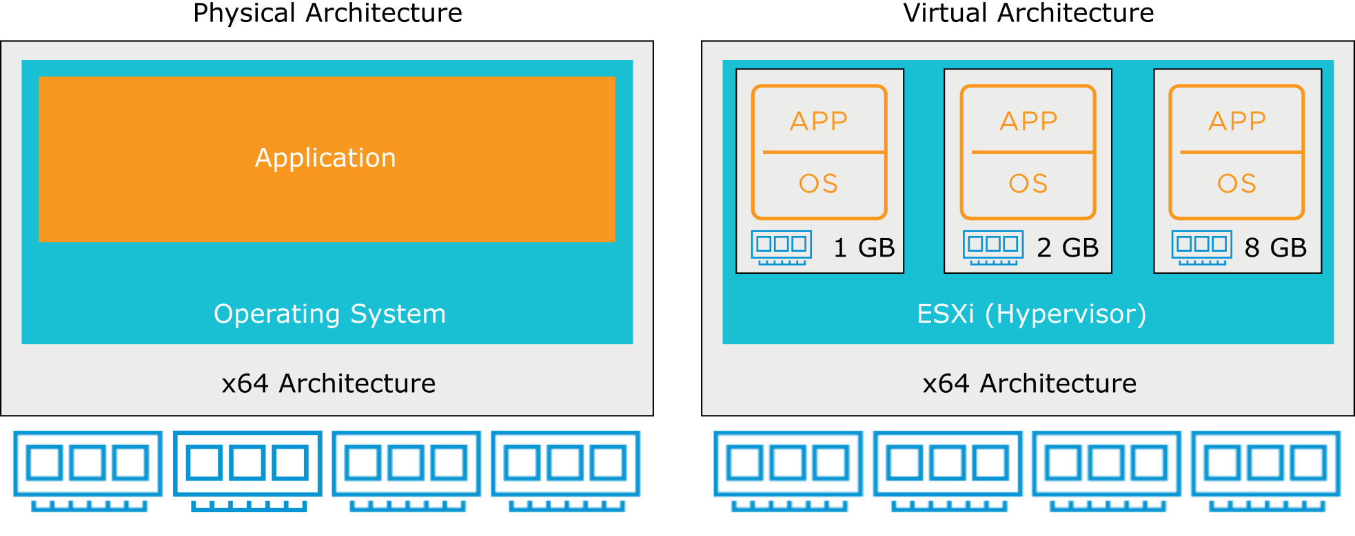
Physical and Virtualized Host Memory Usage
In a physical environment, the operating system assumes the ownership of all the physical memory in the system.
Memory pages are allocated to virtual machines on first access.
Notes:
When an application starts, it uses the interfaces provided by the operating system to allocate or release virtual memory pages during the execution. Virtual memory is an old technique used in most general-purpose operating systems. Operating systems use virtual memory to present more memory to applications than to which they have physical access. Almost all modern processors have hardware to support virtual memory.
Virtual memory creates a uniform virtual address space for applications. With the operating system and hardware, virtual memory can handle the address translation between the virtual address space and the physical address space. The technique adapts the execution environment to support large address spaces, process protection, file mapping, and swapping in modern computer systems. In a virtualized environment, the VMware virtualization layer creates a contiguous addressable memory space for the VM when it is started. The allocated memory space is configured when the VM is created and has the same properties as the virtual address space. With this configuration, the hypervisor can run multiple VMs simultaneously while protecting the memory of each VM from being accessed by others.

Slide 27
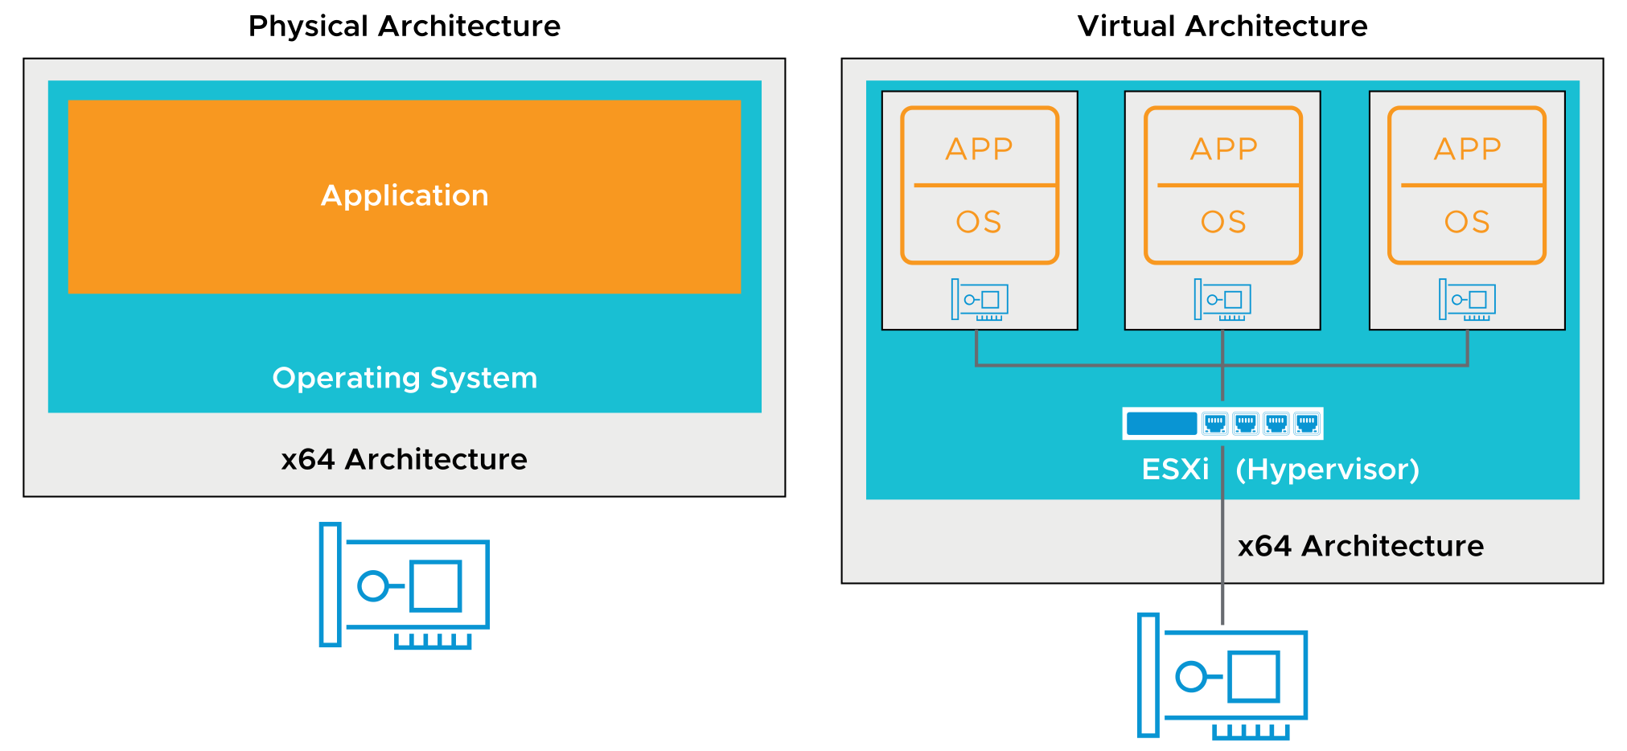
Physical and Virtual Networking
Virtual Ethernet adapters and virtual switches are key virtual networking components.
Notes:
A VM can be configured with one or more virtual Ethernet adapters. VMs use virtual switches on the same ESXi host to communicate with one another by using the same protocols that are used over physical switches, without the need for additional hardware. Virtual switches also support VLANs that are compatible with standard VLAN implementations from other networking equipment vendors. With VMware virtual networking, you can link local VMs together and link local VMs to the external network through a virtual switch.
A virtual switch, like a physical Ethernet switch, forwards frames at the data link layer. An ESXi host might contain multiple virtual switches. The virtual switch connects to the external network through outbound Ethernet adapters, called vmnics. The virtual switch can bind multiple vmnics together, like NIC teaming on a traditional server, offering greater availability and bandwidth to the VMs using the virtual switch.
Virtual switches are similar to modern physical Ethernet switches in many ways. Like a physical switch, each virtual switch is isolated and has its own forwarding table. Every destination that the switch looks up can match only ports on the same virtual switch where the frame originated. The feature improves security and makes it difficult for hackers to break virtual switch isolation.
Virtual switches also support VLAN segmentation at the port level, so that each port can be configured as an access or trunk port, providing access to either single or multiple VLANs.
However, unlike physical switches, virtual switches do not require the spanning tree protocol (STP) because a single-tier networking topology is enforced. Multiple virtual switches cannot be interconnected, and network traffic cannot flow directly from one virtual switch to another virtual switch on the same host. Virtual switches provide all the ports that you need in one switch. Virtual switches do not need to be cascaded because virtual switches do not share physical Ethernet adapters and leaks do not occur between virtual switches.

Slide 28
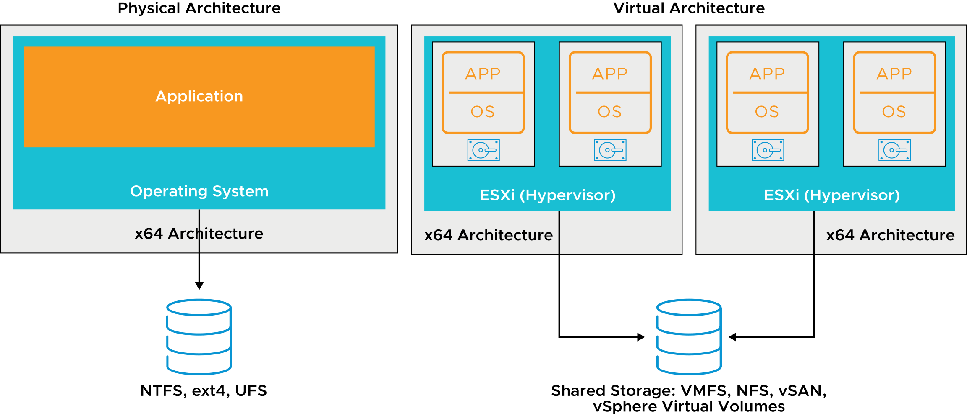
Physical File Systems and Datastores
vSphere datastores provide a distributed storage architecture, where multiple ESXi hosts can read or write to the shared storage concurrently.
Notes:
To store virtual disks, ESXi uses datastores, which are logical containers that hide the specifics of physical storage from VMs and provide a uniform model for storing VM files.
vSphere supports the following types of datastores:
VMFS: VMware Virtual Machine File System (VMFS) is a clustered file system that provides storage virtualization optimized for virtual machine. Multiple ESXi hosts can read and write to the same VMFS datastore simultaneously.
NFS: Network File System (NFS) is a file-sharing protocol that ESXi hosts use to communicate with a network-attached storage (NAS) device.
vSAN: vSAN is a software-defined storage solution that provides shared storage for virtual machines. vSAN virtualizes local physical storage in the form of HDD or SSD devices on ESXi hosts in a cluster, turning them into a unified datastore.
vSphere Virtual Volumes: The datastore virtualizes SAN and NAS devices by abstracting physical hardware resources to logical pools of capacity. Storage arrays or servers are designed to manage all aspects of vSphere Virtual Volumes datastores and ESXi hosts have no direct access to a vSphere Virtual Volumes storage.

Slide 29
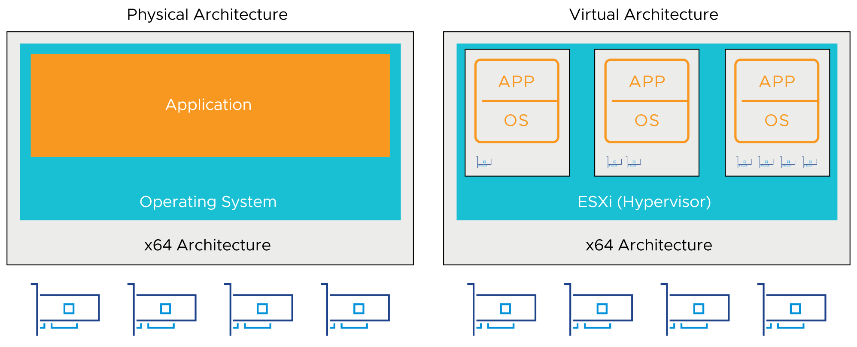
GPU Virtualization
GPU graphics devices optimize complex graphics operations. These operations can run at high performance without overloading the CPU.
Virtual GPUs can be added to VMs for the following use cases:
Rich 2D and 3D graphics
VMware Horizon virtual desktops
Graphics-intensive applications
Scientific computation applications
Artificial intelligence (AI) and machine learning (ML) workloads
Notes:
GPUs (graphical processing units) can be used by developers of server applications. Although servers do not usually have monitors, GPU support is important and relevant to server virtualization. You can configure VMs with up to four vGPU devices to cover use cases requiring multiple GPU accelerators. VMware supports AMD and NVIDIA graphics cards.

Slide 30
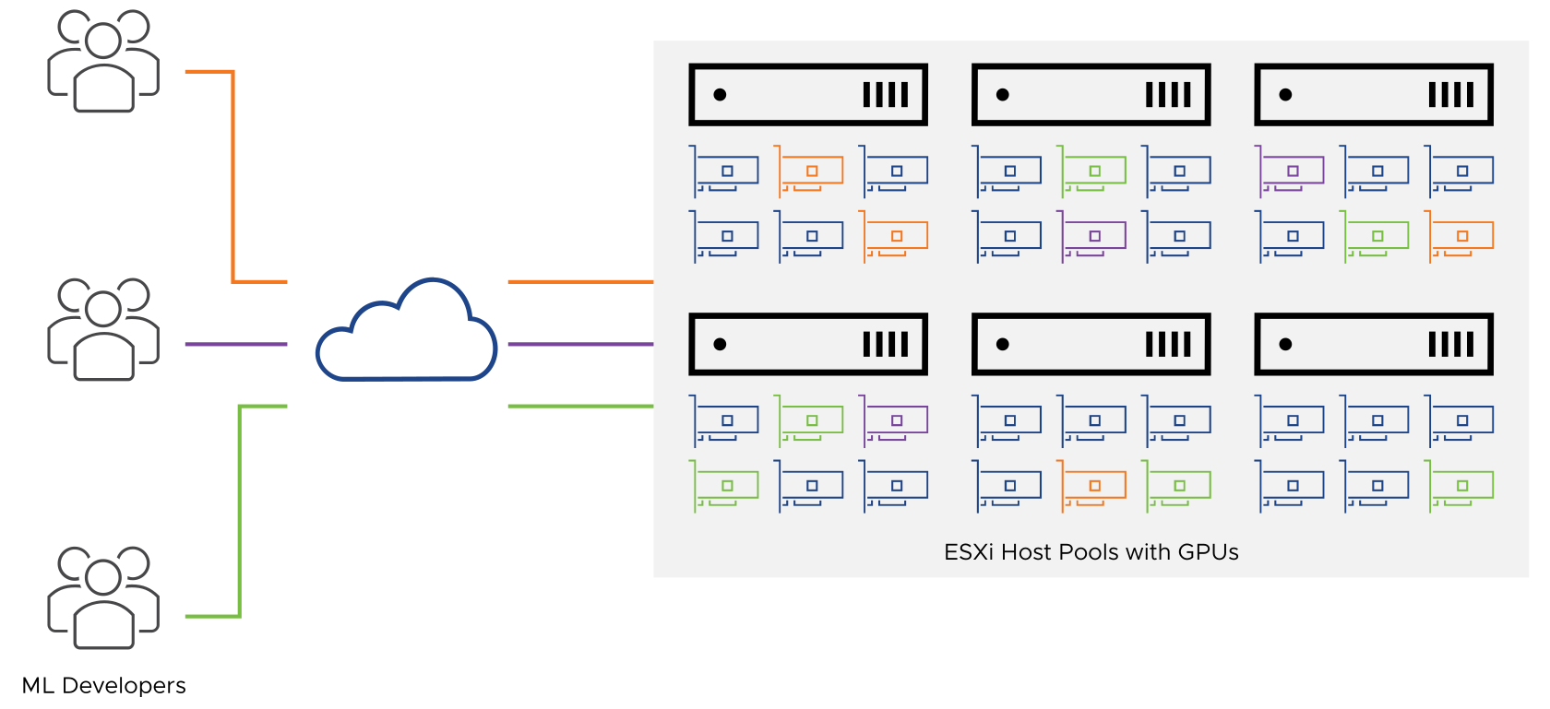
Sharing GPUs with vSphere Bitfusion
vSphere Bitfusion virtualizes hardware accelerators such as GPUs to provide a pool of shared, network-accessible resources that support AI and ML workloads.
Notes:
With vSphere Bitfusion, GPUs on one host can be used by virtual machines running on other hosts.
Business use cases for sharing GPUs include the following areas:
Entertainment and visualizations, such as rendering of complex animations and 3D graphics
Transportation and government, such as autonomous vehicles and smart city projects
Manufacturing and shipping, for example, optimizing factory workflows and supply chain logistics
Infectious disease and epidemiology, for example, vaccine research and modeling how viruses spread
Higher education, such as allocating GPU resources for research both in and out of the classroom
Retail, such as inventory management, analyzing buyer behavior, and helping to detect fraud
Robotics, such as creating models for performing mundane or dangerous tasks
Financial services, such as risk-analysis

Slide 31
Review of Learner Objectives
Explain how ESXi interacts with resources:
CPUs
Memory
Networks
Storage
GPUs

Slide 32
Key Points
Virtual machines are hardware independent.
vSphere consists of two core components, ESXi and vCenter Server.
The ESXi hypervisor runs directly on the host.
VMs share the physical resources of the ESXi host on which they reside.
vSphere abstracts CPUs, GPUs, memory, storage, and networking for VM use.
Questions?

