Slide 1
Installing and Configuring ESXi

Slide 2
Importance
ESXi is the virtualization platform on which you can create and run virtual machines. Proper configuration of the ESXi host ensures that virtual machines run in an environment that is reliable, secure, and performant.

Slide 3
Module Lessons
Installing and Configuring ESXi

Slide 4

Installing and Configuring ESXi

Slide 5
Learner Objectives
Describe the ESXi host architecture
Navigate the Direct Console User Interface (DCUI) to configure an ESXi host
Recognize the user account best practices
Install an ESXi host
Configure the ESXi host settings

Slide 6
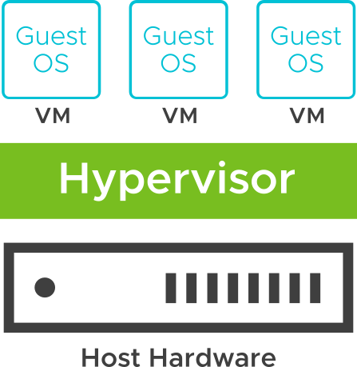
About ESXi
ESXi is a bare-metal hypervisor that is licensed as a part of vSphere. A free version is also available as a standalone server.
ESXi has the following features:
High security:
Host-based firewall
Memory hardening
Kernel module integrity
Trusted Platform Module (TPM 2.0)
UEFI secure boot
Encrypted core dumps
Small disk footprint
Quick boot for faster patching and upgrades
Installable on hard disks, SAN LUNs, SSD, SATADOM, and diskless hosts
Notes:
To verify that your physical servers are supported by ESXi 8.0, check VMware Compatibility Guide at https://www.vmware.com/resources/compatibility.
You can obtain the free version of ESXi, called vSphere Hypervisor, or you can purchase a licensed version with vSphere. ESXi can be installed on a hard disk, SAN LUNs, SSD, and SATADOM. ESXi can also be run on diskless hosts (directly into memory) with vSphere Auto Deploy.
You can use USB-based boot devices however, VMware encourages using SSD devices instead for improved reliability. For more information, see VMware knowledge base article 82515 at http://kb.vmware.com/kb/82515.
ESXi has a small disk footprint for added security and reliability. ESXi provides additional protection with the following features:
Host-based firewall: To minimize the risk of an attack through the management interface, ESXi includes a firewall between the management interface and the network.
Memory hardening: The ESXi kernel, user-mode applications, and executable components, such as drivers and libraries, are located at random, unpredictable memory addresses. Combined with the non-executable memory protections made available by microprocessors, memory hardening provides protection that makes it difficult for malicious code to use memory exploits to take advantage of vulnerabilities.
Kernel module integrity: Digital signing ensures the integrity and authenticity of modules, drivers, and applications as they are loaded by the VMkernel.
Trusted Platform Module: Is a hardware element that creates a trusted platform. This element affirms that the boot process and all drivers loaded are genuine.
UEFI secure boot: The feature is for systems that support UEFI secure boot firmware, which contains a digital certificate to which the VMware infrastructure bundles (VIBs) chain. At boot time, a verifier is started before other processes to check the VIB’s chain to the certificate in the firmware.
ESXi Quick Boot: With this feature, ESXi can reboot without reinitializing the physical server BIOS. Quick Boot reduces remediation time during host patch or host upgrade operations. Quick Boot is activated by default on the supported hardware.

Slide 7
ESXi Installation Requirements
Ensure that the host meets the minimum hardware configurations supported by ESXi 8.0:
Supported server platform
At least two CPU cores
At least 8 GB of physical RAM, 12 GB for a production environment
One or more Gigabit or faster Ethernet controllers
Boot disk of at least 32 GB of persistent storage
Notes:
For a list of supported server platforms, supported processors and supported network adapter models, see the VMware Compatibility Guide at https://www.vmware.com/resources/compatibility.

Slide 8
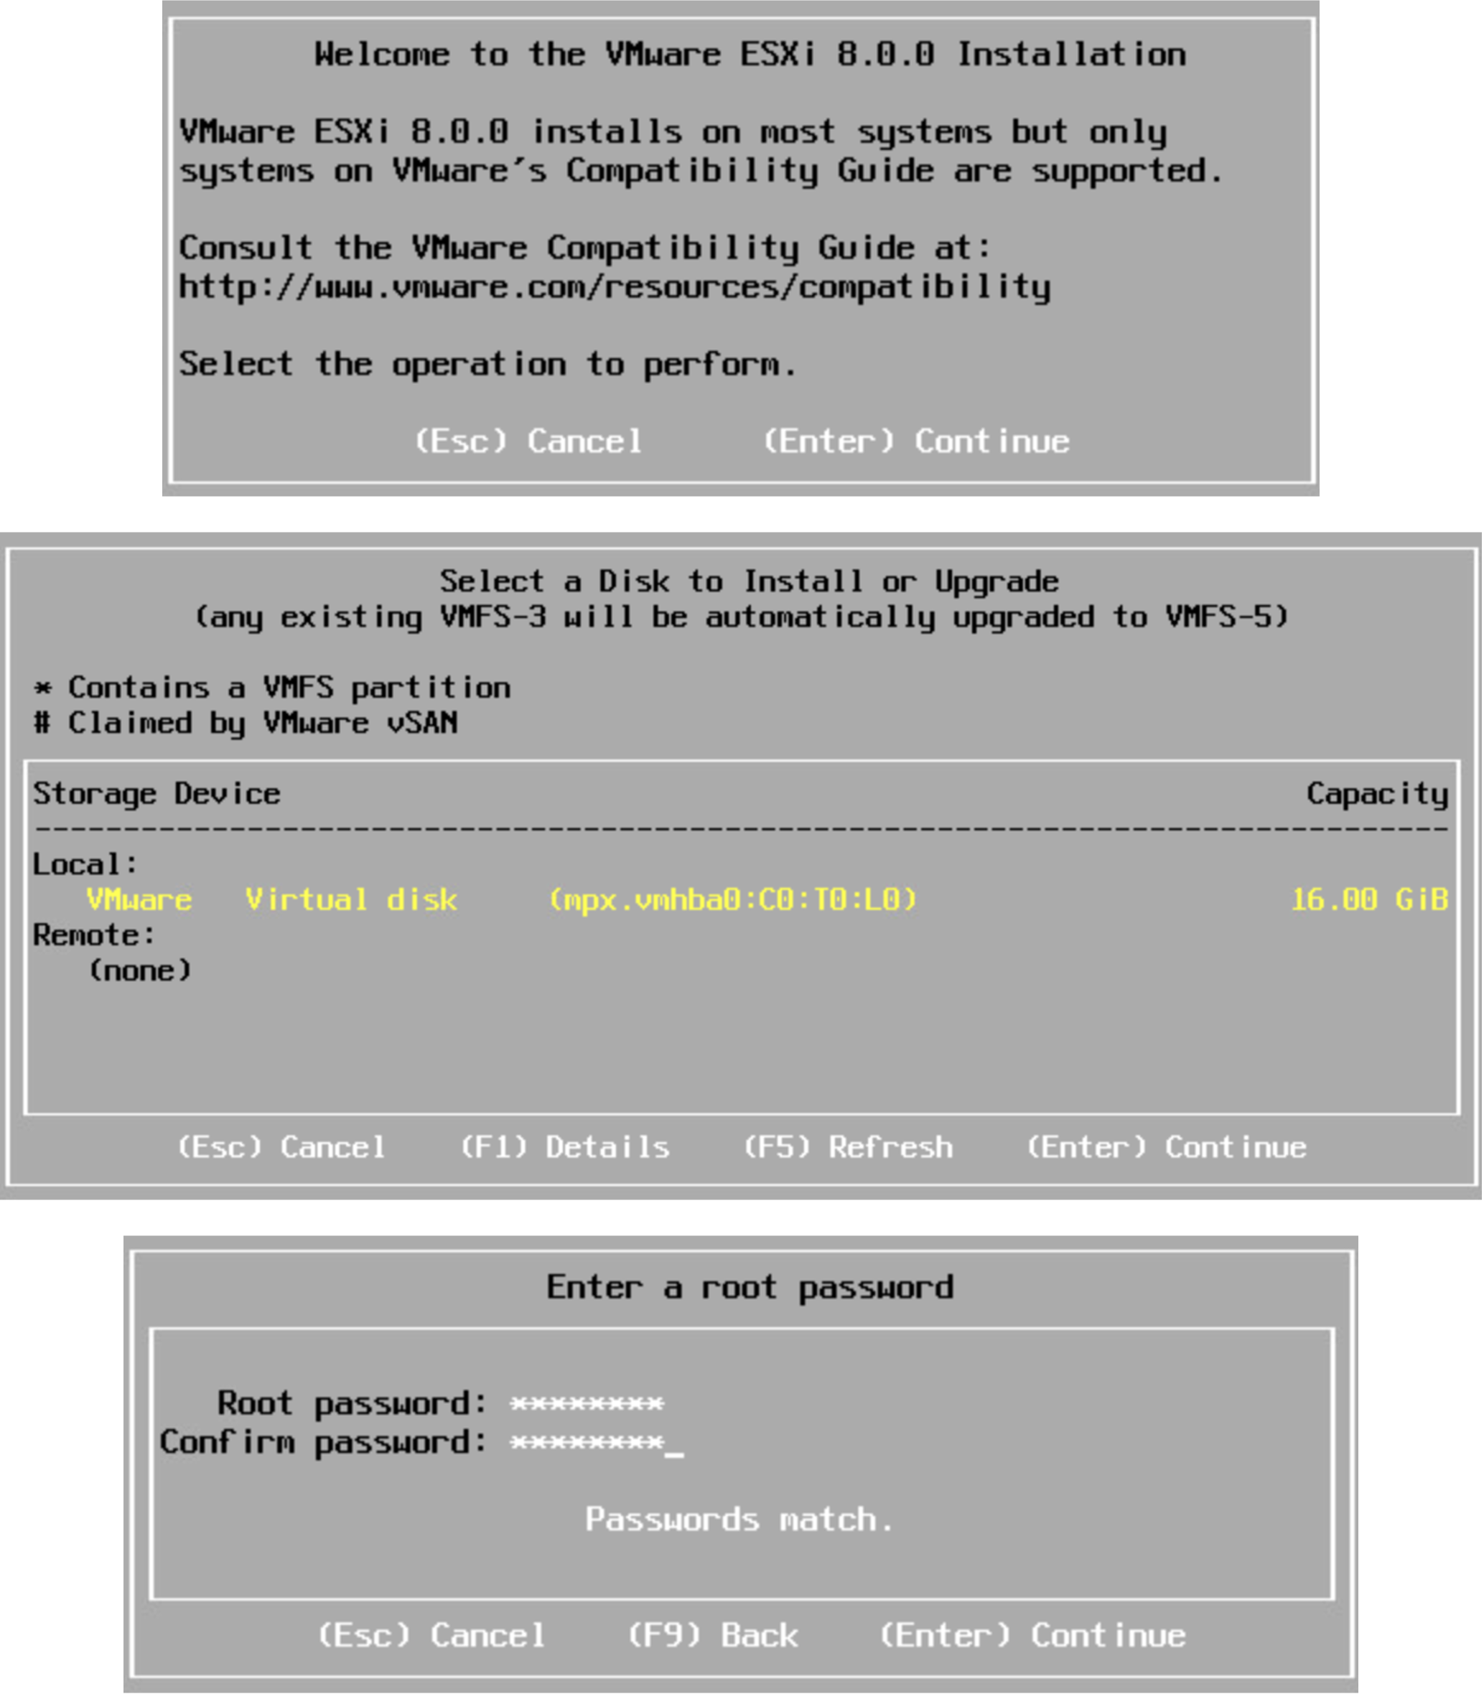
Interactive ESXi Installation
An interactive installation is recommended for small deployments of fewer than five hosts.
You boot from the installer and follow the prompts in the installation wizard:
Start at the Welcome page.
Accept the EULA.
Select the disk.
Select the keyboard layout.
Enter the root password.
Start the installation.
Notes:
You can boot the ESXi installer from a CD or DVD, bootable USB device, or by PXE booting over the network.
For a list of supported server platforms, supported processors and supported network adapter models, see the VMware Compatibility Guide at https://www.vmware.com/resources/compatibility.

Slide 9
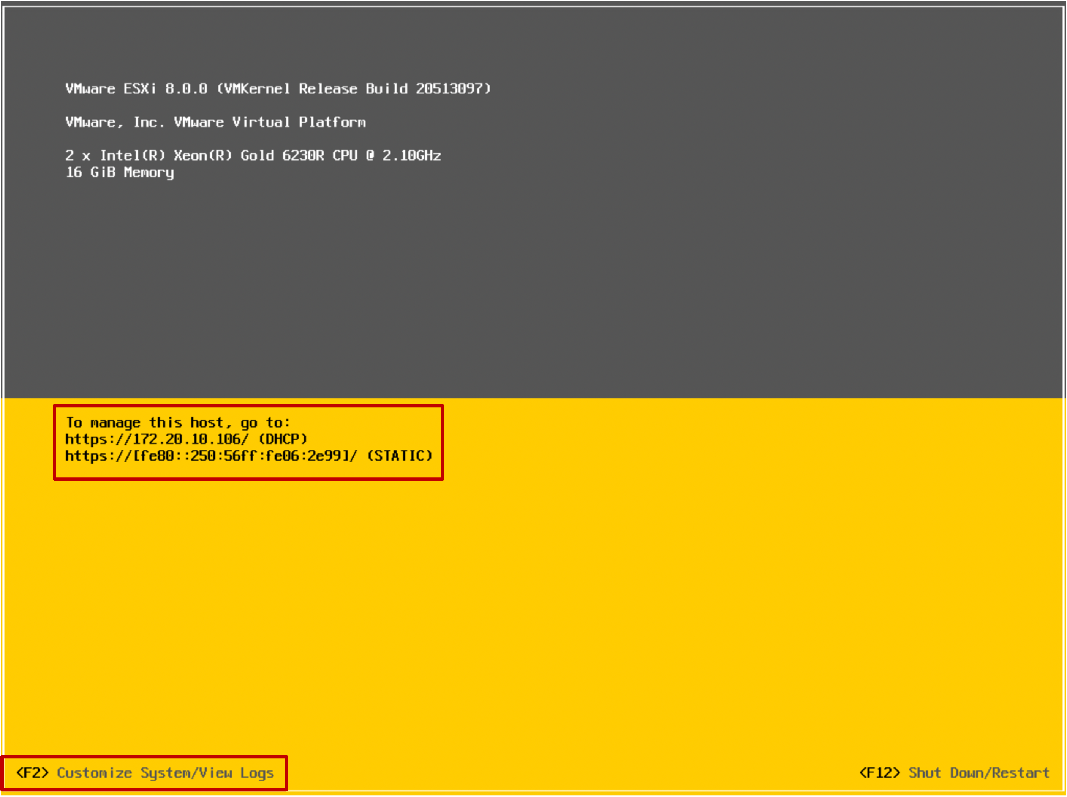
Configuring an ESXi Host
During the ESXi installation, the ESXi host is given a DHCP-assigned IP address.
You use the ESXi host's DCUI to configure certain settings, such as the host's network settings.
The DCUI is a text-based user interface with keyboard-only interaction.
Notes:
You use the Direct Console User Interface (DCUI) to configure certain settings for ESXi hosts. The DCUI is a low-level configuration and management interface, accessible through the console of the server, that is used primarily for initial basic configuration. You press F2 to start customizing system settings.

Slide 10
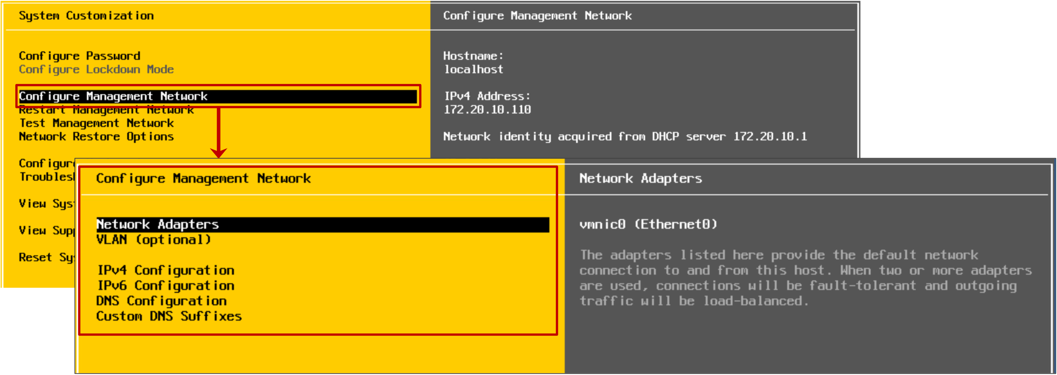
Configuring an ESXi Host: Management Network
You must configure management network settings before your ESXi host is operational. By default, a DHCP-assigned IP address is configured for the ESXi host.
Use the DCUI to configure management network settings:
Network adapter selection
VLAN ID
IPv4 and IPv6 configuration (IP address, subnet mask, default gateway)
Host name
DNS servers and suffixes
Notes:
You can perform the following management network configuration tasks from the DCUI:
Configure VLAN settings
Configure IPv4 addressing
Configure IPv6 addressing
Set custom DNS suffixes
Restart the management network (without rebooting the system)
Test the management network (using ping and DNS requests)
Restore the original network configuration (useful if you misconfigure something)

Slide 11
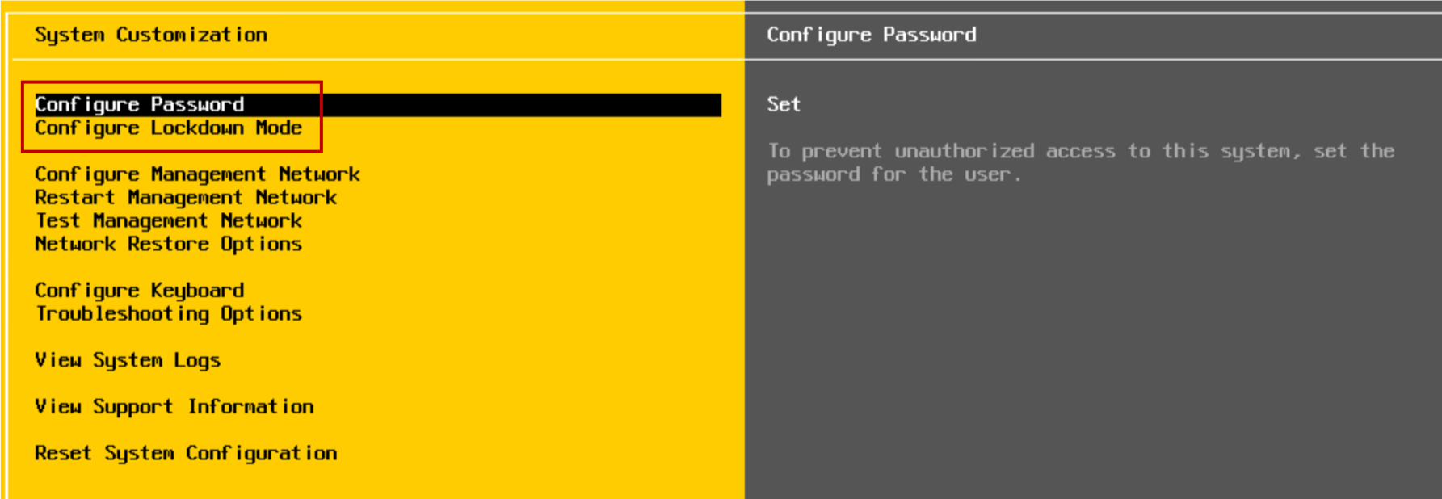
Configuring an ESXi Host: Root Access
Administrators use the DCUI to configure the root access settings:
Change the root password (complex passwords only)
Activate or deactivate the lockdown mode:
Limits the management of the host to vCenter
Can be configured only for hosts managed by a vCenter instance
Notes:
The administrative username for the ESXi host is root. The root password must be configured during the ESXi installation process, but can be changed from the DCUI.

Slide 12
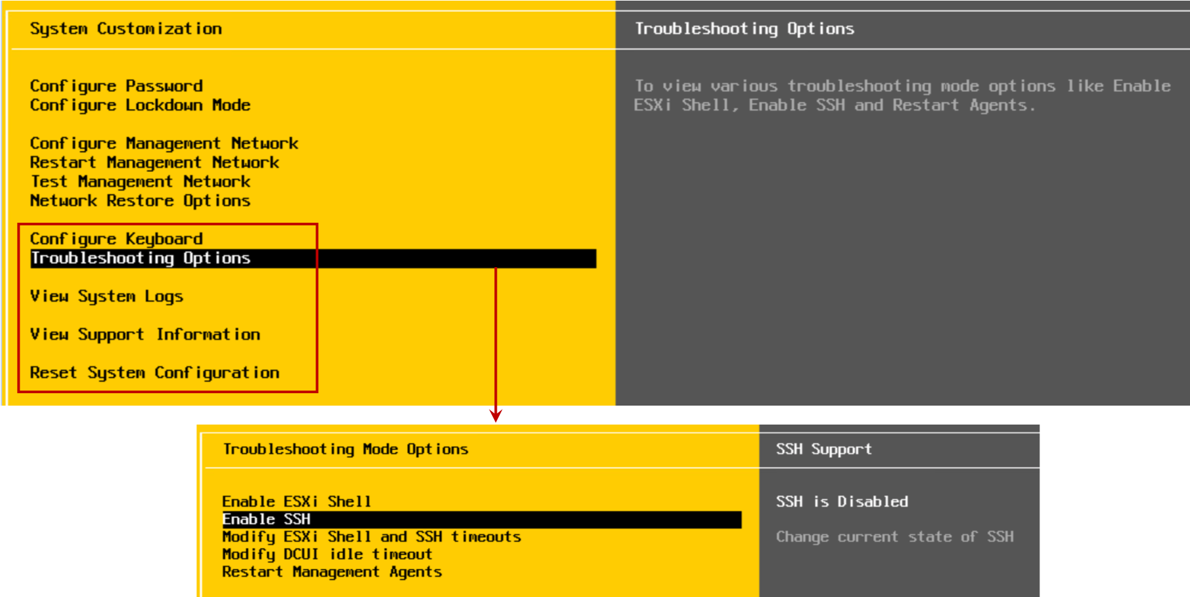
Configuring an ESXi Host: Other Settings
Using the DCUI, you can configure the keyboard layout, activate troubleshooting services, view support information, and view system logs.
Notes:
From the DCUI, you can change the keyboard layout, view support information, such as the host’s license serial number, and view system logs. The default keyboard layout is U.S. English.
You can use the troubleshooting options, which are deactivated by default, to activate or deactivate troubleshooting services:
vSphere ESXi Shell: For troubleshooting problems locally
SSH: For troubleshooting problems remotely by using an SSH client, for example, PuTTY
The best practice is to keep the troubleshooting services deactivated until they are necessary. For example, when you work with VMware technical support to resolve a problem.
By selecting the Reset System Configuration option, you can reset the system configuration to its software defaults and remove custom extensions or packages that you added to the host. This option also deletes the root password, which might allow unauthorized access to the system.

Slide 13
Time Synchronization for the ESXi Host
To ensure precise timekeeping and synchronization between the ESXi host and the other components of the vSphere network, you can synchronize an ESXi host's clock to a time reference.
Time synchronization is important:
For accurate performance graphs
For accurate time stamps in log messages
So that virtual machines have a source to synchronize
Notes:
Synchronizing an ESXi host’s time includes the following benefits:
Performance data can be displayed and interpreted properly.
Accurate time stamps appear in log messages, which make audit logs and troubleshooting meaningful.
VMs can synchronize their time with the ESXi host. Time synchronization benefits applications, for example database applications running on VMs.

Slide 14
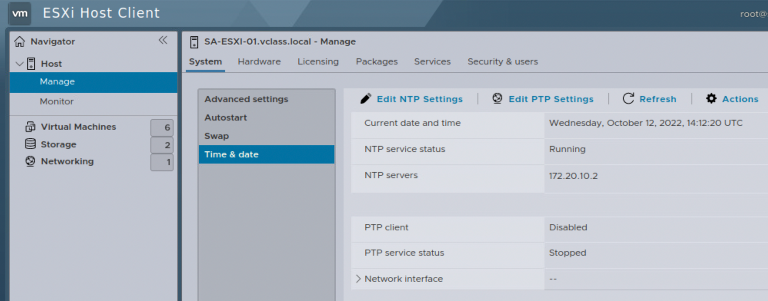
Methods for Synchronizing Time
You can use the time synchronization options:
Manual configuration
NTP, Network Time Protocol, providing millisecond timing accuracy
PTP, Precision Time Protocol, providing microsecond timing accuracy
You can configure NTP or PTP using VMware Host Client or the vSphere Client.
The NTP and PTP services cannot run simultaneously.
Configuring time and date in VMware Host Client
Notes:
For information about using NTP and PTP on ESXi hosts, see the Synchronizing Clocks on the vSphere Network section in vCenter Server and Host Management at https://docs.vmware.com/en/VMware-vSphere/index.html.

Slide 15
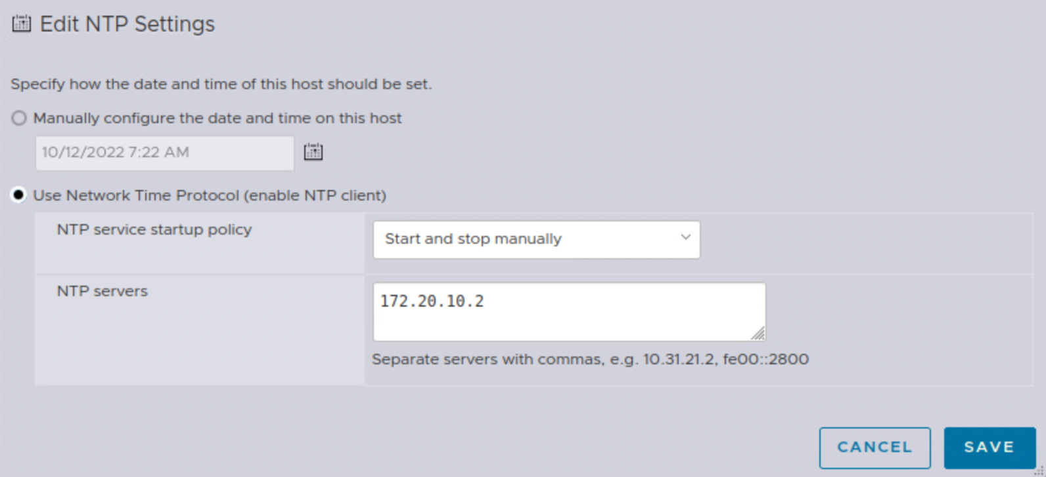
Configuring NTP
An ESXi host can be configured as an NTP client. It can synchronize time with an NTP server on the Internet or your corporate NTP server.
NTP client uses UDP over port 123.
Configuring NTP using VMware Host Client
Notes:
NTP is a client-server protocol. When you configure the ESXi host to be an NTP client, the host synchronizes its time with an NTP server, which is a server on the Internet or your corporate NTP server.
For general information about NTP, see http://www.ntp.org.
For details about configuring NTP on an ESXi host, see the vCenter Server and Host Management, section Use NTP Servers for Time and Date Synchronization of a Host at https://docs.vmware.com/en/VMware-vSphere/7.0/com.vmware.vsphere.vcenterhost.doc/GUID-8756D419-A878-4AE0-9183-C6D5A91A8FB1.html.

Slide 16
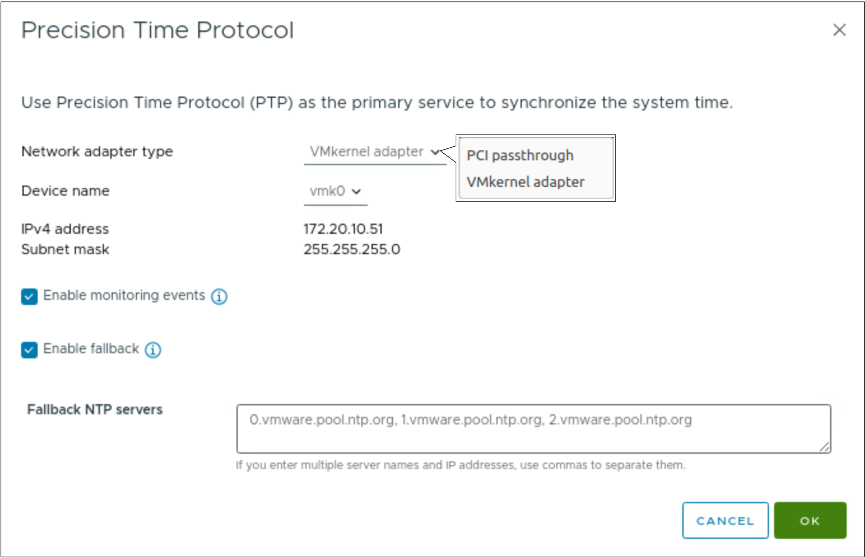
Configuring PTP
PTP provisions hardware-based timestamping for the virtual machines and the hosts within a network.
PTP client uses UDP over ports 319 and 320.
You can use NTP as a fallback if the PTP service does not work.
Configuring PTP using the vSphere Client
Notes:
PTP provides highly accurate time synchronization and allows both software-based and hardware-based timestamping on ESXi hosts:
For configuring hardware timestamping, select PCI passthrough as the network adapter type.
For configuring software timestamping, select VMkernel Adapter as the network adapter type.
For details about configuring PTP on an ESXi host, see the Use PTP for Time and Date Synchronization of a host section in vCenter Server and Host Management at https://docs.vmware.com/en/VMware-vSphere/index.html.

Slide 17
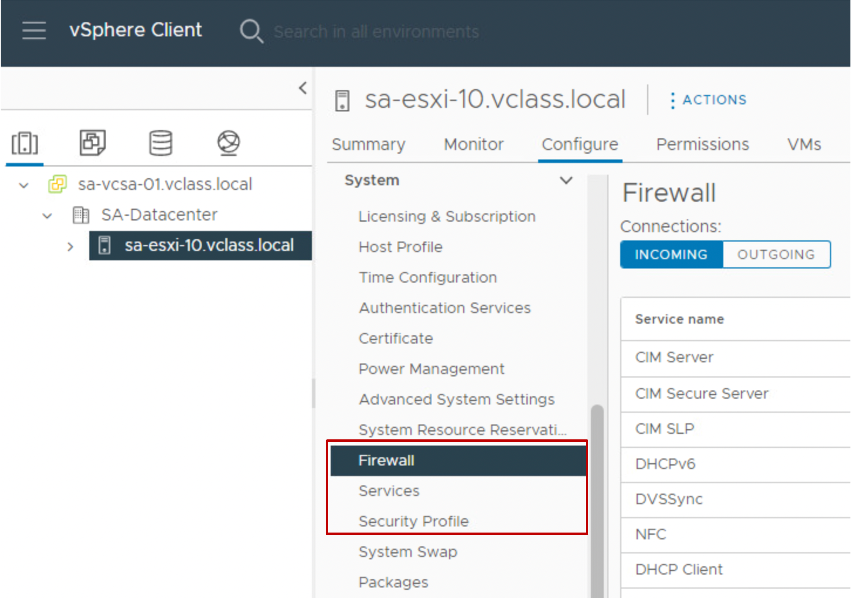
Controlling Remote Access to an ESXi Host
You can use the vSphere Client to customize the essential security settings that control remote access to an ESXi host:
The ESXi firewall is activated by default.
The firewall blocks incoming and outgoing traffic, except for the traffic activated in the host’s firewall settings.
Services, such as the NTP client and the SSH client, are managed by users with administrator privileges.
Lockdown mode prevents remote users from logging in to the host directly. The host is accessible only through the DCUI or vCenter.
Notes:
Every ESXi host includes a firewall. On ESXi hosts, remote clients are prevented from accessing services on the host. Similarly, local clients are prevented from accessing services on the remote hosts. To verify the integrity of the host, few ports are open by default. To enable or prevent access to certain services or clients, you must modify the properties of the firewall.
You can configure the firewall settings for incoming and outgoing connections for a service or a management agent. For some services, you can manage the service details. For example, you can use START, STOP, or RESTART to change the status of a service temporarily. Alternatively, you can change the startup policy so that the service starts with the host or with port use. For some services, you can specify IP addresses, ranges of IP addresses, or entire subnets from which connections are allowed.

Slide 18
Managing User Accounts: Best Practices
When assigning user accounts to access ESXi hosts or vCenter systems, you must follow these security guidelines:
Strictly control root access to the ESXi hosts.
Create strong root account passwords that have at least eight characters. Use special characters, case changes, and numbers. Change passwords periodically.
Manage the ESXi hosts centrally through vCenter Server by using the vSphere Client.
Minimize the use of local users on the ESXi hosts:
Add the ESXi hosts to a domain and add the relevant administrator users to the ESX Admins domain group. Users in the domain group have root privileges on the ESXi hosts.
Notes:
On an ESXi host, the root user account is the most powerful user account on the system. The root user can access all files and all commands. Securing this account is the most important step that you can take to secure an ESXi host.
When possible, use the vSphere Client to log in to the vCenter Server system and manage your ESXi hosts. In some circumstances, for example, when the vCenter Server system is down, you use VMware Host Client to connect directly to the ESXi host. Although you can log in to your ESXi host through the vSphere ESXi Shell, these access methods must be reserved for troubleshooting or configuration that cannot be accomplished by using VMware Host Client.
If a host must be managed directly, avoid creating local users on the host. If possible, join the host to an Active Directory domain and log in with domain credentials instead.

Slide 19
Demonstration: Installing and Configuring ESXi Hosts
Your instructor will run a demonstration.

Slide 20
Lab 1: Configuring an ESXi Host
Use VMware Host Client to configure an ESXi host:
Add an ESXi Host to an LDAP Server
Log In to the ESXi Host as an LDAP User
Activate the SSH and vSphere ESXi Shell Services
Configure the ESXi Host as an NTP Client

Slide 21
Review of Learner Objectives
Describe the ESXi host architecture
Navigate the Direct Console User Interface (DCUI) to configure an ESXi host
Recognize the user account best practices
Install an ESXi host
Configure the ESXi host settings

Slide 22
Key Points
The Direct Console User Interface (DCUI) allows you to configure certain settings for ESXi hosts.
Securing the root user account is very important to secure an ESXi host, as the user is the host's most powerful user.
NTP provides millisecond timing accuracy and PTP provides microsecond timing accuracy for ESXi hosts.
Questions?

