Slide 1
Deploying and Configuring vCenter

Slide 2
Importance
vCenter helps you centrally manage multiple ESXi hosts and their virtual machines. If you do not properly deploy, configure, and manage vCenter, your environment might experience reduced administrative manageability of the ESXi hosts and virtual machines.

Slide 3
Module Lessons
Centralized Management with vCenter
Deploying vCenter Server Appliance
vSphere Licenses
Managing vCenter Inventory
vCenter Roles and Permissions
Monitoring vCenter Events

Slide 4

Centralized Management with vCenter

Slide 5
Learner Objectives
Describe the vCenter architecture
Recognize ESXi hosts communication with vCenter
Identify vCenter services

Slide 6
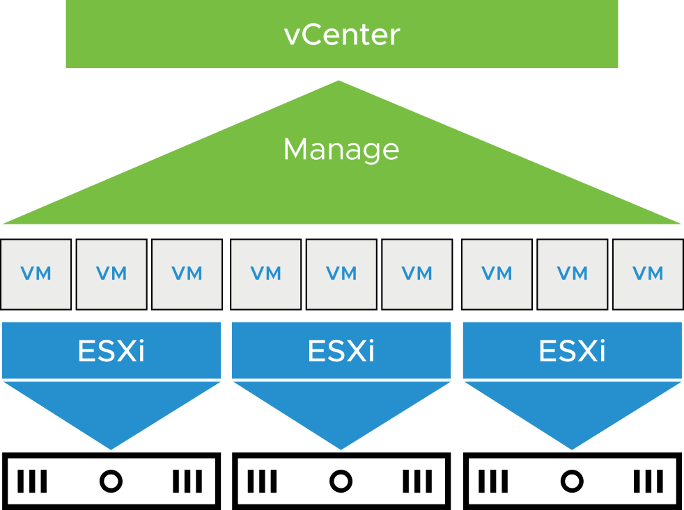
About the vCenter Management Platform
vCenter acts as a central administration point for ESXi hosts and virtual machines. The ESXi hosts and virtual machines connected in a network:
Directs the actions of VMs and hosts
Runs on a Linux-based appliance
Notes:
With vCenter, you can pool and manage the resources of multiple hosts. vCenter provides advanced features, such as vSphere DRS, vSphere HA, vSphere Fault Tolerance, vSphere vMotion, and vSphere Storage vMotion.
vCenter is deployed as a virtual appliance. You deploy vCenter Server Appliance on an ESXi host in your infrastructure. vCenter Server Appliance is a preconfigured Linux-based virtual machine, which is optimized for running vCenter and the vCenter components.

Slide 7
About vCenter Server Appliance
vCenter Server Appliance is a prepackaged Linux-based VM, optimized for running vCenter and associated services.
The vCenter Server Appliance package contains the following software:
Photon OS
PostgreSQL database
vCenter services
During deployment, you can select the vCenter Server Appliance size for your vSphere environment and the storage size for your database requirements.
Notes:
vCenter consists of a collection of services that run in vCenter Server Appliance. vCenter acts as a central administration point for ESXi hosts that are connected to a network.

Slide 8
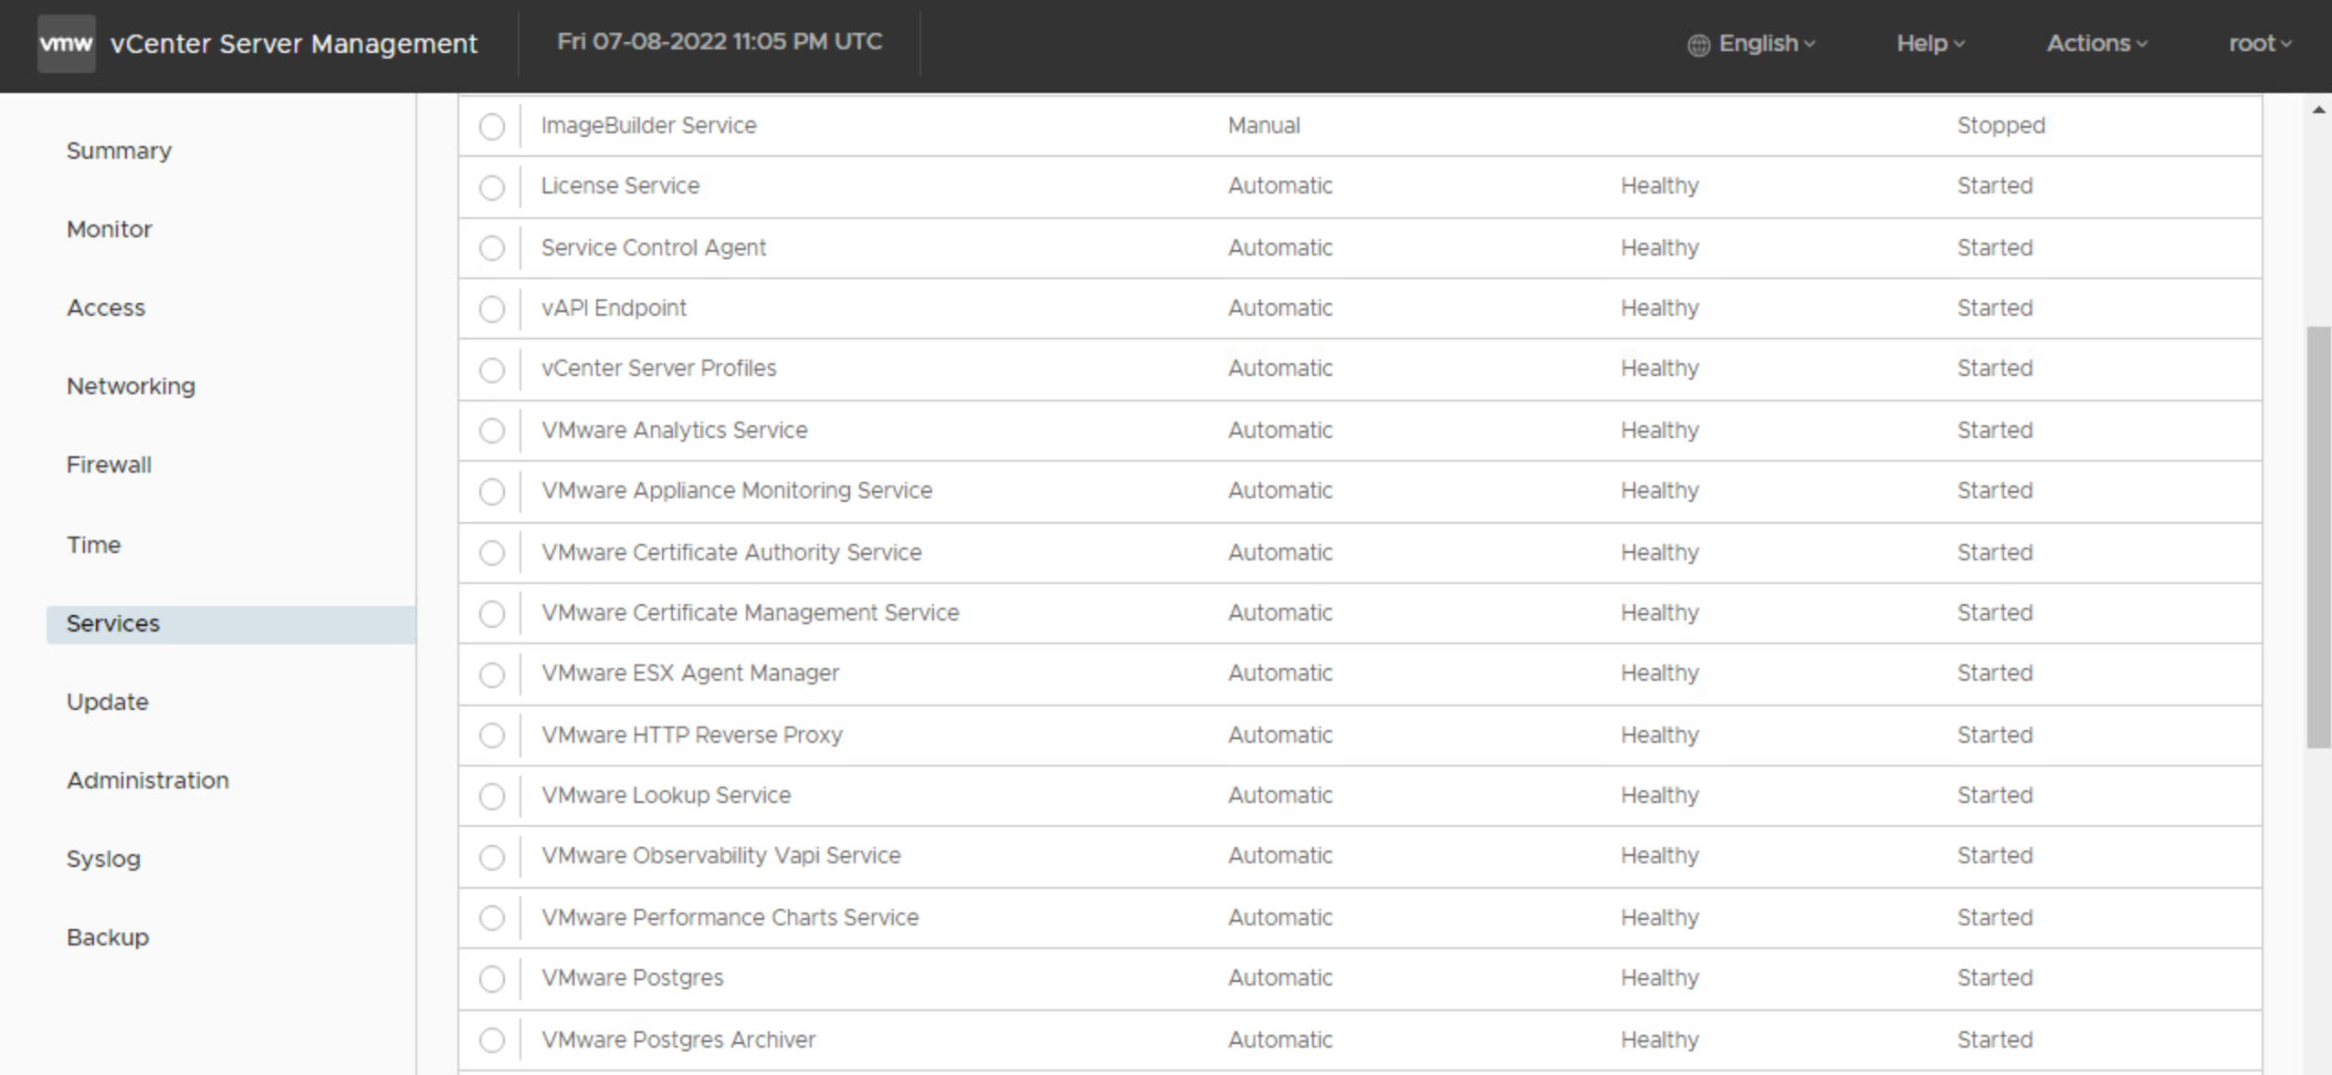
vCenter Services
vCenter services include:
vCenter Server
vSphere Client
License service
Content Library
vSphere Lifecycle Manager
When you deploy vCenter Server Appliance, all these services are included.
Notes:
All vCenter services are installed on a single VM.

Slide 9
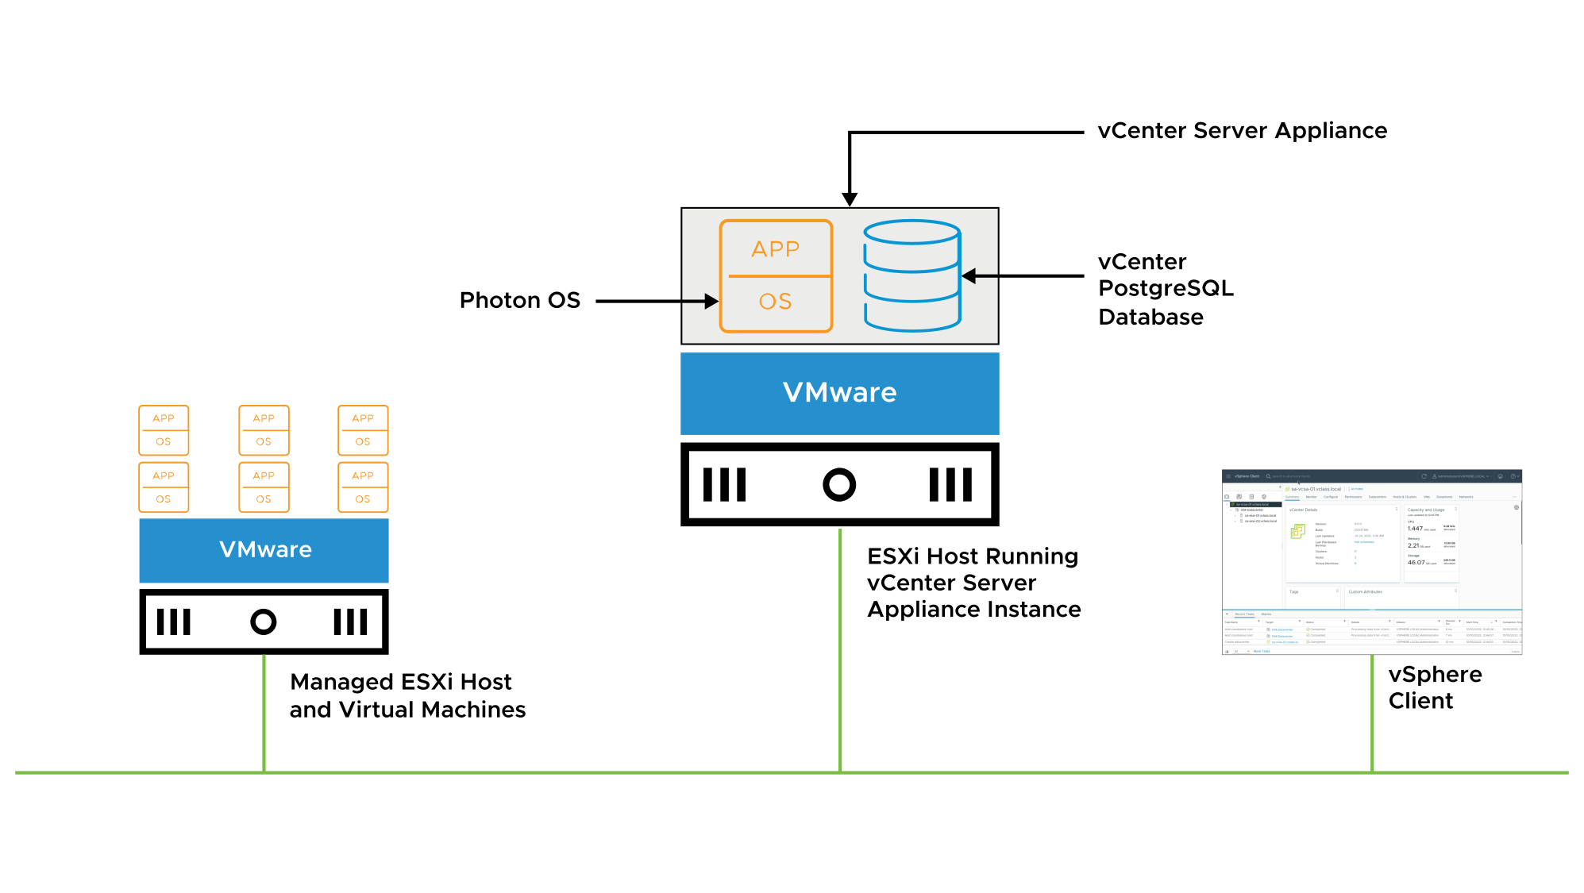
vCenter Architecture
vSphere Client, vCenter database, and managed hosts supports vCenter.
Notes:
The vCenter architecture relies on the following components:
vSphere Client: You use this client to connect to vCenter and manage your ESXi hosts centrally. When vCenter manages an ESXi host, you should always use vCenter and the vSphere Client to manage that host.
vCenter database: The vCenter database is a critical component. The database stores inventory items, security roles, performance data, and other critical information for vCenter.
Managed hosts: You can use vCenter to manage ESXi hosts and the VMs running on ESXi hosts.

Slide 10
About vCenter Single Sign-On
vCenter Single Sign-On allows vSphere components to communicate with each other through a secure token mechanism.
vCenter Single Sign-On can authenticate users using built-in or external identity providers.
Built-in identity providers:
By default, vCenter uses the vsphere.local domain as the identity source.
You can configure vCenter to use Active Directory as the identity source using LDAP, LDAPS, OpenLDAP, or OpenLDAPS.
External identity provider using federated authentication:
vSphere supports Active Directory Federation Services (AD FS).
Notes:
Although you can still configure Integrated Windows Authentication (IWA), VMware recommends using Active Directory over LDAP or Federated Identity with AD FS for authentication for vCenter Server and ESXi. For more details, see VMware knowledge base article 78506 at https://kb.vmware.com/kb/78506.
For details about configuring vCenter Single Sign-On and identity providers, see vSphere Authentication at https://docs.vmware.com/en/VMware-vSphere/index.html.

Slide 11
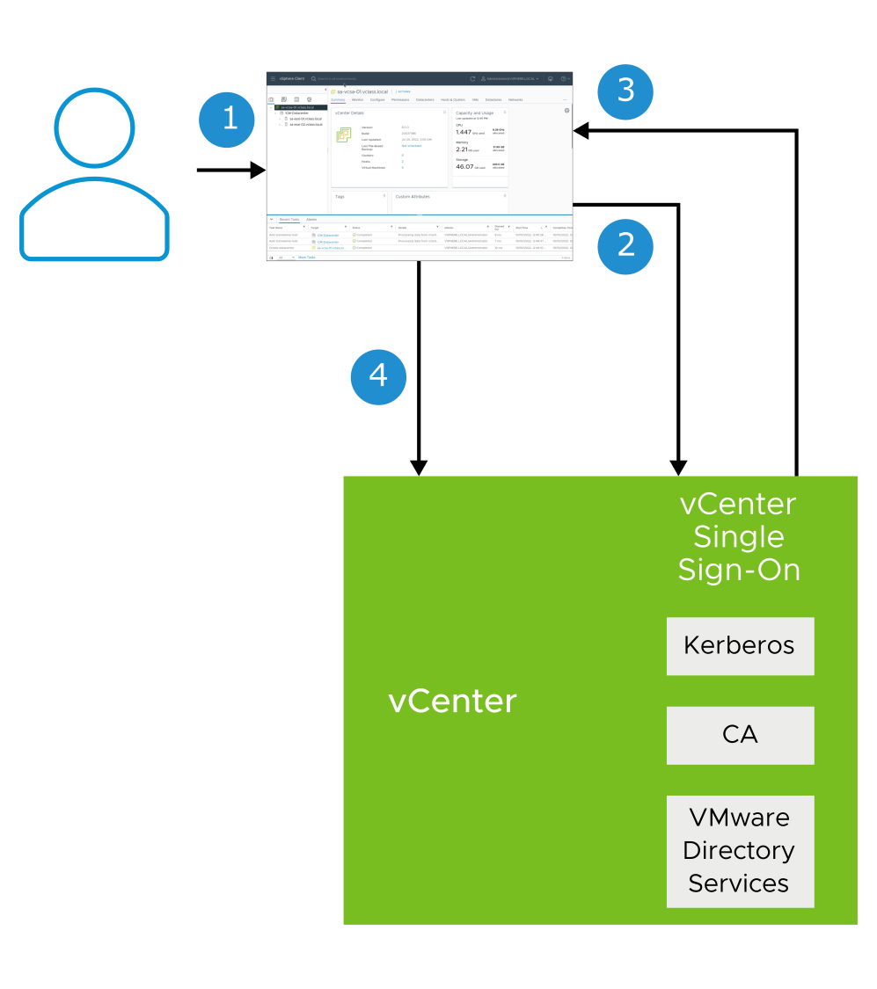
vCenter Single Sign-On with Built-In Identity Provider
The following is the user login flow when vCenter acts as the identity provider:
User logs in to the vSphere Client.
vCenter Single Sign-On authenticates credentials against a directory service (for example, Active Directory).
A SAML token is sent back to the user's browser.
The SAML token is sent to vCenter, and the user is granted access.
Notes:
For more details about user login flow, see vSphere Authentication at https://docs.vmware.com/en/VMware-vSphere/index.html.

Slide 12
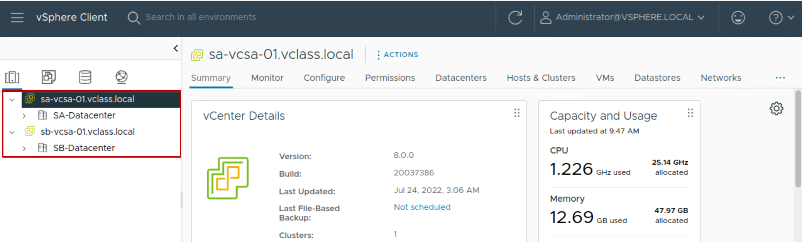
About Enhanced Linked Mode
With Enhanced linked mode, you can log in to the vSphere Client and manage the inventories of all the vCenter instances in the group:
You can link up to 15 vCenter instances in one vCenter Single Sign-On domain.
You can create an enhanced linked mode group during the deployment of vCenter Server Appliance.
Notes:
Enhanced linked mode provides the following features:
You can log in to all linked vCenter instances simultaneously with a single username and password.
You can view and search the inventories of all linked vCenter instances in the vSphere Client.
You can replicate roles, permission, licenses, tags, and policies (such as storage policies) across linked vCenter instances.
To join vCenter instances in Enhanced Linked Mode, connect the vCenter instances to the same vCenter Single Sign-On domain.
You can create a vCenter enhanced linked mode group during the deployment of vCenter Server Appliance. You can also join a vCenter enhanced linked mode group by moving, or repointing, a vCenter instance from one vSphere domain to another existing domain. For more information on repointing vCenter instances, see vCenter Server Installation and Setup at https://docs.vmware.com/en/VMware-vSphere/index.html.
Enhanced linked mode requires the vCenter Standard licensing level. Enhanced linked mode is not supported with vCenter Foundation or vCenter for Essentials.

Slide 13
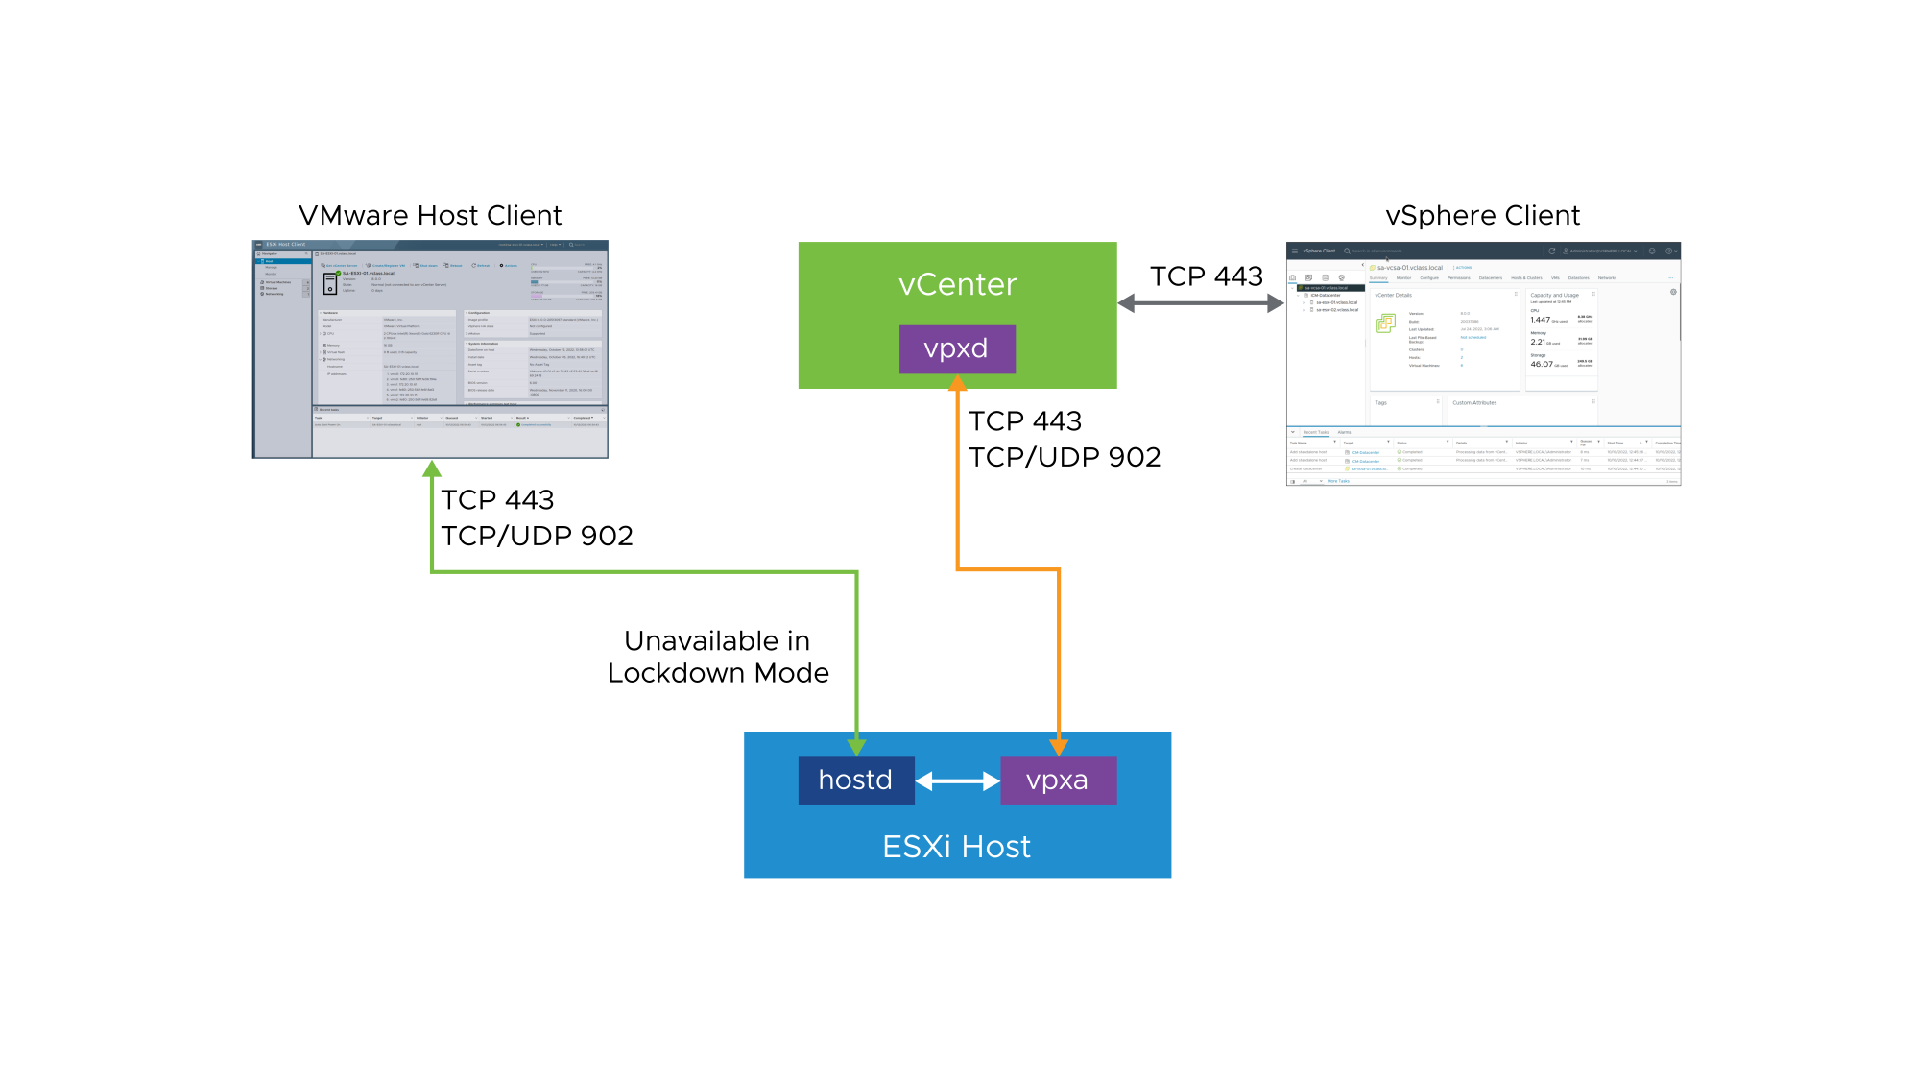
ESXi and vCenter Communication
The vSphere Client is the primary method to manage ESXi hosts. vSphere Client communicates directly with vCenter. If vCenter is not available, you use VMware Host Client to communicate directly with the ESXi host.
Notes:
vCenter provides direct access to the ESXi host through a vCenter agent called virtual provisioning X agent (vpxa). The vpxa process is automatically installed on the host and started when the host is added to the vCenter inventory. The vCenter service (vpxd) communicates with the ESXi host daemon (hostd) through the vCenter agent (vpxa).
Clients that communicate directly with the host, and bypass vCenter, converse with hostd. The hostd process runs directly on the ESXi host and manages most of the operations on the ESXi host. The hostd process is aware of all VMs that are registered on the ESXi host, the storage volumes visible to the ESXi host, and the status of all VMs. Most commands or operations come from vCenter through vpxa. Examples include creating, migrating, and powering on virtual machines. Acting as an intermediary between the vpxd process, which runs on vCenter, and the hostd process, vpxa relays the tasks to perform on the host. When you are logged in to the vCenter system through the vSphere Client, vCenter passes commands to the ESXi host through the vpxa. The vCenter database is also updated. If you use VMware Host Client to communicate directly with an ESXi host, communications go directly to the hostd process and the vCenter database is not updated.

Slide 14
vCenter Scalability
Metric | vCenter 8.0
Hosts per vCenter instance | 2,500
Powered-on VMs per vCenter instance | 40,000
Registered VMs per vCenter instance | 45,000
Hosts per cluster | 96
VMs per cluster | 8,000
Notes:
You can scale vCenter to support large, enterprise environments. For the recommended configuration limits, see VMware Configuration Maximums at https://configmax.vmware.com.

Slide 15
Review of Learner Objectives
Describe the vCenter architecture
Recognize ESXi hosts communication with vCenter
Identify vCenter services

Slide 16
Deploying vCenter Server Appliance

Slide 17
Learner Objectives
Deploy vCenter Server Appliance into an infrastructure
Configure vCenter settings

Slide 18
Preparing for vCenter Server Appliance Deployment
Before deploying vCenter Server Appliance, you must complete several tasks:
Verify that all vCenter Server Appliance system requirements are met.
Get the fully qualified domain name (FQDN) or the static IP of the host machine on which you install vCenter Server Appliance.
Get FQDN and IP address to assign to vCenter Server Appliance.
Ensure that date and time on all VMs in the vSphere network are synchronized.
Notes:
For more information on system requirements for vCenter Server Appliance, see vCenter Server Installation and Setup at https://docs.vmware.com/en/VMware-vSphere/index.html.

Slide 19
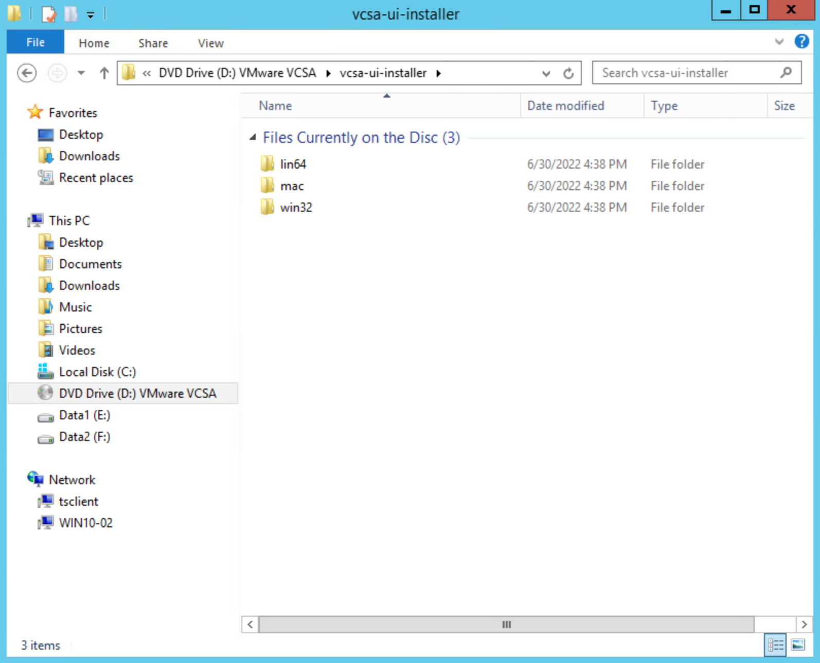
vCenter Server Appliance Native GUI Installer
The vCenter Server Appliance Native GUI installer has several features:
With the GUI installer, you can perform an interactive deployment of vCenter Server Appliance.
The GUI installer is a native application for Windows, Linux, and macOS.
The GUI installer performs validations and prechecks during the deployment.
Notes:
The GUI installer performs validations and prechecks during the deployment phase to ensure that no mistakes are made and that a compatible environment is created.

Slide 20
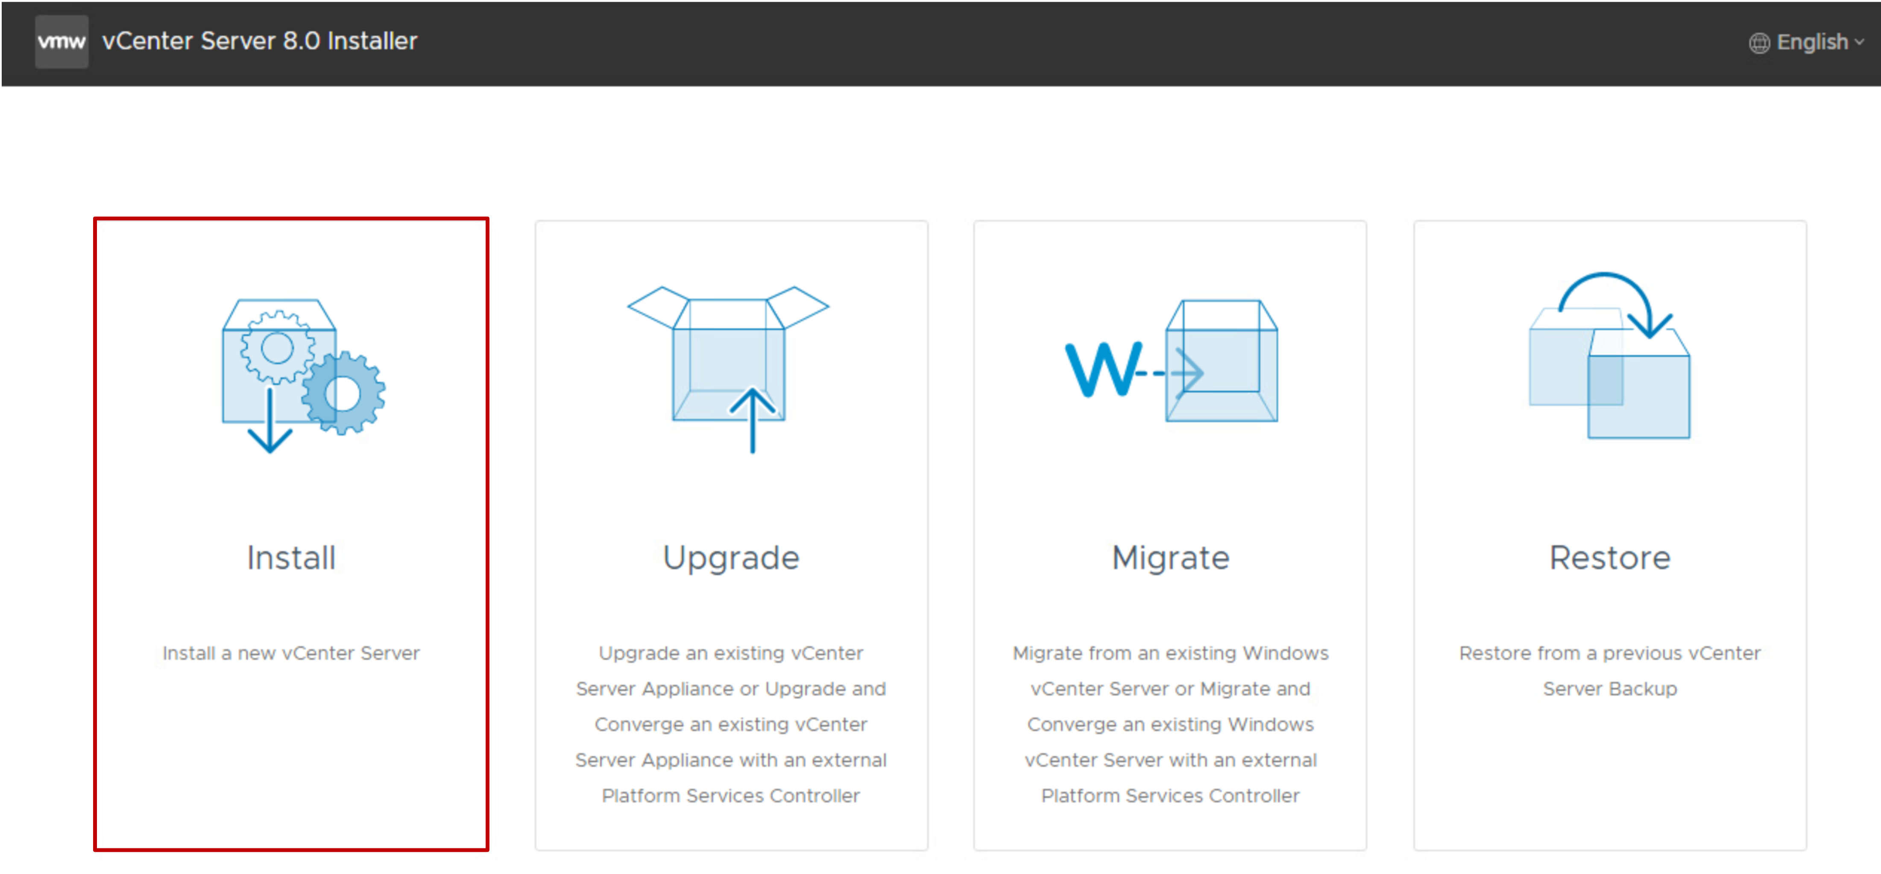
vCenter Server Appliance Installation
The vCenter Server Appliance installation is a two-stage process:
Stage 1: Deployment of OVF
Stage 2: Configuration
The deployment can be fully automated by using JSON templates with the CLI installer on Windows, Linux, or macOS.
Notes:
The Install option installs a new vCenter Server Appliance.
The Upgrade option upgrades an existing vCenter Server Appliance instance, or upgrades and converges an existing vCenter Server Appliance instance with an external Platform Services Controller.
The Migrate option migrates from an existing Windows vCenter instance, or migrates and converges an existing Windows vCenter instance with an external Platform Services Controller.
The Restore option restores from a previous vCenter Server Appliance backup.

Slide 21
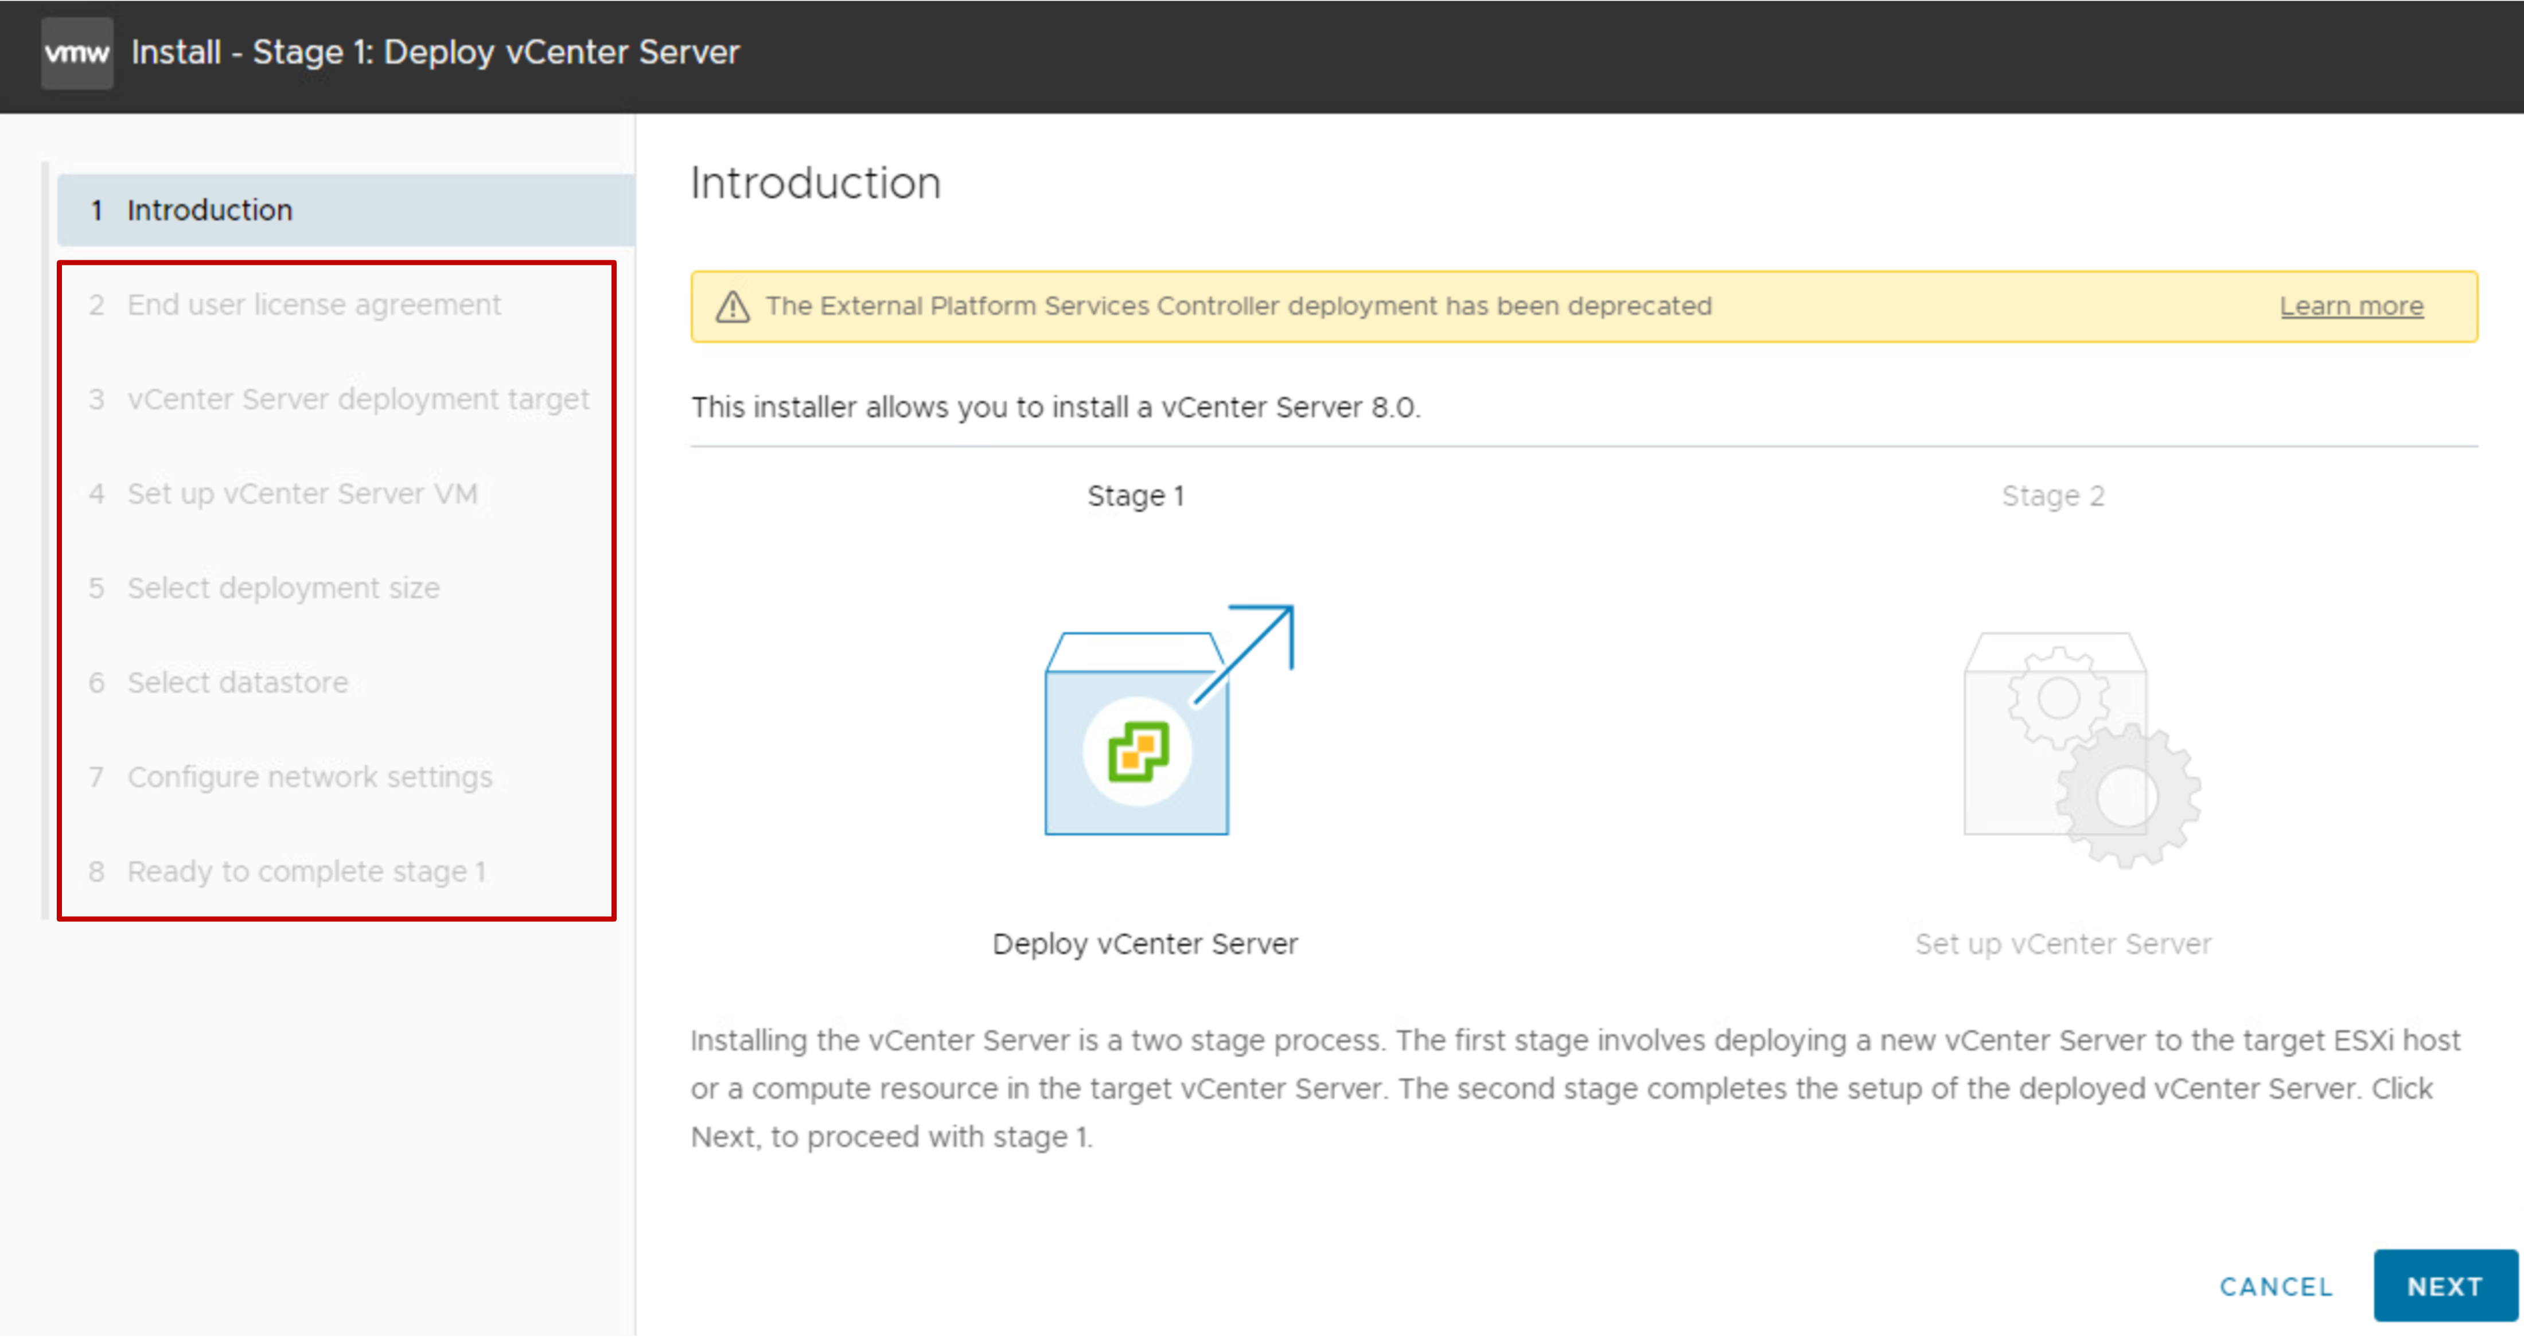
vCenter Server Appliance Installation: Stage 1
Stage 1 begins with the UI phase:
Accept the EULA.
Connect to the target ESXi host or vCenter system.
Define the vCenter Server Appliance name and root password.
Select compute size, storage size, and datastore location (thin disk).
Define networking settings.
Stage 1 continues with the deployment phase:
OVF is deployed to the ESXi host.
Disks and networking are configured.

Slide 22
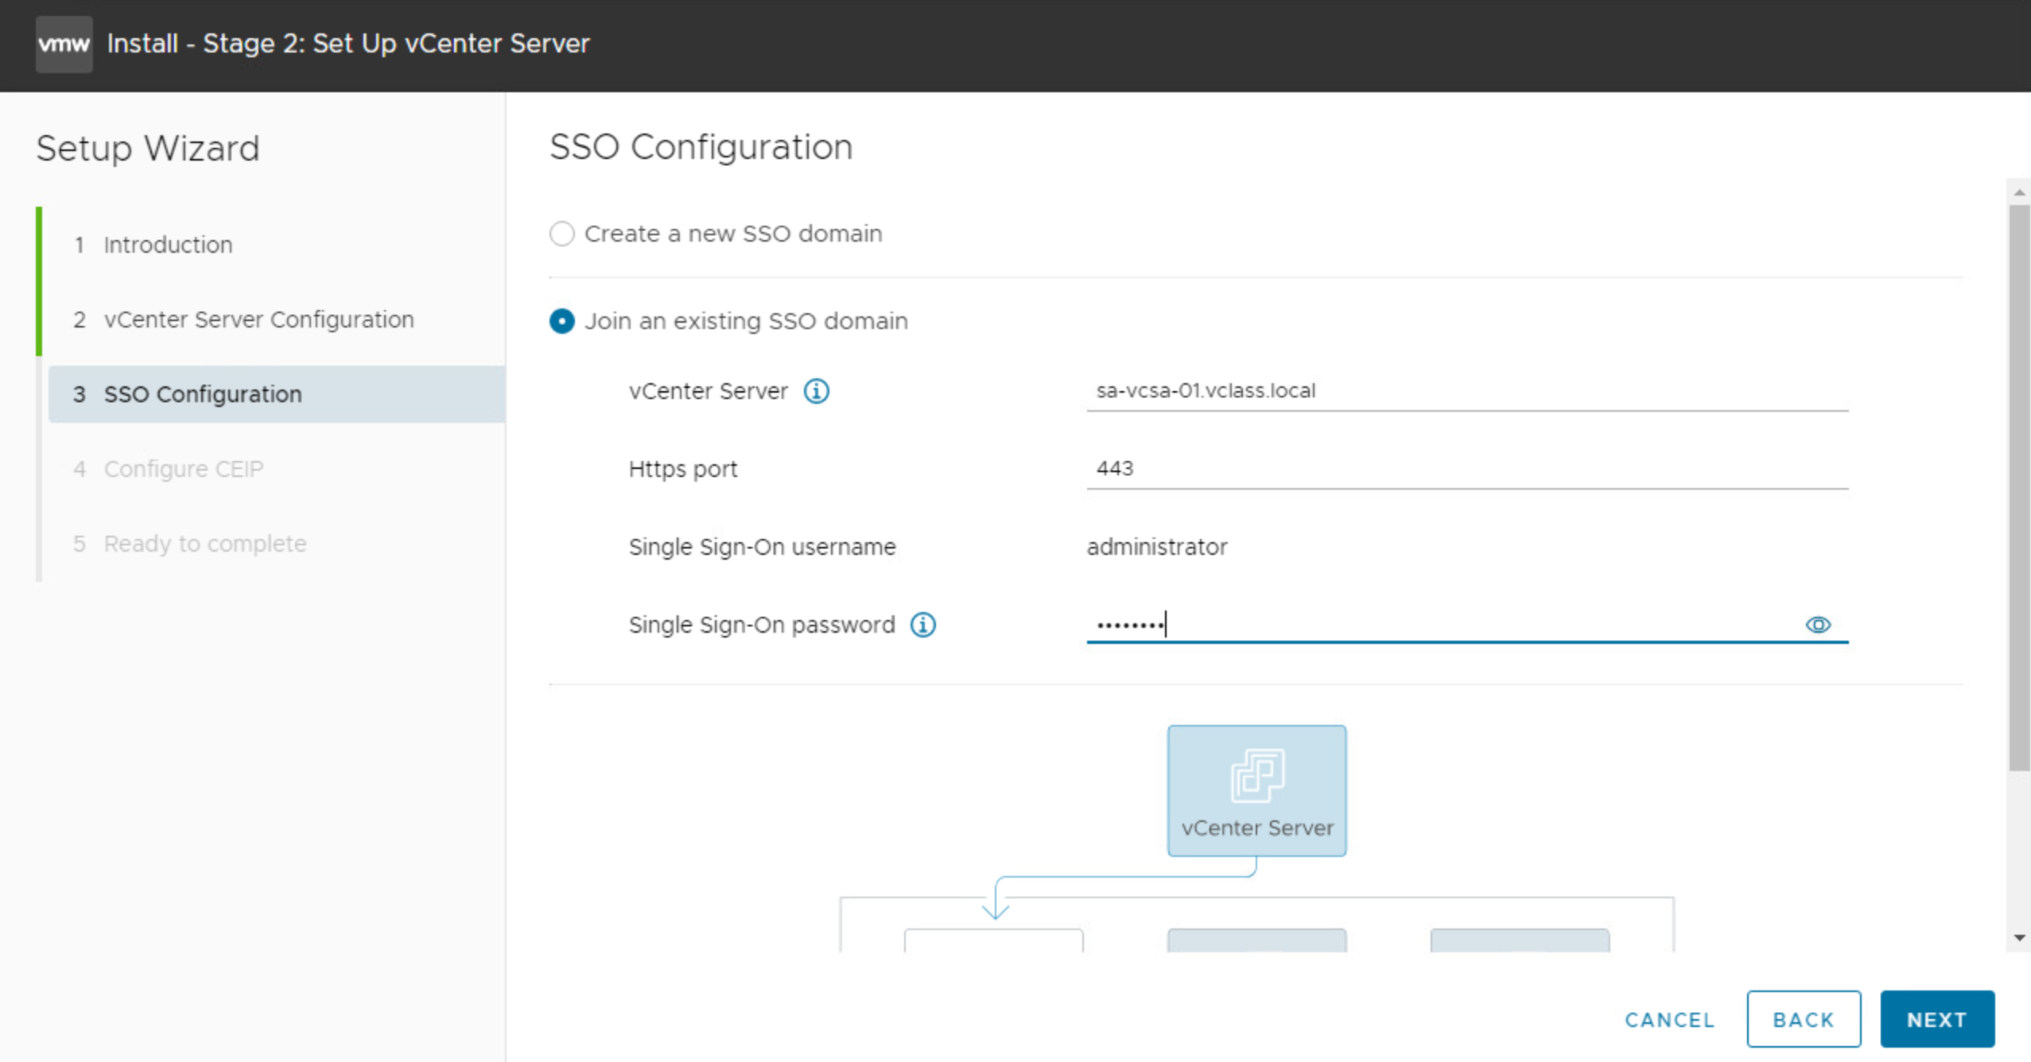
vCenter Server Appliance Installation: Stage 2
Stage 2 is the configuration phase:
Configure time synchronization mode and SSH access.
Create a vCenter Single Sign-On domain or join an existing SSO domain.
Join the Customer Experience Improvement Program (CEIP).
Notes:
In stage 2, you configure whether to use the ESXi host or NTP servers as the time synchronization source. You can also activate SSH access. SSH access is deactivated by default.

Slide 23
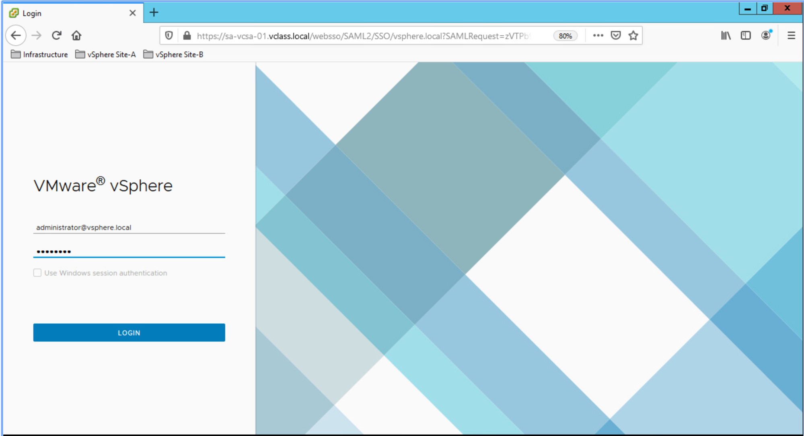
Getting Started with vCenter
After you deploy vCenter Server Appliance, use the vSphere Client to log in and manage your vCenter inventory: https://<vCenter_FQDN_or_IP_address>/ui.

Slide 24
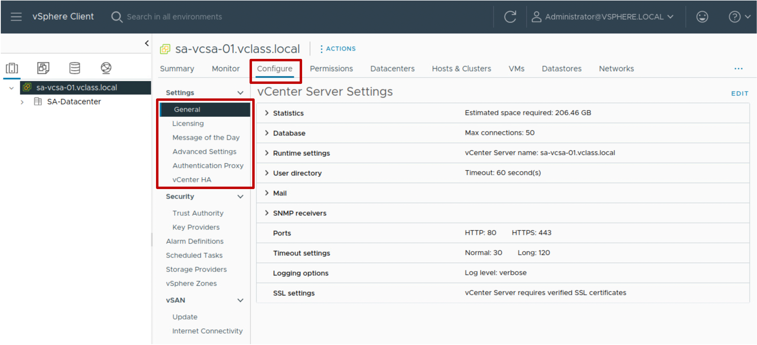
Configuring vCenter Using the vSphere Client
Using the vSphere Client, you can configure vCenter, including settings such as licensing, statistics collection, and logging.
Notes:
To access the vCenter system settings by using the vSphere Client, select the vCenter system in the navigation pane, click the Configure tab, and expand Settings.

Slide 25
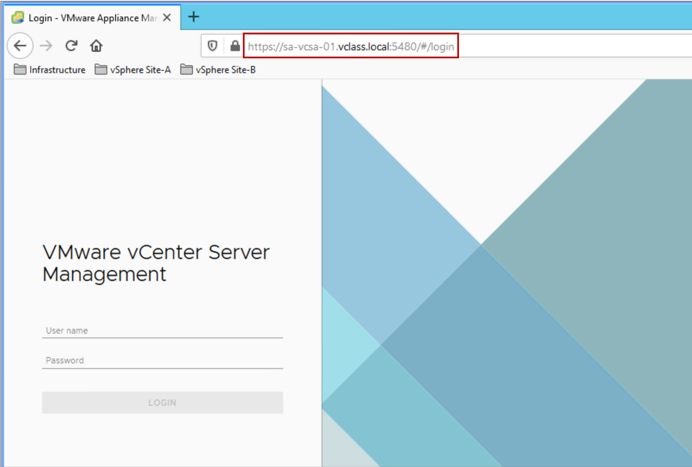
vCenter Management Interface
Using the vCenter Management Interface, you can configure and monitor your vCenter instance.
Tasks include:
Monitoring resource use by the appliance
Backing up the appliance
Monitoring vCenter services
Adding additional network adapters
Notes:
The vCenter Management Interface is an HTML client designed to configure and monitor a vCenter instance.
The vCenter Management Interface connects directly to port 5480. Use the URL https://<FQDN_or_IP_address>:5480.

Slide 26
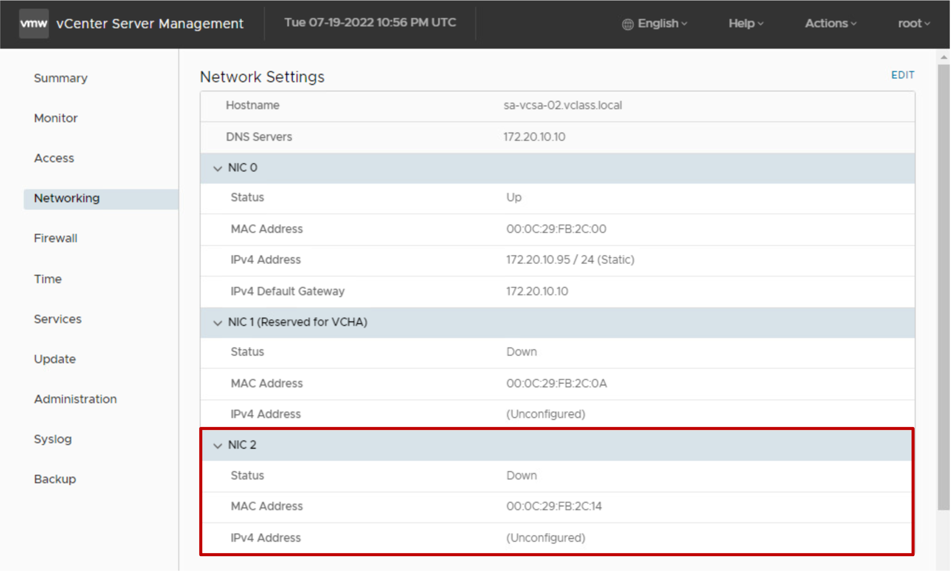
Multi-homing the vCenter Server Appliance
With vCenter Server Appliance multi-homing, you can configure multiple NICs to manage network traffic.
Notes:
A maximum of four NICs are supported for multi-homing. All four multi-homing NIC configurations are preserved during upgrade, backup, and restore processes.

Slide 27
Demonstration: Deploying vCenter Server Appliance
Your instructor will run a demonstration.

Slide 28
Review of Learner Objectives
Deploy vCenter Server Appliance into an infrastructure
Configure vCenter settings

Slide 29
vSphere Licensing

Slide 30
Learner Objectives
View licensed features for vCenter or an ESXi host
Add license keys to vCenter

Slide 31
About vSphere Licenses
VMware provides a number of vSphere products to suit your needs.
vSphere Essential Kit | vSphere Essential Plus Kit | vSphere Standard | vSphere Enterprise Plus
For small businesses (up to three hosts with up to two CPUs each) | For small businesses (up to three hosts with up to two CPUs each) | Entry-level solution for basic server consolidation | Full range of features for transforming your data center into a simplified cloud infrastructure
vCenter and ESXi | vCenter and ESXi | vCenter and ESXi | vCenter and ESXi
 | vSphere vMotion, vSphere Storage vMotion, vSphere HA, vSphere Data Protection, vSphere Replication | vSphere vMotion, vSphere Storage vMotion, vSphere HA, vSphere Replication | vSphere vMotion, vSphere Storage vMotion, vSphere HA, vSphere Trust Authority, VM encryption, vSphere Replication
Notes:
For details, go to the vSphere product on https://store.vmware.com.

Slide 32
vSphere Licensing Overview
Licensing vSphere components is a two-step process:
Add a license to the vCenter License Service
Assign the license to the ESXi hosts, vCenter instances, and other vSphere components

Slide 33
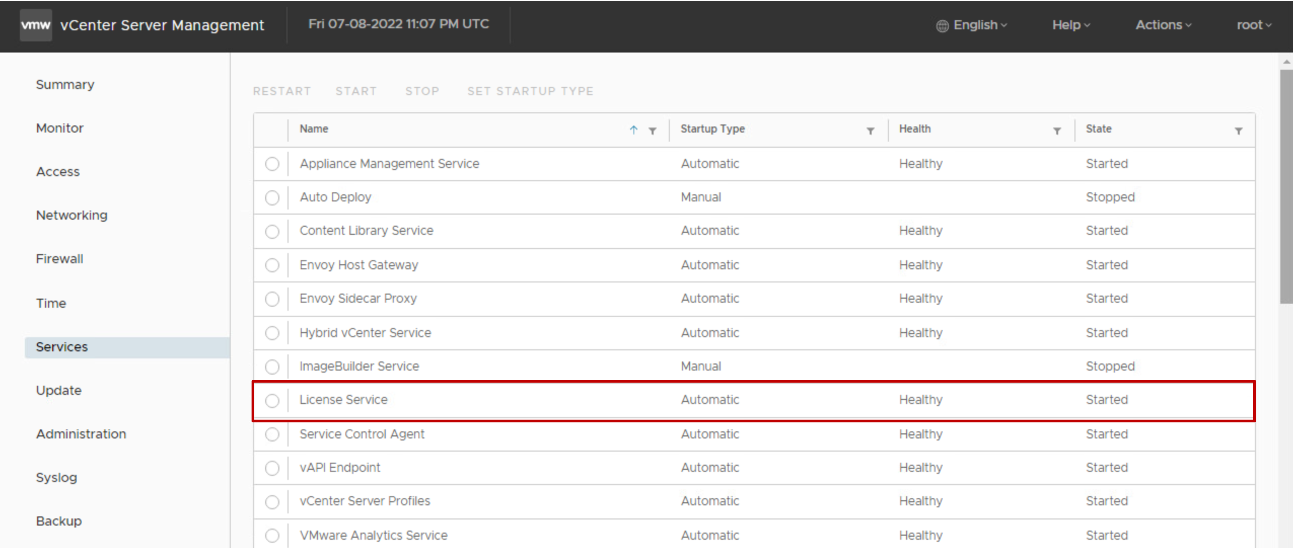
vSphere License Service
The vSphere License Service runs on vCenter.
The vSphere License Service performs the following functions:
Provides centralized license management
Provides an inventory of vSphere licenses
Manages the license assignments for products that integrate with vSphere, such as Site Recovery Manager.
Notes:
The vSphere License Service manages the license assignments for ESXi hosts, vCenter systems, and clusters with vSAN activated.
You can monitor the health and status of the vSphere License Service by using the vCenter Management interface.

Slide 34
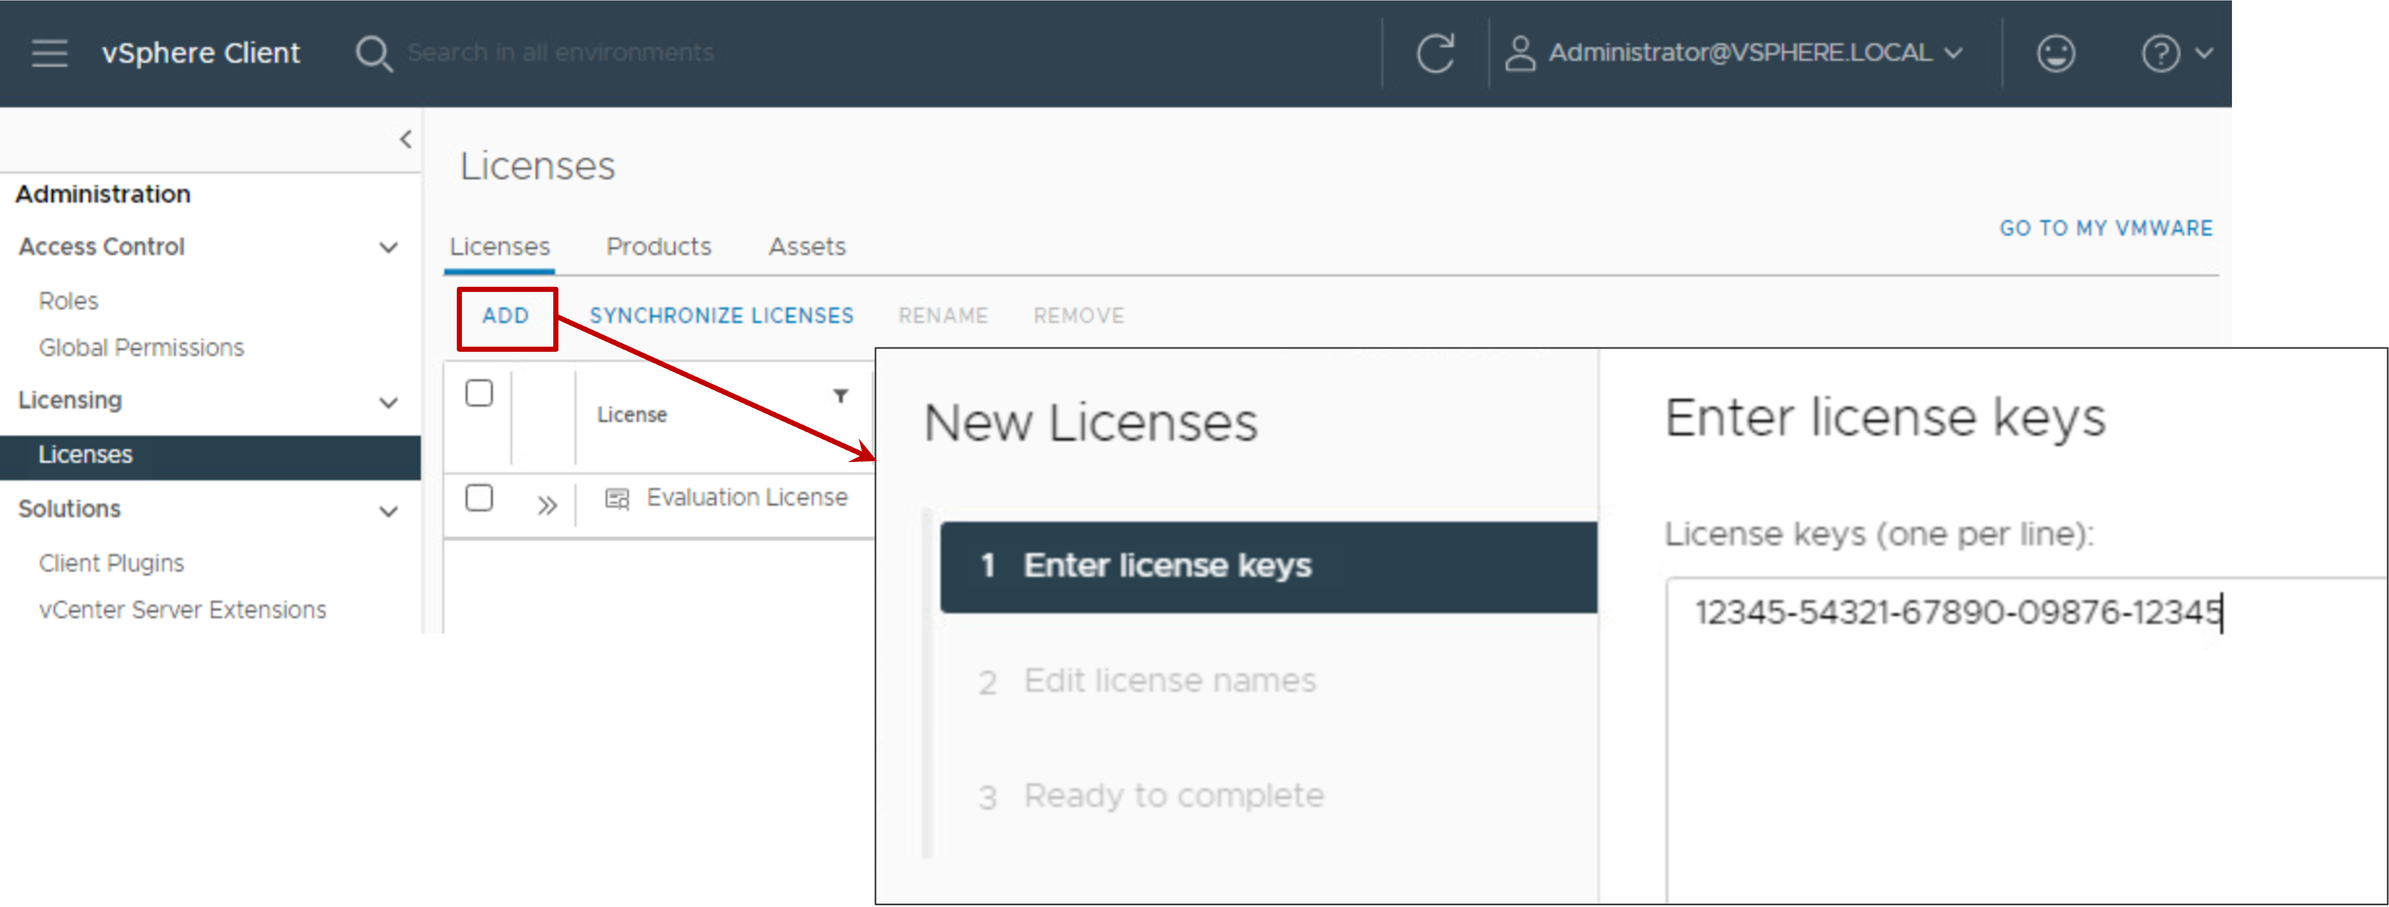
Adding License Keys to vCenter
You must assign a license to vCenter before its 60-day evaluation period expires.
In the vSphere Client from the main menu, select Administration > Licenses to open the Licenses pane.
Notes:
In vSphere, license reporting and management are centralized. All product and feature licenses are encapsulated in 25-character license keys that you can manage and monitor from vCenter.
You can view license information by product, license key, or asset:
Product: A license to use a vSphere software component or feature, for example, vCenter or vSphere Enterprise Plus.
License key: The serial number that corresponds to a product.
Asset: A component that has been assigned a product license. For an asset to run certain software legally, the asset must be licensed.

Slide 35
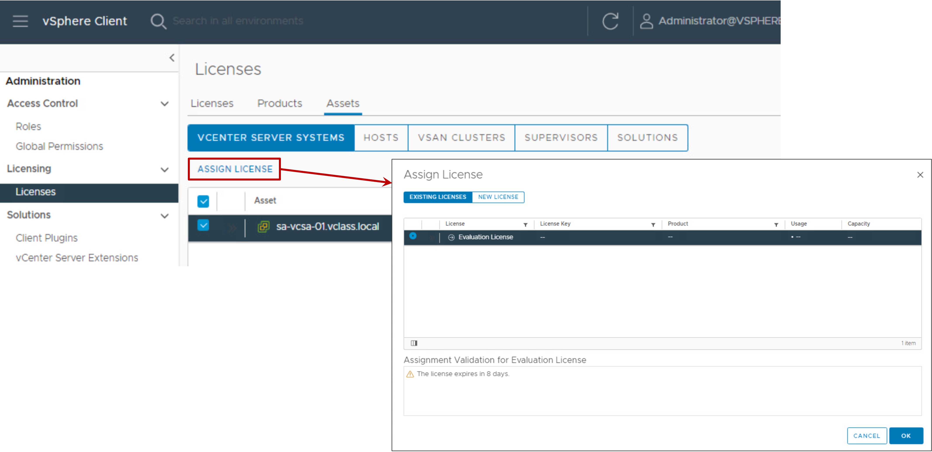
Assigning the License to the vSphere Component
You can assign a license to an asset, such as vCenter.

Slide 36
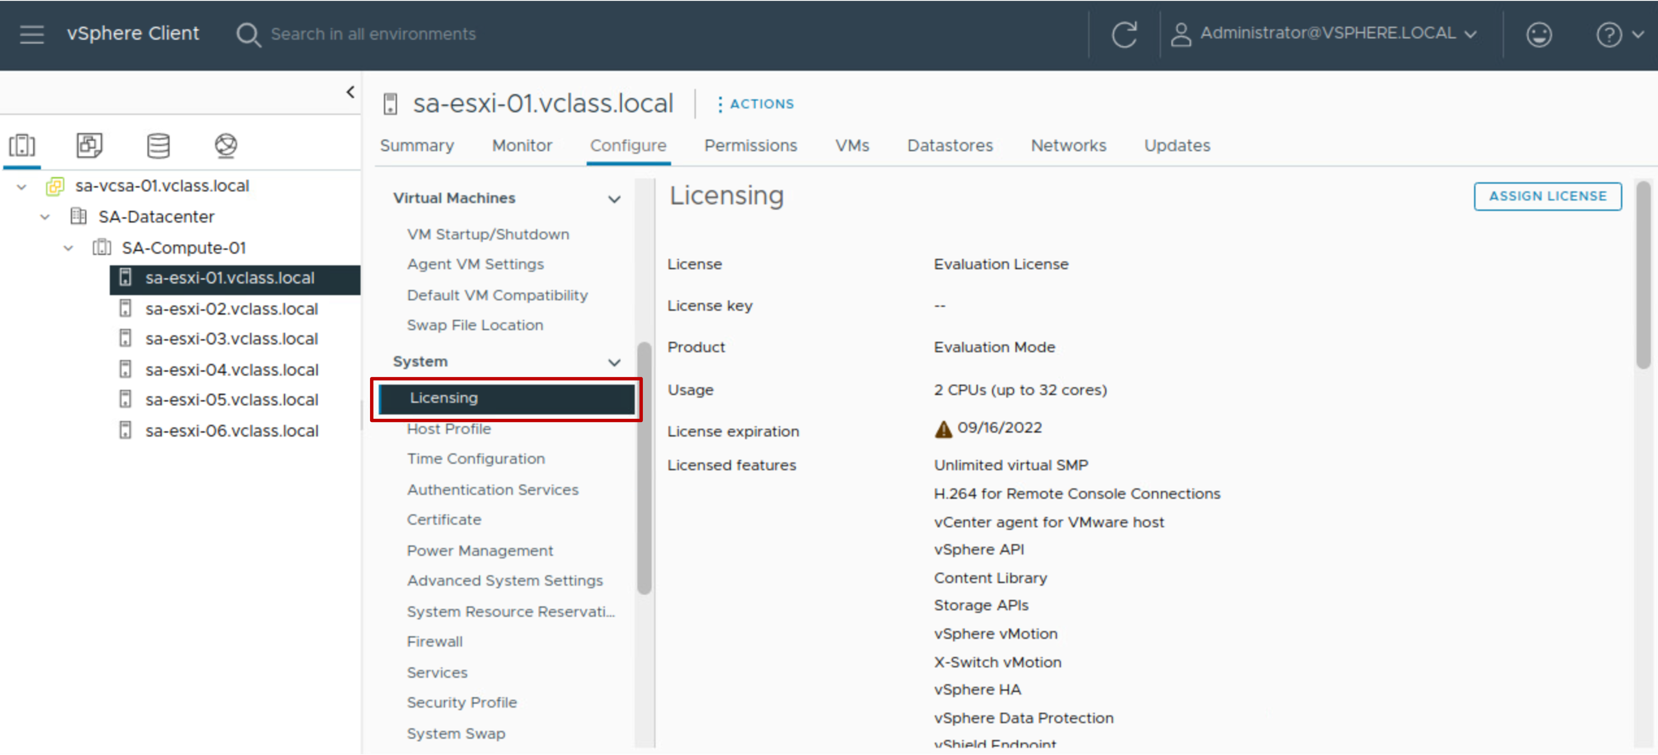
Viewing Licensed Features
You manage licenses using the License pane in vCenter's Configure tab. This pane shows the type of license and available features.
Notes:
Before purchasing and activating licenses for ESXi and vCenter, you can install the software and run it in evaluation mode. Evaluation mode is intended for demonstrating the software or evaluating its features. During the evaluation period, the software is fully operational.
The evaluation period is 60 days from the time of installation. During this period, the software notifies you of the time remaining until expiration. The 60-day evaluation period cannot be paused or restarted. After the evaluation period expires, you can no longer perform some operations in vCenter and ESXi. For example, you cannot power on or reset your virtual machines. In addition, all hosts are disconnected from the vCenter system. To continue to have full use of ESXi and vCenter operations, you must acquire, install and assign license keys.

Slide 37
Lab 1: Adding vSphere Licenses
Use the vSphere Client to add vSphere licenses to vCenter and assign a license to vCenter:
Add vSphere Licenses to vCenter
Assign a License to the vCenter Instance

Slide 38
Review of Learner Objectives
View licensed features for vCenter or an ESXi host
Add license keys to vCenter

Slide 39
Managing vCenter Inventory

Slide 40
Learner Objectives
Use the vSphere Client to manage the vCenter inventory
Create and organize vCenter inventory objects
Add data center and organizational objects to vCenter
Add ESXi hosts to the inventory
Create custom inventory tags for inventory objects

Slide 41
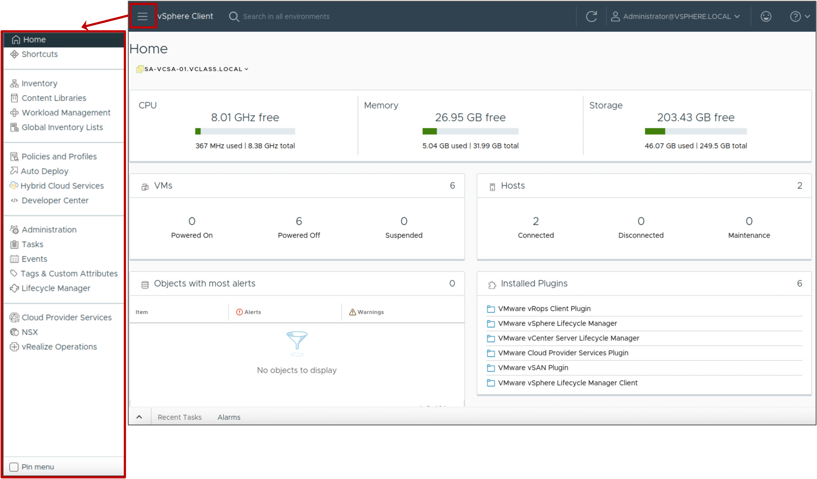
vSphere Client Main Menu
From the vSphere Client main menu, you can manage your vCenter system inventory, manage your infrastructure environment, and complete system administration tasks.
Notes:
The vSphere Client main menu is indicated by a three-lined icon, located in the upper left corner of the vSphere Client window.

Slide 42
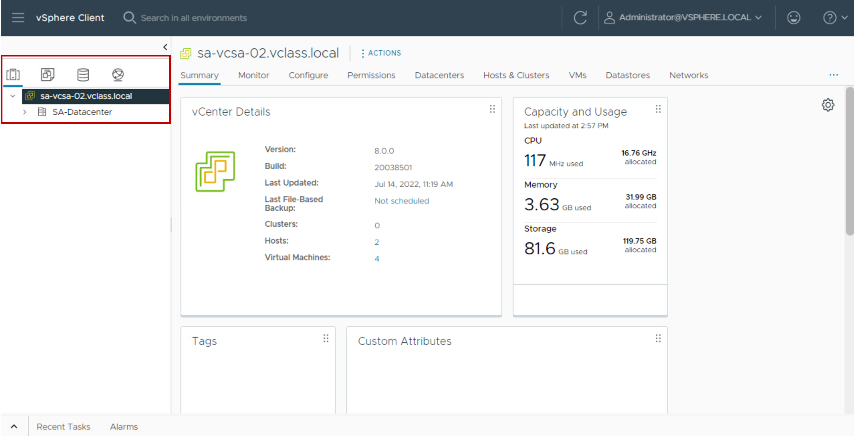
Navigating the Inventory
You can use the navigation pane to browse and select objects in the vCenter inventory.

Slide 43
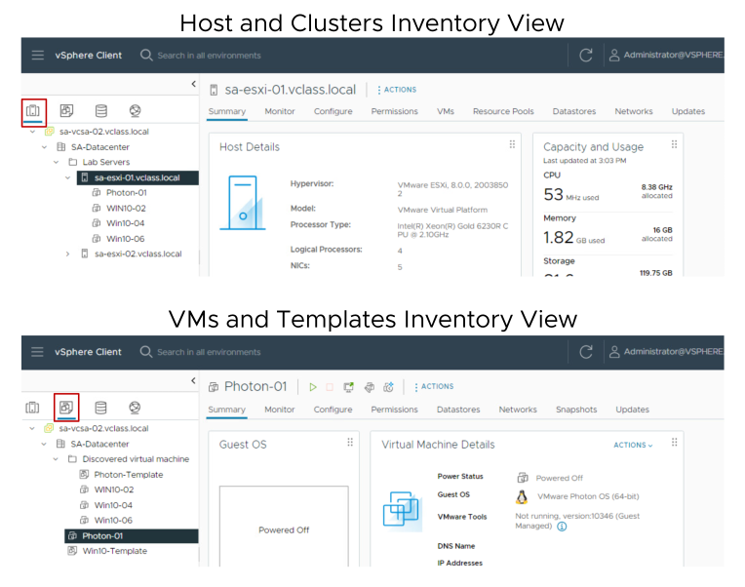
Views for Hosts, Clusters, VMs, and Templates
Host and cluster objects appear in one view, and VM and template objects are displayed in another view.
Notes:
The Hosts and Clusters inventory view shows all host and cluster objects in a data center. You can further organize the hosts and clusters into folders.
The VMs and Templates inventory view shows all VM and template objects in a data center. You can also organize the VMs and templates into folders.

Slide 44
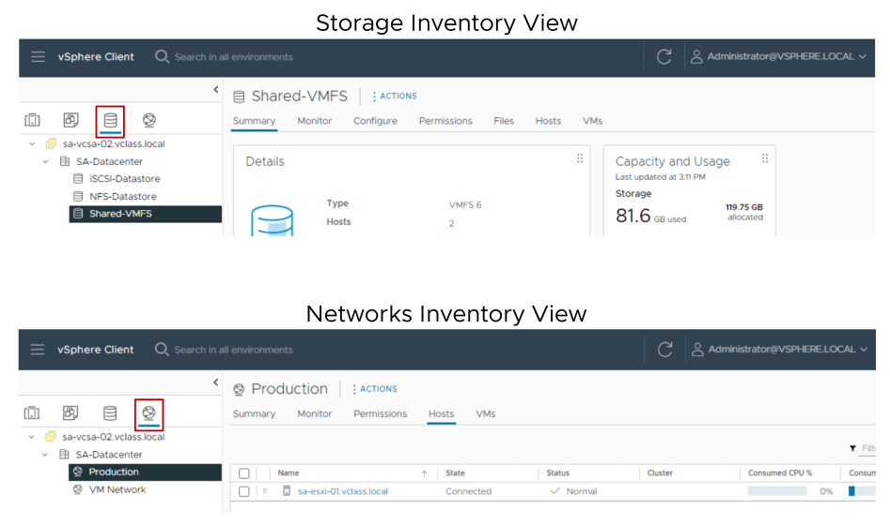
Views for Storage and Networks
The storage inventory view shows all the details for datastores in the data center.
The networking inventory view shows all the port groups on standard switches and distributed switches.
Notes:
As with the other inventory views, you can organize your datastore and network objects into folders.

Slide 45
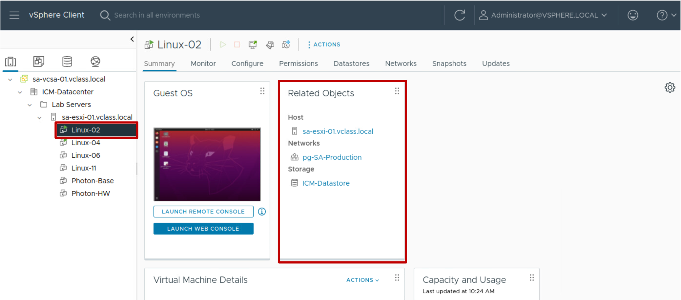
Viewing Object Information
Because you can view object information and access related objects, monitoring and managing object properties is easy.

Slide 46
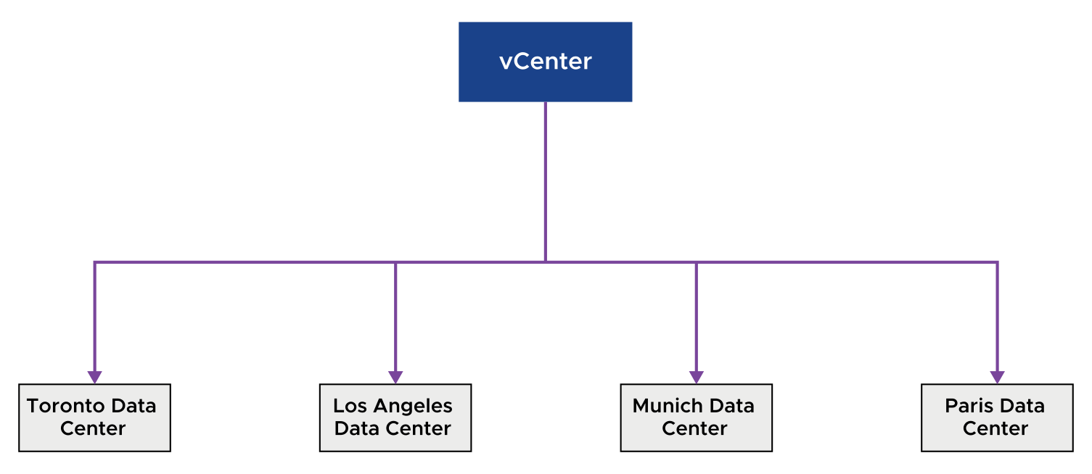
About Data Center Objects
A virtual data center is a logical organization of all the inventory objects. Those inventory objects are required to complete a fully functional environment for operating VMs:
You can create multiple data centers to organize sets of environments.
Each data center has its own hosts, VMs, templates, datastores, and networks.
Notes:
You might create a data center object for each data center geographical location. Or, you might create a data center object for each organizational unit in your enterprise.

Slide 47
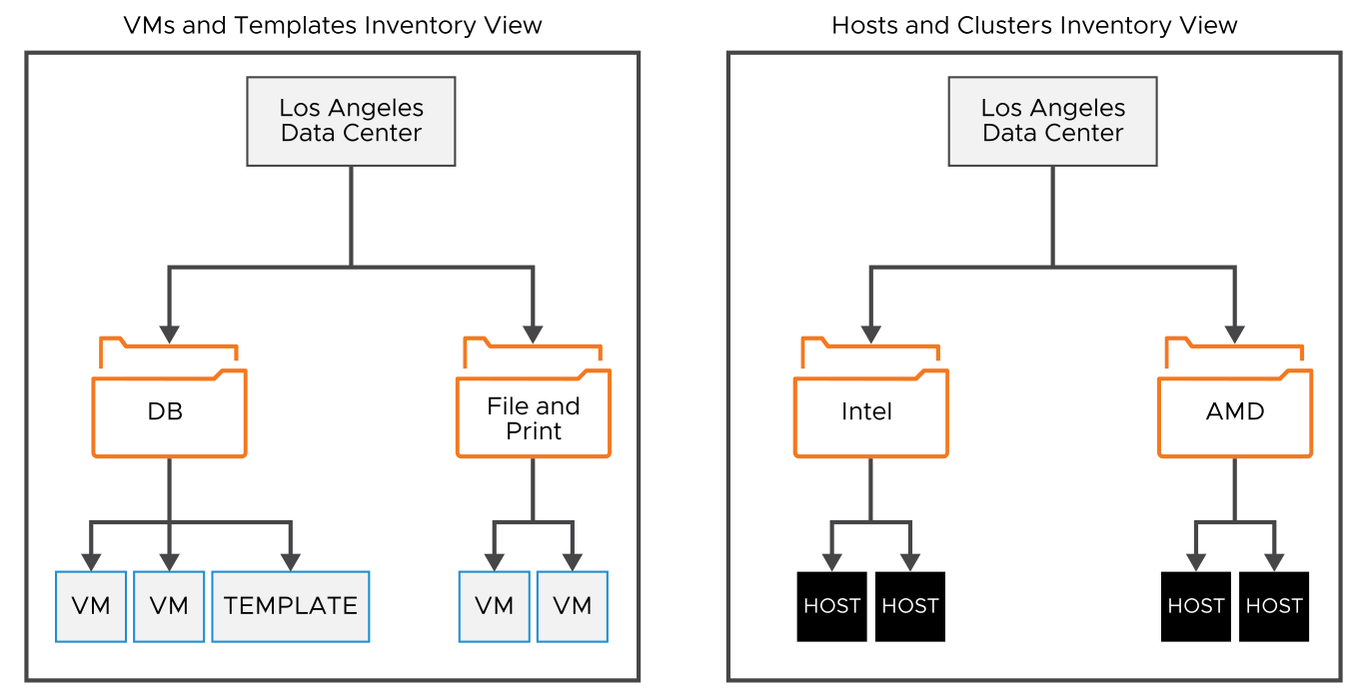
Organizing Inventory Objects into Folders
You can place Objects in a data center in folders. You can create folders and subfolders to better organize systems. Each of the four inventory views has its own folder structure.
Notes:
You plan the setup of your virtual environment depending on your requirements. A large vSphere implementation might contain several virtual data centers with a complex arrangement of hosts, clusters, resource pools, and networks. vSphere implementation might include multiple vCenter systems. Smaller implementations might require a single virtual data center with a less complex topology. Regardless of the scale of your virtual environment, consider how the VMs that it supports are used and administered.
Populating and organizing your inventory involves the following tasks:
Creating data centers
Creating clusters to consolidate the resources of multiple hosts and VMs
Adding hosts to the clusters or to the data centers
Organizing inventory objects in folders
Setting up networking by using vSphere standard switches or vSphere distributed switches
Configuring storage systems and creating datastore inventory objects to provide logical containers for storage devices in your inventory

Slide 48
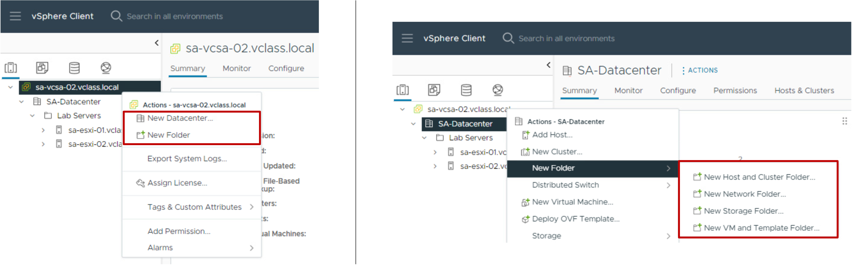
Adding a Data Center and Organizational Objects to vCenter
You can add a data center, a host, a cluster, and folders to vCenter.
You can use folders to group objects of the same type for easier management.

Slide 49
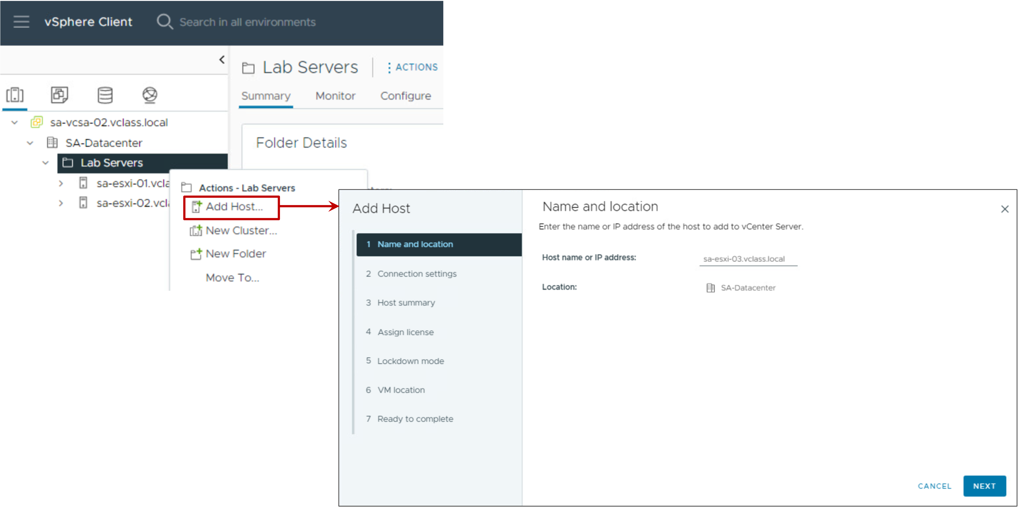
Adding ESXi Hosts to vCenter
You can add ESXi hosts to vCenter using the vSphere Client.

Slide 50
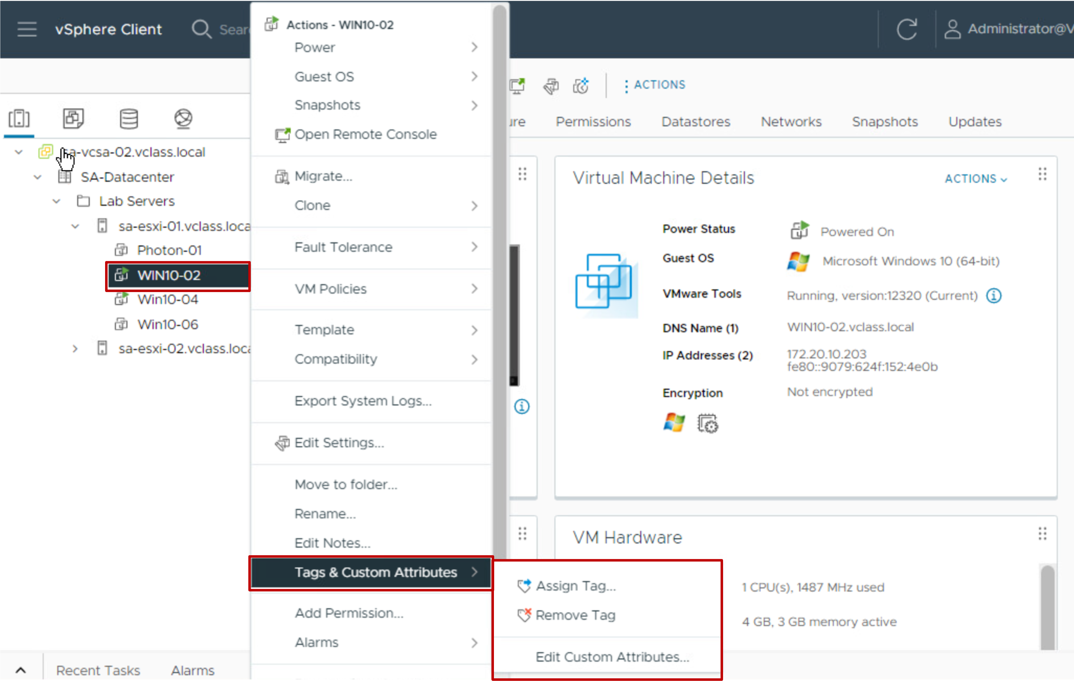
Creating Custom Tags for Inventory Objects
You can use tags to attach metadata to objects in the vCenter inventory. Tags help make these objects more sortable.
You can associate a set of objects of the same type by searching for objects by a given tag.
You can use tags to group and manage VMs, clusters, and datastores, for example:
Tag VMs that run production workloads.
Tag VMs based on their guest operating system.

Slide 51
Lab 2: Creating and Managing the vCenter Inventory
Use the vSphere Client to create and configure objects in the vCenter inventory:
Create a Data Center Object
Add Two ESXi Hosts to the Inventory
View Information About the ESXi Hosts
Configure an ESXi Host as an NTP Client
Create a Folder for the ESXi Hosts
Create Folders for VMs and VM Templates

Slide 52
Review of Learner Objectives
Use the vSphere Client to manage the vCenter inventory
Create and organize vCenter inventory objects
Add data center and organizational objects to vCenter
Add ESXi hosts to the inventory
Create custom inventory tags for inventory objects

Slide 53
vCenter Roles and Permissions

Slide 54
Learner Objectives
Define the term permission in the context of vCenter
Recognize the rules for applying permissions
Create a custom role
Assign global permission to a user

Slide 55
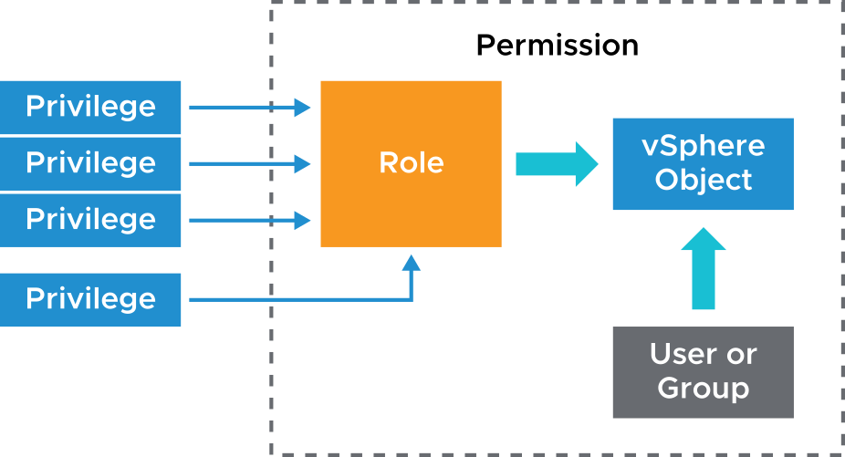
About vCenter Permissions
Using the access control system, the vCenter administrator can define user privileges to access objects in the inventory.
The following concepts are important:
Privilege: An action that can be performed
Role: A set of privileges
Object: The target of the action
User or group: Indication of who can perform the action
Permission: Gives one user or group a role (set of privileges) for the selected object
Notes:
The authorization to perform tasks in vCenter is governed by an access control system. Through this access control system, the vCenter administrator can specify in detail which users or groups can perform which tasks on which objects.
A permission is set on an object in the vCenter object inventory. Each permission associates the object with a group or user and the group or user access roles. For example, you can select a VM object, add one permission that gives the Read-only role to group 1, and add a second permission that gives the Administrator role to user 2.
By assigning a different role to a group of users on different objects, you control the tasks that those users can perform in your vSphere environment. For example, to allow a group to configure memory for the host, select that host and add a permission that grants a role to that group that includes the Host.Configuration.Memory Configuration privilege.

Slide 56
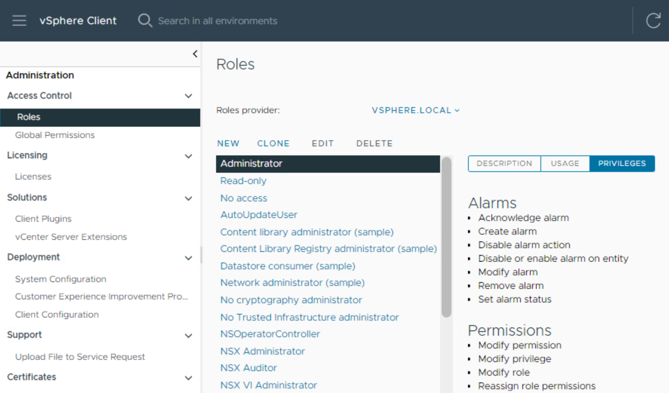
About Roles
Privileges are grouped into roles:
A privilege allows access to a specific task and is grouped with other privileges related to it.
Roles allow users to perform tasks.
vCenter provides a few system roles, which you cannot modify.
Sample roles are also provided. You can clone them to create custom roles.
Notes:
A role is a set of one or more privileges. For example, the Virtual Machine Power User sample role consists of several privileges in categories such as Datastore and Global. A role is assigned to a user or group and determines the level of access of that user or group.
You cannot change the privileges associated with the system roles:
Administrator role: Users with this role for an object may view and perform all actions on the object.
Read-only role: Users with this role for an object may view the state of the object and details about the object.
No access role: Users with this role for an object may not view or change the object in any way.
No cryptography administrator role: Users with this role for an object have the same privileges as users with the Administrator role, except for privileges in the Cryptographic operations category.
All roles are independent of each other. There is no hierarchy or inheritance between roles.

Slide 57
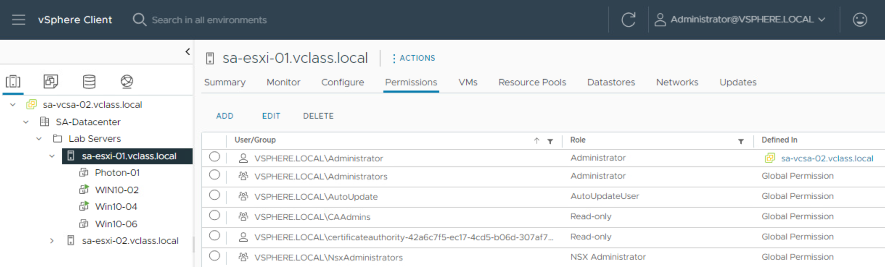
About Objects
Objects are entities on which actions are performed. Objects include data centers, folders, clusters, hosts, datastores, networks, and virtual machines.
All objects have a Permissions tab. The Permissions tab shows which user or group and role are associated with the selected object.

Slide 58
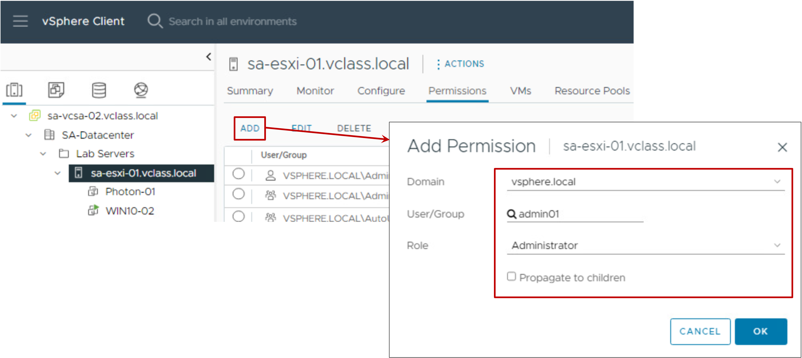
Assigning Permissions
To assign a permission:
Select an object
Select a Domain
Select a User/Group
Select a Role
Propagate the permission to the child objects
Notes:
You can assign permissions to objects at different levels of the hierarchy. For example, you can assign permissions to a host object or to a folder object that includes all host objects. You can also assign permissions to the global root object to apply the permissions to all objects in all solutions.
For information about hierarchical inheritance of permissions and global permissions, see vSphere Security at https://docs.vmware.com/en/VMware-vSphere/index.html

Slide 59
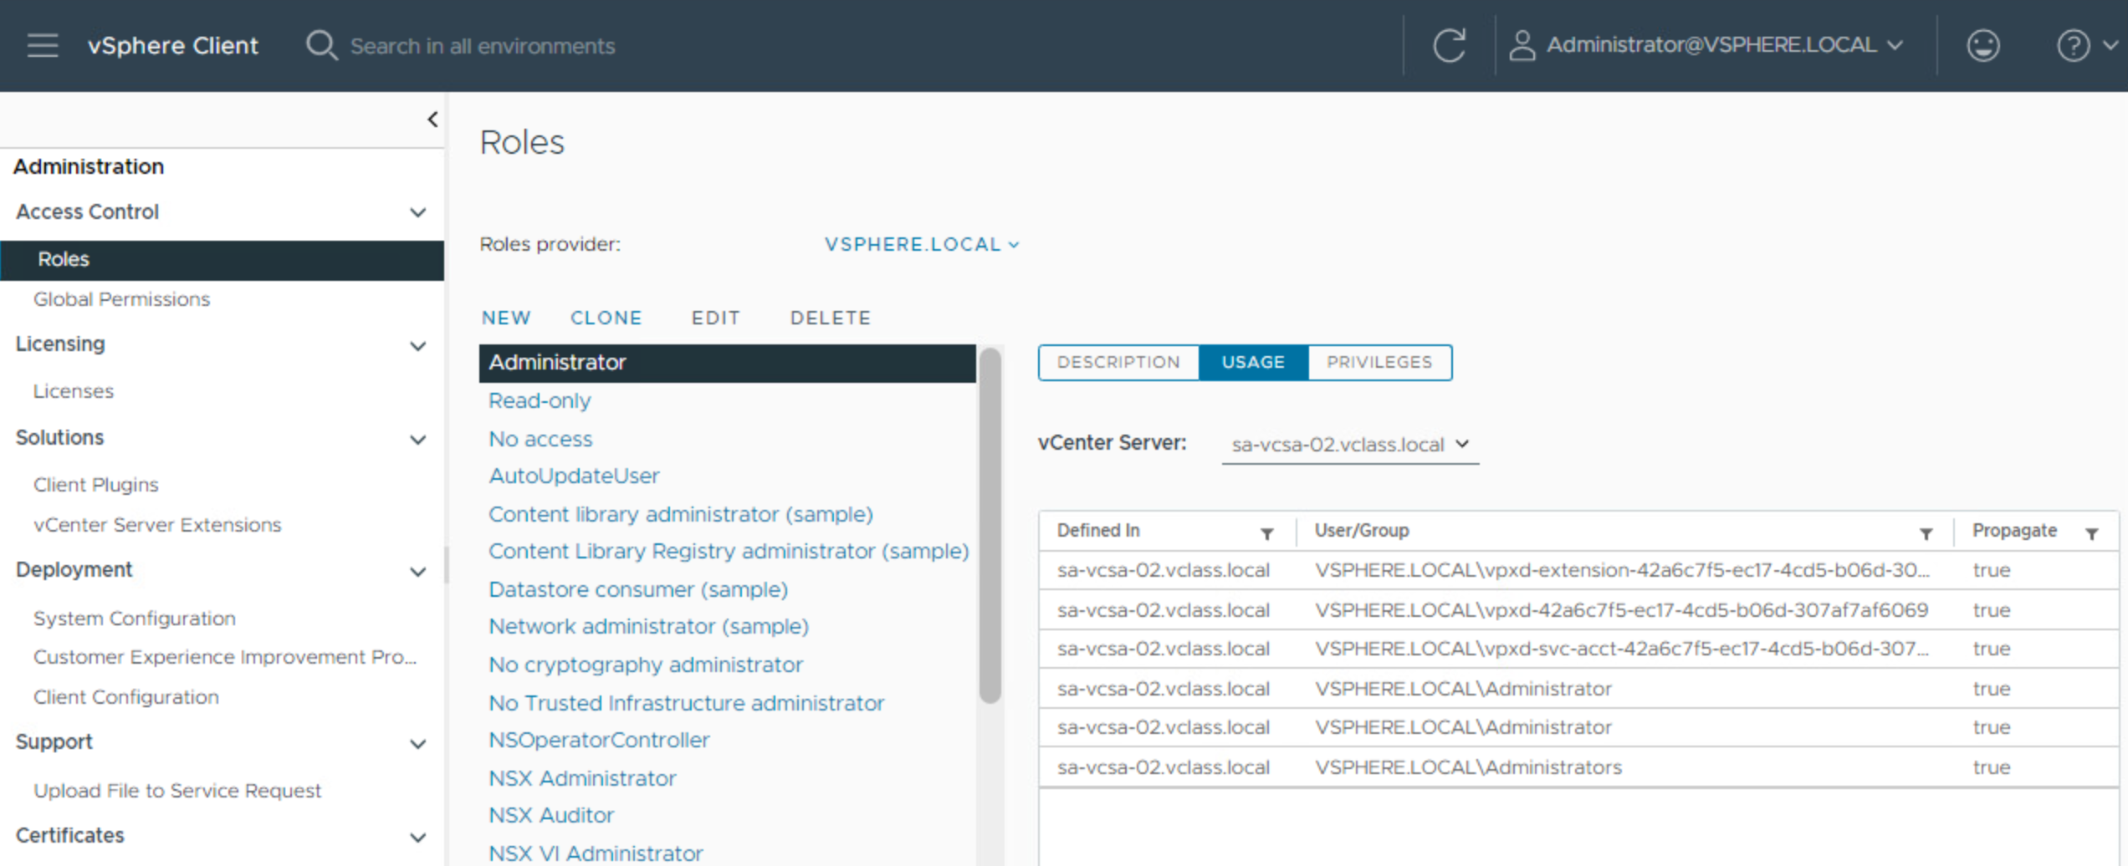
Viewing Roles and User Assignments
The Roles pane shows which users are assigned the selected role on a particular object.
Notes:
You can view all the objects to which a role is assigned and all the users or groups who are granted the role.
To view information about a role, click Usage in the Roles pane and select a role from the Roles list. The information provided to the right shows each object to which the role is assigned and the users and groups who were granted the role.

Slide 60
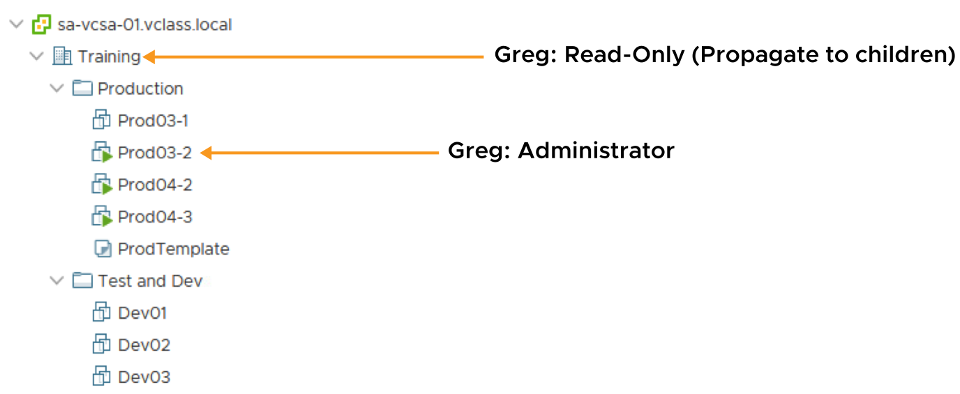
Applying Permissions: Scenario 1
A permission can propagate down the object hierarchy to all sub-objects, or a permission can apply only to a specific object.
Notes:
In addition to specifying whether permissions propagate downward, you can override permissions to set at a higher level by explicitly setting different permissions for a lower-level object.
On the slide, user “Greg,” is given Read-only access to the Training data center. This role is propagated to all child objects except one, the Prod03-2 VM. For this VM, Greg is an administrator.

Slide 61
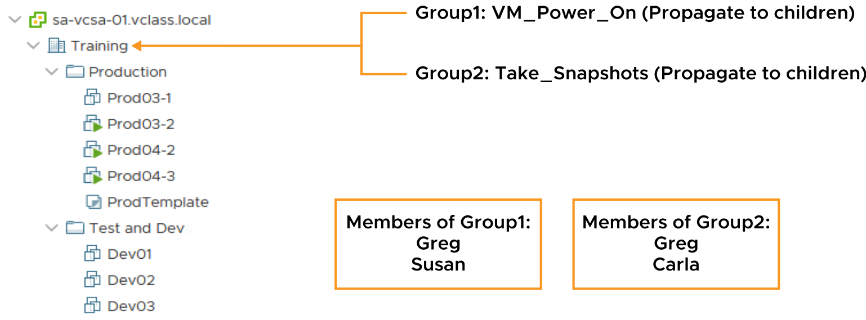
Applying Permissions: Scenario 2
When a user is a member of multiple groups with permissions on the same object, the user is assigned the union of privileges assigned to the groups for that object.
Notes:
On the slide, Group1 is assigned the VM_Power_On role, a custom role that contains only one privilege: the ability to power on a VM. Group2 is assigned the Take_Snapshots role, another custom role that contains the privileges to create and remove snapshots. Both roles propagate to the child objects.
Because Greg belongs to both Group1 and Group2, he gets both VM_Power_On and Take_Snapshots privileges for all objects in the Training data center.

Slide 62
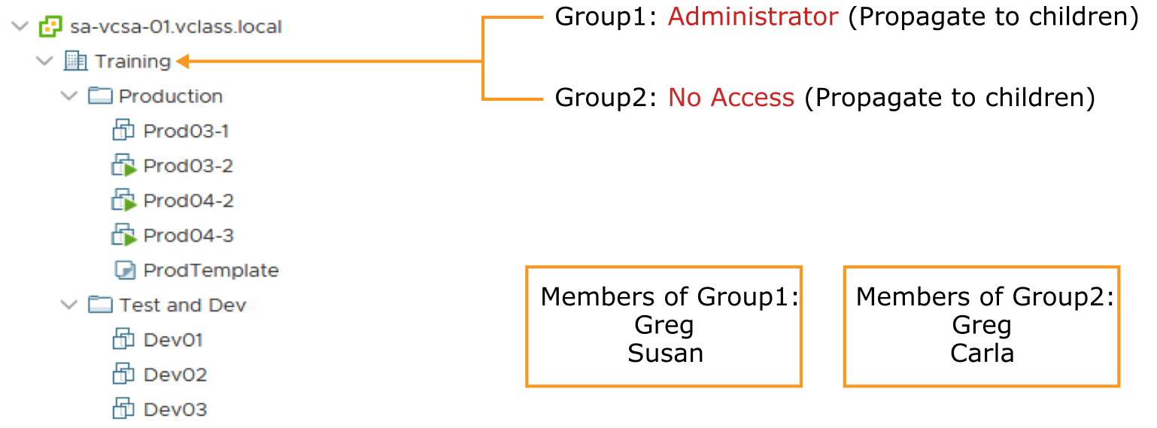
Activity: Applying Group Permissions (1)
If Group1 has the Administrator role and Group2 has the No Access role, what permissions does Greg have?

Slide 63
Activity: Applying Group Permissions (2)
Greg has Administrator privileges.
Greg is assigned the union of privileges assigned to Group1 and Group2.

Slide 64
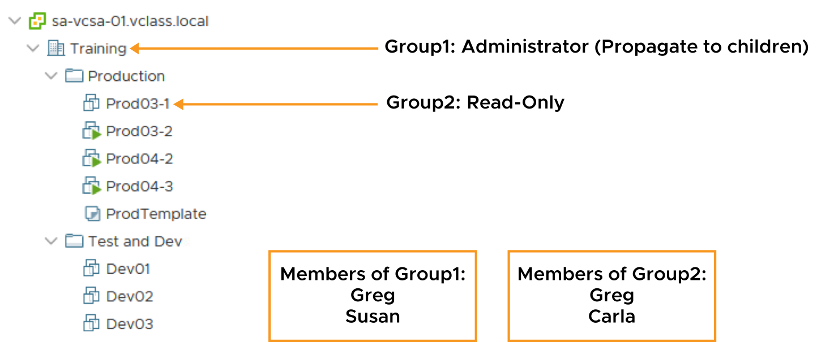
Applying Permissions: Scenario 3
A user can be a member of multiple groups with permissions on different objects. In this case, the same permissions apply for each object on which the group has permissions, as though the permissions were granted directly to the user.
Notes:
You can override permissions set for a higher-level object by explicitly setting different permissions for a lower-level object.
On the slide, Group1 is assigned the Administrator role at the Training data center and Group2 is assigned the Read-only role on the VM object, Prod03-1. The permission granted to Group1 is propagated to child objects.
Because Greg is a member of both Group1 and Group2, he gets administrator privileges on the entire Training data center (the higher-level object), except for the VM called Prod03-1 (the lower-level object). For this VM, Greg gets read-only access.

Slide 65
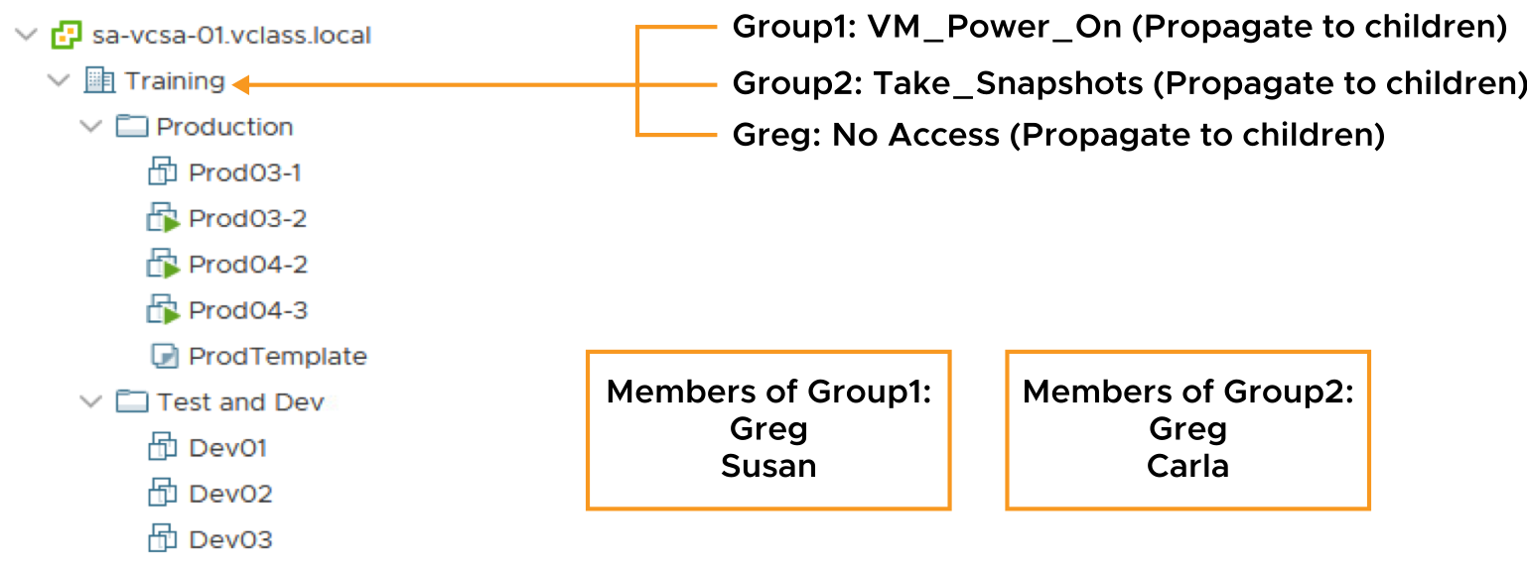
Applying Permissions: Scenario 4
A user (or group) is given only one role for any given object.
Permissions defined explicitly for the user on an object take precedence over all group permissions on that same object.
Notes:
On the slide, three permissions are assigned to the Training data center:
Group1 is assigned the VM_Power_On role.
Group2 is assigned the Take_Snapshots role.
Greg is assigned the No Access role.
Greg is a member of both Group1 and Group2. Assume that propagation to child objects is selected on all roles. Although Greg is a member of both Group1 and Group2, Greg gets the No Access privilege to the Training data center and all objects under it. Greg gets the No Access privilege because explicit user permissions on an object take precedence over all group permissions on that same object.

Slide 66
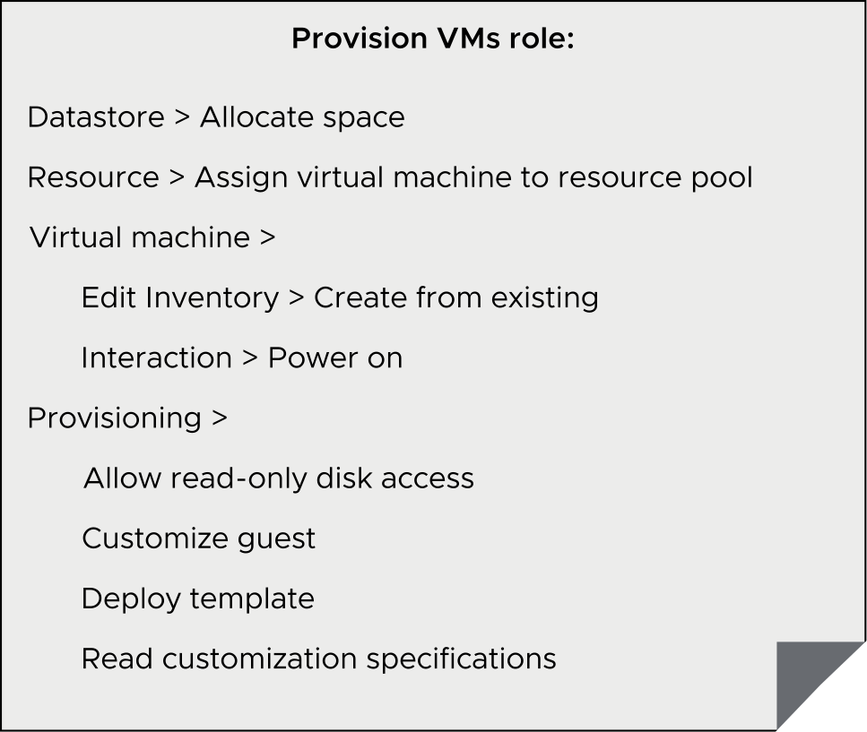
Creating a Role
Create roles with only the necessary privileges.
For example, you can create a Provision VMs role that allows a user to deploy VMs from a template.
Use folders to contain the scope of permissions. For instance, you can assign the Provision VMs role to user nancy@company.com and apply it to the Production VMs folder.
Notes:
The Provision VMs role is one of many examples of roles that you can create. Define a role using the smallest number of privileges possible to maximize security and control over your environment. Give the roles names that explicitly indicate what each role allows, to make its purpose clear.

Slide 67
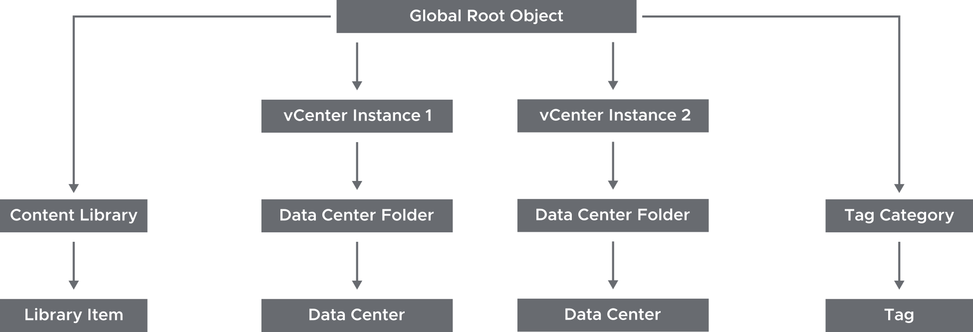
About Global Permissions
Global permissions support assigning privileges across solutions from the global root object:
Span solutions, such as vRealize Orchestrator, and multiple vCenter instances
Give a user or group privileges for all objects in all vCenter hierarchies
Notes:
Often, you apply a permission to a vCenter inventory object, such as an ESXi host or a VM. When you apply a permission, you specify that a user or group has a set of privileges, called a role, on the object. Global permissions give a user or group privileges to view or manage all objects in each of the inventory hierarchies in your deployment. The example shows that the global root object has permissions over all vCenter objects, including content libraries, vCenter instances, and tags. Global permissions allow access across vCenter instances. vCenter permissions, however, Global permissions are effective only on objects in a particular vCenter instance.

Slide 68
Lab 3: Adding an Identity Source
Add vclass.local as an LDAP identity source:
Add vclass.local as an LDAP Identity Source

Slide 69
Lab 4: Users, Groups, and Permissions
Assign roles and permissions so that an LDAP user can perform functions in vCenter:
View LDAP Users
Assign Root-Level Global Permission to an LDAP User
Assign Object Permission to an LDAP User
Verify that the cladmin User Can Access Content Library
Verify that the studentadmin User Can Create a Virtual Machine

Slide 70
Review of Learner Objectives
Define the term permission in the context of vCenter
Recognize the rules for applying permissions
Create a custom role
Assign global permission to a user

Slide 71
Monitoring vSphere Events

Slide 72
Learner Objectives
Monitor tasks and events that occur on objects in the vCenter inventory
Recognize the vCenter log levels for controlling the amount of data collected in the vCenter database

Slide 73
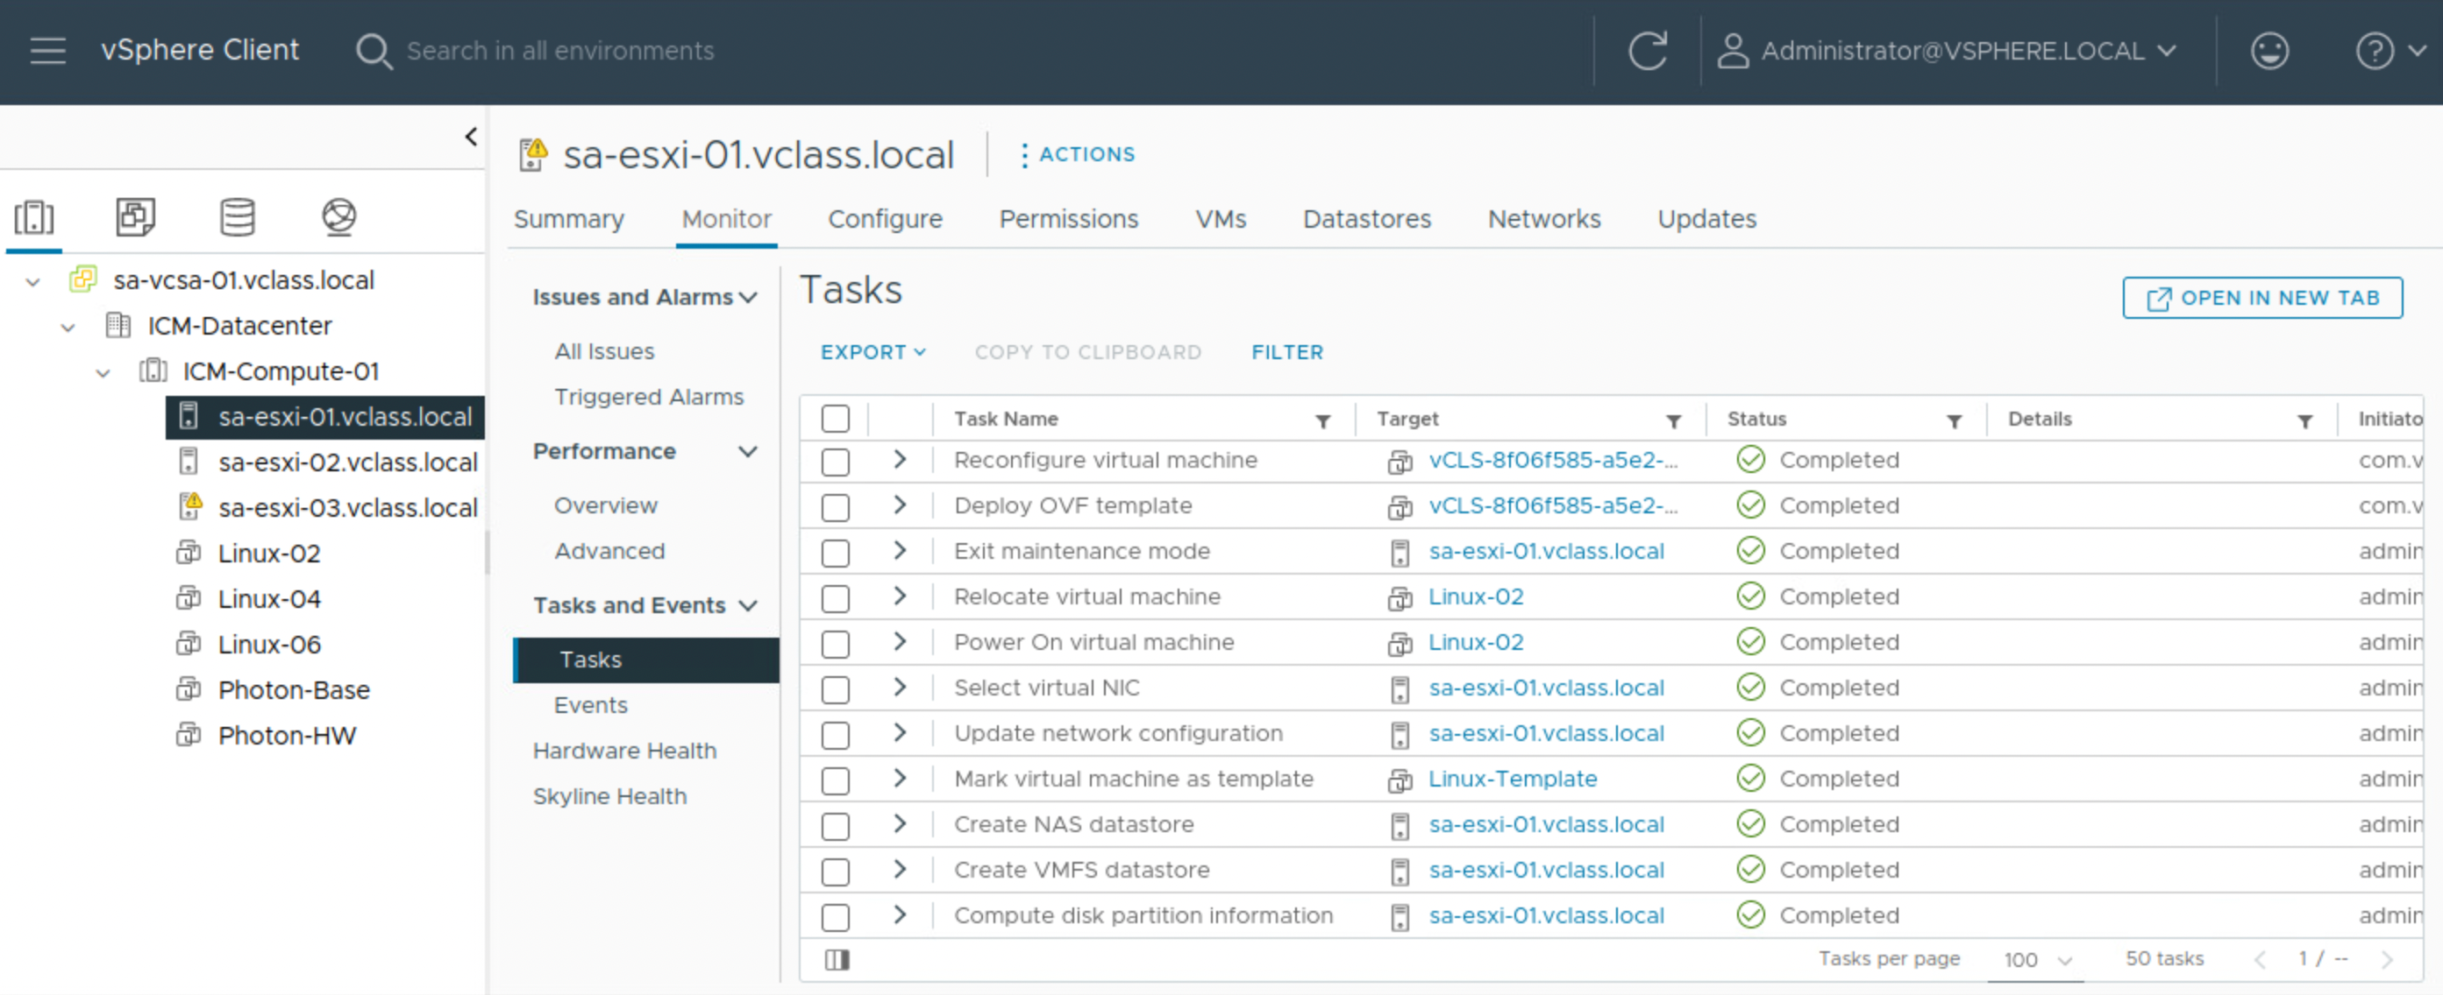
About vSphere Tasks
Every action that you perform in vSphere as a part of your day-to-day operations is called a task, for example:
Powering on a virtual machine
Updating the network configuration
Modifying the configuration of hosts and virtual machines
Notes:
As an administrator, you can monitor who performs tasks in the vSphere Client. Task information is useful when you troubleshoot problems because the tasks list shows the actions performed in the vSphere environment.

Slide 74
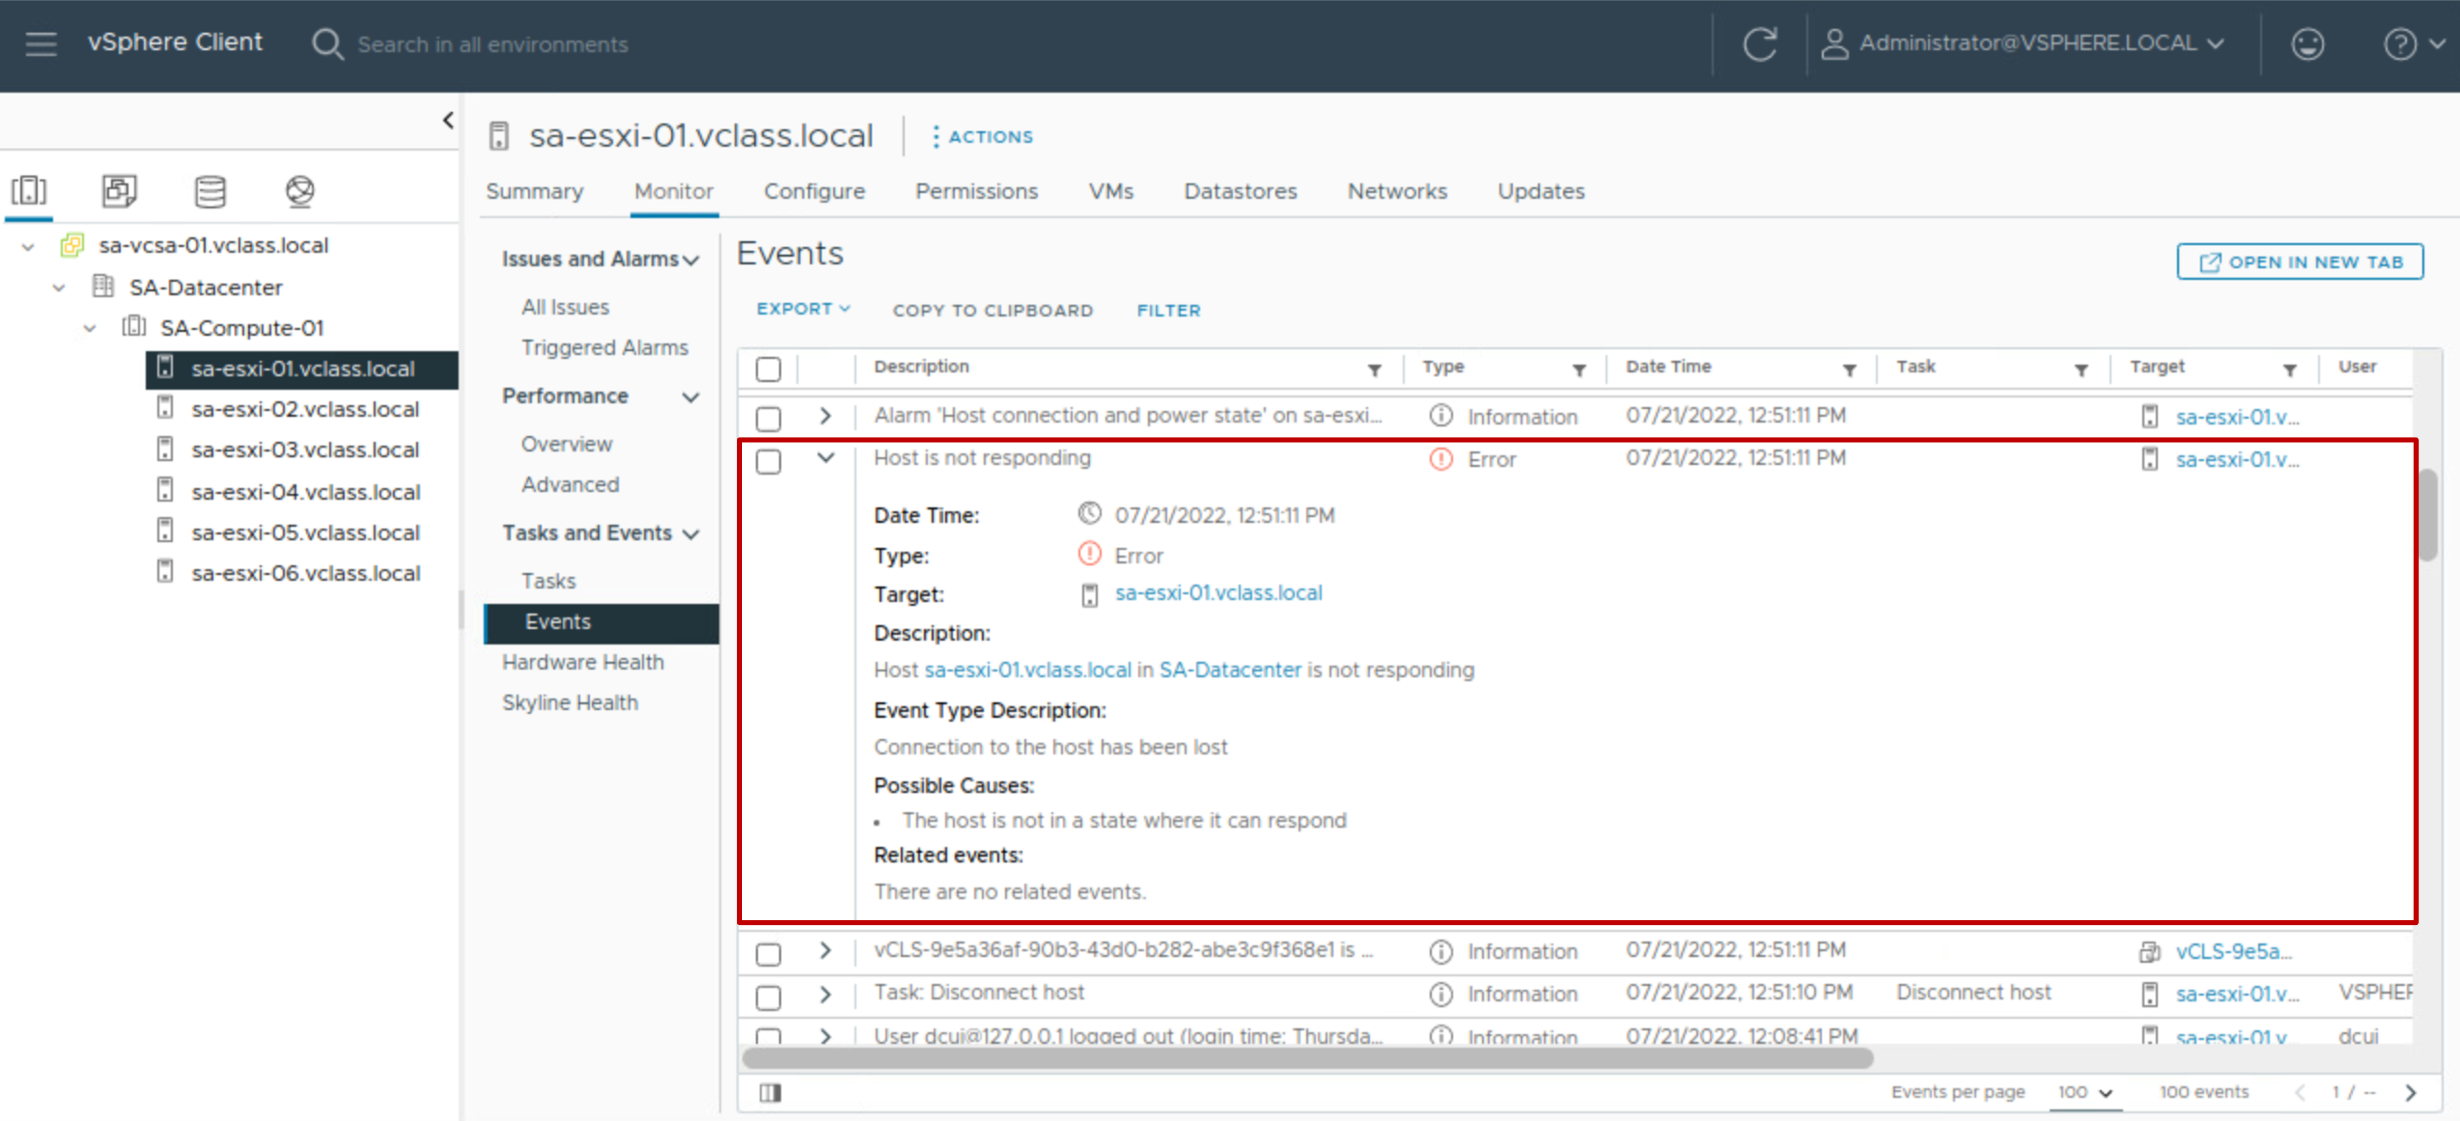
About vSphere Events
vSphere events are records of user actions or system actions that occur on objects in the vCenter inventory:
User-action information includes the user’s account and specific event details.
Event details are reported, such as the event's date and time, type, description, and the object on which the event occurred.
Events and alarms are displayed to alert the user to changes in the vCenter service health or when a service fails.
The vCenter Tasks and Events panes provide an audit trail, maintaining a 30-day history, by default.
Notes:
Actions that might be recorded as events include, but are not limited to, the following examples:
A license key expires.
A virtual machine is powered on.
A user logs in to a virtual machine.
A host connection is lost.

Slide 75
About vCenter Log Levels
vCenter services create their own log files, which can be used for troubleshooting purposes.
You can set log levels to control the quantity and type of information stored by vCenter.
Examples of when to set log levels:
When troubleshooting complex issues, set the log level to verbose or trivia.
For controlling the amount of information being stored in the log files.
Option | Description
None | Turns off logging
Error (errors only) | Displays only error log entries
Warning (errors and warnings) | Displays warning and error log entries
Info (normal logging) | Displays information, error, and warning log entries
Verbose | Displays information, error, warning, and verbose log entries
Trivia (extended verbose) | Displays information, error, warning, verbose, and trivia log entries
Notes:
Changes to the logging settings take effect immediately. You do not have to restart the vCenter system.
When you set the log level to verbose or trivia to troubleshoot problems, always remember to set the log level back to info (normal logging) when you are done.

Slide 76
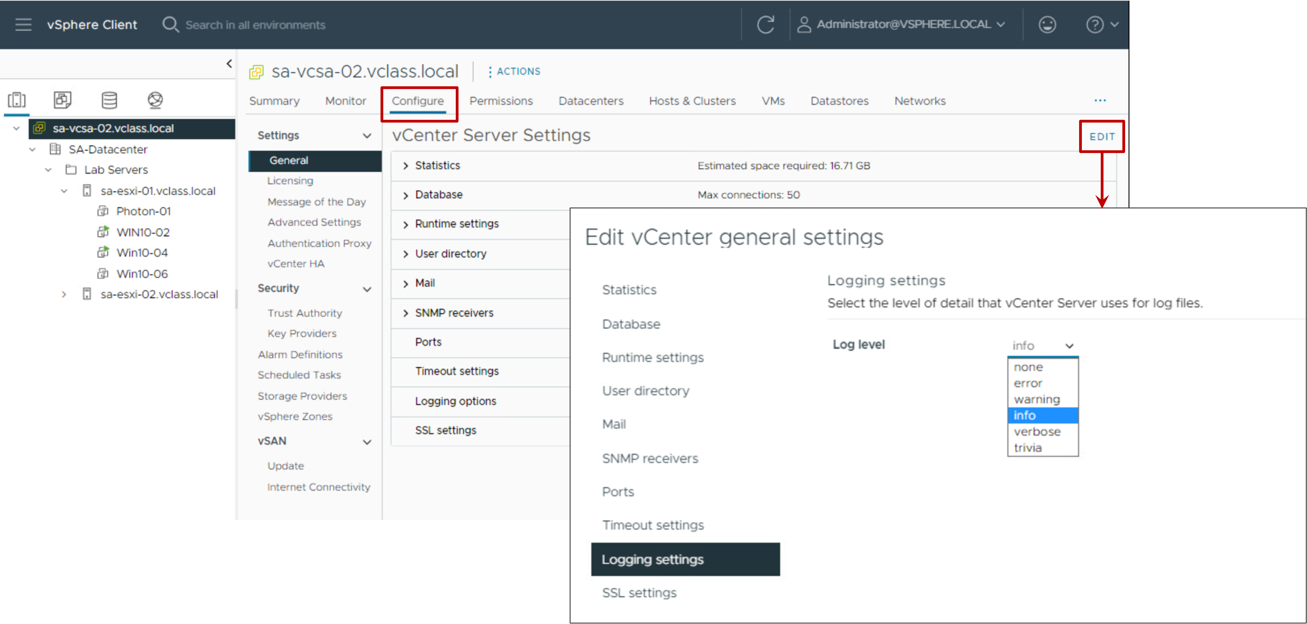
Setting Log Levels
You can configure the amount of log information detail that vCenter collects in log files:
Edit the log levels in the vSphere Client.
More verbose logging requires more space on your vCenter system.
Notes:
To configure logging levels, follow these steps:
In the vSphere Client, select the vCenter instance in the navigation pane
Click the Configure tab
Under Settings, select General
Click EDIT
Select Logging settings in the left pane
Select an option from the Log level drop-down menu

Slide 77
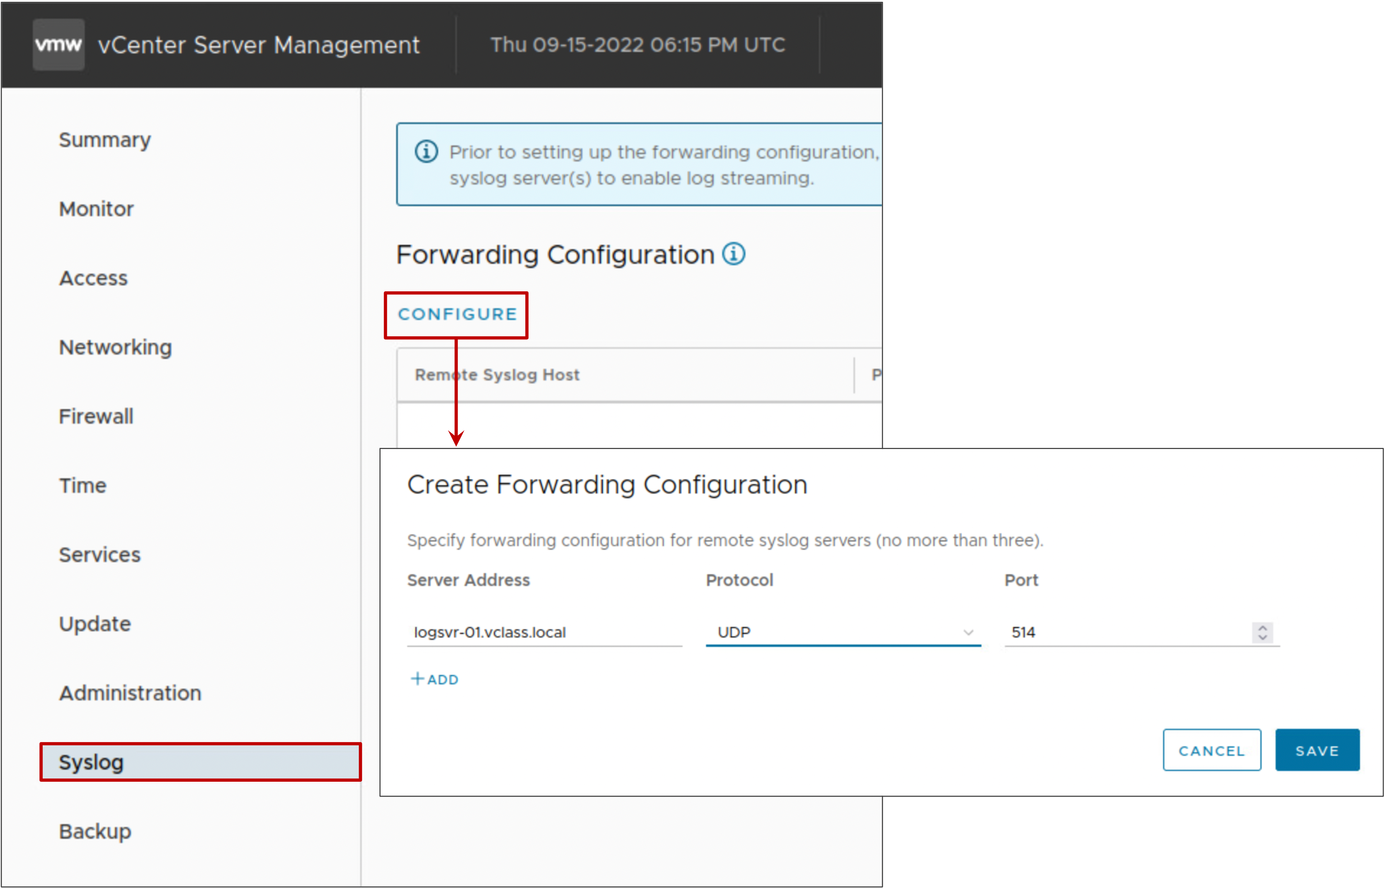
Forwarding vCenter Log Files to a Remote Host
vCenter can stream its log information to a remote Syslog server.
You can activate this feature in the vCenter Management Interface.

Slide 78
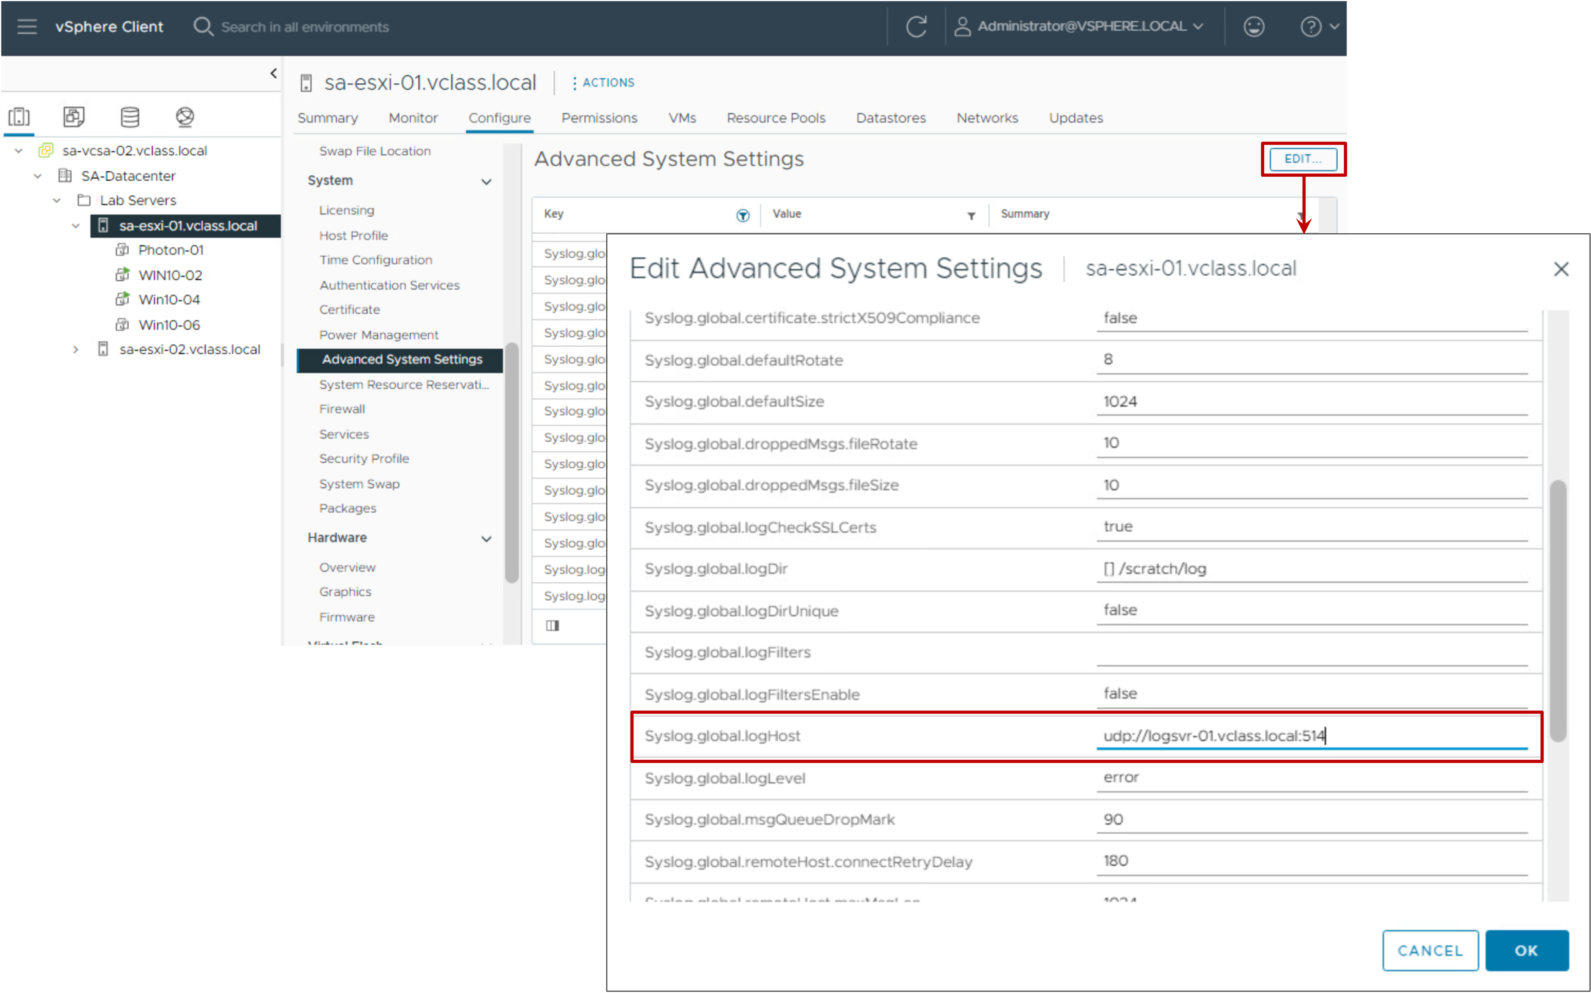
Forwarding ESXi Host Log Files to a Remote Host
For ESXi hosts, specify the remote Syslog server name in the Advanced System Settings pane in the vSphere Client.
You can further analyze ESXi host log files with log analysis products, such as vRealize Log Insight.

Slide 79
Review of Learner Objectives
Monitor tasks and events that occur on objects in the vCenter inventory
Recognize the vCenter log levels for controlling the amount of data collected in the vCenter database

Slide 80
Key Points
vCenter Server Appliance uses the Photon operating system and the PostgreSQL database.
You can use the vCenter Management Interface to manage vCenter, including vCenter networking and vCenter services.
You use the vSphere Client to connect to vCenter instances and manage vCenter inventory objects.
A permission, defined in vCenter, gives one user or group a role (set of privileges) for a selected object.
Global permission allows access to all vCenter objects, including content libraries, vCenter instances, and tags.
You can control the vCenter logging level. Changing the logging level affects the vCenter's filesystem usage.
Questions?

