Slide 1
Deploying Virtual Machines

Slide 2
Importance
Virtual machines are the foundation of your virtual infrastructure. Deploying VMs effectively involves recognizing the different types of virtual hardware. It also requires skills in creating, cloning and managing VMs and templates, modifying VMs, and updating templates.

Slide 3
Module Lessons
Creating Virtual Machines
Virtual Machine Hardware Deep Dive
Modifying Virtual Machines
Creating Templates and Cloning VMs
Introduction to Content Libraries
Subscribing to Content Libraries
Managing Templates in a Content Library

Slide 4

Creating Virtual Machines

Slide 5
Learner Objectives
Create and provision a virtual machine
Explain the importance of VMware Tools
Install VMware Tools
Remove a virtual machine

Slide 6
About Provisioning Virtual Machines
You can create VMs in several ways.
Provisioning Method | Use vSphere Client | Use VMware Host Client
Use the New Virtual Machine wizard. | Yes | Yes
Deploy VMs from existing templates or clones. | Yes | No
Deploy VMs from OVF templates. | Yes | Yes
Notes:
The optimal method for provisioning VMs for your environment depends on factors such as the size and type of your infrastructure and the goals that you want to achieve.
You can use the New Virtual Machine wizard to create a single VM if no other VMs in your environment meet your requirements, such as a particular operating system or hardware configuration. For example, you might need a VM that is configured only for testing purposes. You can also create a single VM, install an operating system on it, and use that VM as a template from which to clone other VMs.
Deploy VMs, virtual appliances, and vApps stored in Open Virtual Machine Format (OVF) to use a preconfigured VM. A virtual appliance is a VM that typically has an operating system and other software preinstalled. You can deploy VMs from OVF templates that are on local file systems (for example, local disks such as C:), removable media (for example, CDs or USB keychain drives), shared network drives, or URLs.
In addition to using the vSphere Client, you can also use VMware Host Client to create a VM by using OVF files. However, several limitations apply when you use VMware Host Client for this deployment method. For information about OVF and OVA limitations for the VMware Host Client, see vSphere Single Host Management - VMware Host Client at https://docs.vmware.com/en/VMware-vSphere/index.html.

Slide 7
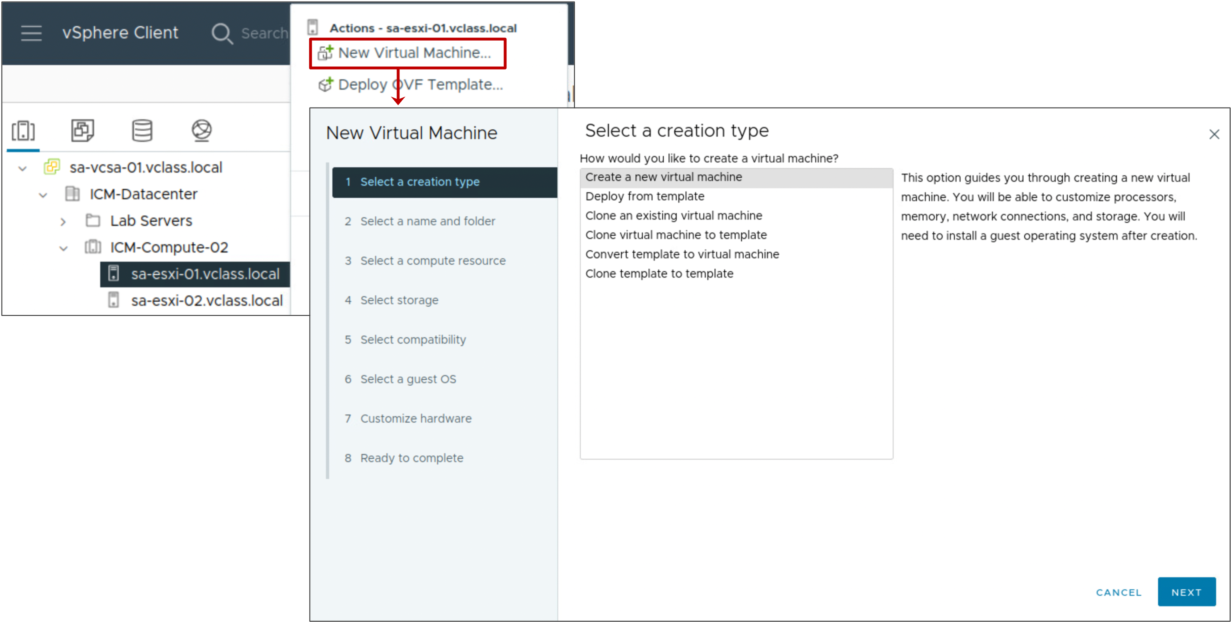
Creating VMs with the New Virtual Machine Wizard
In the vSphere Client, you can use the New Virtual Machine wizard to create a VM.

Slide 8
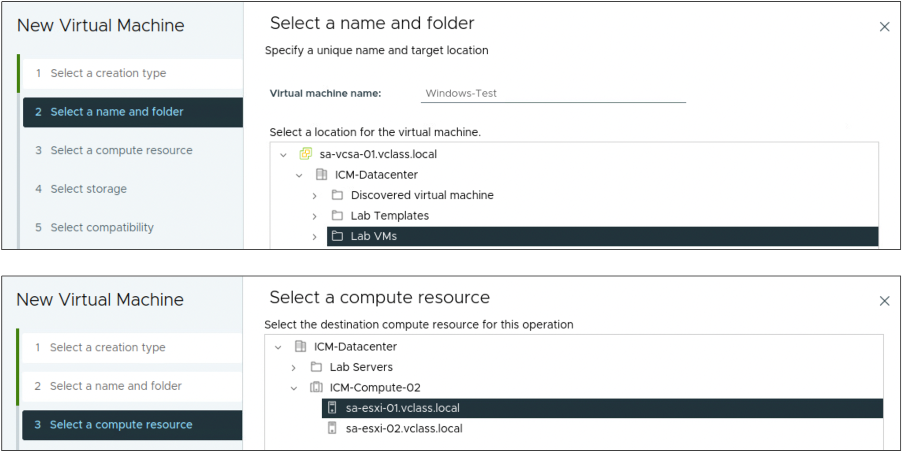
New Virtual Machine Wizard: Name, Folder, Compute Resource
You can use the New Virtual Machine wizard in the vSphere Client to create a VM.
The New Virtual Machine wizard prompts you for standard information:
The VM name
Folder in which to place the VM
Resource on which the VM runs
Notes:
When specifying the compute resource, you can specify a host, a cluster, a vApp, or a resource pool. The VM can access the resources of the selected object.

Slide 9
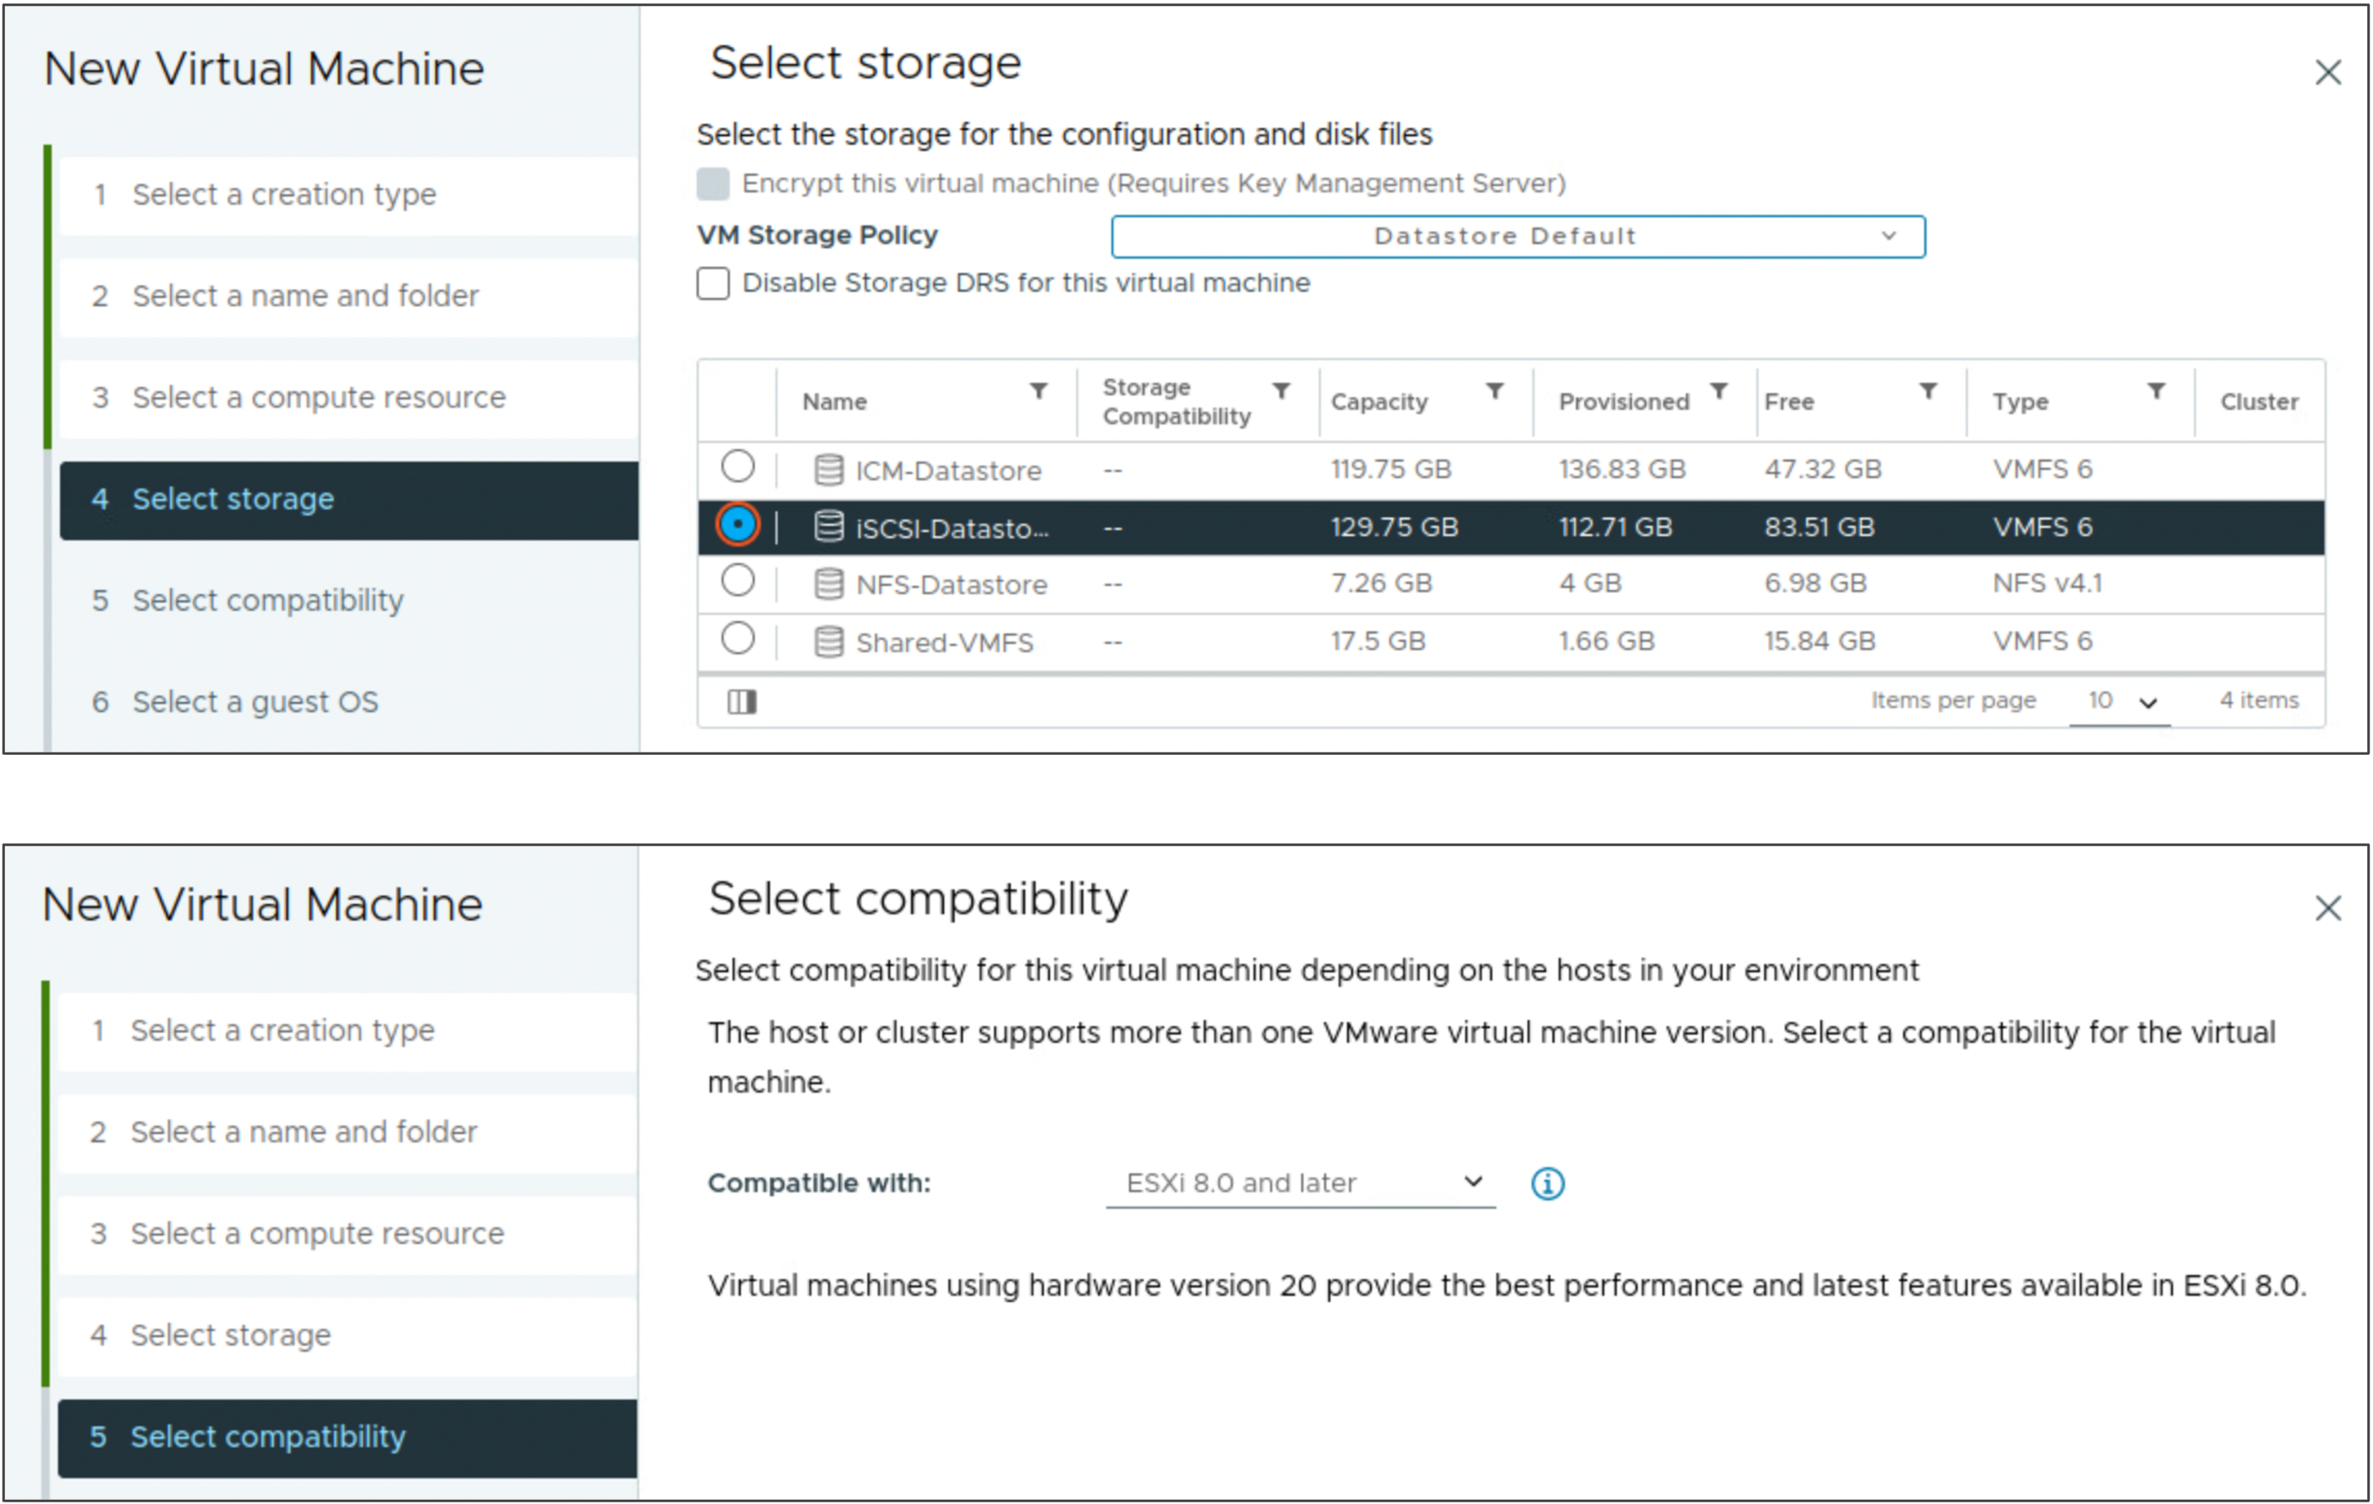
New Virtual Machine Wizard: Storage, Compatibility
You select the datastore on which to store the VM’s files.
You select the ESXi version that this virtual machine will be compatible with.
Notes:
When selecting storage, you can choose the storage policy and datastore. Each datastore might have a different size, speed, availability, and other properties. The available datastores are accessible from compute resource that you selected.
When selecting compatibility, you choose the ESXi host version that you want the virtual machine to be compatible with. To give your VM access to the latest hardware features, select the latest ESXi host version.

Slide 10
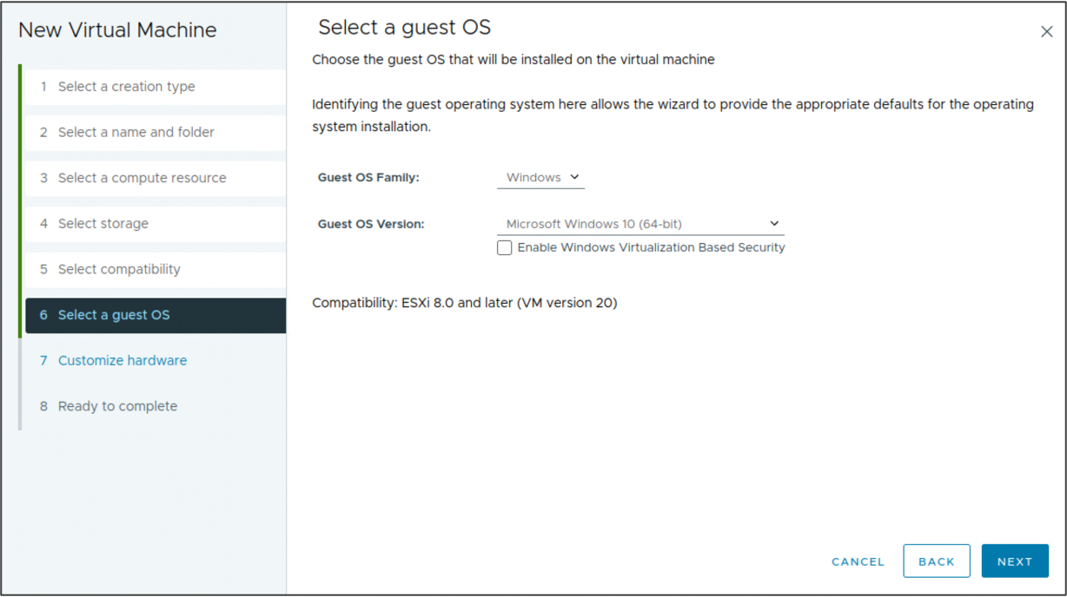
New Virtual Machine Wizard: Guest Operating System
You select the guest OS to be installed in the VM.
Notes:
When you select a guest operating system BIOS or EFI is selected by default, depending on the firmware supported by the operating system. If the operating system supports BIOS and EFI, you can change the default by editing the VM after you create it and before you install the guest operating system. If you select EFI, you cannot boot an operating system that supports only BIOS, and the reverse.

Slide 11
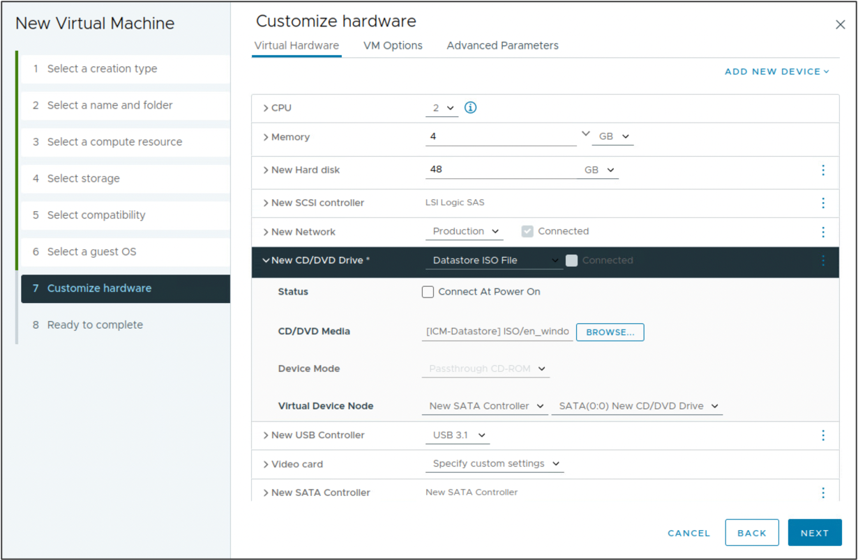
New Virtual Machine Wizard: Virtual Hardware
You can configure the virtual machine hardware. The default values for CPU, memory and hard disk size are based on the guest OS that you selected.
You can also mount the ISO image containing the guest operating system installation files.

Slide 12
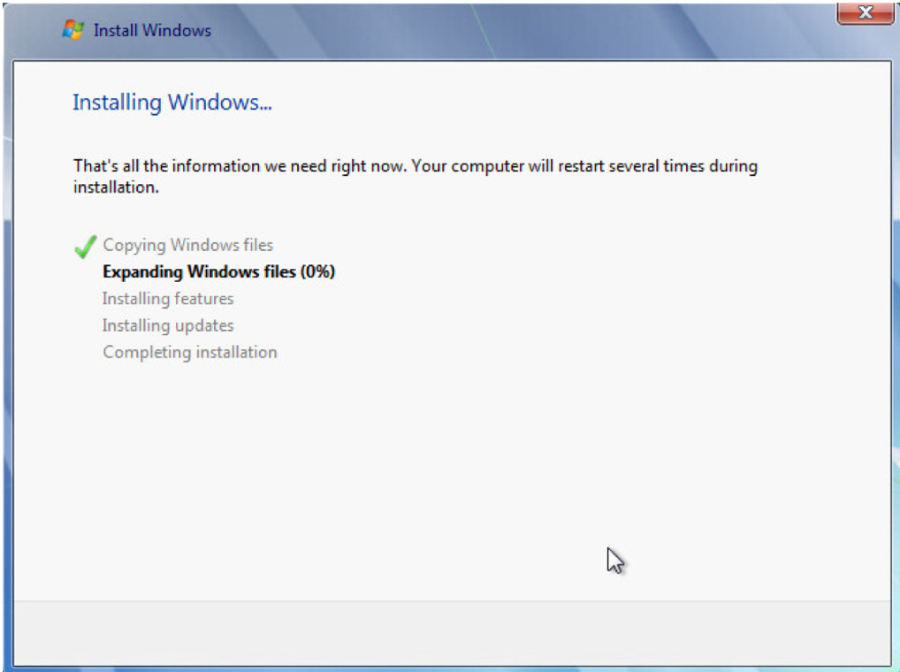
Installing the Guest Operating System
Installing a guest operating system in your VM is similar to installing it on a physical computer.
Notes:
To install the guest operating system, you interact with the VM through the VM console. Using the vSphere Client, you can attach a CD, DVD, or ISO image containing the installation image to the virtual CD/DVD drive.
On the slide, the Windows Server 2008 guest operating system is being installed. You can use the vSphere Client to install a guest operating system. You can also install a guest operating system from an ISO image or a CD. Installing from an ISO image is typically faster and more convenient than a CD installation.
For more information about installing guest operating systems, see vSphere Virtual Machine Administration at https://docs.vmware.com/en/VMware-vSphere/index.html.
For more about the supported guest operating systems, see VMware Compatibility Guide at https://www.vmware.com/resources/compatibility.

Slide 13
About VMware Tools
VMware Tools is a set of features that enhance the performance of a VM’s guest operating system.
Benefits and features include:
Device drivers
SVGA display
VMXNET/VMXNET3
Balloon driver for memory management
Sync driver for quiescing I/O
Paravirtual SCSI controller
Increased graphical performance
Improved mouse performance
Guest OS heartbeat service
Time synchronization
Ability to shut down the VM remotely
Notes:
VMware Tools improves management of the VM by replacing generic operating system drivers with VMware drivers tuned for virtual hardware. You install VMware Tools into the guest operating system. When you install VMware Tools, you install these items:
The VMware Tools service: This service synchronizes the time in the guest operating system with the time in the host operating system.
A set of VMware device drivers, with additional Perfmon monitoring options.
A set of scripts that helps you automate guest operating system operations: You can configure the scripts to run when the VM's power state changes.
VMware Tools enhances the performance of a VM and makes many of the ease-of-use features in VMware products possible:
Faster graphical performance
Shared folders between host and guest file systems
Copying and pasting text, graphics, and files between the virtual machine and the host or client desktop
Scripting that helps automate guest operating system operations
Although the guest operating system can run without VMware Tools, many VMware features are not available until you install VMware Tools. For example, if VMware Tools is not installed in your VM, you cannot use the shutdown or restart options from the toolbar. You can use only the power options.

Slide 14
Installing VMware Tools
Ensure that you select the latest version of VMware Tools for your guest operating system.
To find out which VMware Tools ISO images are bundled with vSphere 8, see the vSphere 8 Release Notes.
The method for installing VMware Tools depends on the guest operating system type.
Guest Operating System Type | VMware Tools Installation Method
Microsoft Windows | Install from windows.iso for Vista and later guests
Linux | Use one of the following methods: Install from linux.iso. For later Linux distributions, use open-vm-tools, available in various Linux package management systems, such as yum, apt, or rpm.
Notes:
For details on installing VMware Tools in a Windows or Linux guest operating system, more information about using Open VM tools, see VMware Tools Administration at https://docs.vmware.com/en/VMware-Tools/index.html.

Slide 15
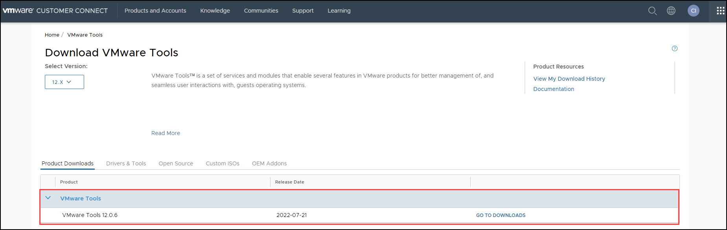
Downloading VMware Tools
You can download a specific version of VMware Tools from the VMware Tools product download page.
Notes:
For information about installing VMware Tools in specific guest operating systems, see VMware Tools Administration at https://docs.vmware.com/en/VMware-Tools/index.html.

Slide 16
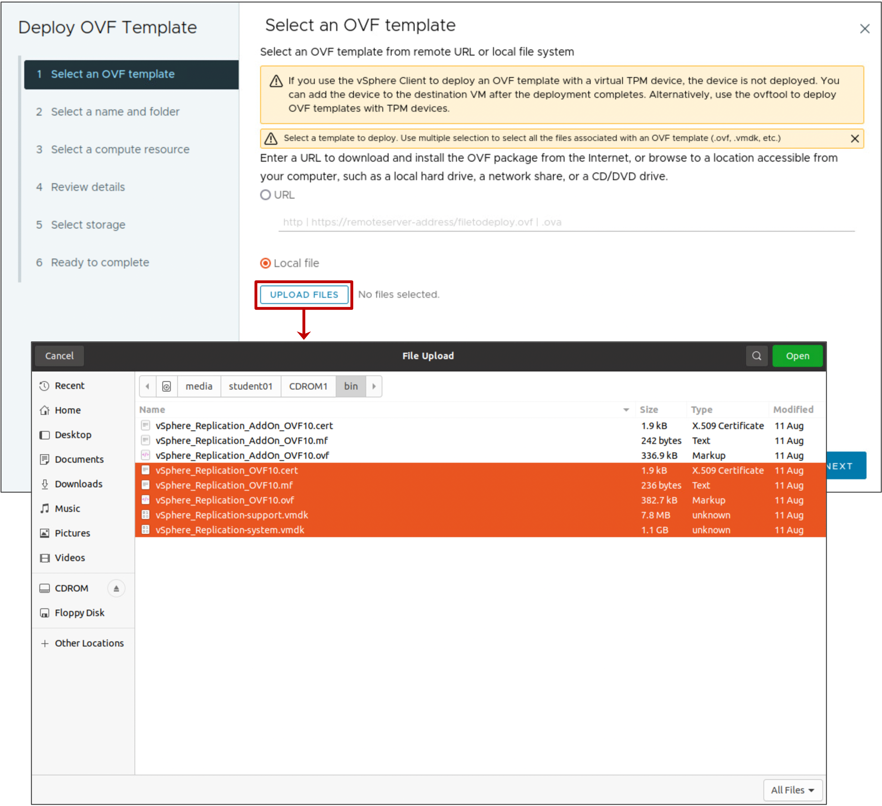
Deploying OVF Templates
You can deploy any VM or virtual appliance stored in OVF format.
Virtual appliances are preconfigured VMs:
They are usually designed for a single purpose.
They are also available from VMware Marketplace.
Notes:
A virtual appliance is a preconfigured VM that typically includes a preinstalled guest operating system and other software. A virtual appliance is usually designed for a specific purpose, for example, to provide a secure web browser, a firewall, or a backup and recovery utility.
A virtual appliance can be added or imported to your vCenter Server system inventory or ESXi inventory. Virtual appliances can be imported from websites such as the VMware Marketplace at https://marketplace.cloud.vmware.com.
Virtual appliances are deployed as OVF templates. OVF is a platform-independent, efficient, extensible, and open packaging and distribution format for VMs. OVF files are compressed, resulting in faster downloads.
To deploy an OVF template using the vSphere Client, right-click the appropriate object, such as a data center or an ESXi host, and select Deploy OVF Template. The Deploy OVF Template wizard appears. Click UPLOAD FILES to select the template files to deploy.
The vSphere Client validates an OVF file before importing it and ensures that it is compatible with the intended destination server. If the appliance is incompatible with the selected host, you cannot import it.

Slide 17
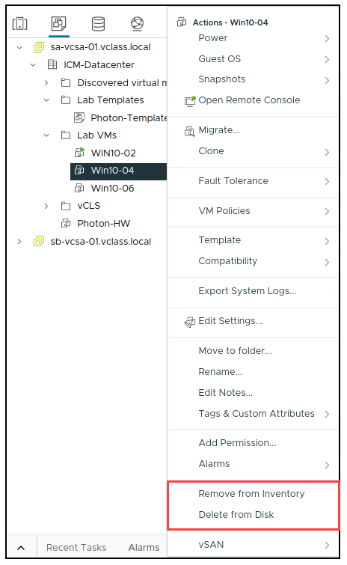
Removing VMs
You can remove a VM in the following ways:
Remove from the inventory:
The VM is unregistered from the ESXi host and vCenter.
The VM’s files remain on the disk.
The VM can later be registered (added) to the inventory.
Delete from disk:
All VM files are permanently deleted from the datastore.
The VM is unregistered from the ESXi host and vCenter.
Notes:
When a VM is removed from the inventory, its files remain at the same storage location, and the VM can be re-registered in the datastore browser.

Slide 18
Lab 1: Creating and Removing a Virtual Machine
Use the vSphere Client to create a VM, remove a VM from the inventory, and delete a VM from the datastore:
Create a Virtual Machine
Remove the Virtual Machine from the vCenter Inventory
Register the Virtual Machine to Re-Add it to the vCenter Inventory
Delete the Virtual Machine from the Datastore

Slide 19
Lab 2: (Simulation) Installing VMware Tools
Use the vSphere Client to install VMware Tools to an existing Windows VM:
Mount the VMware Tools Image to the VM's DVD Drive
Install VMware Tools with the VMware Tools Setup Wizard
Verify that VMware Tools Is Running in the Guest OS

Slide 20
Review of Learner Objectives
Create and provision a virtual machine
Explain the importance of VMware Tools
Install VMware Tools
Remove a virtual machine

Slide 21
Virtual Machine Hardware Deep Dive

Slide 22
Learner Objectives
Identify the files that make up a VM
Compare VM hardware versions
Recognize the virtual hardware components of a VM
Navigate the vSphere Client and examine VM settings
Identify methods for accessing a VM console

Slide 23
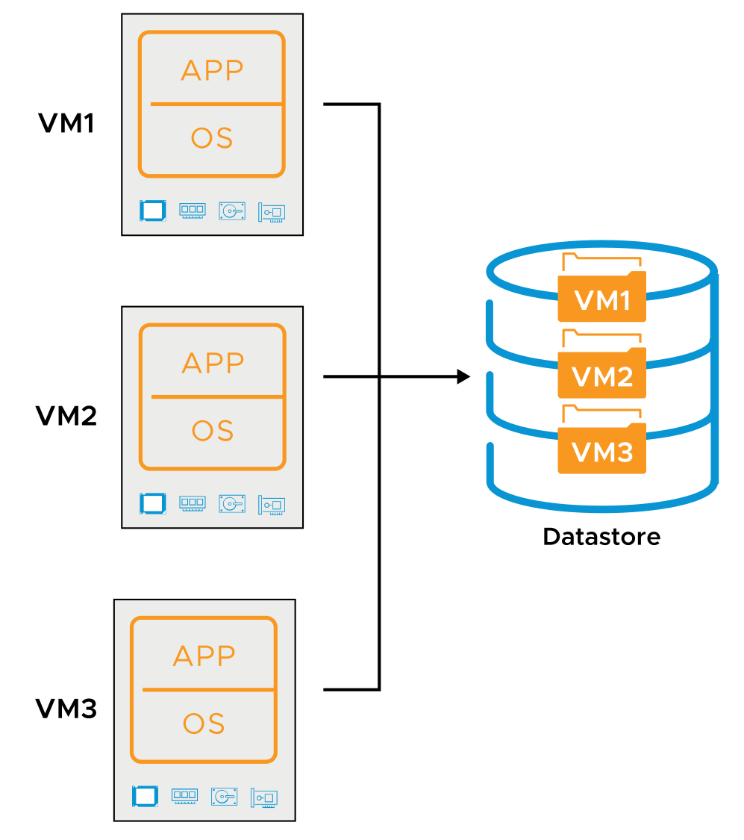
Virtual Machine Encapsulation
Each VM is stored either as a collection of files or objects:
Files in a directory on a VMFS or NFS datastore
Objects on a vSAN or vSphere Virtual Volumes datastore
Each virtual disk is encapsulated into a single file or object.
Notes:
vSphere encapsulates each VM into a few files or objects, making VMs easier to manage and migrate. The files and objects for each VM are stored in a separate folder on a datastore.

Slide 24
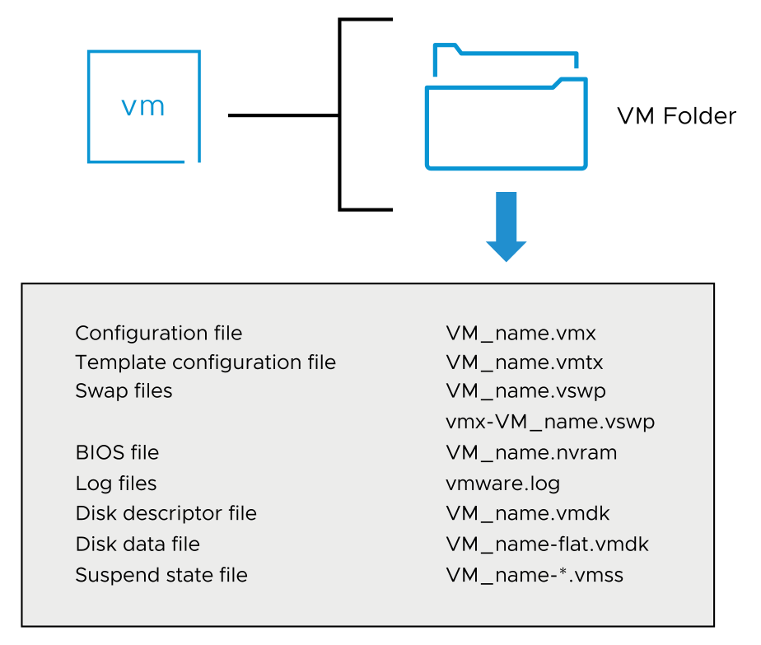
About Virtual Machine Files
A VM includes a set of related files.
Notes:
The slide lists some of the files that make up a VM. Except for the log files, the name of each file contains the VM's name <VM_name>. A VM consists of the following files:
A configuration file (.vmx).
If the VM is converted to a template, a VM template configuration file (.vmtx) replaces the VM configuration file (.vmx).
Swap files (.vswp) used to reclaim memory during periods of contention.
A file containing the VM's BIOS or EFI settings (.nvram).
A VM's current log file (.log) and a set of files used to archive old log entries (-#.log).
In addition to the current log file, vmware.log, up to six archive log files are maintained at one time. For example, -1.log to -6.log might exist at first. The next time an archive log file is created, for example, when the VM is powered off and powered back on, the following actions occur: The -6.log is deleted, the -5.log is recalled to -6.log, and so on. Finally, the previous vmware.log is recalled to the -1.log.
One or more virtual disk files. The first virtual disk has files VM_name.vmdk and VM_name-flat.vmdk.
If the VM has more than one disk file, the file pair for the subsequent disk files is called VM_name_#.vmdk and VM_name_#-flat.vmdk. # is the next number in the sequence, starting with 1. For example, if the VM called Test01 has two virtual disks, this VM has the Test01.vmdk, Test01-flat.vmdk, Test01_1.vmdk, and Test01_1-flat.vmdk files.
The list of files shown on the slide is not comprehensive. For a complete list of all the types of VM files, see vSphere Virtual Machine Administration at https://docs.vmware.com/8.0/TBD.

Slide 25
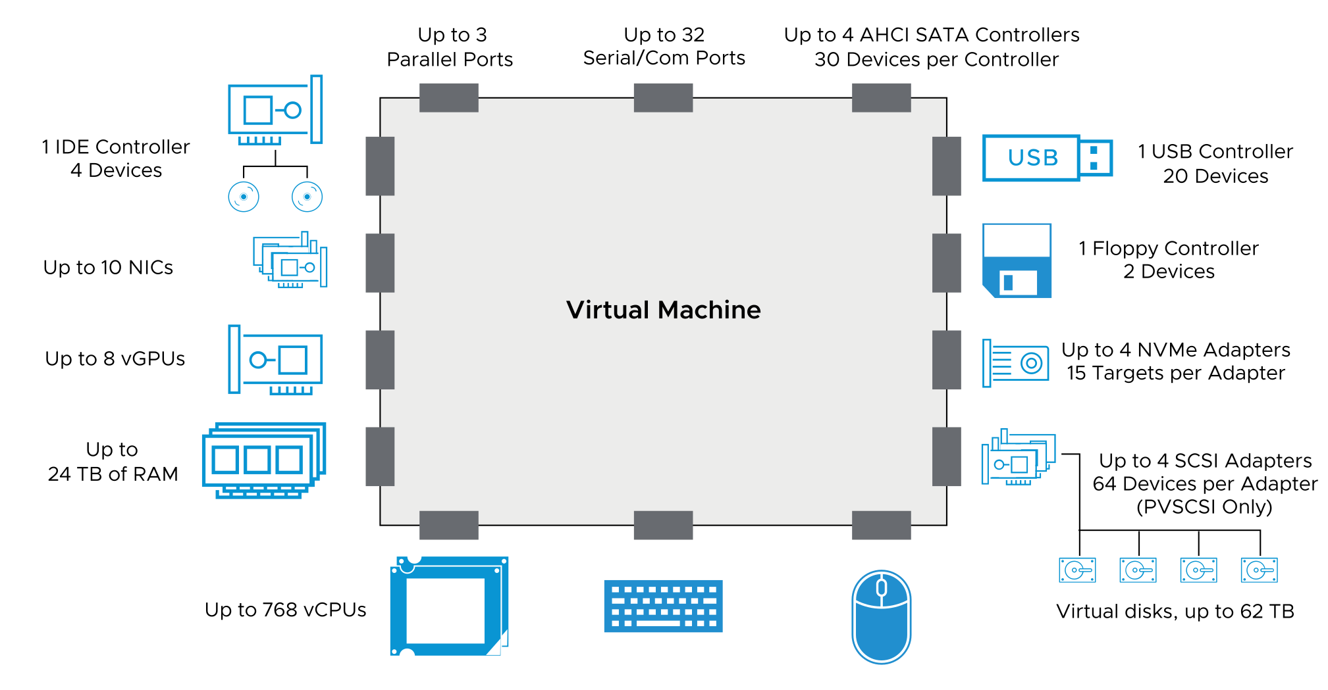
About VM Virtual Hardware
Notes:
A guest OS accesses hardware devices. The guest OS does not know that these devices are virtual, not physical. All VMs have uniform hardware, except for a few variations that the system administrator can apply. Uniform hardware makes VMs portable across VMware virtualization platforms.
You can configure the VM memory and CPU settings. vSphere supports several latest CPU features, including virtual CPU performance counters. You can add virtual hard disks and NICs. You can also add and configure virtual hardware, such as CD/DVD drives, and SCSI devices. Not all devices are available to add and configure. For example, you cannot add video devices, but you can configure the available video devices and video cards.
You can add multiple USB devices, such as security dongles and mass storage devices, to a VM that exists on an ESXi host to which the devices are physically attached. When you attach a USB device to a physical host, the device is available only to VMs that are located on that host. Those VMs cannot connect to a device on another host in the data center. A USB device is available to only one VM at a time. When you remove a USB device from a VM, it is available to the other VMs that are located on the host.
You can have 64 virtual SCSI targets for a virtual SCSI adapter if you use a PVSCSI driver. However, you can have only 15 virtual SCSI targets for a virtual SCSI adapter other than PVSCSI.
The SATA controller provides access to virtual disks, CD/DVD devices, and USB devices. The SATA virtual controller is presented to a virtual machine as an AHCI SATA controller.
The Virtual Machine Communication Interface (VMCI) is an infrastructure that provides a high-speed communication channel between a VM and the hypervisor. You cannot add or remove VMCI devices.
The VMCI SDK facilitates the development of applications that use the VMCI infrastructure. Without VMCI, VMs communicate with the host using the network layer. Using the network layer adds overhead to the communication. With VMCI, communication overhead is minimal and tasks that require communication can be optimized.
The following types of communication are available:
Datagrams: Connectionless and similar to UDP queue pairs
Connection oriented: Similar to TCP
VMCI provides socket APIs that are similar to APIs that are used for TCP/UDP applications. IP addresses are replaced with VMCI ID numbers. For example, you can port netperf to use VMCI sockets instead of TCP/UDP. VMCI is deactivated by default.
For more information about virtual hardware, see vSphere Virtual Machine Administration at https://docs.vmware.com/en/VMware-vSphere/index.html.
For a complete list of virtual machine configuration maximums, see VMware Configuration Maximums at https://configmax.vmware.com.

Slide 26
Virtual Hardware Versions
The virtual hardware version, or VM compatibility level, determines the operating system functions that a VM supports.
Do not use a later version that is not supported by the VMware product.
Compatibility | Virtual Hardware Version
ESXi 8.0 | 20
ESXi 7.0 U2 and later | 19
ESXi 7.0 U1 and later | 18
ESXi 7.0 and later | 17
ESXi 6.7 U2 and later | 15
ESXi 6.7 and later | 14
Virtual hardware version 16 is specific to Workstation and Fusion Pro.
Notes:
Each release of a VMware product has a corresponding VM hardware version included. The table shows the latest hardware version that each ESXi version supports. Each VM compatibility level supports at least five major or minor vSphere releases.
For more information on virtual machine compatibility, see vSphere Virtual Machine Administration at https://docs.vmware.com/en/VMware-vSphere/index.html.
For a complete list of virtual machine hardware versions, see Virtual machine hardware versions KB article at https://kb.vmware.com/s/article/1003746.

Slide 27
About CPU and Memory
You can add, change, or configure CPU and memory resources to improve VM performance.
The maximum number of virtual CPUs (vCPUs) that you can assign to a VM depends on the following factors:
The number of logical CPUs on the host
The type and version of installed guest operating system
A VM running on an ESXi 8.0 host can have up to 768 vCPUs.
The maximum memory size of a VM depends on the VM’s compatibility setting.
The maximum memory size of a VM with ESXi 8.0 compatibility running on ESXi 8.0 is 24 TB.
Notes:
You size the VM's CPU and memory according to the applications and the guest operating system.
You can use the multicore vCPU feature to control the number of cores per virtual socket in a VM. With this capability, operating systems with socket restrictions can use more of the host CPU’s cores, increasing overall performance.
A VM cannot have more virtual CPUs than the number of logical CPUs on the host. The number of logical CPUs is the number of physical processor cores, or twice that number if hyperthreading is activated. For example, if a host has 128 logical CPUs, you can configure the VM for 128 vCPUs.
You can set most of the memory parameters during VM creation or after the guest operating system is installed. Some actions require that you power off the VM before changing the settings. The memory resource settings for a VM determine how much of the host’s memory is allocated to the VM. The virtual hardware memory size determines how much memory is available to applications that run in the VM. A VM cannot benefit from more memory resources than its configured virtual hardware memory size. You can reconfigure the amount of memory allocated to a VM to enhance performance. Maximum memory size for a VM depends on the VM’s compatibility setting.

Slide 28
Compute Maximums
vSphere provides compute maximums, which are available at https://configmax.vmware.com.
 | vSphere 8
Virtual CPUs per VM | 768
Memory per VM | 24 TB
CPUs per host | 896
Memory per host | 24 TB
Hosts per cluster | 96
Notes:
For all configuration maximums, see https://configmax.vmware.com/

Slide 29
About Virtual Storage
Virtual disks are connected to virtual storage adapters.
The ESXi host offers VMs several choices in storage adapters:
BusLogic Parallel
LSI Logic Parallel
LSI Logic SAS
VMware Paravirtual SCSI
AHCI SATA controller
Virtual NVMe
Notes:
Storage adapters provide connectivity for your ESXi host to a specific storage unit or network.
ESXi supports different classes of adapters, including SCSI, iSCSI, RAID, Fibre Channel, Fibre Channel over Ethernet (FCoE), and Ethernet. ESXi accesses the adapters directly through device drivers in the VMkernel:
BusLogic Parallel: The Mylex (BusLogic) BT/KT-958 compatible host bus adapter.
LSI Logic Parallel: The LSI Logic LSI53C10xx Ultra320 SCSI I/O controller is supported.
LSI Logic SAS: The LSI Logic SAS adapter has a serial interface.
VMware Paravirtual SCSI: A high-performance storage adapter that can provide greater throughput and lower CPU use.
AHCI SATA controller: Provides access to virtual disks and CD/DVD devices. The SATA virtual controller appears to a VM as an AHCI SATA controller.
Virtual NVMe: NVMe is a protocol for attaching and accessing flash storage devices to the PCI Express bus. NVMe is an alternative to existing block-based server storage I/O access protocols.

Slide 30
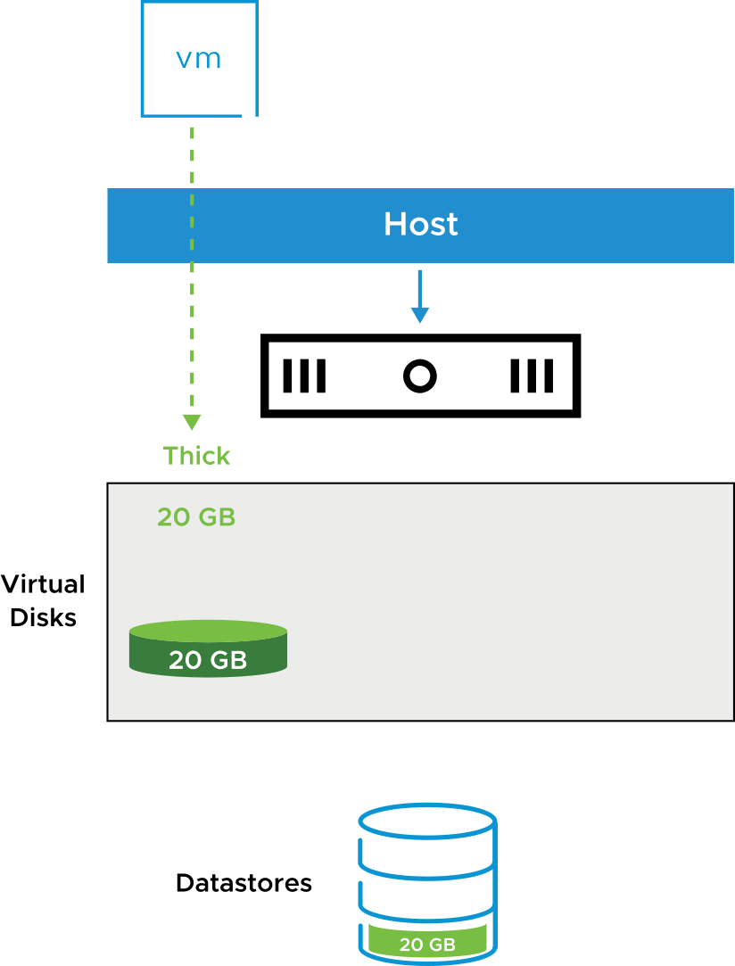
About Thick-Provisioned Virtual Disks
Thick provisioning uses all the defined disk space at the creation of the virtual disk, regardless of how much disk space is actually used by the guest operating system file system.
Thick-provisioned disk types are either eager zeroed or lazy zeroed:
In an eager-zeroed thick-provisioned disk, every block is prefilled with a zero.
In a lazy-zeroed thick-provisioned disk, a block is filled with zeroes before data is written for the first time.
Notes:
In a lazy-zeroed thick-provisioned disk, space required for the virtual disk is allocated during creation. Data remaining on the physical device is not erased during creation. Later, the data is zeroed out on demand on first write from the VM. This disk type is the default.
In an eager-zeroed thick-provisioned disk, the space required for the virtual disk is allocated during creation. Data remaining on the physical device is zeroed out when the disk is created.

Slide 31
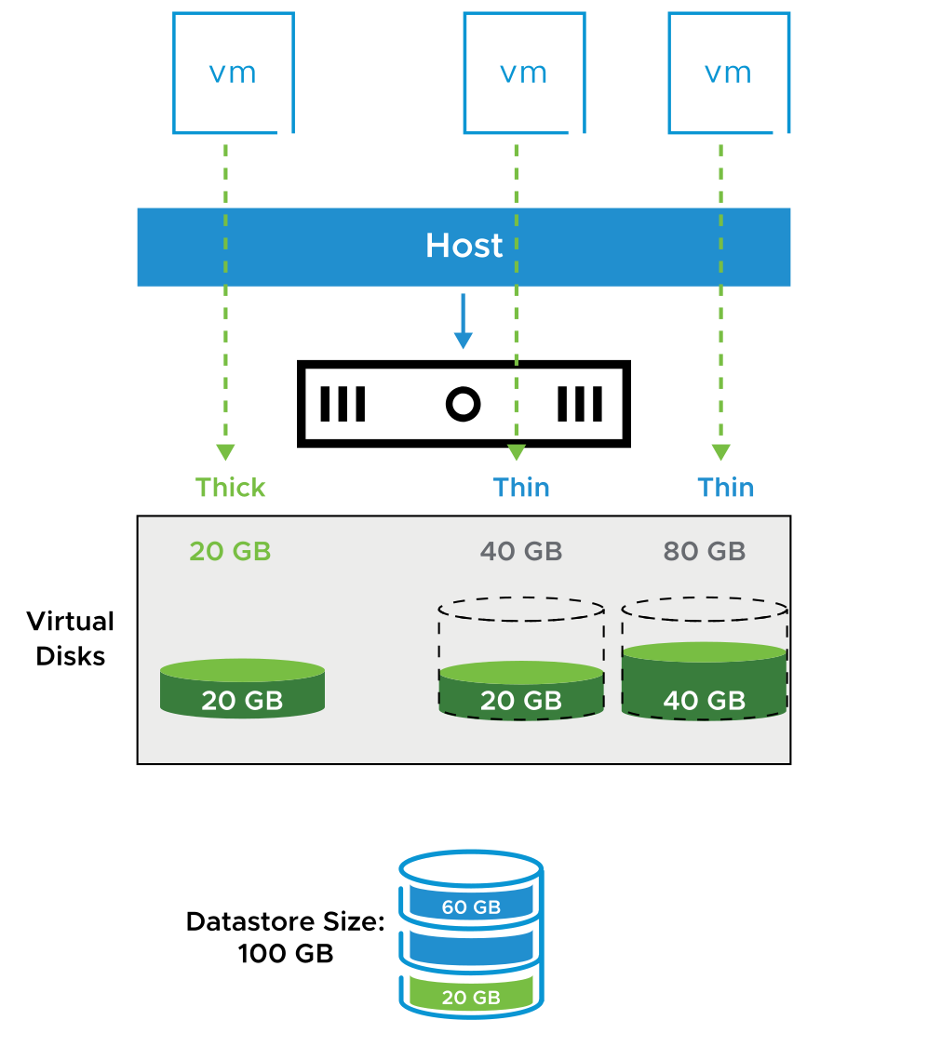
About Thin-Provisioned Virtual Disks
With thin provisioning, VMs use the disk space as needed:
Virtual disks use only the capacity needed to hold the current files.
The VM always sees the full allocated disk size.
Run the unmap command to reclaim the unused space from the virtual disks.
Reporting and alerts help manage allocations and capacity.
You can mix thick and thin formats.
The following examples show efficient use of storage:
Provisioned space for virtual disks: 140 GB
Available datastore capacity: 100 GB
Used datastore capacity: 80 GB
Notes:
A thin-provisioned disk uses only as much datastore space as the disk initially needs. If the thin disk needs more space later, it can expand to the maximum capacity allocated to it.
Thin provisioning provides alarms and reports that track allocation versus the current use of storage capacity. Storage administrators can use thin provisioning to optimize the allocation of storage for virtual environments. With thin provisioning, users can optimally but safely use the available disk space through overallocation.
ESXi supports reclamation of free space, which is also called the unmap command, which helps the storage array reclaim unused free space. For more information about space reclamation and how to run the SCSI unmap command, see vSphere Storage at https://docs.vmware.com/en/VMware-vSphere/index.html.

Slide 32
Managing Datastores Containing Thin-Provisioned Disks
When the total provisioned space of thin-provisioned disks is greater than the size of the datastore, the datastore becomes overcommitted.
To actively monitor datastore capacity:
Set alarms to send notifications about:
Datastore disk overallocation
VM disk use
Use reporting to view space use.
To actively manage datastore capacity:
Increase datastore capacity when necessary.
Use vSphere Storage vMotion to mitigate space use problems on a particular datastore.
Notes:
Using thin-provisioned virtual disks for your VMs is a way to make the most of your datastore capacity. But if your datastore is not sized properly, it can become overcommitted. A datastore becomes overcommitted when the full capacity of its thin-provisioned virtual disks is greater than the datastore’s capacity.
When a datastore reaches capacity, the vSphere Client prompts you to provide more space on the underlying VMFS datastore. VMs will pause if they try to write data to the datastore. Monitor your datastore capacity by setting alarms to alert you about how much a datastore’s disks are fully allocated or how much disk space a VM is using.
Manage your datastore capacity by dynamically increasing the size of your datastore when necessary. You can also use vSphere Storage vMotion to mitigate space use issues. For example, with vSphere Storage vMotion, you can migrate a VM off a datastore. The migration can be done by changing from virtual disks of thick format to thin format at the target datastore.

Slide 33
Thick-Provisioned and Thin-Provisioned Disks
Virtual disk options differ in terms of creation time, block allocation, layout, and zeroing out of allocated file blocks.
 | Thick Provisioned Lazy-Zeroed | Thick Provisioned Eager-Zeroed | Thin Provisioned
Creation time | Fast | Slow and proportional to disk size | Fastest
Block allocation | Fully preallocated | Fully preallocated | Allocated and zeroed out on demand at first write to block
Virtual disk layout | Higher chance of contiguous file blocks | Higher chance of contiguous file blocks | Layout varies according to the dynamic state of the volume at time of block allocation
Zeroing out of allocated file blocks | File blocks are zeroed out when each block is first written to | File blocks are allocated and zeroed out when disk is created | File blocks are zeroed out when blocks are allocated

Slide 34
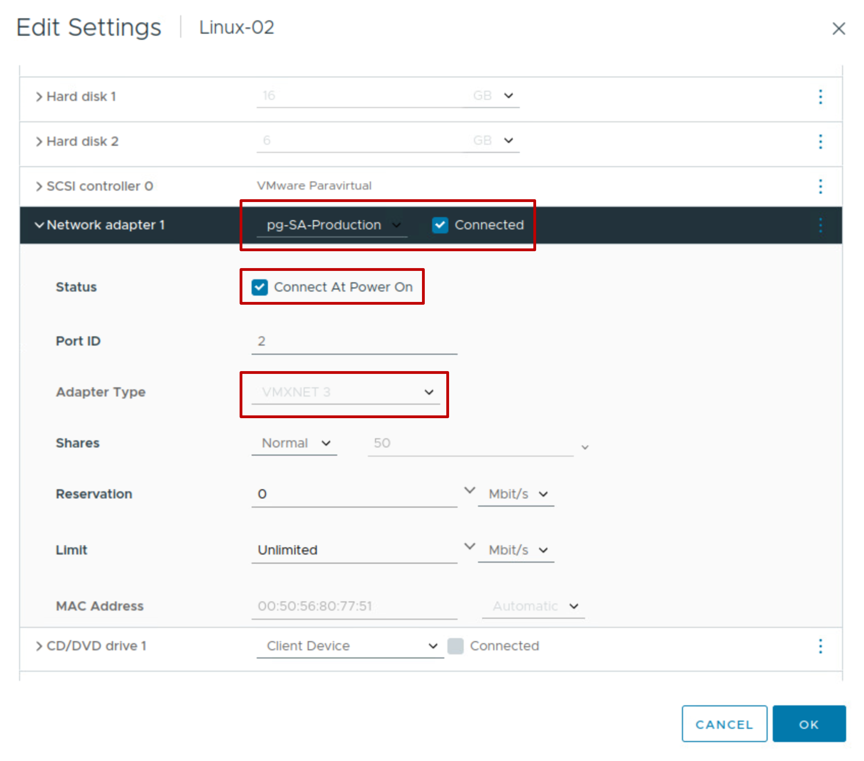
About Virtual Networks
VMs and physical machines communicate through a virtual network.
When you configure networking for a VM, you select or change the following settings:
Network adapter type
Port group to connect to
Network connection state
Whether to connect to the network when the VM powers on
Notes:
For more information about virtual networks, see vSphere Networking at https://docs.vmware.com/en/VMware-vSphere/index.html.

Slide 35
About Virtual Network Adapters
When you configure a VM, you can add network adapters (NICs) and specify the adapter type. Whenever possible, select VMXNET3.
Network Adapter Type | Description
E1000-E1000E | Emulated version of an Intel Gigabit Ethernet NIC, with drivers available in newer guest operating systems.
VMXNET3 | Available only with VMware Tools.
Flexible | Can function as either a Vlance or VMXNET adapter.
PVRDMA | Paravirtualized device that provides improved virtual device performance. It provides an RDMA-like interface for vSphere guests.
SR-IOV pass-through | Allows VM and physical adapter to exchange data without using the VMkernel as an intermediary.
Notes:
The types of network adapters that are available depend on the following factors:
VM compatibility level (or hardware version), which depends on the host that created or most recently updated it. For example, the VMXNET3 virtual NIC requires hardware version 14 or later.
Whether the VM compatibility is updated to the latest version for the current host.
Guest operating system
The following NIC types are supported:
E1000E: Emulated version of the Intel 82574 Gigabit Ethernet NIC. E1000E is the default adapter for Windows 8 and Windows Server 2012.
E1000: Emulated version of the Intel 82545EM Gigabit Ethernet NIC, with drivers available in newer guest operating systems, including Windows XP and later and Linux versions 2.4.19 and later.
Flexible: Identifies itself as a Vlance adapter when a VM starts, but initializes itself and functions as either a Vlance or a VMXNET adapter, depending on which driver initializes it. With VMware Tools installed, the VMXNET driver changes the Vlance adapter to the higher performance VMXNET adapter.
Vlance: Emulated version of the AMD 79C970 PCnet32 LANCE NIC, an older 10 Mbps NIC with drivers available in 32-bit legacy guest operating systems. A VM configured with this network adapter can use its network immediately.
VMXNET3: A paravirtualized NIC designed for performance. VMXNET3 offers all the features available in VMXNET2 and adds several new features, such as multiqueue support (also known as Receive Side Scaling in Windows), IPv6 offloads, and MSI/MSI-X interrupt delivery.
With PVRDMA, multiple guests can access the RDMA device by using verbs API, an industry-standard interface. A set of these verbs was implemented to expose an RDMA-capable guest device (PVRDMA) to applications. The applications can use the PVRDMA guest driver to communicate with the underlying physical device. PVRDMA supports RDMA, providing the following functions:
OS bypass
Zero-copy
Low latency and high bandwidth
Less power use and faster data access
SR-IOV pass-through: Representation of a virtual function on a physical NIC with SR-IOV support. This adapter type is suitable for VMs that require more CPU resources or where latency might cause failure. If VMs are sensitive to network delay, SR-IOV can provide direct access to the virtual functions of supported physical NICs, bypassing the virtual switches and reducing overhead.
SR-IOV pass-through is available for Red Hat Enterprise Linux 6 and later, and Windows Server 2008 R2 with SP2. An operating system release might contain a default virtual function driver for certain NICs. For others, you must download and install it from a location provided by the NIC or host vendor.

Slide 36
About PCI Passthrough Devices
Passthrough devices help your environment use resources efficiently and improve performance.
You connect a VM's guest OS to PCI or PCIe passthrough devices that are configured on an ESXi host.
PCI Passthrough Device | Description
vSphere DirectPath I/O | VM accesses directly the physical PCI or PCIe device on a specific host. VM is restricted to that particular host.
vSphere Dynamic DirectPath I/O | PCI or PCIe passthrough device is not directly mapped to the VM. Allows vSphere DRS to place a VM on any ESXi host in the cluster that provides the assigned passthrough device
NVIDIA GRID GPU | Graphics device that uses the NVIDIA GRID vGPU technology Lets VMs use partial, full, or multiple GPU allocations
Notes:
With vSphere DirectPath I/O, you can directly access devices, such as high-performance graphics or sound cards. A VM specifies a PCI or PCIe device by using its hardware address. When vSphere DirectPath I/O devices are made available to a virtual machine, you cannot perform certain operations on the virtual machine. These operations include suspending, migration with vMotion, and taking or restoring snapshots of the virtual machine.
With vSphere Dynamic DirectPath I/O, the hardware address of the passthrough device is no longer directly mapped to the VM. vSphere Dynamic DirectPath I/O is useful on hosts that have PCI passthrough devices and for virtualized devices that require a directly assigned hardware device to back it. vSphere Dynamic DirectPath I/O allows vSphere DRS to identify a host within the cluster that has an available device with the same vendor and model name. vSphere DRS takes action only during VM power on and does not perform any load balancing actions.
NVIDIA GRID vGPU devices optimize complex graphics operations and make them run at high performance without overloading the CPU. NVIDIA GRID vGPU provides unparalleled graphics performance and scalability by sharing a single physical GPU among multiple virtual machines as separate vGPU-enabled passthrough devices.
For more information on vSphere Dynamic DirectPath I/O, see vSphere 7 - Assignable Hardware at https://blogs.vmware.com/vsphere/2020/03/vsphere-7-assignable-hardware.html.

Slide 37
Other Virtual Devices
A VM must have a vCPU and virtual memory. The addition of other virtual devices makes the VM more useful:
CD/DVD drive: For connecting to a CD, DVD, or ISO image.
USB 3.0 and 3.1: Supported with host-connected and client-connected devices.
Floppy drive: For connecting a VM to a floppy drive or a floppy image.
Generic SCSI devices: A VM can be connected to additional SCSI adapters.
vGPUs: A VM can use GPUs on the physical host for high-computation activities.
Precision Clock: Provides a virtual machine with access to the system time of the primary ESXi host.
vTPM: Trusted Platform Module 2.0 virtual cryptoprocessor, providing hardware-based security-related functions.
Notes:
Virtual CPU (vCPU) and virtual memory are the minimum required virtual hardware. Having a virtual hard disk, virtual NICs, and other virtual devices make the VM more useful.
For information about available virtual machine hardware and about adding virtual hardware to a VM, see vSphere Virtual Machine Administration at https://docs.vmware.com/en/VMware-vSphere/8.0/TBD.

Slide 38
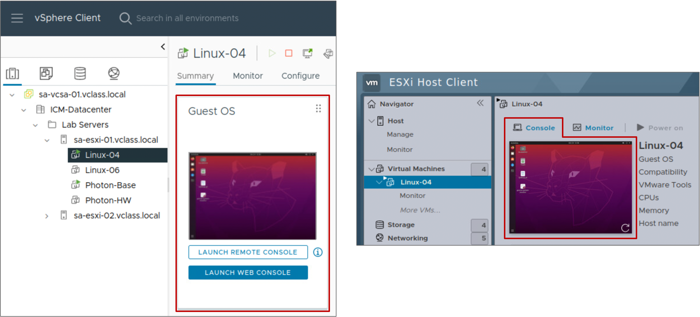
About the Virtual Machine Console
The VM console provides the mouse, keyboard, and screen features to control the VM.
You can use the remote console or the Web console to connect to client devices.
Notes:
You can open the VM console from the vSphere Client:
The Web console displays the VM console in a separate browser tab.
The remote console requires downloading the VMware Remote Console (VMRC) standalone application, which opens in a separate window. The VMware Remote Console standalone application lets you connect to client devices and launch virtual machine consoles on remote hosts.
You use the VM console to access the BIOS or EFI of the VM, install an operating system on a VM, power the VM on and off, and reset the VM.
The VM console is normally not used to connect to the VM for daily tasks. Remote Desktop Connection, Virtual Network Connection, or other options are normally used to connect to the virtual desktop. The VM console is used for tasks such as power cycling, configuring hardware, and troubleshooting network issues.

Slide 39
Lab 3: Adding Virtual Hardware
Use the vSphere Client to examine a virtual machine's configuration and add virtual hardware to the virtual machine:
Examine a Virtual Machine's Configuration
Add Virtual Hard Disks to the Virtual Machine
Compare Thin-Provisioned and Thick-Provisioned Disks

Slide 40
Review of Learner Objectives
Identify the files that make up a VM
Compare VM hardware versions
Recognize the virtual hardware components of a VM
Navigate the vSphere Client and examine VM settings
Identify methods for accessing a VM console

Slide 41
Modifying Virtual Machines

Slide 42
Learner Objectives
Describe virtual machine settings and options
Add a hot-pluggable device
Dynamically increase the size of a virtual disk

Slide 43
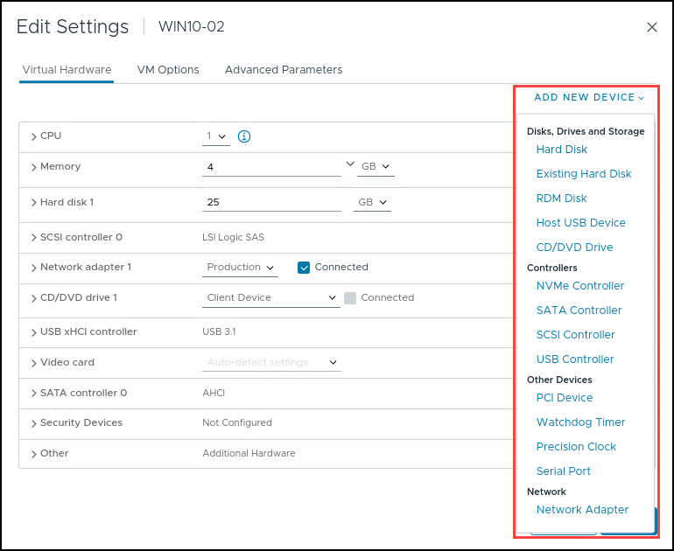
Modifying Virtual Machine Settings
You can modify a VM’s configuration by editing the VM's settings:
Add virtual hardware:
You can add some hardware while the VM is powered on.
Remove virtual hardware:
You can remove some hardware only when the VM is powered off.
Set VM options.
Control a VM’s CPU and memory resources.
Notes:
You might have to modify a VM’s configuration, for example, to add a network adapter or a virtual disk. You can make all VM changes while the VM is powered off. Some VM hardware changes can be made while the VM is powered on.

Slide 44
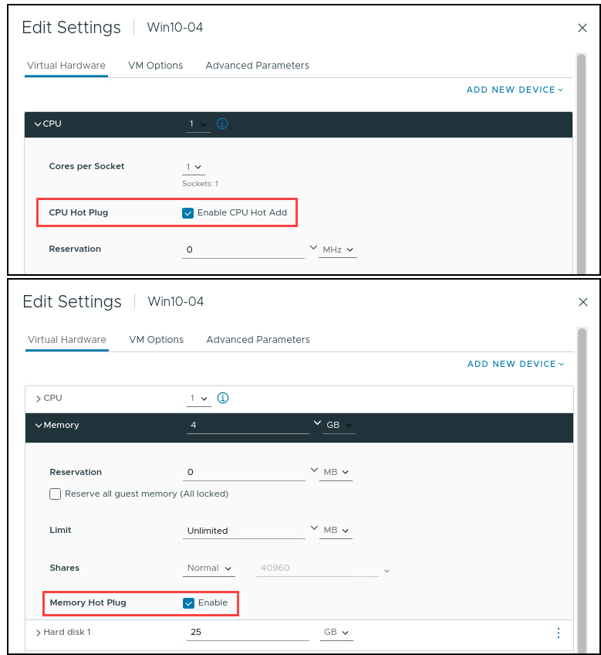
Hot-Pluggable Devices
With the hot plug option, you can add resources to a running VM.
Examples of hot-pluggable devices:
USB controllers
Ethernet adapters
Hard disk devices
With supported guest operating systems, you can also add CPU and memory while the VM is powered on.
Notes:
Adding devices to a physical server or removing devices from a physical server requires that you physically interact with the server in the data center. When you use VMs, resources can be added dynamically without a disruption in service. You must shut down a VM to remove hardware, but you can reconfigure the VM without entering the data center.
You can add CPU and memory while the VM is powered on. These features are called the CPU Hot Add and Memory Hot Plug, which are supported only on guest operating systems that support hot-pluggable functionality. These features are deactivated by default. To use these hot-plug features, the following requirements must be satisfied:
You must install VMware Tools.
The VM must use hardware version 11 or later.
The guest operating system in the VM must support CPU and memory hot-plug features.
The hot-plug features must be activated in the CPU or Memory settings on the Virtual Hardware tab.
If virtual NUMA is configured with virtual CPU hot-plug settings, the VM is started without virtual NUMA. Instead, the VM uses UMA (Uniform Memory Access).

Slide 45
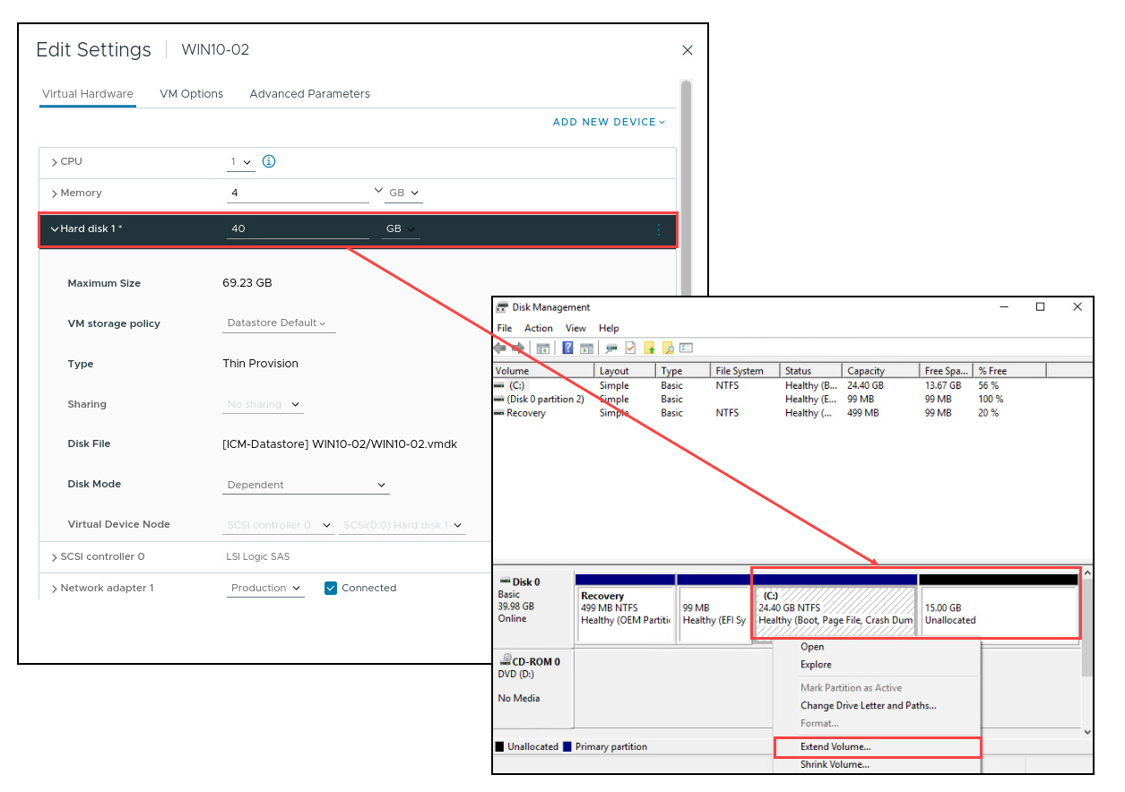
Dynamically Increasing Virtual Disk Size
You can increase the size of a virtual disk that belongs to a powered-on VM.
It must not have snapshots attached.
It might require system tools to make the new space usable.
Notes:
After you increase the size of a virtual disk, you might need to increase the size of the file system on this disk. Use the appropriate tool in the guest OS to configure the file system to use the newly allocated disk space.

Slide 46
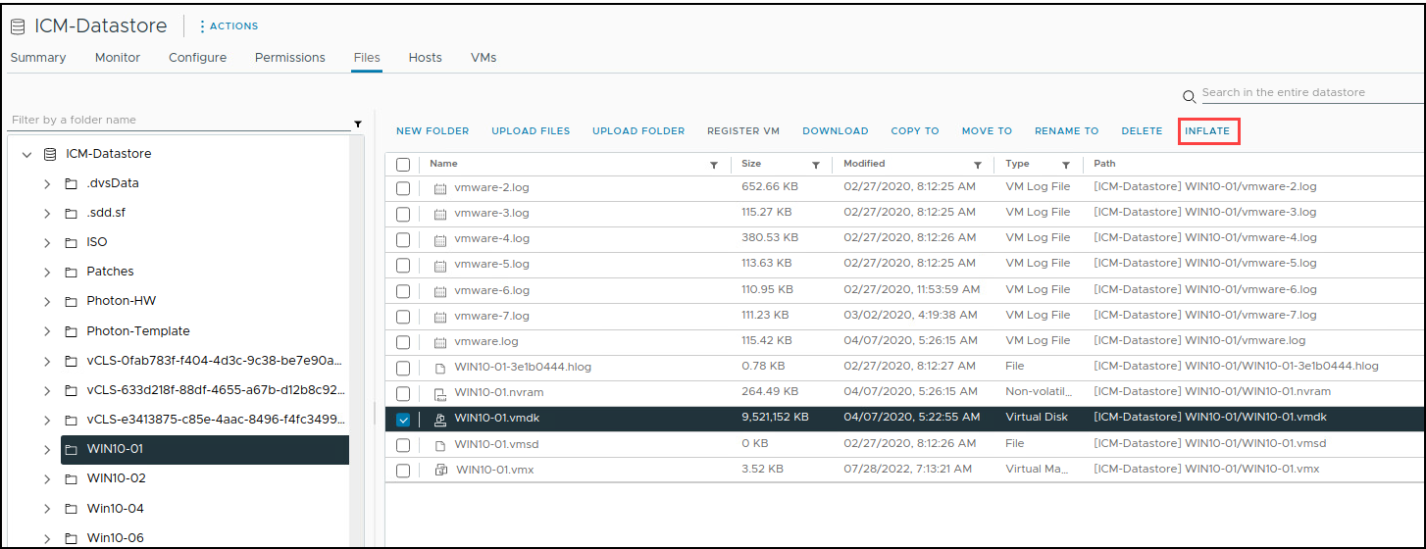
Inflating Thin-Provisioned Disks
Thin-provisioned virtual disks can be converted to a thick, eager-zeroed format.
Choose one of the following methods to inflate a thin-provisioned disk on a VM that is either powered on or off:
Select the VM’s file with the .vmdk extension and select Inflate.
Select thick-provisioned when you use vSphere Storage vMotion to migrate the VM to a different datastore.
Notes:
When you inflate a thin-provisioned disk, the inflated virtual disk occupies the entire datastore space originally provisioned to it. Inflating a thin-provisioned disk converts a thin disk to a virtual disk in thick-provisioned, eager-zeroed format.

Slide 47
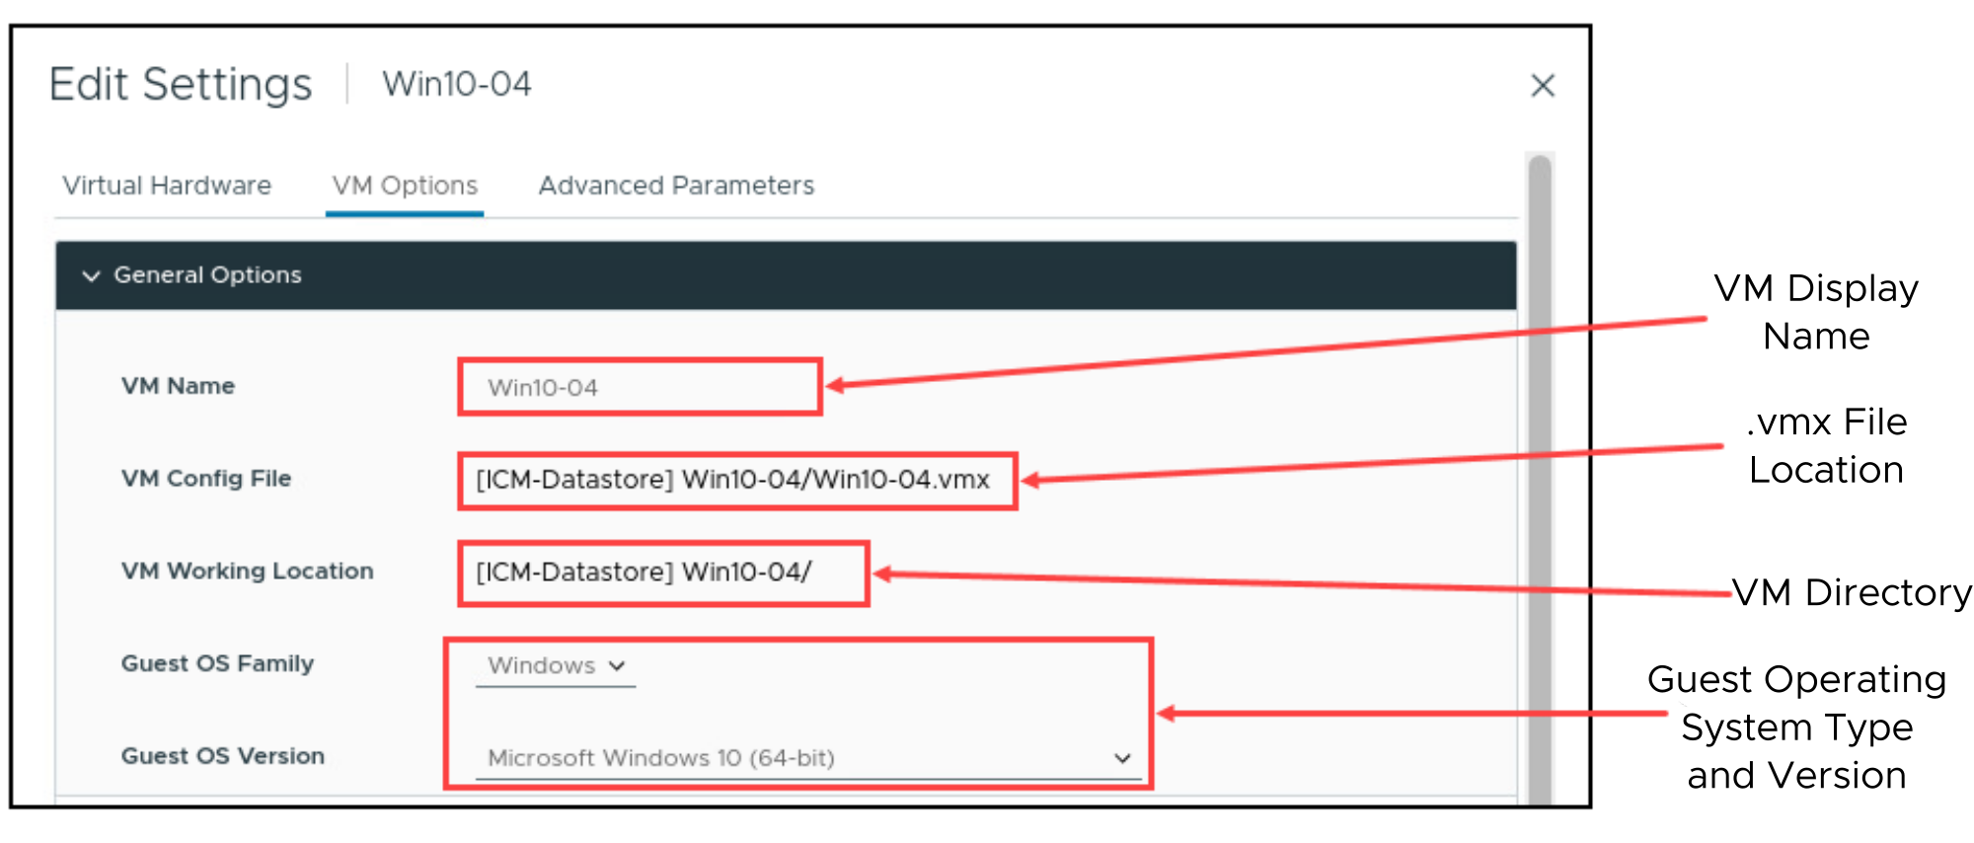
VM Options: General Settings
You can use the VM Options tab to modify properties such as the display name for the VM and the type of guest operating system that is installed.
Notes:
Under General Options, you can view the location and name of the configuration file (with the .vmx extension) and the location of the VM’s directory.
You can select the text for the configuration file and the working location to copy and paste them into a document. However, only the display name and the guest operating system type can be modified.
Changing the display name does not change the names of all the VM files or the directory that the VM is stored in. When a VM is created, the filenames and the directory name associated with the VM are based on its display name. But changing the display name later does not modify the filename and the directory name.

Slide 48
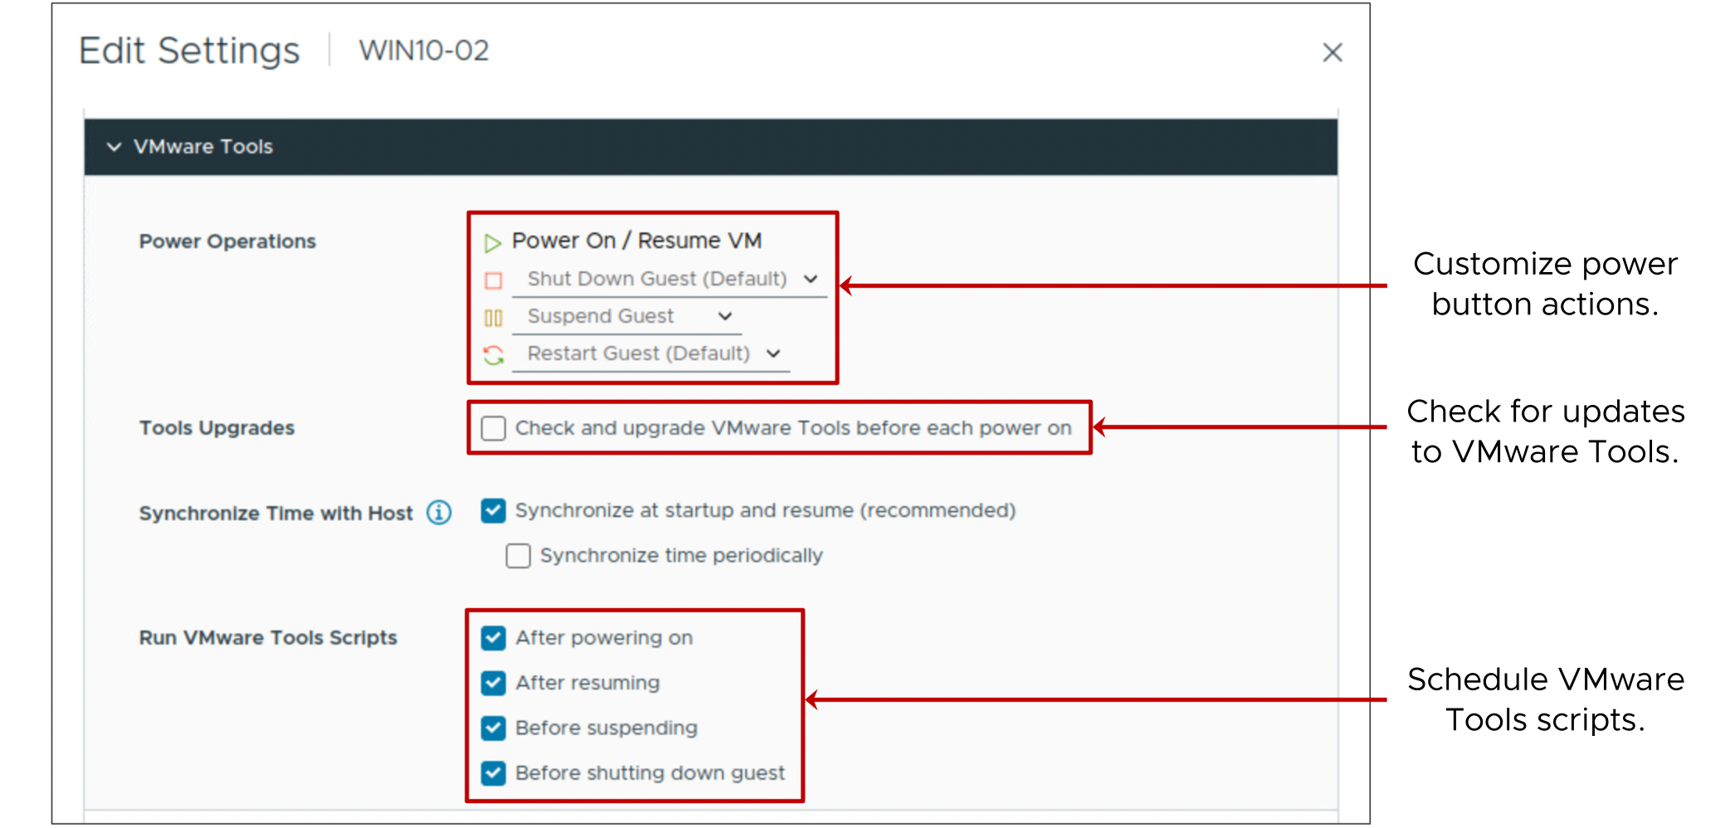
VM Options: VMware Tools Settings
You can use the VMware Tools controls to customize the power buttons on the VM.
Notes:
When you use the VMware Tools controls to customize the power buttons on the VM, the VM must be powered off.
You can select the Check and upgrade VMware Tools before each power on check box to check for a newer version of VMware Tools. If an ISO image containing a newer version is found, VMware Tools is upgraded when the VM is power cycled.
When you select the Synchronize guest time with host check box, the guest operating system’s clock synchronizes with the host.
For information about time keeping best practices for the guest operating systems that you use, see VMware knowledge base articles at http://kb.vmware.com/kb/1318 and http://kb.vmware.com/kb/1006427.

Slide 49
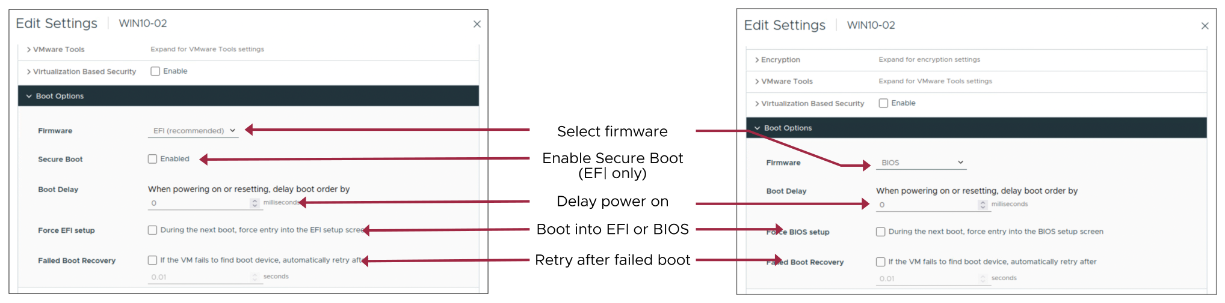
VM Options: VM Boot Settings
Occasionally, you might need to set the VM boot options.
Notes:
When you build a VM and select a guest operating system, BIOS or EFI is selected automatically, depending on the firmware supported by the operating system. If the operating system supports BIOS and EFI, you can change the boot option as needed. However, you must change the option before installing the guest OS.
UEFI Secure Boot is a security standard that helps ensure that only manufacturer-trusted software is used when booting your PC. In an OS that supports UEFI Secure Boot, each piece of boot software is signed, including the bootloader, the operating system kernel, and operating system drivers. If you configure Secure Boot for a VM, you can load only signed drivers into that VM.
With the Boot Delay value, you can set a delay between the time when a VM is turned on and the guest OS starts to boot. A delayed boot can help stagger VM start-ups when several VMs are powered on.
You can change the BIOS or EFI settings. For example, you might want to force a VM to start from a CD/DVD. The next time the VM powers on, it goes straight into the BIOS. A forced entry into the firmware setup is much easier than powering on the VM, opening a console, and quickly trying to press the F2 key.
With the Failed Boot Recovery setting, you can configure the VM to retry booting after 10 seconds (the default) if the VM fails to find a boot device.

Slide 50
Lab 4: Modifying Virtual Machines
Modify a VM’s memory size, increase a VM's storage size, and rename a VM:
Adjust Memory Allocation on a Powered-On Virtual Machine
Increase the Size of a Virtual Disk
Configure the Guest OS to Recognize the Additional Disk Space
Rename a Virtual Machine in the vCenter Inventory

Slide 51
Review of Learner Objectives
Describe virtual machine settings and options
Add a hot-pluggable device
Dynamically increase the size of a virtual disk

Slide 52
Creating Templates and Cloning VMs

Slide 53
Learner Objectives
Create a template of a virtual machine
Deploy a virtual machine from a template
Clone a virtual machine
Create customization specifications for guest operating systems

Slide 54
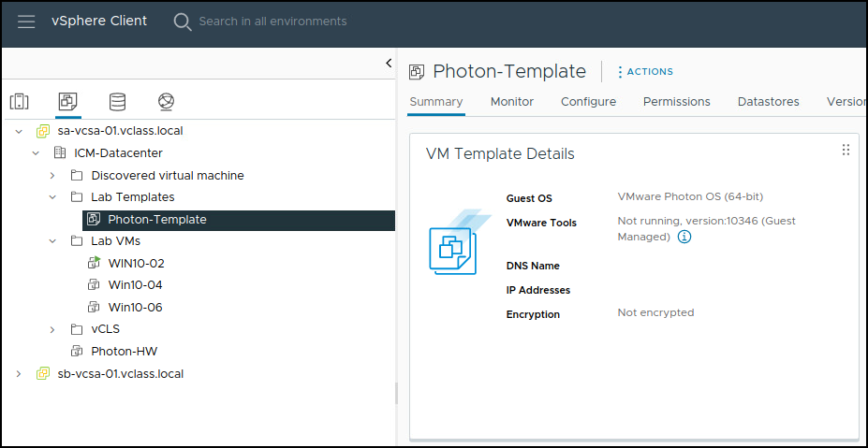
About Templates
A template is a static image of a virtual machine. You use templates to create and provision new VMs.
A template typically includes:
A guest operating system
One or more applications
A specific VM hardware configuration
VMware Tools
To use templates, you must be connected to vCenter.
Notes:
Creating templates makes the provisioning of virtual machines much faster and less error-prone than provisioning physical machines and creating a VM by using the New Virtual Machine wizard.
Templates coexist with VMs in the inventory. You can organize collections of VMs and templates into arbitrary folders and apply permissions to VMs and templates. You can change VMs into templates without having to make a full copy of the VM files and create an object.
You can deploy a VM from a template. The deployed VM is added to the folder that you selected when creating the template.
To create and use templates, you must be connected to vCenter. You cannot use templates if you use VMware Host Client to manage a host directly.

Slide 55
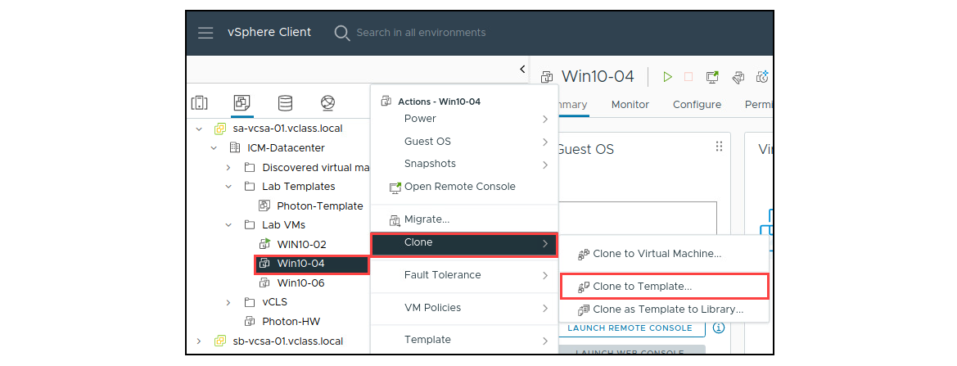
Creating a Template: Clone VM to Template
You can create templates using different methods. One method is to clone the VM to a template. The VM can be powered on or off.
Notes:
One of the choices that the Clone to Template option offers is the type of format for storing the VM's virtual disks:
Same format as source
Thin-provisioned format
Thick-provisioned lazy-zeroed format
Thick-provisioned eager-zeroed format

Slide 56
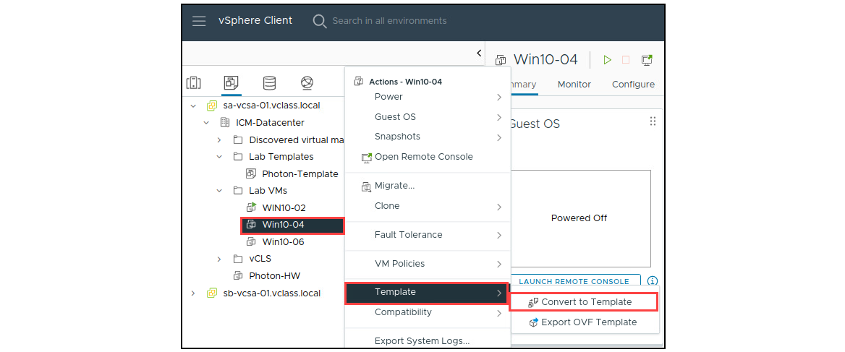
Creating a Template: Convert VM to Template
You can create a template by converting a VM to a template. In this case, the VM must be powered off.
Notes:
The Convert to Template option does not offer a choice of format and leaves the VM’s disk file unchanged. The VM's configuration file (.vmx) is replaced with a template configuration file (.vmtx).

Slide 57
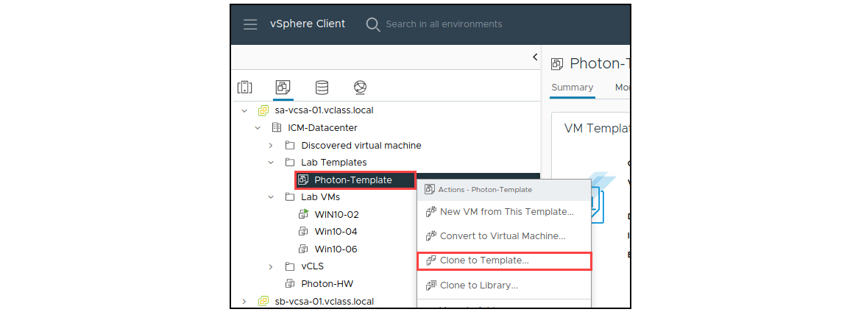
Creating a Template: Clone a Template
You can create a template from an existing template.

Slide 58
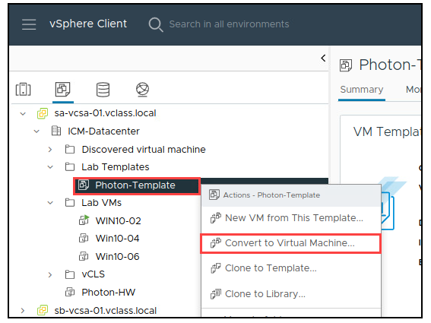
Updating Templates
You update a template to include new patches, add and remove virtual hardware, upgrade VMware Tools, update the VM hardware version, and install new applications.
To update a template:
Convert the template to a VM.
VMs cannot be deployed from this template while it is a VM.
Place the VM on an isolated network to prevent user access.
Make appropriate changes to the VM.
Convert the VM to a template.
Notes:
To update your template to include new patches or software, you do not need to create another template. Instead, you convert the template to a VM. You can then power on the VM and make changes to the VM.
For added security, you might want to prevent users from accessing the VM while you update it. To prevent access, either disconnect the VM from the network or place it on an isolated network.
Log in to the VM’s guest operating system and apply the patch or install the software. When you finish, power off the VM and convert it to a template again.

Slide 59
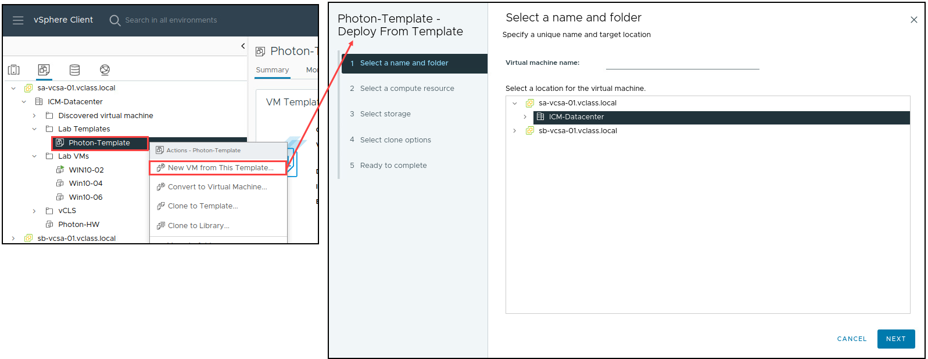
Deploying VMs from a Template
To deploy a VM, you must provide information such as the VM name, inventory location, host, datastore, and guest operating system customization data.

Slide 60
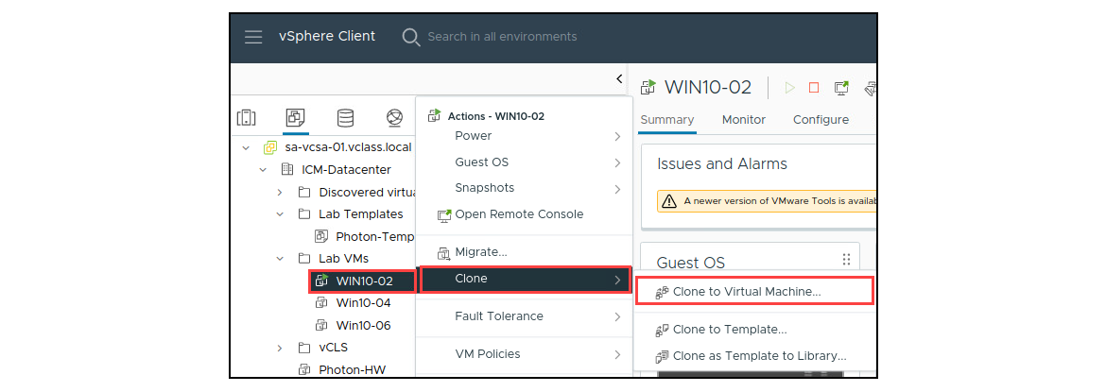
Cloning Virtual Machines
Cloning a VM creates a VM that is an exact copy of the original:
Cloning is an alternative to deploying a VM from a template.
The source VM can be powered on or off.
Notes:
To clone a VM, you must be connected to vCenter. You cannot clone VMs if you use VMware Host Client to manage a host directly.
When you clone a VM that is powered on, services and applications are not automatically quiesced when the VM is cloned.
When deciding whether to clone a VM or deploy a VM from a template, consider the following points:
When you deploy many VMs from a template, all the VMs start with the same base image. Cloning many VMs from a running VM might not create identical VMs, depending on the activity happening within the VM when the VM is cloned.
VM templates use disk space, so you must plan your disk space requirements accordingly.
Deploying a VM from a template is quicker than cloning a running VM, especially when you must deploy many VMs at a time.

Slide 61
Guest Operating System Customization
When you deploy a VM from a template or clone a VM, you can customize some aspects of the guest operating system.
By customizing a guest operating system, you can change information, including the following details:
Computer name
Network settings
License settings
Time zone
Administrator or root password
Windows Security Identifier
Notes:
Customizing the guest operating system prevents conflicts that might occur when you deploy a VM and a clone with identical guest OS settings. Without customization, VMs retain the host name, IP address and so on, of the source VM or template.

Slide 62
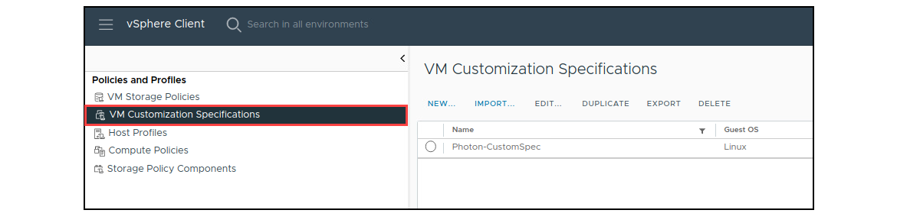
About Customization Specifications
You can create a customization specification to prepare the guest operating system:
Specifications are stored in the vCenter database.
Windows and Linux guests are supported.
Notes:
To manage customization specifications, select Policies and Profiles from the main menu. On the VM Customization Specifications pane, you can create specifications or manage existing ones.

Slide 63
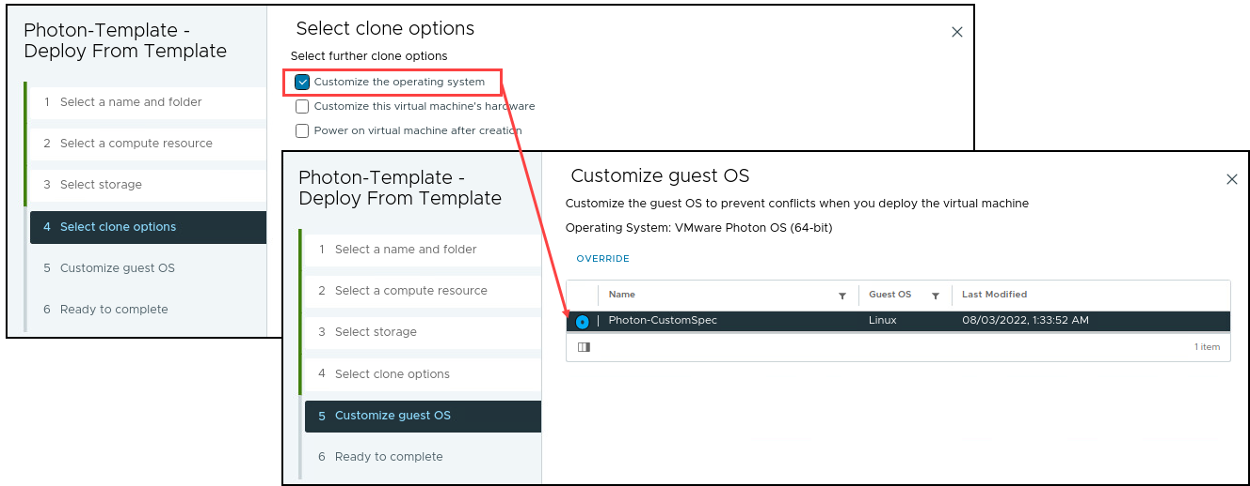
Customizing the Guest Operating System
When cloning a VM or deploying a VM from a template, you can use a customization specification to prepare the guest operating system.
Notes:
You can define the customization settings by using an existing customization specification during cloning or deployment. You create the specification ahead of time. During cloning or deployment, you can select the customization specification to apply to the new VM.
VMware Tools must be installed on the guest operating system that you want to customize. The guest operating system must be installed on a disk attached to SCSI node 0:0 in the VM configuration.
For more about guest operating system customization, see vSphere Virtual Machine Administration at https://docs.vmware.com/en/VMware-vSphere/index.html.

Slide 64
Lab 5: Creating Templates and Deploying VMs
Create a VM template, create a customization specification, and deploy VMs from a template:
Create a Virtual Machine Template
Create Customization Specifications
Deploy Virtual Machines from a Template

Slide 65
Review of Learner Objectives
Create a template of a virtual machine
Deploy a virtual machine from a template
Clone a virtual machine
Create customization specifications for guest operating systems

Slide 66
Introduction to Content Libraries

Slide 67
Learner Objectives
Identify the benefits of a content library
Recognize types of content libraries
Create a local content library
Deploy a virtual machine from a content library

Slide 68
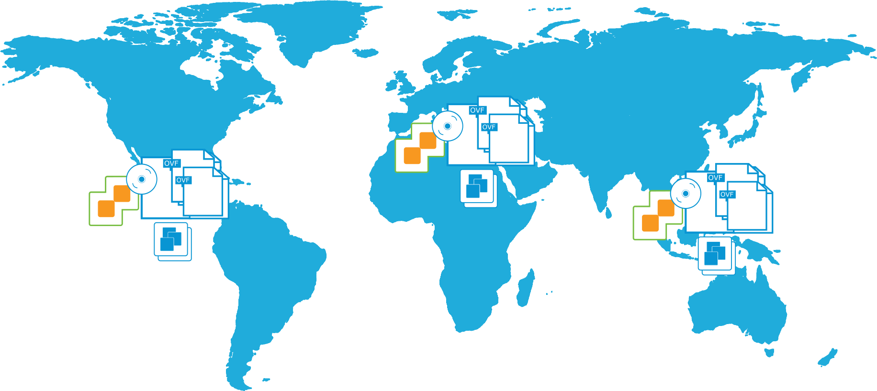
About Content Libraries
Content libraries are repositories of OVF templates and other file types that can be shared and synchronized across vCenter systems globally.
Notes:
Organizations might have multiple vCenter instances in data centers around the globe. On these vCenter instances, organizations might have a collection of templates, ISO images, and so on. The challenge is that all these items are independent of one another, with different versions of these files and templates on various vCenter instances.
The content library is the solution to this challenge. It lets you store OVF templates, ISO images, or any other file types in a central location. The templates, images, and files can be published, and other content libraries can subscribe to and download content. The content library keeps content up to date by periodically synchronizing with the publisher, ensuring that the latest version is available.

Slide 69
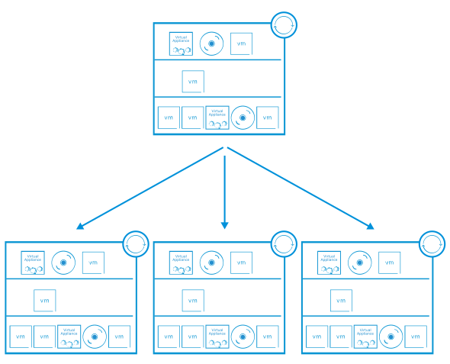
Benefits of Content Libraries
Storage efficiency and consistency are key reasons to install and use a content library.
Using content libraries, administrators can perform the following functions:
Store and share content, such as templates, ISO images, scripts.
Perform distributed file management.
Synchronize content libraries across sites and vCenter instances.
Mount an ISO file directly from a content library.
Maintain versions of VM templates.
Content libraries are stored on vSphere datastores.
Notes:
Sharing content and ensuring that the content is kept up to date are major tasks. For example, for a main vCenter instance, you create a central content library to store the original copies of OVF templates, ISO images, scripts, and other file types. When you publish this content library, other libraries, which might be located anywhere in the world, can subscribe and download an exact copy of the data. When an OVF template is added, modified, or deleted from the published catalog, the subscriber synchronizes with the publisher, and the libraries are updated with the latest content. Starting with vSphere 7, you can update a template while simultaneously deploying VMs from the template. In addition, the content library keeps two copies of the VM template, the previous and current versions. You can roll back the template to reverse changes made to the template.

Slide 70
Content Library Types
Content is stored in one of the content library types:
Local: Content that is controlled by the administrator
Published: A local library that is available for subscription
Subscribed: A library that synchronizes with a published library
Administrators can change content in a local or published content library.
Users cannot change content in a subscribed content library.
A subscribed content library cannot be published.
Notes:
A local library is the simplest form of library. A local library is available for use in data centers that are objects to the local vCenter. A published library is a local library that is available for subscription. Using the vCenter database, the content library tracks version changes. No option to use previous versions of content is available. A subscribed library is configured to subscribe to a published library. An administrator cannot directly change the contents of the subscribed library. But the administrator can control how the data is synchronized to the subscribed content library.

Slide 71
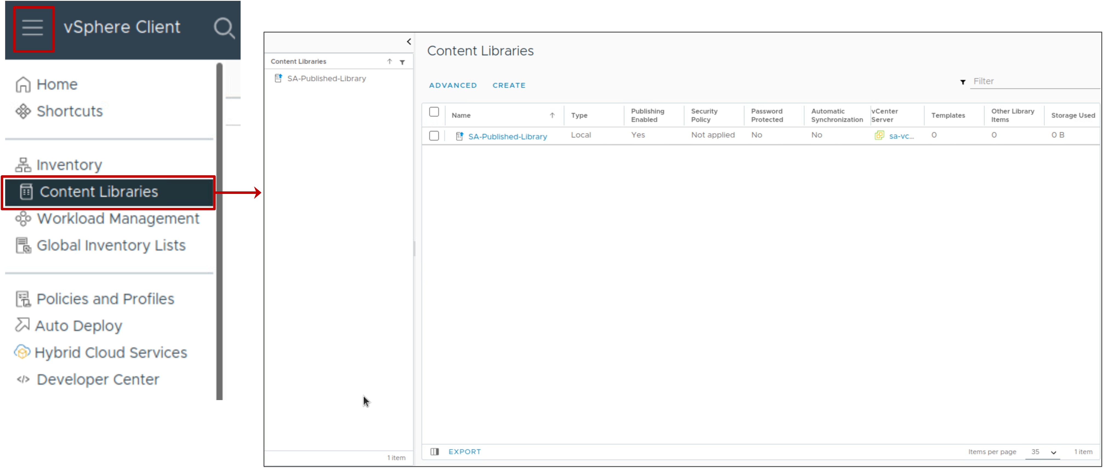
Content Library Interface
To create and manage your content libraries, from the main menu, select Content Libraries.

Slide 72
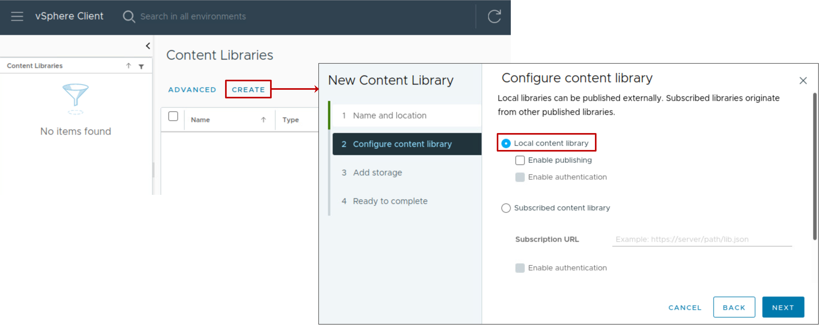
Creating a Local Content Library
When you create a content library, you select the content library type, for example, Local content library.

Slide 73
Populating the Content Library with Templates
You can populate the content library with the following template types:
VM Templates:
Can be stored on any datastore type, except NFS
Stored in the default disk format of the datastore (for example, thick-provisioned eager-zeroed)
Are associated with a host
Appear in the vCenter inventory
OVF Templates:
Must be stored on the datastore (of any type) that is associated with the content library
Stored in thin-provisioned format
Are not associated with a host
Do not appear in the vCenter inventory
Notes:
When you create a VM template (instead of an OVF template) in a content library, the library item is backed by a VM template in the vCenter inventory.
The content library item and the corresponding inventory object are related in the following ways.
If you convert the VM template in the vCenter inventory to a VM, the corresponding VM template library item is deleted.
If you rename the VM template in vCenter inventory, the corresponding VM template library item is also renamed, and vice versa.
If you delete the VM template in the vCenter inventory, the corresponding VM template library item is also deleted.
For the complete list of differences between VM templates and OVF templates in a content library, see vSphere Virtual Machine Administration at https://docs.vmware.com/en/VMware-vSphere/index.html.

Slide 74
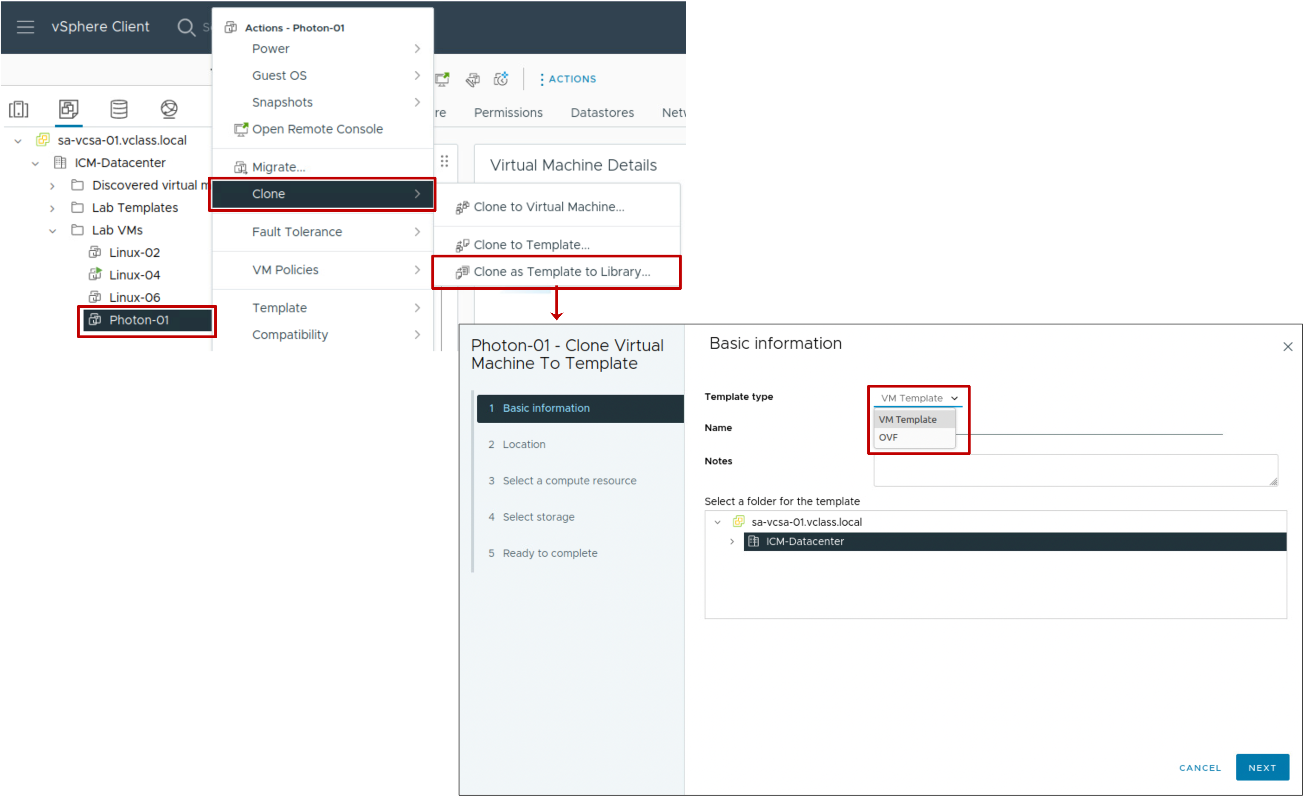
Adding VM or OVF Templates to a Content Library
When you clone a virtual machine into a template in a content library, you can select whether to create a VM template or an OVF template.
Notes:
In this example, you clone the Photon-01 VM as a VM template to a content library.

Slide 75
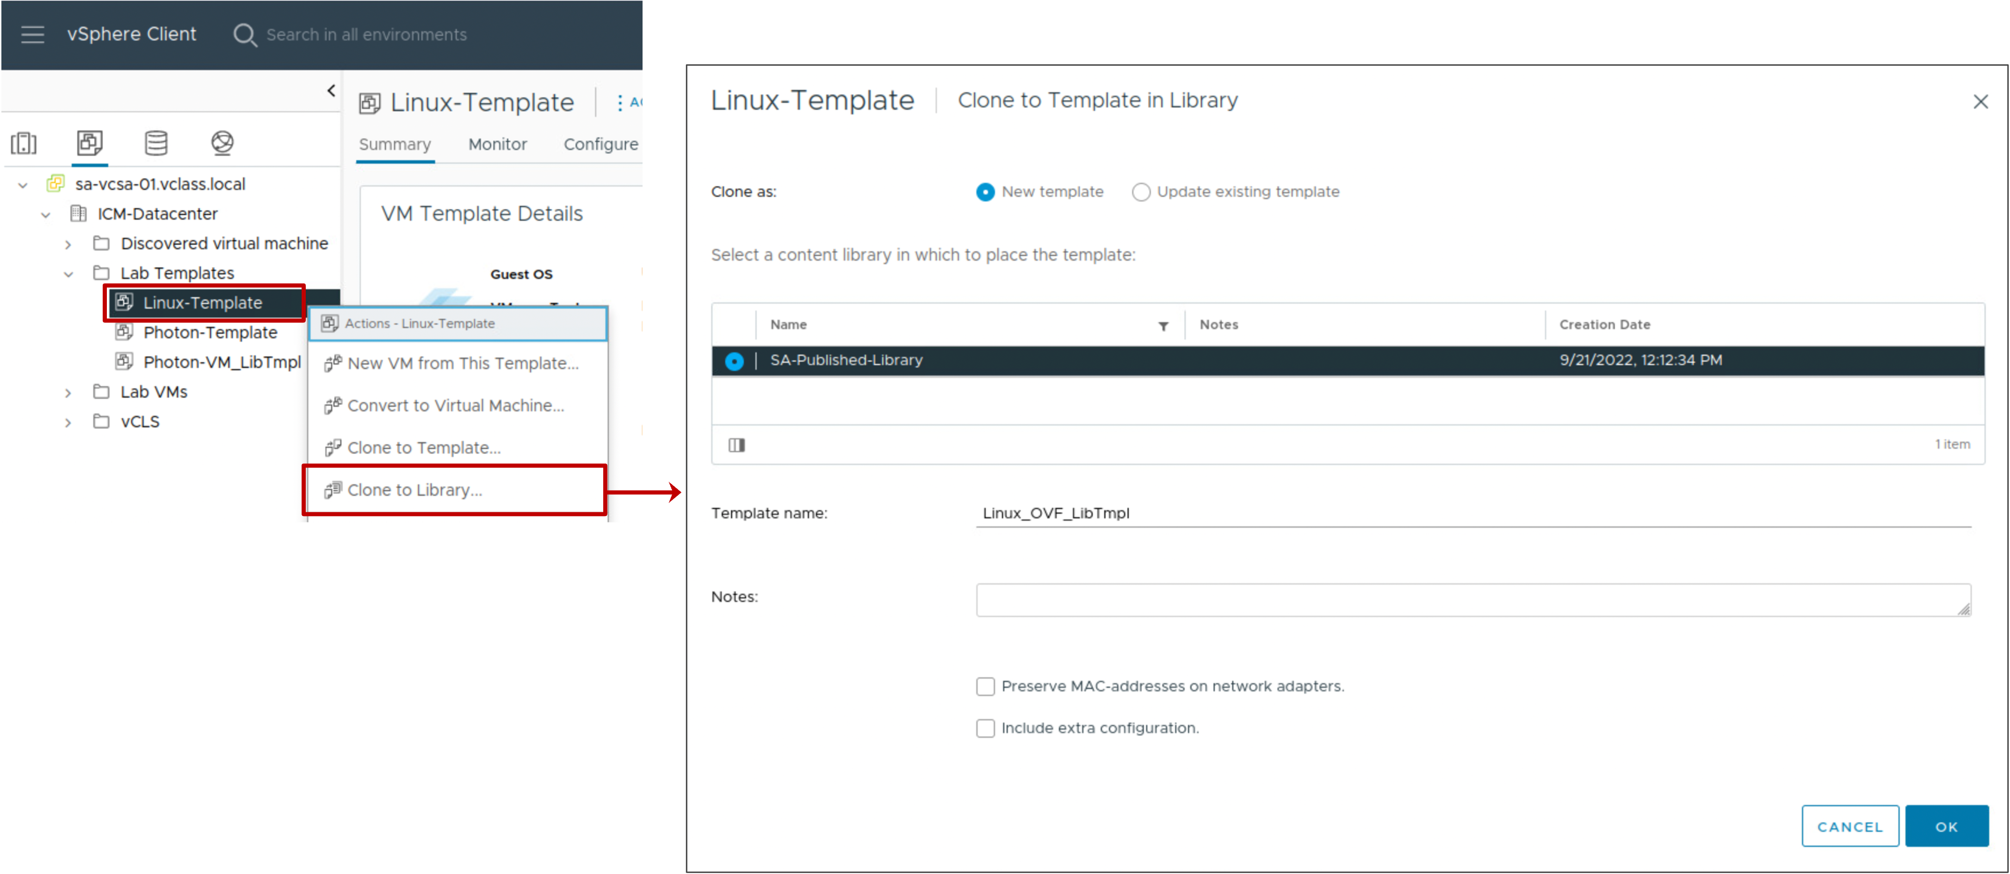
Adding OVF Templates to a Content Library
When you clone a template from the vCenter inventory into a template in a content library, the template is stored as an OVF template in the library.

Slide 76
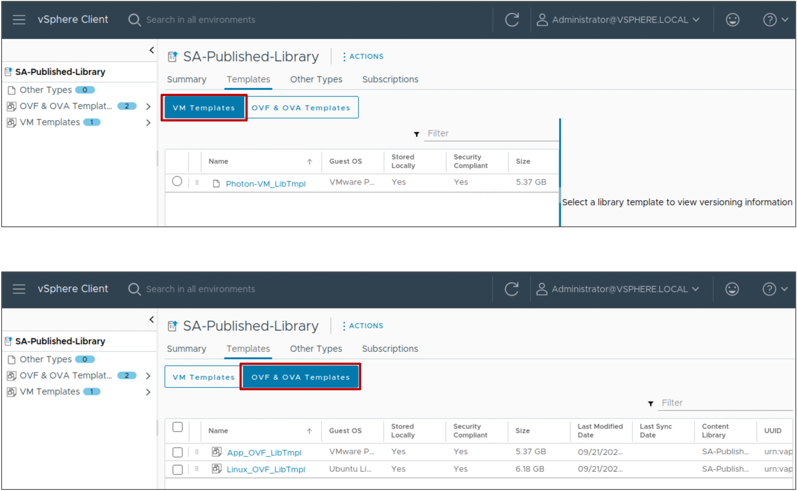
Viewing Content Library Items
The content in the content library is divided into categories:
Templates:
VM templates
OVF templates
Other Types:
All other file types, such as ISO images
Notes:
You can mount an ISO file directly from a content library. You connect the CD/DVD device to an ISO file that is stored in the content library, for example, to install a guest OS on a new VM.
The ISO files are available only to VMs that are registered on an ESXi host that can access the datastore where the content library is located. These ISO files are not available to VMs on hosts that cannot see the datastore on which the content library is located.

Slide 77
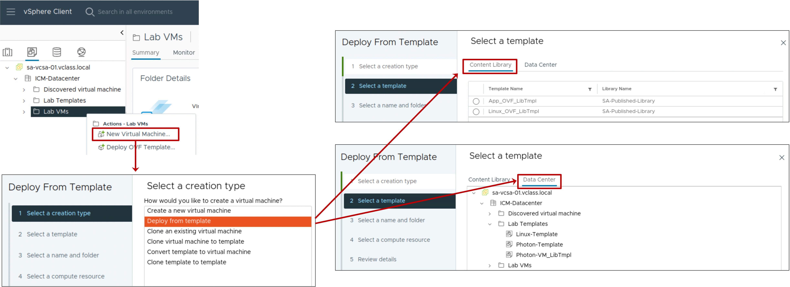
Deploying VMs from a Content Library
You can deploy VMs from templates in a content library by using the New Virtual Machine wizard.
Notes:
On the Select a template page, you can choose a template from a content library or from the vCenter inventory. The Content Library tab lists OVF templates and the Data Center tab lists VM templates, including VM templates that you added to the content library.

Slide 78
Lab 6: Using Local Content Libraries
Create a local content library to clone and deploy virtual machines:
Create a Local Content Library
Create an OVF Template in the Content Library
Create a VM Template in the Content Library
View the Content Library Templates
Deploy a VM from a Template in the Content Library

Slide 79
Review of Learner Objectives
Identify the benefits of a content library
Recognize types of content libraries
Create a local content library
Deploy a virtual machine from a content library

Slide 80
Subscribing to Content Libraries

Slide 81
Learner Objectives
Publish content libraries
Subscribe to a published content library

Slide 82
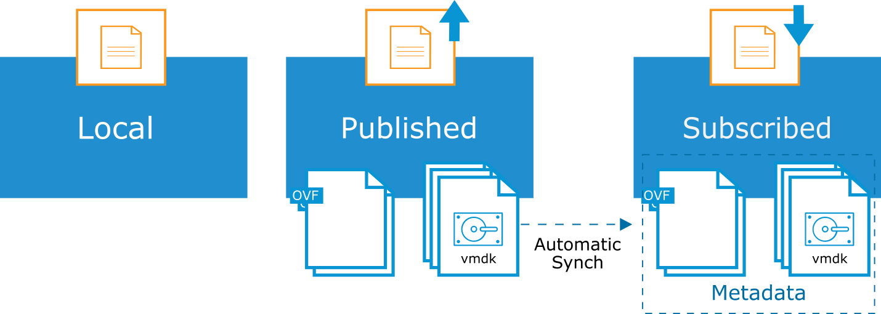
Content Libraries: Local, Published, and Subscribed
You can publish a local content library so that other libraries can subscribe and download a copy of the data.
After synchronization, both published and subscribed libraries contain the same items, or the subscribed library contains the metadata for the items.
Notes:
You can create a local library as the source for content that you want to save or share. You create the local library on a single vCenter instance. Furthermore, you can then add or remove items to and from the local library.
You can publish a local library, and this content library service endpoint can be accessed by other vCenter instances in your virtual environment, whether or not they are in the same enhanced linked mode group. When you publish a library, you can configure the authentication method, which a subscribed library must use to authenticate to it.
You can create a subscribed library and populate its content by synchronizing it to a published library. You can choose whether a subscribed library contains copies of the published library files or only the metadata of the library items. The published library can be on the same vCenter instance as the subscribed library, or more likely, the subscribed library can reference a published library on a different vCenter instance. You cannot add library items to a subscribed library. You can add items only to a local or published library. After synchronization, both libraries contain the same items, or the subscribed library contains the metadata for the items.
You can publish this content library so that other libraries that are located across the world can subscribe and download an exact copy of the data. If an OVF template is added, modified, or deleted from the published library, the subscribed library synchronizes with the published library and the libraries are updated with the latest content.

Slide 83
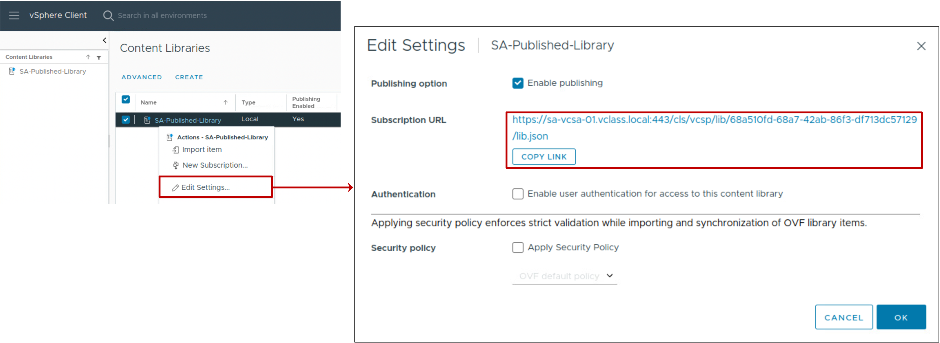
Publishing a Content Library
You can enable publishing on a local content library by editing its settings.
You can add password protection to the library.
Subscribed libraries use the subscription URL to access the published library.

Slide 84
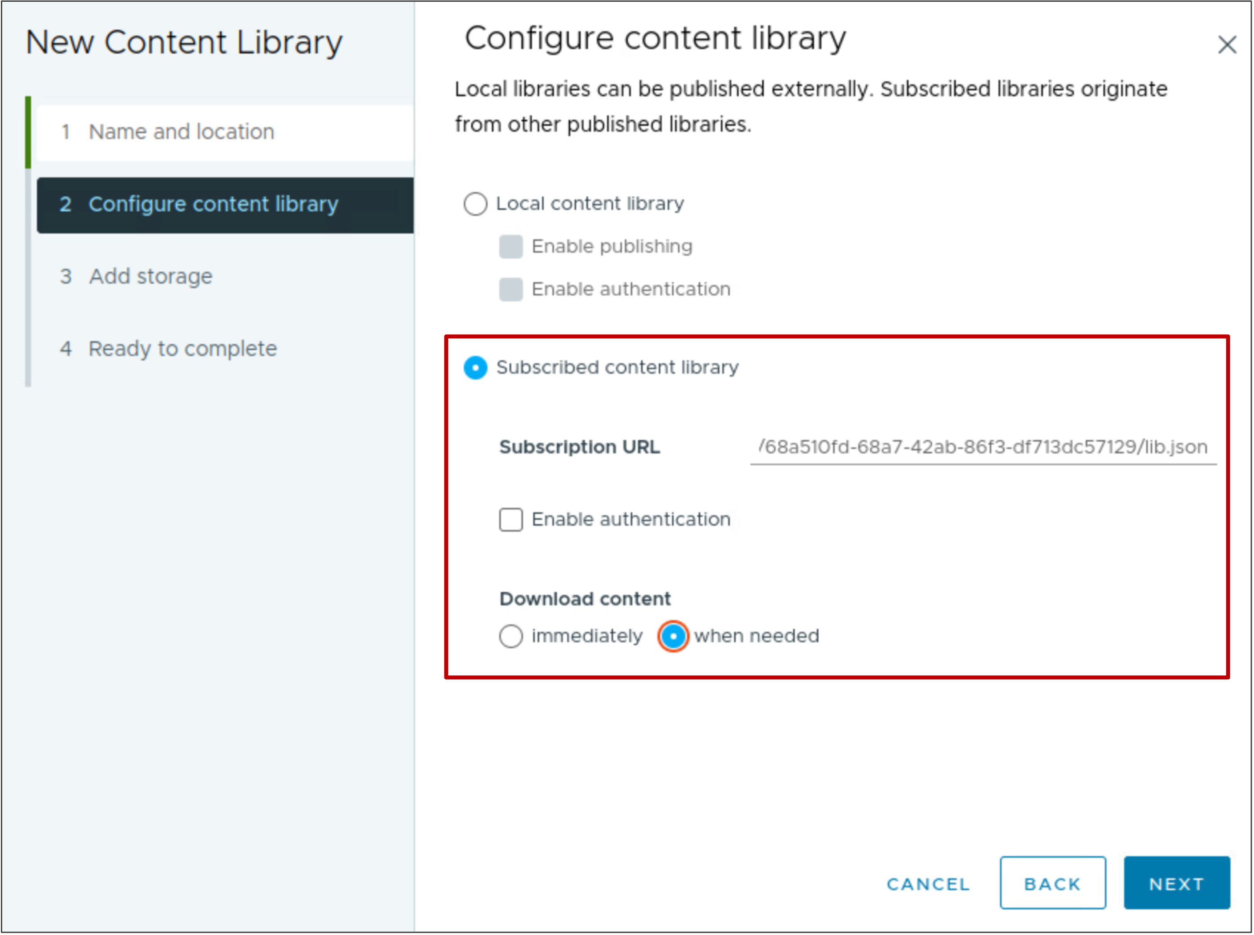
Subscribing to a Content Library
You subscribe a content library to a published content library by configuring the path to the subscription URL:
You can immediately download all library content to the storage location that you configure.
To save space, you can store only metadata for items until they are used.
Notes:
When a content library subscription is created, the administrator selects how the content synchronizes with the published content library. Content can be downloaded immediately if space for the content is not a concern. Synchronization can be set to on-demand so that only the metadata is copied when the subscription is created. The full payload of the content library is downloaded the first time the content is used. So, space is saved because some templates and ISO images are not yet accessed and therefore, not downloaded.

Slide 85
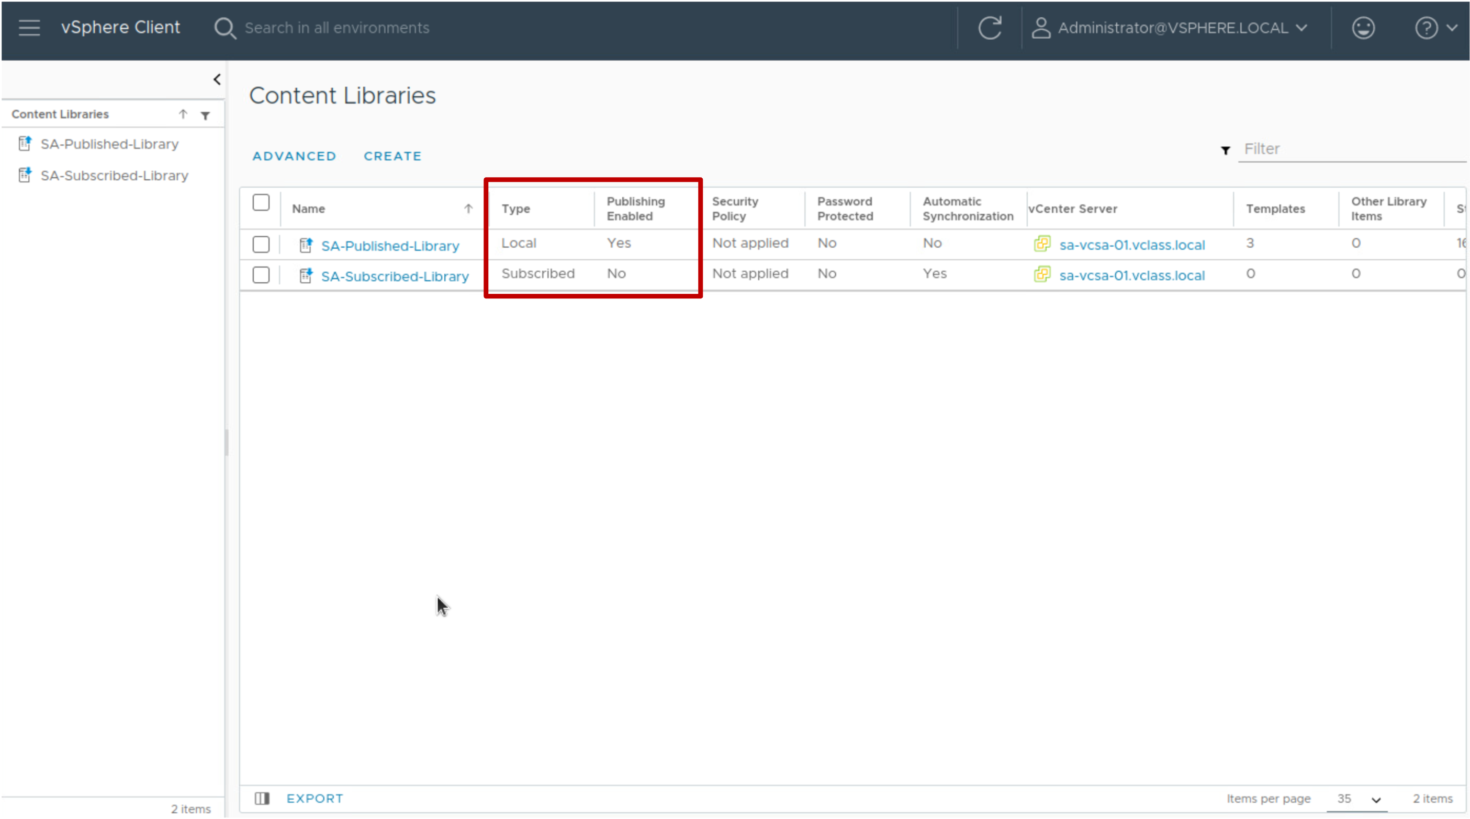
Viewing Content Libraries
The Content Libraries pane shows all local and subscribed libraries and whether publishing is activated on a local library.

Slide 86
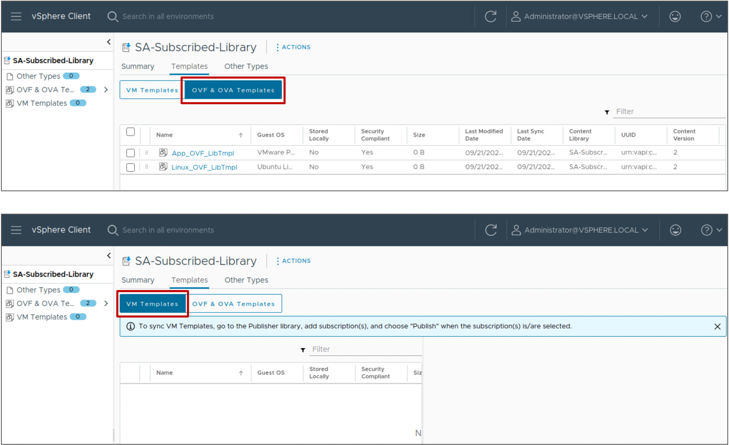
Viewing Subscribed Content Library Templates
The OVF & OVA Templates pane lists OVF templates. To update the list, you select ACTIONS > Synchronize.
The VM Templates pane lists VM templates. To update the list, you must create and publish subscription in the published library to push VM templates to the subscribed library.
Notes:
You can synchronize only OVF templates. If a subscriber initiates synchronization with a published library that contains both VM templates and OVF templates, only the OVF templates are synchronized in the subscribed library. VM templates are synchronized when a publisher library publishes them to its subscribers.
You can publish only VM templates. If you publish an entire library that contains both VM templates and OVF templates, only the VM templates are replicated to the subscriber. To synchronize OVF templates and other types of files, the subscriber must initiate the synchronization.

Slide 87
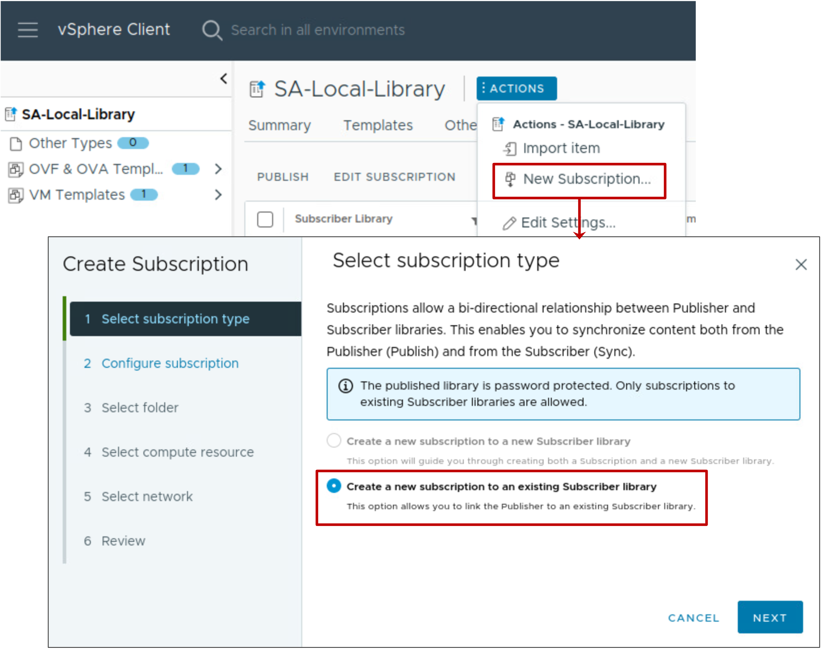
Creating a Subscription to Publish VM Templates
From the published library pane, select ACTIONS > New Subscription and create a subscription.
After the subscription is created, select the subscription in the list and click PUBLISH.
If you add new VM templates to the published library, you must publish them so that the subscribed library receives them.
Notes:
Subscriptions enable you to publish library items to a subscriber whenever you want. Create a subscription for a publisher library to control the distribution of templates to the subscriber.

Slide 88
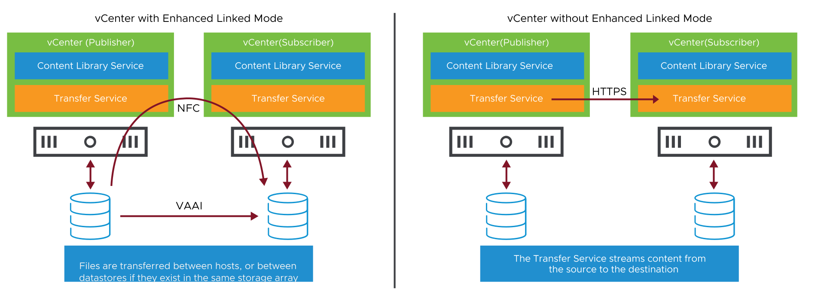
Synchronizing Libraries With or Without Enhanced Linked Mode
Transfer speeds are optimized during the synchronization of published and subscribed content libraries in the same vCenter Single Sign-On domain.
Notes:
If Enhanced Linked Mode is configured across vCenter instances and the ESXi hosts can communicate with each other, then replication takes place between ESXi hosts using NFC. If the datastores used by the published and subscribed libraries exist in the same storage array, then VAAI is used for more efficient transfers.
When Enhanced Linked Mode is not available, the contents of a published library must be streamed over HTTPS through the Transfer Service component. In such a case, three scenarios are possible, based on the storage configuration:
Both published and subscribed libraries reside on a datastore.
Both published and subscribed libraries reside on an NFS file system mounted on the vCenter instances.
The published library resides on an NFS file system, whereas the subscribed library resides on a datastore.
When any item is changed in a content library, the item number is incremented to note the modification. The version number for the content library as a whole is also incremented. This process is called simple versioning. The Content Library Service determines whether synchronization should occur by using simple versioning. Simple versioning does not store multiple versions or offer rollback features, it is purely a numerical value that is assigned to the content library and its content.
The content library's version number is checked first.
If this number matches the one in the published and subscribed libraries, no synchronization is required.
If a discrepancy is found, the version number of each item in the library is checked.
If discrepancies are found, only items with such discrepancies are synchronized.

Slide 89
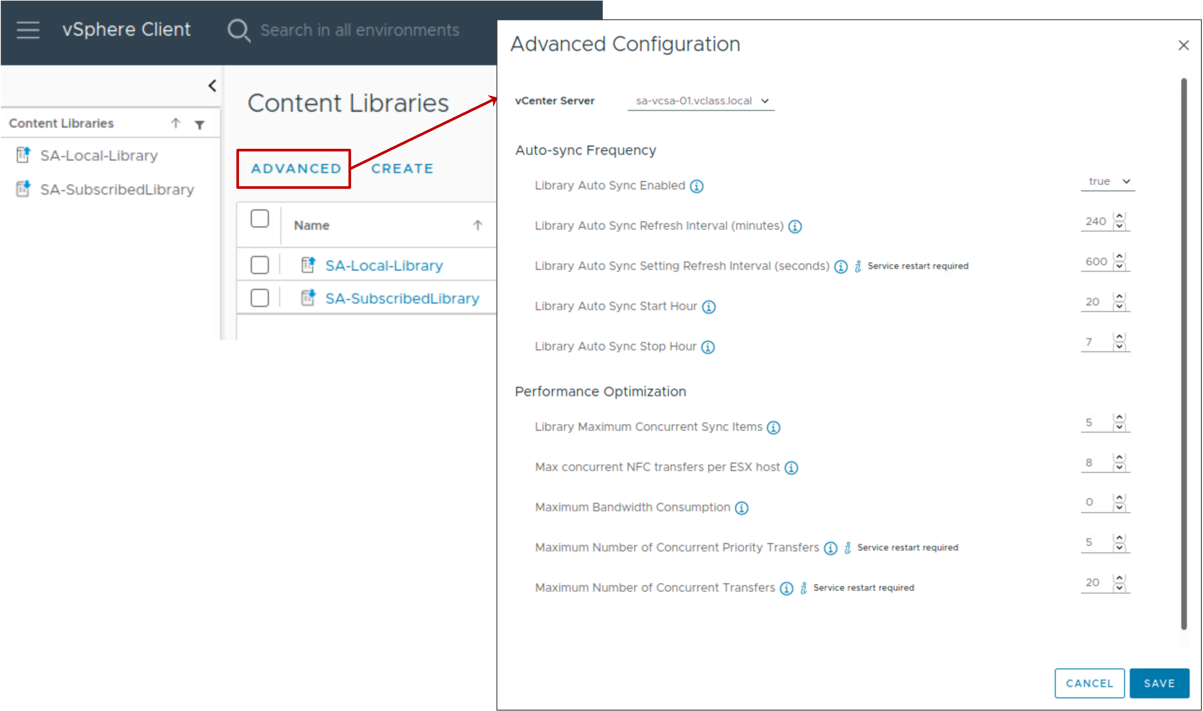
Advanced Configuration
You can use the Advanced Configuration page to control and optimize how a published library stores and synchronizes content.

Slide 90
Content Library Maximums
The content library has the following configuration maximums.
Configuration Item | Maximum
Content library item size | 1 TB
Total items per library | 1,000
Total library items per vCenter instance (across all libraries) | 2,000
Maximum number of concurrent sync operations on the published library’s vCenter instance | 16
Total number of libraries per vCenter instance | 1,000
Notes:
The content library can be supported by a datastore or stored to available storage on vCenter. Regardless of the option selected, the content library can be supported only by a single file system or datastore. The maximum size of a library item is 1 TB. A content library can hold a maximum of 1,000 items and a total of 2,000 items across all libraries in a vCenter instance. The maximum number of concurrent synchronization operations on the published library’s vCenter instance is 16. Automatic synchronization occurs once every 240 minutes by default, but the time and frequency can be configured through the content library advanced configuration settings. The administrator can synchronize an entire content library or an individual item at any time through the vSphere Client.

Slide 91
Lab 7: Using Subscribed Content Libraries
Publish a local content library and create a second library that subscribes to it:
Publish a Local Content Library
Create a Subscribed Content Library
Create a Subscription for VM Templates
Deploy a VM from the Subscribed Content Library

Slide 92
Review of Learner Objectives
Publish content libraries
Subscribe to a published content library

Slide 93
Managing Templates in a Content Library

Slide 94
Learner Objectives
Manage multiple versions of VM templates in content libraries

Slide 95
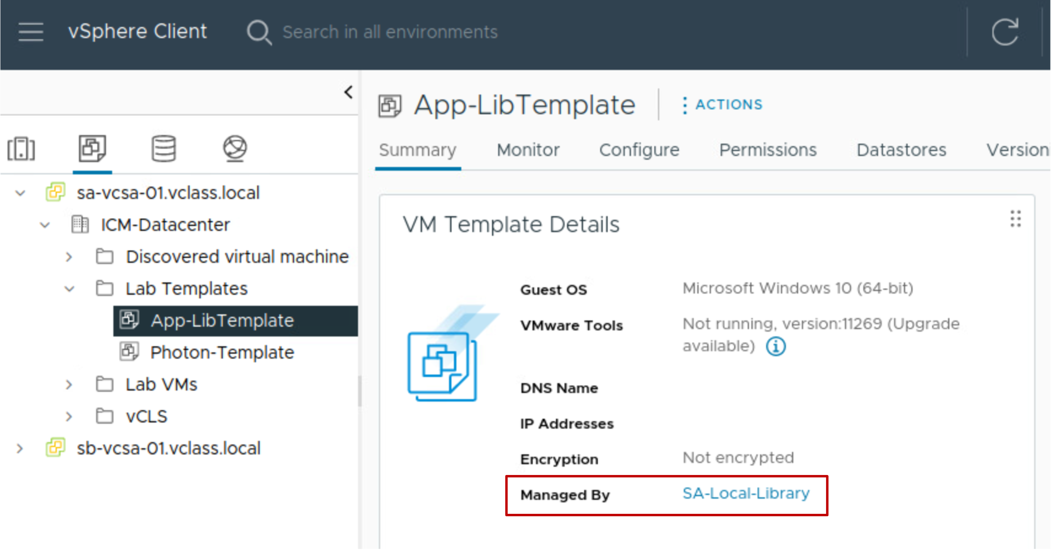
Benefits of Using a Content Library to Manage VM Templates
When managed by a content library, you can work with VM templates in the following ways:
Make changes to VM templates by checking them out.
Deploy VMs while simultaneously patching the VM template.
Get a history of changes made to the VM template.
Access two copies of the VM template, the previous and current versions.
Revert to a previous version of the VM template.
App-LibTemplate is managed by content library SA-Local-Library.
Notes:
Managing VM templates with the content library has several benefits:
You can monitor the changes that have been made by privileged users.
You can patch or modify VMs while the template is being used to deploy VMs.
You can view the history of changes made to a VM.

Slide 96
Overview of the Template Versioning Process
To create a new version of a template, you perform the following steps:
Check out a VM from the template.
Make changes to the VM.
Check in the VM to the template.

Slide 97
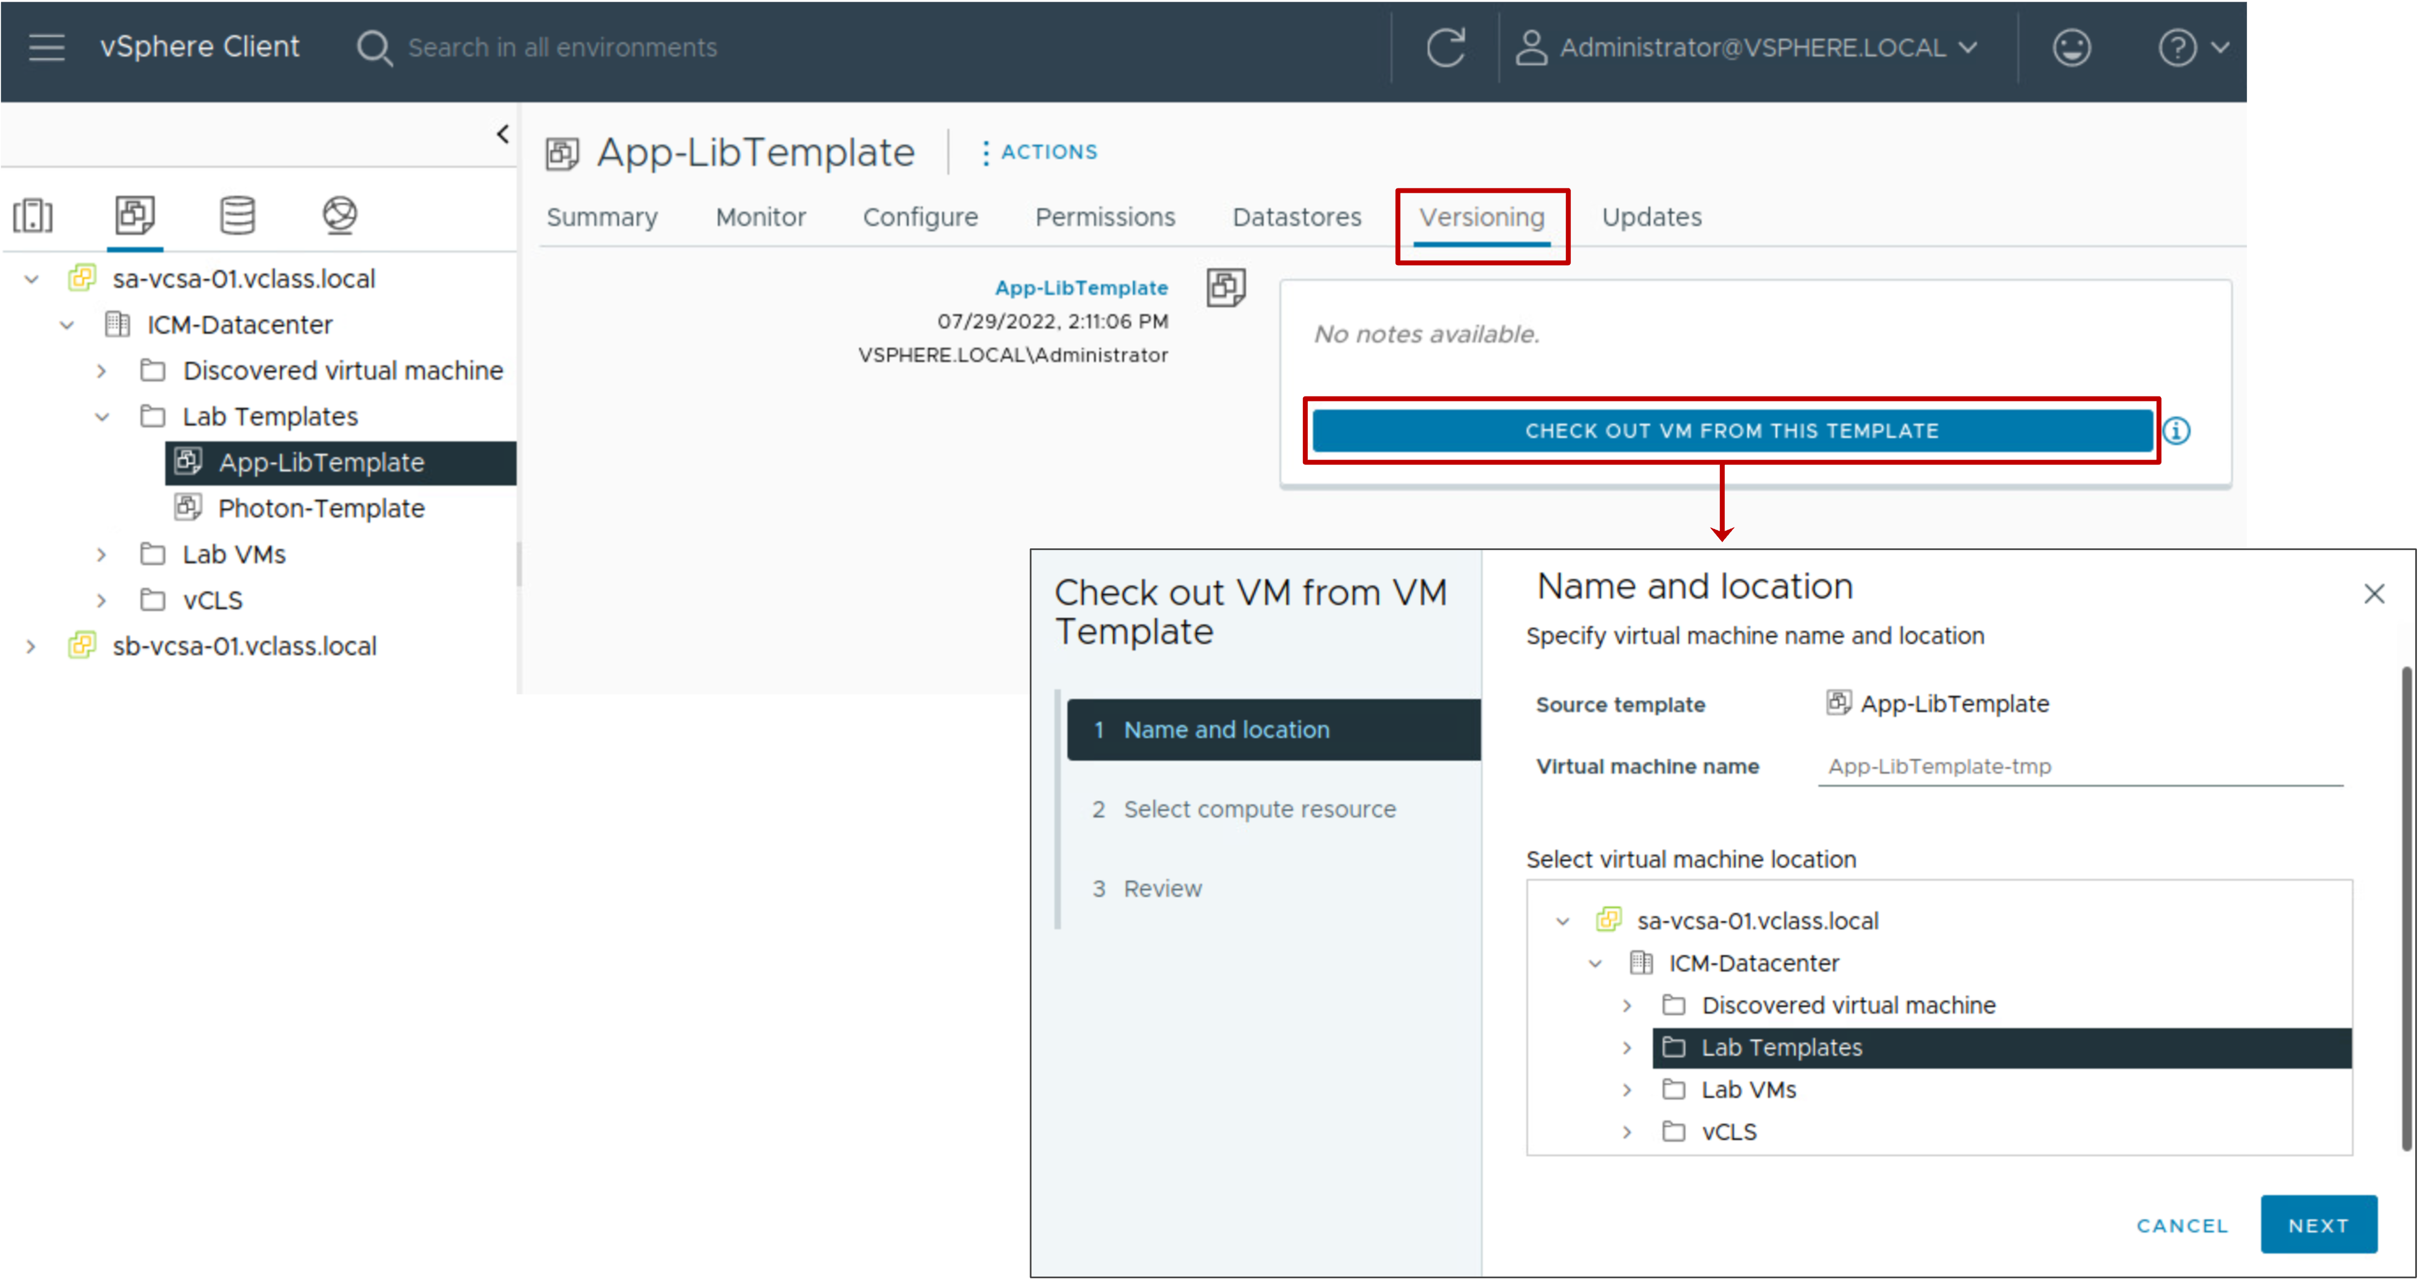
Checking Out a VM from the Template
To update a VM template, you use the Versioning tab to check out a VM from the template.
Notes:
You can perform the checkout operation to update a virtual machine from the VM template. During this process, other users cannot check out the VM template, but they can deploy a virtual machine from the VM template without any disruptions.
When you check out a VM template, you cannot convert the virtual machine to a template or migrate the virtual machine to a different vCenter inventory.

Slide 98

Making Changes to the VM
After checking out the template to a VM, you can make hardware or software changes to the VM.
You can change the VM while the VM template continues to be available for VM deployments.
If you do not want to keep the changes you made to the VM, you can discard the checked out VM.
Notes:
vSphere uses linked clone technology to clone a VM template on checkout. This VM clone is used for changes and updates, whereas the original VM template remains available in the content library to deploy VMs. When the changes to the cloned VM are complete, the VM clone is re-merged with the VM template, the cloned VM is destroyed, and the VM template is updated.
You can discard the checked out virtual machine to avoid creating new versions or to prevent other users from using a faulty version. To discard the checked out VM, click the ellipsis next to the checked out VM and click Discard Checked Out VM.

Slide 99

Checking In the VM to the Template
After making changes to the VM, you check in the VM to the template.
The Check in notes box is required.
Notes:
When you check in the VM to a template, you create a new version of the VM template containing the updated state of the virtual machine.

Slide 100

Viewing Template Versions
The version information appears in the Versioning tab.
Each time you check in the VM back to the template, you create a new version of the VM template.
Notes:
The versioning information highlights the following details:
Who made the updates
When the updates were made
Notes or information added during the updates
The quality of the notes on the Versioning tab can vary, depending on who enters them. Whatever the quality, the notes are captured and retained in the vCenter database until the VM template is deleted.

Slide 101

Deleting and Reverting to Template Versions
Delete a previous version of a VM template if you no longer want to allow the use of the template.
Revert to a VM template version if:
The latest VM template contains changes that you no longer need.
You made a mistake during your last edit.
Notes:
Deleting a VM template removes the template and its content from the inventory.

Slide 102
Lab 8: Versioning Templates in the Content Library
Manage multiple versions of a VM template versioning in the local content library:
Check Out a VM Template in the Content Library
Make Changes to the VM Template
Check In the VM Template to the Content Library
Revert to a Previous Version of the VM Template

Slide 103
Review of Learner Objectives
Manage multiple versions of VM templates in content libraries

Slide 104
Key Points
vCenter provides features for provisioning virtual machines, such as templates, cloning, and content libraries.
By deploying VMs from a template, you can create many VMs easily and quickly.
You can dynamically manage a VM's configuration by adding hot-pluggable devices and increasing the size of a VM's virtual disk.
You can publish a local content library so that other libraries can subscribe and download an exact copy of the data.
You can update a VM template managed by content library while the same VM template is being used to deploy VMs.
Questions?

