Slide 1
Managing Virtual Machines

Slide 2
Importance
Managing VMs effectively requires skills in migrating VMs, taking snapshots, and managing the resources of the VMs.

Slide 3
Module Lessons
Migrating VMs with vSphere vMotion
Configuring Enhanced vMotion Compatibility
Migrating VMs with vSphere Storage vMotion
Cross vCenter Migrations
Creating Virtual Machine Snapshots
Virtual CPU and Memory Concepts
Resource Controls

Slide 4

Migrating VMs with vSphere vMotion

Slide 5
Learner Objectives
Recognize the types of VM migrations that you can perform within a vCenter instance
Explain how vSphere vMotion works
Verify vSphere vMotion requirements
Migrate virtual machines using vSphere vMotion

Slide 6
About VM Migration
Migration means moving a VM from one host, datastore, or vCenter instance to another host, datastore, or vCenter instance.
Migration can be cold or hot:
A cold migration moves a powered-off or suspended VM.
A hot migration moves a powered-on VM.
vCenter performs compatibility checks before migrating suspended or powered-on VMs to ensure that the VM is compatible with the target host.

Slide 7
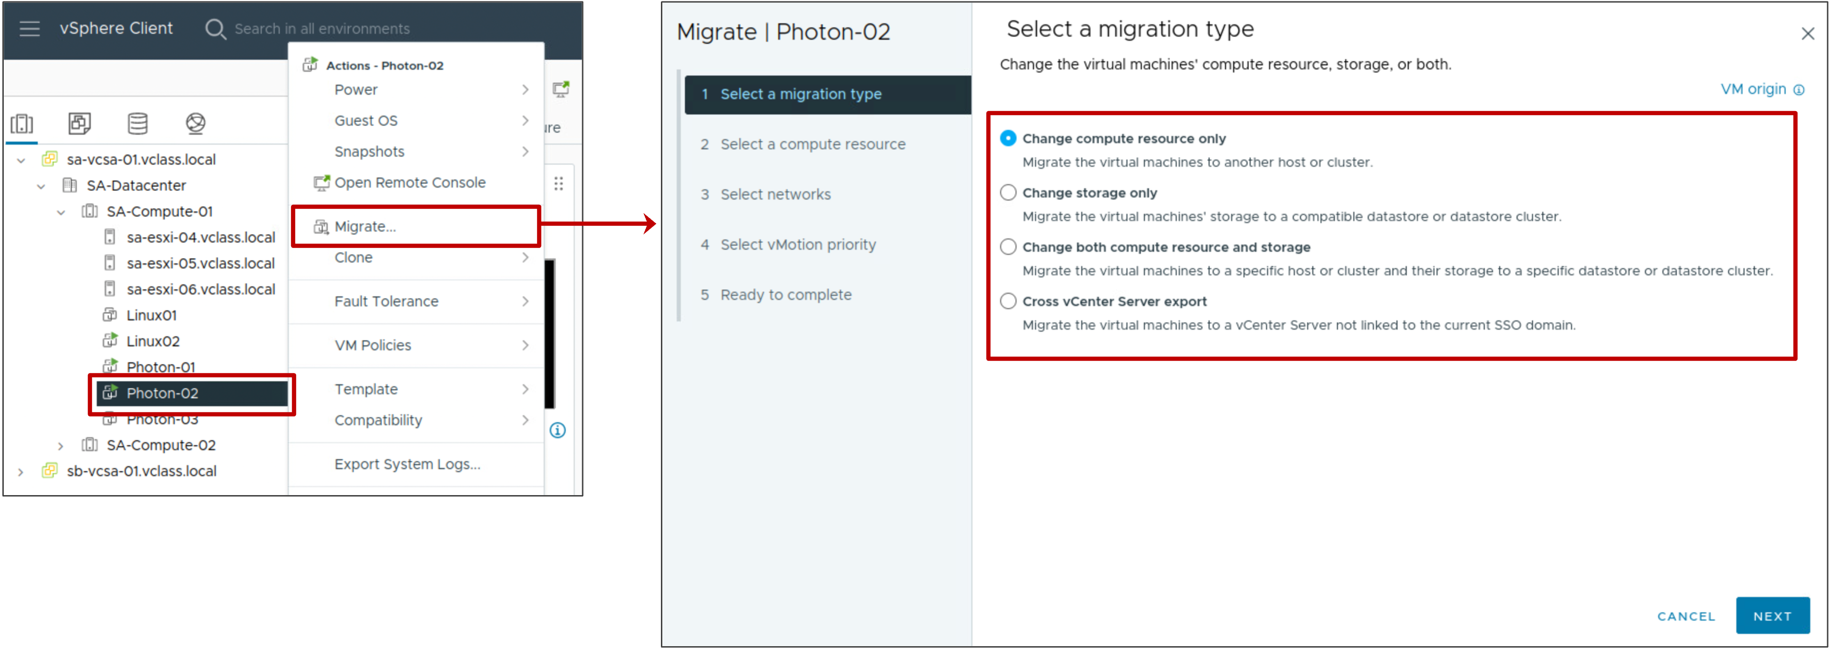
Migration Types
The type of migration that you perform depends on the power state of the VM that you select in the inventory and the migration type that you select in the Migrate wizard.
Notes:
The Migrate wizard provides the following migration options:
Compute resource only:
Move a VM, but not its storage, to another host.
For a hot migration, vSphere vMotion is used to move the VM.
Storage only:
Move a VM's files or objects to a new datastore.
For a hot migration, vSphere Storage vMotion is used to move the VM.
Both compute resource and storage:
Move a VM to another host and datastore.
For a hot migration, vSphere vMotion and vSphere Storage vMotion are used to move the VM.
Cross vCenter Server export:
Move the VM to a host and datastore managed by a different vCenter instance that is not linked to the current SSO domain.
The purpose of the migration determines which migration technique to use. For example, you might need to shut down a host for maintenance but keep the VMs running. Use vSphere vMotion to migrate the VMs instead of performing a cold or suspended VM migration. If you must move a VM’s files to another datastore to better balance the disk load or transition to another storage array, you use vSphere Storage vMotion.
Some migration techniques, such as vSphere vMotion migration, have special hardware requirements that must be met. Other techniques, such as a cold migration, do not have special hardware requirements.

Slide 8
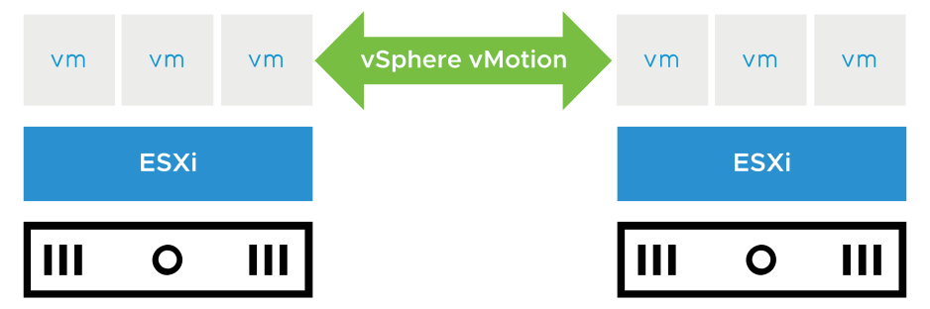
About vSphere vMotion
A vSphere vMotion migration moves a powered-on VM from one host (compute resource) to another.
vSphere vMotion provides the following capabilities:
Improvement in overall hardware use
Continuous VM operation while accommodating scheduled ESXi host downtime
vSphere DRS to balance VMs across hosts
Notes:
Using vSphere vMotion, you can migrate running VMs from one ESXi host to another ESXi host with no disruption or downtime. vSphere DRS uses vSphere vMotion to migrate running VMs from one host to another to ensure that the VMs have the resources that they require.
With vSphere vMotion, the entire state of the VM is moved from one host to another, but the data storage remains in the same datastore.
The state information includes the current memory content and all the information that defines and identifies the VM. The memory content includes transaction data and whatever bits of the operating system and applications are in memory. The definition and identification information stored in the state includes all the data that maps to the VM hardware elements, such as the BIOS or EFI, devices, CPU, and MAC addresses for the Ethernet cards.

Slide 9
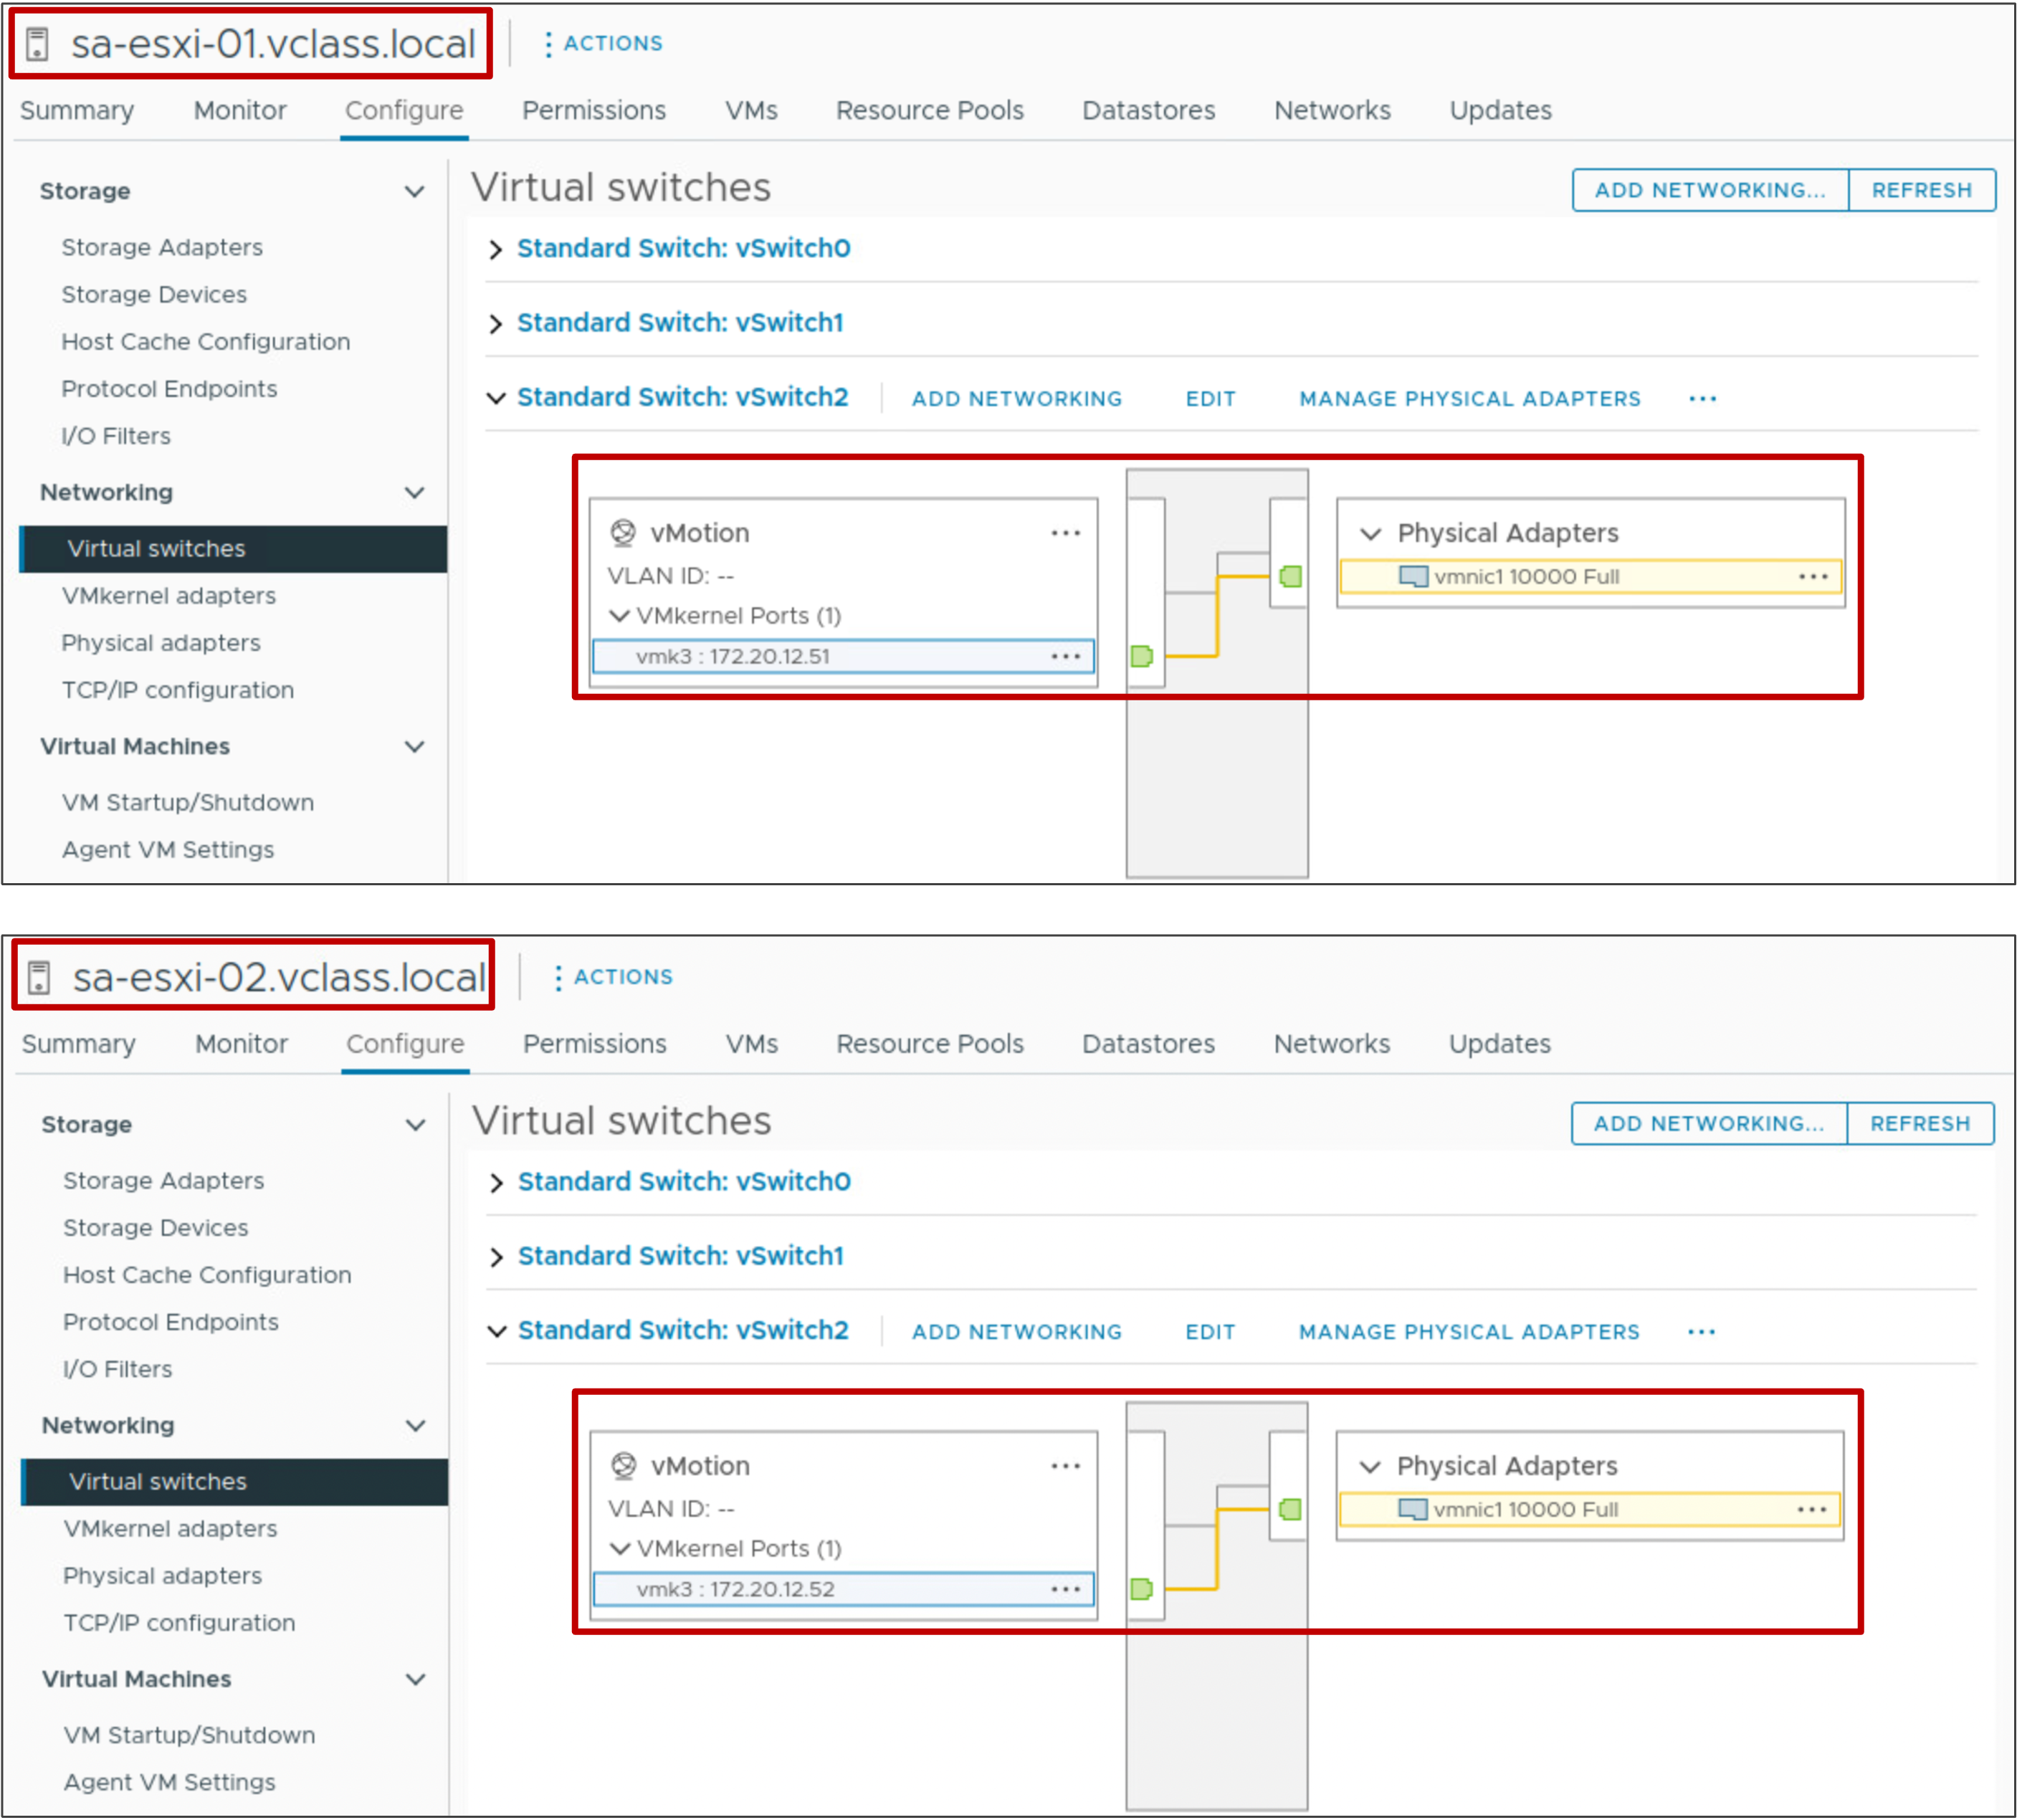
Configuring vSphere vMotion Networks
vSphere vMotion migrations require correctly configured VMkernel adapters on the source and destination hosts.
Notes:
To configure vSphere vMotion networking, you must set up a VMkernel adapter with the vSphere vMotion service activated on the source and destination host.

Slide 10
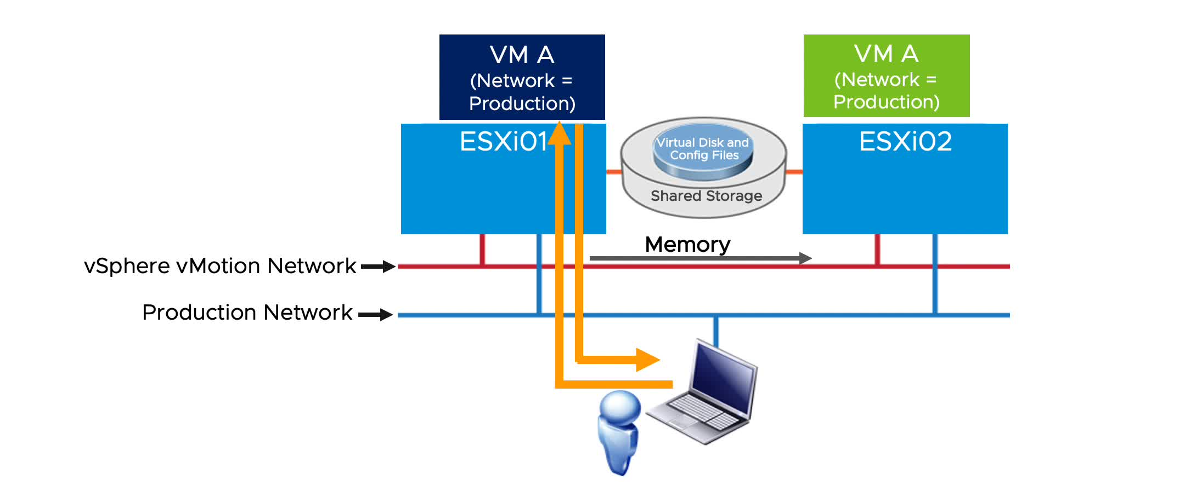
vSphere vMotion Migration Workflow
The source host (ESXi01) and the destination host (ESXi02) can access the shared datastore that holds the VM’s files.
Notes:
To play the animation, go to https://vmware.bravais.com/s/FbzaDb6owpSMKyKc940F.
A vSphere vMotion migration consists of the following steps:
A shadow VM is created on the destination host.
The VM’s memory state is copied over the vSphere vMotion network from the source host to the target host through the vSphere vMotion network. Users continue to access the VM and, potentially, update pages in memory. A list of modified pages in memory is kept in a memory bitmap on the source host.
After the first pass of memory state copy completes, another pass of memory copy is performed to copy any pages that changed during the last iteration. This iterative memory copying continues until the number of changed pages is small enough to copy across within 500 milliseconds.
After most of the VM’s memory is copied from the source host to the target host, the VM is quiesced. No additional activity occurs on the VM. In the quiesce period, vSphere vMotion transfers the VM device state and memory bitmap to the destination host.
Immediately after the VM is quiesced on the source host, the VM is initialized and starts running on the target host. A Gratuitous Address Resolution Protocol (GARP) request notifies the subnet that VM A’s MAC address is now accessible through a different physical switch port. The VM's files are unlocked by the source host and locked by the destination host.
Users access the VM on the target host instead of the source host.
The memory pages that the VM was using on the source host are marked as free.
For a detailed discussion of how vSphere vMotion works, see The vMotion Process Under the Hood at https://blogs.vmware.com/vsphere/2019/07/the-vmotion-process-under-the-hood.html.

Slide 11
VM Requirements for vSphere vMotion Migration
For migration with vSphere vMotion, a VM must meet these requirements:
If it uses an RDM disk, the RDM file and the LUN to which it maps must be accessible by the destination host.
It must not have a connection to a virtual device, such as a CD/DVD or floppy drive, with a host-local image mounted.
You can use vSphere vMotion to migrate a VM with a device that is attached through a remote console (such as a physical device or disk image).
Notes:
For the complete list of vSphere vMotion migration requirements, see vCenter Server and Host Management at https://docs.vmware.com/en/VMware-vSphere/index.html.

Slide 12
Host Requirements for vSphere vMotion Migration (1)
Source and destination hosts must have the following characteristics:
Accessibility to all the VM’s storage:
128 concurrent migrations are possible per datastore.
If the swap file location on the destination host differs from the swap file location on the source host, the swap file is copied to the new location.
VMkernel port with vSphere vMotion activated
Matching management network IP address families (IPv4 or IPv6) between the source and destination hosts
Notes:
You cannot migrate a VM from a host that is registered to vCenter with an IPv4 address to a host that is registered with an IPv6 address.
Copying a swap file to a new location can result in slower migrations. If the destination host cannot access the specified swap file location, it stores the swap file with the VM configuration file.

Slide 13
Host Requirements for vSphere vMotion Migration (2)
The number of concurrent, active vSphere vMotion tasks is a function of the vSphere vMotion network speed:
Each active vSphere vMotion process requires a minimum throughput of 250 Mbit/second (Mbps) on the vSphere vMotion network.
Concurrent migrations are limited to four on a 1 Gbps network.
Concurrent migrations are limited to eight on a 10 Gbps (or faster) network.
For better performance, dedicate at least two VMkernel port groups to the vSphere vMotion traffic.
Compatible CPUs:
The CPU feature sets of both the source host and the destination host must be compatible.
Some features can be hidden by using Enhanced vMotion Compatibility or compatibility masks.
Notes:
For more details on host requirements for vSphere vMotion, see vCenter Server and Host Management at https://docs.vmware.com/en/VMware-vSphere/index.html.

Slide 14
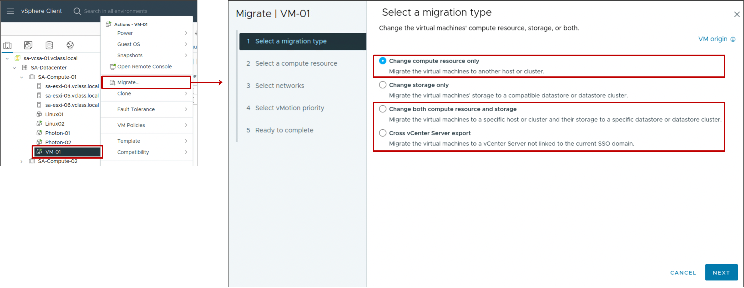
Performing a vSphere vMotion Migration
vSphere vMotion is used to move a powered-on VM to a different host.
Notes:
Whenever you migrate a powered-on VM, vSphere vMotion performs the work of moving the VM from one host to another. The host is also known as the compute resource.
The Migrate wizard has a few options for moving a VM from one compute resource to another.
Change compute resource
Change both compute resource and storage
Cross vCenter Server export
In all of these cases, if the VM being migrated is powered on, then vSphere vMotion performs the migration.

Slide 15
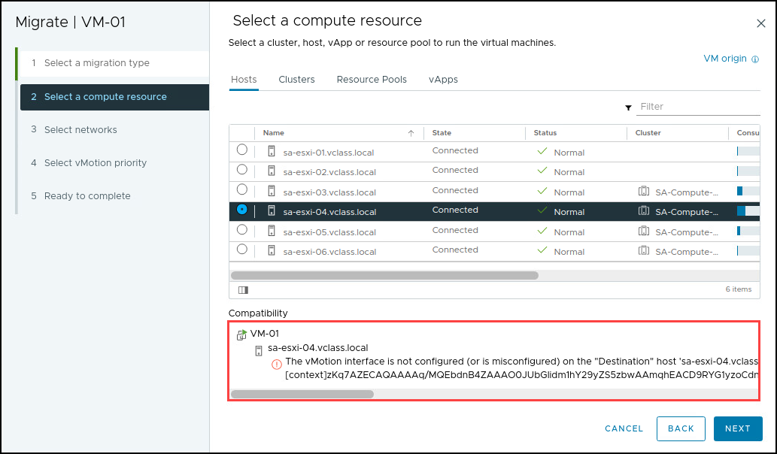
Checking Migration Errors
When you select the host or cluster, validation checks are performed to verify that most vSphere vMotion requirements are met.
Notes:
If validation succeeds, you can continue in the wizard. If validation does not succeed, a list of vSphere vMotion errors and warnings displays in the Compatibility pane.
With warnings, you can still perform a vSphere vMotion migration. But with errors, you cannot continue. You must exit the wizard and fix all errors before retrying the migration.
If a failure occurs during the vSphere vMotion migration, the VM is not migrated and continues to run on the source host.

Slide 16
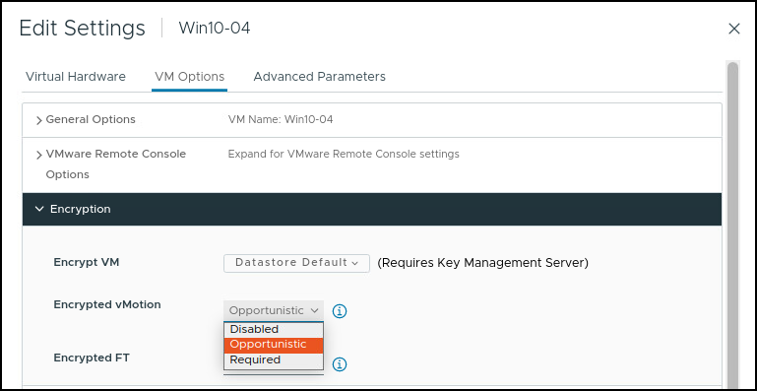
Migrating Encrypted VMs
When powered-on, encrypted VMs are migrated, encrypted vSphere vMotion is automatically used.
For VMs that are not encrypted, select one of the following encrypted vSphere vMotion menu items:
Disabled
Opportunistic (default): Encrypted vSphere vMotion is used if the source and destination hosts support it
Required: If the source or destination host does not support encrypted vSphere vMotion, the migration fails
Notes:
Encrypted vSphere vMotion secures confidentiality, integrity, and authenticity of data that is transferred using vSphere vMotion. Encrypted vSphere vMotion supports all variants of vSphere vMotion, including migration across vCenter systems. Encrypted vSphere Storage vMotion is not supported.
You cannot turn off encrypted vSphere vMotion for encrypted VMs.

Slide 17
Lab 1: vSphere vMotion Migrations
Configure vSphere vMotion networking and migrate virtual machines using vSphere vMotion:
Configure vSphere vMotion Networking on sa-esxi-01.vclass.local
Configure vSphere vMotion Networking on sa-esxi-02.vclass.local
Prepare Virtual Machines for vSphere vMotion Migration
Migrate Virtual Machines Using vSphere vMotion

Slide 18
Review of Learner Objectives
Recognize the types of VM migrations that you can perform within a vCenter instance
Explain how vSphere vMotion works
Verify vSphere vMotion requirements
Migrate virtual machines using vSphere vMotion

Slide 19
Configuring Enhanced vMotion Compatibility

Slide 20
Learner Objectives
Describe the role of Enhanced vMotion Compatibility in migrations
Configure EVC CPU mode on a vSphere cluster
Explain how per-VM EVC CPU mode works with vSphere vMotion
Configure EVC Graphics mode on a vSphere cluster or a VM

Slide 21
CPU Constraints on vSphere vMotion Migration
CPU compatibility between source and target hosts is a vSphere vMotion requirement that must be met.
CPU Characteristics | Exact Match Required By Source Host and Target Host | Reason
Clock speeds, cache sizes, hyperthreading, and number of cores | No | The VMkernel virtualizes these characteristics.
Manufacturer (Intel or AMD) family and generation (Opteron4, Intel Westmere) | Yes | Instruction sets contain many small differences.
Presence or absence of SSE3, SSSE3, or SSE4.1 instructions | Yes | Multimedia instructions are usable directly by applications.
Virtualization hardware assist | For 32-bit VMs: No | The VMkernel virtualizes this characteristic.
 | For 64-bit VMs on Intel: Yes | Intel 64-bit with VMware implementation uses Intel VT.
Notes:
Depending on the CPU characteristic, an exact match between the source and target host might or might not be required. For example, if hyperthreading is activated on the source host and deactivated on the destination host, the vSphere vMotion migration continues because the VMkernel handles this difference in characteristics.
But, if the source host processor supports SSE4.1 instructions and the destination host processor does not support them, the hosts are considered incompatible and the vSphere vMotion migration fails. SSE4.1 instructions are application-level instructions that bypass the virtualization layer and might cause application instability if mismatched after a migration with vSphere vMotion.

Slide 22
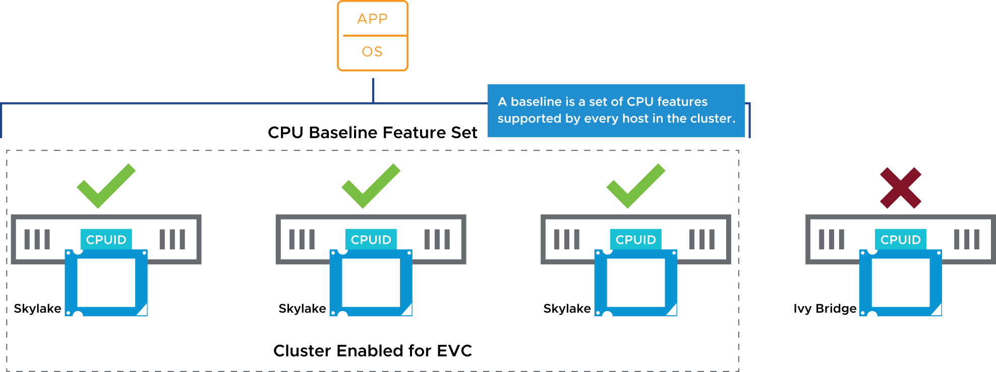
About Enhanced vMotion Compatibility
Enhanced vMotion Compatibility is a cluster feature that enables vSphere vMotion migrations between hosts without identical feature sets.
The feature uses CPU baselines to configure all the processors in the cluster that are activated for Enhanced vMotion Compatibility.
Notes:
Enhanced vMotion Compatibility verifies that all hosts in a cluster present the same CPU feature set to VMs, even if the CPUs on the hosts differ.
Enhanced vMotion Compatibility facilitates safe vSphere vMotion migration across a range of CPU generations. With Enhanced vMotion Compatibility, you can use vSphere vMotion to migrate VMs among CPUs that otherwise are considered incompatible.
With Enhanced vMotion Compatibility, vCenter can enforce vSphere vMotion compatibility among all hosts in a cluster by forcing hosts to expose a common set of CPU features (baseline) to VMs. A baseline is a set of CPU features that are supported by every host in the cluster. When you configure Enhanced vMotion Compatibility, you set all host processors in the cluster to present the features of a baseline processor. After the features are activated for a cluster, hosts that are added to the cluster are automatically configured to the CPU baseline.
Hosts that cannot be configured to the baseline are not permitted to join the cluster. VMs in the cluster always see an identical CPU feature set, no matter on which host they run. Because the process is automatic, Enhanced vMotion Compatibility is easy to use and requires no specialized knowledge of CPU features and masks.

Slide 23
EVC Cluster Requirements for CPU Mode
All hosts in the cluster must meet several CPU-based requirements:
Use CPUs from a single vendor, either Intel or AMD.
Be activated for hardware virtualization: AMD-V or Intel VT.
Be activated for execution-disable technology: AMD No eXecute (NX) or Intel eXecute Disable (XD).
Be configured for vSphere vMotion migration.
Applications in VMs must be CPU ID compatible.
Notes:
Before you create an Enhanced vMotion Compatibility cluster, ensure that the hosts that you intend to add to the cluster meet the requirements.
Enhanced vMotion Compatibility automatically configures hosts whose CPUs have Intel FlexMigration and AMD-V Extended Migration technologies to be compatible with vSphere vMotion with hosts that use older CPUs.
For Enhanced vMotion Compatibility to function properly, the applications on the VMs must be written to use the CPU ID machine instruction for discovering CPU features, as recommended by the CPU vendors. vSphere cannot support Enhanced vMotion Compatibility with applications that do not follow the CPU vendor recommendations for discovering CPU features.
To determine which EVC modes are compatible with your CPU, search the VMware Compatibility Guide at http://www.vmware.com/resources/compatibility. Search for the server model or CPU family, and click the entry in the CPU Series column to display the compatible EVC modes.

Slide 24
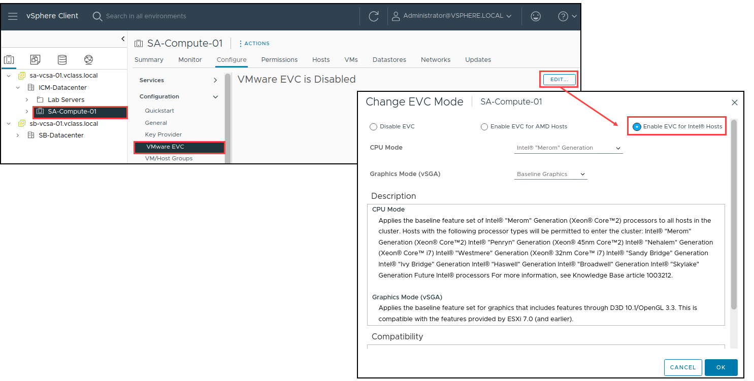
Configuring EVC CPU Mode on an Existing Cluster
You configure EVC CPU mode on an existing cluster to ensure vSphere vMotion CPU compatibility between the hosts in the cluster.
Notes:
You can use one of the following methods to create an Enhanced vMotion Compatibility cluster:
Create an empty cluster with EVC mode configured and move hosts into the cluster.
Configure EVC mode on an existing cluster.
To activate EVC on an existing cluster, all hosts must be placed in maintenance mode, and therefore all VMs in the existing cluster must be powered off or suspended. To avoid VM downtime, the recommended method for activating EVC is to activate this feature on a new, empty cluster.
For information about Enhanced vMotion Compatibility processor support, see VMware knowledge base article 1003212 at http://kb.vmware.com/kb/1003212.

Slide 25
Changing the EVC Mode for a Cluster
Several EVC mode approaches are available to ensure CPU compatibility:
If all the hosts in a cluster are compatible with a newer EVC mode, you can change the EVC mode of an existing Enhanced vMotion Compatibility cluster.
You can configure EVC mode for a cluster that does not have EVC mode configured.
You can raise or lower the EVC mode, but the VMs must be in the correct power state to do so.
EVC Mode | VM Power Action
Raise the EVC mode to a CPU baseline with more features. | Running VMs can remain powered on. New EVC mode features are not available to the VMs until they are powered off and powered back on again (Suspending and resuming the VM is not sufficient.)
Lower the EVC mode to a CPU baseline with fewer features. | Power off VMs if they are powered on and running at a higher EVC mode than the one you intend to configure.

Slide 26
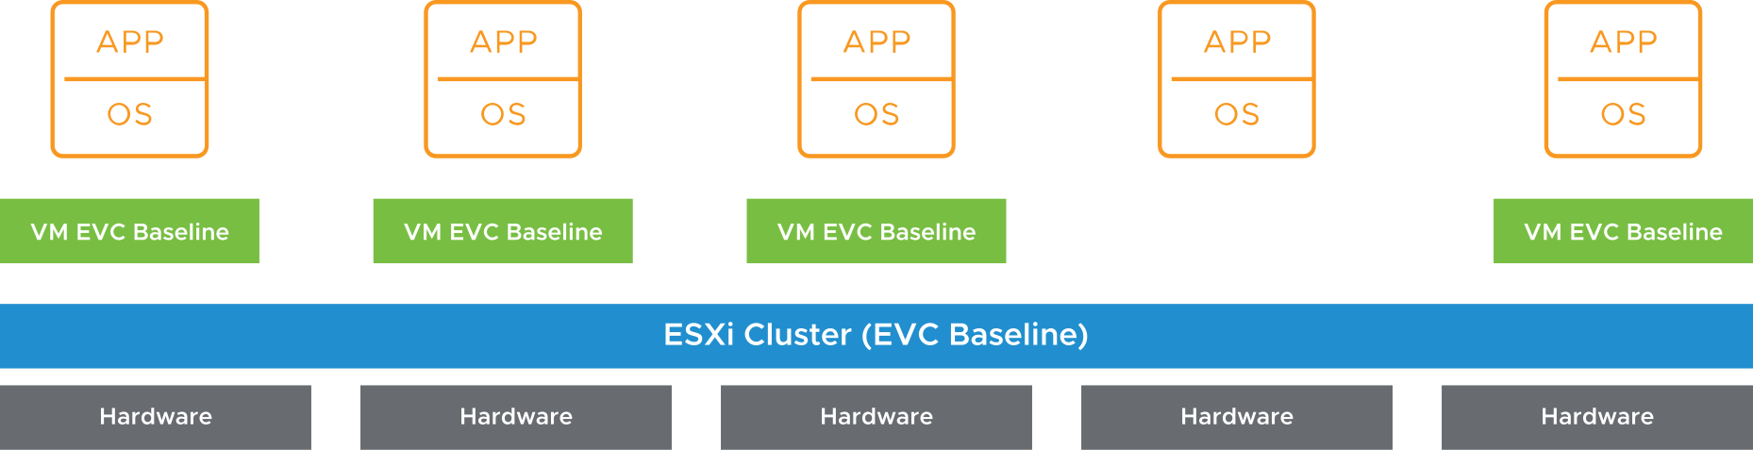
Virtual Machine EVC CPU Mode
EVC mode can be applied to some or all VMs in a cluster:
At the VM level, EVC mode facilitates the migration of VMs beyond the cluster and across vCenter systems and data centers.
You can apply more granular definitions of Enhanced vMotion Compatibility for specific VMs.
VM EVC mode is independent of the EVC mode defined at the cluster level.
Notes:
With per-VM EVC mode, the EVC mode becomes an attribute of the VM rather than the specific processor generation it happens to be booted on in the cluster. This feature supports seamless migration between two data centers that have different processors. Further, the feature is persisted per VM and does not lose the EVC mode during migrations across clusters or during power cycles.
In this diagram, EVC mode is not configured on the cluster. The cluster consists of differing CPU models with different feature sets. The VMs with per-VM EVC mode can run on any ESXi host that can satisfy the defined EVC mode.

Slide 27
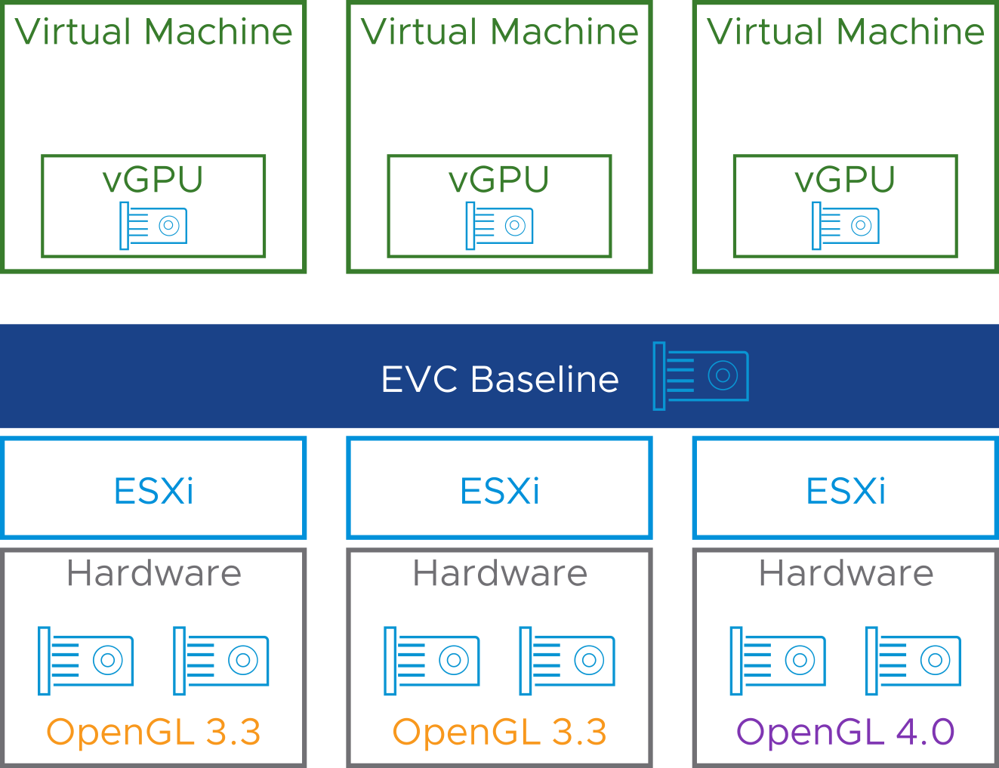
Enhanced vMotion Compatibility for vSGA GPUs
EVC can also define a common baseline of GPU feature sets in a cluster.
Notes:
Features not included in the applied baseline are masked and not exposed to VMs.
Enhanced vMotion Compatibility for vSGA is supported with hardware GPUs and also software GPU renderers.

Slide 28
EVC Cluster Requirements for Graphics Mode
EVC for vSGA GPUs is configured at the ESXi cluster level:
All ESXi hosts must satisfy GPU requirements of the defined baseline.
Additional hosts cannot join the cluster if they cannot satisfy the baseline requirements.
A mixed cluster of ESXi 6.7 and ESXi 7.0 hosts is supported when using Enhanced vMotion Compatibility at a cluster level.
EVC for vSGA GPUs is configured at a virtual machine level:
VM compatibility for ESXi 7.0 Update 1 is required (virtual machine hardware version 18).
VMs using GPU Enhanced vMotion Compatibility at a VM level must run on ESXi 7.0 Update 1.

Slide 29
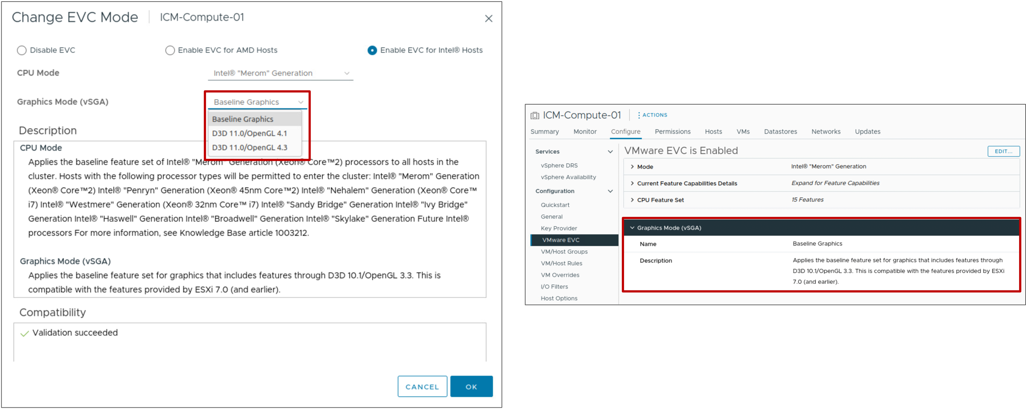
Configuring EVC Graphics Mode on an Existing Cluster
At the cluster level, you configure EVC for vSGA in the same EVC settings as EVC for CPU.

Slide 30
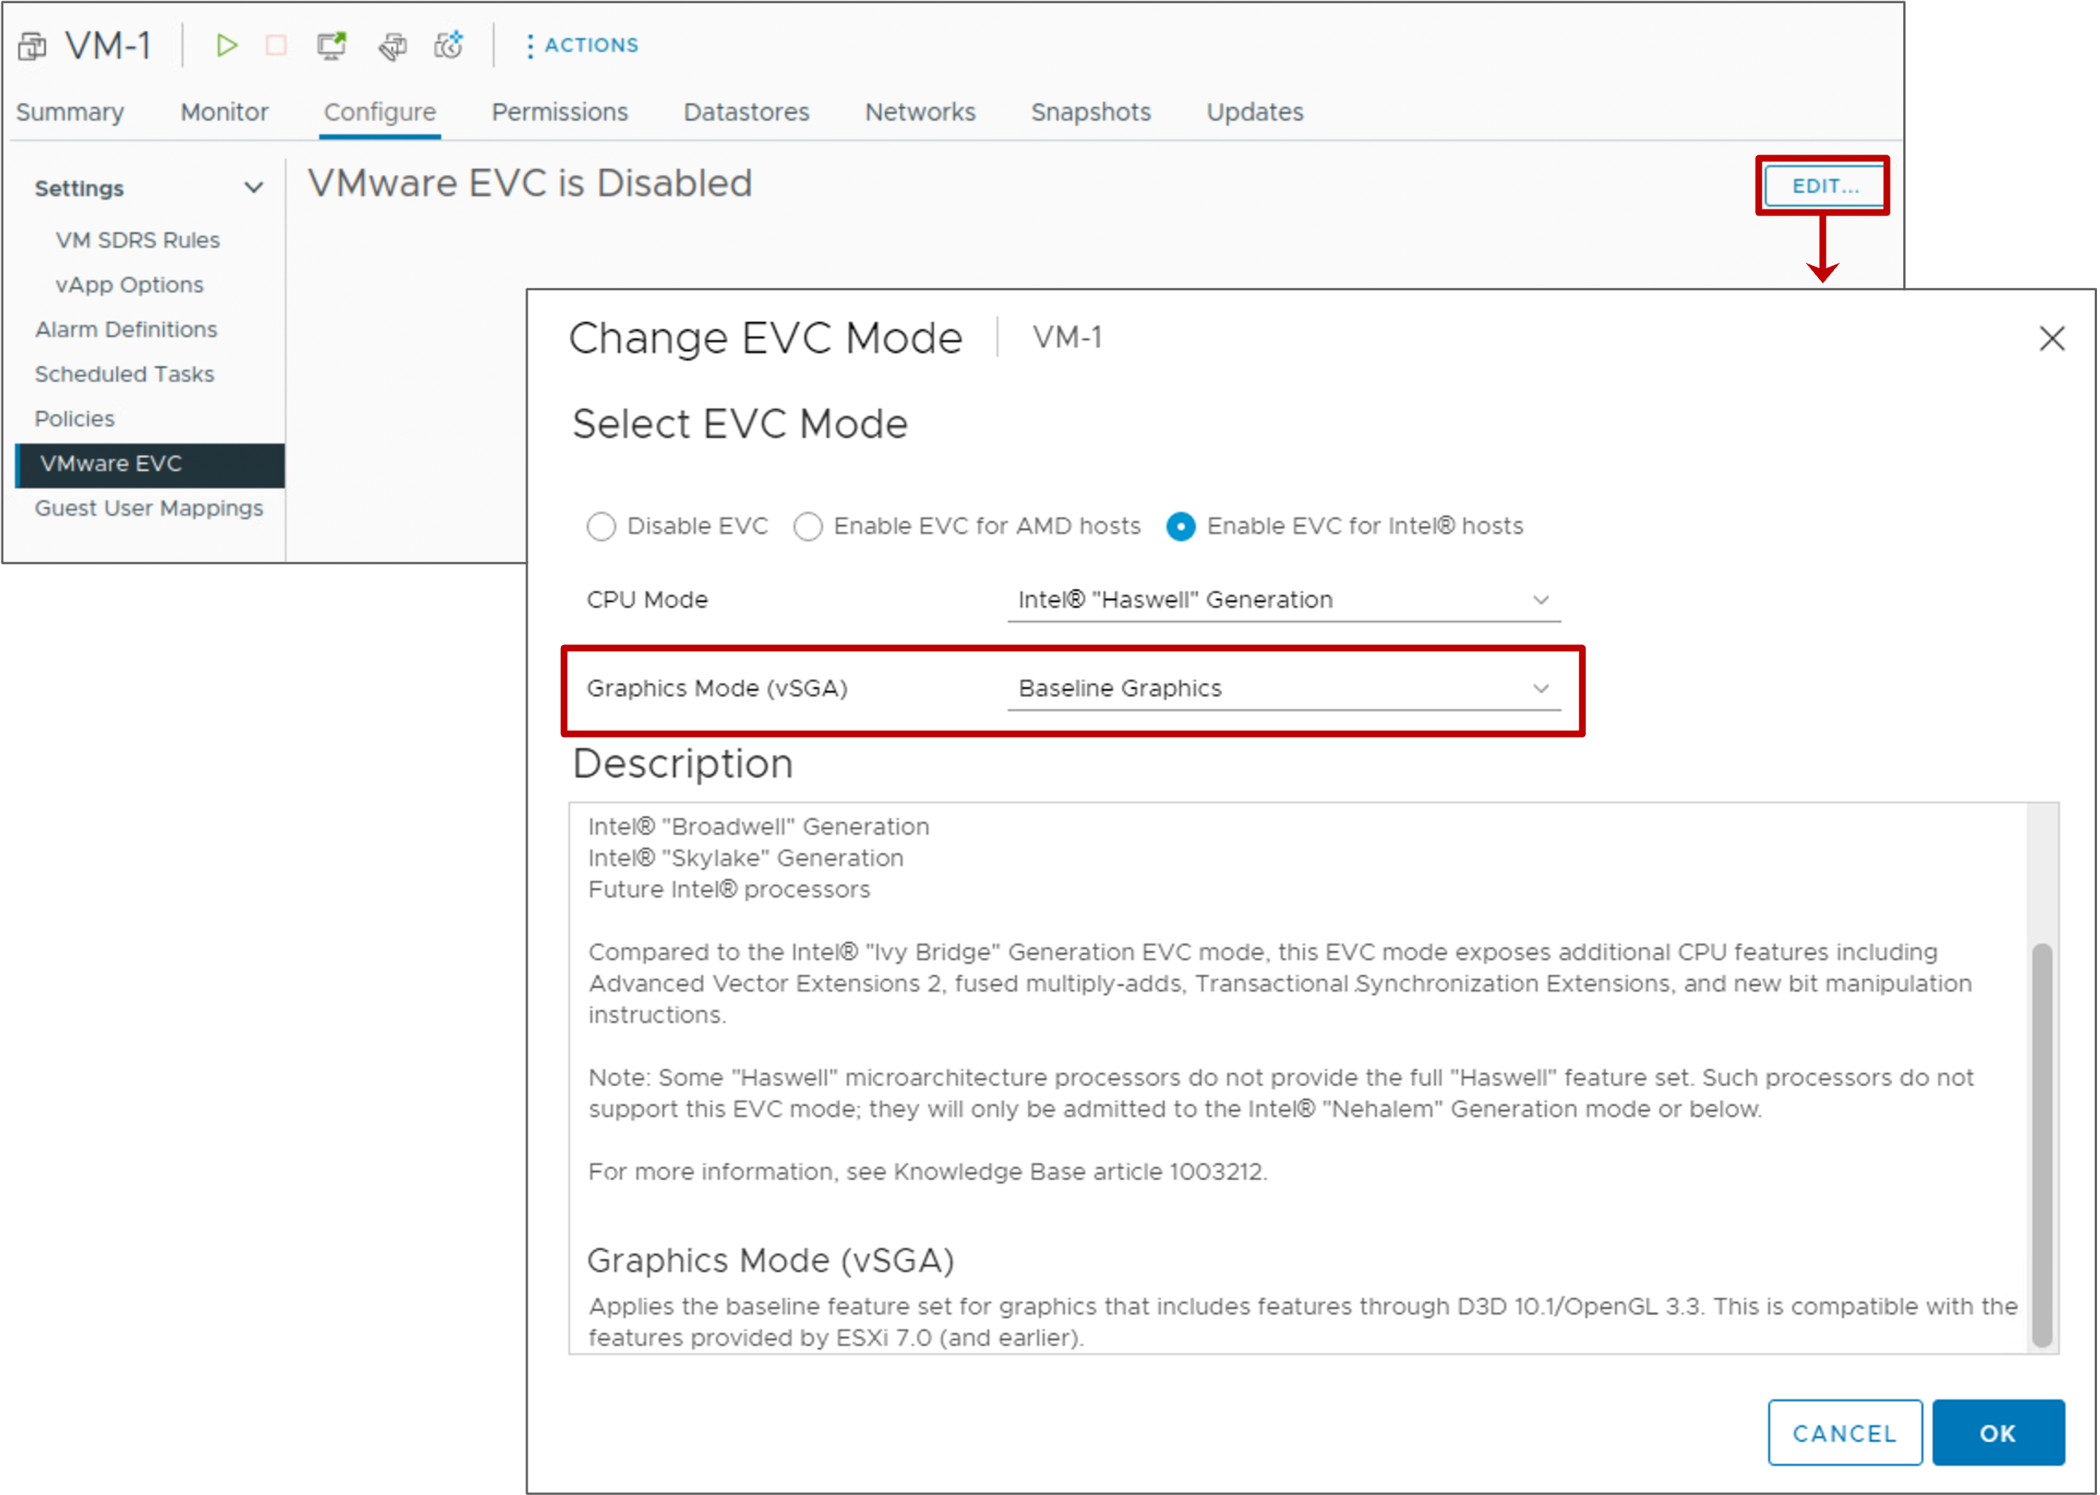
Virtual Machine EVC Graphics Mode
At the VM level, you configure EVC for vSGA in the same VM EVC settings as EVC for CPU.

Slide 31
Review of Learner Objectives
Describe the role of Enhanced vMotion Compatibility in migrations
Configure EVC CPU mode on a vSphere cluster
Explain how per-VM EVC CPU mode works with vSphere vMotion
Configure EVC Graphics mode on a vSphere cluster or a VM

Slide 32
Migrating VMs with vSphere Storage vMotion

Slide 33
Learner Objectives
Explain how vSphere Storage vMotion works
Recognize guidelines for using vSphere Storage vMotion
Migrate virtual machines using vSphere Storage vMotion
Migrate both the compute resource and storage of a virtual machine

Slide 34
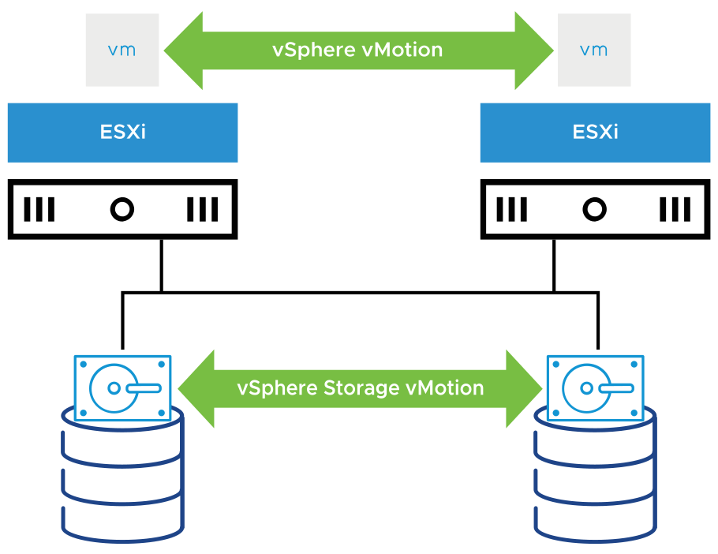
About vSphere Storage vMotion
With vSphere Storage vMotion, you can migrate a powered-on VM from one datastore to another datastore of any type.
Using vSphere Storage vMotion, you can perform the following tasks:
Move VMs off arrays for maintenance or to upgrade.
Change the disk provisioning type.
Change VM files on the destination datastore to match the inventory name of the VM.
Migrate between datastores to balance traffic across storage paths and reduce latencies.
Redistribute VMs or virtual disks to different storage volumes to balance capacity or improve performance.
Notes:
vSphere Storage vMotion provides flexibility to relocate virtual disks for performance or transform disk types, which you can use to reclaim space.
You can place the VM and all its disks in a single location, or you can select separate locations for the VM configuration file and each virtual disk. During a migration with vSphere Storage vMotion, the VM does not change the host that it runs on.
Whether performing a vSphere Storage vMotion migration or a cold migration, you can rename a VM's files on the destination datastore. The migration renames all virtual disk, configuration, snapshot, and .nvram files.

Slide 35
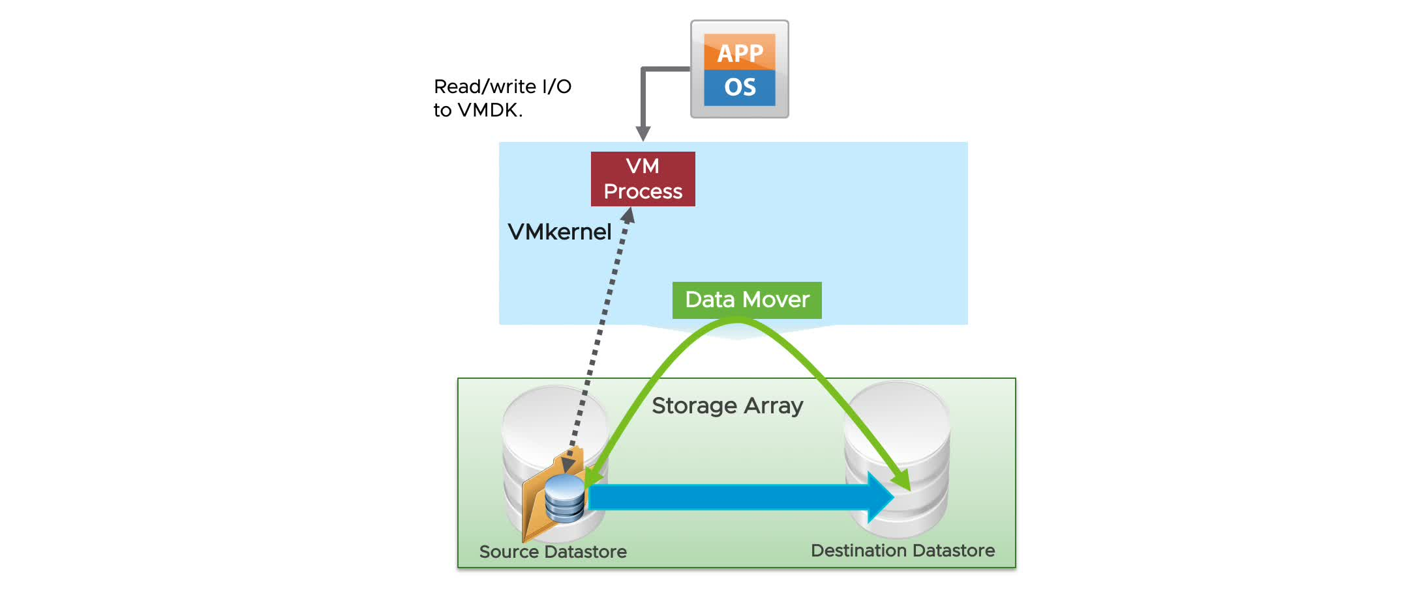
vSphere Storage vMotion In Action
vSphere Storage vMotion uses an I/O mirroring architecture to copy disk blocks between the source and destination.
Notes:
To play the animation, go to https://vmware.bravais.com/s/FnHZwq043PJ8dV3ZRV7p.
The vSphere Storage vMotion migration process includes the following steps:
Initiate storage migration.
Use the VMkernel data mover or vSphere Storage APIs – Array Integration to copy data.
Start a new VM process.
Mirror I/O calls to file blocks that are already copied to the virtual disk on the destination datastore.
Transition to the destination VM process to begin accessing the virtual disk copy.
The storage migration process does a single pass of the disk, copying all the blocks to the destination disk. If blocks are changed after they are copied, the blocks are synchronized from the source to the destination through the mirror driver, with no need for recursive passes.
This approach guarantees complete transactional integrity and is fast enough to be unnoticeable to the end user. The mirror driver uses the VMkernel data mover to copy blocks of data from the source disk to the destination disk. The mirror driver synchronously mirrors writes to both disks during the vSphere Storage vMotion operation.
Finally, vSphere Storage vMotion operations are performed either internally on a single ESXi host or offloaded to the storage array. Operations performed internally on the ESXi host use a data mover built into the VMkernel. Operations are offloaded to the storage array if the array supports vSphere Storage APIs - Array Integration, also called hardware acceleration.

Slide 36
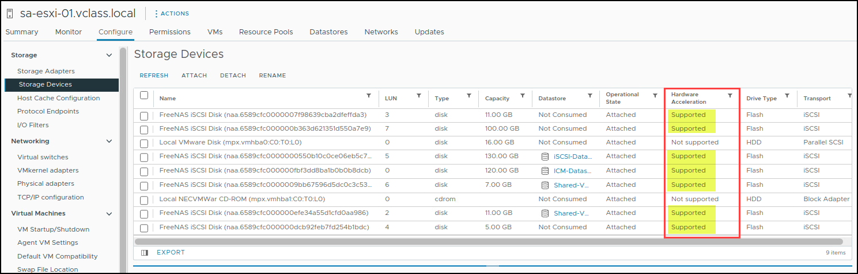
Identifying Storage Arrays That Support vSphere Storage APIs – Array Integration
vSphere Storage vMotion offloads its operations to the storage array if:
The array supports VMware vSphere Storage APIs – Array Integration, also called hardware acceleration.
Both datastores are located within the same storage array.
Use the vSphere Client to determine whether your storage array supports hardware acceleration.

Slide 37
vSphere Storage vMotion Guidelines and Limitations
Guidelines:
Plan the migration and coordinate with administrators
Perform migrations during off-peak hours
Limitation:
Independent virtual machine disks must be in persistent mode
Notes:
A VM and its host must meet certain resource and configuration requirements for the virtual machine disks (VMDKs) to be migrated with vSphere Storage vMotion. One of the requirements is that the host on which the VM runs must have access both to the source datastore and to the target datastore.
During a migration with vSphere Storage vMotion, you can change the disk provisioning type. Migration with vSphere Storage vMotion changes VM files on the destination datastore to match the inventory name of the VM. The migration renames all virtual disk, configuration, snapshot, and .nvram files. If the new names exceed the maximum filename length, the migration does not succeed.

Slide 38
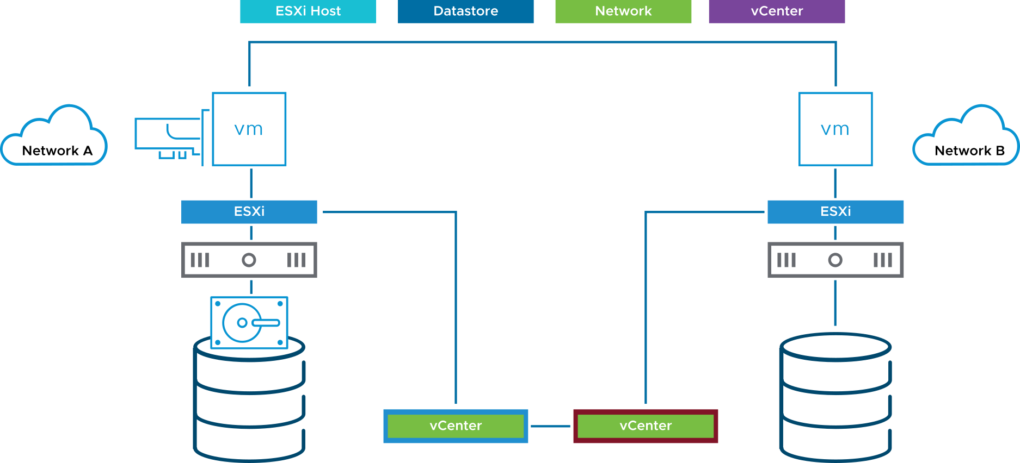
Changing Both Compute Resource and Storage During Migration
When you change both compute resource and storage during migration, a VM changes its host and datastore and optionally its network, either within or across vCenter instances.
This technique combines vSphere vMotion and vSphere Storage vMotion into a single operation.
You can migrate VMs across clusters, data centers, and vCenter instances.
Notes:
You can migrate VMs beyond storage accessibility boundaries and between hosts, within and across clusters, data centers, and vCenter instances.

Slide 39
Use Cases for Changing Both Compute Resource and Storage
Compute resource and storage migration is useful in the following cases:
Migrating a VM located on a host's local storage to a host that uses shared storage
Migrating a VM to a new cluster, when the target cluster does not have access to the source cluster's storage
Migrating a VM to a different data center, whose storage is not shared with the source data center
Migrating a VM to a different vCenter instance, whose storage is not shared with the source vCenter instance

Slide 40
Lab 2: vSphere Storage vMotion Migrations
Use vSphere Storage vMotion to migrate virtual machines:
Migrate Virtual Machine Files from One Datastore to Another
Migrate Both the Compute Resource and Storage of a Virtual Machine

Slide 41
Review of Learner Objectives
Explain how vSphere Storage vMotion works
Recognize guidelines for using vSphere Storage vMotion
Migrate virtual machines using vSphere Storage vMotion
Migrate both the compute resource and storage of a virtual machine

Slide 42
Cross vCenter Migrations

Slide 43
Learner Objectives
Recognize the types of VM migrations that you can perform across vCenter instances

Slide 44
About Cross vCenter Migrations
With vSphere vMotion, you can migrate VMs between vCenter instances, whether or not they are in the same Enhanced Linked Mode group.
Cross vCenter migrations are helpful in the following cases:
Balancing workloads across clusters and vCenter instances that are in the same site or in another geographical area.
Moving VMs between environments that have different purposes, for example, from a development environment to production environment.
Moving VMs to meet different service level agreements (SLAs) for storage space, performance, and so on.
Moving VMs from an on-premises vSphere data center to a data center in the public cloud, such as VMware Cloud on AWS.

Slide 45
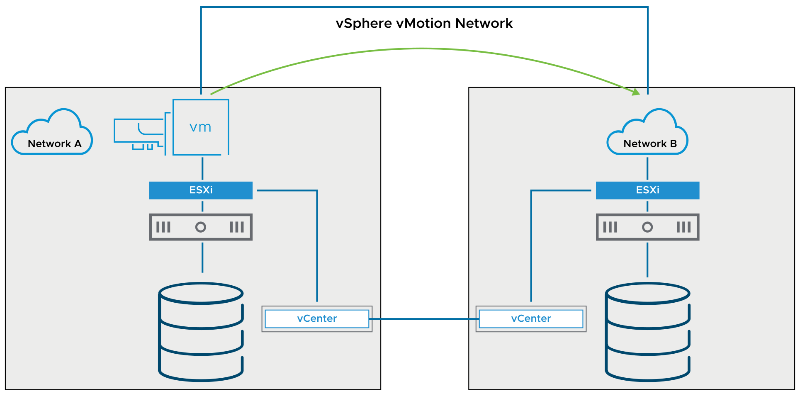
Cross vCenter Migration Requirements
Cross vCenter migrations have the following requirements:
Hosts must be time-synchronized.
Both vCenter instances can be in the same or different vCenter Single Sign-On domain.
Notes:
Cross vCenter migrations must meet the following requirements:
Both vCenter instances must be time-synchronized with each other for correct vCenter Single Sign-On token verification.
Both vCenter instances do not need to be in the same Enhanced Linked Mode group.
For migration of compute resources only, both vCenter instances must be connected to the shared storage on which the VM is located.
You can perform cross vCenter migrations between vCenter instances of different versions. For information on the supported versions, see VMware knowledge base article 2106952 at http://kb.vmware.com/kb/2106952.

Slide 46
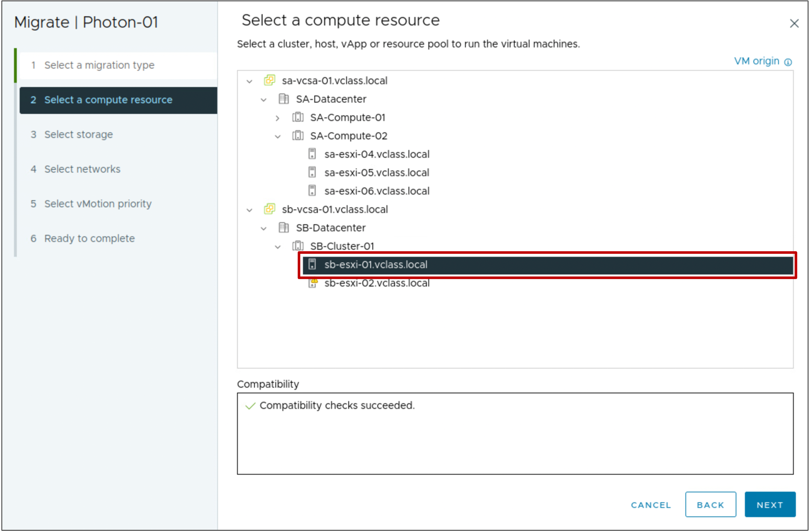
Performing a Cross vCenter vMotion in Same SSO Domain
In the Migrate wizard, select a compute resource at the destination vCenter instance.

Slide 47
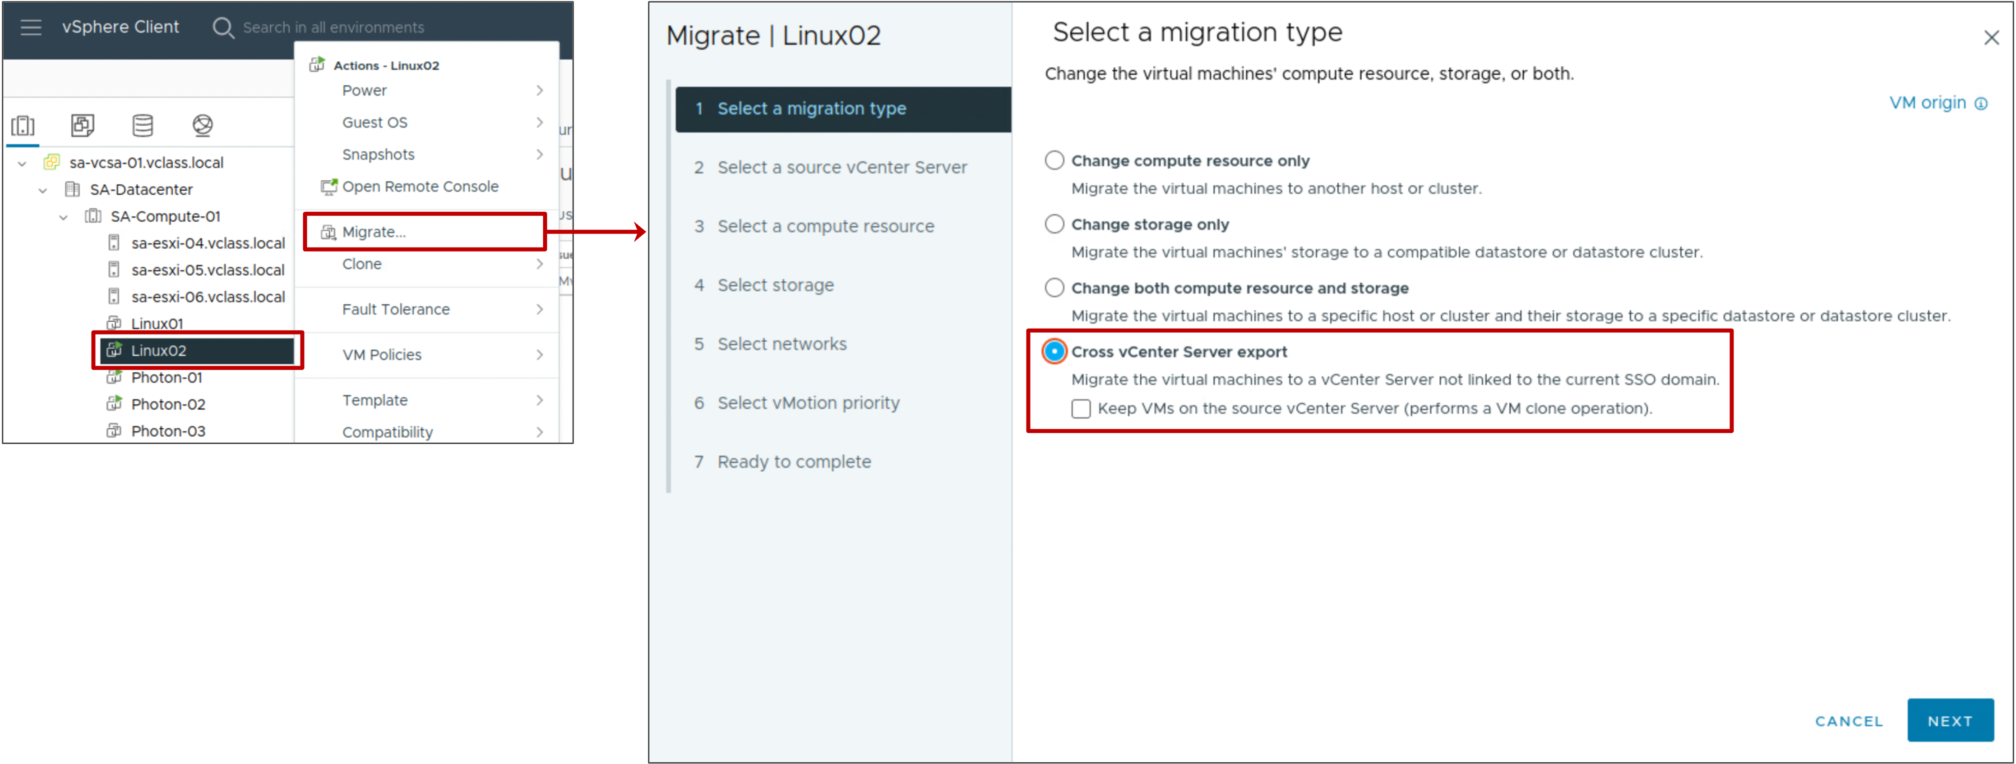
Performing a Cross vCenter vMotion in Different SSO Domain (1)
From the Migrate wizard, select Cross vCenter Server export as the migration type.
Optionally, you can clone the VM rather than migrate it.
Notes:
In the Migrate wizard, you specify the FQDN or IP address of the target vCenter instance and the vCenter credentials. The other wizard options are similar to the option for changing both compute resource and storage: you select the compute resource, datastore, and VM network to use in the target vCenter instance.

Slide 48
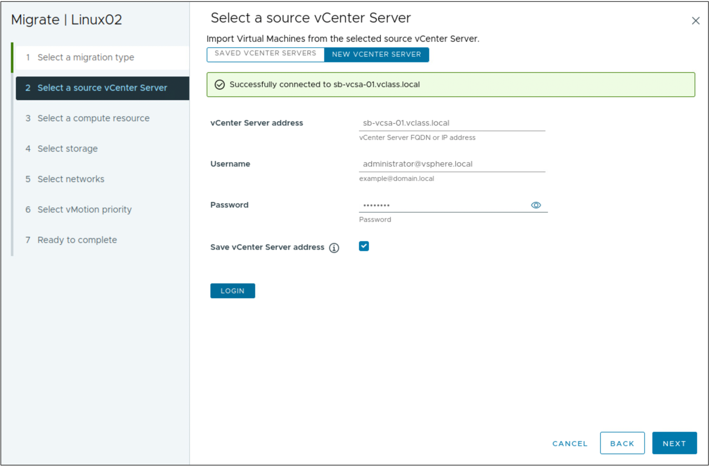
Performing a Cross vCenter vMotion in Different SSO Domain (2)
Then, you specify the FQDN or IP address of the target vCenter instance and the vCenter credentials.
Notes:
The other wizard options are similar to the option for changing both compute resource and storage: you select the compute resource, datastore, and VM network to use in the target vCenter instance.

Slide 49
Network Checks for Cross vCenter Migrations
vCenter performs several network compatibility checks to prevent the following configuration problems:
MAC address incompatibility on the destination host
vSphere vMotion migration from a distributed switch to a standard switch
vSphere vMotion migration between distributed switches of different versions

Slide 50
VMkernel Networking Layer and TCP/IP Stacks
The VMkernel networking layer provides connectivity to hosts and handles the standard system traffic of vSphere vMotion, IP storage, vSphere Fault Tolerance, vSAN, and others.
TCP/IP stacks at the VMkernel level that are configured by default:
Default TCP/IP stack
vSphere vMotion TCP/IP stack
Provisioning TCP/IP stack
You can also create a custom TCP/IP stack.
Notes:
Consider the following key points about TCP/IP stacks at the VMkernel level:
Default TCP/IP stack: Provides networking support for the management traffic between vCenter and ESXi hosts and for system traffic such as vSphere vMotion, IP storage, and vSphere Fault Tolerance.
vSphere vMotion TCP/IP stack: Supports the traffic for hot migrations of VMs.
Provisioning TCP/IP stack: Supports the traffic for VM cold migration, cloning, and snapshot creation. You can use the provisioning TPC/IP stack to handle NFC traffic during long-distance vSphere vMotion migration. VMkernel adapters configured with the provisioning TCP/IP stack handle the traffic from cloning the virtual disks of the migrated VMs in long-distance vSphere vMotion.
By using the provisioning TCP/IP stack, you can isolate the traffic from the cloning operations on a separate gateway. After you configure a VMkernel adapter with the provisioning TCP/IP stack, all adapters on the default TCP/IP stack are deactivated for the provisioning traffic.
Custom TCP/IP stacks: You can create a custom TCP/IP stack on a host to forward networking traffic through a custom application. Open an SSH connection to the host and run the vSphere CLI command:
esxcli network ip netstack add -N="stack_name"
Take appropriate security measures to prevent unauthorized access to the management and system traffic in your vSphere environment. For example, isolate the vSphere vMotion traffic in a separate network that includes only the ESXi hosts that participate in the migration. Isolate the management traffic in a network that only network and security administrators can access.

Slide 51
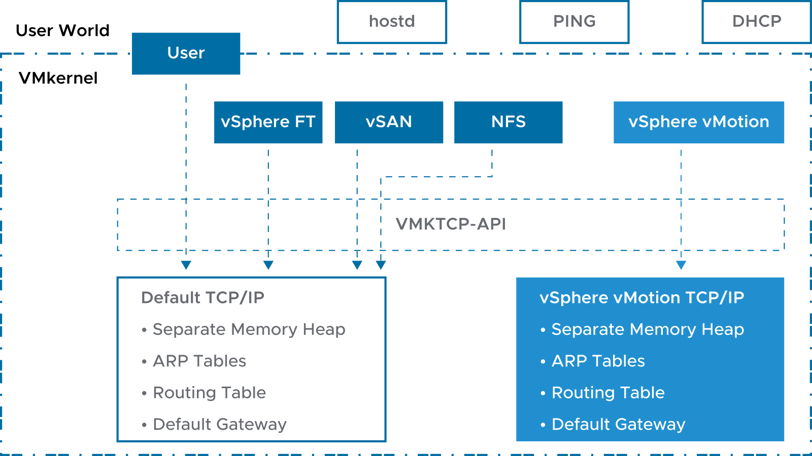
vSphere vMotion TCP/IP Stacks
Each ESXi host has a second TCP/IP stack that is dedicated to vSphere vMotion migration.
Notes:
vSphere vMotion TCP/IP stacks support the traffic for hot migrations of VMs. Use the vSphere vMotion TCP/IP stack to provide better isolation for the vSphere vMotion traffic. After you create a VMkernel adapter on the vSphere vMotion TCP/IP stack, you can use only this stack for vSphere vMotion migration on this host.
The VMkernel adapters on the default TCP/IP stack are deactivated for the vSphere vMotion service after you create a VMkernel adapter on the vSphere vMotion TCP/IP stack. If a hot migration uses the default TCP/IP stack while you configure VMkernel adapters with the vMotion TCP/IP stack, the migration completes successfully. However, these VMkernel adapters on the default TCP/IP stack are deactivated for future vSphere vMotion sessions.

Slide 52
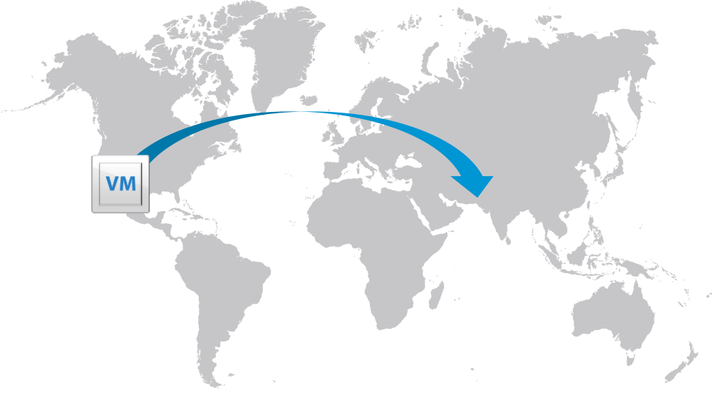
About Long-Distance vSphere vMotion Migration
Long-distance vSphere vMotion migration is an extension of cross vCenter migration.
vCenter instances are spread across large geographic distances and where the latency across sites is high.
Use cases for long-distance vSphere vMotion migration:
Permanent migrations
Disaster avoidance
Site Recovery Manager and disaster avoidance testing
Multisite load balancing
Follow-the-sun scenario support
Notes:
In the follow-the-sun scenario, a global support team might support a certain set of VMs. As one support team ends their workday, another support team in a different timezone takes over support duty. The VMs being supported can be moved from one geographical location to another so that the support team on duty can access those VMs locally instead of long distance.

Slide 53
Networking Prerequisites for Long-Distance vSphere vMotion
Long-distance vSphere vMotion migrations must connect over layer 3 connections:
Virtual machine network:
L2 connection
The same VM IP address is available at the destination
vSphere vMotion network:
L3 connection
250 Mbps per vSphere vMotion operation
Round-trip time between hosts can take up to 150 milliseconds.

Slide 54
Review of Learner Objectives
Recognize the types of VM migrations that you can perform across vCenter instances

Slide 55
Creating Virtual Machine Snapshots

Slide 56
Learner Objectives
Take a snapshot of a virtual machine
Manage multiple snapshots
Delete virtual machine snapshots
Consolidate snapshots

Slide 57
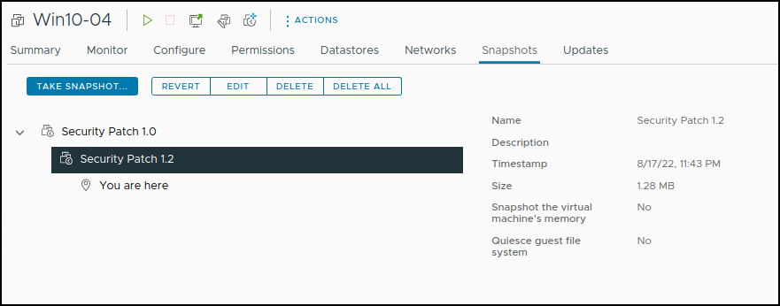
About VM Snapshots
With snapshots, you can preserve the state of the VM so that you can repeatedly return to the same state.
For example, if problems occur during the patching or upgrading process, you can revert to the previous state.
VM snapshots are not recommended as a VM backup strategy.
Notes:
Snapshots are useful when you want to revert repeatedly to the same state but do not want to create multiple VMs. Examples include patching or upgrading the guest operating system in a VM.
The relationship between snapshots is like the relationship between a parent and a child. Snapshots are organized in a snapshot tree. In a snapshot tree, each snapshot has one parent and one or more children, except for the last snapshot, which has no children.

Slide 58
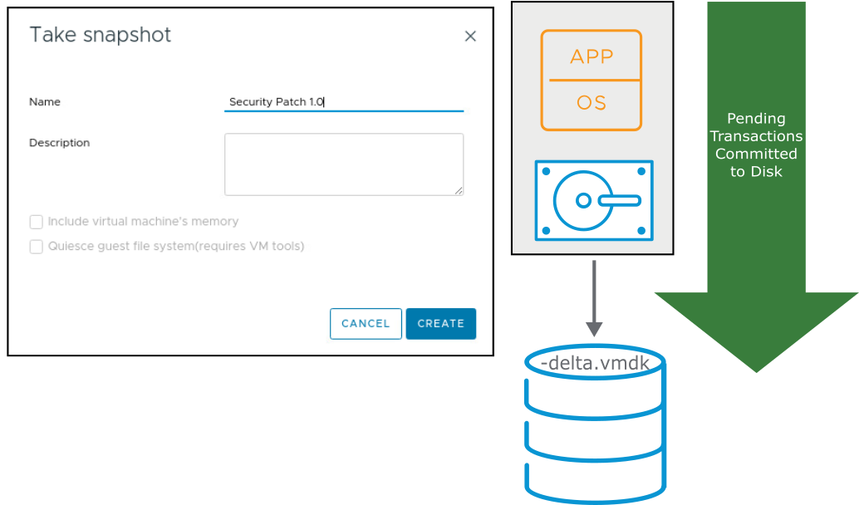
Taking Snapshots
You can take a snapshot while a VM is powered on, powered off, or suspended.
A snapshot captures the following items:
VM configuration
VM memory state (optional)
Virtual disks
A snapshot capture does not include Independent virtual disks (persistent and nonpersistent).
Notes:
A snapshot captures the entire state of the VM at the time that you take the snapshot, including the following states:
Memory state: The contents of the VM’s memory. The memory state is captured only if the VM is powered on and if you select the Snapshot the virtual machine’s memory check box (selected by default).
Settings state: The VM settings.
Disk state: The state of all the VM’s virtual disks.
At the time that you take the snapshot, you can also quiesce the guest operating system. This action quiesces the file system of the guest operating system. This option is available only if you do not capture the memory state as part of the snapshot.

Slide 59
Types of Snapshots
A delta or child disk is created when you create a snapshot:
On the datastore, the delta disk is a sparse disk.
Delta disks use different sparse formats depending on the type of datastore.
Snapshot Type | Datastore Type | Filename | Block Size
VMFSsparse | VMFS5 with virtual disks smaller than 2 TB | #-delta.vmdk | 512 bytes
SEsparse | VMFS6 VMFS5 with virtual disks larger than 2 TB Space efficient (thin provisioned) Supports disk reclamation (unmap) | #-sesparse.vmdk | 4 KB
vsanSparse | vSAN | Delta object | 4 MB
Notes:
Delta disks use different sparse formats depending on the type of datastore.
VMFSsparse: VMFS5 uses the VMFSsparse format for virtual disks smaller than 2 TB. VMFSsparse is implemented on top of VMFS. The VMFSsparse layer processes I/O operations issued to a snapshot VM. Technically, VMFSsparse is a redo log that starts empty, immediately after a VM snapshot is taken. The redo log expands to the size of its base VMDK, when the entire VMDK is rewritten with new data after the VM snapshot. This redo log is a file in the VMFS datastore. On snapshot creation, the base VMDK attached to the VM is changed to the newly created sparse VMDK.
SEsparse: SEsparse is a default format for all delta disks on the VMFS6 datastores. On VMFS5, SEsparse is used for virtual disks of the size 2 TB and larger. SEsparse is a format that is like VMFSsparse with some enhancements. This format is space efficient and supports the space-reclamation technique. With space reclamation, blocks that the guest OS deletes are marked. The system sends commands to the SEsparse layer in the hypervisor to unmap those blocks. The unmapping helps to reclaim space allocated by SEsparse after the guest operating system deletes the data.

Slide 60
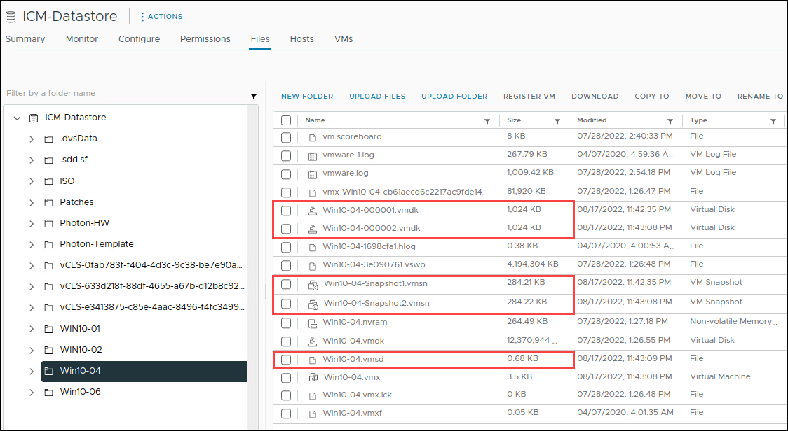
VM Snapshot Files
A snapshot consists of a set of files:
-Snapshot#.vmsn: Configuration state
-Snapshot#.vmem: Memory state (optional)
-00000#.vmdk: Disk descriptor
-00000#-delta.vmdk: VMFS5 delta
-00000#-sesparse.vmdk: VMFS6 delta
.vmsd: Stores names, descriptions, and relationships for all the VM's snapshots
Notes:
A VM can have one or more snapshots. For each snapshot, the following files are created:
Snapshot delta file: This file contains the changes to the virtual disk’s data since the snapshot was taken. When you take a snapshot of a VM, the state of each virtual disk is preserved. The VM stops writing to its -flat.vmdk file. Writes are redirected to >-######-delta.vmdk (or -######-sesparse.vmdk) instead (for which ###### is the next number in the sequence). You can exclude one or more virtual disks from a snapshot by designating them as independent disks. Configuring a virtual disk as independent is typically done when the virtual disk is created, but this option can be changed whenever the VM is powered off.
Disk descriptor file: -00000#.vmdk. This file is a small text file that contains information about the snapshot.
Configuration state file: -.vmsn. # is the next number in the sequence, starting with 1. This file holds the active memory state of the VM at the point that the snapshot was taken, including virtual hardware, power state, and hardware version.
Memory state file: -.vmem. This file is created if the option to include memory state was selected during the creation of the snapshot. It contains the entire contents of the VMs at the time that the snapshot of the VM was taken.
Snapshot active memory file: -.vmem. This file contains the contents of the VM memory if the option to include memory is selected during the creation of the snapshot.
The .vmsd file is the snapshot list file and is created at the time that the VM is created. It maintains snapshot information for a VM so that it can create a snapshot list in the vSphere Client. This information includes the name of the snapshot .vmsn file and the name of the virtual disk file.
The snapshot state file has a .vmsn extension and is used to store the state of a VM when a snapshot is taken. A new .vmsn file is created for every snapshot that is created on a VM and is deleted when the snapshot is deleted. The size of this file varies, based on the options selected when the snapshot is created. For example, including the memory state of the VM in the snapshot increases the size of the .vmsn file.
You can exclude one or more of the VMDKs from a snapshot by designating a virtual disk in the VM as an independent disk. Placing a virtual disk in independent mode is typically done when the virtual disk is created. If the virtual disk was created without activating independent mode, you must power off the VM to activate it.
Other files might also exist, depending on the VM hardware version. For example, each snapshot of a VM that is powered on has an associated _.vmem file, which contains the guest operating system main memory, saved as part of the snapshot.

Slide 61
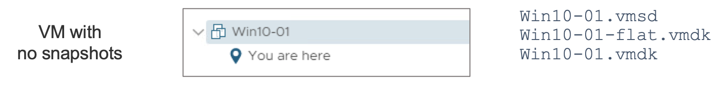
VM Snapshot Files Example (1)
Notes:
This example shows the snapshot and virtual disk files that are created when a VM has no snapshots.

Slide 62
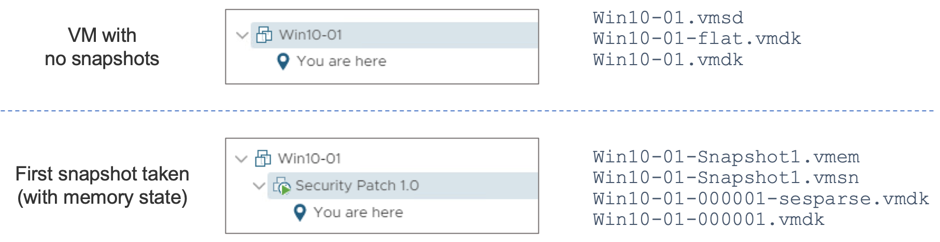
VM Snapshot Files Example (2)
Notes:
This example shows the snapshot and virtual disk files that are created when a VM has one snapshot.

Slide 63
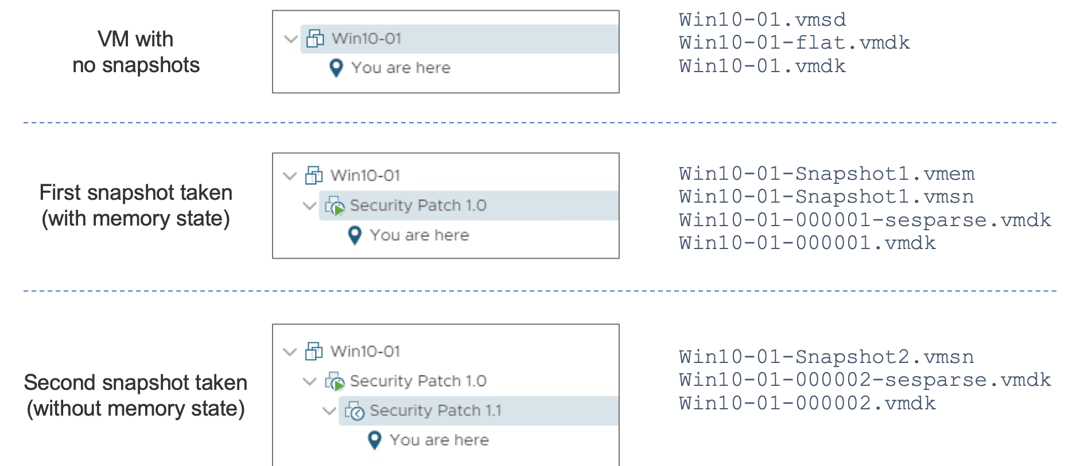
VM Snapshot Files Example (3)
Notes:
This example shows the snapshot and virtual disk files that are created when a VM has two snapshots.

Slide 64
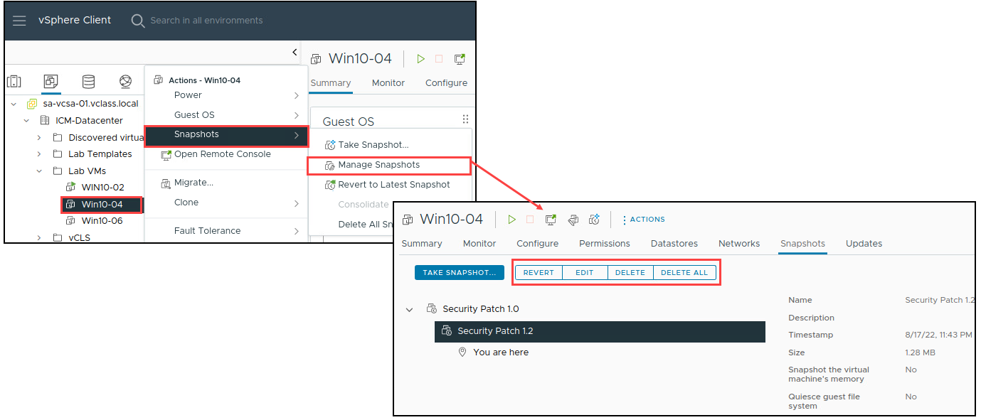
Managing Snapshots
In the vSphere Client, you can view snapshots for the active VM and take edit, delete, and revert to actions.
Notes:
You can perform the following actions from the Manage Snapshots window:
Edit the snapshot: Edit the snapshot name and description.
Delete the snapshot: Remove the snapshot from the Snapshot Manager, consolidate the snapshot files to the parent snapshot disk, and merge with the VM base disk.
Delete all snapshots: Commit all the intermediate snapshots before the current-state icon (You are here) to the VM and remove all snapshots for that VM.
Revert to a snapshot: Restore, or revert to, a particular snapshot. The snapshot that you restore becomes the current snapshot.
When you revert to a snapshot, you return all these items to the state that they were in at the time that you took the snapshot. If you want the VM to be suspended, powered on, or powered off when you start it, ensure that the VM is in the correct state when you take the snapshot.
Deleting a snapshot (DELETE or DELETE ALL) consolidates the changes between snapshots and previous disk states. Deleting a snapshot also writes to the parent disk all data from the delta disk that contains the information about the deleted snapshot. When you delete the base parent snapshot, all changes merge with the base VMDK.

Slide 65
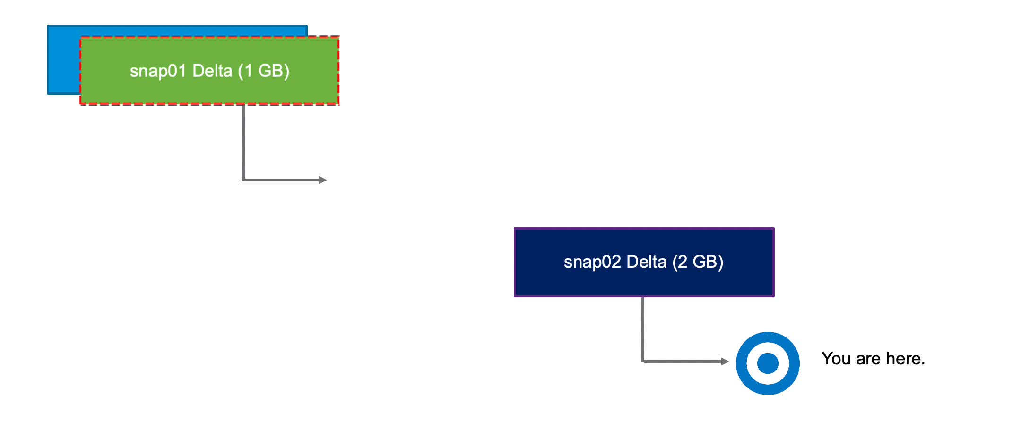
Deleting VM Snapshots (1)
If you delete a snapshot one or more levels above the, You are here level, the snapshot state is deleted. In this example, the snap01 data is committed into the parent (base disk), and the foundation for snap02 is retained.
Notes:
To play the animation, go to https://vmware.bravais.com/s/WhbcXR4sSwk2Vl7MeaXD.

Slide 66
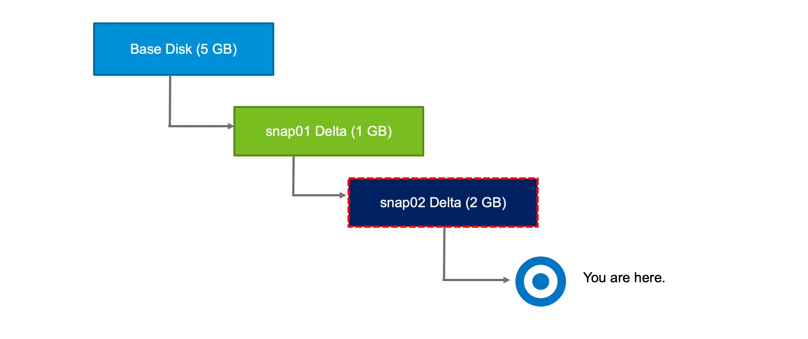
Deleting VM Snapshots (2)
If you delete the latest snapshot, the changes are committed to its parent. The snap02 data is committed into snap01 data, and the snap02 -delta.vmdk file is deleted.
Notes:
To play the animation, go to https://vmware.bravais.com/s/l0JYYQzMTv7pvxBqNcQp.

Slide 67
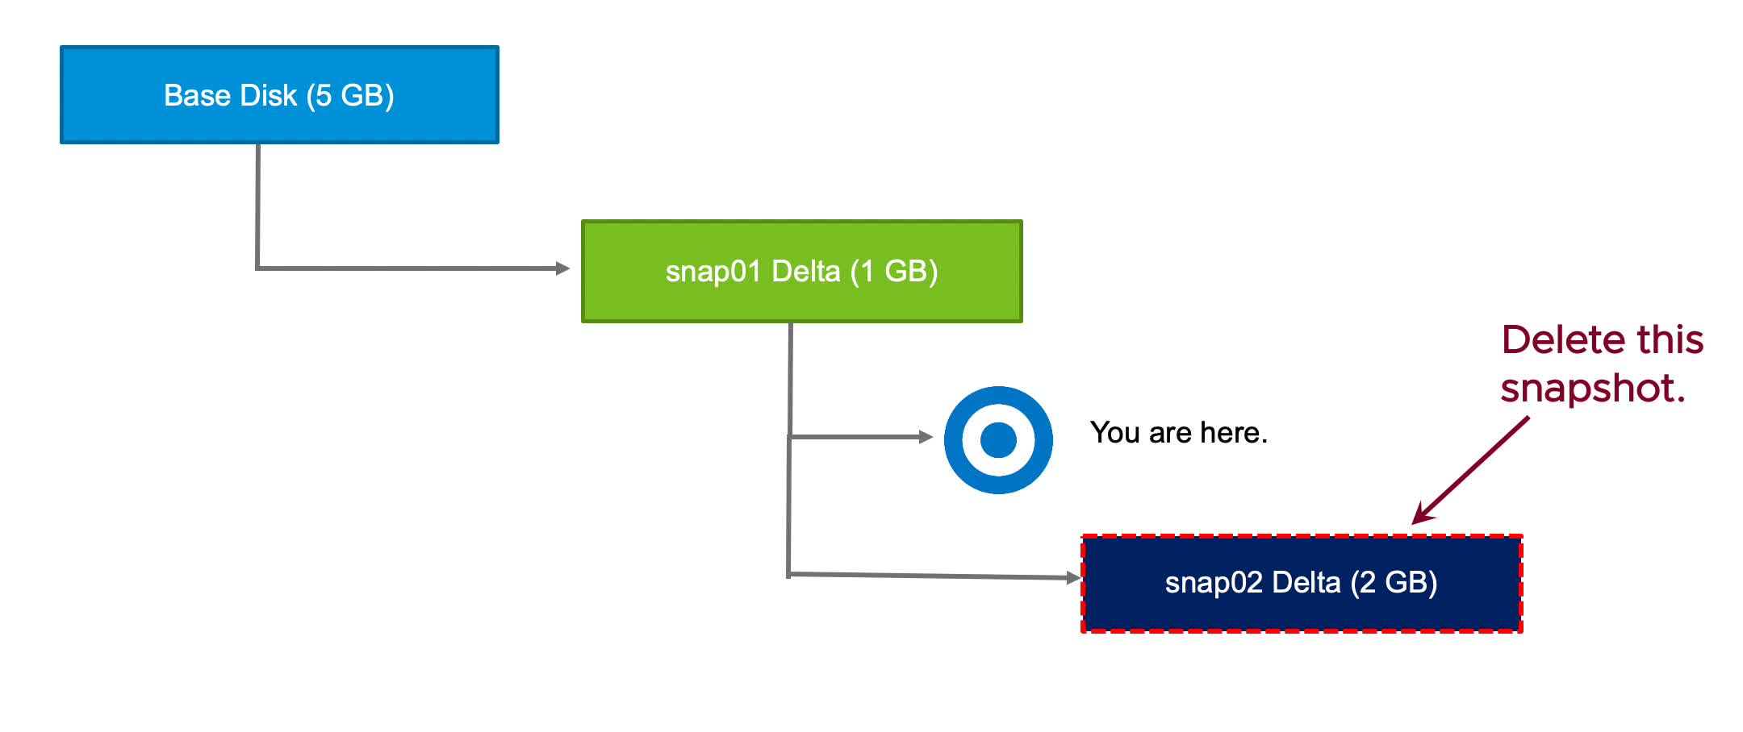
Deleting VM Snapshots (3)
If you delete a snapshot one or more levels below the You are here level, subsequent snapshots are deleted, and you can no longer return to those states. The snap02 data is deleted.
Notes:
To play the animation, go to https://vmware.bravais.com/s/NiQxPT3iycemQ8WYXKom.

Slide 68
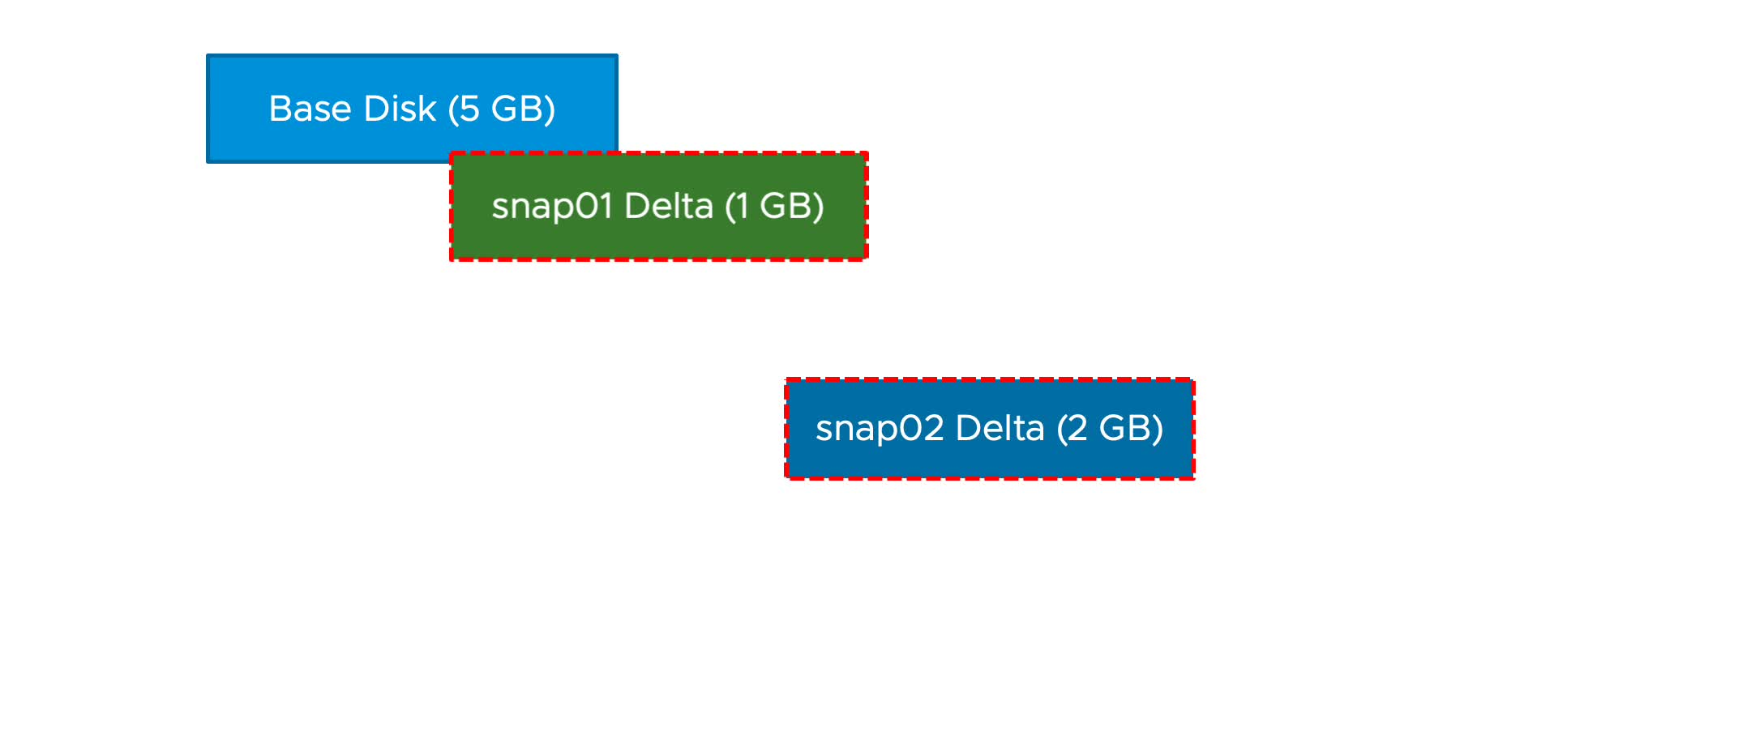
Deleting All VM Snapshots
The delete-all-snapshots mechanism uses storage space efficiently. The size of the base disk does not increase. Snap01 is committed to the base disk before snap02 is committed.
Notes:
To play the animation, go to https://vmware.bravais.com/s/L3ilQHlrywEhIgr5p7RP.
All snapshots before the You are here point are committed all the way up to the base disk. All snapshots after You are here are discarded.
Like a single snapshot deletion, changed blocks in the snapshot overwrite their counterparts in the base disk.

Slide 69
About Snapshot Consolidation
Snapshot consolidation is a method for committing a chain of delta disks to the base disks when the Snapshot Manager shows that no snapshots exist, but the delta disk files remain on the datastore.
Snapshot consolidation resolves problems that might occur with snapshots:
The snapshot descriptor file is committed correctly, and the Snapshot window shows that all the snapshots are deleted.
The snapshot files (-delta.vmdk or -sesparse.vmdk) still exist in the VM's folder on the datastore.
Snapshot files can continue to expand until they reach the size of the -flat.vmdk file or until the datastore runs out of space.
Notes:
Snapshot consolidation is a way to clean unneeded delta disk files from a datastore. If no snapshots are registered for a VM, but delta disk files exist, snapshot consolidation commits the chain of the delta disk files and removes them.
If consolidation is not performed, the delta disk files might expand to the point of consuming all the remaining space on the VM’s datastore or the delta disk file reaches its configured size. The delta disk cannot be larger than the size configured for the base disk.

Slide 70
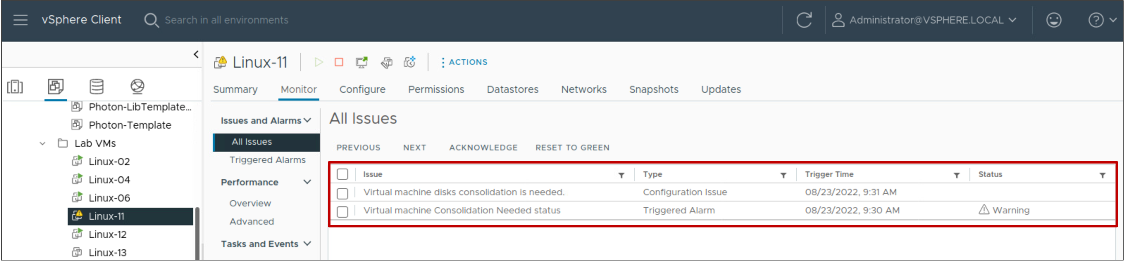
Discovering When to Consolidate Snapshots
On the Monitor tab under All Issues for the VM, a warning notifies you that a consolidation is required.
Notes:
With snapshot consolidation, vCenter displays a warning when the descriptor and the snapshot files do not match. After the warning displays, you can use the vSphere Client to commit the snapshots.

Slide 71
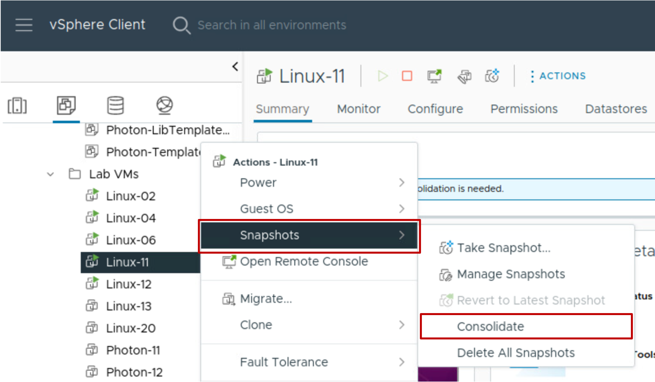
Consolidating Snapshots
After the snapshot consolidation warning appears, you can use the vSphere Client to consolidate the snapshots.
All snapshot delta disks are committed to the base disks.
Notes:
For a list of best practices for using snapshots in a vSphere environment, see VMware knowledge base article 1025279 at http://kb.vmware.com/kb/1025279.

Slide 72
Lab 3: Working with Snapshots
Take VM snapshots, revert a VM to a different snapshot, and delete snapshots:
Take Snapshots of a Virtual Machine
Add Files and Take Another Snapshot of a Virtual Machine
Revert the Virtual Machine to a Snapshot
Delete a Snapshot
Delete All Snapshots

Slide 73
Review of Learner Objectives
Take a snapshot of a virtual machine
Manage multiple snapshots
Delete virtual machine snapshots
Consolidate snapshots

Slide 74
Virtual CPU and Memory Concepts

Slide 75
Learner Objectives
Describe CPU and memory concepts in relation to a virtualized environment
Recognize techniques for addressing memory resource overcommitment
Identify additional technologies that improve memory use
Describe how VMware Virtual SMP works
Explain how the VMkernel uses hyperthreading

Slide 76
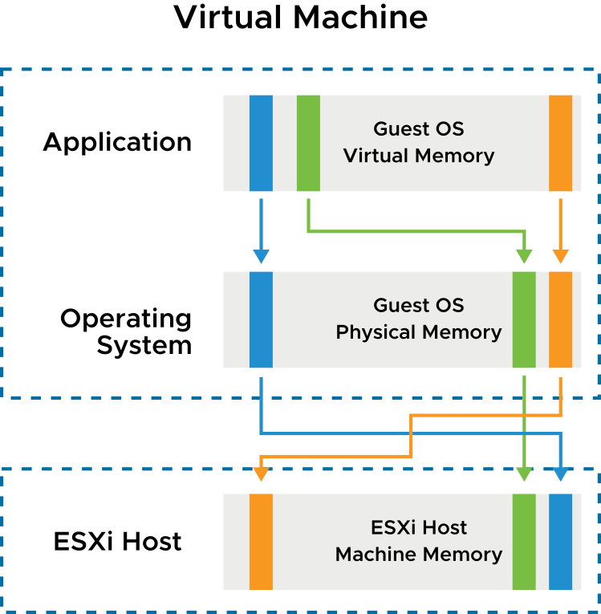
Memory Virtualization Basics
vSphere has the following layers of memory:
Guest OS virtual memory is presented to applications by the operating system
Guest OS physical memory is presented to the virtual machine by the VMkernel
Host machine memory that is managed by the VMkernel provides a contiguous, addressable memory space that is used by the VM
Notes:
When running a virtual machine, the VMkernel creates a contiguous addressable memory space for the VM. This memory space has the same properties as the virtual memory address space presented to applications by the guest operating system. This memory space allows the VMkernel to run multiple VMs simultaneously while protecting the memory of each VM from being accessed by others. From the perspective of an application running in the VM, the VMkernel adds an extra level of address translation that maps the guest physical address to the host physical address.

Slide 77
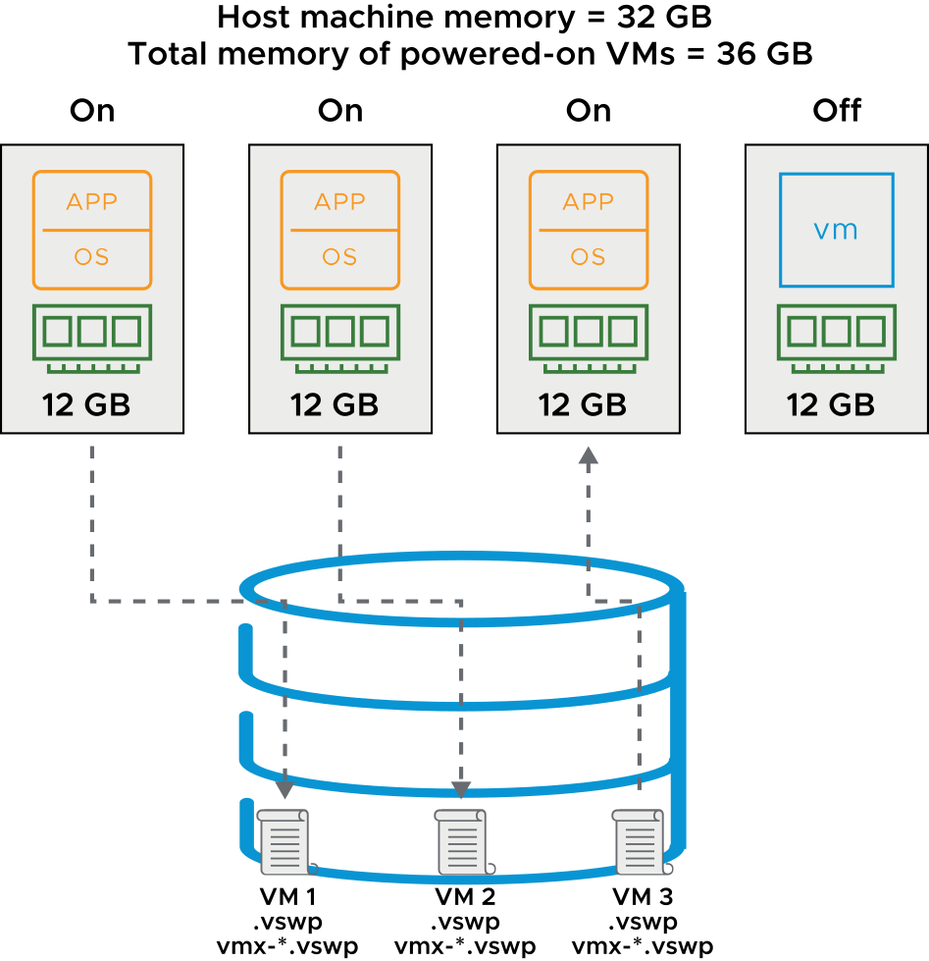
VM Memory Overcommitment
Memory is overcommitted when the combined configured memory footprint of all powered-on VMs exceeds that of the host memory sizes.
When memory is overcommitted:
VMs do not always use their full allocated memory
To improve memory use, an ESXi host reclaims memory from idle VMs to allocate to VMs that need more memory
VM memory can be swapped out to the .vswp file
VM memory overhead can be swapped out to the vmx-*.vswp file
Notes:
The total configured memory sizes of all VMs might exceed the amount of available physical memory on the host. However, this condition does not necessarily mean that memory is overcommitted. Memory is overcommitted when the working memory size of all VMs exceeds that of the ESXi host’s physical memory size.
Because of the memory management techniques used by the ESXi host, your VMs can use more virtual RAM than the available physical RAM on the host. For example, you can have a host with 32 GB of memory and three VMs running with 12 GB of memory each. In that case, the memory is overcommitted. If all three VMs are idle, the combined consumed memory is below 32 GB. However, if all VMs are actively consuming memory, then their memory footprint might exceed 32 GB and the ESXi host becomes overcommitted. An ESXi host can run out of memory if VMs consume all reservable memory in an overcommitted memory environment. Although the powered-on VMs are not affected, a new VM might fail to power on because of lack of memory. Overcommitment makes sense because, typically, some VMs are lightly loaded whereas others are more heavily loaded, and relative activity levels vary over time.
VM memory from this file is swapped out to disk when host machine memory is overcommitted. Extra memory from a VM is gathered into a swap file with the .vswp extension. The host uses the vmx-*.vswp swap file to gather and track memory overhead. Memory overhead refers to memory used by the VMX (VM Executable) process.

Slide 78
Memory Overcommit Techniques
An ESXi host uses memory overcommit techniques to allow the overcommitment of memory while possibly avoiding the need to page memory out to disk.
Methods Used by the ESXi Host | Details
Transparent page sharing | This method economizes the use of physical memory pages. In this method, pages with identical contents are stored only once.
Ballooning | This method uses the VMware Tools balloon driver to deallocate memory from virtual machines. The ballooning mechanism becomes active when memory is scarce, sometimes forcing VMs to use their own paging areas.
Memory compression | This method reduces a VM's memory footprint by storing memory in a compressed format.
Host-level SSD swapping | The ESXi host can swap out memory to locally-attached solid-state drives.
VM memory paging to disk | Using VMkernel swap space is the last resort because of poor performance.
Notes:
The VMkernel uses various techniques to dynamically reduce the amount of physical RAM that is required for each VM. Each technique is described in the order that the VMkernel uses it:
Page sharing: ESXi can use a proprietary technique to transparently share memory pages between VMs, eliminating redundant copies of memory pages. Although pages are shared by default within VMs, as of vSphere 6.0, pages are no longer shared by default among VMs.
Ballooning: If the host memory begins to get low and the VM's memory use approaches its memory target, ESXi uses ballooning to reduce that VM's memory demands. Using the VMware-supplied vmmemctl module installed in the guest operating system as part of VMware Tools, ESXi can cause the guest operating system to relinquish the memory pages it considers least valuable. Ballooning provides performance closely matching that of a native system under similar memory constraints. To use ballooning, the guest operating system must be configured with sufficient swap space.
Memory compression: If the VM's memory use approaches the level at which host-level swapping is required, ESXi uses memory compression to reduce the number of memory pages that it must swap out. Because the decompression latency is much smaller than the swap-in latency, compressing memory pages has significantly less impact on performance than swapping out those pages.
Swap to host cache: Host swap cache is an optional memory reclamation technique that uses local flash storage to cache a virtual machine’s memory pages. By using local flash storage, the virtual machine avoids the latency associated with a storage network that might be used if it swapped memory pages to the virtual swap (.vswp) file.
Regular host-level swapping: When memory pressure is severe and the hypervisor must swap memory pages to disk, the hypervisor swaps to a host swap cache rather than to a .vswp file. When a host runs out of space on the host cache, a virtual machine’s cached memory is migrated to a virtual machine’s regular .vswp file. Each host must have its own host swap cache configured.

Slide 79
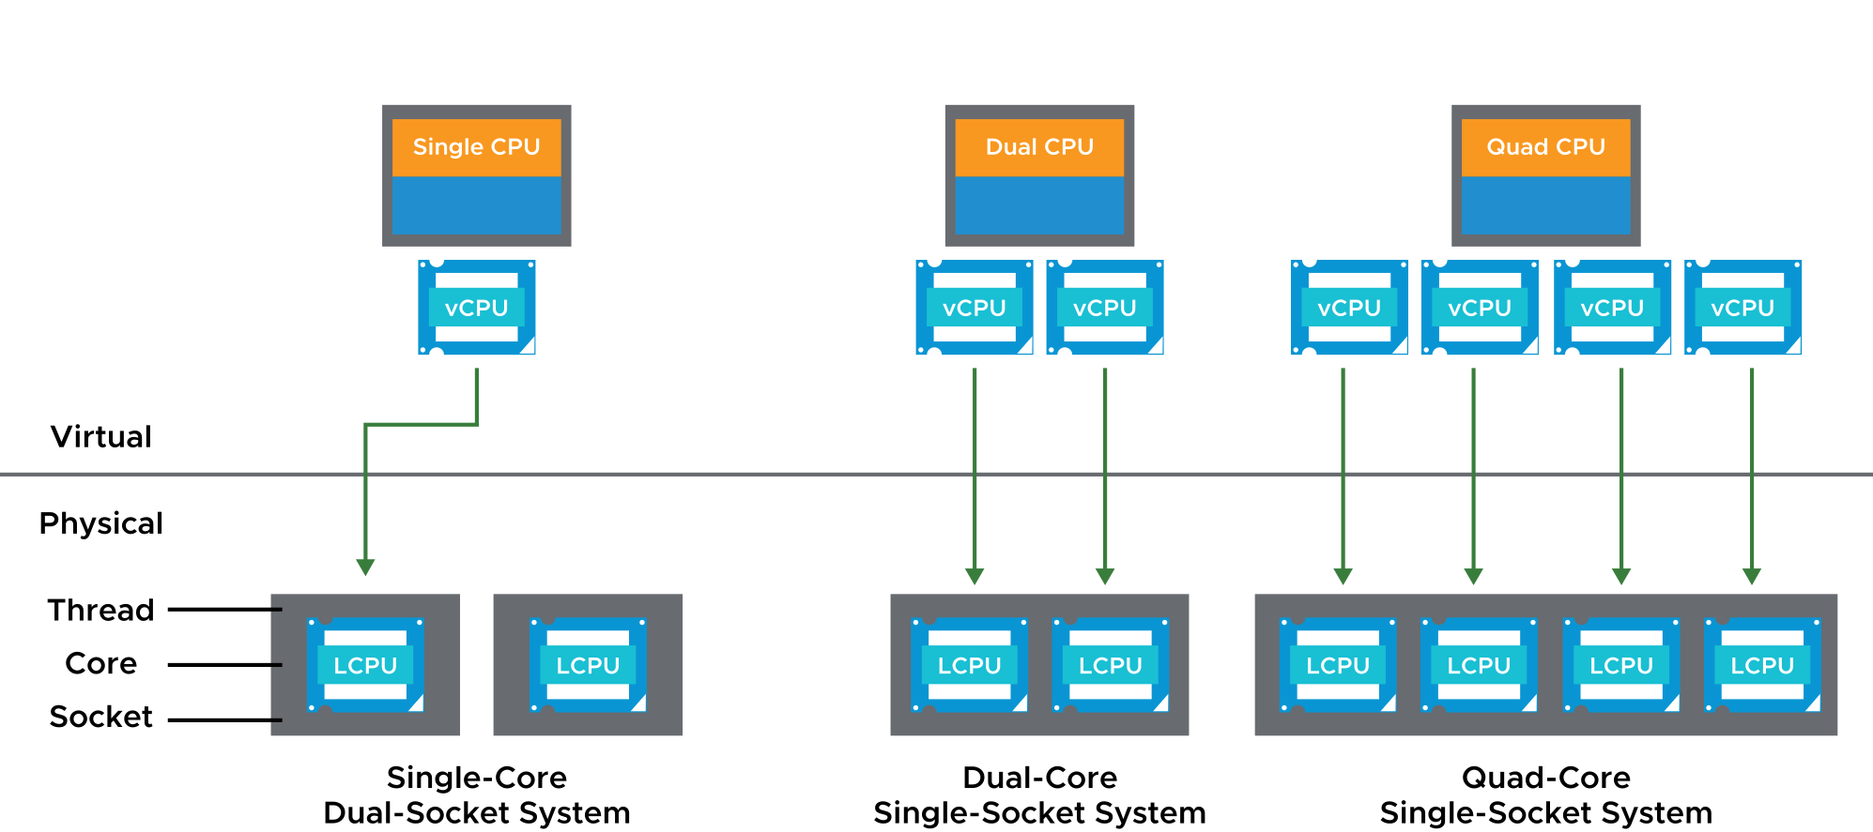
Configuring Multicore VMs
You can build VMs with multiple virtual CPUs (vCPUs). The number of vCPUs that you configure for a single VM depends on the physical architecture of the ESXi host.
Notes:
In addition to the physical host configuration, the number of vCPUs configured for a VM also depends on the guest operating system, the needs and scalability limits of the applications, and the specific use case for the VM itself.
The VMkernel includes a CPU scheduler that dynamically schedules vCPUs on the physical CPUs of the host system.
The VMkernel scheduler considers socket-core-thread topology when making scheduling decisions. Intel and AMD processors combine multiple processor cores into a single integrated circuit, called a socket in this discussion.
A socket is a single package with one or more physical CPUs. Each core has one or more logical CPUs (LCPU in the diagram) or threads. With logical CPUs, the core can schedule one thread of execution.
On the slide, the first system is a single-core, dual-socket system with two cores and, therefore, two logical CPUs.
When a vCPU of a single-vCPU or multi-vCPU VM must be scheduled, the VMkernel maps the vCPU to an available logical processor.

Slide 80
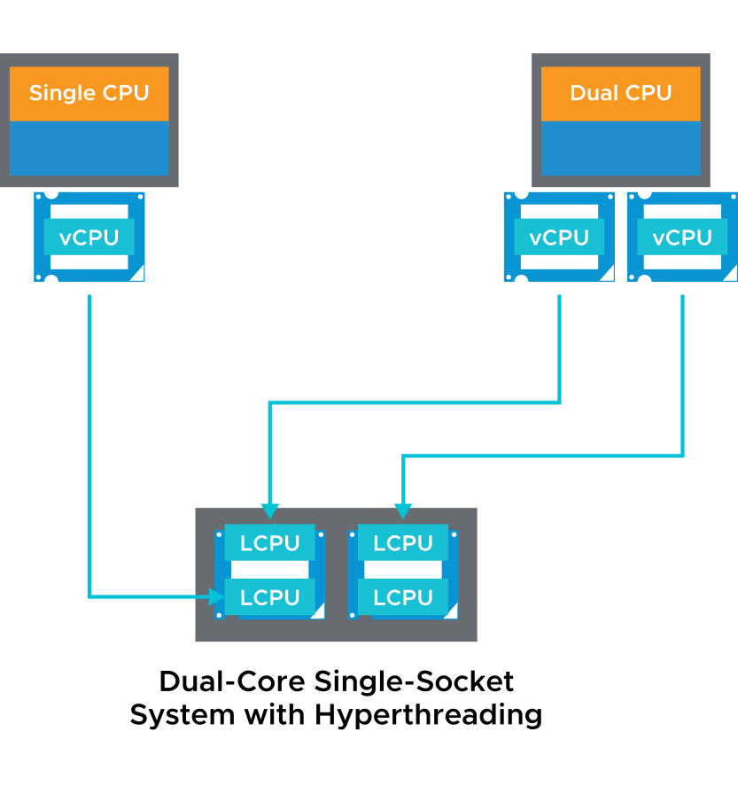
About Hyperthreading
With hyperthreading, a core can execute two threads or sets of instructions at the same time:
Hyperthreading provides more logical CPUs on which vCPUs can be scheduled
Hyperthreading is activated by default
To activate hyperthreading:
Verify that the host system supports hyperthreading
Activate hyperthreading in the system BIOS
Ensure that hyperthreading for the ESXi host is turned on
Notes:
If hyperthreading is activated, ESXi can schedule two threads at the same time on each processor core (physical CPU). The drawback of hyperthreading is that it does not double the power of a core. So, if both threads of execution need the same on-chip resources at the same time, one thread has to wait. Still, on systems that use hyperthreading technology, performance is improved.
An ESXi host that is activated for hyperthreading should behave almost exactly like a standard system. Logical processors on the same core have adjacent CPU numbers. Logical processors 0 and 1 are on the first core, logical processors 2 and 3 are on the second core, and so on.
Consult the host system hardware documentation to verify whether the BIOS includes support for hyperthreading. Then, activate hyperthreading in the system BIOS. Some manufacturers call this option Logical Processor and others call it Enable Hyperthreading.
Use the vSphere Client to ensure that hyperthreading for your host is turned on. To access the hyperthreading option, go to the host’s Summary tab and select CPUs under Hardware.

Slide 81
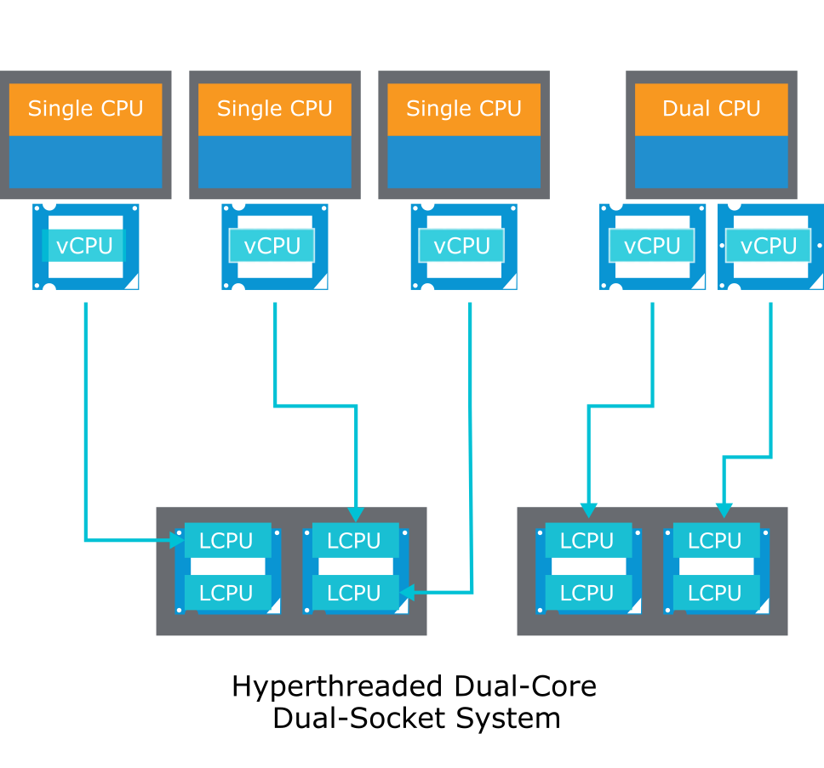
CPU Load Balancing
The VMkernel balances processor time to guarantee that the load is spread smoothly across processor cores in the system.
Notes:
The CPU scheduler can use each logical processor independently to execute VMs, providing capabilities that are similar to traditional symmetric multiprocessing (SMP) systems. The VMkernel intelligently manages processor time to guarantee that the load is spread smoothly across processor cores in the system. Every 2 milliseconds to 40 milliseconds (depending on the socket-core-thread topology), the VMkernel seeks to migrate vCPUs from one logical processor to another to keep the load balanced. The VMkernel does its best to schedule VMs with multiple vCPUs on two different cores, rather than on two logical processors on the same core. But, if necessary, the VMkernel can map two vCPUs from the same VM to threads on the same core.
If a logical processor has no work, it is put into a halted state. This action frees its execution resources, and the VM running on the other logical processor on the same core can use the full execution resources of the core. Because the VMkernel scheduler accounts for this halt time, a VM running with the full resources of a core is charged more than a VM running on a half core. This approach to processor management ensures that the server does not violate the ESXi resource allocation rules.

Slide 82
Review of Learner Objectives
Describe CPU and memory concepts in relation to a virtualized environment
Recognize techniques for addressing memory resource overcommitment
Identify additional technologies that improve memory use
Describe how VMware Virtual SMP works
Explain how the VMkernel uses hyperthreading

Slide 83
Resource Controls

Slide 84
Learner Objectives
Assign share values for CPU and memory resources
Describe how virtual machines compete for resources
Define CPU and memory reservations and limits

Slide 85
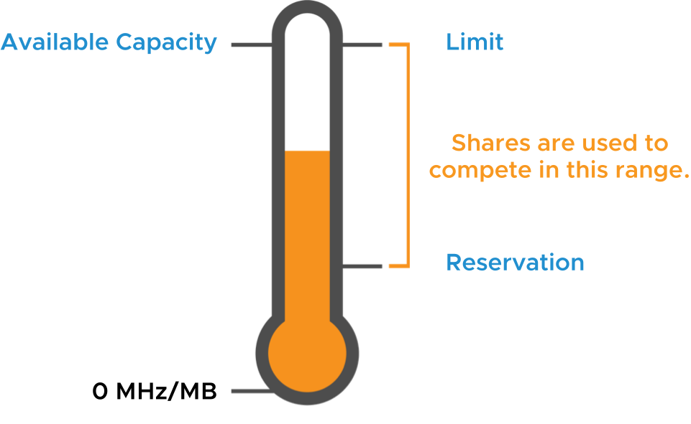
Reservations, Limits, and Shares
Beyond the CPU and memory configured for a VM, you can apply resource allocation settings to a VM to control the amount of resources granted:
A reservation specifies the guaranteed minimum allocation for a VM
A limit specifies an upper bound for CPU or memory that can be allocated to a VM
A share is a value that specifies the relative priority or importance of a VM's access to a given resource
Notes:
Because VMs simultaneously use the resources of an ESXi host, resource contention can occur.
To manage resources efficiently, vSphere provides mechanisms to allow less, more, or an equal amount of access to a defined resource. vSphere also prevents a VM from consuming large amounts of a resource. vSphere grants a guaranteed amount of a resource to a VM whose performance is not adequate or that requires a certain amount of a resource to run properly.
When host memory or CPU is overcommitted, a VM’s allocation target is somewhere between its specified reservation and specified limit, depending on the VM’s shares and the system load. vSphere uses a share-based allocation algorithm to achieve efficient resource use for all VMs and to guarantee a given resource to the VMs that need it most.

Slide 86
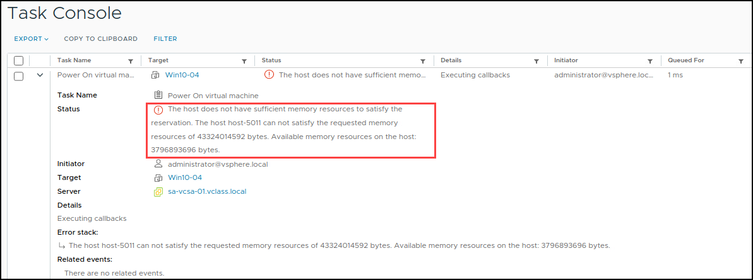
Resource Allocation Reservations: RAM
RAM reservations:
Memory reserved to a VM is guaranteed never to swap or balloon.
If an ESXi host does not have enough unreserved RAM to support a VM with a reservation, the VM does not power on.
Reservations are measured in MB, GB, or TB. The default is 0 MB.
Notes:
When configuring a memory reservation for a VM, you can specify the VM's configured amount of memory to reserve all the VM's memory. For example, if a VM is configured with 4 GB of memory, you can set a memory reservation of 4 GB for the VM. You might configure such a memory reservation for a critical VM that must maintain a high level of performance.
The ESXi host must have enough RAM to support a VM with a reservation plus a certain amount of overhead memory. VMs require a certain amount of available overhead memory to power on. For example, a VM with 4 GB of memory and two virtual CPUs requires approximately 53 MB of overhead memory. For information on sample overhead memory on VMs, see vSphere Resource Management at https://docs.vmware.com/en/VMware-vSphere/index.html.

Slide 87
Resource Allocation Reservations: CPU
CPU reservations:
CPU that is reserved for a VM is guaranteed to be immediately scheduled on physical cores. The VM is never placed in a CPU ready state.
If an ESXi host does not have enough unreserved CPU to support a VM with a reservation, the VM does not power on.
Reservations are measured in MHz or GHz.
The default is 0 MHz.

Slide 88
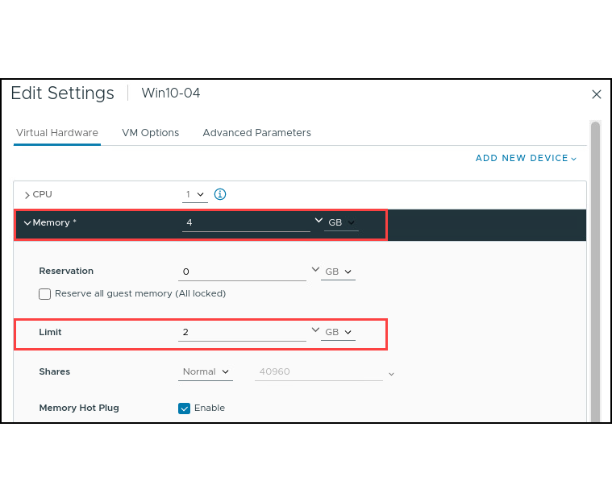
Resource Allocation Limits
RAM limits:
VMs never consume more physical RAM than is specified by the memory allocation limit.
VMs use the VM swap mechanism (.vswp) if the guest OS attempts to consume more RAM than is specified by the limit.
CPU limits:
VMs never consume more physical CPU than is specified by the CPU allocation limit.
CPU threads are placed in a ready state if the guest OS attempts to schedule threads faster than the limit allows.
Usually, specifying a limit is not necessary.
Notes:
Specifying limits has the following benefits and drawbacks:
Benefits: Assigning a limit is useful if you start with a few VMs and want to manage user expectations. The performance deteriorates as you add more VMs. You can simulate having fewer resources available by specifying a limit.
Drawbacks: You might waste idle resources if you specify a limit. The system does not allow VMs to use more resources than the limit, even when the system is underused and idle resources are available. Specify the limit only if you have good reasons for doing so.

Slide 89
Resource Allocation Shares
Shares define the relative importance of a VM:
If a VM has twice as many shares of a resource as another VM, the VM is entitled to consume twice as much of that resource when these two VMs compete for resources.
Share values apply only if an ESXi host experiences contention for a resource.
You can set shares to high, normal, or low. You can also select the custom setting to assign a specific number of shares to each VM.
Setting | CPU Share Values | Memory Share Values
High | 2,000 shares per vCPU | 20 shares per MB of configured VM memory
Normal | 1,000 shares per vCPU | 10 shares per MB of configured VM memory
Low | 500 shares per vCPU | 5 shares per MB of configured VM memory
Notes:
High, normal, and low settings represent share values with a 4:2:1 ratio, respectively. A custom value of shares assigns a specific number of shares (which expresses a proportional weight) to each VM.

Slide 90
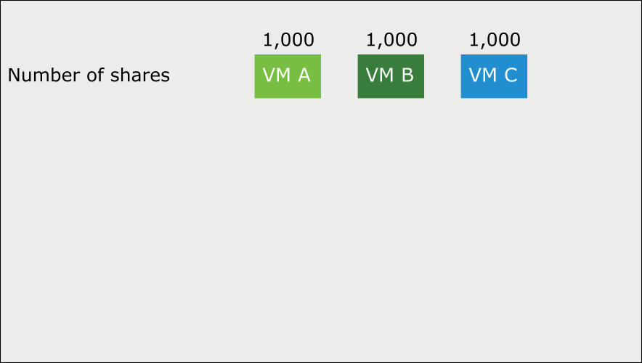
Resource Shares Example (1)
VMs are resource consumers. The default resource settings that you assign during VM creation work well for most VMs.
Notes:
The proportional share mechanism applies to CPU, memory, storage I/O, and network I/O allocation. The mechanism operates only when VMs contend for the same resource.

Slide 91
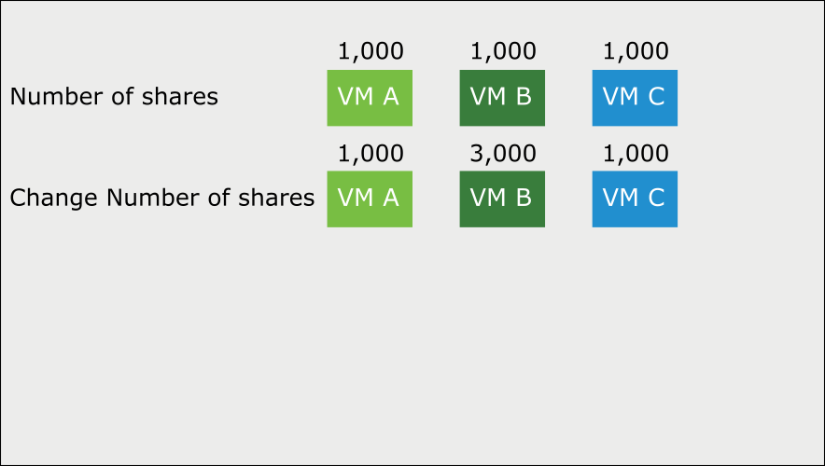
Resource Shares Example (2)
You can add shares to a virtual machine while it is running.
Notes:
You can add shares to a VM while it is running, and the VM gets more access to that resource (assuming competition for the resource). When you add a VM, it gets shares too. The VM’s share amount factors into the total number of shares, but existing VMs are guaranteed not to be starved for the resource.

Slide 92
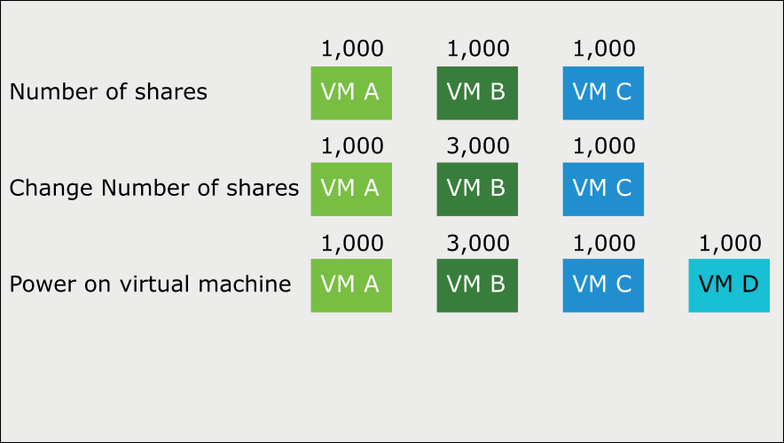
Resource Shares Example (3)
Shares guarantee that a VM is given a certain amount of a resource.
Notes:
Shares guarantee that a VM is given a certain amount of a resource (CPU, RAM, storage I/O, or network I/O).
For example, consider the third row of VMs on the slide:
VM D is powered on with 1,000 shares.
Before VM D was powered on, a total of 5,000 shares were available, but VM D’s addition increases the total shares to 6,000.
The result is that the other VMs' shares decline in value. But VM A is still allocated one-sixth of the resource because it owns one-sixth of the shares.

Slide 93
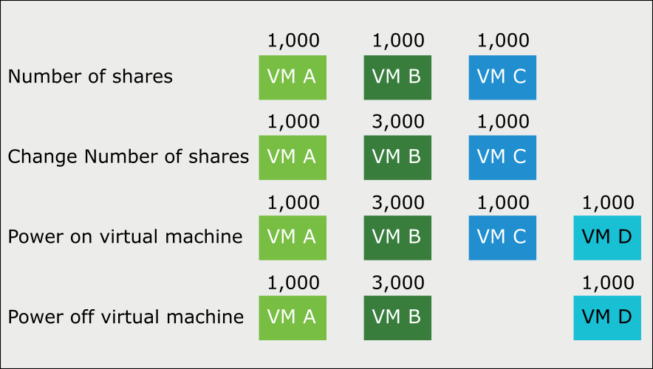
Resource Shares Example (4)
When you delete or power off a VM, fewer total shares remain, so the surviving VMs get more access.

Slide 94
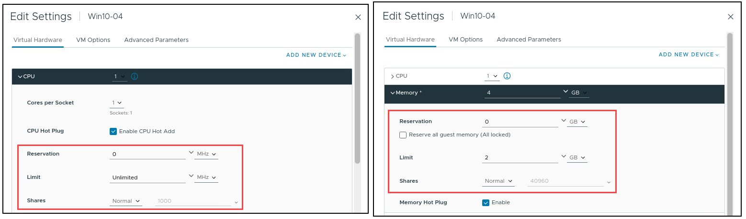
Defining Resource Allocation Settings for a VM
You can edit a VM's settings to configure CPU and memory resource allocations.
Notes:
When reserving memory, you can select the Reserve all guest memory (All locked) check box. Selecting this check box ensures that all the VM's memory gets reserved, even if you change the total amount of memory for the VM. The memory reservation is immediately readjusted when the VM's memory configuration changes.

Slide 95
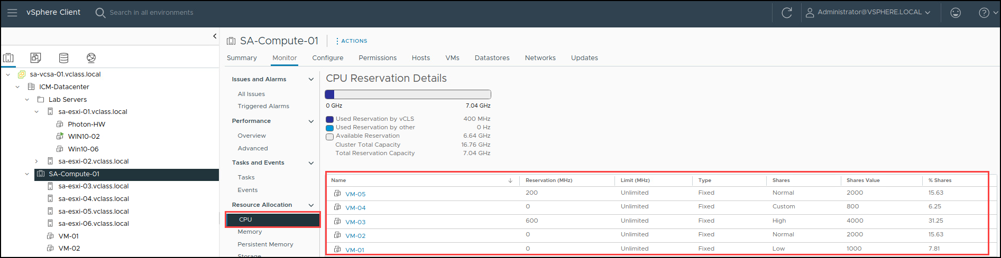
Viewing VM Resource Allocation Settings
You can view reservations, limits, and shares settings for all VMs in a cluster.

Slide 96
Lab 4: Controlling VM Resources
Observe the behavior of VMs with different CPU share values:
Create CPU Contention
Verify the CPU Share Functionality

Slide 97
Review of Learner Objectives
Assign share values for CPU and memory resources
Describe how virtual machines compete for resources
Define CPU and memory reservations and limits

Slide 98
Key Points
Hot migrations use vSphere vMotion, vSphere Storage vMotion, or both.
You can migrate VMs between vCenter instances, whether they are in the same SSO domain, different SSO domain, or geographically far apart.
Enhanced vMotion Compatibility prevents vSphere vMotion migrations from failing because of incompatible CPUs or incompatible vSGA GPUs.
You can use VM snapshots to preserve the state of the VM so that you can return repeatedly to the same state.
You can apply reservations, limits, and shares against a VM to control the amount of CPU and memory resources granted.
Questions?

