Slide 1
Deploying and Configuring vSphere Clusters

Slide 2
Importance
Most organizations rely on computer-based services such as email, databases, and web-based applications. The failure of these services can mean lost productivity and revenue.
By understanding and using vSphere HA, you can configure highly available, computer-based services, which are important for an organization to remain competitive in contemporary business environments. And by developing skills in using vSphere DRS, you can improve service levels by guaranteeing appropriate resources to virtual machines.

Slide 3
Module Lessons
vSphere Clusters Overview
vSphere Distributed Resource Scheduler
Introduction to vSphere High Availability
vSphere High Availability Architecture
Configuring vSphere High Availability

Slide 4

vSphere Clusters Overview

Slide 5
Learner Objectives
Create a vSphere cluster
Recognize cluster options that you can configure with Cluster Quickstart
View information about a vSphere cluster

Slide 6
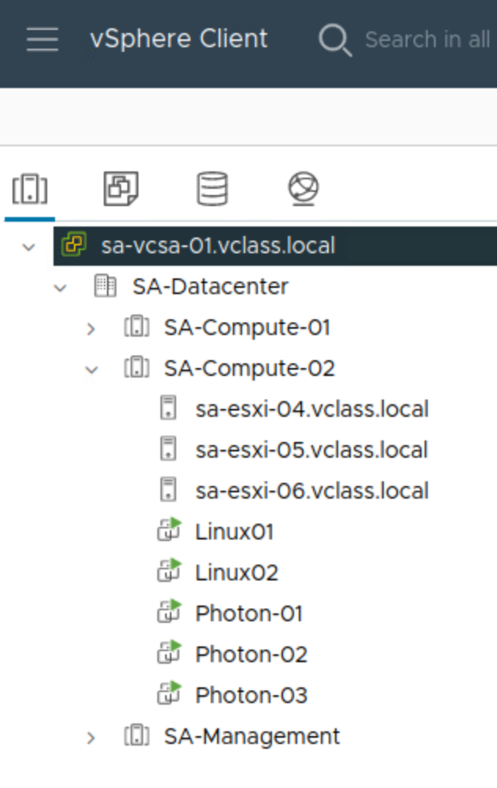
About vSphere Clusters
A cluster is used in vSphere to share physical resources between a group of ESXi hosts. vCenter manages cluster resources as a single pool of resources.
You can create one or more clusters based on the purpose each cluster must fulfill, for example:
Management
Production
Compute
A cluster can contain up to 96 ESXi hosts.
Notes:
In this screenshot, five clusters are shown: SA-Compute-01, SA-Compute-02, SA-Management, SB-Development, and SB-Management.
To support 96 hosts per cluster, vSphere 7 Update 1 or later is required.

Slide 7
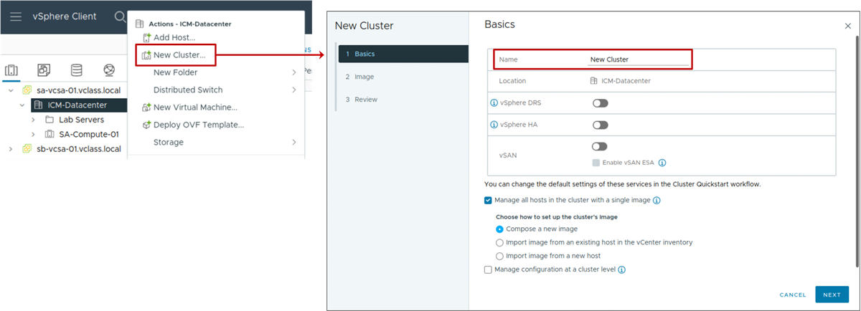
Creating a vSphere Cluster
You can create a cluster by giving it a name and selecting the relevant cluster services.
Notes:
You can activate the following services in a vSphere cluster:
vSphere HA, for high availability
vSphere DRS, for VM placement and load balancing
vSAN, for software-defined storage
You can also manage host updates using images. With vSphere Lifecycle Manager, you can update all hosts in the cluster collectively, using a specified ESXi image.

Slide 8
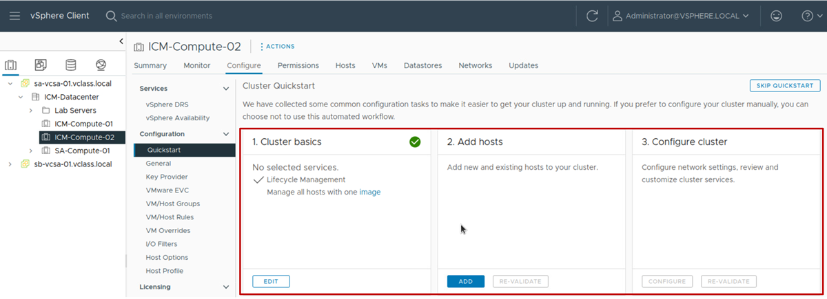
About Cluster Quickstart
After you create a cluster, you can use the Cluster Quickstart workflow to configure the cluster.
Notes:
The Cluster Quickstart workflow guides you through the deployment process for clusters. It covers every aspect of the initial configuration, such as host, network, and vSphere settings. With Cluster Quickstart, you can also add additional hosts to a cluster as part of the ongoing expansion of clusters.
Cluster Quickstart reduces the time it takes to configure a cluster.
The workflow includes the following tasks:
Setting up services such as vSphere HA, vSphere DRS, and vSAN
Verifying hardware and software compatibility
Deploying vSphere Distributed Switches
Configuring network settings for vSphere vMotion and vSAN
Creating a vSAN stretched cluster or vSAN fault domains
Ensuring consistent NTP configuration across the cluster
For more information about creating clusters, see vCenter Server and Host Management at https://docs.vmware.com/en/VMware-vSphere/index.html.

Slide 9
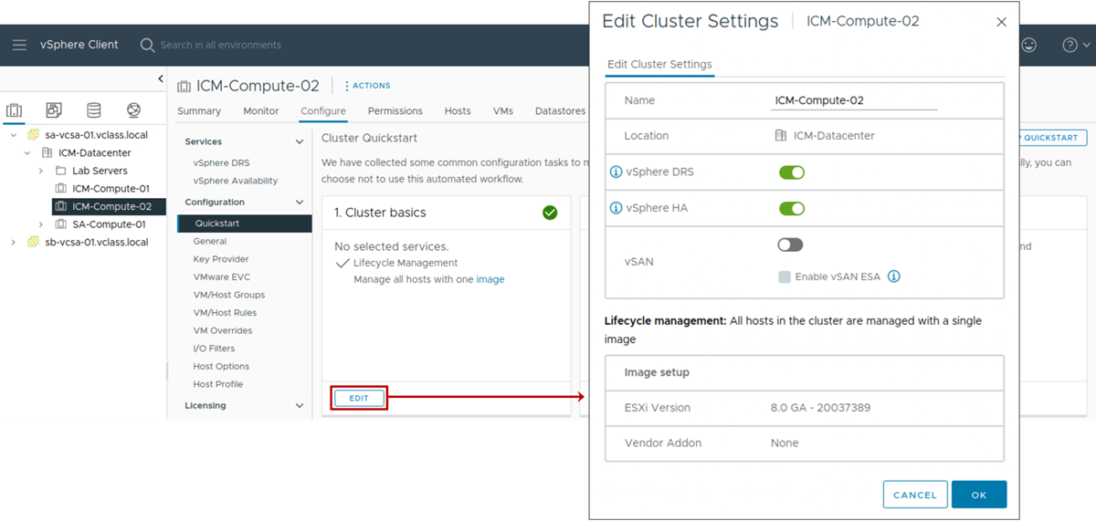
Cluster Quickstart: Activating Services
The first step in the Cluster Quickstart workflow is to check that the correct cluster services are selected.
Notes:
The Cluster basics pane lets you configure the following information:
Edit the cluster's name.
Activate or deactivate the vSphere DRS, vSphere HA, and vSAN services.
Select the image for vSphere Lifecycle Manager to use to manage hosts in the cluster.
For more information about creating clusters, see vCenter Server and Host Management at https://docs.vmware.com/en/VMware-vSphere/index.html.

Slide 10
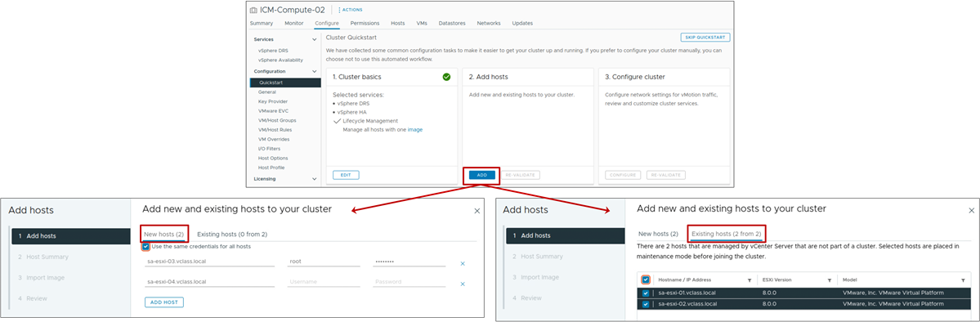
Cluster Quickstart: Adding Hosts
The second step in the Cluster Quickstart workflow is to add new or existing hosts to the cluster.
Notes:
The Add hosts pane lets you add ESXi hosts to the cluster. Select New hosts to add hosts to the inventory and cluster simultaneously. For each host that you add to the cluster, you enter the IP address or FQDN of each host. Select Existing hosts to add hosts to the cluster that are already present in the inventory.
After hosts are added, the workflow shows the total number of hosts that are present in the cluster and provides a health check validation for those hosts.

Slide 11
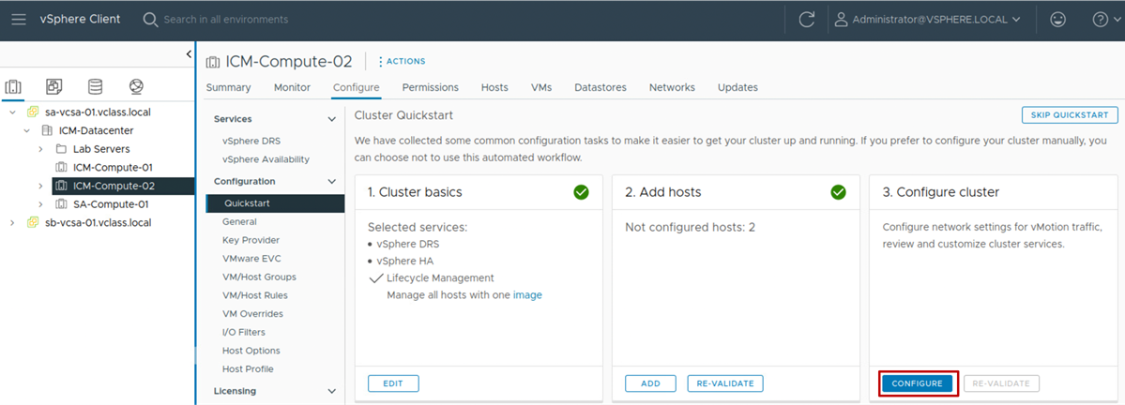
Cluster Quickstart: Configuring the Cluster
The third step is to configure the host networking settings and customize cluster services.
Notes:
If you click SKIP QUICKSTART, you can manually configure your cluster by using the menus in the vSphere Client. By skipping the Cluster Quickstart workflow, you cannot restore it for the current cluster. Any hosts added to this cluster must be configured manually.

Slide 12
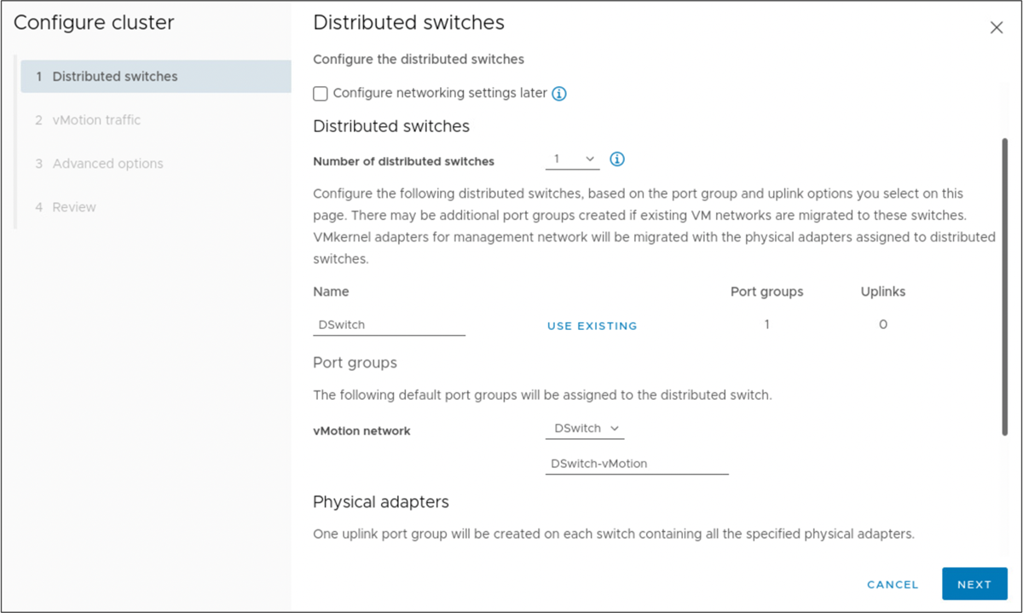
Configuring a Cluster: Distributed Switches
To configure a cluster, you can:
Select up to three distributed switches.
Select a network for vSphere vMotion.
Select at least one physical adapter.
You can also configure networking settings later.
Notes:
You can select the Configure networking settings later check box to configure the default settings only for the cluster services and to hide all options that are related to host networking. But, by selecting this option, you cannot perform the networking configuration by using the Configure cluster wizard.

Slide 13
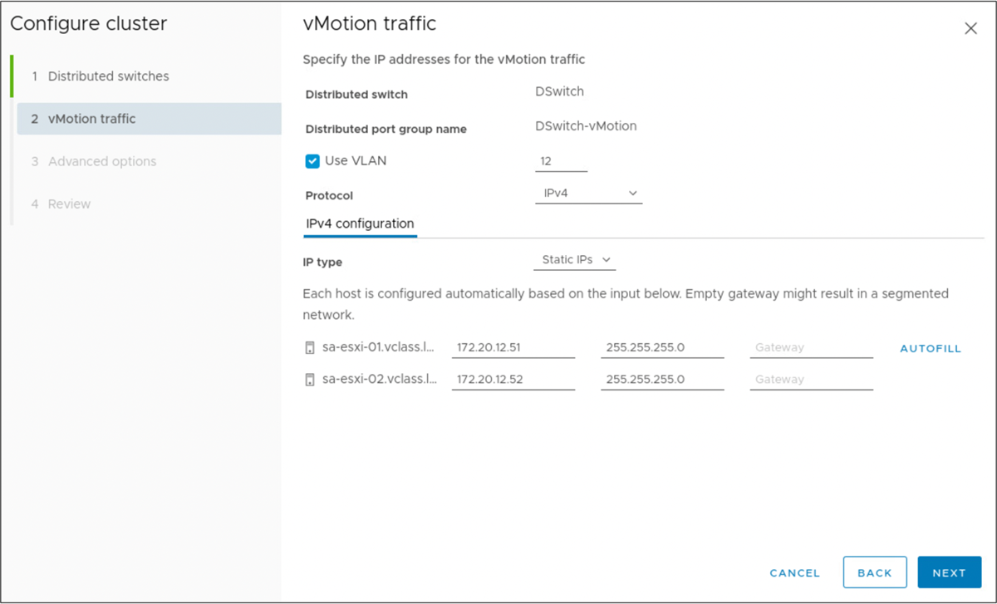
Configuring a Cluster: vSAN and vMotion Traffic
If you selected vSphere DRS, you are prompted to enter the IP address information for the vSphere vMotion network.
If you selected vSAN, you are prompted to enter the IP information for the vSAN network.
Notes:
On the vMotion traffic page, if the IP information for ESXi hosts is similar, you can enter the information for the first host and click AUTOFILL to complete the fields for the following hosts.

Slide 14
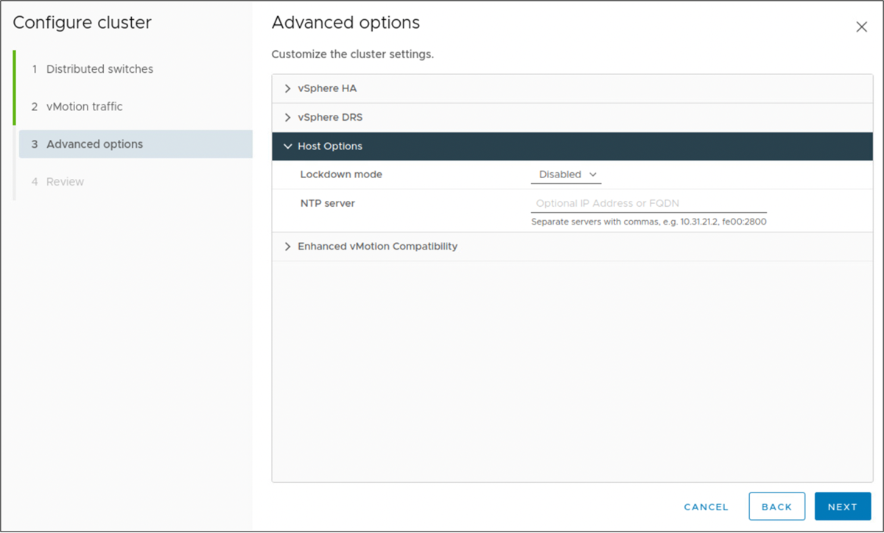
Configuring a Cluster: Advanced Options
You get different settings depending on the cluster services that are enabled:
High Availability (optional)
Distributed Resource Scheduler (optional)
Host Options
Enhanced vMotion Compatibility

Slide 15
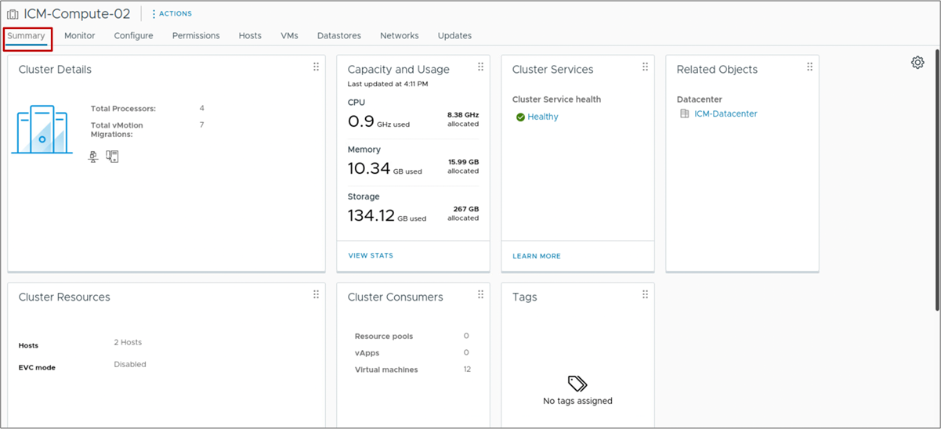
Viewing Cluster Summary Information
The Summary tab provides a quick view of information about a cluster's resources and its consumers.

Slide 16
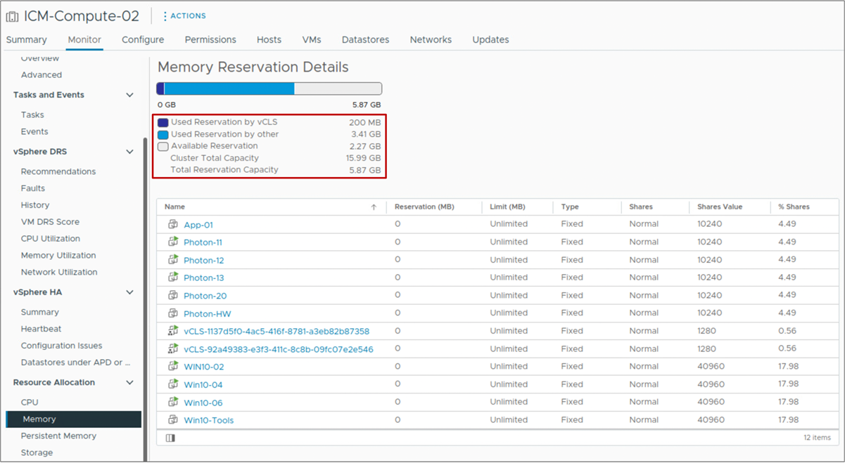
Monitoring Cluster Resources
You can view CPU and memory allocation details.
Memory statistics for the cluster
Notes:
You can view a report of total cluster CPU, memory, memory overhead, storage capacity, the capacity reserved by VMs, and how much capacity remains available.

Slide 17
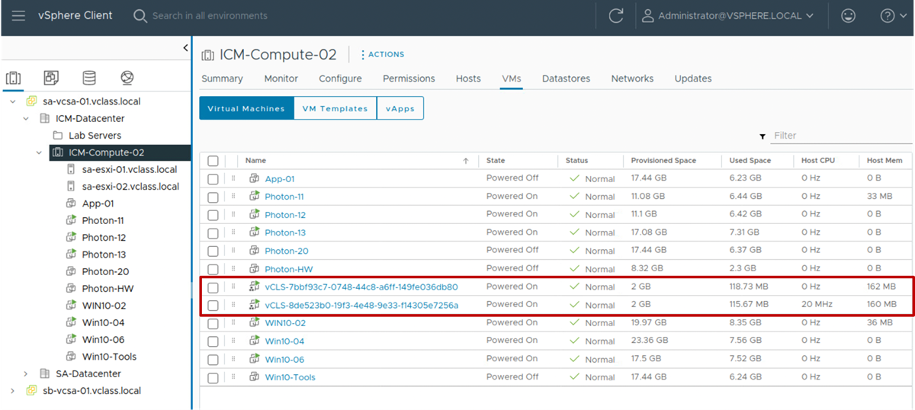
vSphere Cluster Services VMs
Up to three vSphere Cluster Service VMs are present in each vSphere cluster.
These VMs are required for maintaining the health and availability of cluster services such as vSphere DRS and vSphere HA.
Notes:
vSphere Cluster Service VMs are deployed to a cluster at cluster creation and after hosts are added to the cluster. A vSphere Cluster Service VM is deployed from an OVA with a minimal installed profile of Photon OS. vSphere Cluster Services Manager is a vCenter service that manages the resources, power state, and availability of these VMs. Any impact on the power state or resources of these VMs might degrade the health of vSphere Cluster Services and cause vSphere DRS to stop working in the cluster.
In the vSphere Client, vSphere Cluster Service VMs are not visible in the Hosts and Clusters inventory view. However, you can view these VMs from the cluster's VMs tab. You can also view these VMs from the VMs and Templates inventory view.
The vSphere cluster shows an alert message if healthy vSphere Cluster Service VMs are not available in the cluster.
If vSphere Cluster Service VMs are manually powered off, these VMs are automatically powered on by vCenter.

Slide 18
Review of Learner Objectives
Create a vSphere cluster
Recognize cluster options that you can configure with Cluster Quickstart
View information about a vSphere cluster

Slide 19
vSphere Distributed Resource Scheduler

Slide 20
Learner Objectives
Describe the functions of a vSphere DRS cluster
Explain how vSphere DRS determines VM placement on hosts in the cluster
Recognize use cases for vSphere DRS settings
Configure vSphere DRS in a cluster
Monitor a vSphere DRS cluster

Slide 21
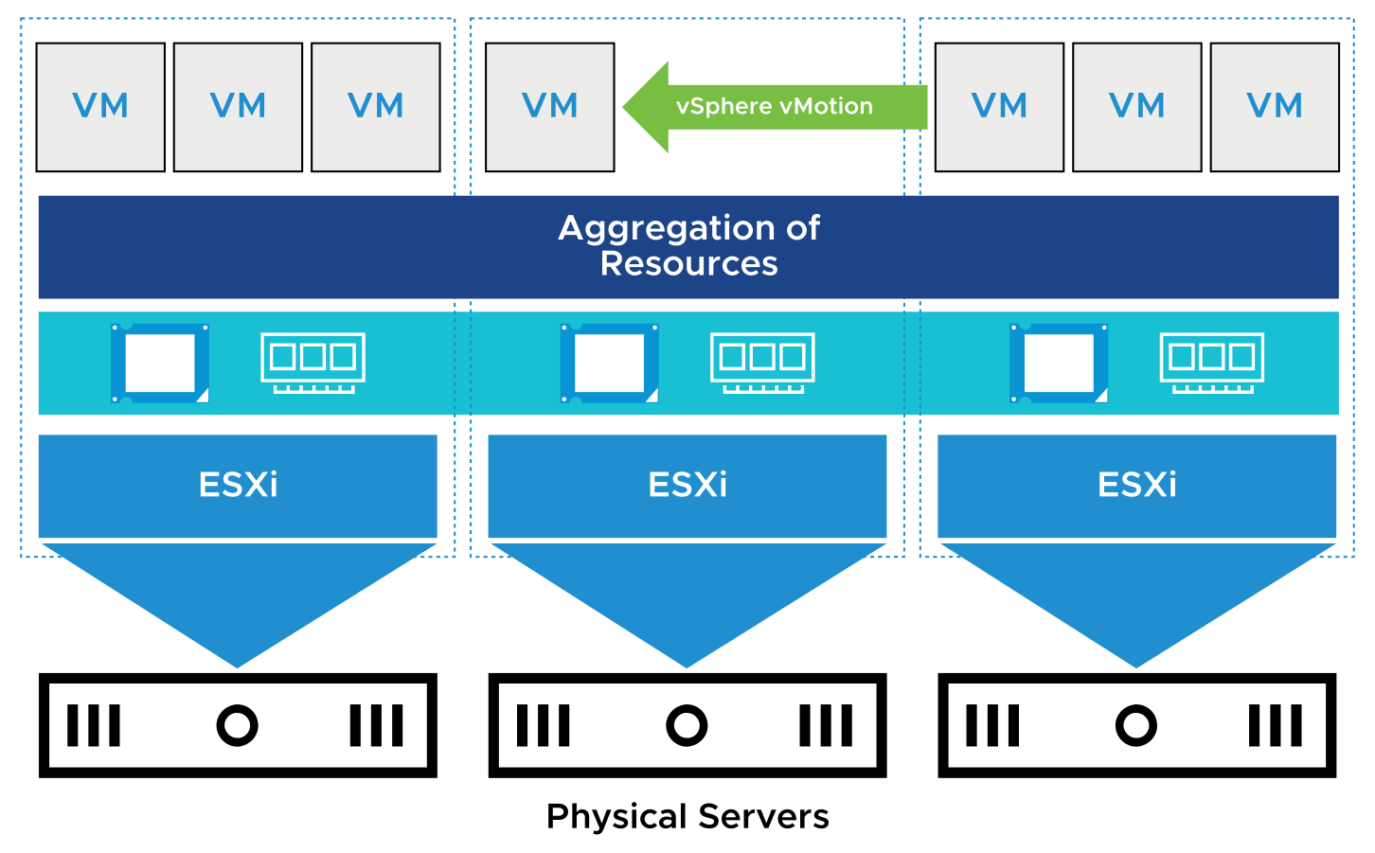
About vSphere Distributed Resource Scheduler
vSphere Distributed Resource Scheduler (DRS) helps to improve resource allocation across all hosts in a cluster.
vSphere DRS use cases:
Initial placement when a VM is powered on
Load balancing
Migrating VMs when an ESXi host is placed in maintenance mode
Notes:
vSphere DRS aggregates computing capacity across a collection of servers into logical resource pools.
When you power on a VM in the cluster, vSphere DRS either places the VM on the host with the most available resources when DRS is in Fully Automated mode, or makes a resource allocation recommendations when DRS is in Partially Automated or Manual mode.
DRS attempts to improve resource use across the cluster by performing automatic migrations of VMs (using vSphere vMotion) or by providing a recommendation for VM migrations.
Before an ESXi host enters maintenance mode, VMs running on the host must be migrated to another host either manually or automatically by DRS, shut down, or suspended.

Slide 22
vSphere DRS: VM Focused
vSphere DRS is VM focused:
While the VM is powered on, vSphere DRS operates on an individual VM basis by ensuring that each VM's resource requirements are met.
vSphere DRS calculates a score for each VM and gives recommendations (or migrates VMs) for meeting VM's resource requirements.
Notes:
The DRS algorithm recommends where individual VMs should be moved for maximum performance. If the cluster is in fully automated mode, DRS executes the recommendations and migrates VMs to their optimal host based on the underlying calculations performed every minute.

Slide 23
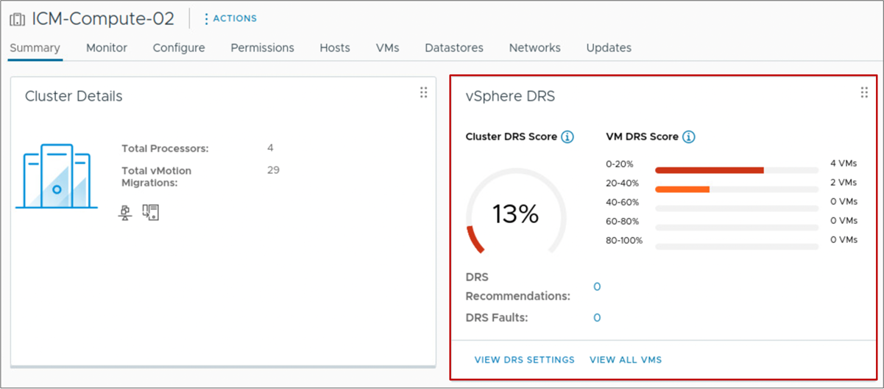
About the VM DRS Score
The VM DRS score tracks how well a VM's resource requirements are met.
Scores closer to 0% indicate severe resource contention.
Scores closer to 100% indicate mild to no resource contention.
Notes:
A VM DRS score is computed from an individual VM's CPU, memory, and network metrics. DRS uses these metrics to gauge the goodness or wellness of the VM.
In vSphere 7 and later, the DRS algorithm runs every minute. The Cluster DRS Score is the last result of DRS running and is filed into one of five buckets. These buckets are simply 20 percent ranges: 0-20, 20-40, 40-60, 60-80 and 80-100 percent over the sample period.

Slide 24
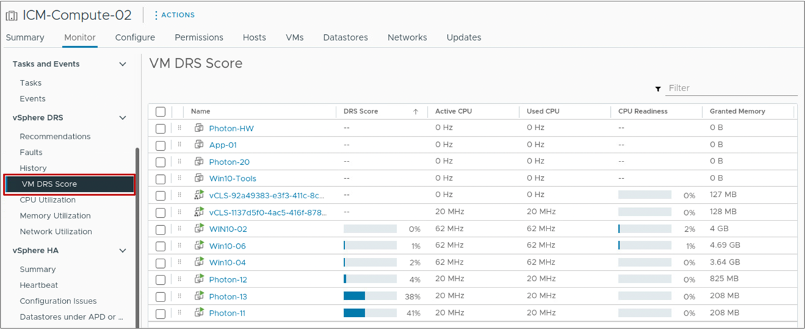
VM DRS Score List
The cluster's Monitor tab lists the VM DRS Score and more detailed metrics for all the VMs in the cluster.
Notes:
The VM DRS Score page shows the following values for VMs that are powered on:
DRS Score
Active CPU
Used CPU
CPU Readiness
Granted Memory
Swapped Memory
Ballooned Memory

Slide 25
vSphere DRS Cluster Requirements
ESXi hosts that are added to a vSphere DRS cluster must meet certain requirements to use cluster features successfully:
To use vSphere DRS for load balancing, the hosts in your cluster must be part of a vSphere vMotion network:
  If the hosts are not part of a vSphere vMotion network, vSphere DRS can still make initial placement recommendations.
  vSphere DRS works best if the VMs meet vSphere vMotion requirements.
Configure all managed hosts to use shared storage.

Slide 26
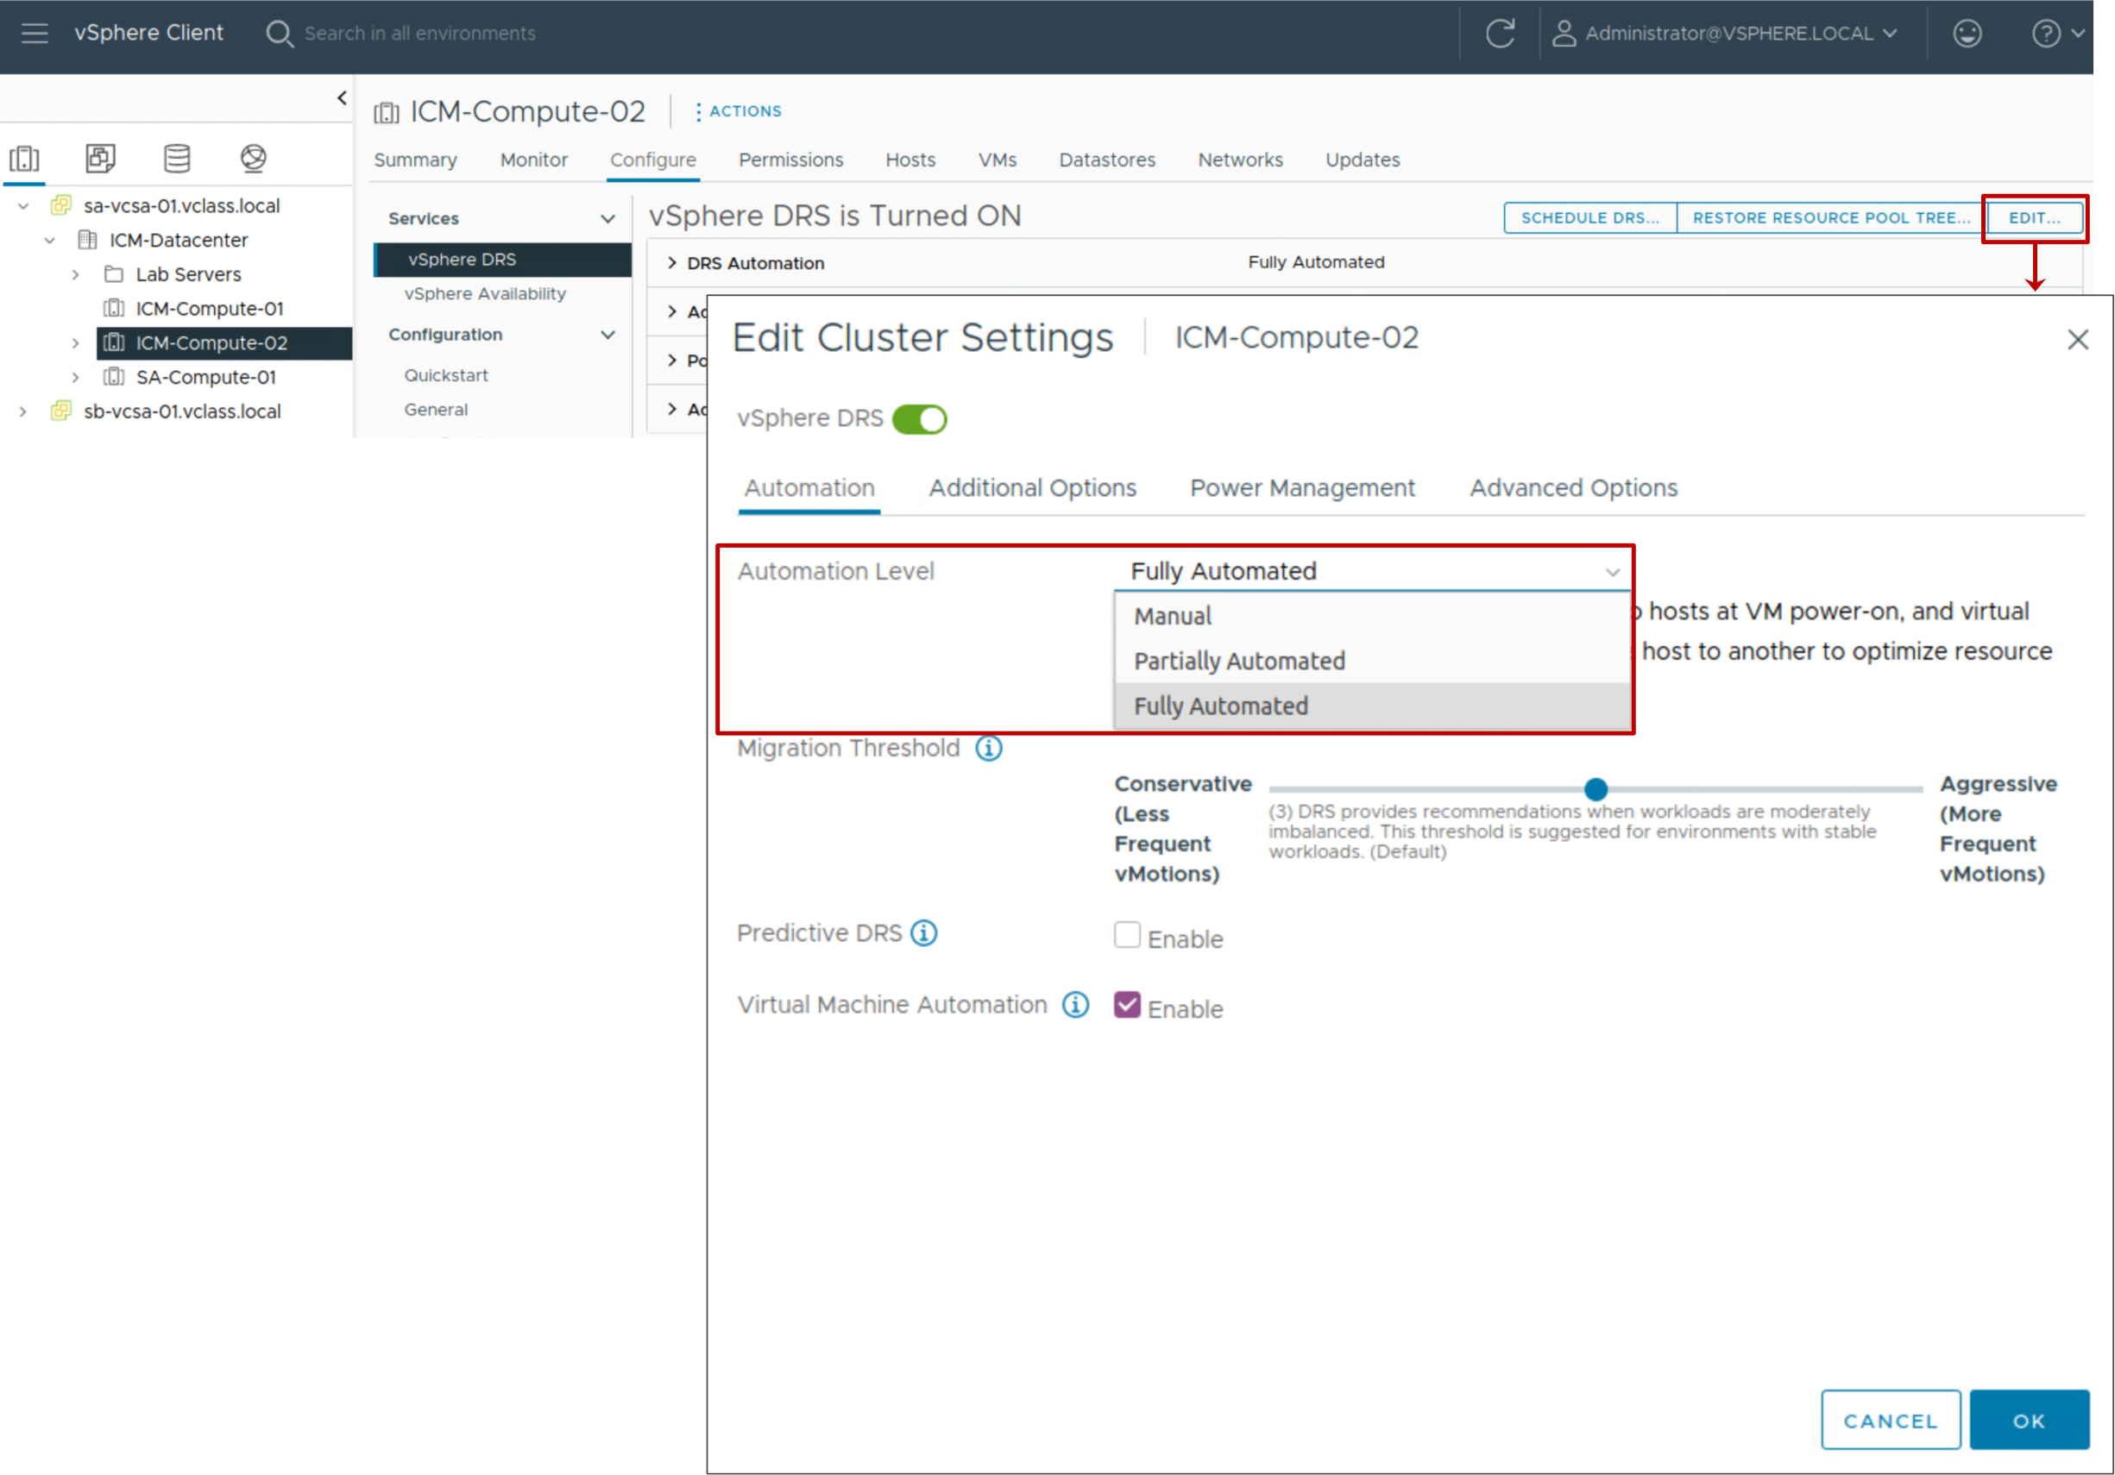
vSphere DRS Settings: Automation Level
You can configure the automation level for the initial placement of VMs and for dynamic balancing while VMs are running.
Notes:
The automation level determines whether vSphere DRS makes migration recommendations or automatically places VMs on hosts. vSphere DRS makes placement decisions when a VM powers on and when VMs must be rebalanced across hosts in the cluster.
The following automation levels are available:
Manual: When you power on a VM, vSphere DRS displays a list of recommended hosts on which to place the VM. To improve the cluster's overall DRS score, vSphere DRS displays recommendations for manual VM migration.
Partially automated: When you power on a VM, vSphere DRS places it on the best-suited host. To improve the cluster's overall DRS score, vSphere DRS displays recommendations for manual VM migration.
Fully automated: When you power on a VM, vSphere DRS places it on the best-suited host. To improve the cluster's overall DRS score, vSphere DRS automatically migrates VMs between hosts.

Slide 27
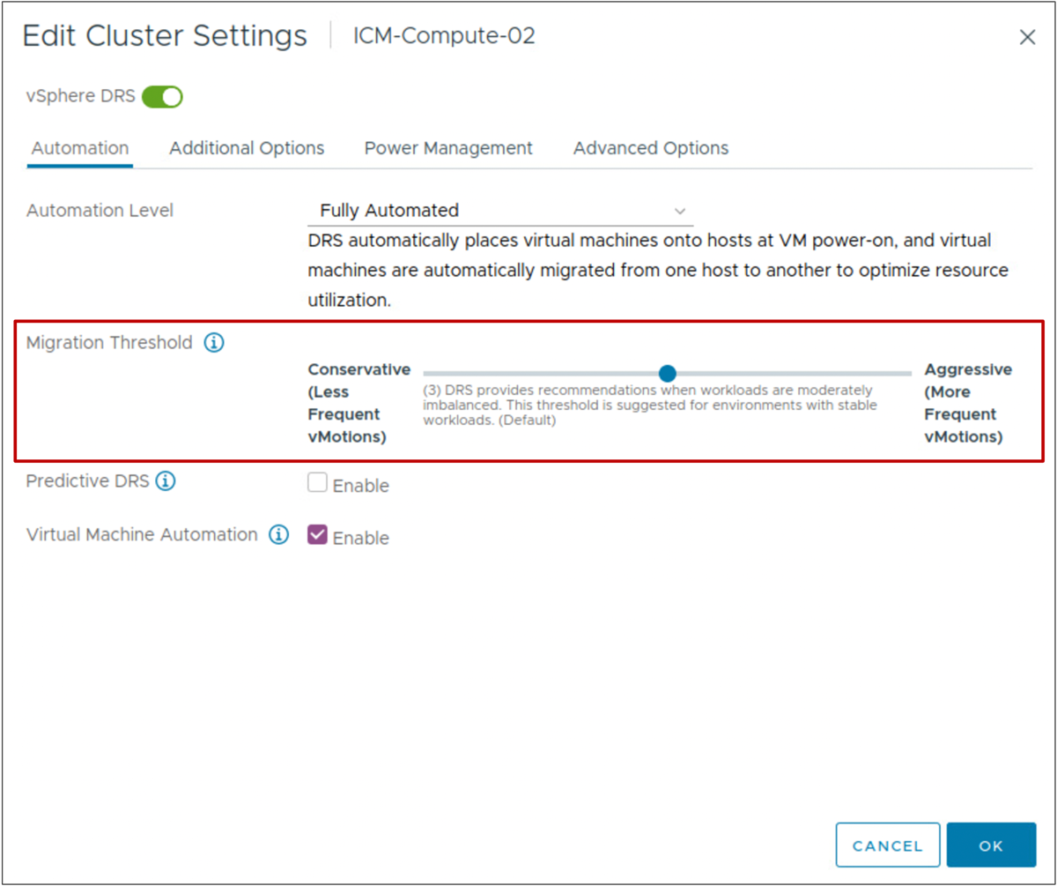
vSphere DRS Settings: Migration Threshold
The migration threshold determines how aggressively vSphere DRS selects to migrate VMs.
Notes:
The following migration threshold settings are available:
Level 1 (Conservative): Applies only priority 1 recommendations. vCenter applies only recommendations that must be taken to satisfy VMs' requirements, such as affinity rules and host maintenance.
Level 2: Apply priority 1 and priority 2 recommendations. vCenter applies recommendations that promise a significant improvement to the cluster's overall DRS score.
Level 3 (default): Apply priority 1, priority 2, and priority 3 recommendations. vCenter applies recommendations that promise at least a good improvement to the cluster's overall DRS score.
Level 4: Apply priority 1, priority 2, priority 3, and priority 4 recommendations. vCenter applies recommendations that promise even a moderate improvement to the cluster's overall DRS score.
Level 5 (Aggressive): Apply all recommendations. vCenter applies recommendations that promise even a slight improvement to the cluster's overall DRS score.

Slide 28
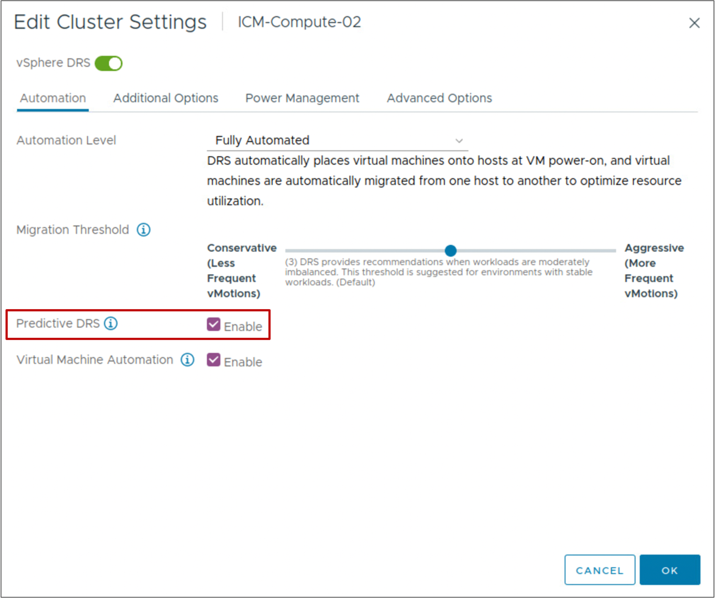
vSphere DRS Settings: Predictive DRS
Predictive DRS is used to predict future demand and determine when and where high resource utilization occurs.
To make predictive decisions, the vSphere DRS data collector retrieves the following data:
Resource usage statistics from ESXi hosts
Predicted usage statistics from the VMware Aria Operations server
Goals of Predictive DRS:
Move VMs before their DRS score drops.
Perform migrations before host resources are in contention.
Notes:
Predicted usage statistics always take precedence over current usage statistics.

Slide 29
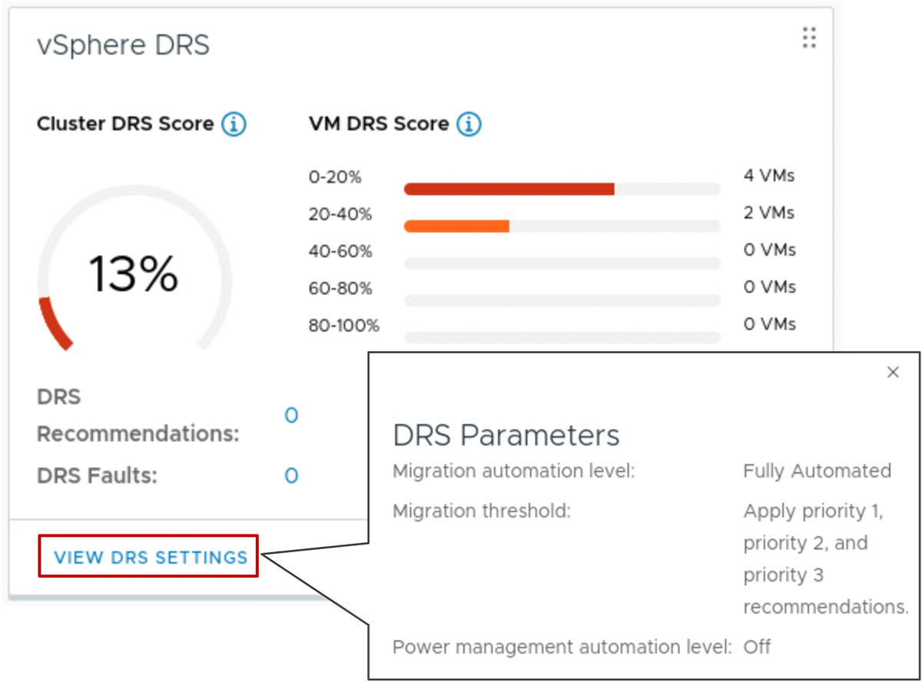
Viewing vSphere DRS Settings
When you click VIEW DRS SETTINGS, the main vSphere DRS parameters and their current values are shown.
vSphere DRS settings include:
Automation level
Migration threshold
Notes:
To view the vSphere DRS pane, go to the cluster's Summary tab.

Slide 30
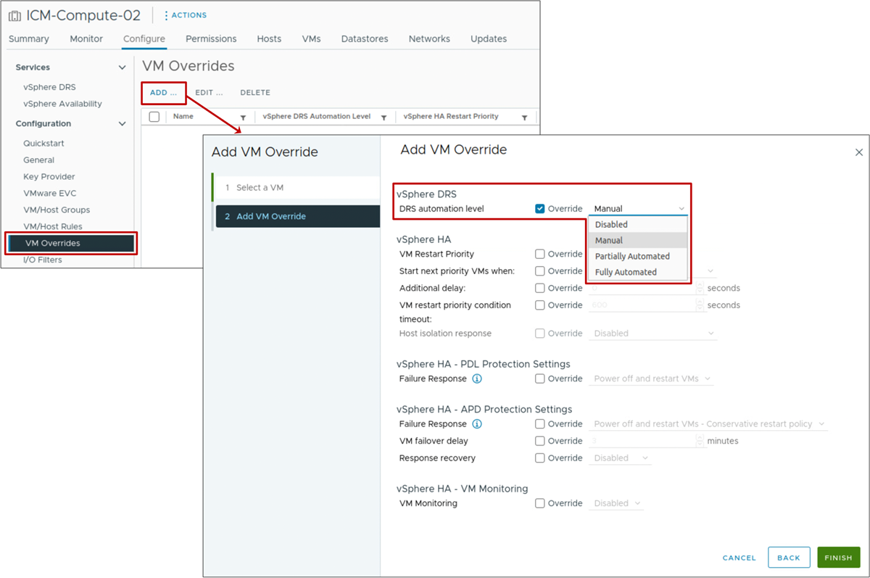
vSphere DRS Settings: VM-Level Automation
You can customize the automation level for individual VMs in a cluster to override the automation level set on the entire cluster.
Notes:
By setting the automation level for individual VMs, you can fine-tune automation to suit your needs. For example, you might have a VM that is especially critical to your business. You want more control over its placement, so you set its automation level to Manual.
If a VM’s automation level is set to Disabled, vSphere DRS does not migrate the VM, nor does it provide initial placement or migration recommendations.
Select the automation level based on your environment and level of comfort.
For example, if you are new to vSphere DRS clusters, you might select Partially Automated because you want control over the movement of VMs.
When you are comfortable with what vSphere DRS does and how it works, you might set the automation level to Fully Automated.
You can set the automation level to Manual on VMs over which you want more control, such as your business-critical VMs.

Slide 31
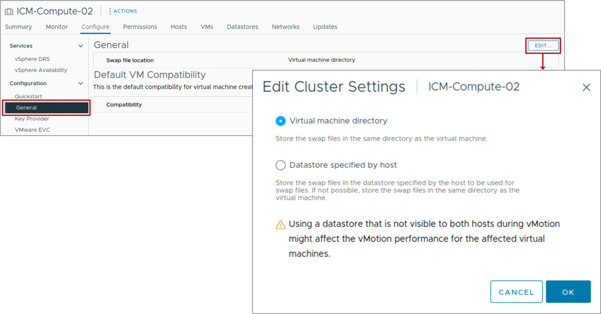
vSphere DRS Settings: VM Swap File Location
ESXi hosts can be configured to place VM swap files on a local datastore.
If vSphere DRS is configured, you should place the VM swap files on a shared datastore.
Notes:
On a VMFS or NFS datastore, the VM's swap space is a set of two swap files. On a vSAN or vSphere Virtual Volumes datastore, the swap files are created as a separate objects.
Two swap files are created by the ESXi host when a VM is powered on. If these files cannot be created, the VM cannot power on.
By default, swap files for a VM are on a datastore in the folder containing the other VM files. Instead of accepting the default, you can also use the following options:
Use per-VM configuration options to change the datastore to another shared storage location.
Use host-local swap, which allows you to specify a datastore stored locally on the host. You can swap at a per-host level. However, it can lead to a slight degradation in performance for vSphere vMotion because pages swapped to a local swap file on the source host must be transferred across the network to the destination host. Currently, vSAN and vSphere Virtual Volumes datastores cannot be specified for host-local swap.

Slide 32
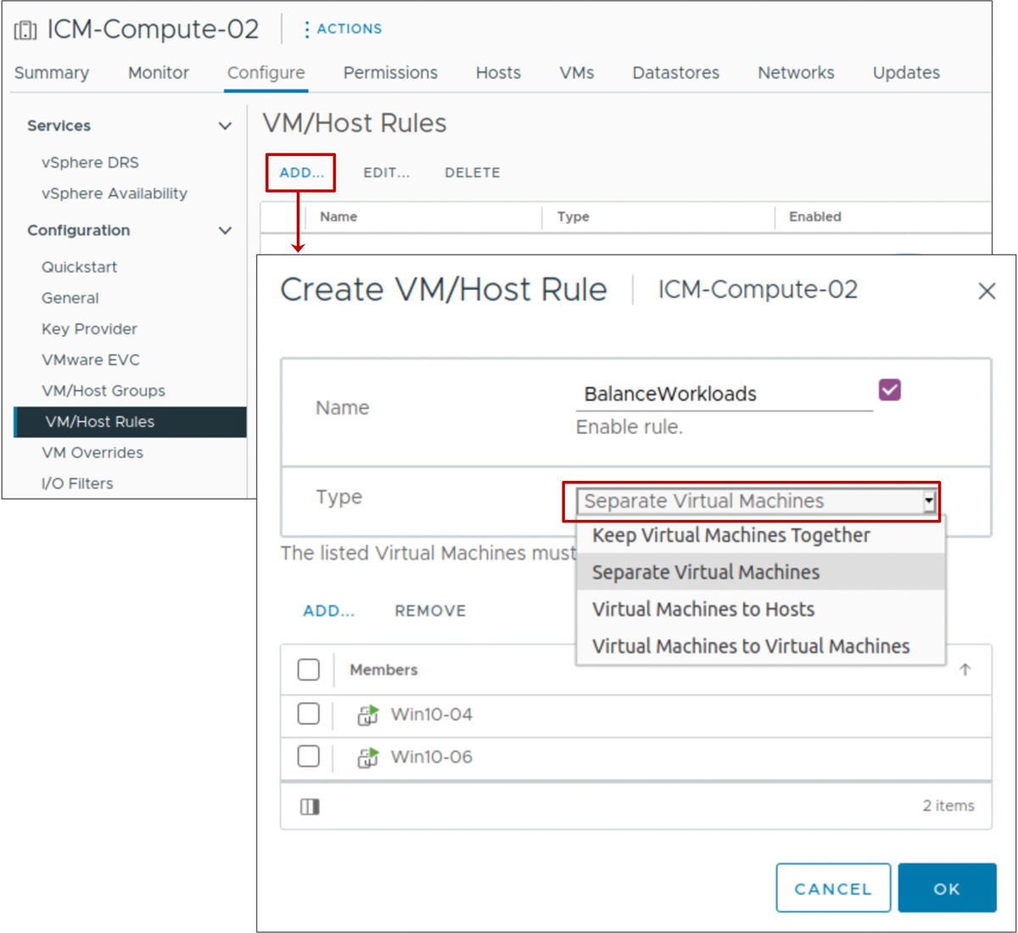
vSphere DRS Settings: VM Affinity
vSphere DRS virtual machine affinity rules specify that selected VMs be placed either on the same host or on separate hosts:
Affinity rules: For VMs that communicate heavily with one another
Anti-affinity rules: For VMs where load balancing or high availability is desired.
Notes:
After a vSphere DRS cluster is created, you can edit its properties to create rules that specify affinity. The following types of rules can be created:
Affinity rules: vSphere DRS keeps certain VMs together on the same host (for example, for performance reasons).
Anti-affinity rules: vSphere DRS ensures that certain VMs are placed on different hosts (for example, for availability reasons).
If two rules conflict, you are prevented from activating both.
When you add or edit a rule, and the cluster is immediately in violation of that rule, the cluster continues to operate and tries to correct the violation.
For vSphere DRS clusters that have an automation level of manual or partially automated, migration recommendations are based on both rule fulfillment and load balancing.

Slide 33
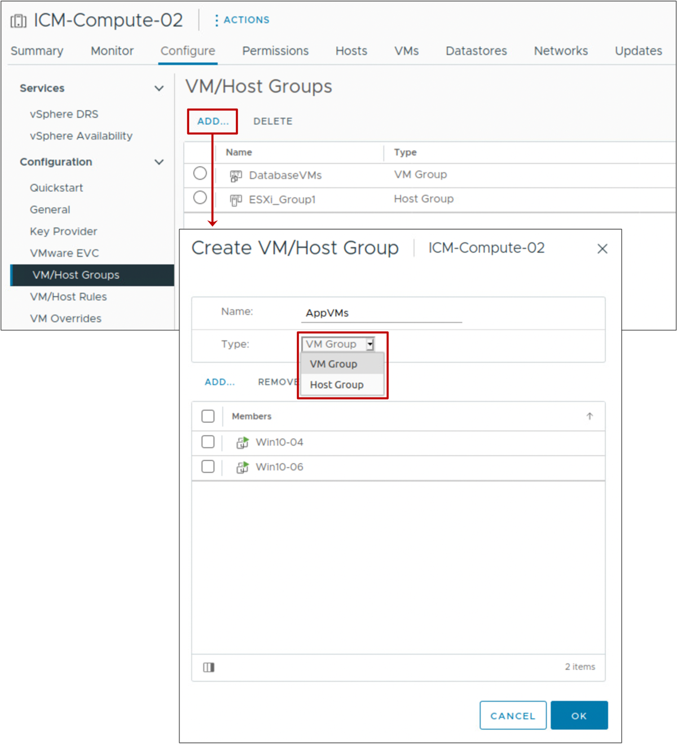
vSphere DRS Settings: DRS Groups
VM groups and host groups are used in defining VM-Host affinity rules.
The VM-Host affinity rule specifies whether a VM can or cannot be run on a host.
Types of groups:
VM group: One or more VMs
Host group: One or more ESXi hosts
A VM can belong to multiple VM groups.
A host can belong to multiple host groups.
Notes:
For ease of administration, virtual machines can be placed in VM or host groups. You can create one or more VM groups in a vSphere DRS cluster, each consisting of one or more VMs. A host group consists of one or more ESXi hosts.
The main use of VM groups and host groups is to help in defining the VM-Host affinity rules.

Slide 34
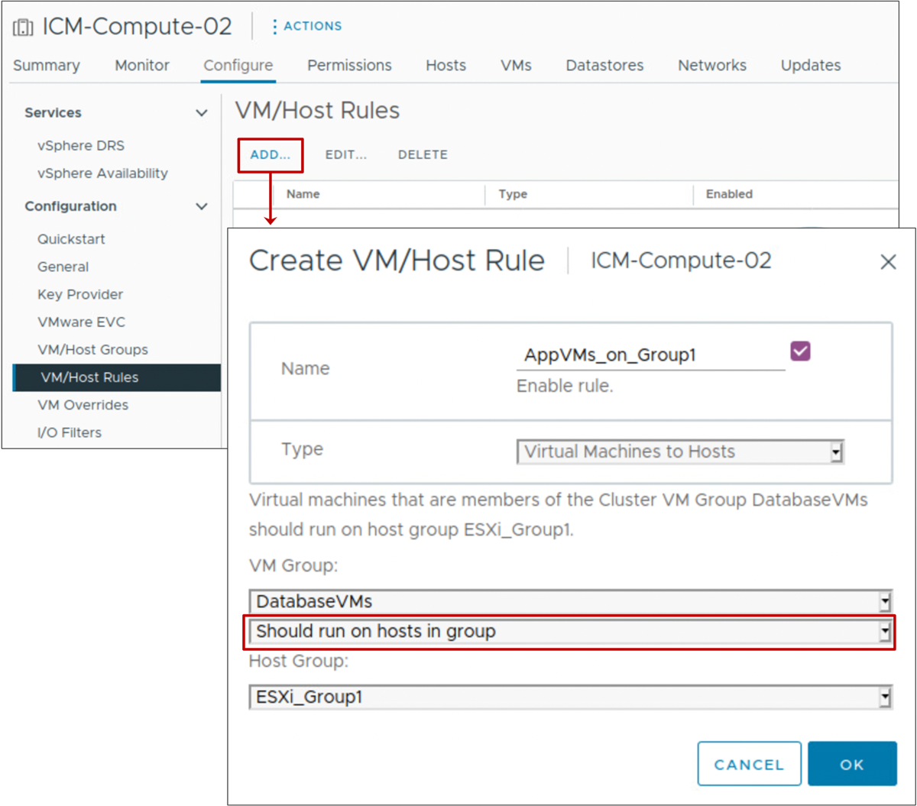
vSphere DRS Settings: VM-Host Affinity Rules
A VM-Host affinity rule:
Defines an affinity (or anti-affinity) relationship between a VM group and a host group
Is either a required rule or a preferential rule
Rule options:
Must run on hosts in group
Should run on hosts in group
Must not run on hosts in group
Should not run on hosts in group
Notes:
A VM-Host affinity or anti-affinity rule specifies whether the members of a selected VM group can run on the members of a specific host group.
Unlike an affinity rule for VMs, which specifies affinity (or anti-affinity) between individual VMs, a VM-Host affinity rule specifies an affinity relationship between a group of VMs and a group of hosts.
Because VM-Host affinity rules are cluster-based, the VMs and hosts that are included in a rule must all reside in the same cluster. If a VM is removed from the cluster, the VM loses its membership from all VM groups, even if it is later returned to the cluster.

Slide 35
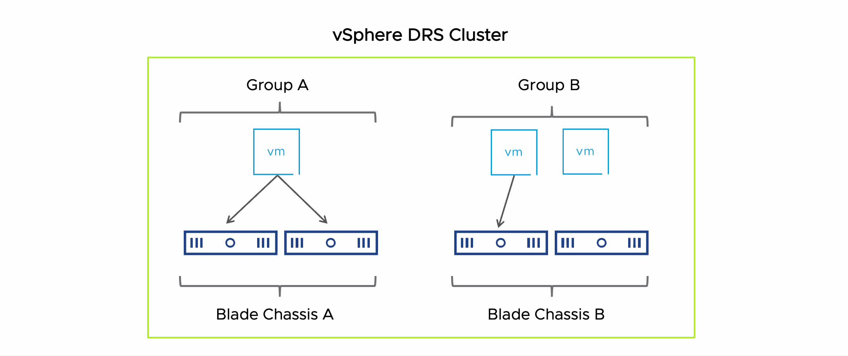
VM-Host Affinity Preferential Rules
A preferential rule is softly enforced and can be violated if necessary.
Example: Separate VMs on different blade systems for improved performance.
Notes:
To play the animation, go to https://vmware.bravais.com/s/2V3GkAYpnmAK6d43Oheh
Preferential rules can be violated to allow the proper functioning of vSphere DRS, vSphere HA, and VMware vSphere DPM.
On the slide, Group A and Group B are VM groups. Blade Chassis A and Blade Chassis B are host groups. The goal is to force the VMs in Group A to run on the hosts in Blade Chassis A and to force the VMs in Group B to run on the hosts in Blade Chassis B. If the hosts fail, vSphere HA restarts the VMs on the other hosts in the cluster. vSphere DRS moves the VMs to the other hosts in the cluster if the hosts are put into maintenance mode or hosts are needed to satisfy VMs' resource requirements.

Slide 36
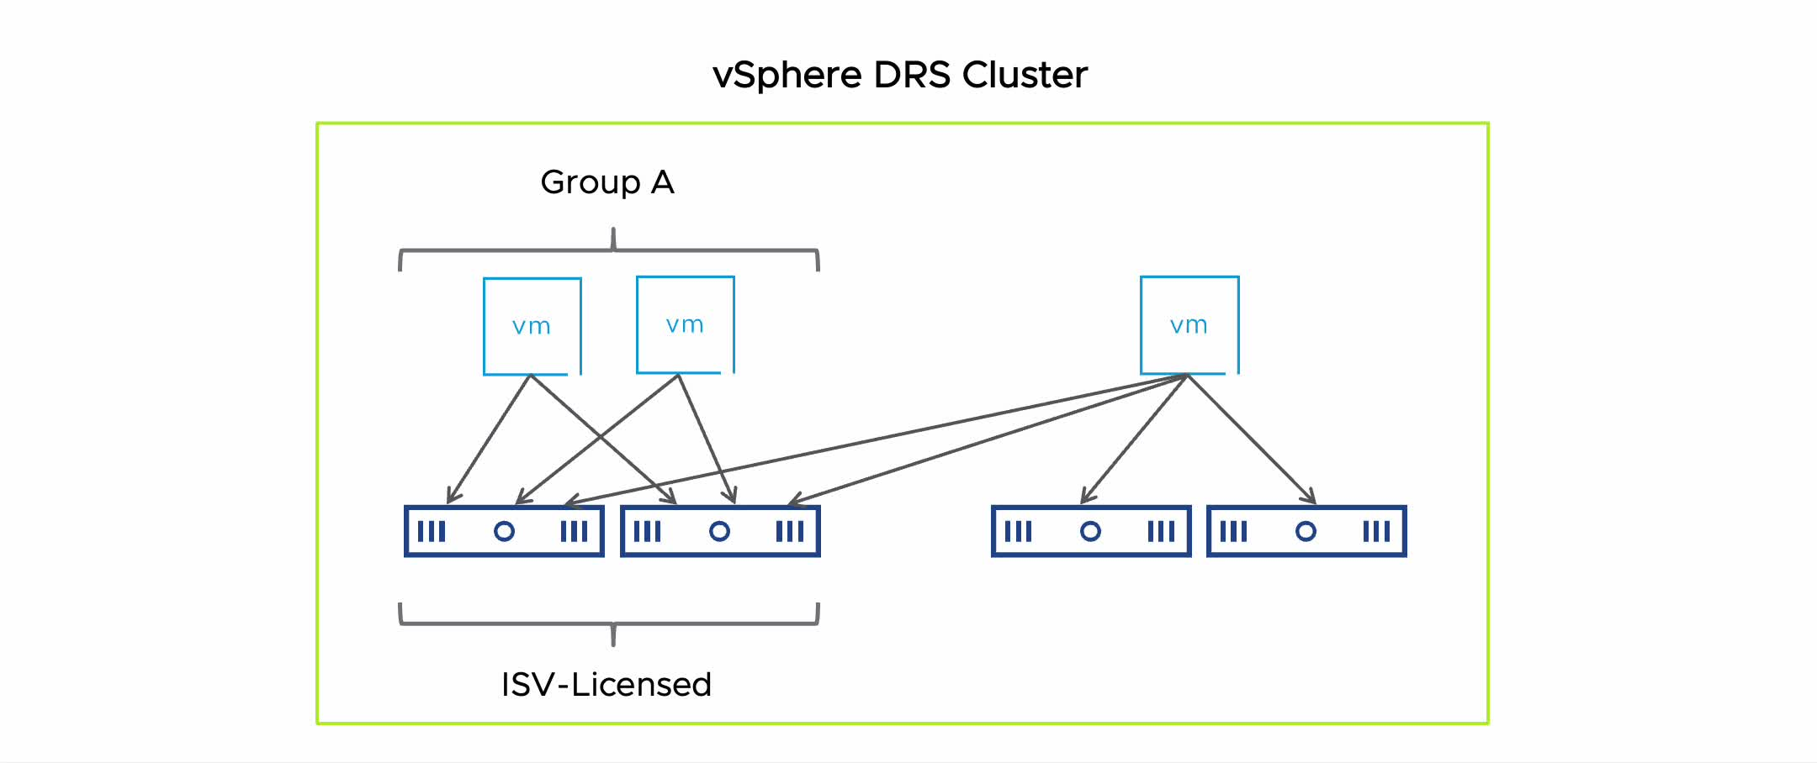
VM-Host Affinity Required Rules
A required rule is strictly enforced and can never be violated.
Example: Enforce host-based ISV licensing.
Notes:
To play the animation, go to https://vmware.bravais.com/s/4UeCSZE8oK4Tc3SJ8kiM
A VM-Host affinity rule that is required, instead of preferential, can be used when the software running in your VMs has licensing restrictions. You can enforce this rule when the software running in your VMs has licensing restrictions. You can place such VMs in a VM group. Then you can create a rule that requires the VMs to run on a host group, which contains hosts with the required licenses.
When you create a VM-Host affinity rule that is based on the licensing or hardware requirements of the software running in your VMs, you are responsible for ensuring that the groups are properly set up. The rule does not monitor the software running in the VMs. Nor does it know which third-party licenses are in place on which ESXi hosts.
On the slide, Group A is a VM group. You can force Group A to run on hosts in the ISV-Licensed group to ensure that the VMs in Group A run on hosts that have the required licenses. But if the hosts in the ISV-Licensed group fail, vSphere HA cannot restart the VMs in Group A on hosts that are not in the group. If the hosts in the ISV-Licensed group are put into maintenance mode or become overused, vSphere DRS cannot move the VMs in Group A to hosts that are not in the group.

Slide 37
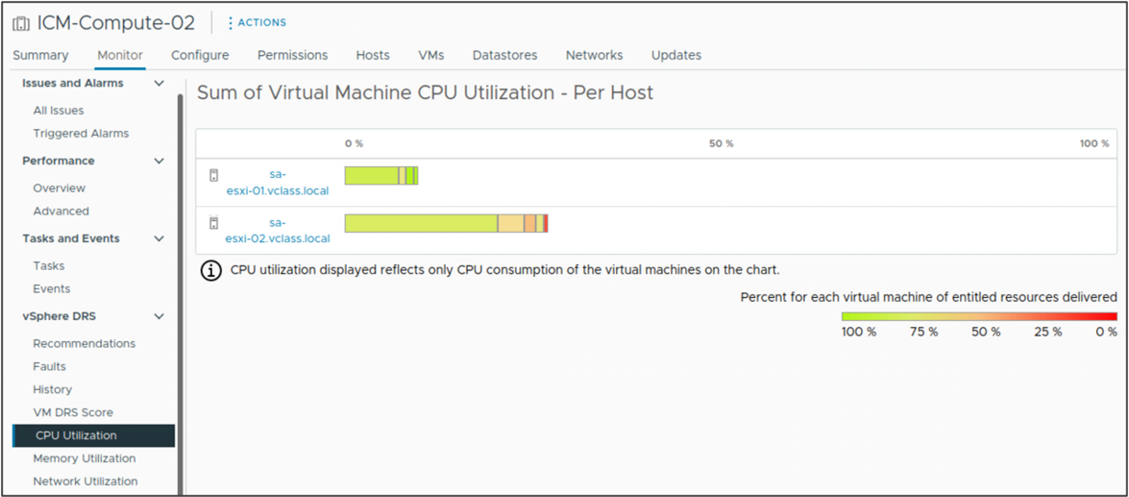
Viewing vSphere DRS Cluster Resource Utilization
From the cluster's Monitor tab, you can view CPU, memory, and network utilization per host.
Notes:
The CPU Utilization chart shows all the hosts in the cluster and how their CPU resources are allocated to each VM. For CPU usage, a colored box represents the VM information. If you point to the colored box, the VM’s CPU usage information appears. If the VM is receiving the resources that it is entitled to, the box is green. Green means that 100 percent of the VM’s entitled resources are delivered. If the box is not green (for example, entitled resources are 80 percent or less) for an extended time, you might want to investigate what is causing this shortfall (for example, unapplied recommendations).
The Memory Utilization chart shows all the hosts in the cluster and how their memory resources are allocated to each VM. For memory usage, the VM boxes are not color-coded because the relationship between consumed memory and entitlement is often not easily categorized.
The Network Utilization chart displays network data, which reflects all traffic across physical network interfaces on the host.

Slide 38
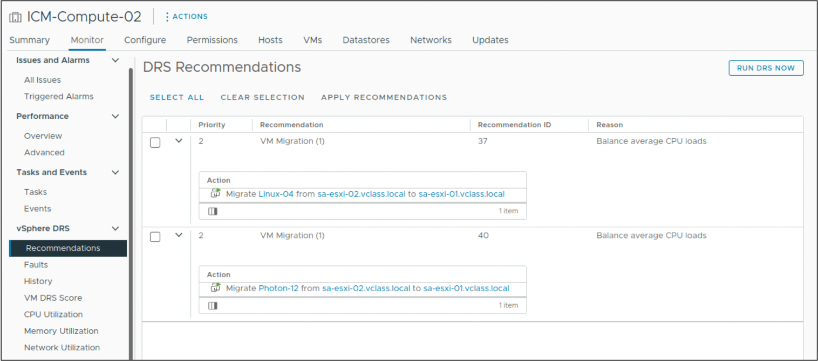
Viewing vSphere DRS Recommendations
Select Recommendations to display information about the vSphere DRS recommendations made for the cluster.
Notes:
In the DRS Recommendations pane, you can see the current set of recommendations that are generated for optimizing resource use in the cluster through either migrations or power management. Recommendations appear in the list if vSphere DRS is set for Manual or Partially Automated mode.
To refresh the recommendations, click RUN DRS NOW.
To apply all recommendations, click SELECT ALL to select all recommendations and click APPLY RECOMMENDATIONS.
To apply a subset of the recommendations, select the checkbox next to each desired recommendation and click APPLY RECOMMENDATIONS.
In addition to the DRS Recommendations pane, you can select Faults to view the faults that occurred when the recommendations were applied. You can select History to view the history of vSphere DRS actions.

Slide 39
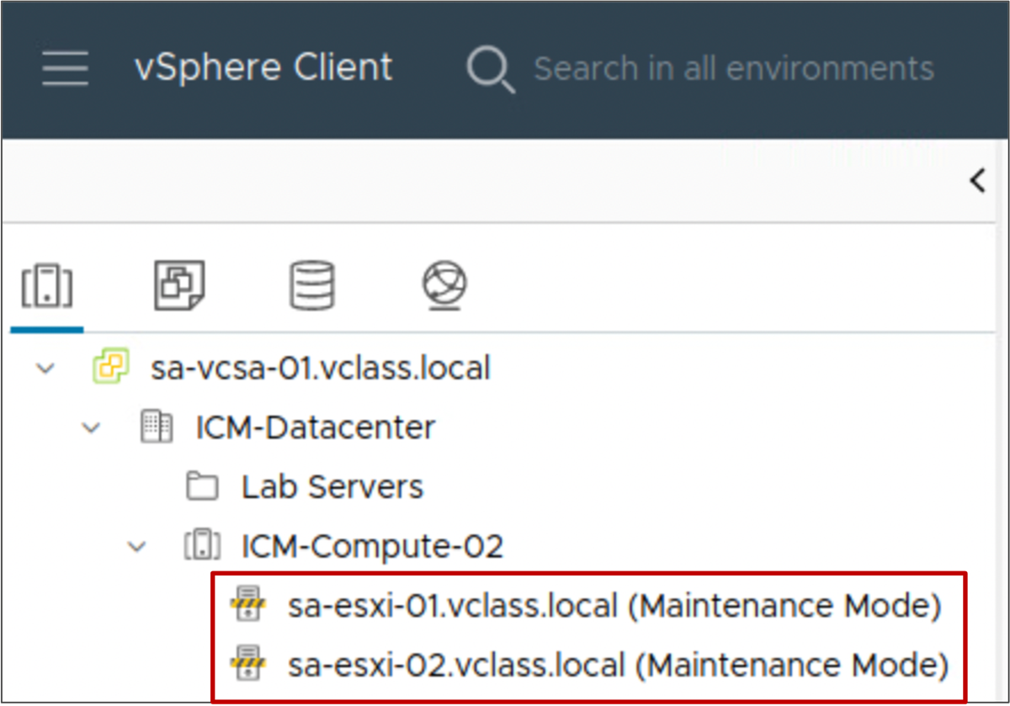
Maintenance Mode and Standby Mode
Maintenance mode:
Should be used to service a host in a cluster
Makes the host's resources unavailable for use
Standby mode:
Is used by vSphere DPM to optimize power usage. When a host is placed in standby mode, it is powered off.
Notes:
A host enters or leaves maintenance mode as the result of a user request. While in maintenance mode, the host does not allow you to deploy or power on a VM.
VMs that are running on a host entering maintenance mode must be shut down, suspended, or migrated to another host (either manually by a user or automatically by vSphere DRS). The host continues to run the Enter Maintenance Mode task until all VMs are powered down or moved away.
When no more running VMs are on the host, the host’s icon indicates that it has entered maintenance mode. The host’s Summary tab indicates the new state.
Place a host in maintenance mode before servicing the host, in instances such as installing more memory or removing a host from a cluster.
You can place a host in standby mode manually. When a host is placed in standby mode, it is powered off, except for the Baseboard Management Controller (BMC). The BMC is powered on even when the host itself is powered off. For more information on vSphere DPM, see vSphere Resource Management at https://docs.vmware.com/en/VMware-vSphere/index.html.
If you place a host in standby mode, the next time that vSphere DRS runs, it might undo your change or recommend that you undo the changes. If you want a host to remain powered off, place it in maintenance mode and turn it off.

Slide 40
Removing a Host from the vSphere DRS Cluster
To remove a host from a cluster:
Place the host in maintenance mode.
  All running VMs on the host must be migrated to another host, shut down or suspended.
  If DRS is in fully automated mode, powered-on VMs are automatically migrated from a host that is placed in maintenance mode.
Drag the host to a different inventory location, for example, the data center or another cluster.
The resources available for the cluster decrease.
Notes:
When a host is put into maintenance mode, all its running VMs must be shut down, suspended, or migrated to other hosts by using vSphere vMotion. VMs with disks on local storage must be powered off, suspended, or migrated to another host and datastore.
When you remove the host from the cluster, the VMs that are currently associated with the host are also removed from the cluster. If the cluster still has enough resources to satisfy the reservations of all VMs in the cluster, the cluster adjusts resource allocation to reflect the reduced amount of resources.

Slide 41
Lab 1: Implementing vSphere DRS Clusters
Create a vSphere DRS cluster, use Cluster Quickstart to perform the basic configuration, and verify proper vSphere DRS functionality:
Create a Cluster That Is Configured for vSphere DRS
Verify vSphere vMotion Configuration on the ESXi Hosts
Add ESXi Hosts to the Cluster
Modify vSphere DRS Settings
Power On VMs and Review vSphere DRS Recommendations
Review vSphere DRS Recommendations When the Cluster Is Imbalanced

Slide 42
Review of Learner Objectives
Describe the functions of a vSphere DRS cluster
Explain how vSphere DRS determines VM placement on hosts in the cluster
Recognize use cases for vSphere DRS settings
Configure vSphere DRS in a cluster
Monitor a vSphere DRS cluster

Slide 43
Introduction to vSphere High Availability

Slide 44
Learner Objectives
Describe how vSphere HA responds to various types of failures
Describe how vSphere HA responds to network isolation
Identify options for configuring network redundancy in a vSphere HA cluster

Slide 45
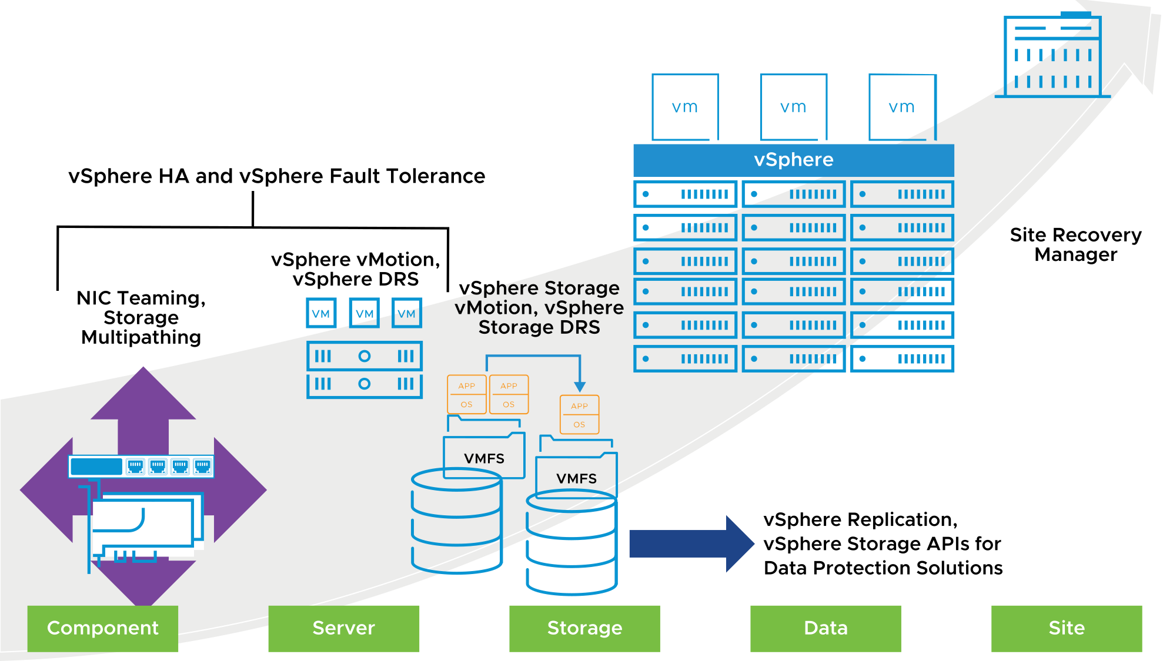
Protection at Every Level
With vSphere, you can reduce planned downtime, prevent unplanned downtime, and recover rapidly from outages.
Notes:
Whether planned or unplanned, downtime brings with it considerable costs. However, solutions to ensure higher levels of availability are traditionally costly, hard to implement, and difficult to manage.
VMware's software makes it simpler and less expensive to provide higher levels of availability for important applications. With vSphere, organizations can easily increase the baseline level of availability provided for all applications and provide higher levels of availability more easily and cost effectively. With vSphere, you can:
Provide higher availability independent of hardware, operating system, and applications.
Reduce planned downtime for common maintenance operations.
Provide automatic recovery in cases of failure.
vSphere HA provides a base level of protection for your VMs by restarting VMs if a host fails. vSphere Fault Tolerance provides a higher level of availability, allowing users to protect any VM from a host failure with no loss of data, transactions, or connections. vSphere Fault Tolerance provides continuous availability by ensuring that the states of the primary and secondary VMs are identical at any point in the instruction execution of the VM.
vSphere vMotion and vSphere Storage vMotion keep VMs available during a planned outage, for example, when hosts or storage must be taken offline for maintenance. System recovery from unexpected storage failures is simple, quick, and reliable with the encapsulation property of VMs. You can use vSphere Storage vMotion to support planned storage outages resulting from upgrades to storage arrays to newer firmware or technology and VMFS upgrades.
With vSphere Replication, a vSphere platform can protect VMs natively by copying their disk files to another location where they are ready to be recovered.
VM encapsulation is used by third-party backup applications that support file and image-level backups using vSphere Storage APIs – Data Protection. Backup solutions play prominent roles in recovering from deleted files or disks and corrupt or infected guest operating systems or file systems.
With Site Recovery Manager, you can quickly restore your organization’s IT infrastructure, shortening the time that you experience a business outage. Site Recovery Manager automates setup, failover, and testing of disaster recovery plans. Site Recovery Manager requires that you install vCenter at the protected site and at the recovery site. Site Recovery Manager also requires either host-based replication through vSphere Replication or preconfigured array-based replication between the protected site and the recovery site.

Slide 46
About vSphere HA
vSphere High Availability (HA) provides rapid recovery from outages and cost-effective high availability for applications running in VMs. vSphere HA protects application availability in several ways.
Protects Against | How Does vSphere HA Provide Protection?
ESXi host failure | By restarting the VMs on other hosts within the cluster
VM failure | By restarting the VM when a VMware Tools heartbeat is not received within a set time
Application failure | By restarting the VM when an application heartbeat is not received within a set time
Datastore accessibility failure | By restarting the affected VMs on other hosts that still can access the datastores.
Network isolation | By restarting VMs if their host becomes isolated on the heartbeat network. This protection is provided even if the network becomes partitioned.
Notes:
Unlike other clustering solutions, vSphere HA protects all workloads by using the infrastructure itself. After you configure vSphere HA, no actions are required to protect new VMs. All workloads are automatically protected by vSphere HA.

Slide 47
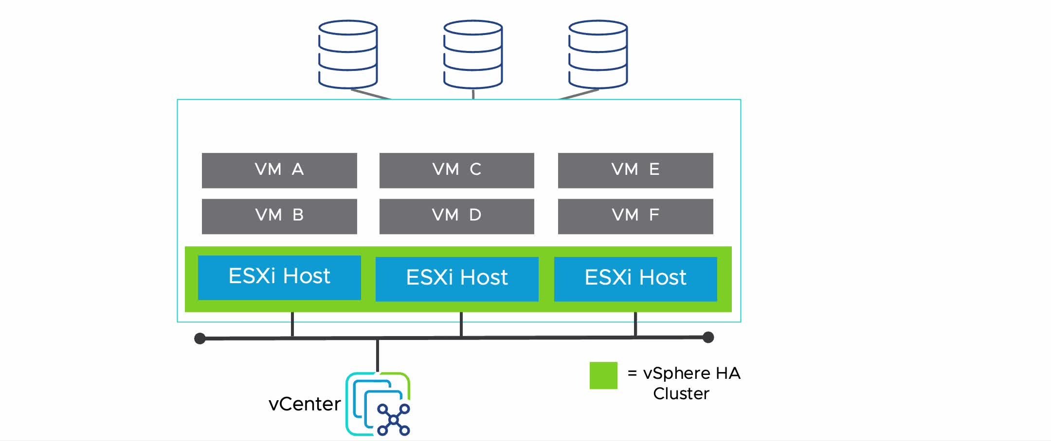
vSphere HA Scenario: ESXi Host Failure
When a host fails, vSphere HA restarts the impacted VMs on other hosts in the cluster.
Notes:
To play the animation, go to https://vmware.bravais.com/s/Ww2W2cOxz1xVpMdinLsQ
vSphere HA can determine whether a ESXi host is isolated or has failed. If an ESXi host fails, vSphere HA attempts to restart all VMs that were running on the failed host by using the remaining hosts in the cluster.
In every cluster, the time to recover depends on how long it takes your guest operating systems and applications to restart when the VM is failed over.

Slide 48
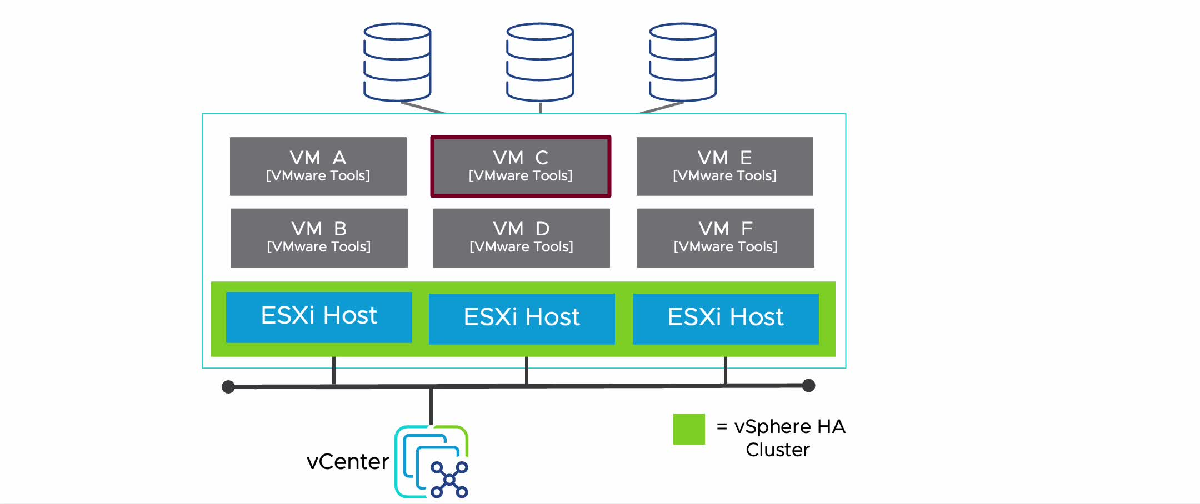
vSphere HA Scenario: Guest Operating System Failure
When a VM stops sending heartbeats or the VM process (vmx) fails unexpectedly, vSphere HA restarts the VM on the same host.
Notes:
To play the animation, go to https://vmware.bravais.com/s/51nBTCVaUE3JJH0Ou0E2
If VM monitoring is configured, the vSphere HA agent on each individual host monitors VMware Tools in each VM running on the host. When a VM stops sending heartbeats, the VM is restarted on the same host.

Slide 49
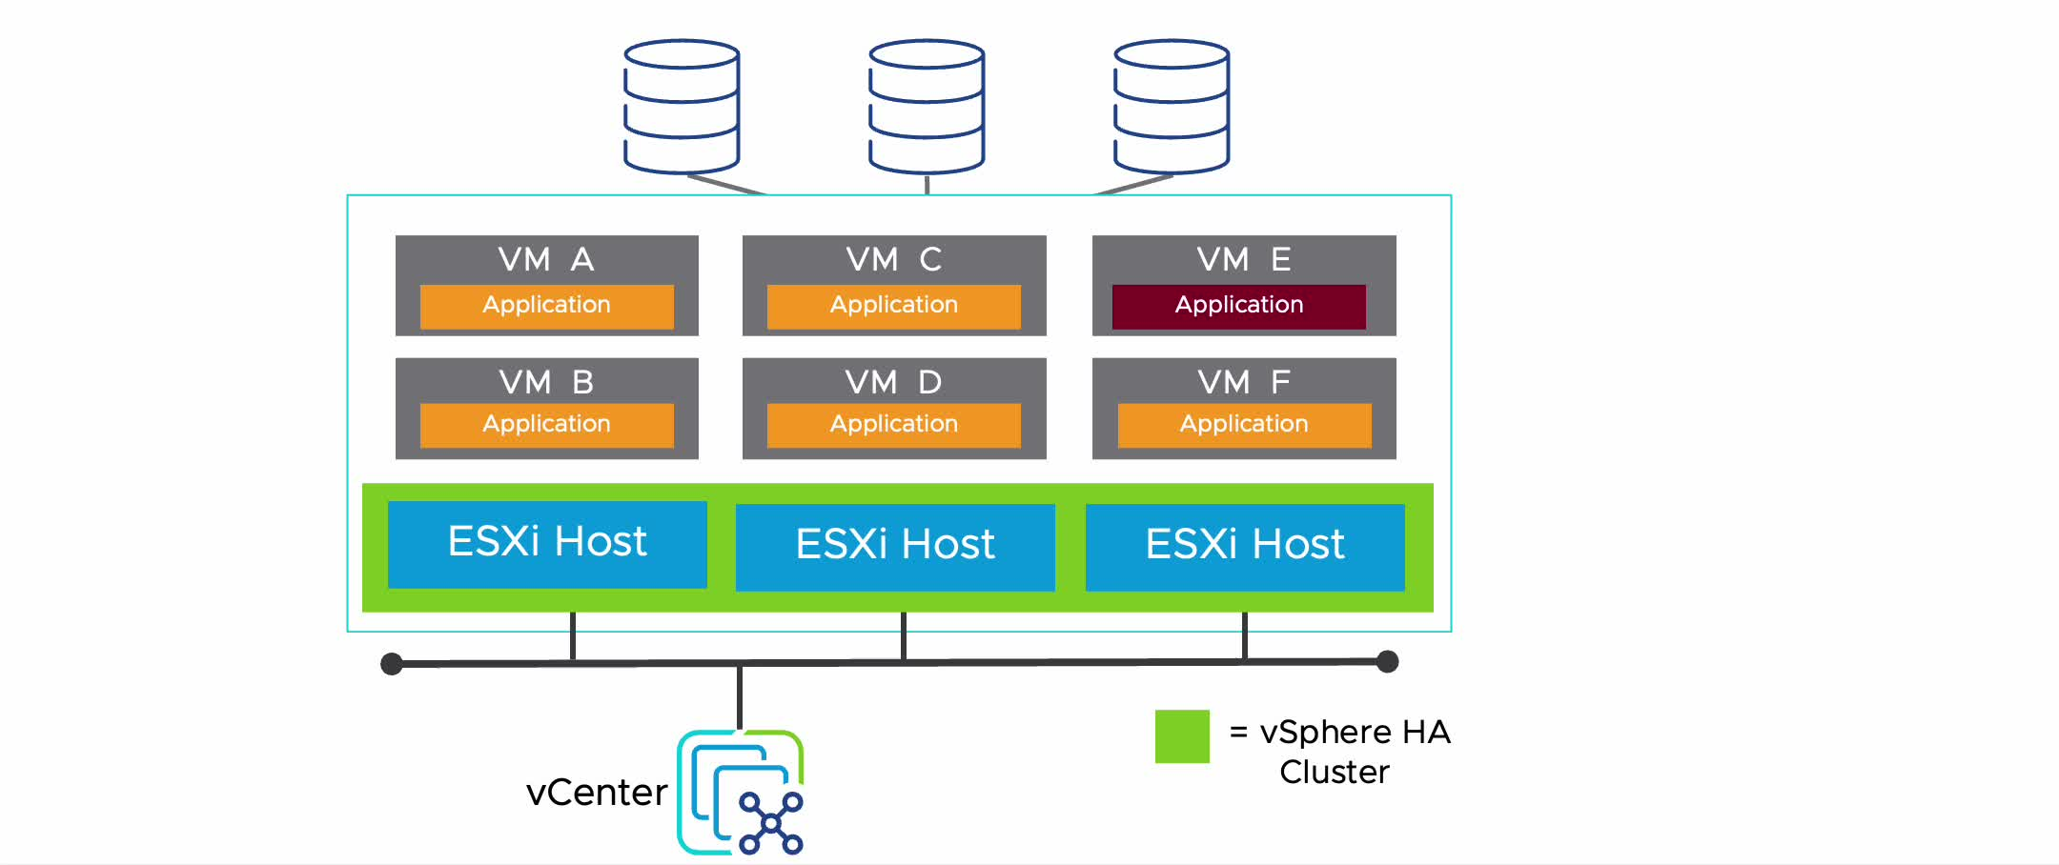
vSphere HA Scenario: Application Failure
When an application stops sending heartbeats, vSphere HA restarts the impacted VM on the same host.
Notes:
To play the animation, go to https://vmware.bravais.com/s/sYP7PbI2HxVLZxu9pbbO
To enable Application Monitoring, you must obtain the appropriate SDK, or use an application that supports VMware Application Monitoring. Then, use the application to set up customized heartbeats for the applications you want to monitor. After you have done this, Application Monitoring works much the same way that VM Monitoring does. The agent on each host can monitor heartbeats of applications running in each VM. When an application fails (stops sending heartbeats), the VM on which the application was running is restarted on the same host.

Slide 50
vSphere HA Scenario: Datastore Accessibility Failures
vSphere HA can detect datastore accessibility failures and provide automated recovery for affected VMs.
You can determine the response that vSphere HA makes to such a failure:
All paths down (APD):
  Recoverable.
  Represents a transient or unknown accessibility loss.
  Response can be either Issue events, Power off and restart VMs – Conservative restart policy, or Power off and restart VMs – Aggressive restart policy.
Permanent device loss (PDL):
  Unrecoverable loss of accessibility.
  Occurs when a storage device reports that the datastore is no longer accessible by the host.
  Response can be either Issue events or Power off and restart VMs.
Notes:
You can determine the response that vSphere HA makes to such a failure, ranging from the creation of event alarms to VM restarts on other hosts.
Power off and restart VMs – Conservative restart policy: vSphere HA does not attempt to restart the affected VMs unless vSphere HA determines that another host can restart the VMs. The host experiencing the all paths down (APD) communicates with the vSphere HA primary host to determine whether the cluster has sufficient capacity to power on the affected VMs. If the primary host determines that sufficient capacity is available, the host experiencing the APD stops the VMs so that the VMs can be restarted on a healthy host. If the host experiencing the APD cannot communicate with the primary host, no action is taken.
Power off and restart VMs – Aggressive restart policy: vSphere HA stops the affected VMs even if it cannot determine that another host can restart the VMs. The host experiencing the APD attempts to communicate with the primary host to determine whether the cluster has sufficient capacity to power on the affected VMs. If the primary host is not reachable, sufficient capacity to restart the VMs is unknown. In this scenario, the host takes the risk and stops the VMs, so they can be restarted on the remaining healthy hosts. However, if sufficient capacity is not available, vSphere HA might not be able to recover all the affected VMs. This result is common in a network partition scenario where a host cannot communicate with the primary host to get a definitive response to the likelihood of a successful recovery.

Slide 51
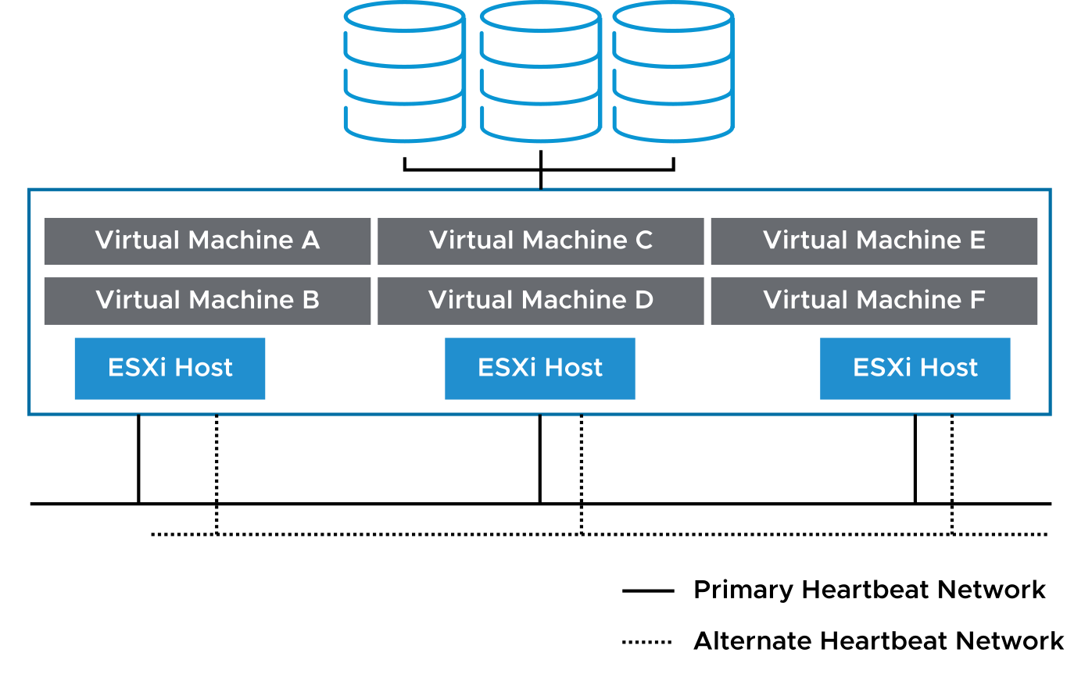
Importance of Heartbeat Networks
A heartbeat network is implemented by using a VMkernel port that is marked for management or vSAN traffic.
Heartbeats have the following characteristics:
They are sent between the primary host and the secondary hosts.
They are used to determine whether a primary host or a secondary host has failed.
They are sent over a heartbeat network.
When both vSAN and vSphere HA are activated on the cluster, vSphere HA uses the vSAN network as the heartbeat network instead of the management network.
Notes:
Redundant heartbeat networking supports the reliable detection of failures and prevents isolation or partition conditions from occurring because heartbeats can be sent over multiple networks.
Redundant heartbeat networking is the best approach for your vSphere HA cluster. When a primary host’s connection fails, a second connection is still available to send heartbeats to the other hosts. If you do not provide redundancy, your failover setup has a single point of failure.

Slide 52
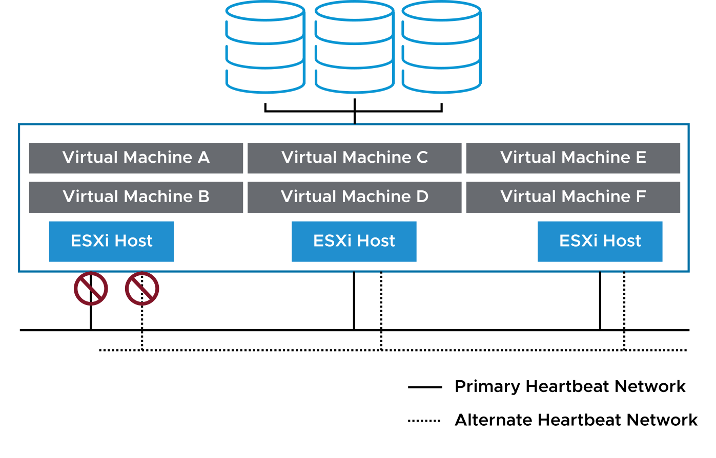
vSphere HA Scenario: Protecting VMs Against Network Isolation
vSphere HA restarts VMs if their host is isolated on the management or vSAN network.
Host network isolation occurs when a host is still running, but it can no longer observe traffic from the vSphere HA agents on the heartbeat network.
Notes:
If you verify that the network infrastructure is sufficiently redundant and that at least one network path is always available, host network isolation might not occur.

Slide 53
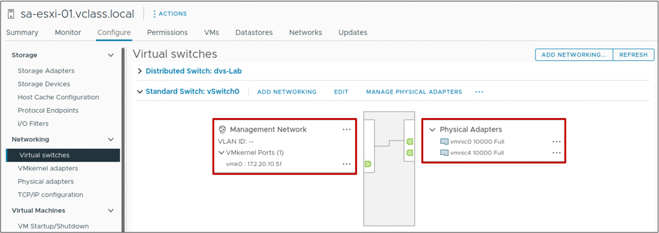
Heartbeat Network Redundancy Using NIC Teaming
Redundant heartbeat networks ensure reliable failure detection and minimize the chance of host-isolation scenarios.
You can use NIC teaming to create a redundant heartbeat network on ESXi hosts.
Notes:
In this example, vmnic0 and vmnic4 form a NIC team in the Management network. The vmk0 VMkernel port has the Management service activated.

Slide 54
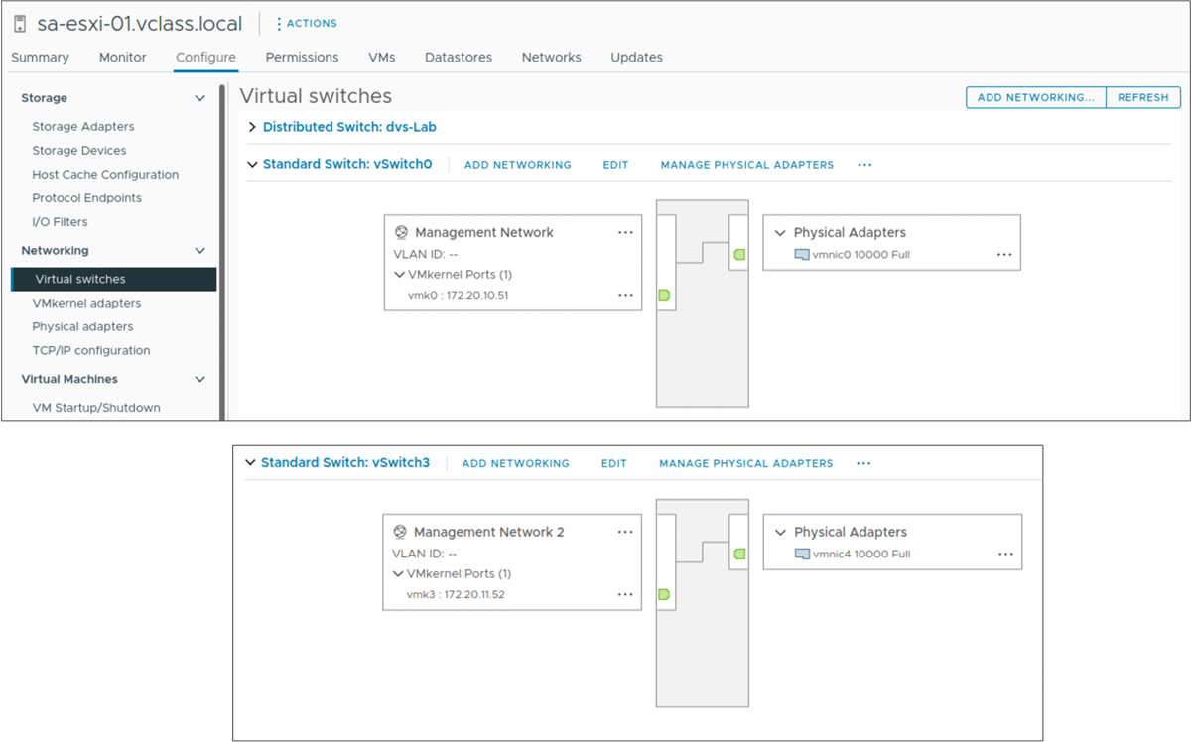
Heartbeat Network Redundancy Using Additional Networks
You can create redundancy by configuring additional heartbeat networks.
For example, create a second VMkernel port in a port group on a separate virtual switch with its own physical adapter.
Notes:
In most implementations, NIC teaming provides sufficient heartbeat redundancy. As an alternative, you can create a second VMkernel port attached to a separate virtual switch. Both VMkernel ports can also be on the same virtual switch, but in different port groups, each port group using a different physical adapter.
In this example, the management network is used as the heartbeat network. The original management network connection is used for network and management purposes. When the second management network connection is created, the primary host sends heartbeats over both management network connections. If one path fails, the primary host still sends and receives heartbeats over the other path.

Slide 55
Review of Learner Objectives
Describe how vSphere HA responds to various types of failures
Describe how vSphere HA responds to network isolation
Identify options for configuring network redundancy in a vSphere HA cluster

Slide 56
vSphere HA Architecture

Slide 57
Learner Objectives
Identify the heartbeat mechanisms used by vSphere HA
Describe failure scenarios
Recognize vSphere HA design considerations

Slide 58
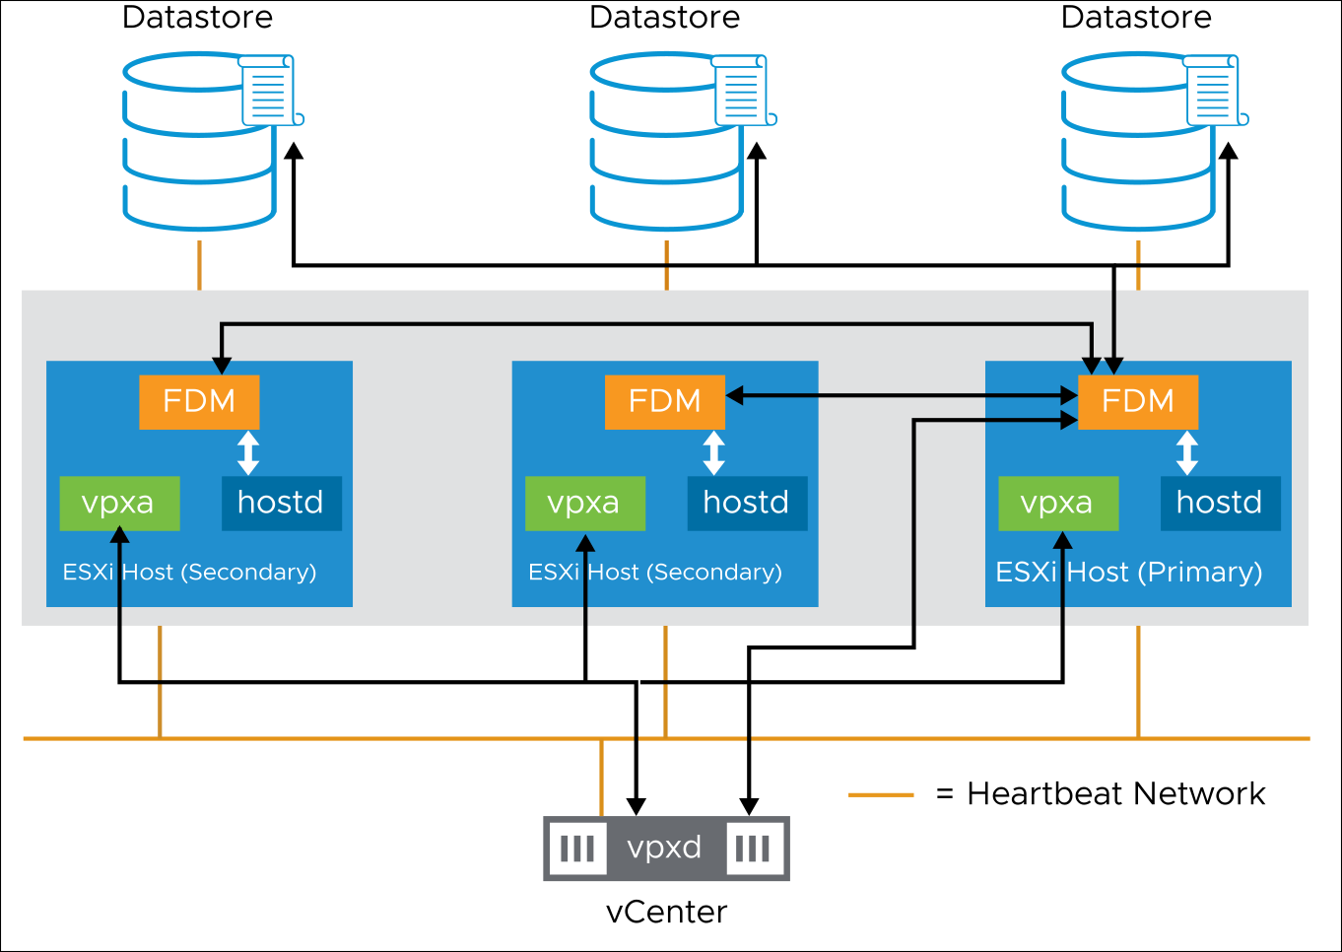
vSphere HA Architecture: Agent Communication
When vSphere HA is configured in a cluster, the Fault Domain Manager (FDM) service is uploaded to each host in the cluster and started.
The FDM service is also known as the vSphere HA agent.
Notes:
The vSphere HA cluster is managed by a primary host. All other hosts are called secondary hosts. Fault Domain Manager (FDM) services on secondary hosts all communicate with FDM on the primary host.
Hosts cannot participate in a vSphere HA cluster if they are in maintenance mode, in standby mode, or disconnected from vCenter.
To determine which host is the primary host, an election process takes place. The host that can access the greatest number of datastores is elected the primary host. If more than one host sees the same number of datastores, the election process determines the primary host by using the host Managed Object ID (MOID) assigned by vCenter.
The election process for a new primary host completes in approximately 15 seconds and occurs under these circumstances:
vSphere HA is configured.
The primary host encounters a system failure because of one of the following factors:
The primary host is placed in maintenance mode.
The primary host is placed in standby mode.
vSphere HA is reconfigured.
The secondary hosts cannot communicate with the primary host because of a network problem.
During the election process, the candidate vSphere HA agents communicate with each other over the heartbeat network (vSAN or management network) by using User Datagram Protocol (UDP). All network connections are point-to-point. After the primary host is determined, the primary host and secondary hosts communicate using secure TCP. When vSphere HA is started, vCenter contacts the primary host and sends a list of hosts with membership in the cluster with the cluster configuration. That information is saved to local storage on the primary host and then pushed out to the secondary hosts in the cluster. If additional hosts are added to the cluster during normal operation, the primary host sends an update to all hosts in the cluster.
The primary host provides an interface for vCenter to query the state of and report on the health of the fault domain and VM availability. vCenter tells the vSphere HA agent which VMs to protect with their VM-to-host compatibility list. The agent learns about state changes through hostd and vCenter learns through vpxa. The primary host monitors the health of the secondary hosts and takes responsibility for VMs that were running on a failed secondary host.
A secondary host monitors the health of VMs running locally and sends state changes to the primary host. A secondary host also monitors the health of the primary host.
vSphere HA is configured, managed, and monitored through vCenter. The vpxd process, which runs on the vCenter system, maintains the cluster configuration data. The vpxd process reports cluster configuration changes to the primary host. The primary host advertises a new copy of the cluster configuration information, and each secondary host fetches an updated copy. Each secondary host writes the updated configuration information to local storage. A list of protected VMs is stored on each datastore. The VM list is updated after each user-initiated power-on (protected) and power off (unprotected) operation. The VM list is updated after vCenter observes these operations.
A VM becomes protected when an operation results in a power on. Reverting a VM to a snapshot with memory state causes the VM to power on and become protected. Similarly, a user action that causes the VM to power off, for example, reverting to a snapshot without memory state or a standby operation performed in the guest, causes the VM to become unprotected.

Slide 59
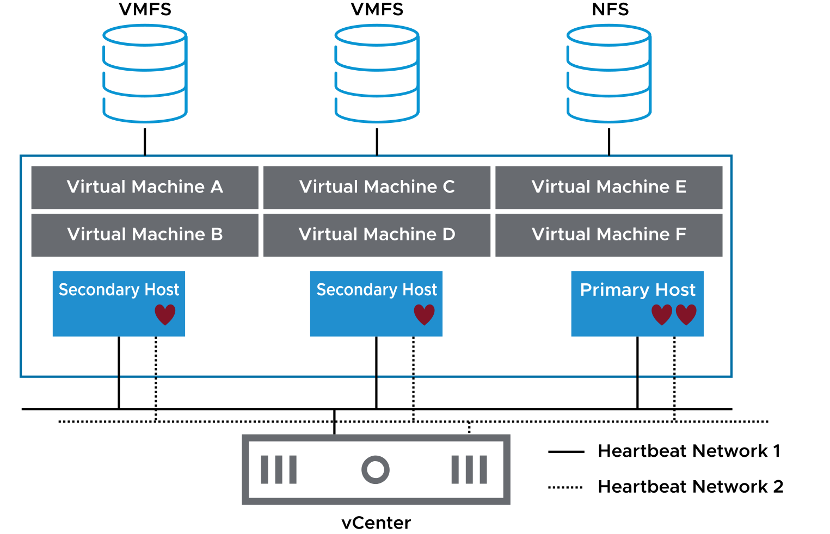
vSphere HA Architecture: Network Heartbeats
The primary host sends periodic heartbeats to the secondary hosts.
In this way, the secondary hosts know that the primary host is alive, and the primary host knows that the secondary hosts are alive.
Notes:
Heartbeats are sent to each secondary host from the primary host over all configured heartbeat networks. However, secondary hosts use only one heartbeat network to communicate with the primary host. If the heartbeat network used to communicate with the primary host fails, the secondary host switches to another heartbeat network to communicate with the primary host.
If the secondary host does not respond within the predefined timeout period, the primary host declares the secondary host as agent unreachable. When a secondary host is not responding, the primary host attempts to determine the cause of the secondary host’s inability to respond. The primary host must determine whether the secondary host crashed, is not responding because of a network failure, or the vSphere HA agent is in an unreachable state.

Slide 60
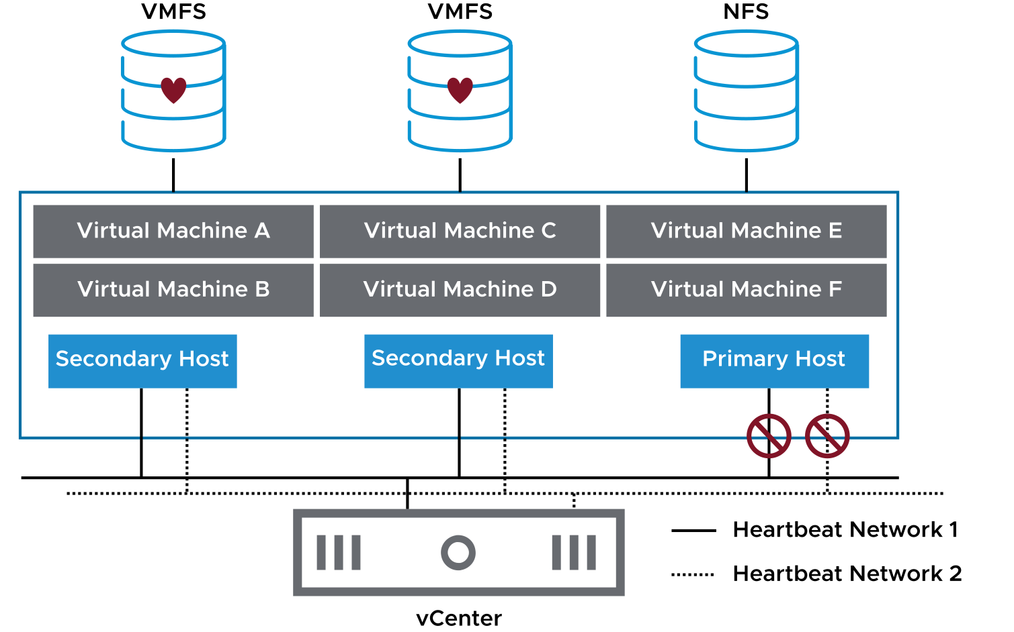
vSphere HA Architecture: Datastore Heartbeats
When the primary host cannot communicate with a secondary host over the heartbeat network, the primary host uses datastore heartbeating to determine the cause:
Secondary host failure
Network partition
Network isolation
Notes:
Using datastore heartbeating, the primary host determines whether a host has failed or a network isolation has occurred. If datastore heartbeating from the host stops, the host is considered failed. In this case, the failed host’s VMs are started on another host in the vSphere HA cluster.

Slide 61
vSphere HA Failure Scenarios
vSphere HA can identify and respond to various types of failures:
Secondary host failure
Primary host failure
Network failure (host isolation)
Datastore accessibility failures:
  APD
  PDL
Notes:
vSphere HA can also determine whether an ESXi host is isolated or has failed. Isolation refers to when an ESXi host cannot see traffic coming from the other hosts in the cluster and cannot ping its configured isolation address. If an ESXi host fails, vSphere HA attempts to restart the VMs that were running on the failed host on the remaining hosts in the cluster. If the ESXi host is isolated because it cannot ping its configured isolation address and sees no heartbeat network traffic, the host executes the Host Isolation Response.

Slide 62
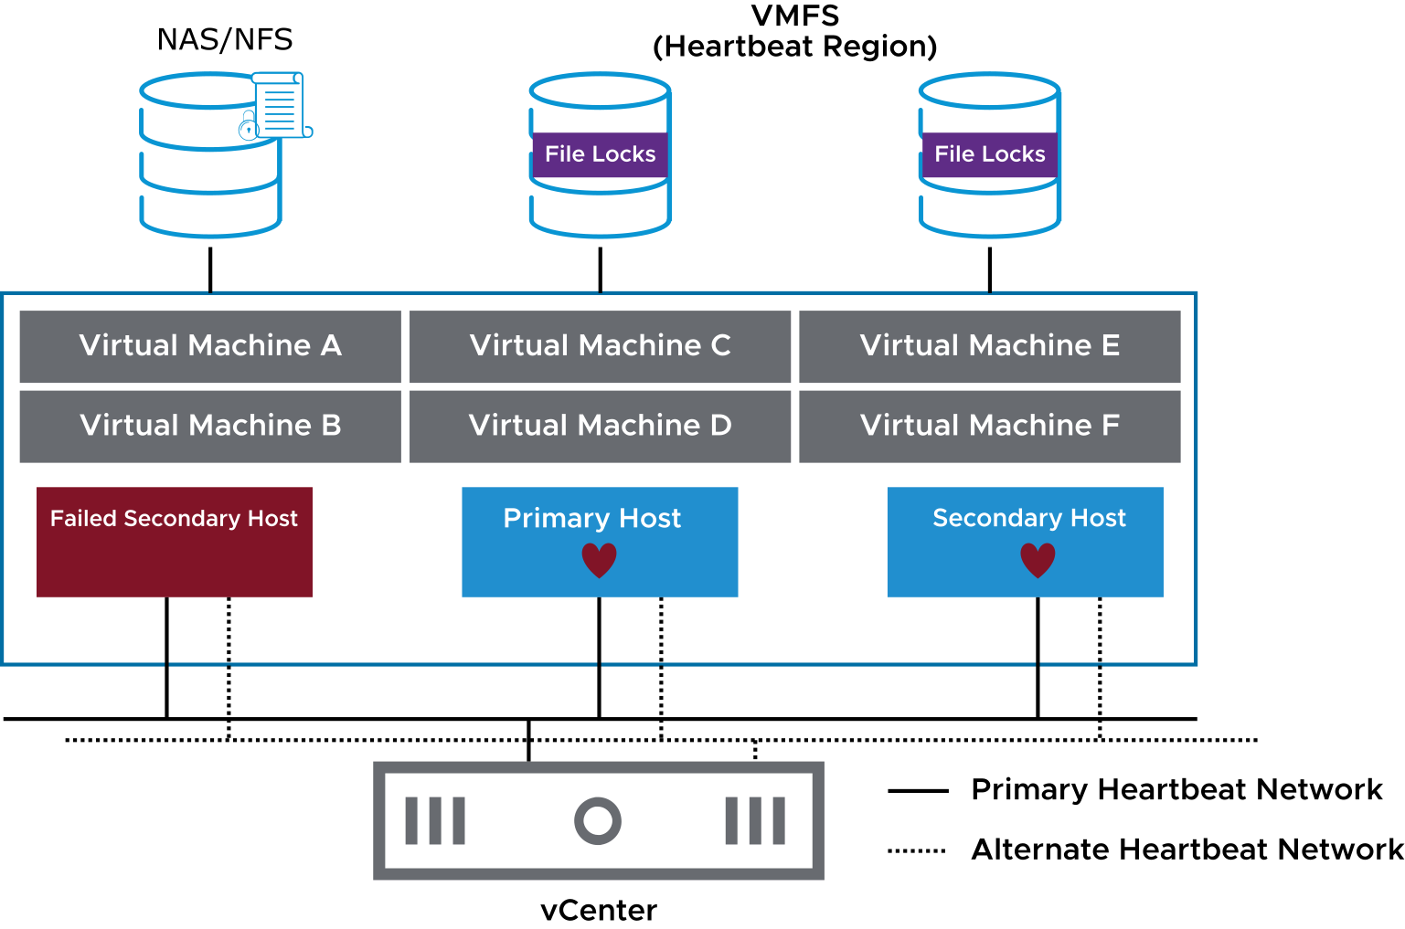
Failed Secondary Hosts
When a secondary host does not respond to the network heartbeat issued by the primary host, the primary host tries to identify the cause.
Notes:
The primary host must determine whether the secondary host is isolated or has failed, for example, because of a misconfigured firewall rule or component failure. The type of failure dictates how vSphere HA responds.
When the primary host cannot communicate with a secondary host over the heartbeat network, the primary host uses datastore heartbeating to determine whether the secondary host failed, is in a network partition, or is network-isolated. If the secondary host stops datastore heartbeating, the secondary host is considered to have failed, and its virtual machines are restarted elsewhere.
For VMFS, a heartbeat region on the datastore is read to find out if the host is still heartbeating to it. For NFS datastores, vSphere HA reads the host--hb file, which is locked by the ESXi host accessing the datastore. The file guarantees that the VMkernel is heartbeating to the datastore and periodically updates the lock file.
The lock file time stamp is used by the primary host to determine whether the secondary host is isolated or has failed.
In both storage examples, the vCenter instance selects a small subset of datastores for hosts to heartbeat to. The datastores that are accessed by the greatest number of hosts are selected as candidates. But two datastores are selected (by default) to keep the associated overhead and processing to a minimum.

Slide 63
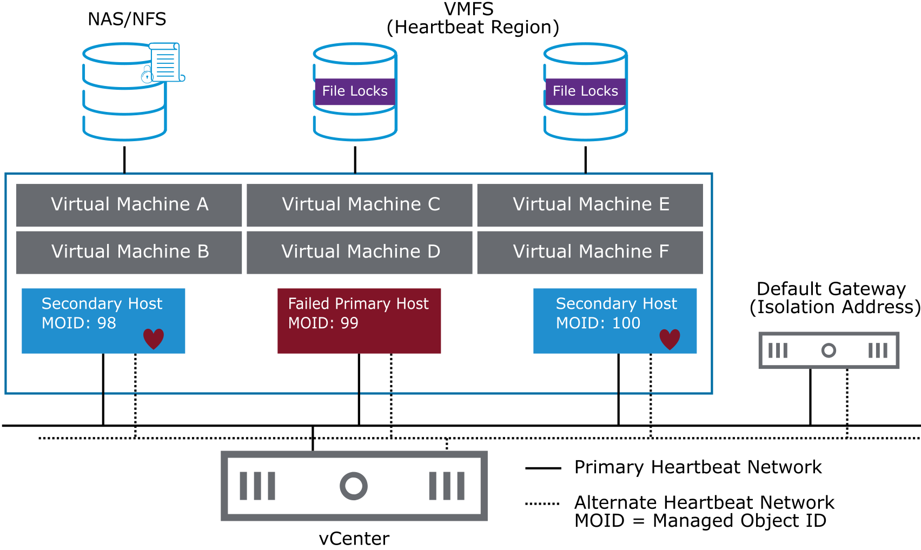
Failed Primary Hosts
When the primary host is placed in maintenance mode or fails, the secondary hosts detect that the primary host is no longer issuing heartbeats.
Notes:
To determine which host is the primary host, an election process takes place. The host that can access the greatest number of datastores is elected the primary host. If more than one host sees the same number of datastores, the election process determines the primary host by using the host Managed Object ID (MOID) assigned by vCenter. If the primary host fails, is shut down, or is placed into maintenance mode, a new election is held.

Slide 64
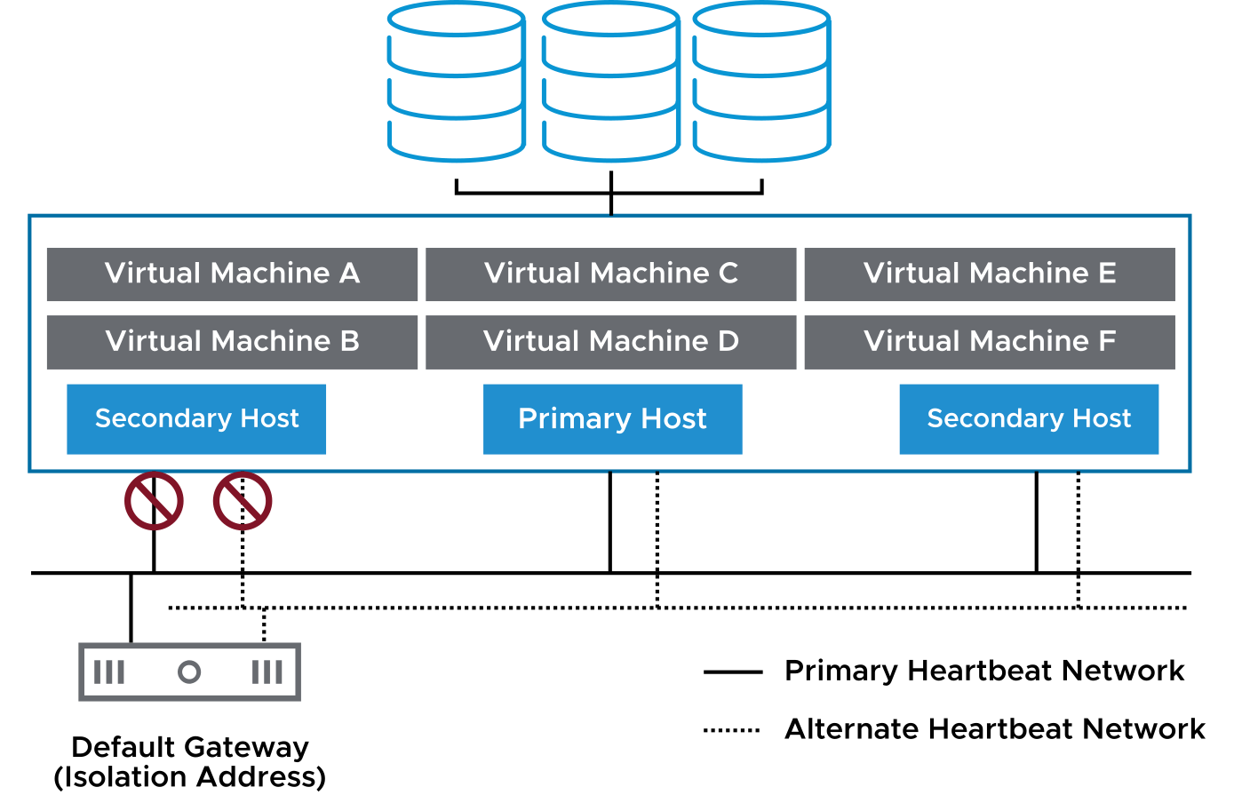
Isolated Hosts
A host is declared isolated when both the following conditions occur:
The host does not receive network heartbeats.
The host cannot ping its isolation addresses.
When a host identifies itself as isolated, it executes the cluster's isolation response.
Notes:
The slide illustrates a scenario that might lead to host isolation. If a host loses connectivity to both the primary heartbeat network and the alternate heartbeat network, the host does not receive network heartbeats from the other hosts in the vSphere HA cluster. The same host cannot ping its isolation address. An isolation address is an IP address or FQDN that can be manually specified (the default is the host's default gateway).
If a host is isolated, the primary host must determine if that host is active and merely isolated, by checking for the datastore heartbeats. Datastore heartbeats are used by vSphere HA only when a host is isolated or partitioned.
Host isolation response determines what happens when a host in a vSphere HA cluster loses its heartbeat network connections but continues to run. You can use the isolation response for vSphere HA to power off virtual machines that run on an isolated host and restart them on a nonisolated host.

Slide 65
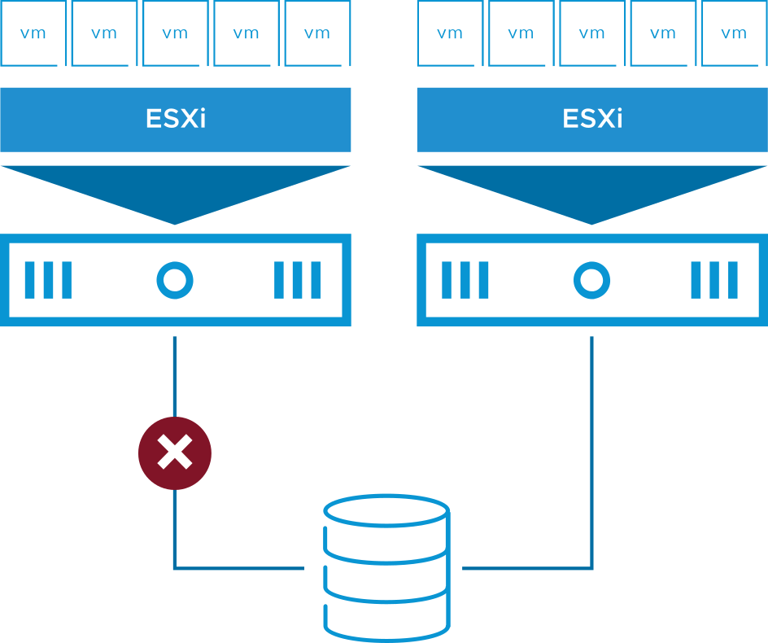
VM Storage Failures
Storage connectivity problems might arise because of:
Network or switch failure
Array misconfiguration
Power outage
Storage connectivity problems affect VM availability:
VMs on affected hosts are difficult to manage.
Applications with attached disks fail.

Slide 66
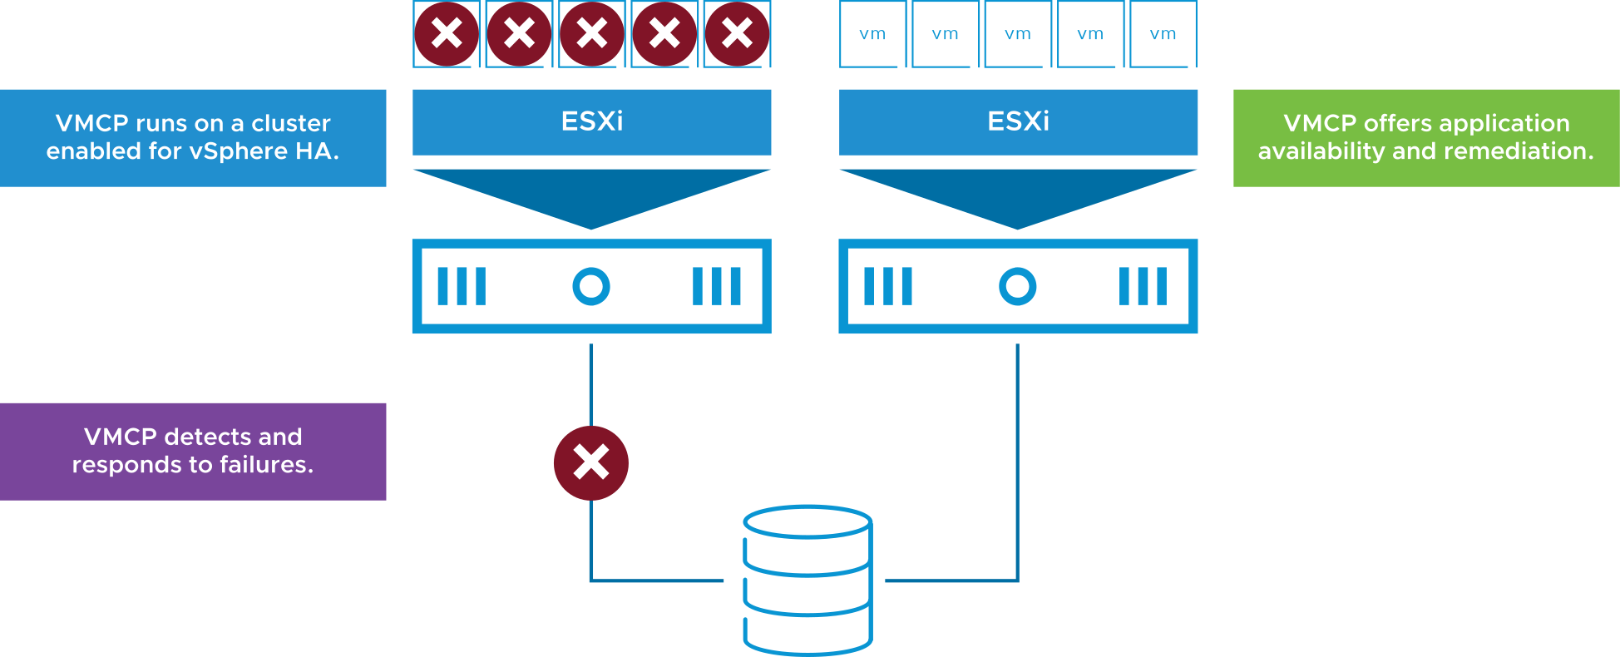
Protecting Against Storage Failures with VMCP
VM Component Protection protects against storage failures on a VM.
With VMCP, vSphere HA can detect datastore accessibility failures and provide automated recovery for affected VMs.
Notes:
When a datastore accessibility failure occurs, the affected host can no longer access the storage path for a specific datastore. You can determine the response that vSphere HA gives to such a failure, ranging from the creation of event alarms to VM restarts on other hosts.
For more information about VM Component Protection, see https://blogs.vmware.com/vsphere/.

Slide 67
vSphere HA Design Considerations
When designing your vSphere HA cluster, consider these guidelines:
Implement redundant heartbeat networks and redundant isolation addresses:
  Redundancy minimizes host isolation events.
Physically separate VM networks from the heartbeat networks.
Implement datastores so that they are separated from the heartbeat network by using one or both of the following approaches:
  Use Fibre Channel over fiber optic for your datastores.
  If you use IP storage, physically separate your IP storage network from the heartbeat network.
Notes:
If a datastore is based on Fibre Channel, an Ethernet network failure does not disrupt datastore access. When using datastores based on IP storage (for example, NFS, iSCSI, or Fibre Channel over Ethernet), you must physically separate the IP storage network and the heartbeat network.

Slide 68
Review of Learner Objectives
Identify the heartbeat mechanisms used by vSphere HA
Describe failure scenarios
Recognize vSphere HA design considerations

Slide 69
Configuring vSphere HA

Slide 70
Learner Objectives
Recognize the requirements for creating and using a vSphere HA cluster
Recognize the use cases for various vSphere HA settings
Recognize when to use vSphere Fault Tolerance
Configure a vSphere HA cluster

Slide 71
vSphere HA Prerequisites
To create a vSphere HA cluster, you must meet several requirements:
All hosts must be configured with static IP addresses. If you are using DHCP, the address must persist across host reboots.
All hosts must have at least one heartbeat network in common.
For VM monitoring to work, VMware Tools must be installed in every VM.
You must not exceed the maximum number of hosts that are allowed in a cluster.
See VMware Configuration Maximums at https://configmax.vmware.com.
Notes:
To determine the maximum number of hosts per cluster, see VMware Configuration Maximums at https://configmax.vmware.com.

Slide 72
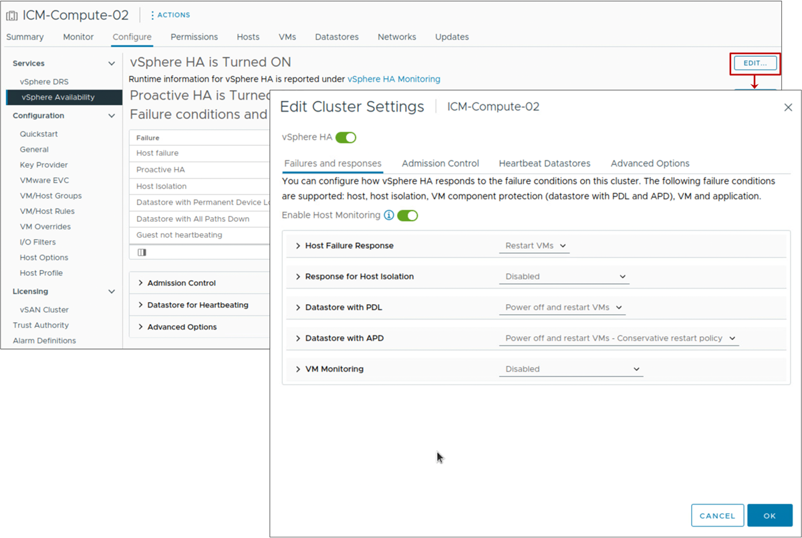
Configuring vSphere HA Settings
When you create or configure a vSphere HA cluster, you must configure settings that determine how the feature works.
Notes:
In the vSphere Client, you can configure the following vSphere HA settings:
Availability failure conditions and responses: Provide settings for host failure responses, host isolation, VM monitoring, and VMCP.
Admission control: Activate or deactivate admission control for the vSphere HA cluster and select a policy for how it is enforced.
Heartbeat datastores: Specify preferences for the datastores that vSphere HA uses for datastore heartbeating.
Advanced options: Customize vSphere HA behavior by setting advanced options.

Slide 73
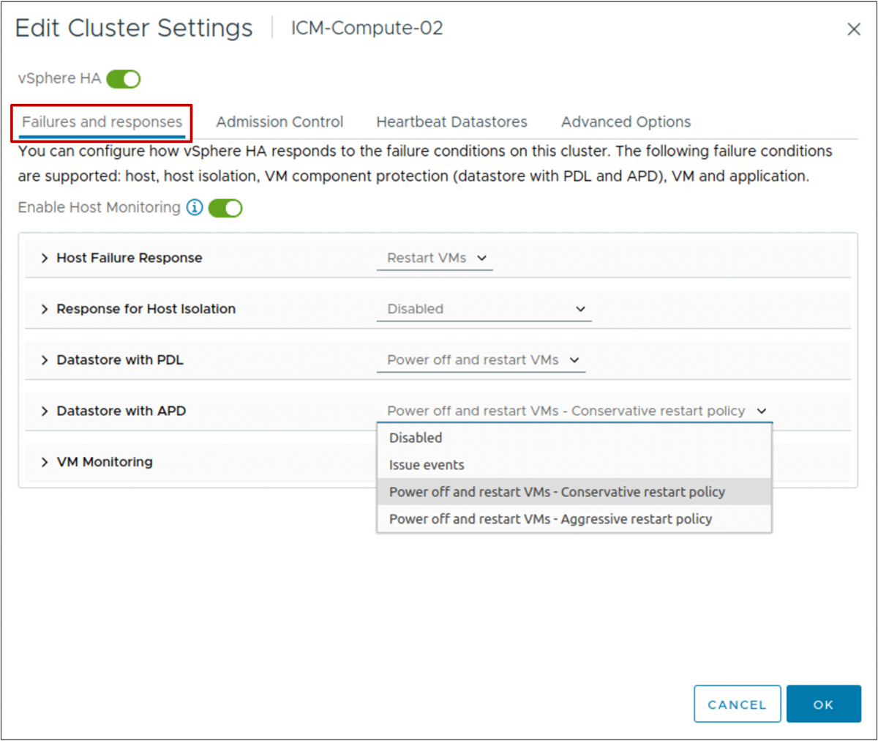
vSphere HA Settings: Failures and Responses
You use the Failures and responses pane to configure a cluster’s response if a failure occurs.
Notes:
Using the Failures and Responses pane, you can configure how your cluster must function when problems occur. You can specify the vSphere HA cluster’s response for host failures and isolation. You can configure the VMCP actions when permanent device loss and all paths down situations occur and activate the VM monitoring.
The following host failure responses are available:
Disabled: Host monitoring is turned off and VMs are not restarted.
Restart VMs: VMs are failed over based on their restart priority.
The following responses to host isolation are available:
Disabled
Power off and restart VMs
Shut down and restart VMs
The following responses to a datastore PDL condition are available:
Disabled
Issue events: No action is taken against the affected VMs. The administrator is notified when a PDL event occurs.
Power off and restart VMs
The following responses to a datastore APD condition are available:
Disabled
Issue events: No action is taken against the affected VMs. The administrator is notified when an APD event occurs.
Power off and restart VMs - Conservative restart policy: vSphere HA does not attempt to restart the affected VMs unless vSphere HA determines that another host can restart the VMs.
The host experiencing the APD communicates with the primary host to determine whether sufficient capacity exists in the cluster to power on the affected VMs. If the primary host determines that sufficient capacity exists, the host experiencing the APD stops the VMs so that the VMs can be restarted on a healthy host. If the host experiencing the APD cannot communicate with the primary host, the VM is not stopped.
Power off and restart VMs - Aggressive restart policy: vSphere HA stops the affected VMs even if it cannot determine that another host can restart the VMs.
The host experiencing the APD attempts to communicate with the primary host to determine if sufficient capacity exists in the cluster to power on the affected VMs. If the primary host is not reachable, sufficient capacity for restarting the VMs is unknown. In this scenario, the host takes the risk and stops the VMs so that they can be restarted on the remaining healthy hosts.
However, if sufficient capacity is not available, vSphere HA might not be able to recover all the affected VMs. This result is common in a network partition scenario in which a host cannot communicate with the primary host.
The following VM monitoring options are available:
VM monitoring only
VM and application monitoring

Slide 74
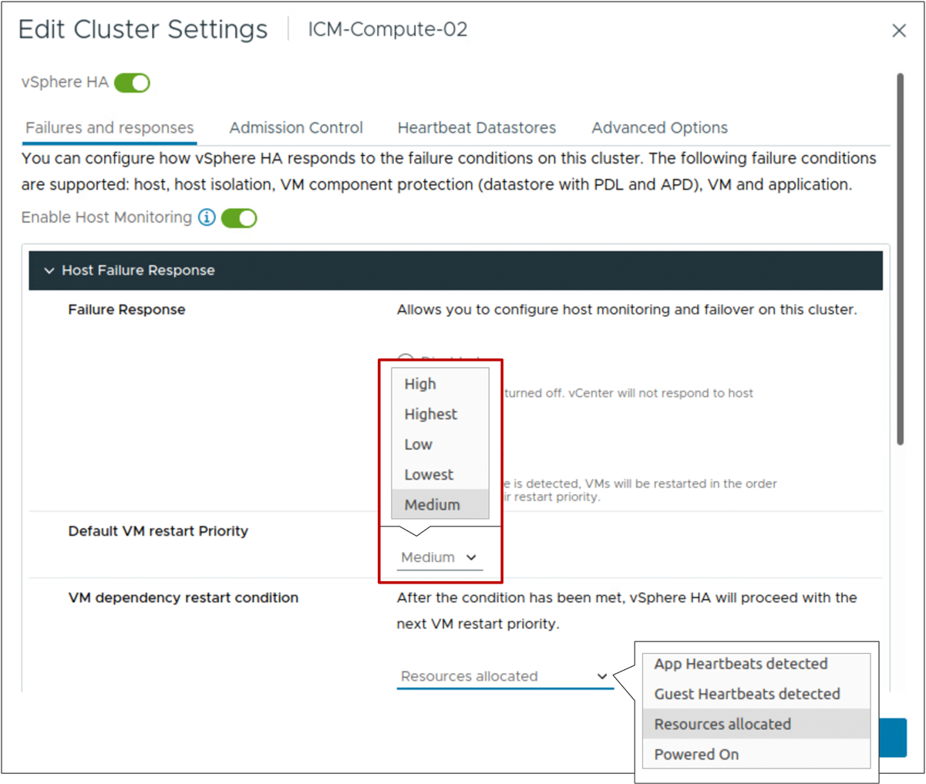
vSphere HA Setting: Default VM Restart Priority
The VM restart priority determines the order in which vSphere HA restarts VMs on a running host.
VMs are assigned the Medium restart priority by default, unless the restart priority is explicitly set using VM overrides.
Notes:
After a host failure, VMs are assigned to other hosts with unreserved capacity, with the highest priority VMs placed first. The process continues to those VMs with lower priority until all have been placed, or no more cluster capacity is available to meet the reservations or memory overhead of the VMs. A host then restarts the VMs assigned to it in priority order.
If insufficient resources exist, vSphere HA waits for more unreserved capacity to become available, for example, because of a host coming back online, and then retries the placement of these VMs. To reduce the chance of this situation occurring, configure vSphere HA admission control to reserve more resources for failures. With admission control, you can control the amount of cluster capacity that is reserved by VMs, which is unavailable to meet the reservations and memory overhead of other VMs if a failure occurs.
Optionally, you can configure a delay when a certain restart condition is met.
The following conditions must be met before a VM is considered ready:
VM has resources allocated
VM is powered on
VMware Tools heartbeat is detected
VMware Tools application heartbeat is detected

Slide 75
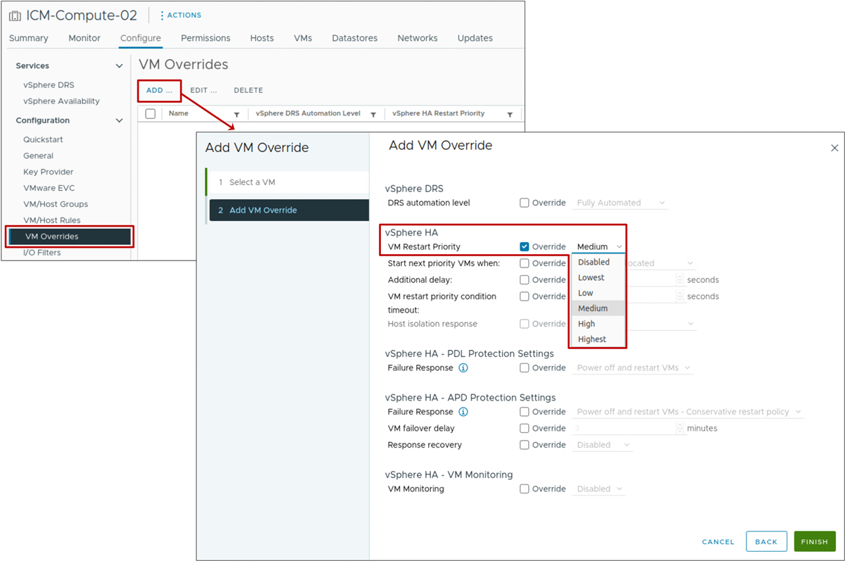
vSphere HA Settings: VM-Level Restart Priority
You can customize the restart priority for individual VMs in a cluster to override the default level set for the entire cluster.

Slide 76
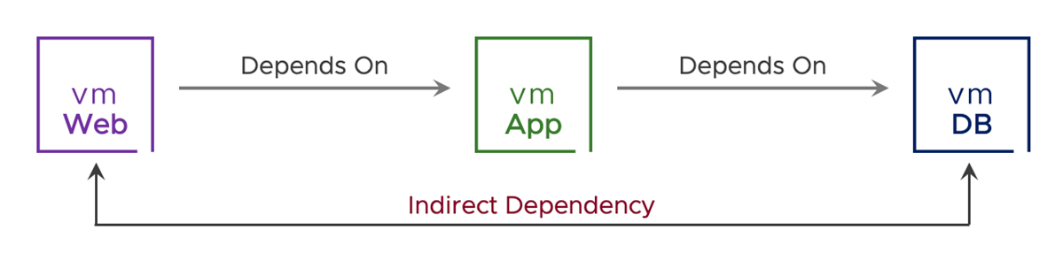
About vSphere HA Orchestrated Restart
Orchestrated restart is an alternative to using the VM restart priority settings for vSphere HA.
With orchestrated restart, you define the order in which the VMs restart, which is useful when services must be started in a particular order.
A common use case is for restarting a three-tier application.
Notes:
Only direct dependencies are supported. Creating cyclical dependencies causes a VM's restart to fail.

Slide 77

Orchestrated Restart In Action
vSphere HA restarts VMs only from a failed host. Configure affinity rules to keep VMs on the same host if necessary.
Notes:
To play the animation, go to https://vmware.bravais.com/s/FPFepiQhbhlhdTfJwW4N

Slide 78

Configuring Orchestrated Restart
To configure an orchestrated restart:
Create VM groups for each of the VMs or VM category.
Create VM rules (of type Virtual Machines to Virtual Machines) to define the VM restart dependencies.
Notes:
In the orchestrated restart example, the database server VMs restart before the application server VMs and the application server VMs restart before the Web server VMs.
The following VM groups are created:
App-VMs: Contains the App-01 VM
Web-VMs: Contains the Web-01 and Web-02 VMs
DB-VMs: Contains the DB-01 VM
The following VM rules of the Virtual Machines to Virtual Machines type are created:
DB VMs <- App VMs: Verifies that the VMs in group DB-VMs are restarted before the VMs in group App-VMs
App VMs <- Web VMs: Verifies that the VMs in the App VMs group are restarted before the VMs in the Web VMs group
To create the DB VMs <- App VMs rule:
On the cluster's Configure tab, select VM/Host Rules and click ADD.
In the Name text box, enter DB VMs <- App VMs.
From the Type drop-down menu, select Virtual Machines to Virtual Machines.
From the first drop-down menu, select DB-VMs.
From the second drop-down menu, select App-VMs.
The rule must appear as: On restart for VM group DB-VMs, the VM dependency restart condition must be met before continuing to App-VMs.
Create the App-VMs <- Web VMs rule similarly, by selecting App-VMs from the first drop-down menu and Web-VMs from the second drop-down menu. The rule must appear as: On restart for VM group App-VMs, the VM dependency restart condition must be met before continuing to Web-VMs.
The restart rules that you create enforce the restart order for each VM in the dependency chain. Creating these dependencies increases the likelihood that an impacted application properly recovers when vSphere HA restarts VMs.

Slide 79

vSphere HA Settings: VM Monitoring
You use VM Monitoring settings to control the monitoring of VMs and applications.
By default, VM and Application Monitoring is set to Disabled.
Notes:
The VM monitoring service determines that the VM has failed if one of the following events occurs:
VMware Tools heartbeats are not received.
The guest operating system has not issued an I/O for the last 2 minutes (by default).
If the VM has failed, the VM monitoring service resets the VM to restore services.
You can configure the level of monitoring sensitivity. Highly sensitive monitoring results in a more rapid conclusion that a failure has occurred. Although unlikely, highly sensitive monitoring might lead to falsely identifying failures when the VM or application is still working but heartbeats have not been received because of factors like resource constraints. Low-sensitivity monitoring results in longer interruptions in service between actual failures and VMs being reset. Select an option that is an effective compromise for your needs.
You can select VM and Application Monitoring to activate application monitoring. Application monitoring restarts a virtual machine if the heartbeats for an application it is running are not received.

Slide 80

vSphere HA Settings: Admission Control
vCenter uses admission control to ensure the following:
Sufficient resources are available in a cluster to provide failover protection.
VM resource reservations are respected.
Admission control settings:
Disabled
Slot Policy
Cluster Resource Percentage (default)
Dedicated Failover Hosts
Notes:
After you create a cluster, you can use admission control to specify whether VMs can be started if they violate availability constraints. The cluster reserves resources to allow failover for all running VMs for a specified number of host failures.
The admission control settings include:
Disabled: This option deactivates admission control, allowing the VMs violating availability constraints to power on (Not recommended).
Slot Policy: A slot is a logical representation of memory and CPU resources. With the slot policy option, vSphere HA calculates the slot size, determines how many slots each host in the cluster can hold, and therefore determines the current failover capacity of the cluster.
Cluster Resource Percentage: (Default) This value specifies a percentage of the cluster’s CPU and Memory resources to be reserved as spare capacity to support failovers.
Dedicated Failover Hosts: This option selects hosts to use for failover actions. If a default failover host does not have enough resources, failovers can still occur to other hosts in the cluster.

Slide 81

Example: Admission Control Using Cluster Resources Percentage
Example of calculating total failover capacity using cluster resource percentages:
Total cluster capacity:
  CPU: 18 GHz
  Memory: 24 GB
Total VM reservations:
  CPU: 7 GHz
  Memory: 6 GB
Current failover CPU capacity is 61%:
  ((18 GHz - 7 GHz)/18 GHz) = 61%
Current failover memory capacity is 75%:
  ((24 GB - 6 GB)/24 GB) = 75%
Notes:
Cluster resource percentage is the default admission control policy. Recalculations occur automatically as the cluster's resources change, for example, when a host is added to or removed from the cluster.

Slide 82

Example: Admission Control Using Slots (1)
A slot is calculated by combining the largest memory reservation and the largest CPU reservation of any running VM in the cluster.
vSphere HA performs admission control by calculating the following values:
Slot size:
  In this example, the slot size is 2 GHz CPU and 2 GB memory.
Number of slots each host in the cluster can hold:
  Three
  The cluster has a total of nine slots (3 + 3 + 3).

Slide 83
Example: Admission Control Using Slots (2)
vSphere HA also calculates the current failover capacity. In this example, the failover capacity is one host:
If the first host fails, six slots remain in the cluster, which is sufficient for all five of the powered-on VMs.
If the first and second hosts fail, only three slots remain, which is insufficient for all five of the VMs.
If the current failover capacity is less than the configured failover capacity, vSphere HA does not allow any more VMs to power on.

Slide 84

vSphere HA Settings: Performance Degradation VMs Tolerate
The Performance degradation VMs tolerate threshold specifies the percentage of performance degradation that the VMs in the cluster are allowed to tolerate during a failure.
Notes:
Admission control can also be configured to offer warnings when the actual use exceeds the failover capacity percentage. The resource reduction calculation takes into account a VM's reserved memory and memory overhead.
By setting the Performance degradation VMs tolerate threshold, you can specify when a configuration issue should generate a warning or notice. For example:
The default value is 100 percent, and produces no warnings.
If you reduce the threshold to 0 percent, a warning is generated when cluster use exceeds the available capacity.
If you reduce the threshold to 20 percent, the performance reduction that can be tolerated is calculated as performance reduction = current use x 20 percent.
When the current use minus the performance reduction exceeds the available capacity, a configuration notice is issued.
The Performance degradation VMs tolerate threshold is not available unless vSphere DRS is configured.

Slide 85

vSphere HA Settings: Heartbeat Datastores
A heartbeat file is created on the selected datastores and is used if the heartbeat network fails.
Heartbeat datastores:
VMFS
NFS
vSphere Virtual Volumes
A vSAN datastore cannot be used for datastore heartbeating.
Notes:
vSphere HA takes checking the health of a host to another level by checking more than the heartbeat network to determine a host’s health. You can select which datastores to use for datastore heartbeating, or you can let vSphere HA decide. You can also combine both methods.

Slide 86
vSphere HA Settings: Advanced Options
You can set advanced vSphere HA options to customize vSphere HA behavior.
Description | Option | Value
Force a cluster not to use the default isolation address (default gateway). | das.usedefaultisolationaddress | false
Force a cluster to ping alternate isolation addresses. | das.isolationaddressX | IP address or FQDN
Force a cluster to wait beyond the default 30-second isolation action window. | das.config.fdm.isolationPolicyDelaySec | >=30 seconds
Force maximum bound on the memory slot size. | das.slotmeminmb | 100
Force maximum bound on the CPU slot size. | das.slotcpuinmhz | 32
Notes:
You can set advanced options that affect the behavior of your vSphere HA cluster. For more details, see vSphere Availability at https://docs.vmware.com/en/VMware-vSphere/index.html.

Slide 87

Network Configuration and Maintenance
Deactivate host monitoring before modifying virtual networking components that involve the VMkernel ports configured for management or vSAN traffic.
This practice prevents unwanted attempts to fail over VMs.
Notes:
The following network maintenance suggestions can help you avoid the false detection of host failure and network isolation because of dropped vSphere HA heartbeats:
Changing your network hardware or networking settings can interrupt the heartbeats used by vSphere HA to detect host failures, and might result in unwanted attempts to fail over VMs. When changing the management or vSAN networks of the hosts in the vSphere HA-configured cluster, suspend host monitoring and place the host in maintenance mode.
Deactivating host monitoring is required only when modifying virtual networking components and properties that involve the VMkernel ports configured for the Management or vSAN traffic, which are used by the vSphere HA networking heartbeat service.
To recap the previous bullet points, you must reconfigure vSphere HA on all hosts in the cluster if you:
Change the networking configuration on ESXi hosts
Add port groups
Remove virtual switches
Suspend host monitoring
This reconfiguration causes the network information to be reinspected. Then, you must reactivate host monitoring.

Slide 88

Monitoring vSphere HA Cluster Status
You can monitor the status of a vSphere HA cluster on the Summary page of the Monitor tab.
Notes:
Your cluster or its hosts can experience configuration issues and other errors that adversely affect proper vSphere HA operation.

Slide 89
Using vSphere HA with vSphere DRS
vSphere HA is closely integrated with vSphere DRS:
When a failover occurs, vSphere HA checks whether resources are available on each host for the failover.
If resources are not available, vSphere HA asks vSphere DRS to accommodate for the VMs where possible.
vSphere HA might not be able to fail over VMs for the following reasons:
vSphere HA admission control is deactivated, and resources are insufficient in the remaining hosts to power on all the failed VMs.
Notes:
When vSphere HA performs failover and restarts VMs on different hosts, its first priority is the immediate availability of all VMs. After the VMs are restarted, the hosts on which they were restarted are usually heavily loaded, and other hosts are comparatively lightly loaded. vSphere DRS helps to balance the load by migrating VMs between hosts in the cluster.

Slide 90

About vSphere Fault Tolerance
vSphere Fault Tolerance protects mission-critical, high-performance applications regardless of the operating system used.
vSphere Fault Tolerance provides instantaneous failover and continuous availability:
Zero downtime
Zero data loss
No loss of VM network connectivity
Notes:
You can use vSphere Fault Tolerance for most mission-critical VMs. vSphere Fault Tolerance is built on the ESXi host platform.
The protected VM is called the primary VM. The duplicate VM is called the secondary VM. The secondary VM is created and runs on a different host to the primary VM. The secondary VM’s execution is identical to that of the primary VM. The secondary VM can take over at any point without interruption and provide fault-tolerant protection.
The primary VM and the secondary VM continuously monitor the status of each other to ensure that fault tolerance is maintained. A transparent failover occurs if the host running the primary VM fails, in which case the secondary VM is immediately activated to replace the primary VM. A new secondary VM is created and started, and fault tolerance redundancy is reestablished automatically. If the host running the secondary VM fails, the secondary VM is immediately replaced. In either case, users experience no interruption in service and no loss of data.

Slide 91

vSphere Fault Tolerance Checkpointing
Changes on the primary VM are note processed on the secondary VM. The memory is updated on the secondary VM.
Notes:
To play the animation, go to https://vmware.bravais.com/s/CAQIyfAA4o5uRM54k6oU.

Slide 92

vSphere Fault Tolerance with vSphere HA and vSphere DRS
vSphere HA and vSphere DRS are vSphere Fault Tolerance aware:
vSphere HA is required for vSphere Fault Tolerance.
vSphere DRS:
  Selects which hosts run the primary and secondary VM, when a VM is powered on
  Does not automatically migrate fault-tolerant VMs
Notes:
To play the animation, go to https://vmware.bravais.com/s/uZwjd73t46eXD69ZqXdW.
A fault-tolerant VM and its secondary copy are not allowed to run on the same host. The restriction ensures that a host failure cannot result in the loss of both the VMs. In addition, vSphere vMotion cannot be used to migrate the VMs to the same host.

Slide 93
vSphere Fault Tolerance Features
vSphere Fault Tolerance:
Supports VMs configured with up to 8 vCPUs and 128 GB memory
Supports up to four fault-tolerant VMs per host with no more than eight vCPUs between them
Supports vSphere vMotion migration for primary and secondary VMs
Creates a secondary copy of all VM files and disks
Supports multiple VM disk formats:
  Thin provision
  Thick provision lazy-zeroed
  Thick provision eager-zeroed
Supports interoperability with vSAN
Provides fast checkpoint copying to keep primary and secondary VMs synchronized
Notes:
For details on vSphere Fault Tolerance, see vSphere Availability at https://docs.vmware.com/en/VMware-vSphere/index.html.

Slide 94

Configuring vSphere Fault Tolerance on a VM
You can turn on vSphere Fault Tolerance for a VM using the vSphere Client.
Notes:
After you perform the required steps for configuring vSphere Fault Tolerance for your cluster, you can use the feature by turning it on for individual VMs.
Before vSphere Fault Tolerance can be turned on, validation checks are performed on a VM. When vSphere Fault Tolerance is turned on, vCenter resets the VM’s memory limit to the default (unlimited memory) and sets the memory reservation to the memory size of the VM. When vSphere Fault Tolerance is turned on, you cannot change the memory reservation, size, limit, number of virtual CPUs, or shares. You also cannot add or remove disks for the VM. When vSphere Fault Tolerance is turned off, any parameters that were changed are not reverted to their original values.
In addition to turning on vSphere Fault Tolerance for a VM, additional options are available:
Turn Off Fault Tolerance: Deletes the secondary virtual machine, its configuration, and all history.
Suspend Fault Tolerance: Suspends the vSphere Fault Tolerance protection, but preserves the secondary VM, its configuration, and all history. Use this option if at a future time, you want to resume vSphere Fault Tolerance protection on the VM.
Migrate Secondary: Migrates the secondary VM to the specified host.
Test Failover: Induces a failover situation for the selected primary VM to test your vSphere Fault Tolerance protection. The option is unavailable if the virtual machine is powered off.
Test Restart Secondary: Induces the failure of a secondary VM to test the vSphere Fault Tolerance protection provided for the selected primary VM. The option is unavailable if the virtual machine is powered off.

Slide 95
Lab 2: Configuring vSphere HA
Configure vSphere HA and test its functionality:
Configure vSphere HA in a Cluster
View Information About the vSphere HA Cluster
Configure Network Management Redundancy
Test the vSphere HA Functionality
View the vSphere HA Cluster Resource Usage
Configure the Percentage of Resource Degradation to Tolerate

Slide 96
Review of Learner Objectives
Recognize the requirements for creating and using a vSphere HA cluster
Recognize the use cases for various vSphere HA settings
Recognize when to use vSphere Fault Tolerance
Configure a vSphere HA cluster

Slide 97
Key Points
When you create a cluster, you can configure vSphere DRS, vSphere HA, vSAN, and the ability to manage image updates on all hosts collectively.
vSphere DRS clusters provide automated resource management to ensure that VMs' resource requirements are satisfied.
vSphere DRS works best when the VMs meet vSphere vMotion migration requirements.
vSphere HA protects against various types of failures: host, guest OS, application, datastore accessibility, and network isolation.
You implement redundant heartbeat networks either with NIC teaming or by creating additional heartbeat networks.
vSphere Fault Tolerance provides zero downtime for applications that must always be available.
Questions?

